Slide 1
Human Activity Recognition Based on Dynamic Active Learning
IEEE Journal of Biomedical and Health Informatics, August 2020
21/01/13
AIV1 Sato
https://ieeexplore.ieee.org/document/9153742

Slide 2



Background
Sensor-based human activity recognition (HAR) is widely used
On Smartphone, Smartwatch, Wearable Sensors, edge
App: healthcare, tracking activities, indoor localization, etc
Tracking of hand washing time
(WearOS, Apple Watch)
Activity recognition (Walking, jogging, swimming, etc)
Self-learning sensor (BHI260AP, Bosch)

Slide 3
Traditional challenges
Challenges of HAR
(i) Require large amount of labelled data
Majority of current approaches are based on supervised learning
Annotation is too difficult and time consuming
(ii) Take full account of the diversity of human activities
1) Different individual have diverse daily activity
2) People act differently when performing the same activity
3) There may be differences even for the same person and activity, due to factors such as physical and emotional state, etc

Slide 4
Challenge and Needs
Challenges of HAR
(i) Require large amount of labelled data
Majority of current approaches are based on supervised learning
Annotation is too difficult and time consuming
(ii) Take full account of the diversity of human activities
1) Different individual have diverse daily activity
2) People act differently when performing the same activity
3) There may be differences even for the same person and activity, due to factors such as physical and emotional state, etc
Needs
Training with
less labelled data
Detect and add new classes flexibly
Personalization
Robustness against variation
This paper addresses these needs↑

Slide 5
Contributions of this paper
Propose a dynamic active learning-based activity recognition framework
Active Learning: minimize expert involvement during the annotation by iteratively discovering the most informative set of samples for manual annotation
Introduce novel sample selection policy
(i) selection by unsupervised novelty class detection
Discover new activities and patterns “dynamically”
(ii) selection by the uncertainty of samples
Select the samples close to the decision boundaries
Experiment results:
achieves SoTA performance with considerably reduced annotation
be adaptive for scenarios with novel activities and patterns
Needs
address
Training with
less labelled data
Detect and add new classes flexibly
address
Personalization
Robustness against variation

Slide 6
Menu
Introduction
Proposed Method
Experiments

Slide 7
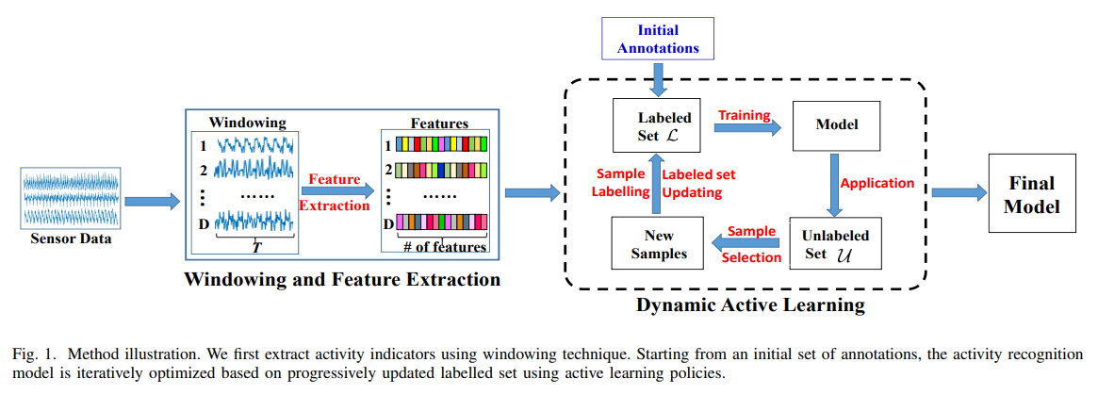
Overview
At first, sensor data is be converted into features (details in next slide)
Next, We iteratively update the training set by adding informative and representative labels with active learning policies (details in next-next slide)
The final model is obtained when the stopping criterion of active learning is met
no label
Annotation by human(oracle)

Slide 8
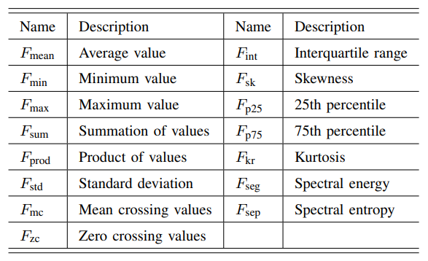
Preprocessing: Feature Extraction
Sensor data (Time-Series) is separated by sliding window
Window-length: 6sec, no overlap
In each window, 15 types of features are calculated
Calculation is done in each dimension separately
Traditional hand-crafted feature
These features are used only for the sample selection in Dynamic Active learning
Unrelated to input of classification model
Features Employed in the proposed method
←Example of result
in one window. This
D x 15 dim features set is regarded as “a sample” in next process

Slide 9
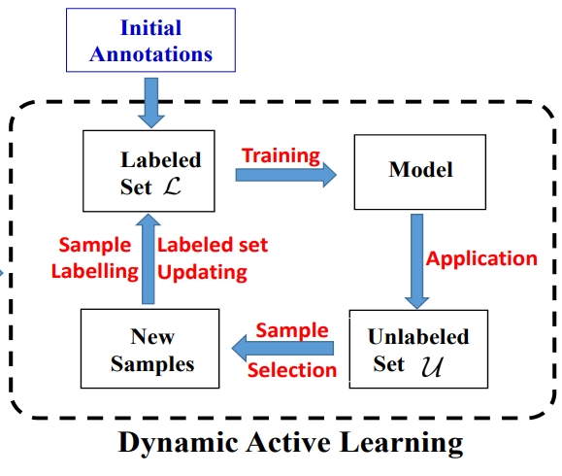
Procedure of Dynamic Active Learning
2 Steps:
(i) Activity and pattern discovery
Substep1: select samples that are dissimilar to the currently labeled ones
Substep2: select the most representative samples and pass them to the annotator(oracle)
(ii) Uncertainty-based sample selection
iteratively choose the samples with maximal information (near decision boundary) and pass them to the annotator(oracle)
This figure shows step(ii) process mainly.
In step(i), Model training and Application is not conducted.

Slide 10
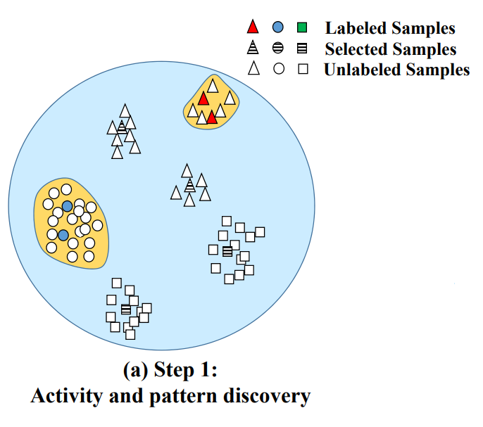
(i) Activity and Pattern Discovery
Substep1:
Use one-class SVM(OCSVM) to separate the novel class samples
OCSVM is an unsupervised learning algorithm that is trained only on the known observation (i.e., positive samples)
Decision boundary is learned to surround as many positive samples as possible
Train OCSVM models in each class
The samples which fall outside the decision boundary of each OCSVM are “novel class” candidates.
This candidates’ information is passed to Substep 2:
Decision boundary of OCSVM in class△
Decision boundary of OCSVM in class○
Novel class candidate

Slide 11
(i) Activity and Pattern Discovery
Substep2:
Apply Affinity Propagation(AP)-based clustering on the novel candidates
AP clustering divides all samples to clusters based on the concept of “message passing” between data point
In contrast to K-means, AP clustering chose the representative samples among the observed data samples instead of computed as hypothetical averages of cluster samples.
The representive samples presented to the annotator(oracle) and get new annotations
After annotations, Labelled sample set L and unlabelled sample set U are then updated.
Goto step2
Decision boundary of OCSVM in class△
Decision boundary of OCSVM in class○
Cluster and Representative samples (denoted as “Selected Samples”, striped)

Slide 12


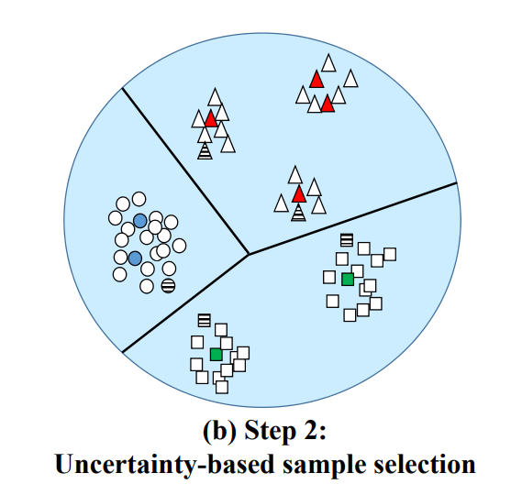
(ii) Uncertainty-based Sample Selection
iteratively choose the samples with maximal information (near decision boundary) and pass them to the annotator(oracle)
Apply BvSB-based active selection strategy
It measures the class probability difference between the first and the second most probable classes
With this strategy, the samples close to the decision boundaries are preferred to be chosen (like right figure)
The Selected samples are presented to the annotator(oracle)
Step (ii) is often repeated until stopping criterion is satisfied
Criterion: number or repeatation, or number of labelled samples
In experiment, several selection strategy are compared, and it is demonstrated that BvSB-based strategy is best
FΘ represent the learning model, P(yB|xi , FΘ) and P(ySB|xi , FΘ) denote
the two highest estimated class probabilities of sample xi output from the classifier
Decision boundary

Slide 13
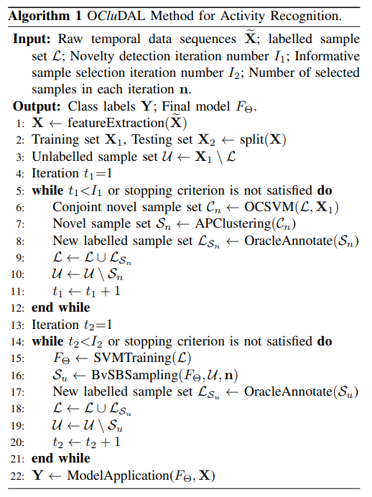
Pseudo code
Step1:
Novel class discovery
Not limited to SVM
Step2:
Uncertainty-based Sample Selection

Slide 14
Menu
Introduction
Proposed Method
Experiments

Slide 15
Experiments
Validity Analysis: Evaluate the effectiveness of two key components
(i) Comparison of sampling strategy (BvSB and others)
(ii) Value of new-activity-discovery process
Performance Assessment on real dataset
(i) with USC-HAD dataset
(ii) with UCI-HAR dataset
Abbreviated (Almost same result as (i))

Slide 16
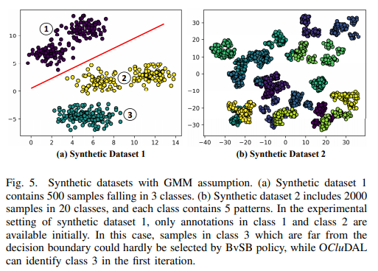
Dataset
(i) Synthetic datasets
Be generated from Gaussian Mixture Model (GMM)
2 types:
(a) 500 samples falling in 3 classes
(b) 2000 samples in 20 classes
Each class consists of 5 clusters
(ii) USC-HAD (real data)
Collected using tri-axial accelerometer and gyroscope which were attached to participant’s front right hip
Involves 12 common human activities in daily life
walking forward, walking left, walking right, walking upstairs, walking downstairs, running forward, jumping, sitting, standing, sleeping, elevator up and elevator down
14 Participants (7 males and 7 females)

Slide 17
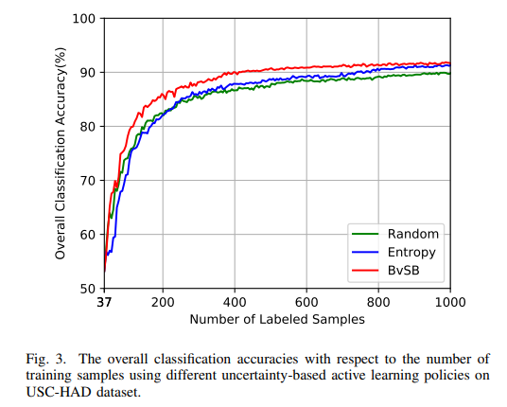
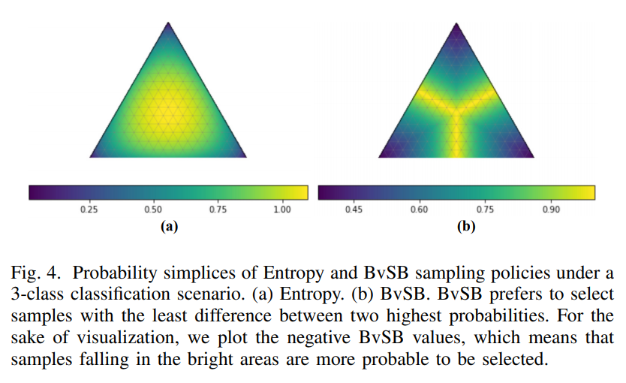
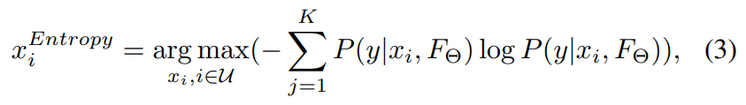
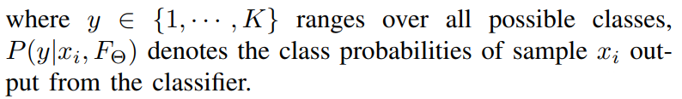
Validity Analysis: (i) Comparison of sampling policy
Compare BvSB sampling strategy with (i)Random and (ii)Entropy-based sampling
Entropy-based sampling is the most commonly applied method
Experimental Configuration:
Use USC-HAD dataset (real data)
Without novel class discovery: the initial annotations cover the full activity label set
Starting from randomly selected samples which account for 1/100 of training set, we iteratively train an SVM with incrementally updated labelled samples chosen using each strategy
Result: BvSB is best
Why?
Multi-class probability entropy is below
It’s inclined to choose samples whose probabilities scatter on all classes, these distribution is not match well with optimal decision boundaries
class1
class1
2
3
2
3
BvSB can select samples near decision boundary more faithfully than Entropy-based strategy

Slide 18
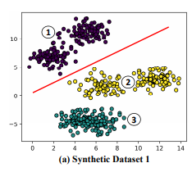
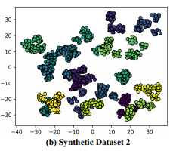
Validity Analysis: (ii) Value of new-activity-discovery process
Present the benefits brought by new activity discovery
Compare proposed method and BvSB-based traditional active learning method (AL)
Experimental Configuration
Use two synthetic dataset for two goal
Experiment at synthetic 1
Goal: for showing different behaviors of AL and proposed method in detecting new classes
Starting from a classifier trained with initial annotations only in Class 1 and Class 2
We iteratively update the labelled sample set using AL and proposed method respectively, and retrain the classifiers
Experiment at synthetic 2
Goal: for further quantitative analysis
Both AL and DAL models are initially trained on 1/10 of training samples in class 0 and class 1
Then iteratively retrained using the updated labelled sample set

Slide 19
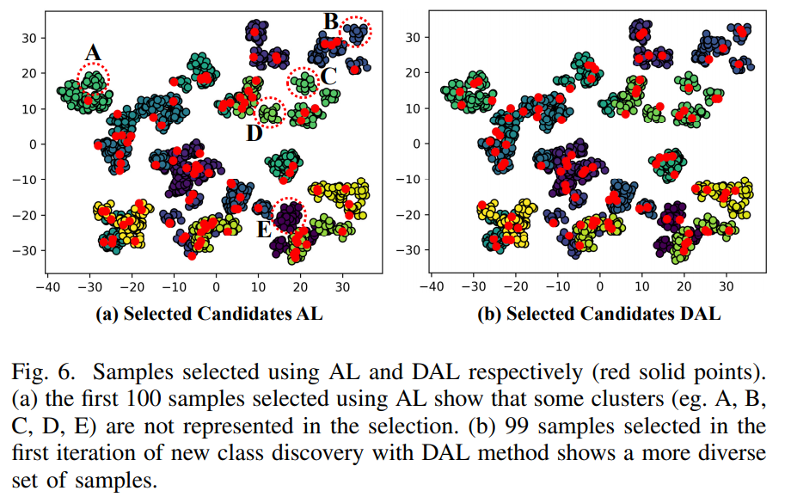
Validity Analysis: (ii) Value of new-activity-discovery process
Result of experiment at synthetic 1
AL: Class 3 are not selected as annotation candidates until a larget number of new samples are labelled
Labelled 115 sample
BvSB won’t select sample in class 3 because they are far from decision boundary
Proposed: Class 3 is identified with only 5 sample are labelled
Result of experiment at synthetic 2
Visualize the class coverage until first 100 samples are labelled
The samples selected by proposed method cover most of the classes and patterns
While a number of patterns could not be identified by AL
The novelty check and clustering enable comprehensive understanding of the full data distribution

Slide 20
Performance Assessment on real dataset(USC-HAD)
Comparison of other method related to HAR method based on active learning
Competitor:
traditional AL with (i) BvSB or (ii) Entropy based sampling strategy
(iii) Ensil[12] : Entropy sampling strategy with silhouette coefficient
(iv) QBC[57] : QBC sampling strategy to select informative samples
Where three independent classifiers, including extra tree classifier , linear SVM and naïve Bayes are used to choose samples for annotation
A query for annotation will be issued when any pair of these classifiers predict different label
(v) CNN-BvSB[67]: deep active learning method which incorporates CNN and BvSB-based sample selection into one framework

Slide 21
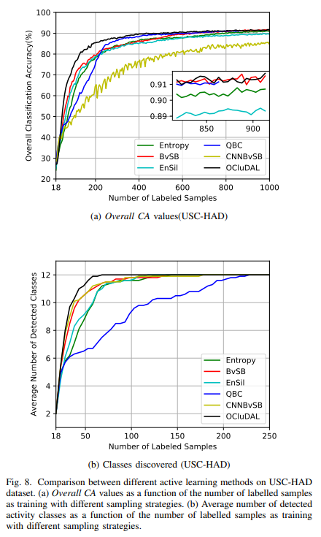
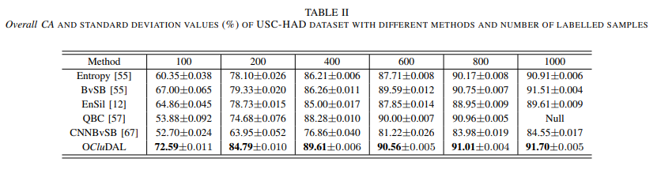
Performance Assessment on real dataset(USC-HAD)
proposed method consistently yields the highest Overall CA values compared with other 5 competing method
In dynamic active learning scenario, the classification performance is tightly related to the discovery of new activities.
This can be validated by comparing BvSB and OCluDAL.
when the labelled sample number is limited by annotation cost, selecting the diverse and representative samples can greatly improve the classification performance
The performance of QBC appears inferior to other methods. This is because in the early iterations of the classification, all the three committee classifiers misclassify the walking left samples as walking upstairs
The performance of CNNBvSB method lags far behind all the other methods. This is because the performance of deep learning methods is heavily dependent on the size of the training set
proposed

Slide 22
Performance Assessment on real dataset(USC-HAD)
From these experimental results we conclude that our proposed dynamic active learning method can effectively discover novel activities, greatly improve the classification performance and further reduce the annotation cost.

Slide 23
Conclusion
本論文では，動的能動学習に基づく人間活動認識手法OCluDALを提案した．この手法では，まず新規性検出やクラスタリング技術を用いて未知の活動やパターンを特定し，データ分布を包括的に把握する．次に、ベスト対セカンドベストのサンプリングポリシーを用いて、最も情報量の多いサンプルを反復的に選択し、分類器の決定境界線の精緻化を加速させる。2つの合成データセットと2つの実際のベンチマークデータセットを用いて，OCluDALの有効性と性能を評価するための実験を実施した．実験の結果，以下のことが明らかになった
1) OCluDAL のアノテーションコストは他の手法に比べて大幅に削減されている。OCluDALは同量のラベルを用いた場合、他の手法と比較して一貫して優れた性能を達成しています。この利点はアノテーション予算が限られている場合にはさらに顕著です。
2) OCluDAL は適応性に優れた手法であり，新しいアクティビティやパターンを持つ多様なシナリオに対応可能である．
Feature work:
- 教師なしディープ特徴抽出とディープニューラルネットワークベースのアクティブサンプル選択を フレームワークに組み込んだディープ能動学習法の開発
- 能動学習をベースとした共同活動認識や屋内定位アプローチの設計にも興味を持っている。

Slide 24
End

