Slide 1
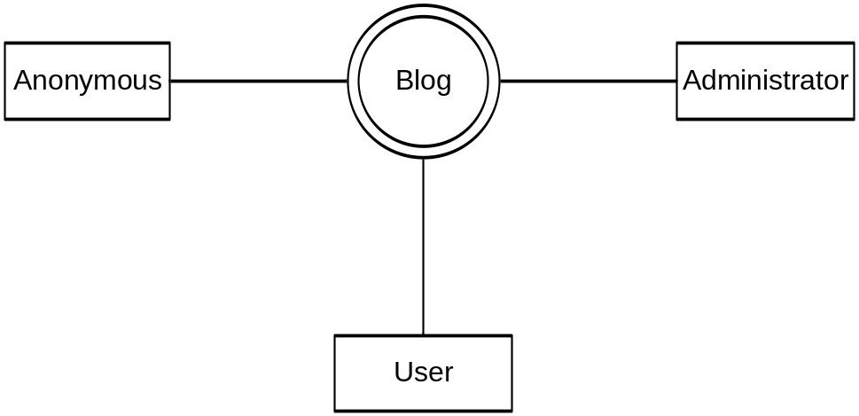
Data Flow Context Diagram
Notes:
Up while Brenda is running initial parts of demo

Slide 2
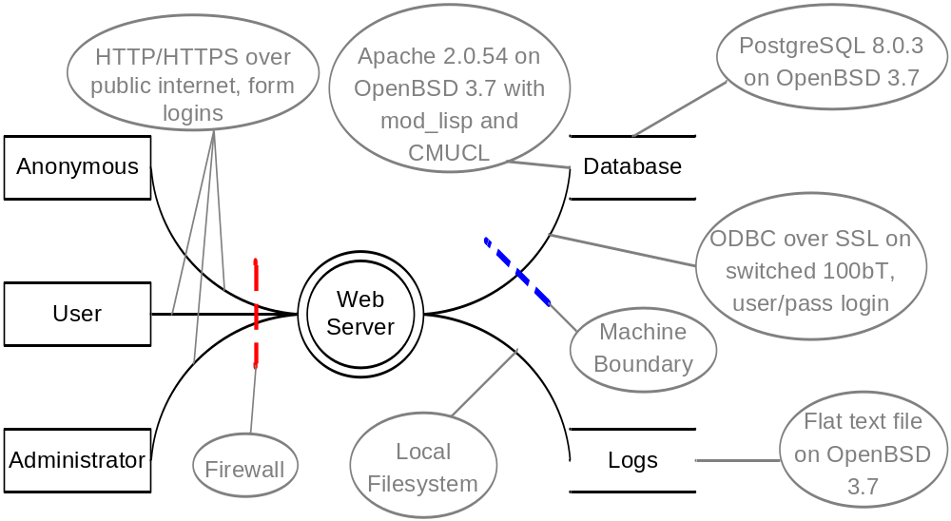
Data Flow Diagram Level 0
Notes:
Up while Brenda is running initial parts of demo

Slide 3
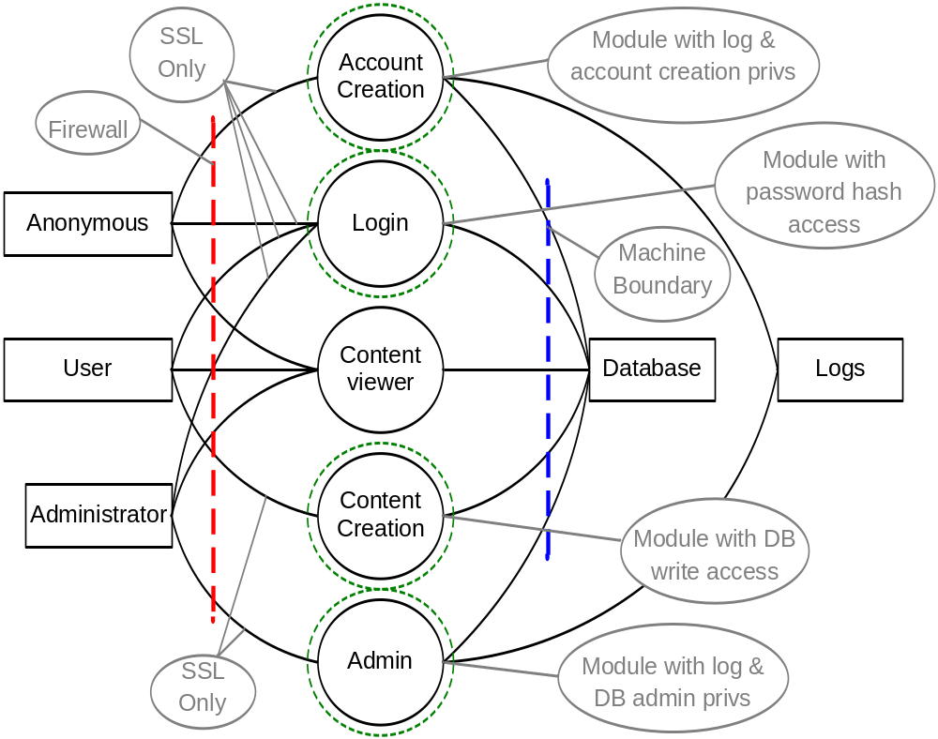
Data Flow Diagram Level 1

Slide 4
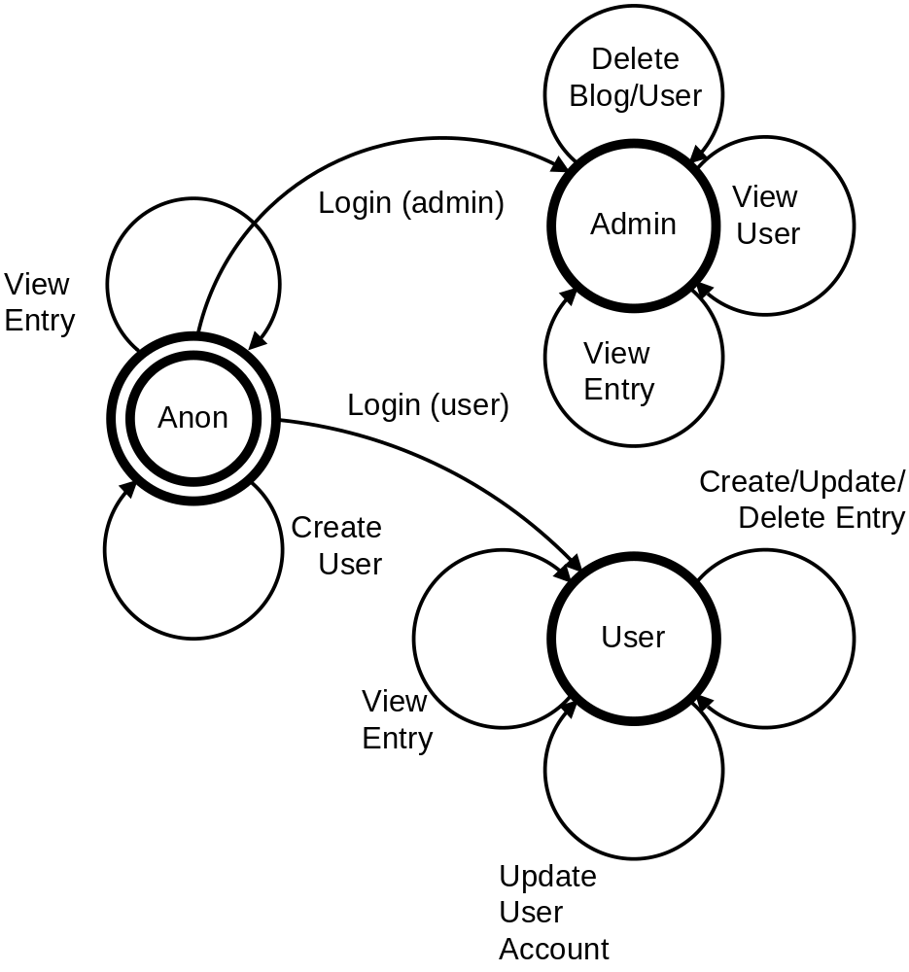
State Machine

Slide 5
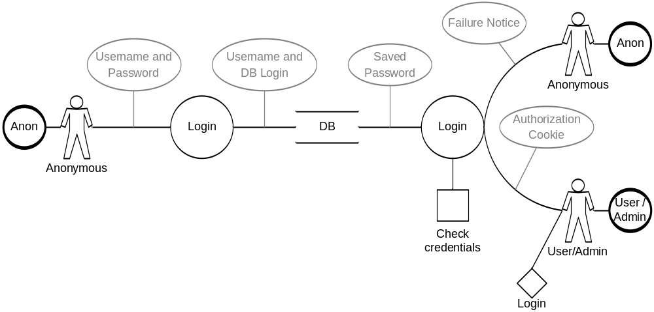
Use Flow

Slide 6
Risk Computation Examples

Slide 7
Actor and Asset Values
Actors: Risk
Anonymous 5
User 4
Admin 1
Assets: Value:
User Account $100
Blog $75
Blog Entry $5

Slide 8
Questions?

