Slide 1
Simulation.m

Slide 2
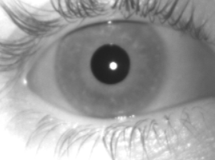
CalculateEyeRotationQuaternion.m
Image coordinates
(0,0)
eyeDataH + right on image (left on head)
Torsion is top pole to right (pretty sure but need to double check)
eyeDataV
+ down

Slide 3
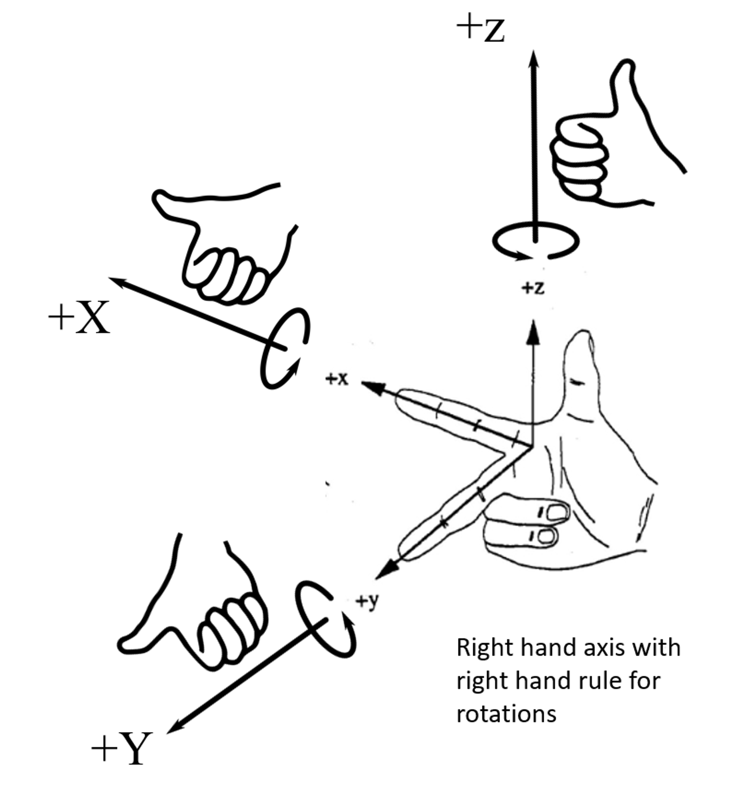
For quaternions
Pure rotations
Q2 = sin( rot around x / 2)
Q3 = sin( rot around y / 2)
Q4 = sin( rot around z / 2)

Slide 4
CalculateEyeRotationQuaternion.m
Qt is rotation around axes from eye to camera
Q is supposed to be the quaternion that moves the gaze from the current position to the camera (or viceversa??)
Angle is the magnitude of the rotation of Q along an axis that is contained in the plane parallel to the camera.
ecc is the angle of that axis relative to the orientation of the camera
(y,z)
Angle
eyeCalibrationModelCenter

Slide 5
CalculateEyeRotationQuaternion.m
Seems like q is being actually calculated in a left handed reference frame
q3 = -sin(angle)* sin(ecc/2);
should be q3 = sin(angle)* sin(ecc/2);
That however matches what openiris is doing.
// quaternion defining the rotation of the eyeball (ignoring torsion) just the center of the pupil
var yC = iris.Center.Y - eyeModel.Center.Y;
var xC = iris.Center.X - eyeModel.Center.X;
// First get the polar angle of the rotation. As the direction angle the eye moves from eye model center
// to iris center.
var angle = Math.Atan2(yC, xC);
// Then, get the eccentricity from the length of the vector in pixels to the angle that moves the eye that far
var ecc = Math.Asin(Math.Sqrt(yC * yC + xC * xC) / eyeModel.Radius);
// Finally get the quaternion that defines that rotation. This is a rotation without torsion in a reference frame perpendicular to the camera
var q = new Quaternions(Math.Cos(ecc / 2), -Math.Sin(angle) * Math.Sin(ecc / 2), Math.Cos(angle) * Math.Sin(ecc / 2), 0);

Slide 6
When doing the rotation of the iris we build a 3D axis on the image to give volume to the eyeball. In this axis the z points out and the x and y axes are the ones from the image. So it becomes a left handed reference frame.
(0,0)
x + right on image (left on head)
Z
+ out
Torsion is top pole to right (pretty sure but need to double check)
y
+ down

Slide 7
qEyePosInRef2Camera
Left-handed quaternion
(1,0,0,0) means looking at the camera with no torsion relative to the orientation of the camera

Slide 8
camPosition
Left-handed quaternion
(1,0,0,0) eye pointing at the camera
Rotates the eye to look horizontal straight

Slide 9
Is this the problem?
Line 43 q3 = -sin(angle)* sin(ecc/2);
IS this attempting to do a flip from left handed to right handed. But I think that would cause problems because that’s not what open iris assumed.
… maybe…
Q needs to be the same quaternion as the one in open iris

