Slide 1
LaTeX Workshop
12/11/25
Oliver Cunningham
Queen’s University Belfast

Slide 2

What is LaTeX?
LaTeX is a typesetting system including features to produce technical and scientific documentation
Overleaf is a free browser-based LaTeX editor
Access to a premium account is free for QUB students

Slide 3
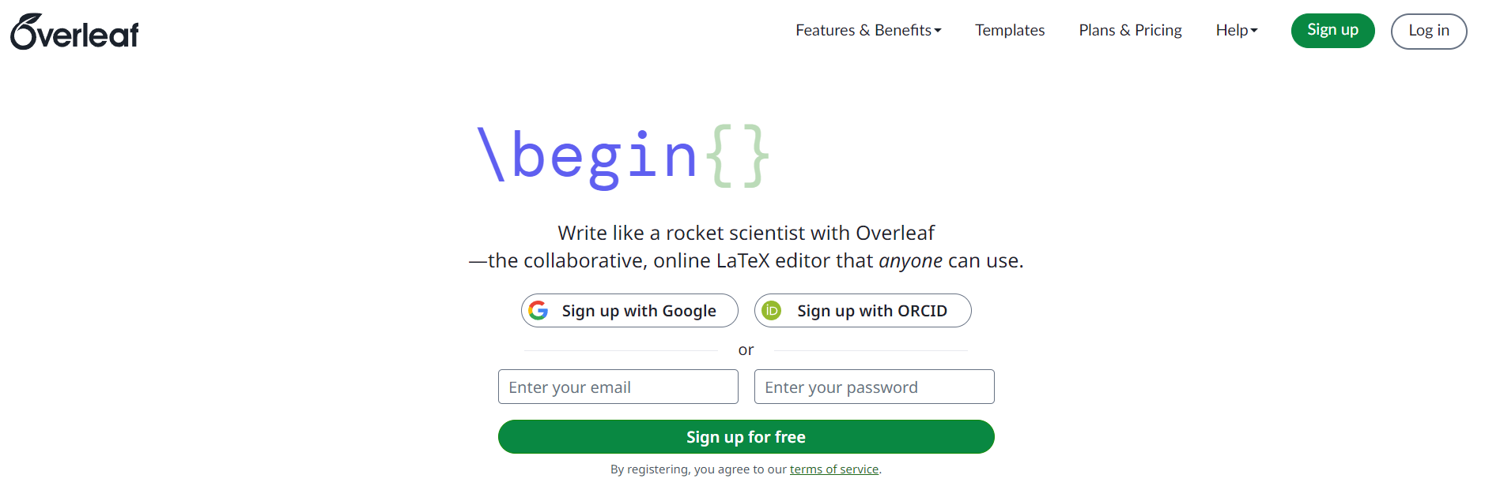
How to create an Overleaf account.
Go to https://www.overleaf.com
Select sign up
Select Log in with SSO
Enter your QUB email

Slide 4
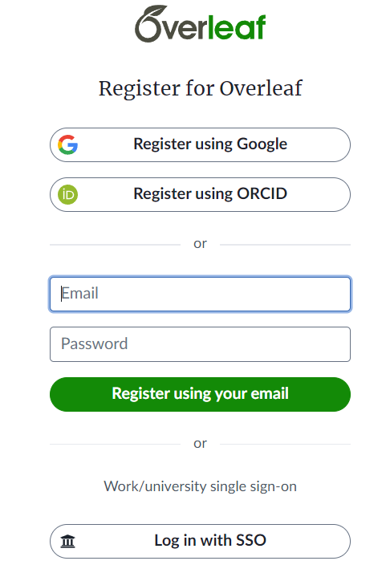
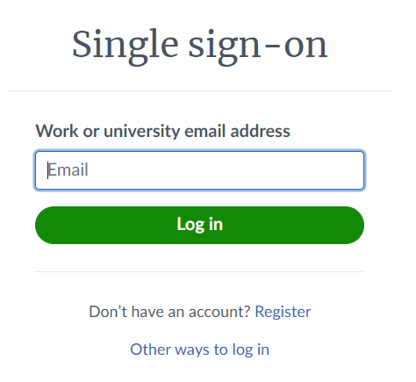
How to create an Overleaf account.
Go to https://www.overleaf.com
Select sign up
Select Log in with SSO
Enter your QUB email.

Slide 5
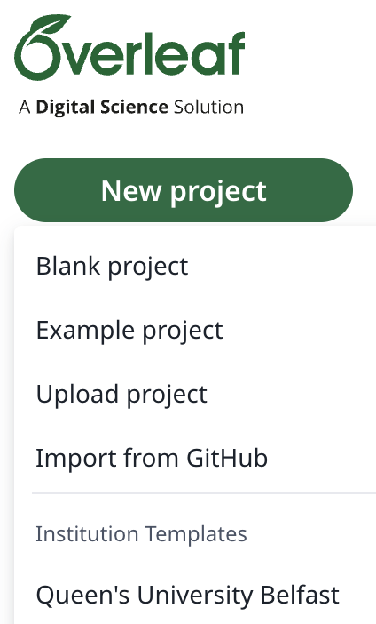
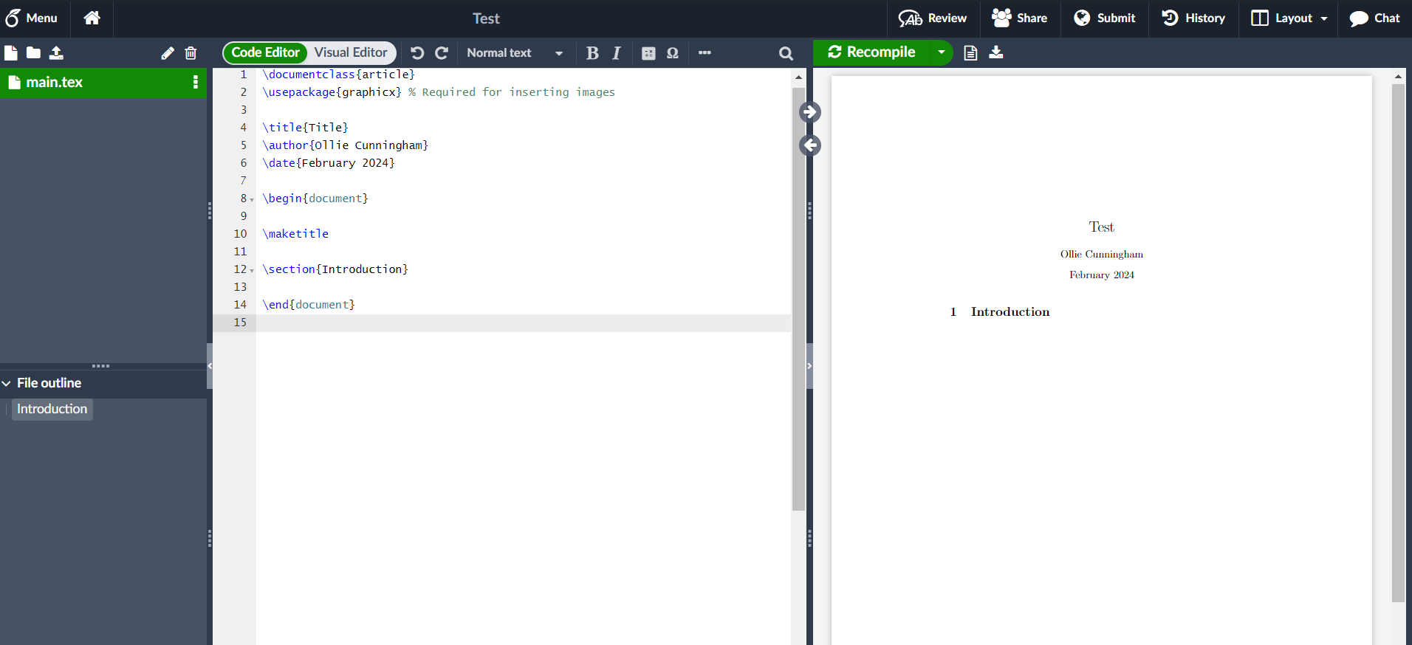
Creating a Blank Document
Select New Project
Select Blank Project
You can also select many different templates
Notes:
Lots of premade templates. Institutional templates has good dissertation template.

Slide 6

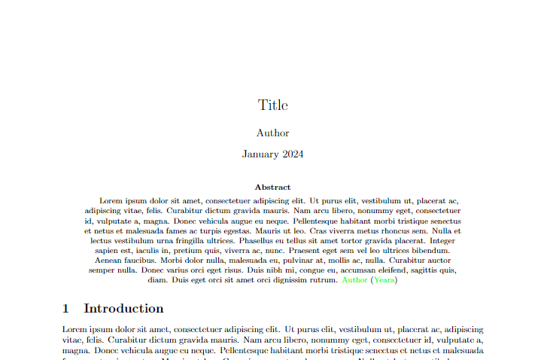
Document Class
Defines the overall layout of document
Commonly used classes are article and report
Notes:
Article on left, On right is report. Report has dedicated title page, dedicated abstract page

Slide 7
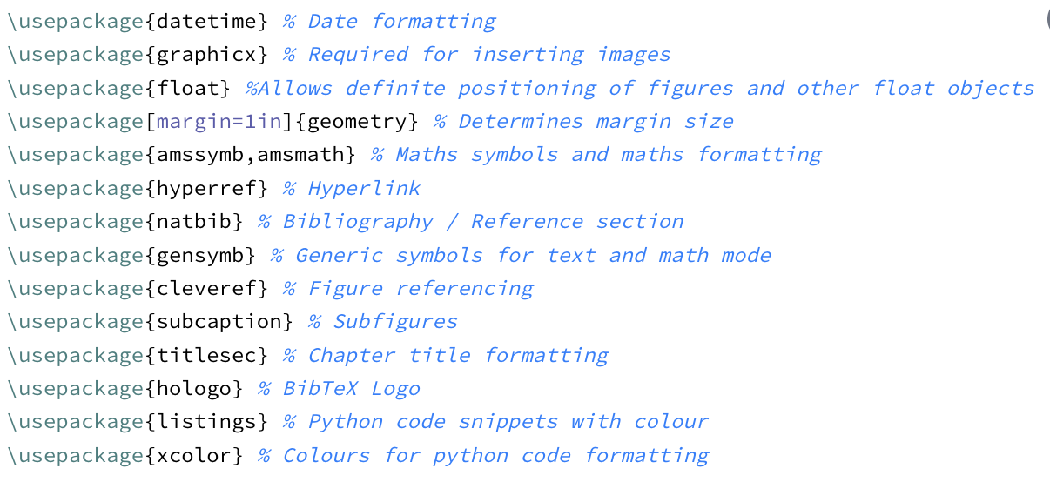
Packages
Many external packages to add new commands and functions
For example, natbib for referencing and amsmath for equations

Slide 8

Title, Date, Author
Before \begin{document}: \title{}, \date{}, \author{} do as labelled
After \begin{document}: \maketitle generates title, author and date
Alternatively, after \begin{document}, use \begin{titlepage} for further customisation

Slide 9
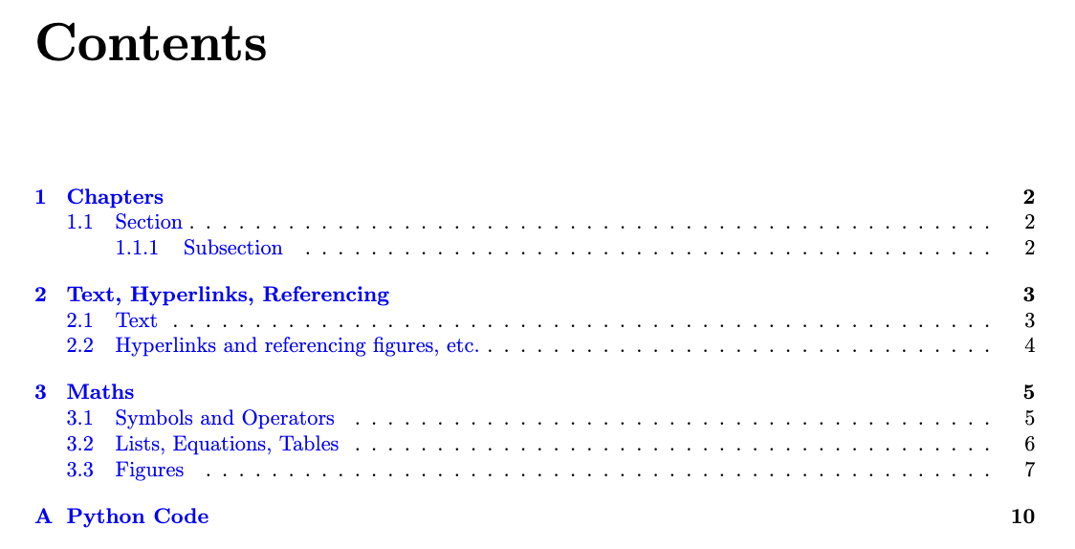
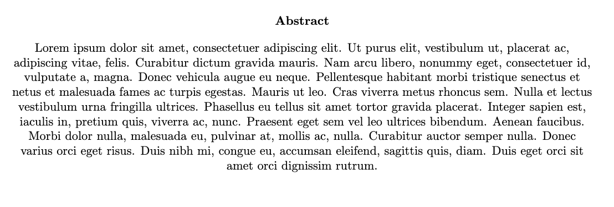
Abstract and Table of Contents
\begin{abstract} creates an unnumbered abstract section
In a report class document this is on a separate page
\tableofcontents generates a table of contents based on the document’s sections

Slide 10
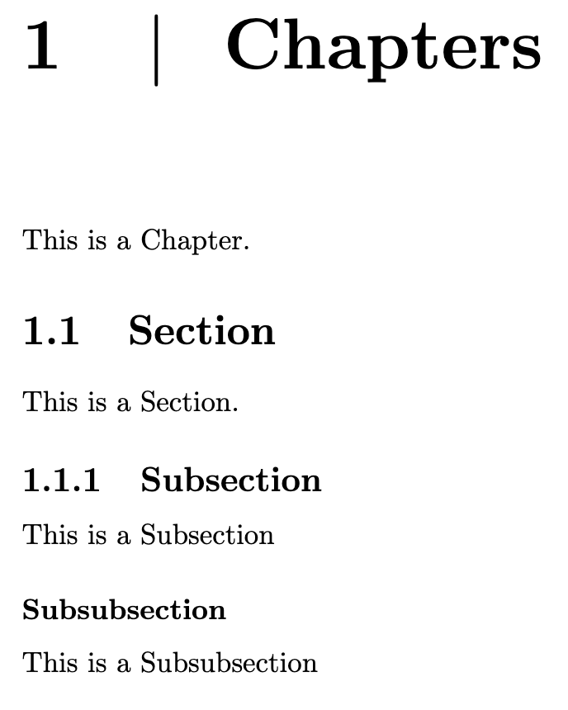
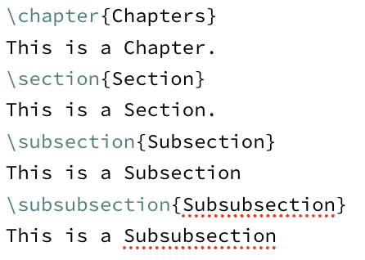
Sections
\section{} creates section headings which are numbered
These can be followed by \subsection{} and \subsubsection{}
In a report class document \chapter{} is the highest section type

Slide 11
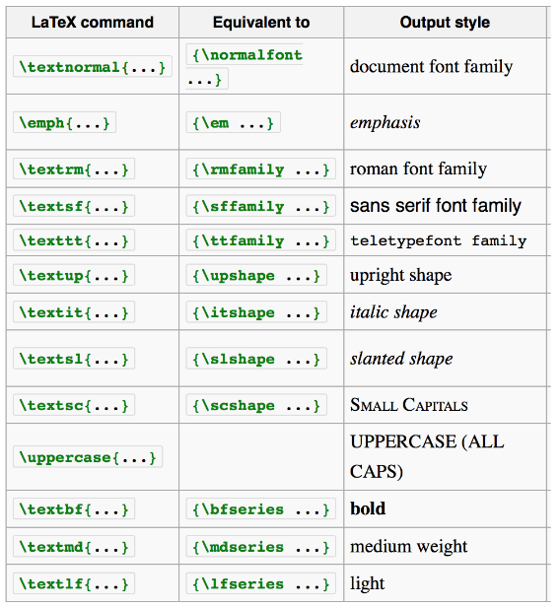
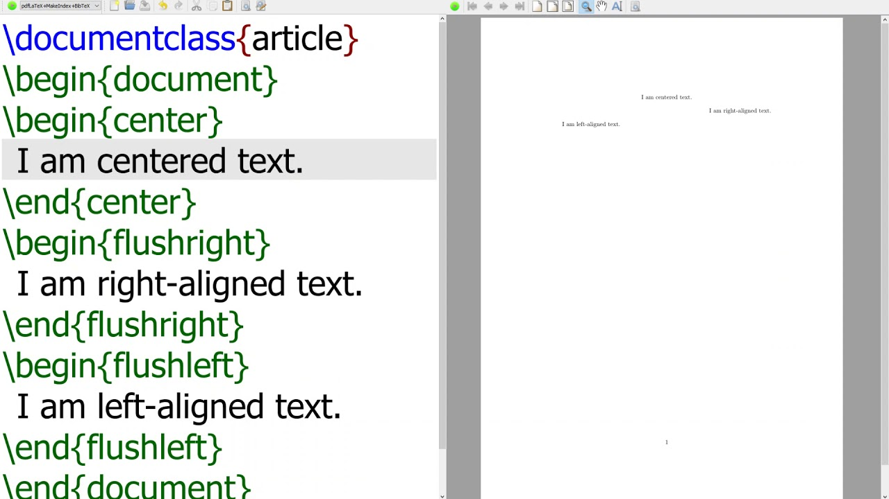
Basic text formatting
\\ creates a new line, \newpage takes a new page
\centering centers text
\(…\) and $...$ allow maths commands to be used in text such as Greek letters \alpha
\textbf{} makes text bold
Above: https://i.ytimg.com/vi/6Rv3RFrB6k8/maxresdefault.jpg
Left: https://en.wikibooks.org/w/index.php?title=LaTeX/Fonts&oldid=4240865

Slide 12

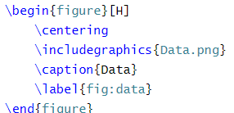
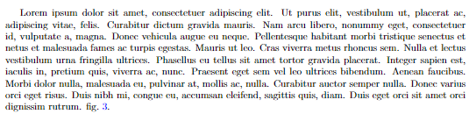
Referencing figures in text.
\ref{fig:name} allows you to reference a certain figure, by number, based on the figure label
This will appear, in text, as a number
The cleveref package uses \cref{} which adds the label

Slide 13
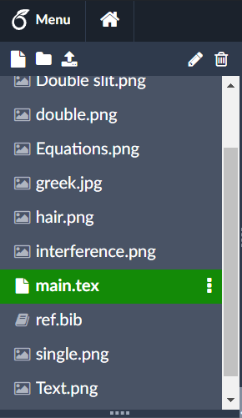
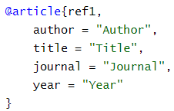
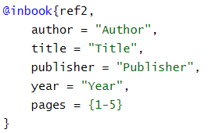

References
LaTeX can automatically compile your reference section based on what you reference.
This works through a separate file called a .bib file.
References in a .bib file have different classes such as article.

Slide 14
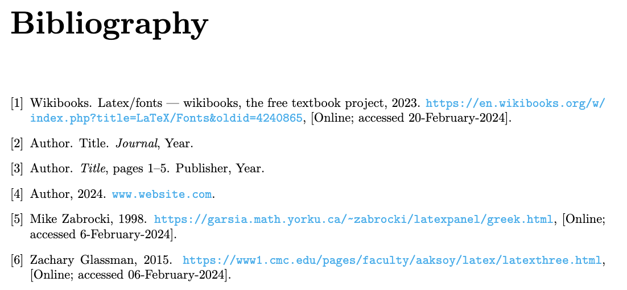

Bibliography
\bibliography{ref} is the command that compiles your bibliography based on references you have cited in your work.
To cite a reference, you use \cite{label} where the label is the name you gave the reference in the .bib file.
\bibliographystyle{} determines the layout of your references and how they appear in your text.

Slide 15
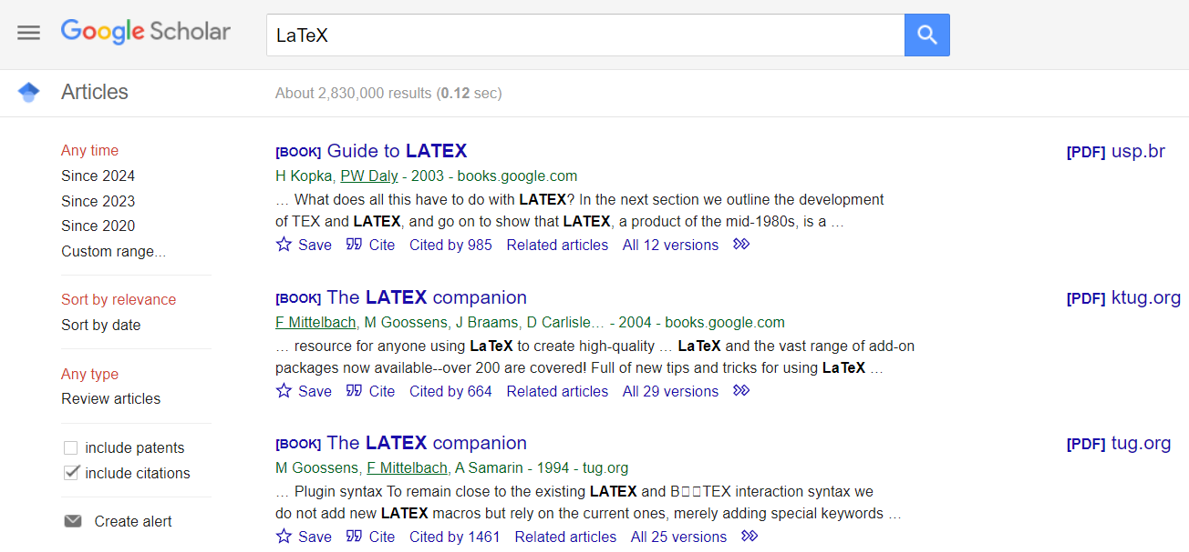
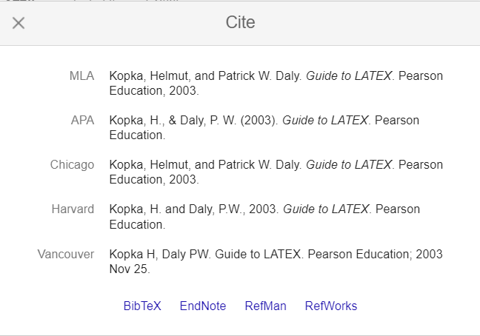
Bibliography
Google Scholar will generate BibTeX entries for any paper

Slide 16
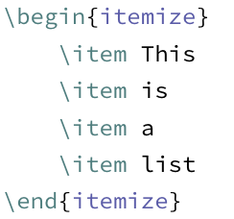
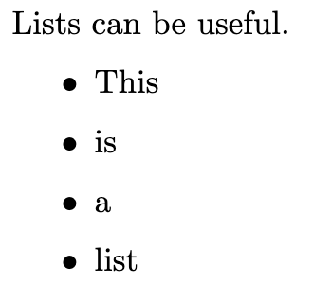
Lists
Use the \begin{itemize] command to create lists with bullet points
Each bullet point is created using a \item command

Slide 17

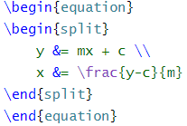
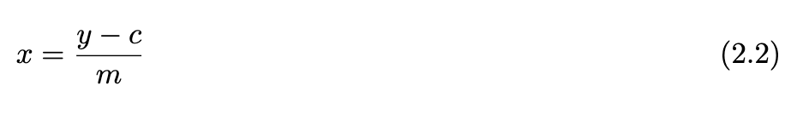
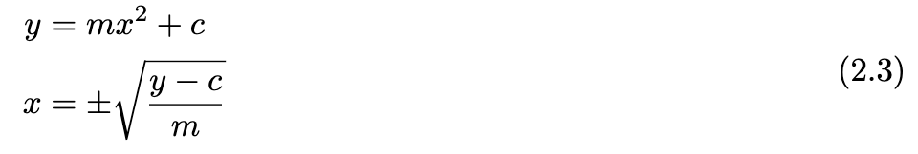
Equations
\begin{equation} opens a maths environment
This allows the free use of math commands
Equations will be automatically labelled and numbered
Split allows multiple equations in one environment

Slide 18
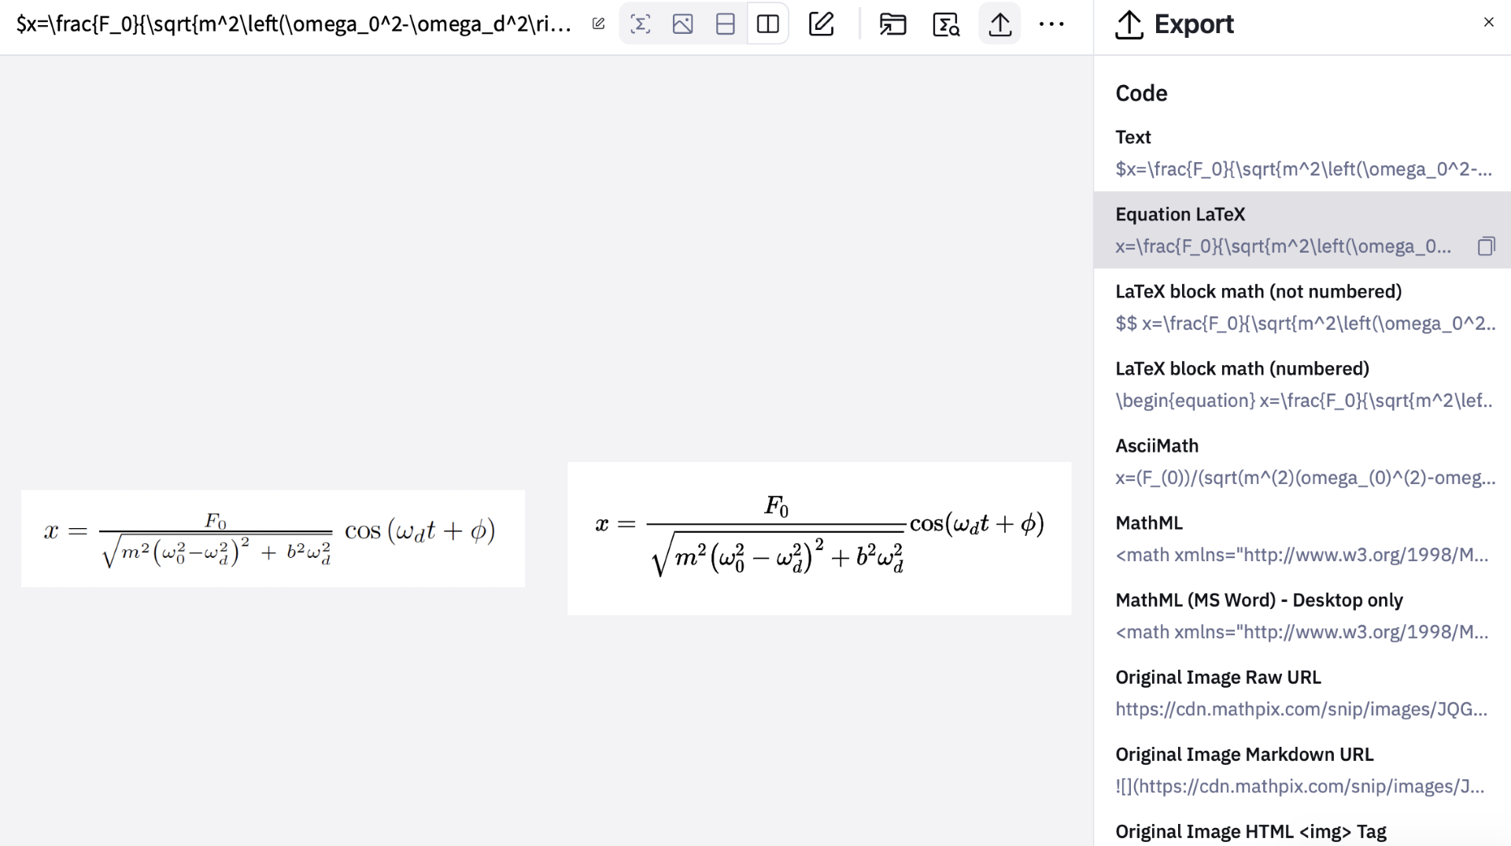
Equations
Mathpix can convert images of equations to LaTeX code
Useful for long equations
https://mathpix.com/image-to-latex

Slide 19
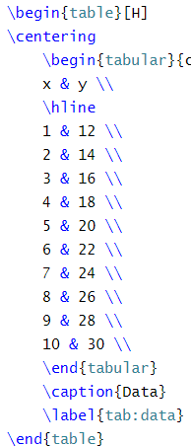
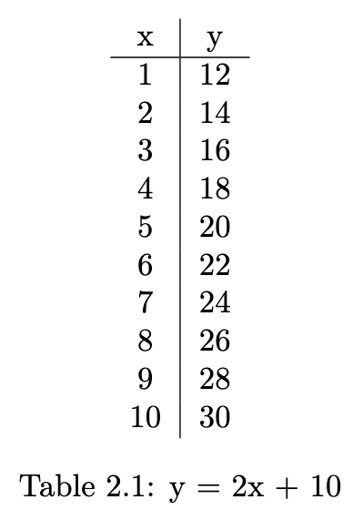
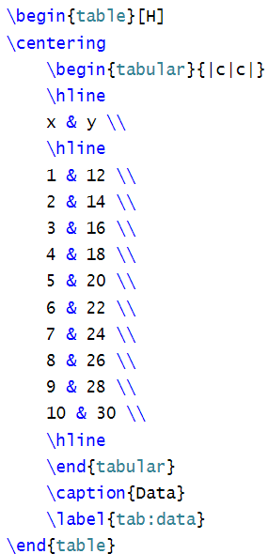
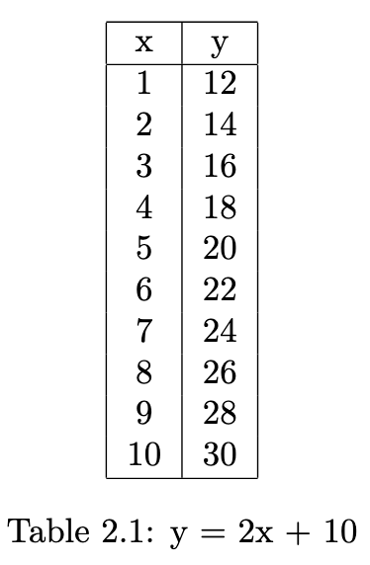
Tables
\begin{table} creates a list environment
\begin{tabular}{|c|c|} creates your table
c represents one column and | inserts lines between columns
Data in a row is separated by & and a new line is taken with \\
\hline adds horizontal lines

Slide 20
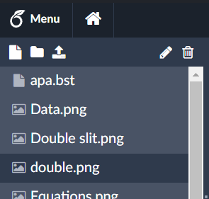
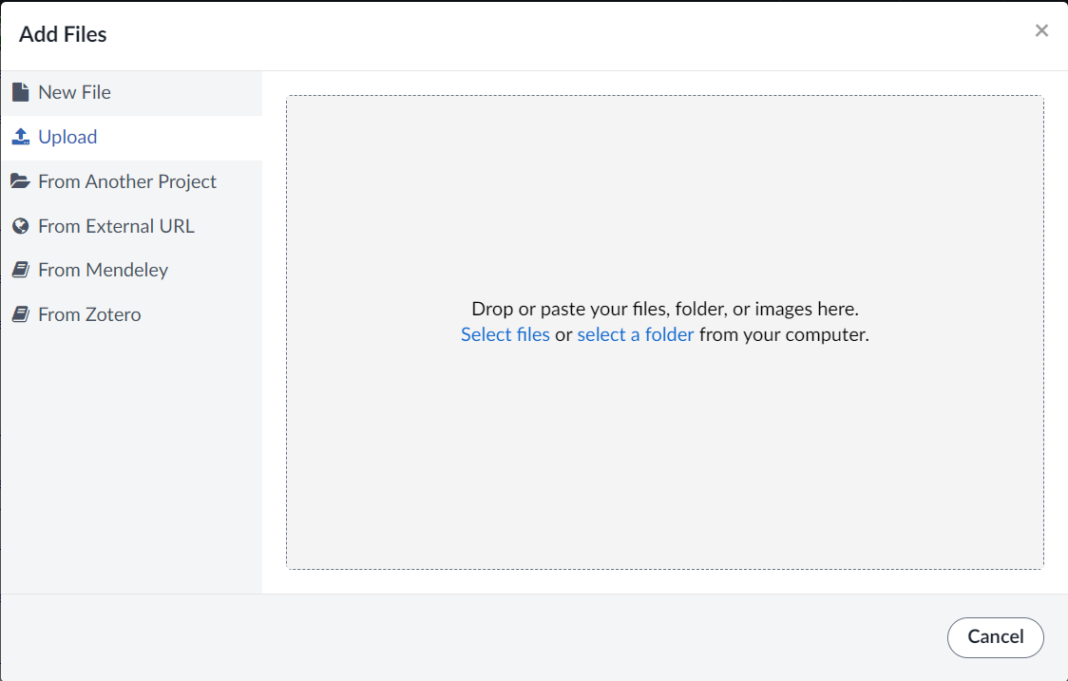
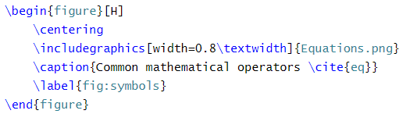
Figures
\begin{figure} allows you to insert images using \includegraphics
These will automatically be labelled as figures and be numbered
By default, LaTeX will place images where they fit best. Use [h!] as alternative

Slide 21
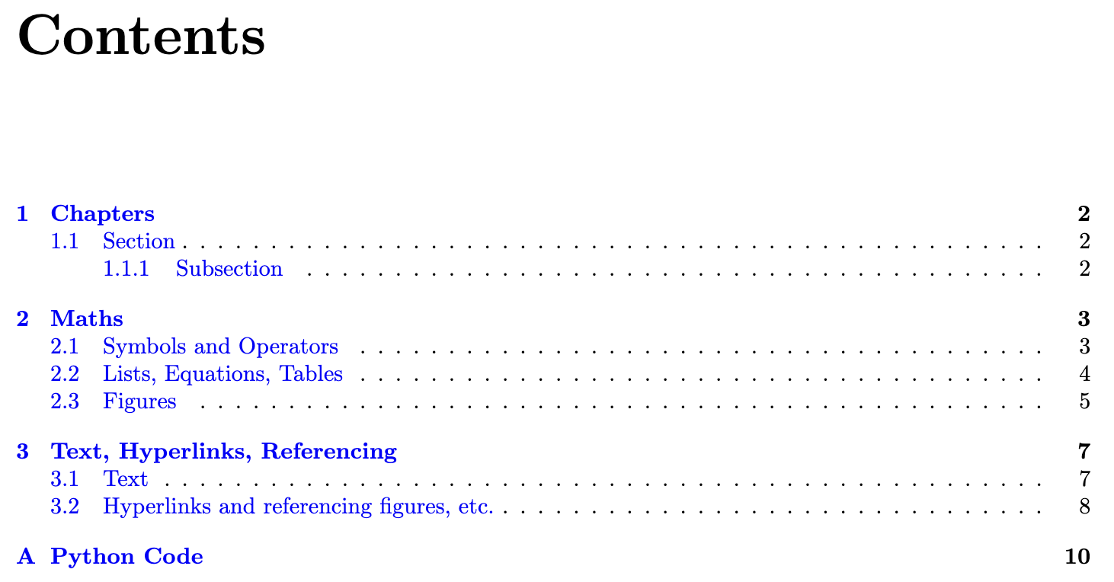
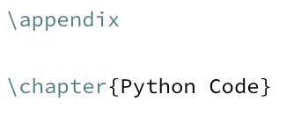

Appendix
By using the \appendix command new sections added are labelled by letters instead of numbers

Slide 22
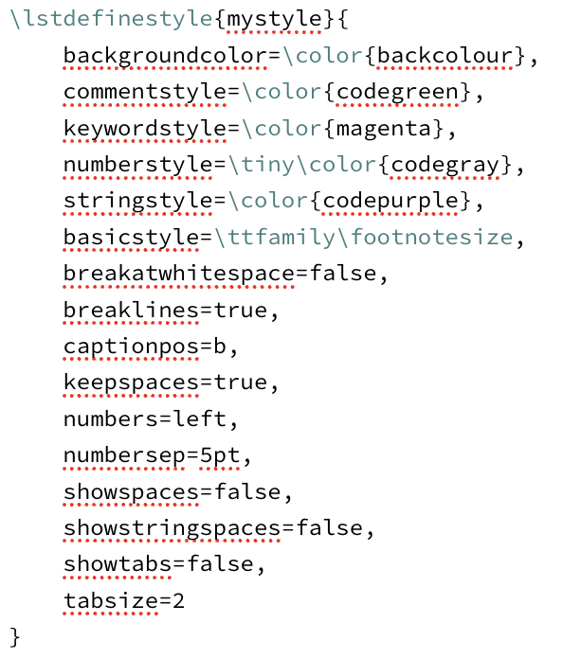
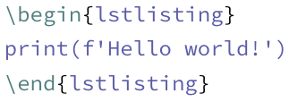

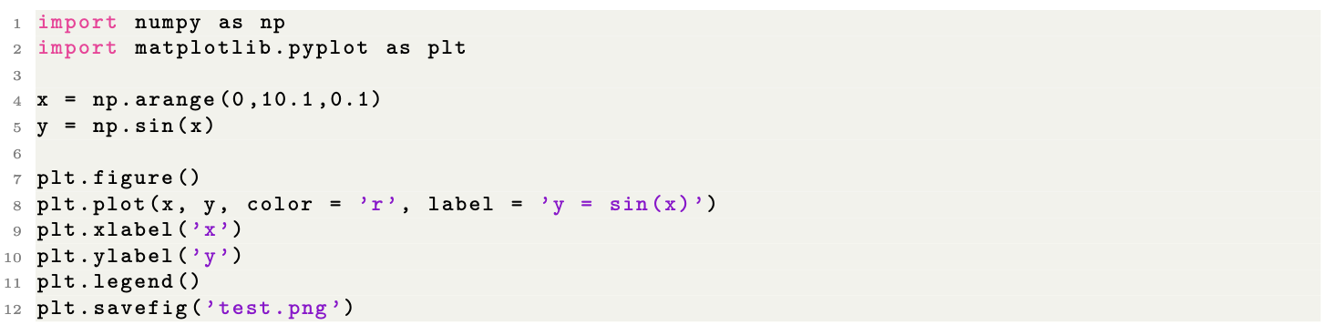
Python code
Using the \begin{lstlisting} command we can have text appear like python using defined lst styles
Using \lstlistinginput{file} we can insert certain lines or all of a file.
Adding firstline =x and lastline = y after the language allows certain lines to be chosen

Slide 23
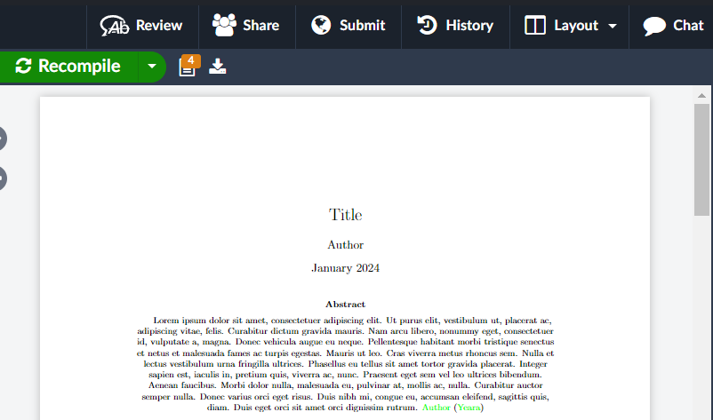
Notes
Overleaf has a large amount of user documentation on their website to help with many issues you may come across.
TeX – LaTeX Stack Exchange can answer any other questions you may have.
Overleaf allows collaboration on documents.

Slide 24


Thank you!
Please fill out the feedback form below.
Find the resources on my GitHub linked below

