Slide 1

2026 US Agriculture:
The best house in a bad neighborhood
Owen Wagner
Senior Analyst, Grains & Oilseeds

Slide 2

Glass half full:
Glass half empty:
Stocks
World coming off record production and record stocks
Input prices
Weighing on growers’ balance sheets
Consumer confidence
Inflationary impacts of tariffs and events in Iran
Policy
Clarity on 45Z and latest iteration of the RFS is very supportive
Direct payments have been generous
War premium
High diesel price is a boon to oilseeds
The best cure for low prices…
High input prices and a Super El Nino could mark the start of a turnaround

Slide 3
Global surpluses have translated to a build up in domestic stocks
At a global level, increased Brazilian production allows world to operate with lower stock
US corn stocks
US soybean stocks

Slide 4
US farmers were able to avoid the worst of the spike in input prices on their 2026 crop
Iran
Corn
Fertilizer purchase window
Planting
Soy
Harvest
Growth

Slide 5
2026 US soybean yields
Current soybean yield projection is 53 bu/acre – 101% of trend
But, soy yield estimates will become much more accurate in the next two weeks
Mid-Sept. – crop condition / yield correlation
Mid-Sept. – crop condition / yield correlation
Source: US EPA
Source: WTO trade statistics

Slide 6
2026 US corn yields
The consistent trend in yield improvements has made it hard to bet against US corn
Even with corn at 57% good/excellent condition – yields of 180 bu/acre can be expected
Mid-Sept. – crop condition / yield correlation
Mid-Sept. – crop condition / yield correlation
Source: US EPA
Source: WTO trade statistics

Slide 7
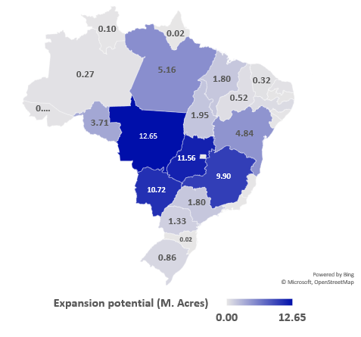
Temporary pause in Brazilian growth
2026/27 will mark the first pause in soy expansion in 20 years
Brazilian corn export supremacy was short lived due to ethanol boom
Conservatively, 70 million acres of expansion potential lie ahead
BZ corn and bean growth
Brazil row crop expansion potential

Slide 8
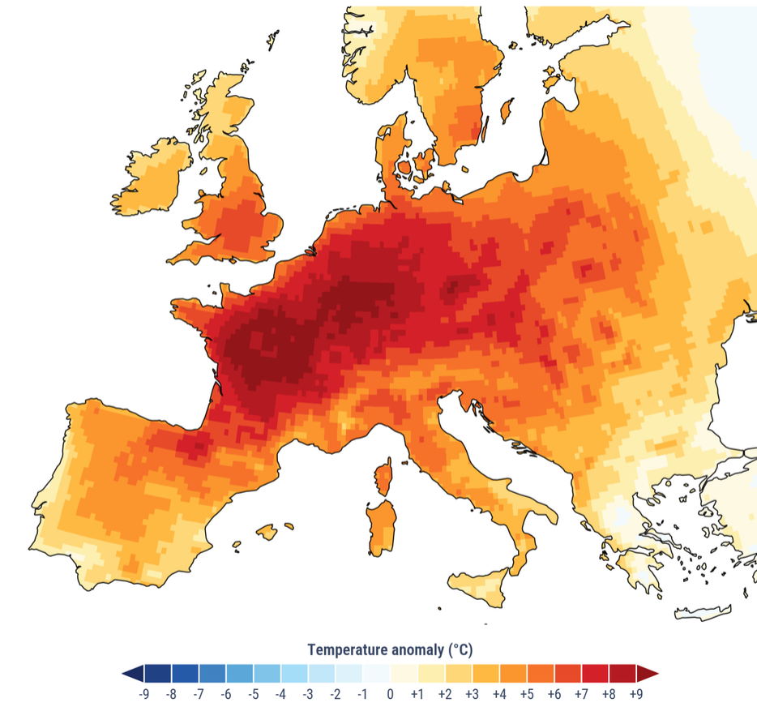
Crops roasting in western Europe
Smallest French corn crop in 50 years, smallest wheat crop in 50 years
June 2026 average temperature anomaly
French corn crop condition

Slide 9

Eastern European wheat locked in conflict
Smallest Russian wheat crop in 12 years
Lowest wheat exports from region since conflict began
Golden Leo – 7/27/2026
Ukraine + Russia wheat exports

Slide 10
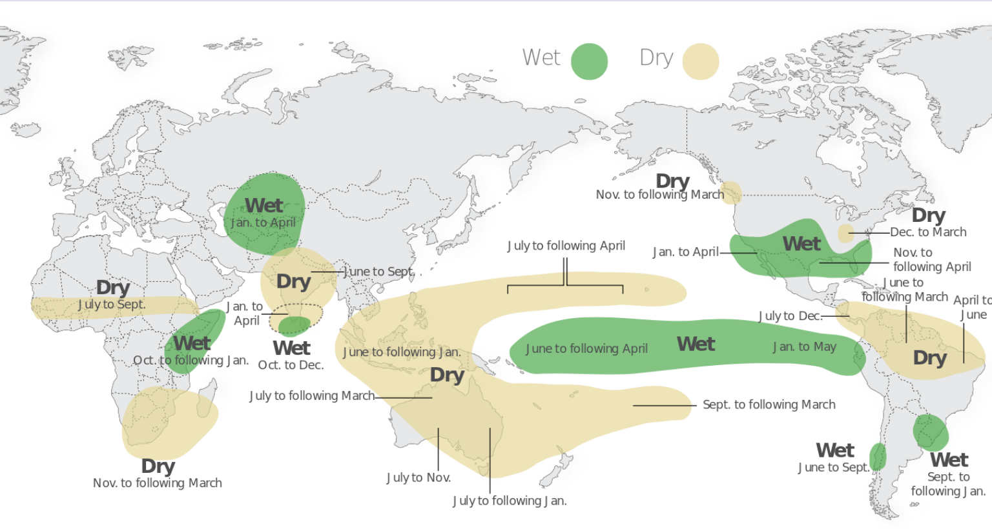
“Super” El Nino to compound fertilizer impacts
Increasingly likely we will see strongest El Nino in at least ten years
Odds of forthcoming El Nino
El Nino regional impacts

Slide 11
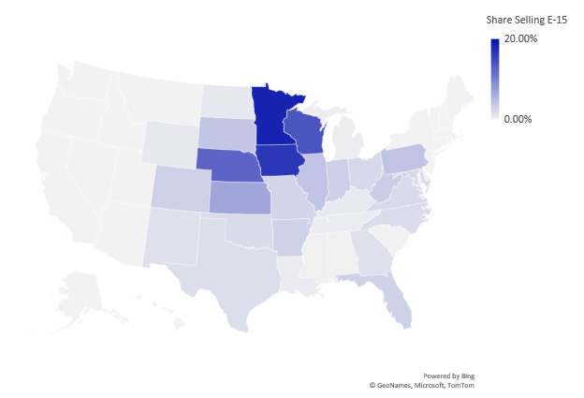
Biofuel prospects improve with RVO, 45z, Iran
Biodiesel has returned to profitability with improved RVO and higher diesel price
Gasoline usage in the US has peaked, ethanol continues focus on E15 blending
Biodiesel profitability with credit stack
E15 infrastructure by state

Slide 12
Mixed Chinese performance
Meeting commitments for soybeans
Woefully behind on total purchase commitment of $17 billion
Chinese purchases of US soybeans
Chinese purchases of US ag products

Slide 13
2026 soybean cost curve – US is not a monolith
Recent jump in futures has gone a long way in resolving profitability problem
Source: US EPA
Source: WTO trade statistics

Slide 14
2026 soybean cost curve – regional breakout
Southern tier of US is most in need of am alternative to the commodity corn-soy rotation
Source: US EPA
Source: WTO trade statistics

Slide 15
Farm supports no longer countercyclical
Risk of excessive support distorting market signal received by US farmers
Shift coincided with 2008 Farm Bill
Market returns vs gov’t support 1980/81-2006/07
Market returns vs gov’t support 2007/08-present

Slide 16
Cotton doing well under an enhanced US farm safety net
Cotton will see the biggest relative increase in government support among all commodities
Increase in commodity safety net under OBBB
Increase in insurance subsidies under OBBB
Source: Rabobank
Source: USDA

Slide 17
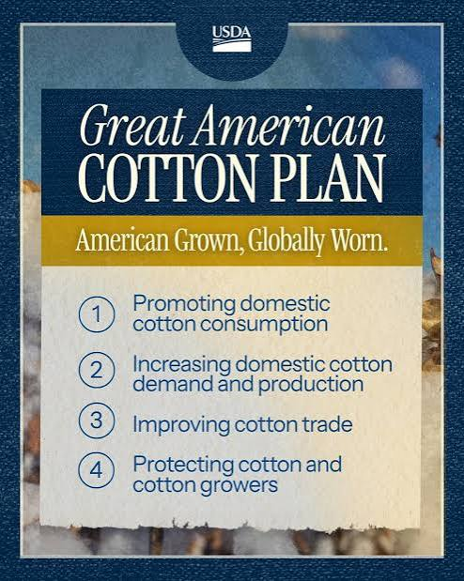
Support culminating under the
“Great American Cotton Plan”
Consider the “Buy American Cotton Act”
Provides tax breaks for using US cotton and reshoring US textile capacity
Scenario | Cotton price | Price factor | Loc. factor | Credit
US cotton to non-FTA country | $0.85 | 1 | 18% | $0.15
US yarn to non-FTA country | $0.85 | 1.6 | 18% | $0.24
US fabric to non-FTA country | $0.85 | 6.5 | 18% | $0.99
US cotton to FTA country or US | $0.85 | 1 | 24% | $0.20
US yarn to FTA country or US | $0.85 | 1.6 | 24% | $0.33
US fabric to FTA country or US | $0.85 | 6.5 | 24% | $1.33

Slide 18
More beans and cotton in 2027
Prices telling farmers to shift a million acres (each) into soy and cotton in the year ahead
Corn/soy price and acreage ratios
Corn/cotton price and acreage ratios

