Slide 1
Scrum Manager
Full Stack Development - Immersive Program SDGKU
By: Paola Cortes,
Odasys Soberanes

Slide 2
Scrum Manager – Project Idea
Scrum Manager is a software application used for issue tracking and project management.
The system permits to users create projects, sprints, task, subtask.
The Scrum Manager project can be used for the following purposes:
Project Management
Task Management
Is the use of specific knowledge, skills, tools and techniques to deliver something of value to people.
It’s an organized system for identifying, monitoring, and managing the work you and your team.
Scrum Agile Methodology
Is a project management system that relies on incremental development.

Slide 3


Scrum Manager – Technologies

Slide 4
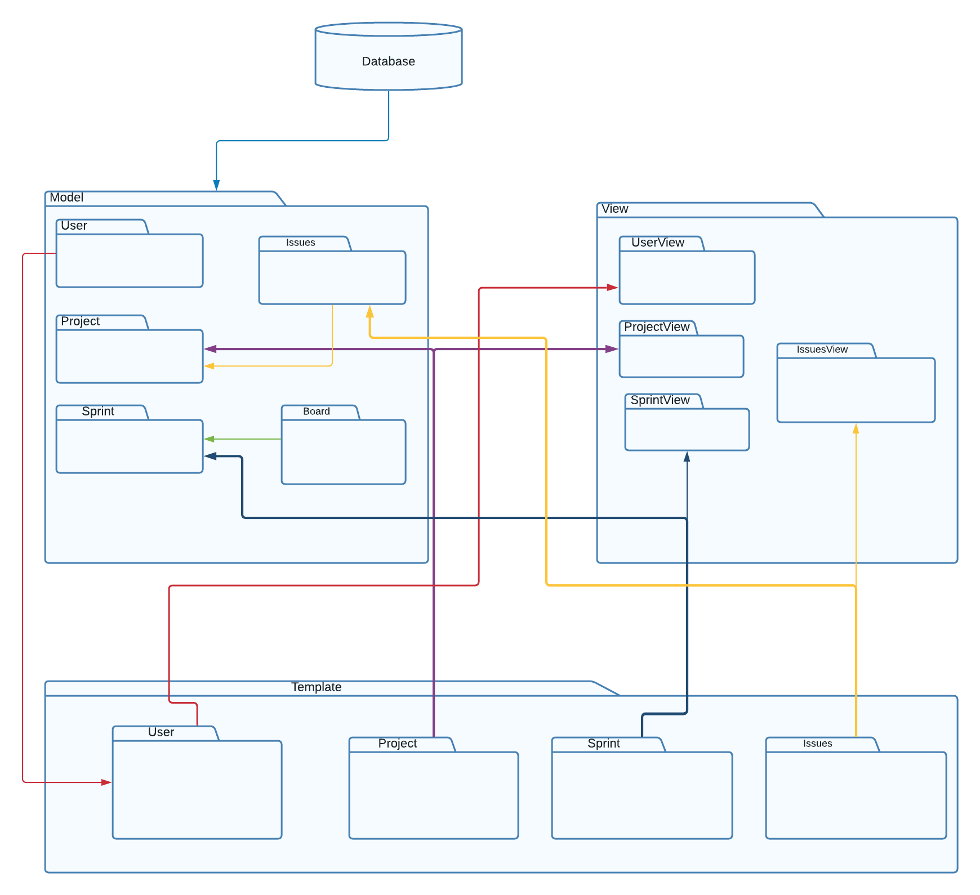
DJANGO - Model View Template
View
Model
Is used to execute the business logic and interact with a model to carry data and renders a template.
Helps to handle database. It is a data access layer which handles the data
Templete
Is a presentation layer which handles User Interface part completely.

Slide 5
Scrum Manager - Models
SPRINT
TASK
name
description
start
duration
end
project
user
title
description
complete
created
sprint
status
subtask
ACTIONS
name
task
PROJECT
name
start

Slide 6
Scrum Manager
Register
Add Task
Log In
Edit Task
Add Project
Task Detail
Edit Project
Delete Task
Delete Project
Add Sprint
Edit Sprint
Sprint Detail
Delete Sprint

Slide 7

Scrum Manager - Personas
Personas
John Collins
Age: 28
Location: San Diego CA. United States.
Occupation: Software Developer
Income: 78k
Status: Single
By day, John is a developer. He is working as a developer of different web applications but he has a lot of responsibilities and something he is confusing about what are their task for each project.
Goals
Know his pending task for each project
Frustrations
Have a clear goal for each project in any sprint
Personality Traints
Learning
Self-taught person
Introvert
“Never stop learning because life never stops teaching”

Slide 8


Scrum Manager – Log In / Register
Log In
Register

Slide 9
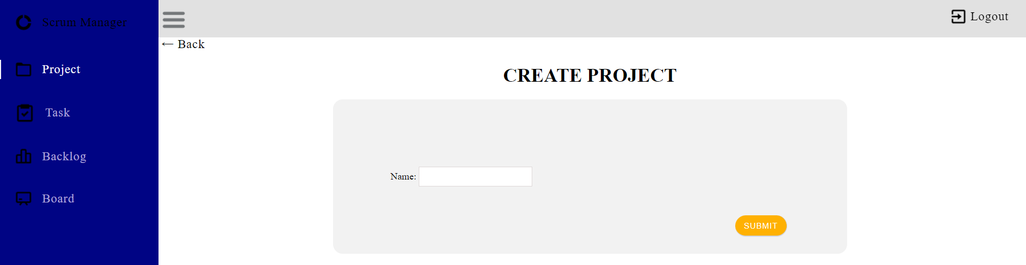
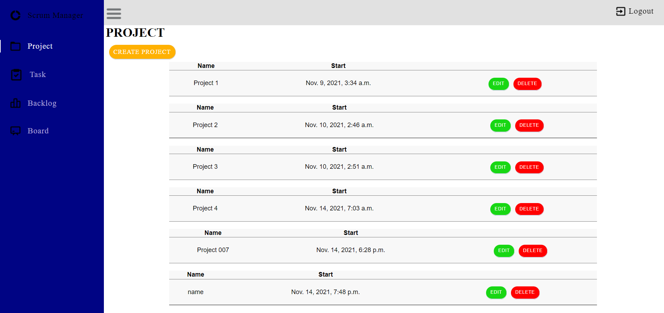
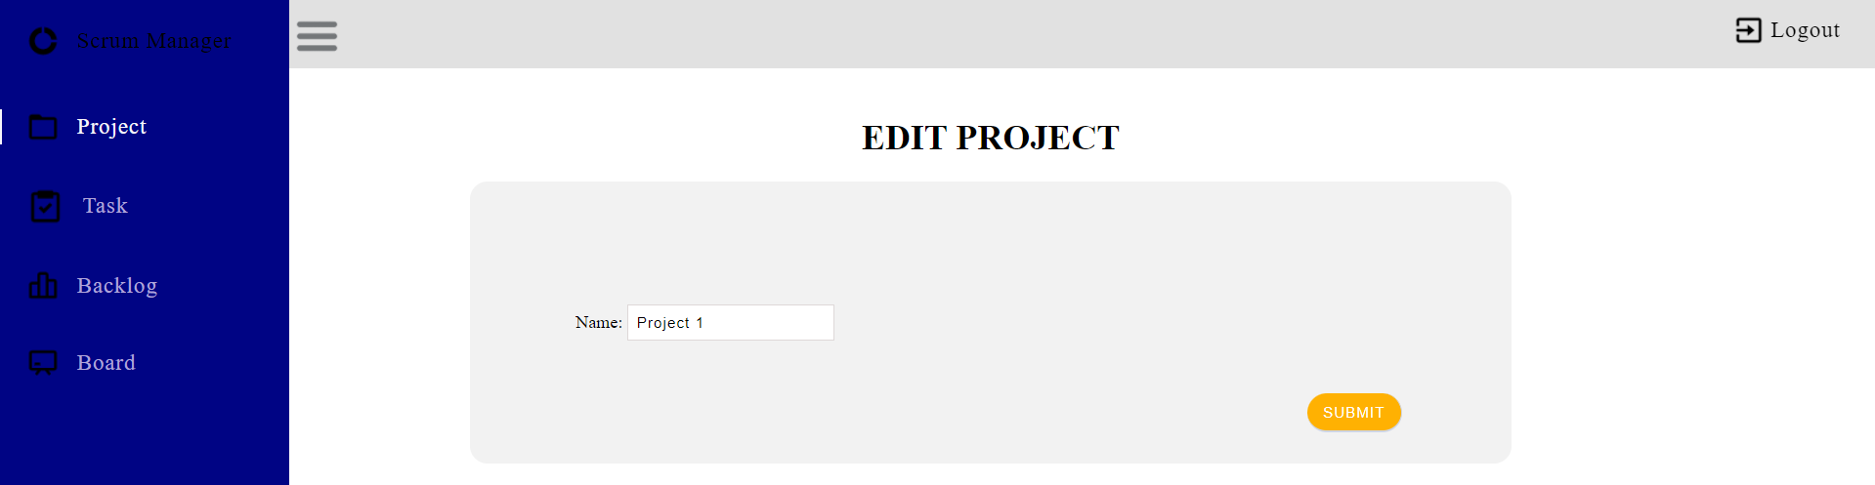
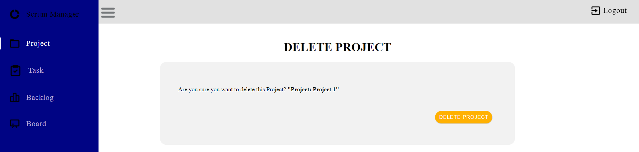
Scrum Manager – Project
Create Project
Project
Edit Project
Delete Project

Slide 10
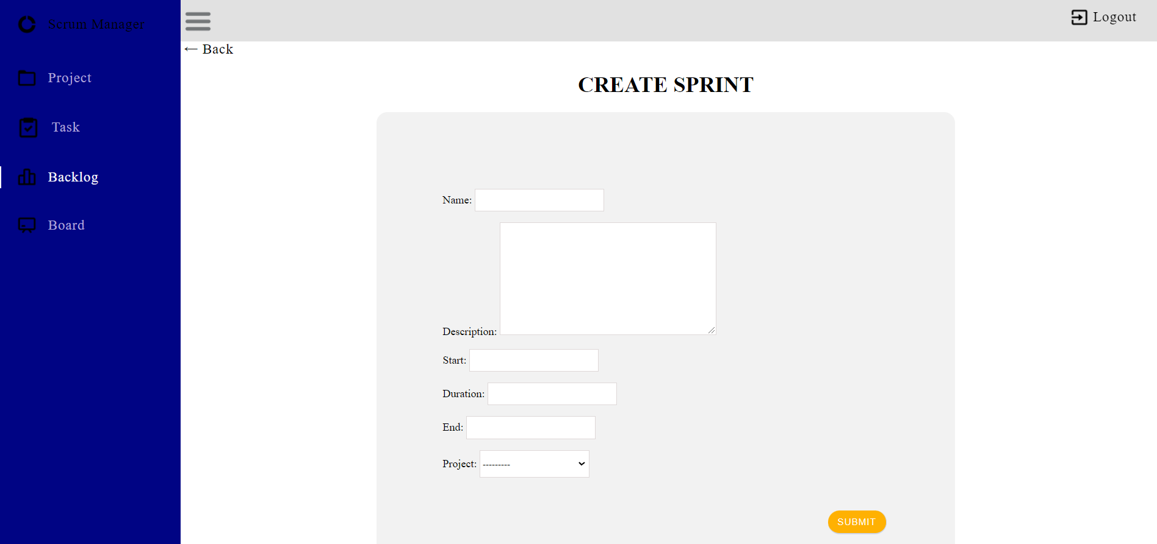
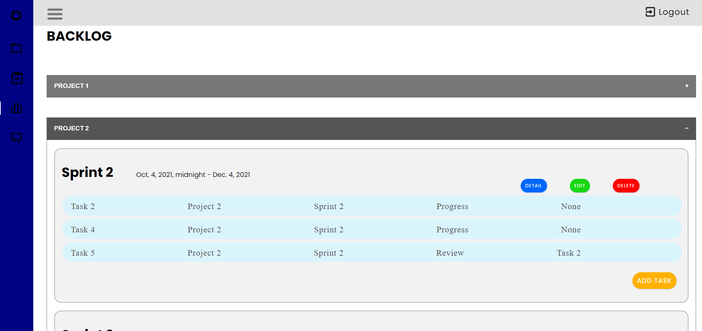
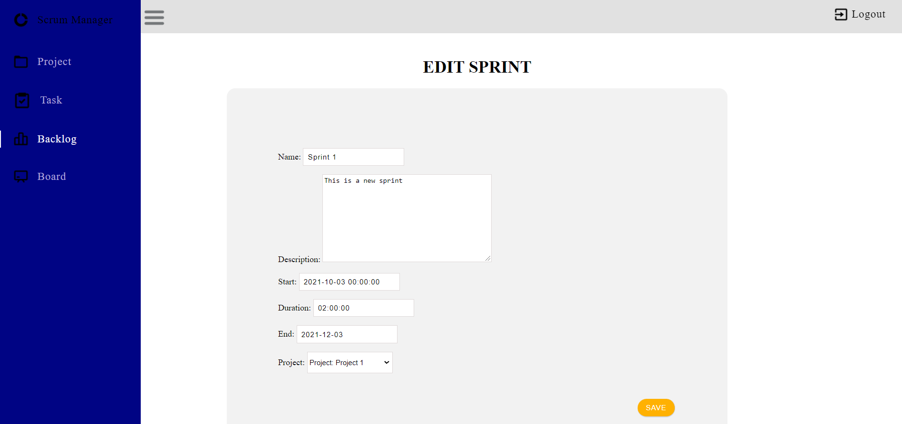
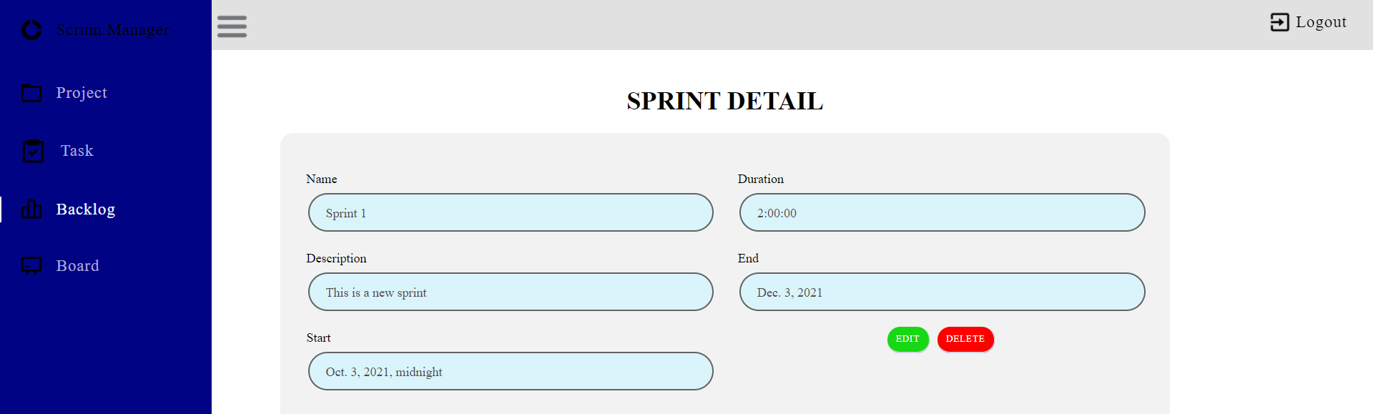
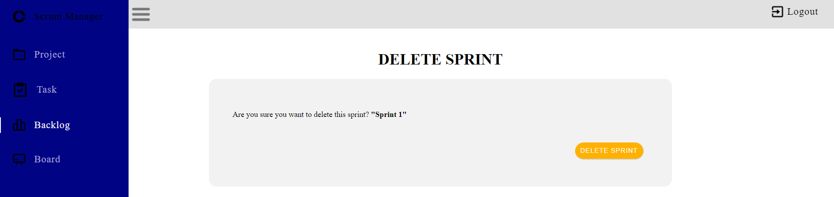
Scrum Manager – Sprint
Create Sprint
Sprints
Edit Sprint
Sprint Detail
Delete Sprint

Slide 11
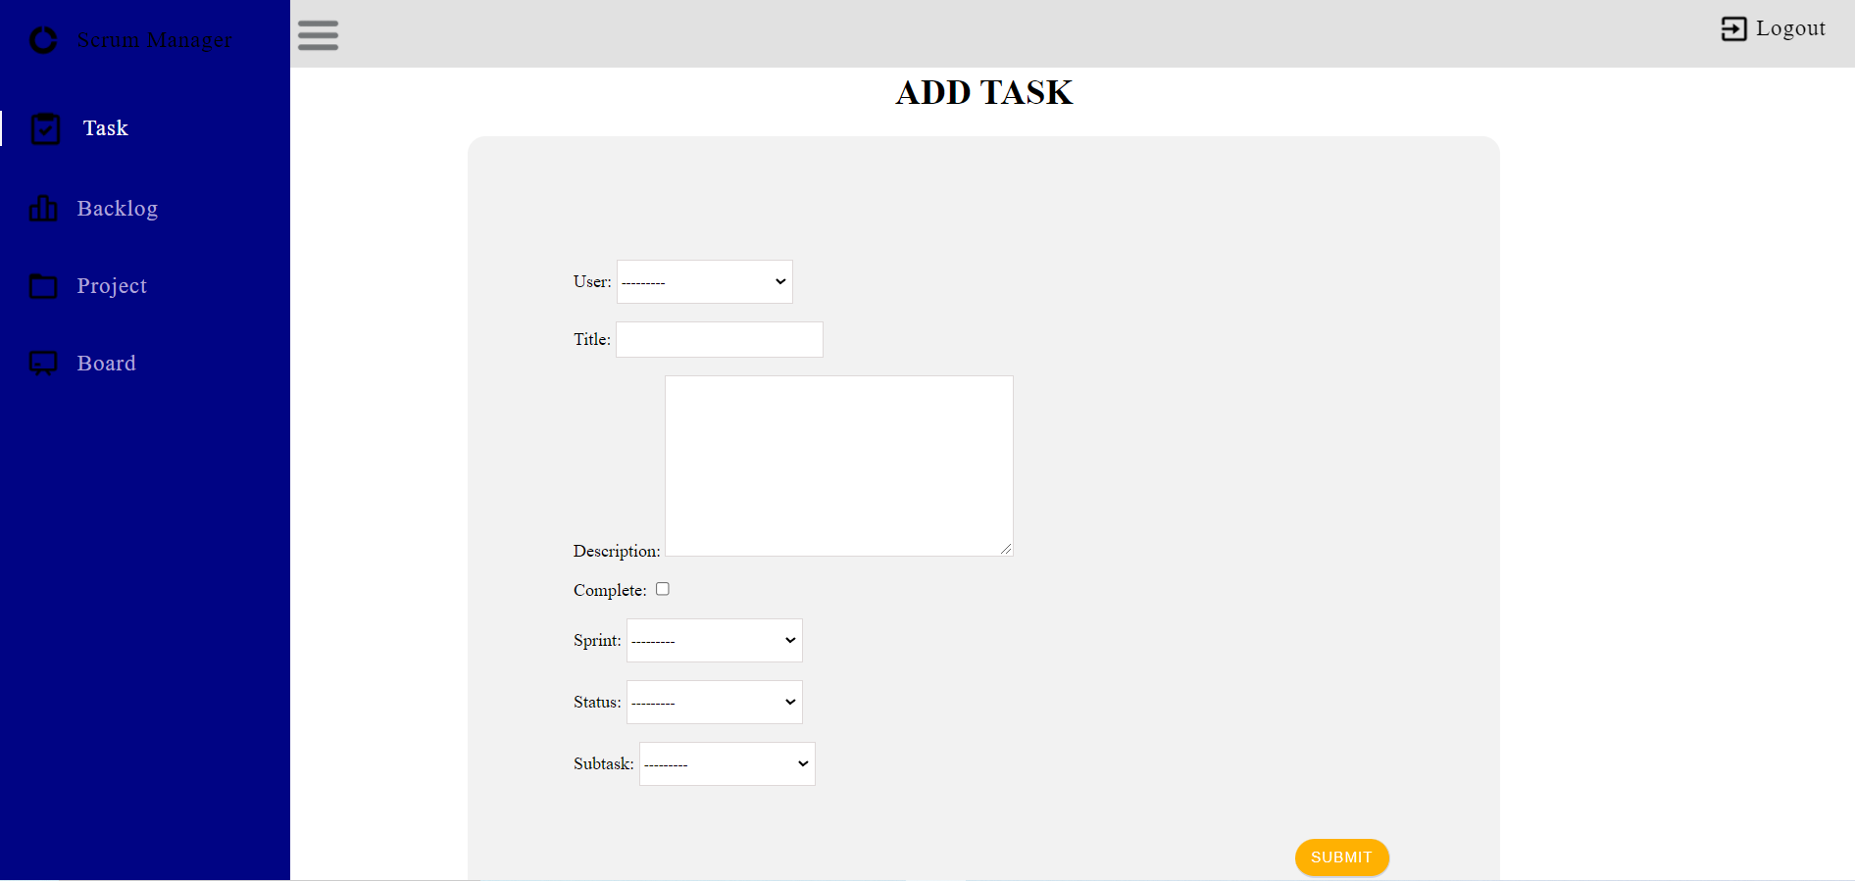
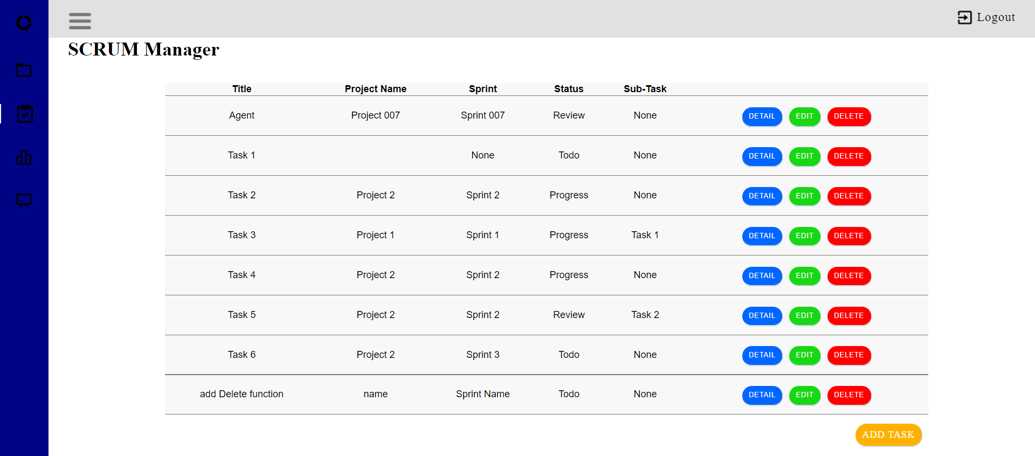

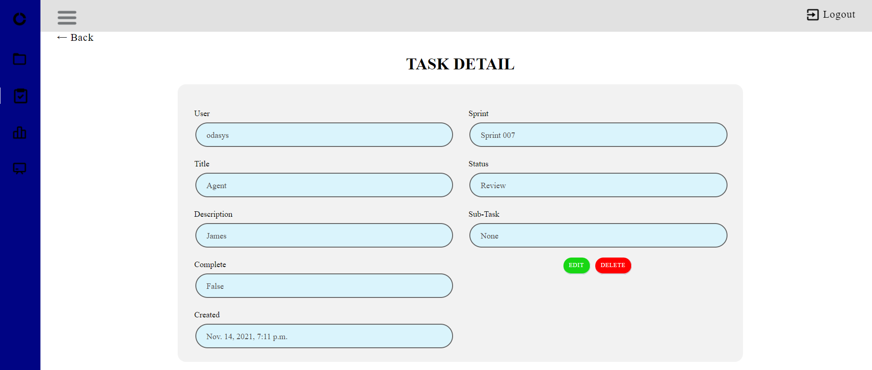
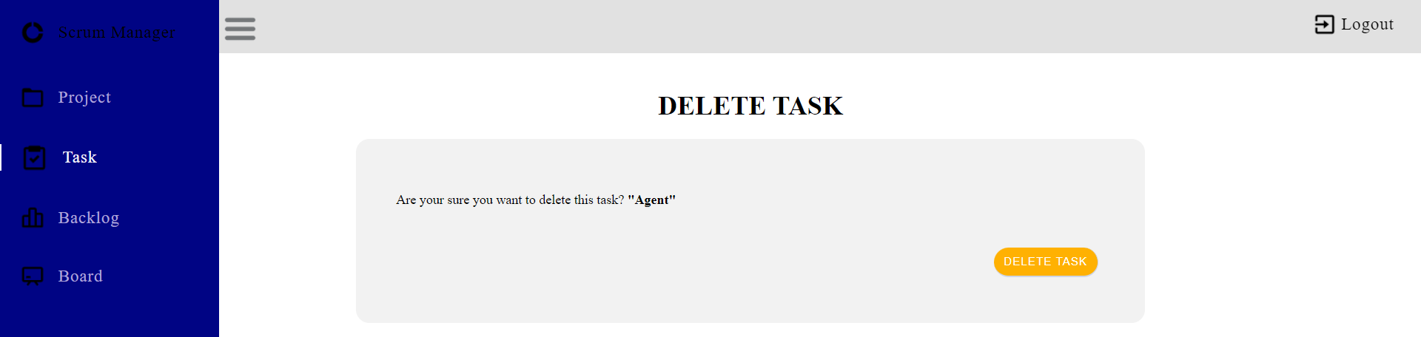
Scrum Manager – Task
Create Task
Tasks
Edit Task
Task Detail
Delete Task

Slide 12
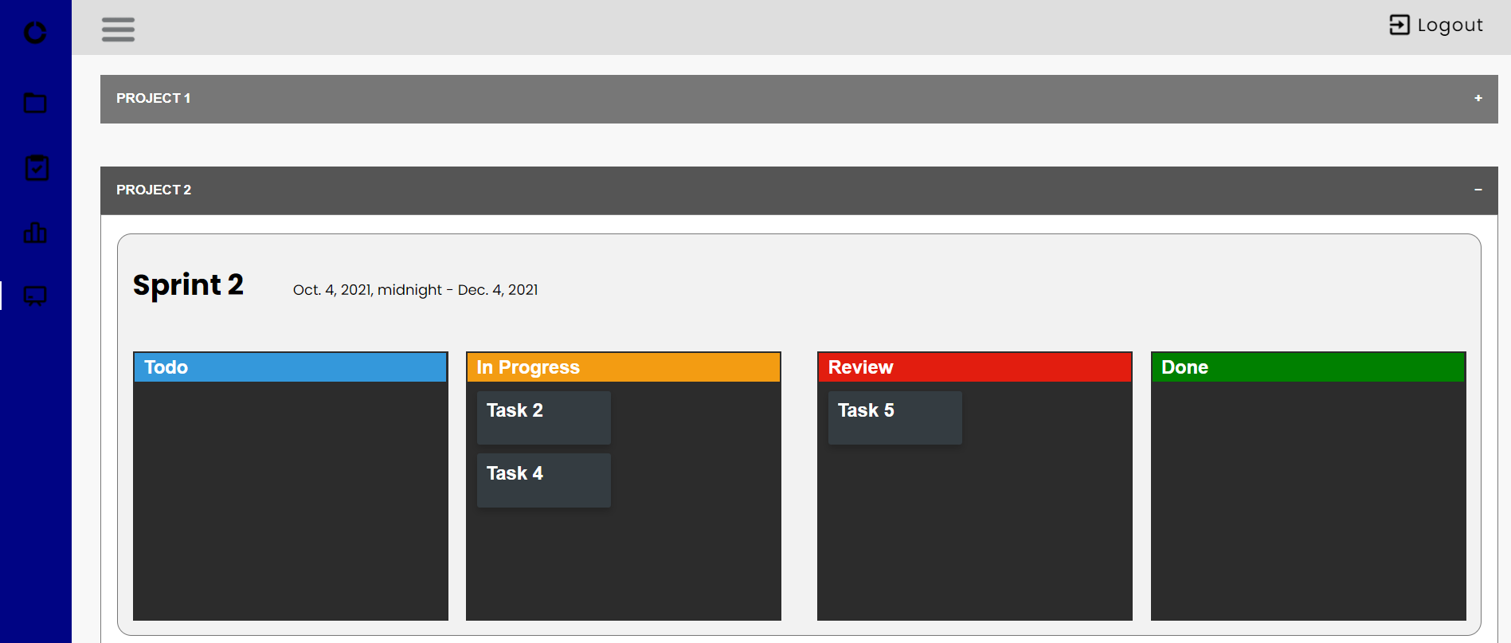
Scrum Manager – Board
Board

Slide 13
Our Team
Odasys Soberanes
Paola Cortes
odasyss@gmail.com
pcorteszaragoza@gmail.com
Thank you!

