Slide 1

Poems Auto Completion System
Presenters:
Oday Ziq 1201168

Slide 2

Introduction
Good [morning/afternoon], everyone. Today, we are excited to present our project on the Poems Auto Completion System. My name is Oday Ziq, and with me are Mahmoud Abu Sharekh and Ahmad Sayyad.
Our project aims to create a system that can autocomplete Arabic and English poems using deep learning techniques. This tool can assist poets and writers by suggesting contextually relevant and creative continuations for their poetry.

Slide 3

Background
Poetry generation is a challenging area in Natural Language Processing (NLP) due to the need for creativity, rhythm, and meter. Traditional text generation methods struggle with these aspects.
In our project, we explore the use of Long Short-Term Memory (LSTM) networks to tackle these challenges. LSTM networks are well-suited for capturing long-term dependencies in text, making them ideal for poetry generation.

Slide 4
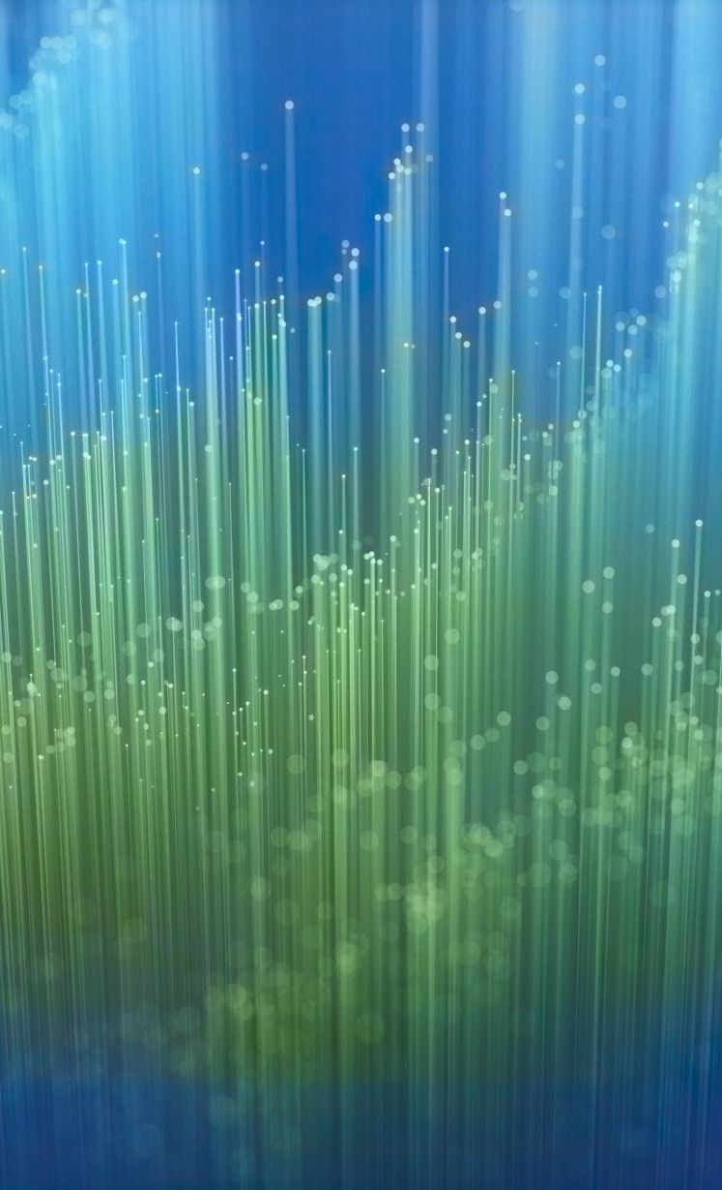
Data Collection and Preprocessing
To build our models, we collected a large dataset of Arabic and English poems from publicly available sources.
For Arabic poems, preprocessing steps included normalization of Alif forms, removal of diacritics, and elimination of non-Arabic characters and stop words.
For English poems, preprocessing was simpler: we converted text to lowercase, removed punctuation, and tokenized the text into individual words.

Slide 5
Model Architecture and Training
We used an LSTM-based model for both Arabic and English poem autocompletion. The model consists of three key layers: the Embedding Layer, the LSTM Layer, and the Fully Connected Layer.
The Embedding Layer transforms input words into dense vectors. The LSTM Layer analyzes these word embeddings and captures dependencies within the sequence. Finally, the Fully Connected Layer maps the LSTM's output to the vocabulary space to predict the next word.
We trained our models using the Adam optimizer and cross-entropy loss function. We used a batch size of 64 and a learning rate of 0.001. The Arabic model was trained for 35 epochs, while the English model was trained for 100 epochs.

Slide 6
Evaluation and Testing
We evaluated our models using beam search to generate possible continuations of given input sequences. Here are some examples of the autocompleted phrases for both Arabic and English poems.
For instance, given the Arabic input 'فهيهات ان', the model generated 'فهيهات ان يعيد الامه له في الزند لظى'. For the English input 'crashing against', the model generated 'crashing against noise still; droplet dragons convey'.
Our models achieved a hit ratio of 82.3% for Arabic and 91.3% for English, demonstrating their effectiveness in generating contextually relevant and creative poetic lines.

Slide 7
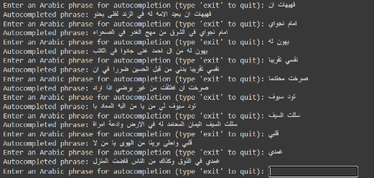
Test Cases
Arabic poems

Slide 8
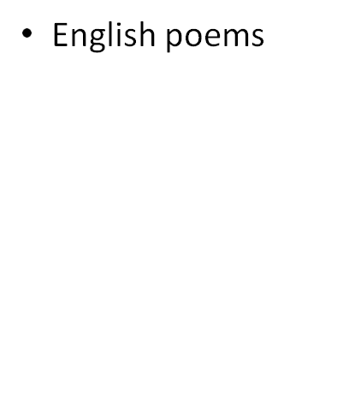
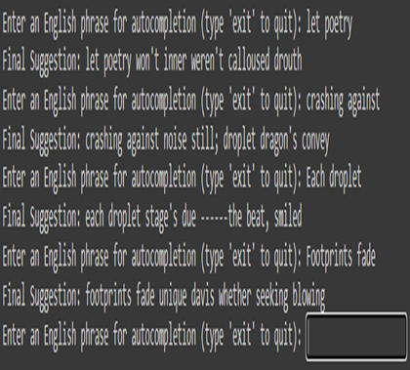
Test Cases

Slide 9
Future Work
While our models have shown promising results, there is always room for improvement. One potential direction is to incorporate transformer models like GPT-3, which have demonstrated superior performance in text generation tasks.
Improving the preprocessing techniques for Arabic, such as using better stop word lists and morphology analyzers, can also enhance the model's performance.
Additionally, expanding our dataset to include more diverse types of poems and implementing real-time suggestion systems can make our tool even more useful for poets and writers.

Slide 10

Conclusion
In conclusion, our project demonstrates the potential of LSTM-based models in autocompleting poems in both Arabic and English. Our models have shown that they can generate coherent and creative poetic lines, aiding poets in their creative process.
We look forward to further improving our models and expanding their capabilities. Thank you for your attention. We are now open to any questions you may have.

Slide 11

Q&A
We are happy to answer any questions you may have about our project.

