Slide 1
Introduction to .NET Framework
Rajeswari Indupuri

Slide 2
.NET – What Is It?
Software platform
Language neutral
In other words:
.NET is not a language (Runtime and a library for writing and executing written programs in any compliant language)

Slide 3
What Is .NET
.Net is a new framework for developing web-based and windows-based applications within the Microsoft environment.
The framework offers a fundamental shift in Microsoft strategy: it moves application development from client-centric to server-centric.

Slide 4
.NET – What Is It?
.NET Application
.NET Framework
Operating System + Hardware

Slide 5
Framework, Languages, And Tools
VB
VC++
VC#
JScript
…
Visual Studio.NET
Common Language Specification
ASP.NET: Web Services
and Web Forms
Windows Forms
ADO.NET: Data and XML
Base Class Library
Common Language Runtime
Notes:
The .NET framework exposes numerous classes to the developer. These classes allow the development of rich client applications and Web based applications alike. In the above slide these classes have been divided into 4 areas.
ASP.NET provides the core Web infrastructure such as Web Forms for UI based development and Web Services for programmatic interface development,
User interface development on the Windows platform can be done using Windows Forms
ADO.NET and XML provide the functionality for data access.
Finally, the core base classes provide infrastructure services such as security, transaction management etc.

Slide 6
The .NET Framework .NET Framework Services
Common Language Runtime
Windows® Forms
ASP.NET
Web Forms
Web Services
ADO.NET, evolution of ADO
Visual Studio.NET
Notes:
Common Language Runtime
Common, secure execution environment.
We’ll drill into this in some detail in the first parts of the presentation.
Windows® forms
Framework for building rich clients
A demonstration will highlight some of these features, such as the delegate-based event model.
ASP.NET
Web forms
Manageable code (non spaghetti)
Logical evolution of ASP (compiled)
Again, we’ll drill into a hint at the power of Web Forms with a demonstration
Web Services
Programming the Internet to leverage the "power at the edge of the cloud".
We will cover this in detail, as this – along with the CLR – is one of the more powerful aspects of .NET Framework.
ADO.NET, evolution of ADO
New objects (e.g., DataSets, Datareader)
Visual Studio.NET
Most productive development environment gets better and fully supports the .NET Framework

Slide 7
Common Language Runtime (CLR)
CLR works like a virtual machine in executing all languages.
All .NET languages must obey the rules and standards imposed by CLR. Examples:
Object declaration, creation and use
Data types,language libraries
Error and exception handling
Interactive Development Environment (IDE)

Slide 8
Common Language Runtime
Development
Mixed language applications
Common Language Specification (CLS)
Common Type System (CTS)
Standard class framework
Automatic memory management
Consistent error handling and safer execution
Potentially multi-platform
Deployment
Removal of registration dependency
Safety – fewer versioning problems

Slide 9
Common Language Runtime Multiple Language Support
CTS is a rich type system built into the CLR
Implements various types (int, double, etc)
And operations on those types
CLS is a set of specifications that language and library designers need to follow
This will ensure interoperability between languages

Slide 10
Compilation in .NET
Code in VB.NET
Code in C#
Code in another
.NET Language
VB.NET compiler
C# compiler
Appropriate
Compiler
IL(Intermediate
Language) code
CLR just-in-time
execution

Slide 11
Intermediate Language (IL)
.NET languages are not compiled to machine code. They are compiled to an Intermediate Language (IL).
CLR accepts the IL code and recompiles it to machine code. The recompilation is just-in-time (JIT) meaning it is done as soon as a function or subroutine is called.
The JIT code stays in memory for subsequent calls. In cases where there is not enough memory it is discarded thus making JIT process interpretive.

Slide 12
Languages
Languages provided by MS
VB, C++, C#, J#, JScript
Third-parties are building
APL, COBOL, Pascal, Eiffel, Haskell, ML, Oberon, Perl, Python, Scheme, Smalltalk…

Slide 13
Windows Forms
Framework for Building Rich Clients
RAD (Rapid Application Development)
Rich set of controls
Data aware
ActiveX® Support
Licensing
Accessibility
Printing support
Unicode support
UI inheritance

Slide 14
ASP.NET
ASP.NET - the platform services that allow to program Web Applications and Web Services in any .NET language
ASP.NET uses .NET languages to generate HTML pages. HTML page is targeted to the capabilities of the requesting Browser
ASP.NET “Program” is compiled into a .NET class and cached the first time it is called. All subsequent calls use the cached version.

Slide 15
ASP.NET
Logical Evolution of ASP
Supports multiple languages
Improved performance
Control-based, event-driven execution model
More productive
Cleanly encapsulated functionality
Notes:
The first incarnation of ASP proved very successful. As part of the .NET Framework, Microsoft support ASP.NET. ASP.NET is a logical evolution of ASP, but addresses many of the issues associated with ASP.
ASP.NET is now compiled and not interpreted.
A great deal of work has also been done to make sure that ASP.NET development becomes cleaner and more productive.

Slide 16
ASP.NET Web Forms
Allows clean cut code
Code-behind Web Forms
Easier for tools to generate
Code within is compiled then executed
Improved handling of state information
Support for ASP.NET server controls
Data validation
Data bound grids
Notes:
The Web Form is basically an ASP.NET file (.ASPX) that makes use of the new features of ASP.NET. ASP.NET in conjunction with Web Forms eliminate a number of the traditional problems associated with ASP.
ASP.NET provides the developer with the option of separating the code from the UI elements using ‘code-behind’ forms. Using such a mechanism will also make Form tools much easier to develop.
ASP.NET also conquers one of the annoying side effects of using ASP – state. Imagine that a user has filled in an ASP generated form and then hits the submit button. At this stage IIS (server side) will regenerate the form and as a side effect all the information that the user entered into the form will be erased. In many situations this is unacceptable, and many an ASP developer has struggled to find work arounds (most of which may not be considered elegant). Fortunately, ASP.NET allows controls to maintain state.
ASP.NET supports a number of new rich server controls. These controls can be used to improve data connectivity (data bound controls) and data validation.

Slide 17
ASP.NET Web Services
A technical definition
“A programmable application component accessible via standard Web protocols”
Notes:
Technically a Web Service is “A programmable application component accessible via standard Web protocols”. In other words, it’s a component that can be called remotely, over the internet, from a client application.
Take our previous example of a Web application that required ‘stock information’. This Web application possibly would not have that information readily at hand. However, what if another Web application (possibly on another machine, on the other side of the planet) did? Further more what if this remote machine exposed a component with a method such as ‘GetStockPrice (string strCompanyName)’. Surely this would make life much easier, making separate Web sites act like ‘one big application’.
Web service consumers can send and receive messages using XML, and therefore the audience of clients is unlimited.

Slide 18
Web Services
It is just an application…
…that exposes its features and capabilities over the network…
…using XML…
…to allow for the creation of powerful new applications that are more than the sum of their parts…

Slide 19
ADO.NET (Data and XML)
New objects (e.g., DataSets)
Separates connected / disconnected issues
Language neutral data access
Uses same types as CLR
Great support for XML

Slide 20
Visual Studio.NET
Development tool that contains a rich set of productivity and debugging features

Slide 21
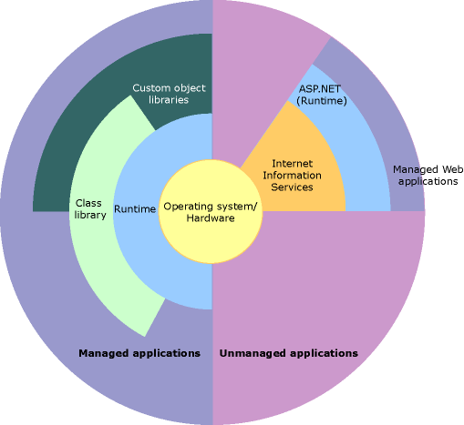
.NET – Hierarchy, Another View
CLR
CLR

Slide 22
Summary
The .NET Framework
Dramatically simplifies development and deployment
Provides robust and secure execution environment
Supports multiple programming languages

Slide 23
Comparison between J2EE and .NET

Slide 24
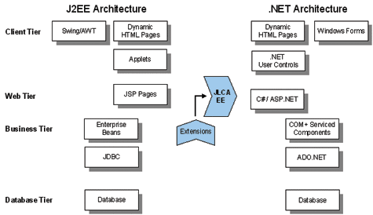
Comparison between J2EE and .NET Architectures

Slide 25
J2EE and .NET
Execution Engine
J2EE
Java source code compiles into machine-independent byte code
Runtime Environment : JVM
.NET
Any compliant language compiles into MSIL
Runtime environment : CLR
Both JVM and CLR ,support services, such as code verification, memory management via garbage collection, and code security

Slide 26
J2EE and .NET
Cross Platform Portability
J2EE
Platform Independent
JDK should exist on target machine
.NET
Supports Windows platform
CLR should exist on target machine
Can support other platforms provided it has its own JIT complier

Slide 27
J2EE and .NET
Language Support
J2EE
Tied to Java
Supports other languages via interface technology
.NET
Language independent
Supports any language if mapping exists from that
language to IL

Slide 28
J2EE and .NET
Tools Support
J2EE
Can employ any number of tools
Pro :Developer has a great deal of choice
Con :Difficulty in choosing a right tool for a given job
.NET
Visual Studio.NET, single IDE for building an application

