Slide 1
FSC 311
History and Philosophy of Science
LECTURE NOTES 001. 2021/2022 SESSION
KHALID ADEKOYA
kadekoya@unilag.edu.ng

Slide 2
Outline - HISTORY
Science in the Ancient World
What Science is and its historical evolution
Prehistory – Babylon, Egypt and Greece
The age of Alchemy
Renaissance Science – da Vinci, Copernicus, Kepler, Galileo and Newton
The mechanical philosophy – Darwin and Evolution, Mendel and Genetics
Industrial revolution – Faraday, Maxwell, Pasteur, Dalton etc
The new era of Science

Slide 3
OUTLINE - PHILOSOPHY
What is Science and what it does
Philosophic disciplines and their relation to science- metaphysics, epistemology and logic
Genesis of scientific thought and knowledge
Science as a human activity
Roots of reason – habit formation intelligence, knowing- myths, anthropomorphic and animistic explanation
The Greeks and origins of criticisms
The methods of Science; observation and empirical science
Criteria for observation
Models and representation of facts
Abstraction and order
Measurements
Hypothesis and experiments
Laws and theories

Slide 4
Science in the Ancient World
The history of science in early cultures covers protoscience in ancient history to Islamic Science
advice and knowledge was passed from generation to generation in an oral tradition or oral lore (songs. speeches, folktales, ballads, chants, incantations, prose, verses, poems etc )
The development of writing enabled knowledge to be stored and communicated across generations with much greater fidelity
Science is founded on the idea that experience, effort, and reason are valid, while magic is founded on intuition and hope.
In ancient times, it was common for science to be merged with magic, religion, mysticism, and philosophy, since the limits of the scientific discipline were not fully understood

Slide 5
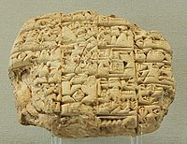
Ancient near East
Mesopotamian clay tablet-letter from 2400 BC, Louvre. (from King of Lagash, found at Girsu)
Mesopotamia – Came from Sumer Now Iraq.(3500BC)
Pythagoras law, Astronomy, Medicine (Babylonian)
Egypt – Medicine, Astronomy and Mathematics (Egyptian)
Persia – Mathematics, Astronomy, Physics, Chemistry, Biology, (Science and Technology in Medieval Islam, Iran))

Slide 6
Greco-Roman World
History of science in Classical Antiquity
Scientific thought in Classical Antiquity becomes tangible from the 6th century BC in pre-Socratic philosophy (Thales, Pythagoras).
In c. 385 BC, Plato founded the Academy. With Plato's student Aristotle begins the "scientific revolution" of the Hellenistic period culminating in the 3rd to 2nd centuries with scholars such as Eratosthenes, Euclid, Aristarchus of Samos, Hipparchus and Archimedes.
The important legacy of this period included substantial advances in factual knowledge, especially in anatomy, zoology, botany, mineralogy, geography, mathematics and astronomy;
an awareness of the importance of certain scientific problems, especially those related to the problem of change and its causes; and a recognition of the methodological importance of applying mathematics to natural phenomena and of undertaking empirical research.

Slide 7
India
Science and technology in ancient India
Indian astronomy, Indian mathematics, Ayurveda, and History of metallurgy in the Indian subcontinent
Excavations at Harappa, Mohenjo-daro and other sites of the Indus Valley civilization (IVC) have uncovered evidence of the use of "practical mathematics".

Slide 8
China and the Far East
History of science and technology in China and Four Great Inventions
The first recorded observations of solar eclipses and supernovae were made in China.
On July 4, 1054, Chinese astronomers observed a guest star, a supernova, the remnant of which is now called the Crab Nebula.
The "Four Great Inventions" of China as among some of the most important technological advances are. the
compass,
gunpowder,
papermaking, and
printing,

Slide 9
Islamic Science
7th and 16th century marks the time period of the embarking of Islamic civilizations
Islamic Medicine
Islamic Astronomy
Within the people researching there was Ibn Sina (Avicenna) out of the many things he did including writing The Canon of Medicine; he established free hospitals and developed many great treatments unknown to man
Three main figures were Abu Ma'shar al-Balkhi, al-Biruni and Nasir al-Din al-Tusi these three men all wrote Treatise having to deal with astrology.
Abd al-Rahman al-Sufi was one the most influential figures in improving the geometrical models of Ptolemy. Abd wrote Book of the Images of the Fixed Stars which described the forty-eight constellations formed by fixed stars.

Slide 10
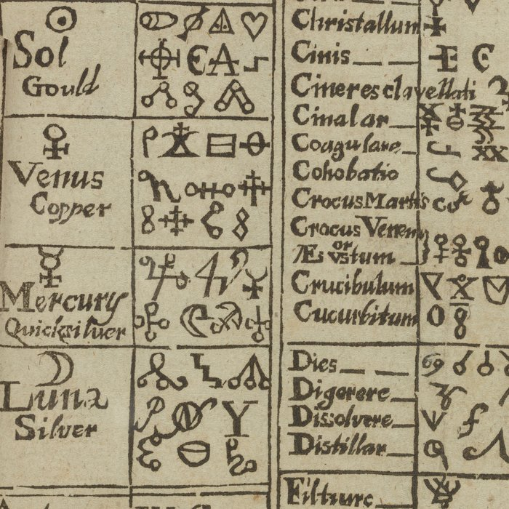
Age of Alchemy
alchemy conjures up images of mysticism or a fool’s quest for gold.
But alchemy’s golden age ( ca 1300 – 1700)was much more.
In this era of experimental discovery and practical skill, physicians and chemists worked
to heal the human body.
They studied the secrets of the natural world.
These men and women ushered in change, creativity, and scientific inquiry.
This digital collection features selected manuscripts, rare books, paintings, and ephemera relating to alchemical topics and experimentation. Materials in this collection include depictions of alchemists’ workshops and pursuits on philosophy, magic, medicine, spiritual wisdom, and the transformation of matter.

Slide 11
Renaissance science
Rebirth of Science and culture after the ancient Science
There was an escalation in the study of astronomy, anatomy and medicine, geography, alchemy, mathematics and architecture
One of the major scientific discoveries of the Renaissance came from Polish mathematician and astronomer Nicolaus Copernicus
Both the microscope and the telescope were invented during the Renaissance
The Renaissance contributed to the Scientific Revolution by focusing on humanity instead of the divine

Slide 12
Renaissance science (Contd.)
During the Renaissance, great advances occurred in geography, astronomy, chemistry, physics, mathematics, manufacturing, anatomy and engineering.
The Renaissance and the Scientific Revolution constituted what was, perhaps, the most significant period of discovery and growth of the sciences in the whole of history
science and technology began a cycle of mutual advancement
Astronomer Nicolaus Copernicus put forth a new theory during the Renaissance. He said that the Sun was the center of the universe and that the Earth and the planets orbited the Sun

Slide 13
Renaissance science (Contd.)
Petrarch laid the foundation to Renaissance humanism through his writings, and he came to be known as the father of the Renaissance
Leonardo da Vinci, Michelangelo, and Claudio Monteverdi may have earned their reputations as artists and musicians but they were also inventors, physicians, and acousticians
Galileo Galilei, Johannes Kepler, and Isaac Newton may be known primarily as scientists but they were also writers, musicians, and philosophers

Slide 14
Renaissance science (Contd.)
The developments in science during the 16th and 17th centuries have traditionally been called the “Scientific Revolution.” The era that began with Nicolaus Copernicus (b. 1473–d. 1543) and ended with Isaac Newton (b. 1642–d.
The period saw significant developments in the following areas:
Alchemy
Astronomy
Mathematics (Greek mathematics)
Medicine (Medical renaissance)
Geography and the New World.

Slide 15
Mechanical Philosophy
Descartes was a French-born philosopher who developed what came to be known as 'the mechanical philosophy', according to which the natural world consists in nothing but matter in motion.
The mechanical philosophy is a form of natural philosophy which compares the universe to a large-scale mechanism (i.e. a machine).
The mechanical philosophy derived from the views of the Greek philosopher Epicurus (341–271 b.c.e.), who sought the key to the good life. He considered the good life to be one that maximizes pleasure and minimizes pain.

Slide 16
Darwin and Evolution
Darwin proposed that species can change over time, that new species come from pre-existing species, and that all species share a common ancestor.
five theories that Darwin combined: evolution as such, common descent, gradualism, multiplication of species, and natural selection.
The theory of evolution is based on the idea that all species? are related and gradually change over time.
The theory of evolution is not a hypothesis, but the scientifically accepted explanation of the incontrovertible fact that life and its many forms has changed over the years
"The basic theory of evolution has been confirmed so completely that most modern biologists consider evolution simply a fact.

Slide 17
Mendel and Genetics
Gregor Mendel, through his work on pea plants, discovered the fundamental laws of inheritance.
The Mendel's four postulates and laws of inheritance are:
(1) Principles of Paired Factors
(2) Principle of Dominance
(3) Law of Segregation or Law of Purity of Gametes (Mendel's First Law of Inheritance) and
(4) Law of Independent Assortment (Mendel's Second Law of Inheritance).

Slide 18
Industrial Revolution
The Industrial Revolution was the transition from creating goods by hand to using machines.
Its start and end are widely debated by scholars, but the period generally spanned from about 1760 to 1840.
the process of change from an agrarian and handicraft economy to one dominated by industry and machine manufacturing.
It brought about sweeping changes in economic and social organization.

Slide 19
The most important of the changes that brought about the Industrial Revolution were the:
invention of machines to do the work of hand tools,
use of steam and later of other kinds of power, and
adoption of the factory system.
The 4 industrial revolution periods and significance
First Industrial Revolution: Coal in 1765.
Second Industrial Revolution: Gas in 1870.
Third Industrial Revolution: Electronics and Nuclear in 1969.
Fourth Industrial Revolution: Internet and Renewable Energy in 2000

Slide 20
The Industrial Revolution began in Great Britain, and many of the technological and architectural innovations were of British origin.
Impacts of Industrial revolution.
sweeping changes in economic and social organization.
wider distribution of wealth and
increased international trade
managerial hierarchies also developed to oversee the division of labor

Slide 21
Inventors and Inventions of the Industrial Revolution
Spinning and weaving. ...
The steam engine. ...
Harnessing electricity. ...
The telegraph and the telephone. ...
The internal-combustion engine and the automobile.

Slide 22
Scientists contributions (Selected)
Michael Faraday FRS was an English scientist who contributed to the study of electromagnetism and electrochemistry. His main discoveries include the principles underlying electromagnetic induction, diamagnetism and electrolysis
James Clerk Maxwell FRSE FRS was a Scottish mathematician and scientist responsible for the classical theory of electromagnetic radiation, which was the first theory to describe electricity, magnetism and light as different manifestations of the same phenomenon

Slide 23
Louis Pasteur FRS was a French chemist and microbiologist renowned for his discoveries of the principles of vaccination, microbial fermentation and pasteurization, the latter of which was named after him
John Dalton FRS was an English chemist, physicist and meteorologist. He is best known for introducing the atomic theory into chemistry, and for his research into colour blindness, which he had. Colour blindness is known as Daltonism in several languages, being named after him.

Slide 24
New Era of Science
Scientific knowledge allows us to develop new technologies, solve practical problems, and make informed decisions
With a dramatically changing media environment, challenging economic and social climates, shifting relationships between citizens and policy makers and an evolving understanding of democracy, science stands as a ready tool to help combat modern difficulties
Emerging technologies are _ Drones, Robotics, Vertical farming, Biometrics, 6G Technology, Artificial Uterus, Airless tyres, Green bullet, memory erassure, Artificial Intelligence, Molecular Electronics etc.

Slide 25
History of Science
covers the development of science from ancient times to the present.
studies the emergence and development of systematic knowledge.
It covers the three branches of Science : NATURAL, SOCIAL and FORMAL
NATURAL - cosmological, geological, physical, chemical, and biological
SOCIAL - the study of human behavior in its social and cultural aspects
FORMAL - the study of formal systems, such as those under the branches of logic and mathematics, which use an a priori, as opposed to empirical, methodology.
A priori ("from the earlier") and a posteriori ("from the later")
Earliest root of Science is traced to Ancient Egypt and Mesopotamia (3000 – 1200 BCE)

Slide 26
A priori Vs A posteriori
A priori ("from the earlier") and a posteriori ("from the later") are Latin phrases used in philosophy to distinguish types of knowledge, justification, or argument by their reliance on empirical evidence or experience.
A priori knowledge is independent from current experience (e.g., as part of a new study). Examples include mathematics,^{[i]} tautologies, and deduction from pure reason.
A posteriori knowledge depends on empirical evidence. Examples include most fields of science and aspects of personal knowledge.

Slide 27
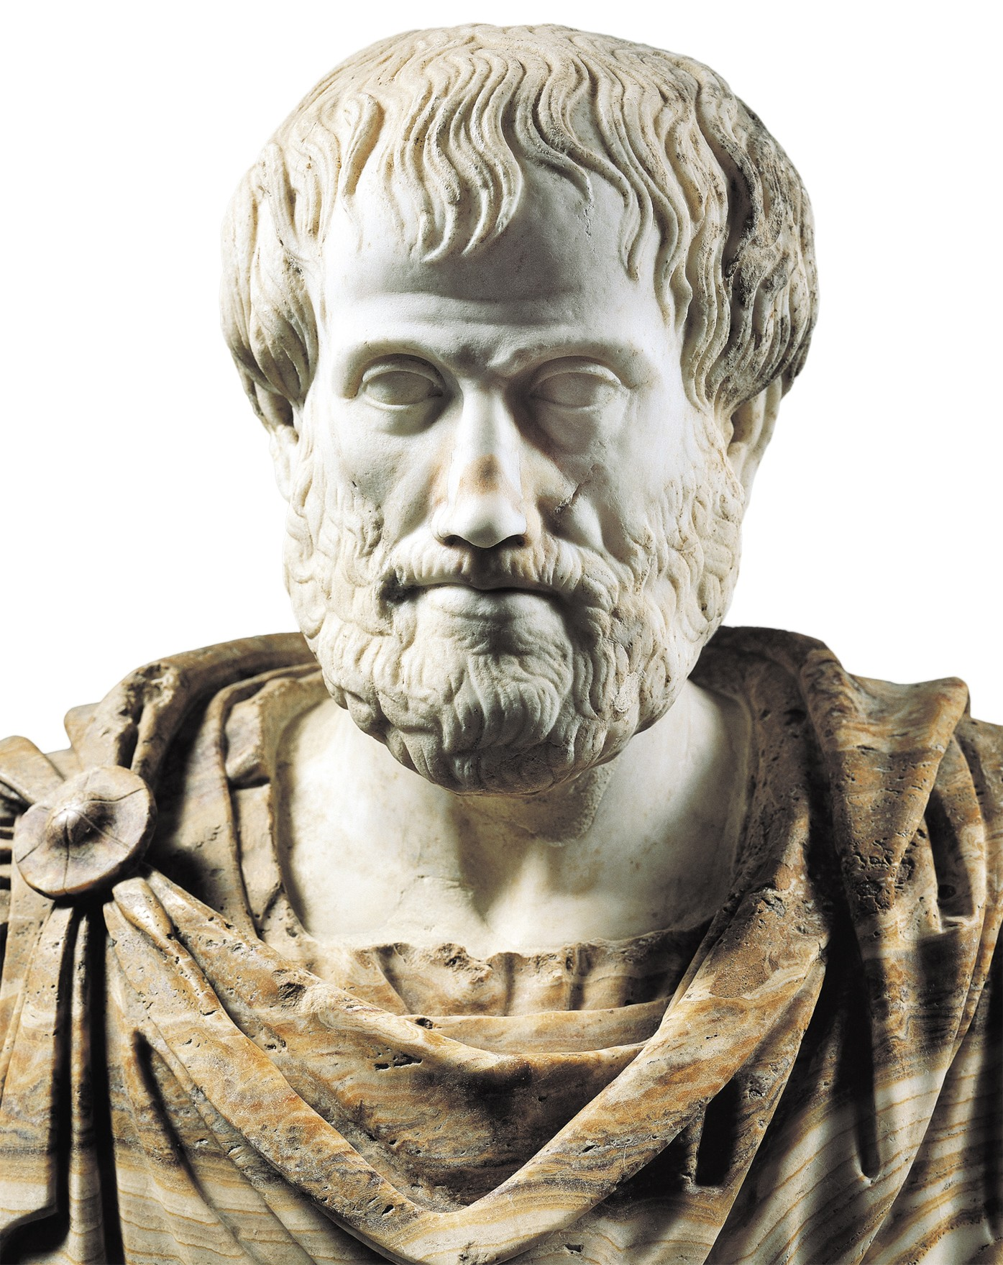
Who first discovered science?
ARISTOTLE is considered by many to be the first scientist, although the term postdates him by more than two millennia.
In Greece in the fourth century BC, he pioneered the techniques of logic, observation, inquiry and demonstration
Aristotle further informed that _ Thales, Anaximander and Anaximenes, 6th century Ionian philosophers, were the first to investigate natural phenomena.
Whewell coined the term Science in 1833
What came first in science? The observation of nature came first, then followed by the practical use
Who wrote the first book “History of science” is about development of science - F. Cojori.

Slide 28
It was the Greeks who first suggested that matter was made up of atoms, it was agreed that Science started from them.
Astronomy is the oldest of all the sciences
Why is history called the mother of all sciences?
History by its very nature, scope, form, structure, subject matter and values, stands out as an important discipline to be earnestly pursued. History, in as much as it incorporates all human activity, is the mother of all disciplines.

Slide 29

WHAT IS SCIENCE
FAT TEXT BOOKS
WHITE LABORATORY COATS
MICROSCOPES
COMPLEX NUMBERS CALCULATIONS
GADGETS
TELESCOPES
FIELD TRIPS
EXPERIMENTS
COMPUTERS?
………… WHAT DID SCIENCE MEAN TO YOU BEFORE NOW

Slide 30
What is Science? Science (from Latin scientia, meaning "knowledge")
the pursuit and application of knowledge and understanding of the natural and social world following a systematic methodology based on evidence
is a systematic enterprise that builds and organizes knowledge in the form of testable explanations and predictions about the universe
Body of knowledge comprising of measurable or verifiable facts acquired through application of the scientific method, and generalized into scientific laws or principles.

Slide 31
the intellectual and practical activity encompassing the systematic study of the structure and behaviour of the physical and natural world through observation and experiment.
a method that allows a person to possess, with the highest degree of certainty possible, reliable knowledge (justified true belief) about nature
Can you attempt your own definitions
----------
----------
-----------
4

Slide 32
USING SCIENCE IN SENTENCES
---gives you the ability to discover different ways things operate, why they operate, and what the outcome would be
---has made many things possible, from finding out cures to deadly diseases, to enabling human beings to walk on the moon’s surface.
behind yoga --- is helping many instructors to understand how their muscles are working and how this corresponds to negative and positive emotions in the brain

Slide 33
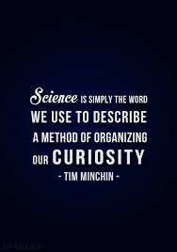
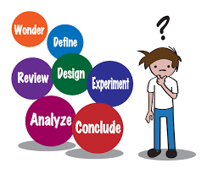

Slide 34
GOALS OF SCIENCE
Explore and understand the Natural World
Explain events in the Natural World
Use those explanations to make useful predictions
Are some things unpredictable
To Satisfy basic human needs and improve living standards………..

Slide 35
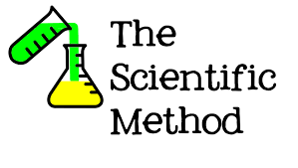
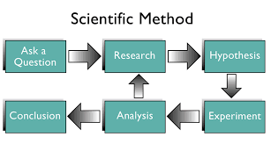

Slide 36
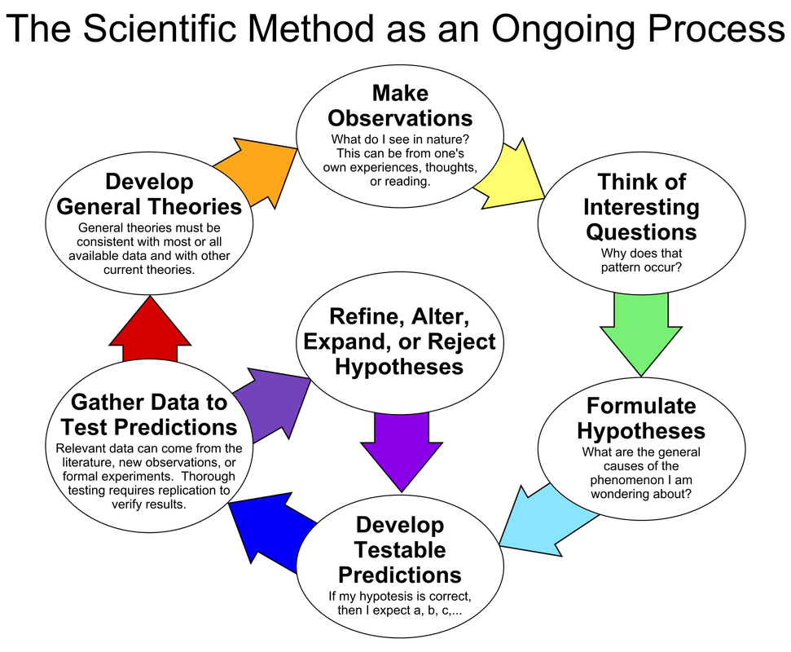

Slide 37
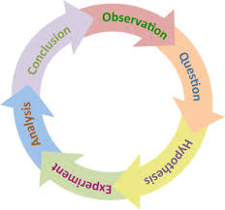

Slide 38
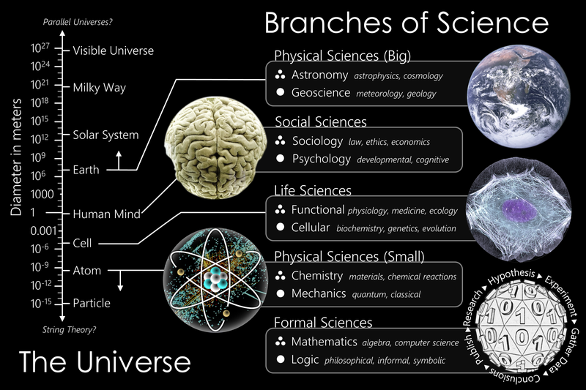

Slide 39
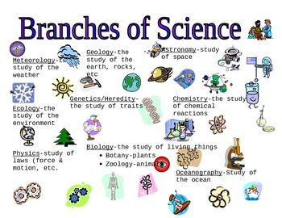

Slide 40
