Slide 1


TESA COHORT 6 — AI ENGINEERING
Loan Application
Data Analysis
Understanding Applicant Profiles, Financial Patterns & Loan Characteristics
Prepared by Bamigbele Oluwaseun

Slide 2
USE CASE
Understanding the Lending Challenge
A lending institution wants to better understand its loan applicants and the types of loans they request.
BUSINESS GOAL
Identify meaningful patterns that can support more structured loan assessment and loan-product planning.
THE ANALYSIS EXAMINES
Applicant demographics and employment characteristics
Applicant and coapplicant income
Credit history
Requested loan amounts and repayment terms
Education and property area
A clearer view of applicant behavior today informs better lending decisions tomorrow.
These factors together define the scope of the analysis.
02

Slide 3
DATASET OVERVIEW
What We're Working With
981
12
Loan Applications
Variables Recorded
Applicant Profile
Gender • Marital status • Dependents • Education • Self-employment
Financial Information
Applicant income • Coapplicant income • Loan amount • Loan term
Assessment Context
Credit history • Property area
03

Slide 4
DATA QUALITY & CLEANING
Getting the Data Analysis-Ready
The raw dataset contained several quality issues that were addressed before analysis.
Missing values in categorical and numerical fields
Inconsistent Gender values: m/Male and f/Female
Multiple Property_Area spelling variations
Two zero ApplicantIncome records investigated and retained
One 350-month loan term investigated and retained
No duplicate records identified
Cleaning principle: standardize genuine inconsistencies without deleting potentially valid observations.
04

Slide 5
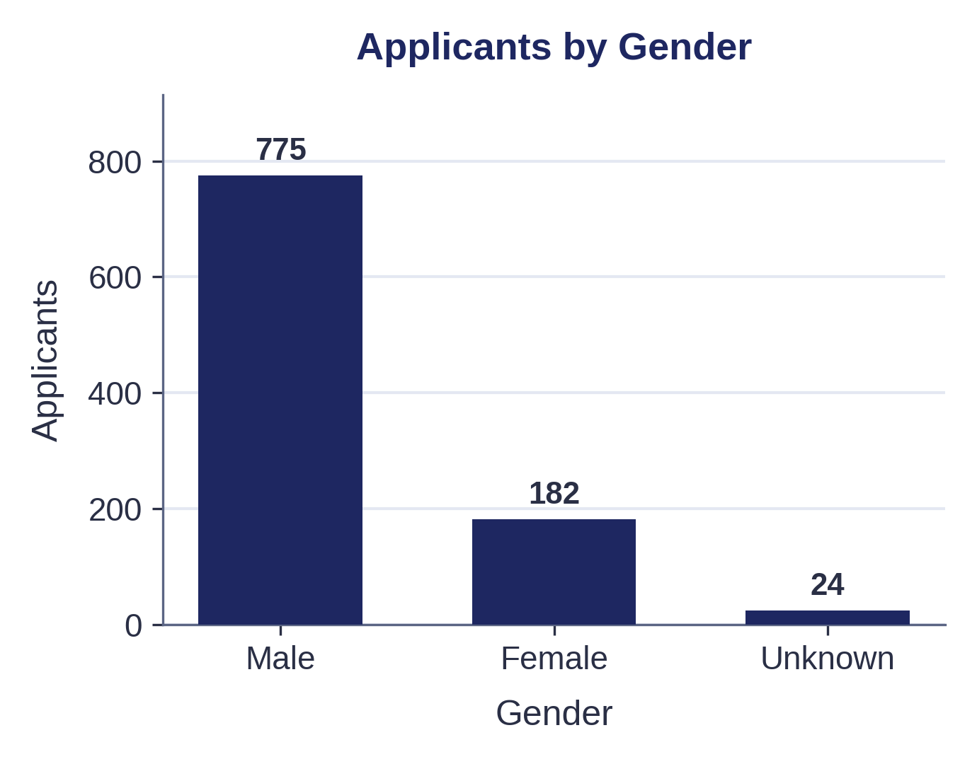
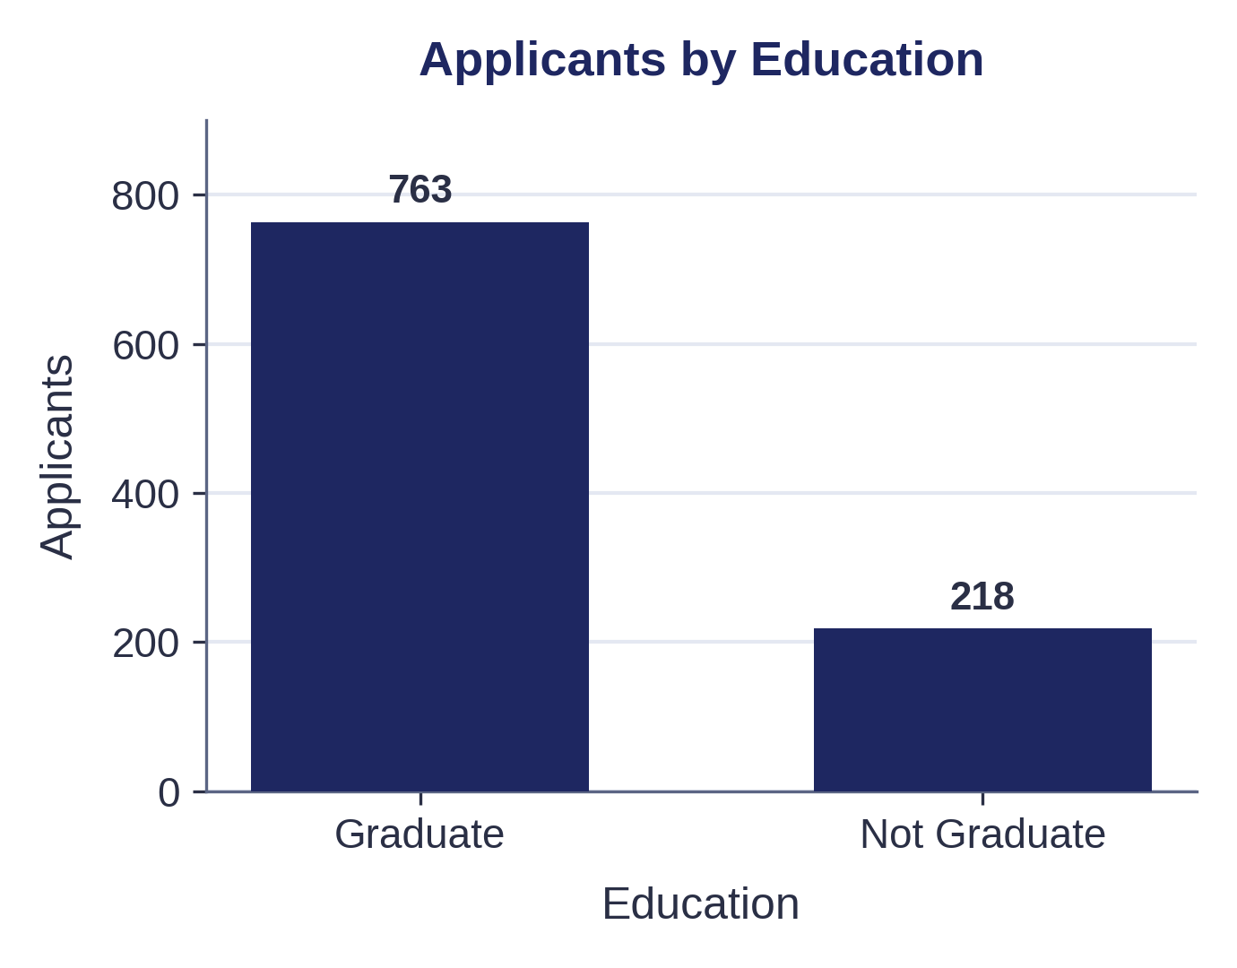
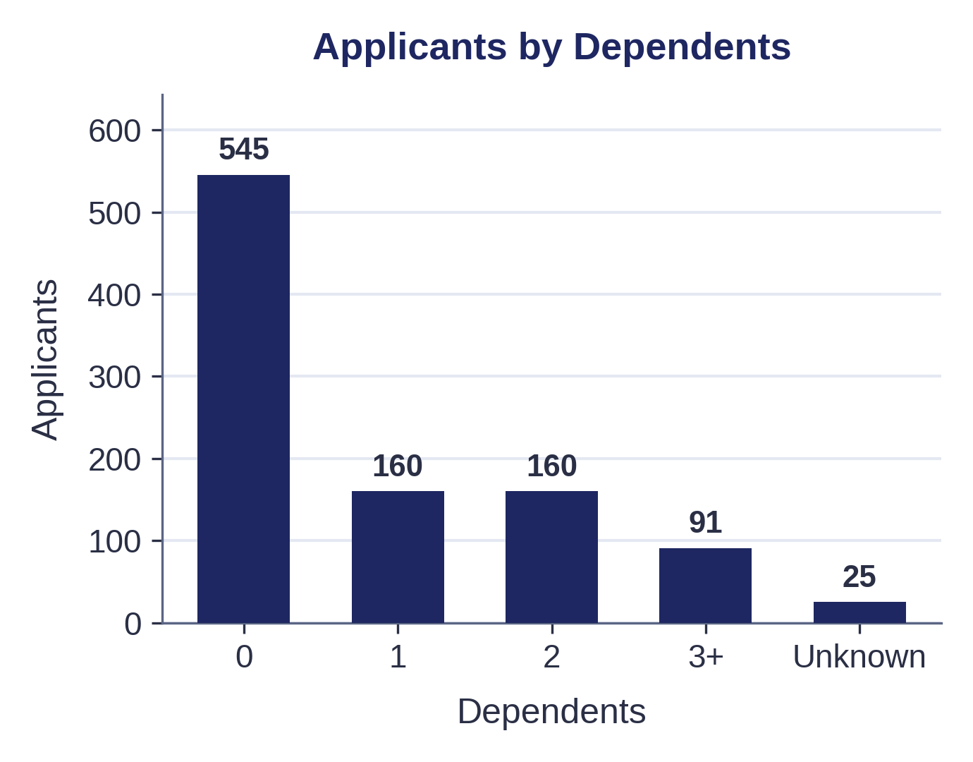
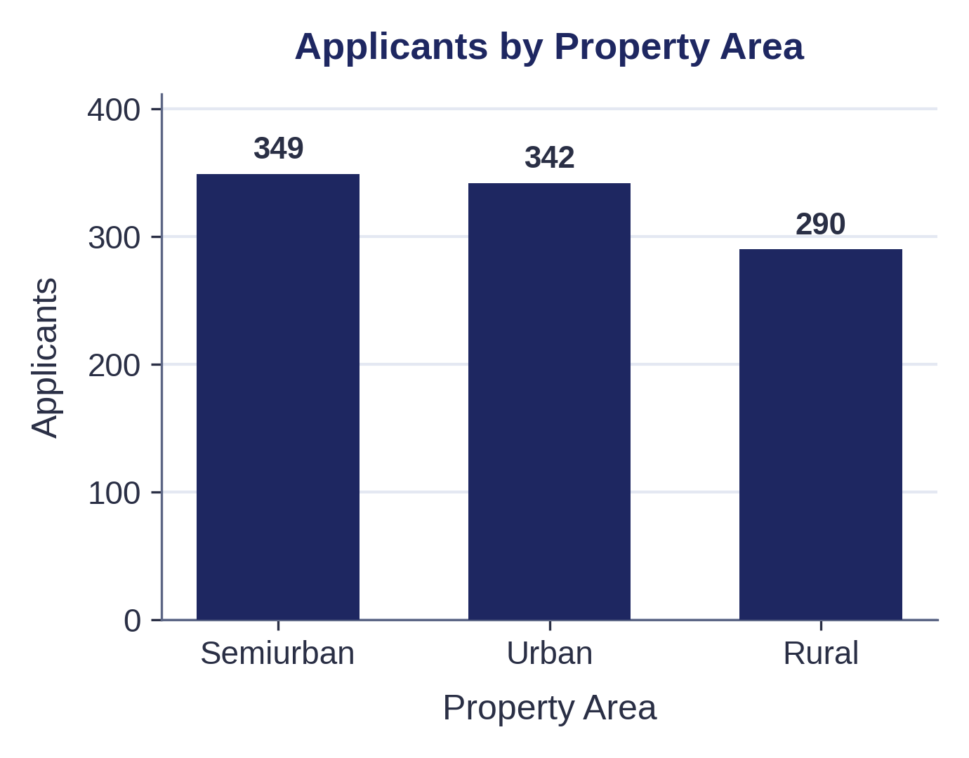
APPLICANT PROFILE
Who Is Applying for Loans
The applicant population is not evenly distributed across demographic categories.
Male applicants form the larger group.
Graduate applicants form the larger education group.
Applicants with zero dependents are the largest dependent category.
The dataset contains Urban, Rural and Semiurban areas.
These characteristics establish the composition of the loan applicant population.
05

Slide 6
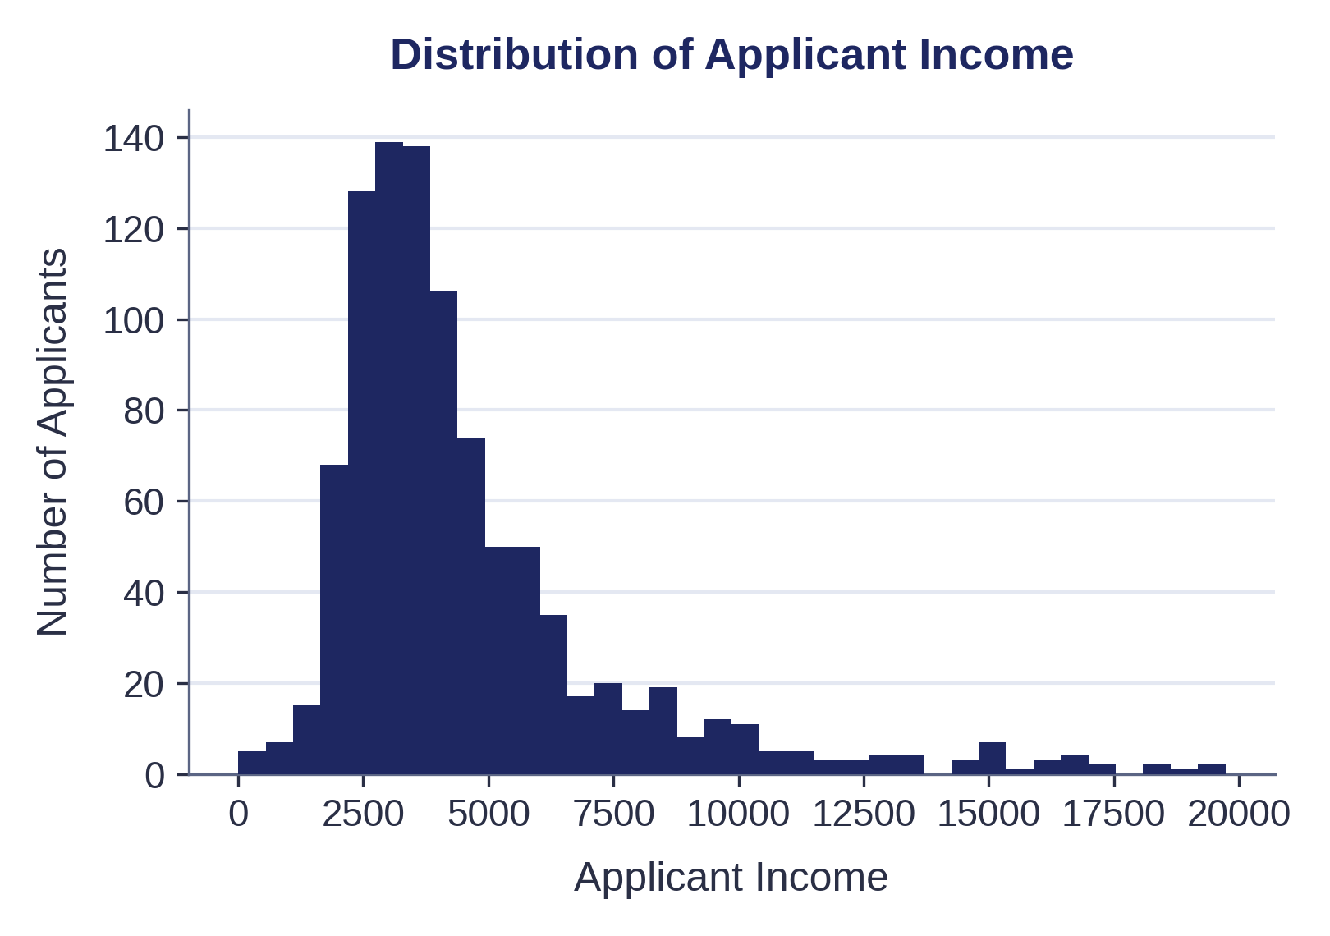
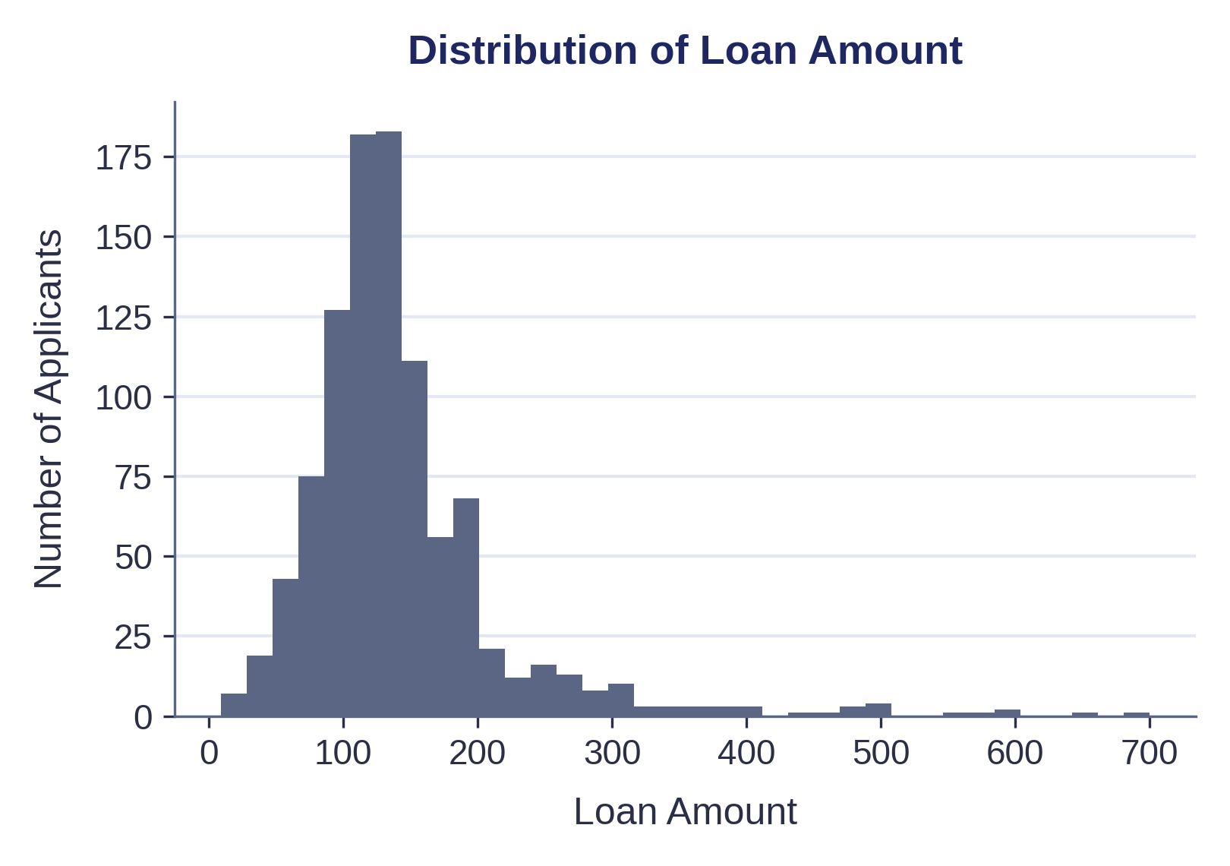
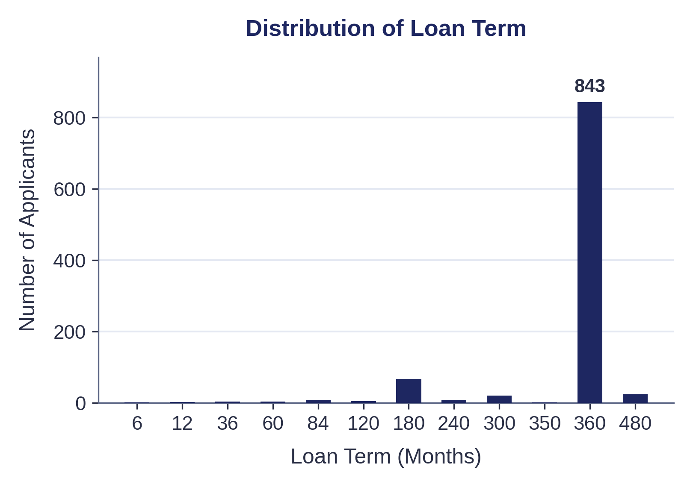
FINANCIAL PROFILE
Income, Loan Size & Term
Income variables are unevenly distributed, with a small number of very high observations.
Loan amounts are concentrated in a narrower range than income values.
The 360-month term is by far the most common repayment period.
Key implication: averages alone may not fully represent the applicant population because extreme financial observations are present.
06

Slide 7
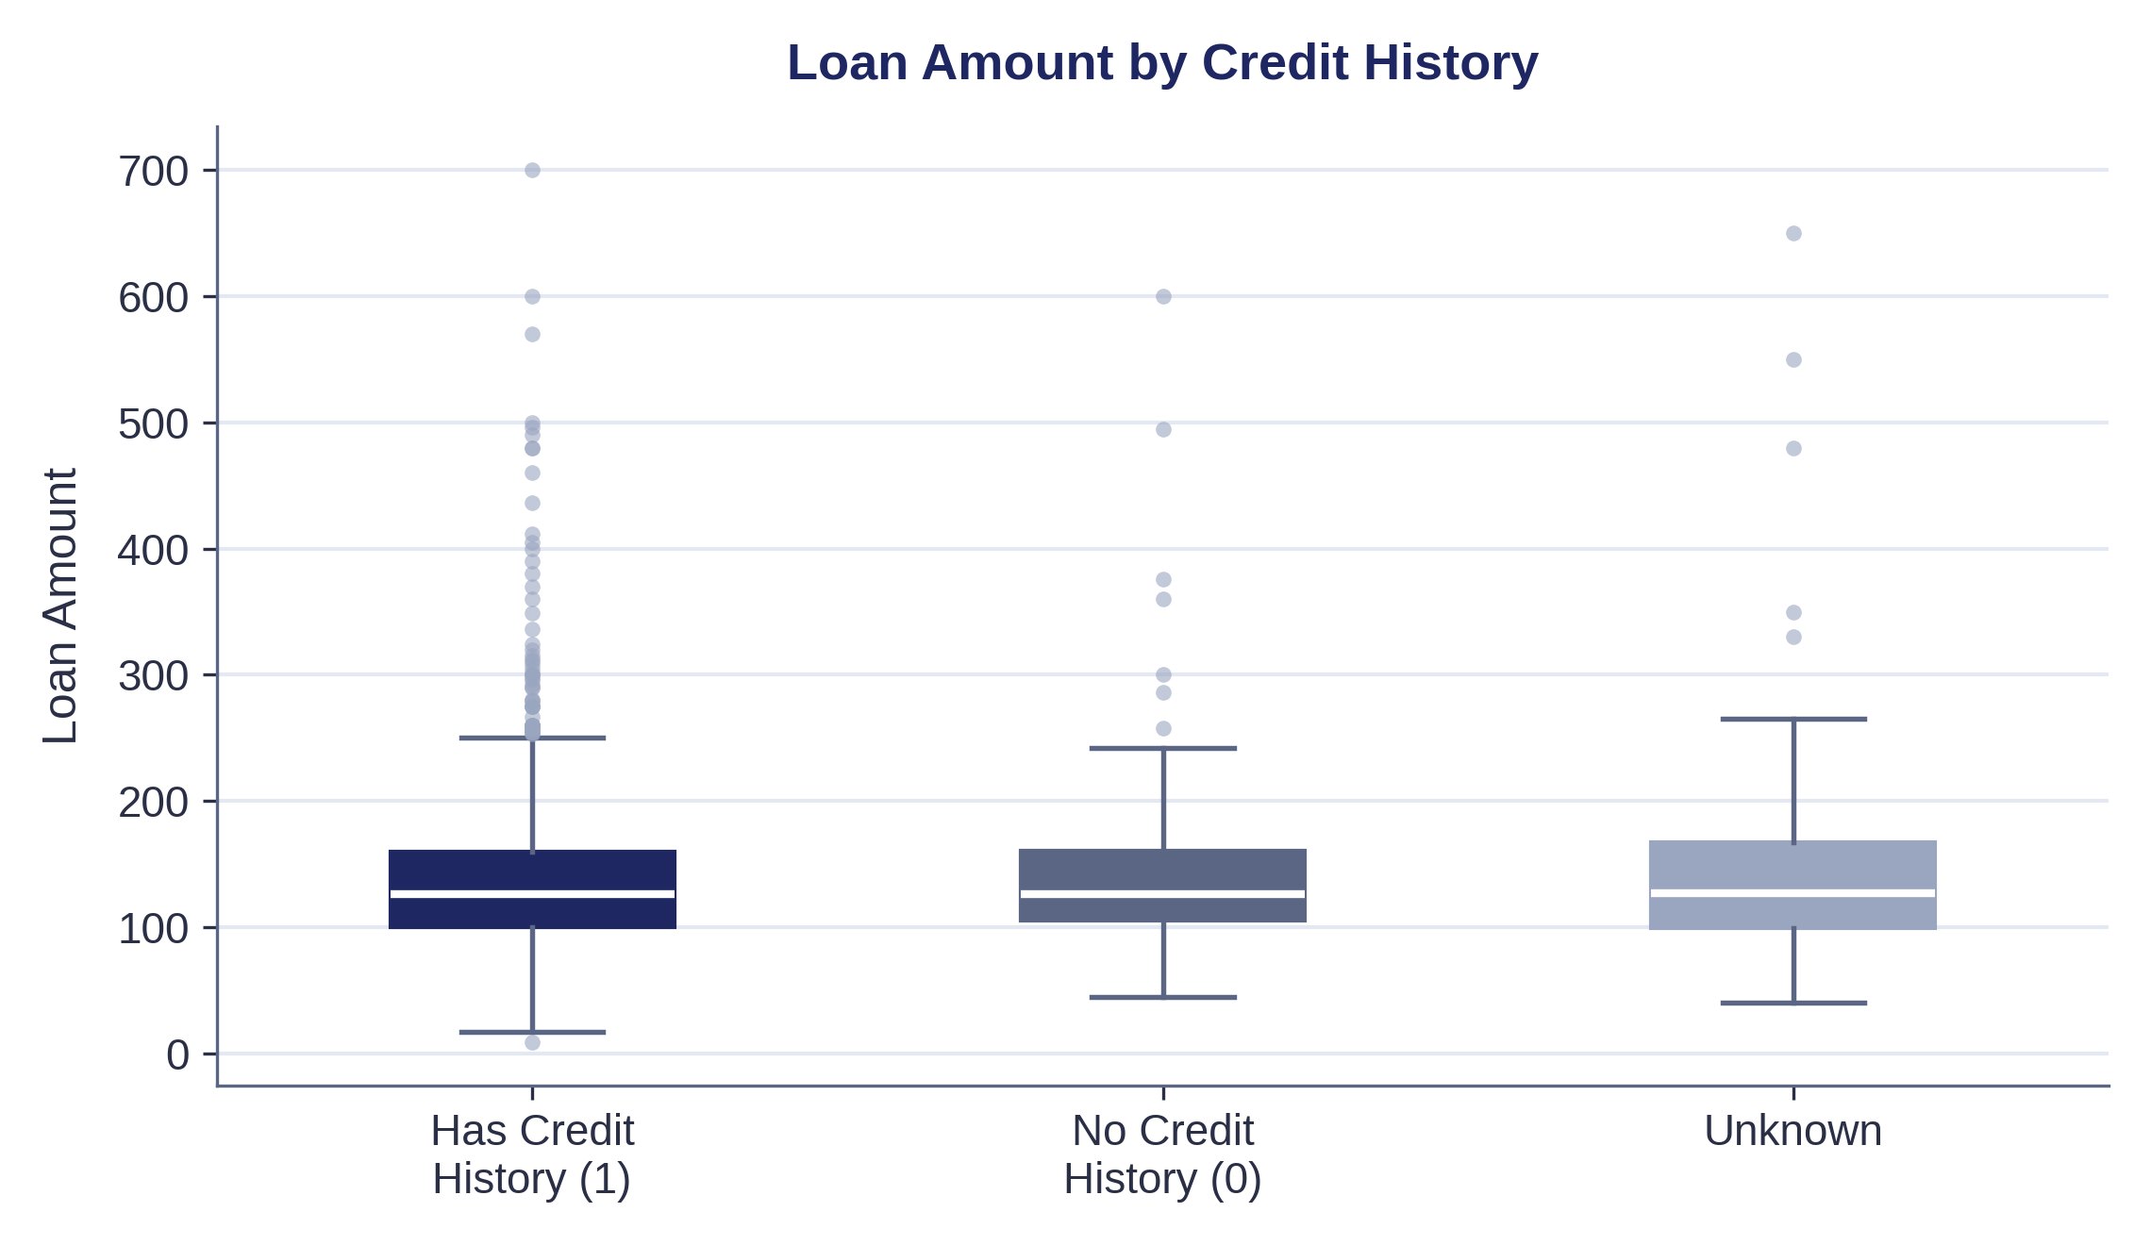
CREDIT HISTORY & LOAN AMOUNT
Does Credit History Affect Loan Size?
Credit history provides an important dimension for comparing requested loan amounts.
The boxplot shows that the distribution of requested loan amounts differs across credit-history categories.
This supports examining credit history together with financial variables rather than viewing loan amount in isolation.
07

Slide 8
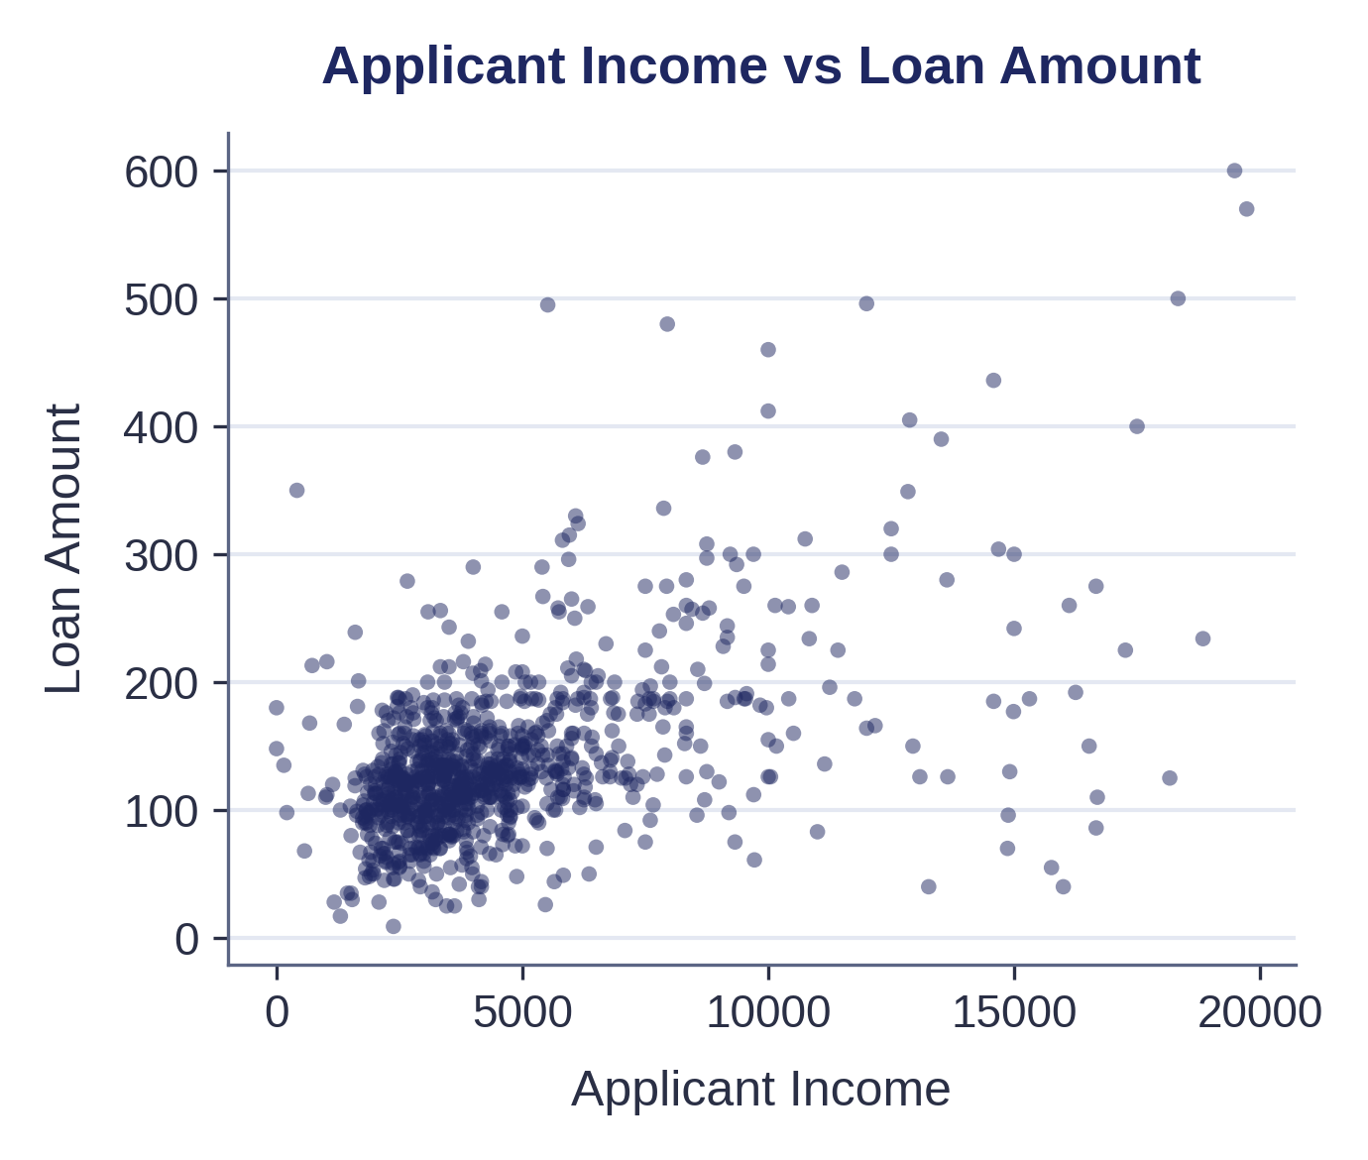
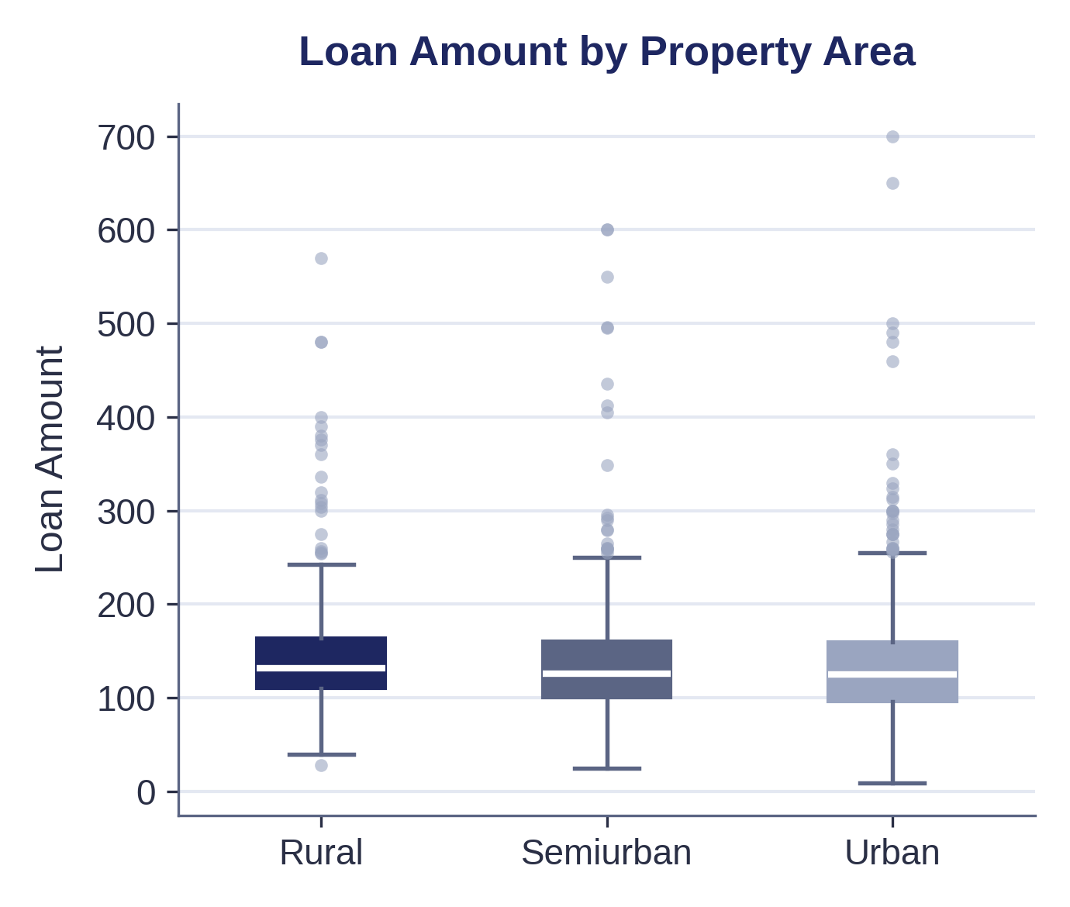
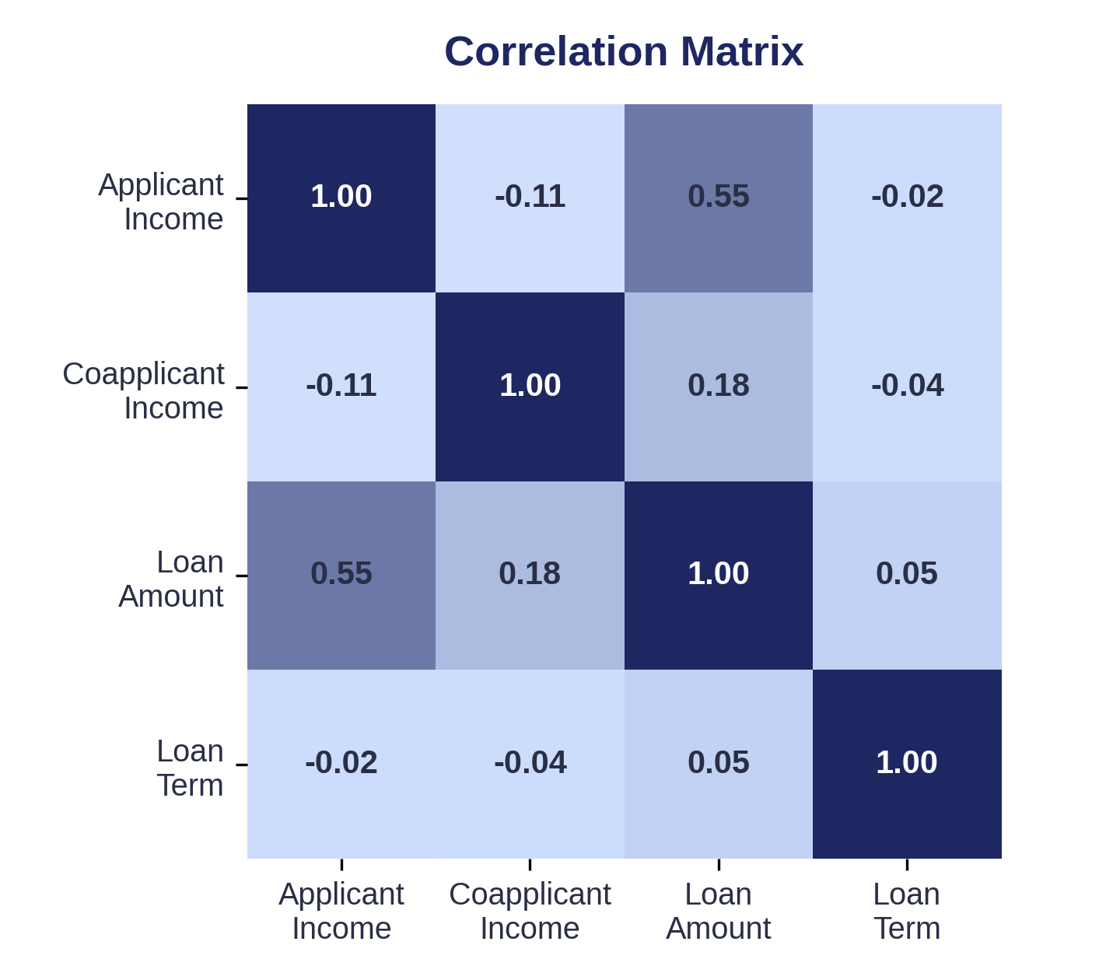
RELATIONSHIPS IN THE DATA
How the Variables Connect
Applicant Income ↔ Loan Amount
Loan Amount ↔ Property Area
Numerical Correlations
Examines whether requested loan size changes with applicant income.
Loan amounts show differences across Urban, Rural and Semiurban applicants.
A compact view of relationships among numerical financial variables.
08

Slide 9
KEY INSIGHTS
What the Data Tells Us
Applicant profiles are concentrated in particular demographic categories.
01
Income distributions contain substantial variation and extreme observations.
02
Requested loan amounts are more concentrated than income values.
03
Credit history provides useful context for differences in loan-amount distributions.
04
Applicant characteristics and property area provide additional context for understanding loan demand.
05
09

Slide 10
BUSINESS DECISION
Turning Insight Into Action
Use multiple applicant attributes together when structuring loan assessment and review.
CONSIDER
● Applicant income
● Coapplicant income
● Credit history
● Requested loan amount
● Applicant characteristics
● Property area
The analysis can help the business understand common loan demand and identify applications that may require additional review.
10

Slide 11
FROM DATA TO DECISION
The Path We Followed
DATA
CLEANING
ANALYSIS
INSIGHT
BUSINESS DECISION
Loan applications
Standardized categories, handled missing information, investigated unusual values
Applicant profiles, financial distributions, relationships
Understand applicant and loan patterns
Use multiple data points to support structured loan assessment
→
→
→
→
Use multiple data points to support structured loan assessment.
11

