Slide 1


TESA COHORT 6 — AI ENGINEERING
Loan Application
Data Analysis
Understanding Applicant Profiles, Financial Patterns & Loan Characteristics
Prepared by Bamigbele Oluwaseun

Slide 2
USE CASE
Understanding the Lending Challenge
A lending institution wants to better understand its loan applicants and the types of loans they request.
BUSINESS GOAL
Identify meaningful patterns that can support more structured loan assessment and loan-product planning.
THE ANALYSIS EXAMINES
Applicant demographics and employment characteristics
Applicant and coapplicant income
Credit history
Requested loan amounts and repayment terms
Education and property area
A clearer view of applicant behavior today informs better lending decisions tomorrow.
These factors together define the scope of the analysis.
02

Slide 3
DATASET OVERVIEW
What We're Working With
981
12
Loan Applications
Variables Recorded
Applicant Profile
Gender • Marital status • Dependents • Education • Self-employment
Financial Information
Applicant income • Coapplicant income • Loan amount • Loan term
Assessment Context
Credit history • Property area
03

Slide 4
DATA QUALITY & CLEANING
Getting the Data Analysis-Ready
The raw dataset contained several quality issues that were addressed before analysis.
Missing values in categorical and numerical fields
Inconsistent Gender values: m/Male and f/Female
Multiple Property_Area spelling variations
Two zero ApplicantIncome records investigated and retained
One 350-month loan term investigated and retained
Cleaning principle: standardize genuine inconsistencies without deleting potentially valid observations.
04

Slide 5
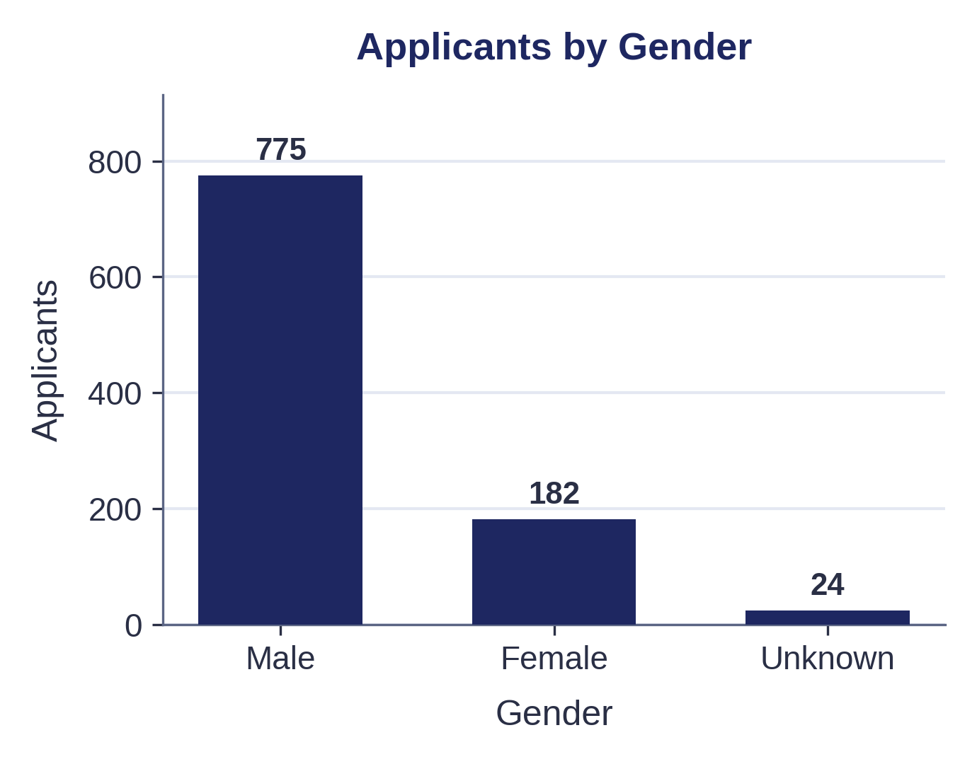
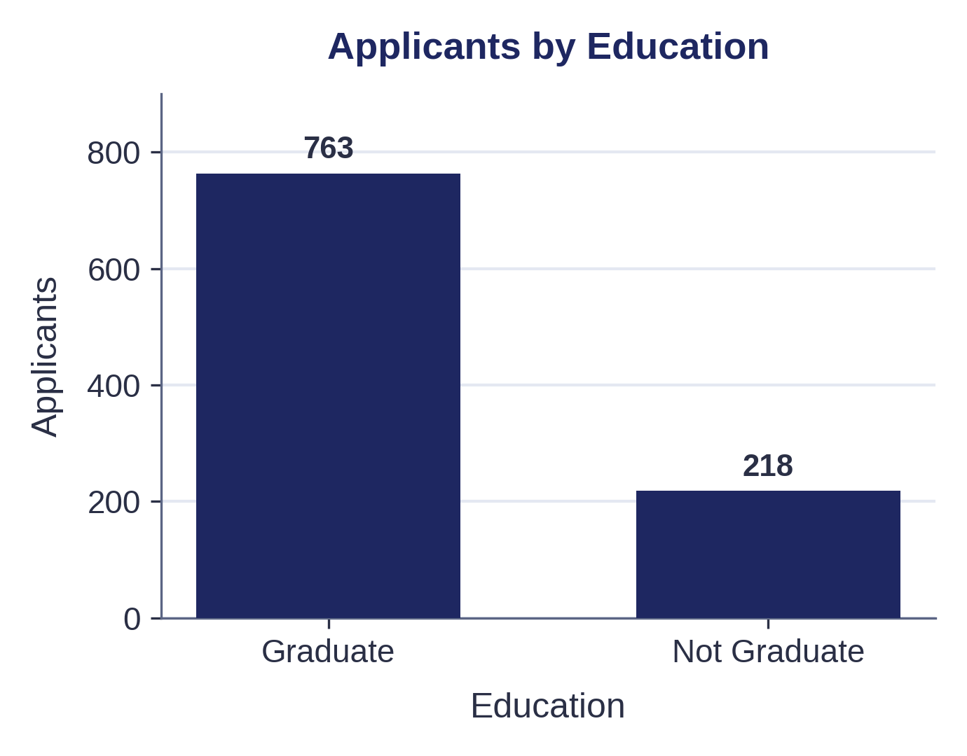
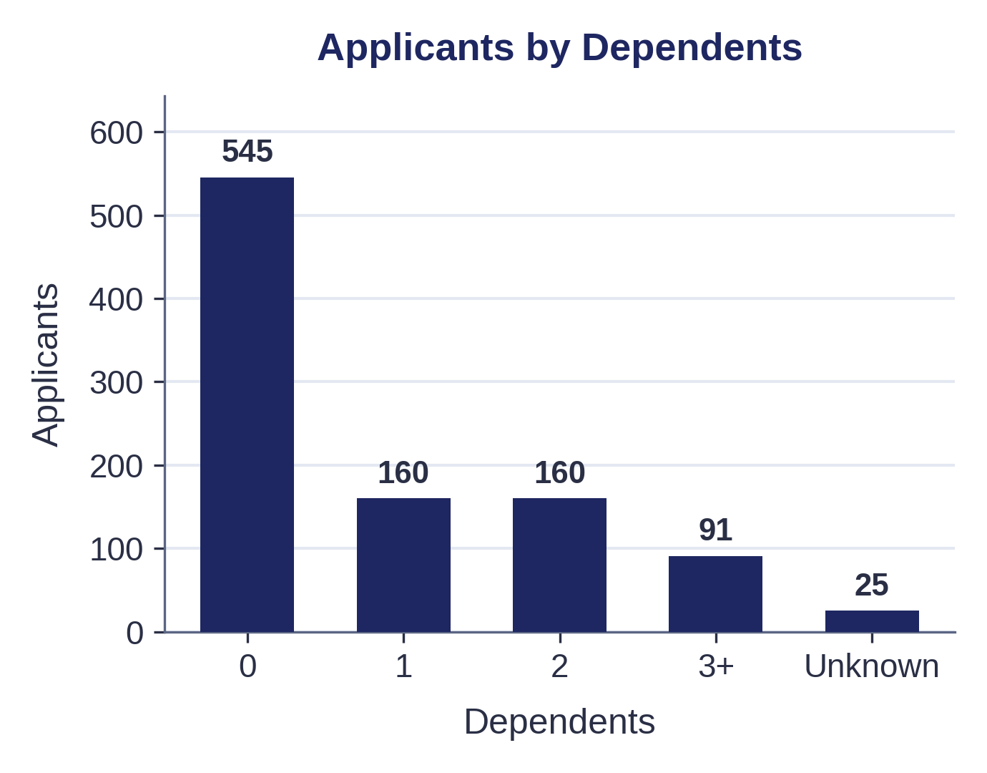
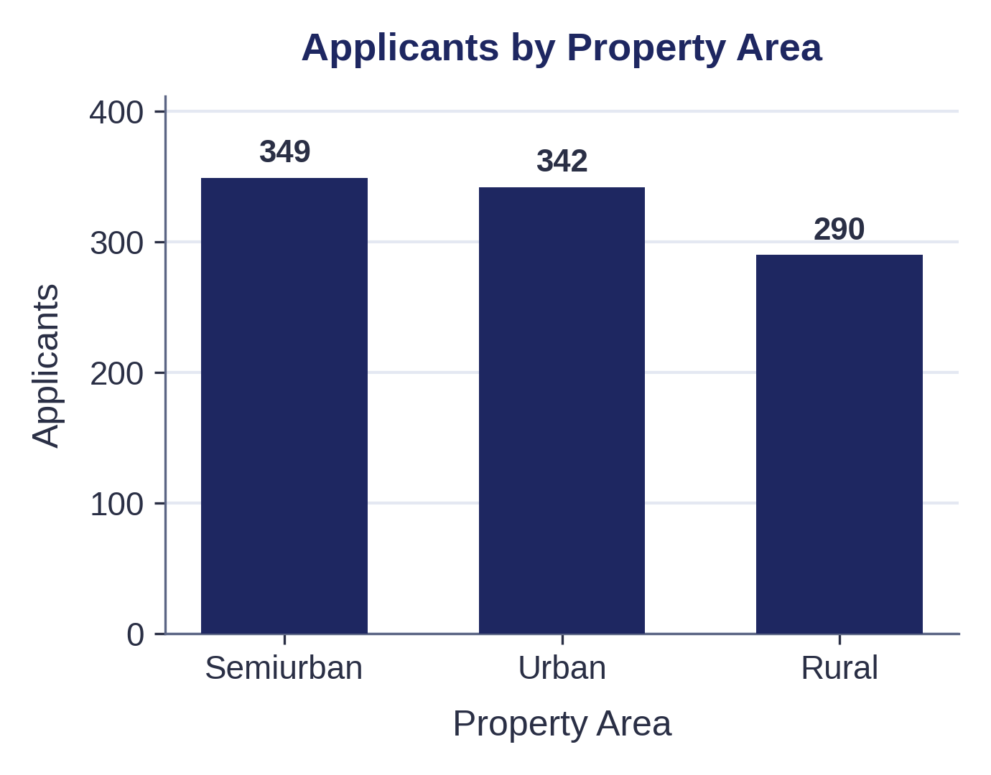
APPLICANT PROFILE
Who Is Applying for Loans
The applicant population is not evenly distributed across demographic categories.
Male applicants form the larger group.
Graduate applicants form the larger education group.
Applicants with zero dependents are the largest dependent category.
The dataset contains Urban, Rural and Semiurban areas.
These characteristics establish the composition of the loan applicant population.
05

Slide 6
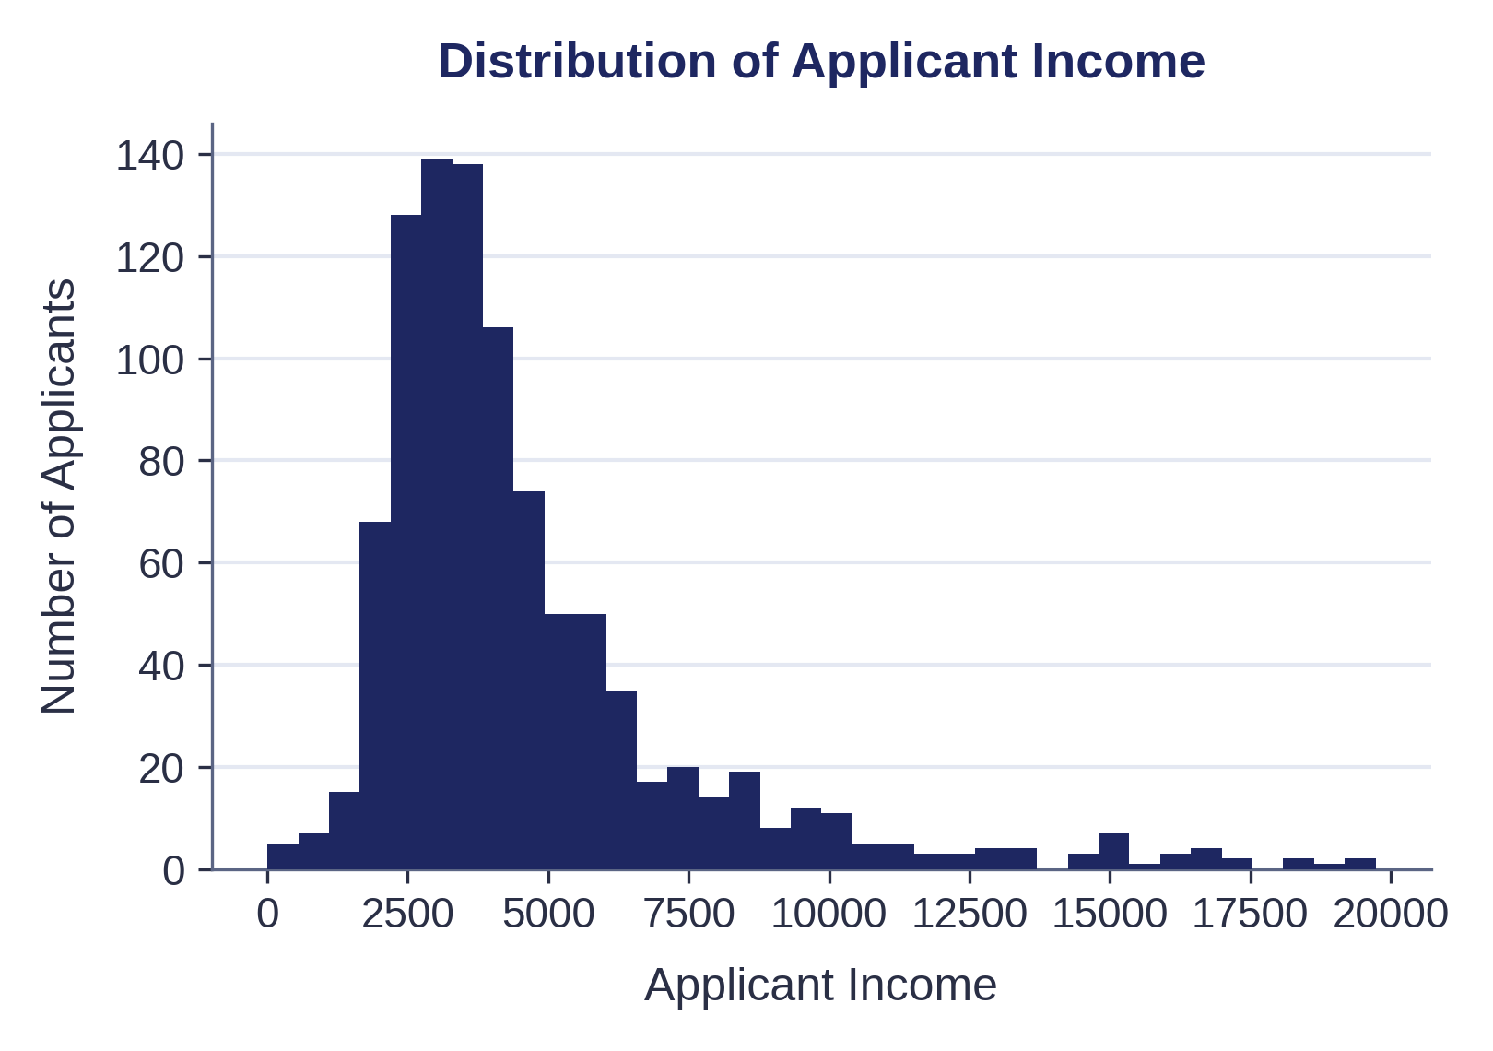
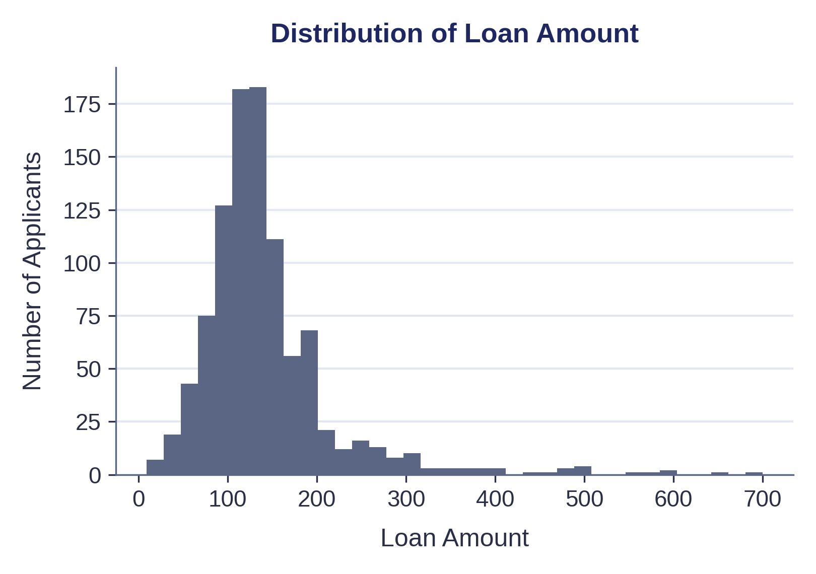
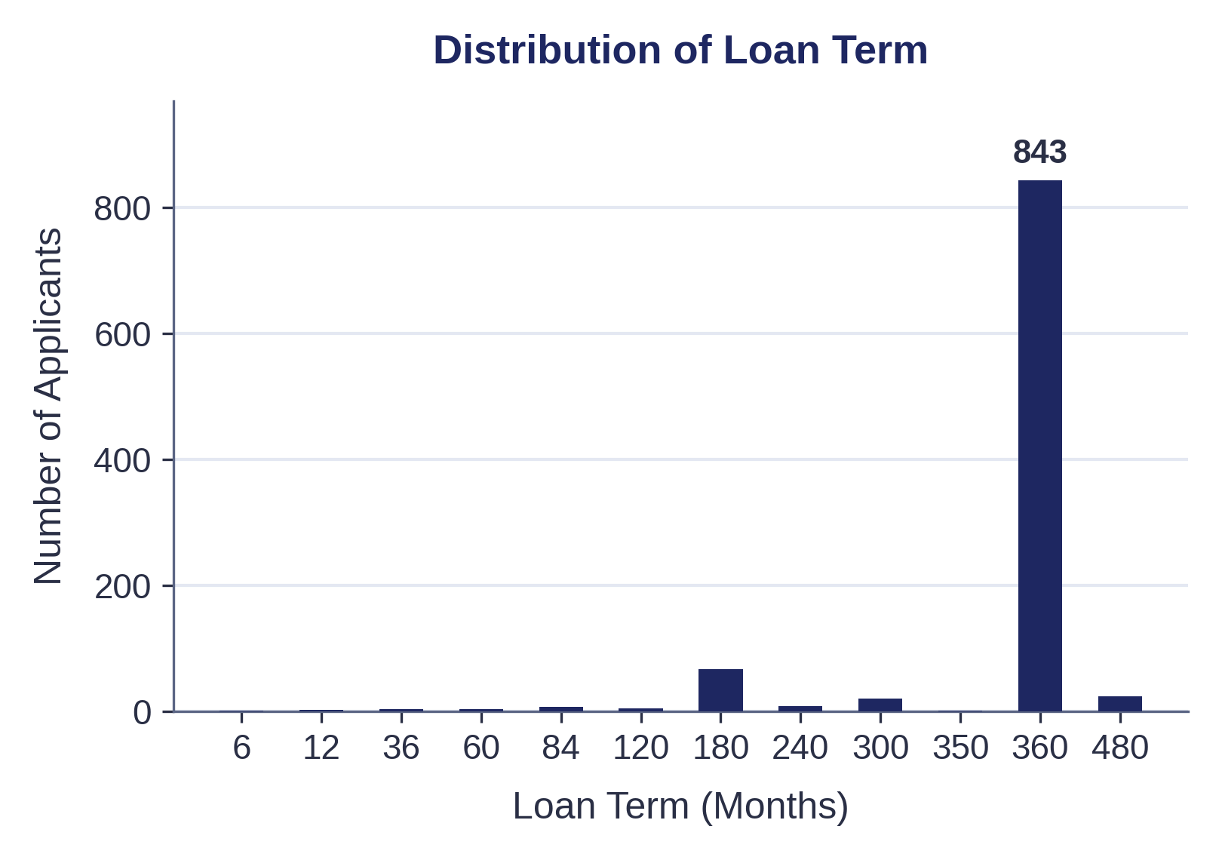
FINANCIAL PROFILE
Income, Loan Size & Term
Income variables are unevenly distributed, with a small number of very high observations.
Loan amounts are concentrated in a narrower range than income values.
The 360-month term is by far the most common repayment period.
Key implication: averages alone may not fully represent the applicant population because extreme financial observations are present.
06

Slide 7
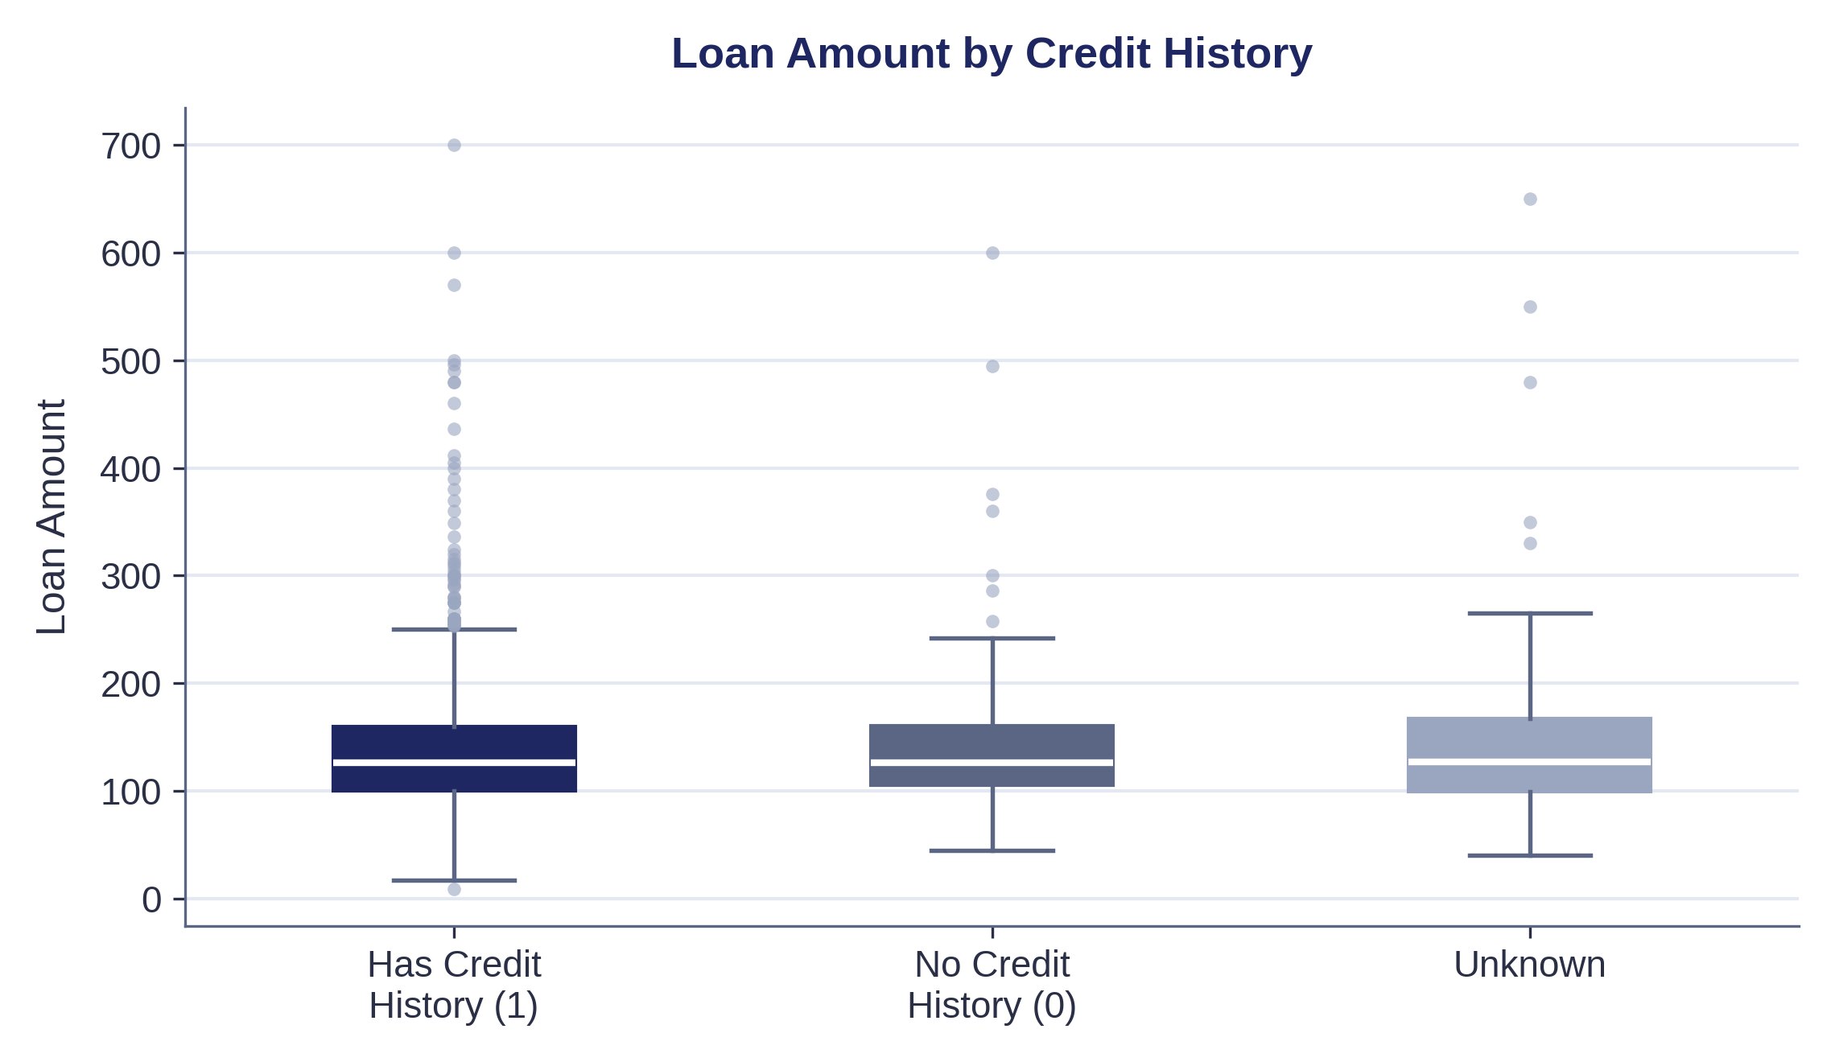
CREDIT HISTORY & LOAN AMOUNT
Does Credit History Affect Loan Size?
The median requested loan amount is almost identical whether an applicant has a credit history or not — 126 versus 126.5.
The real difference is in the tail: applicants with a confirmed credit history include noticeably more high-value outliers, up to 700.
Credit history is better suited to flagging unusually large requests than to predicting typical loan size.
07

Slide 8
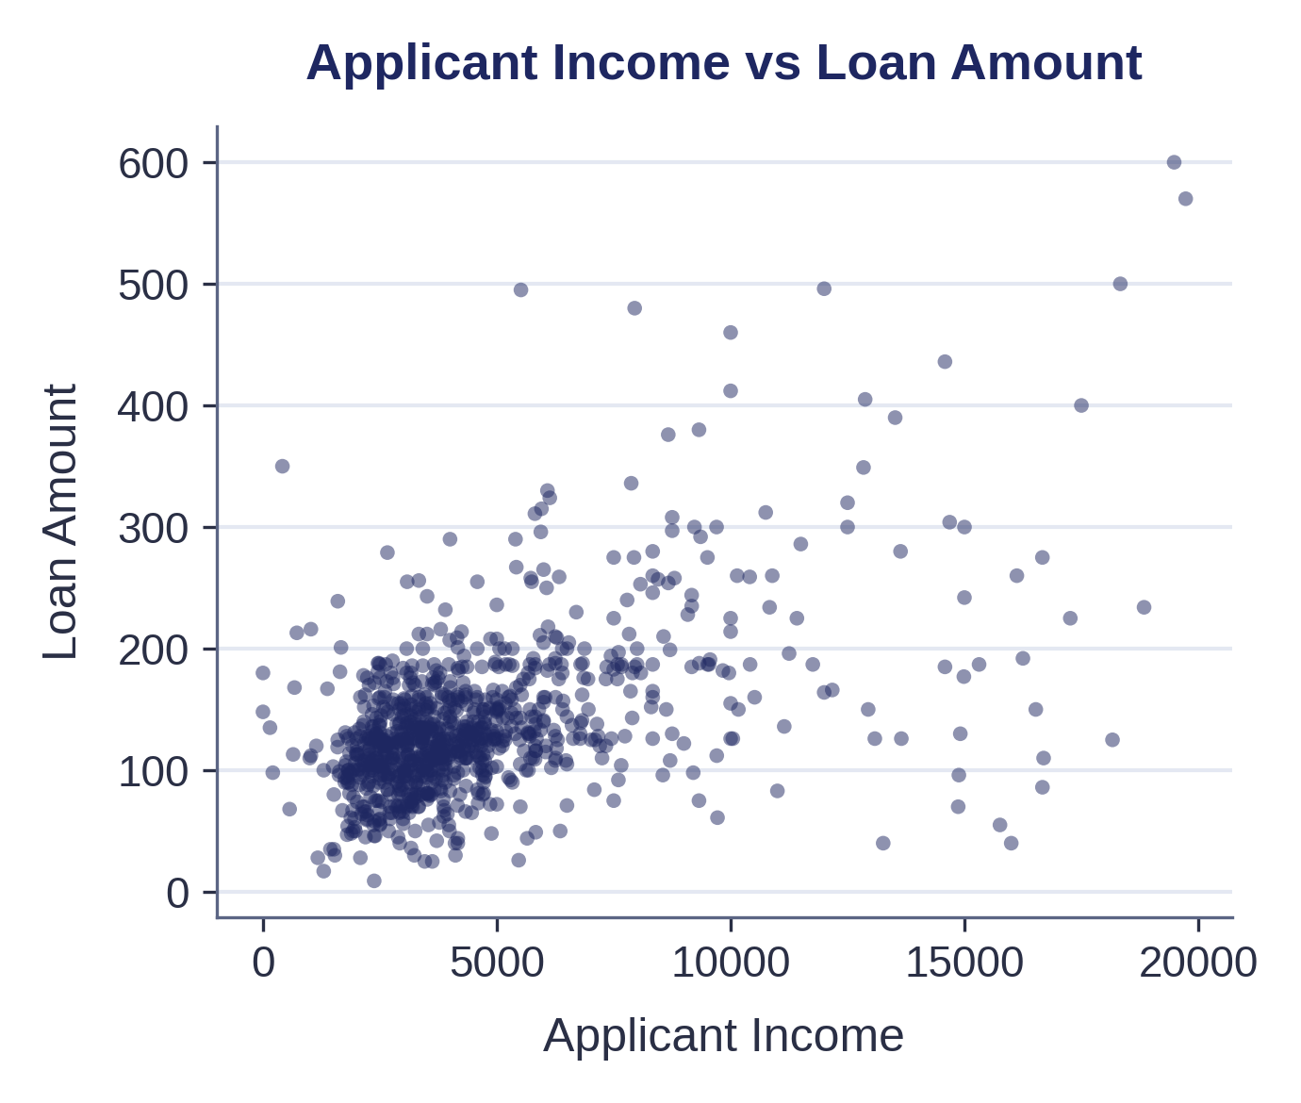
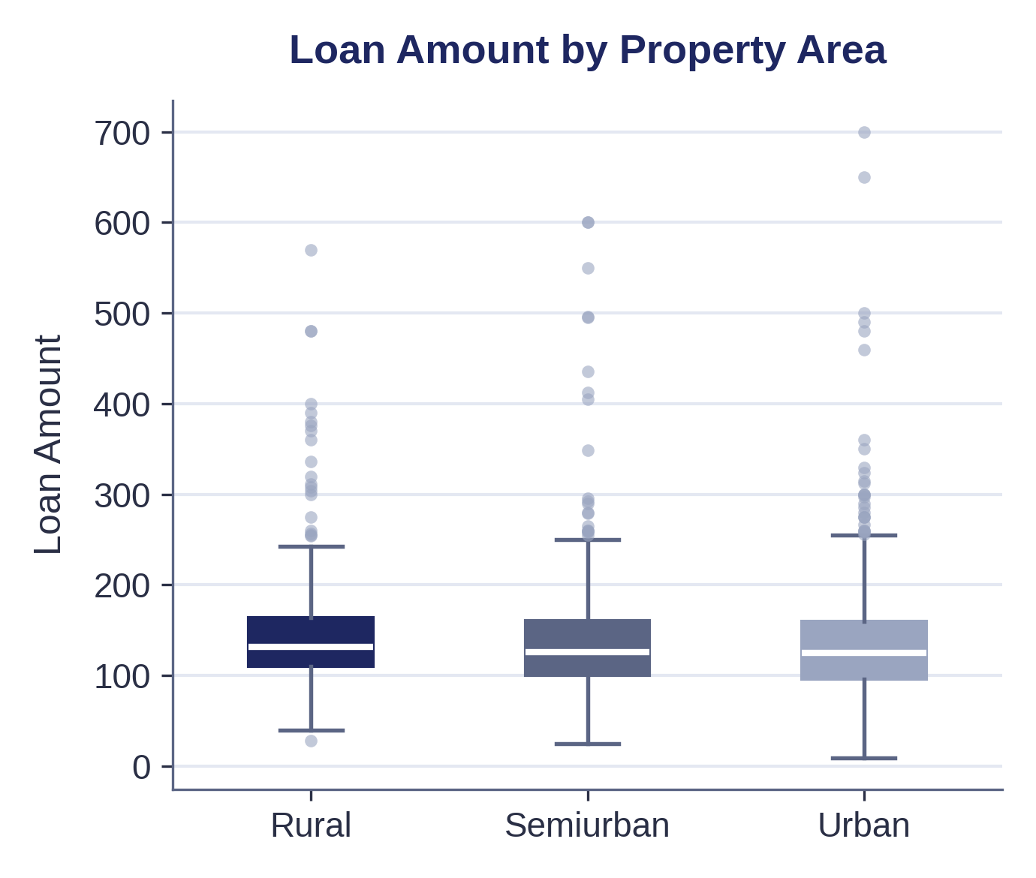
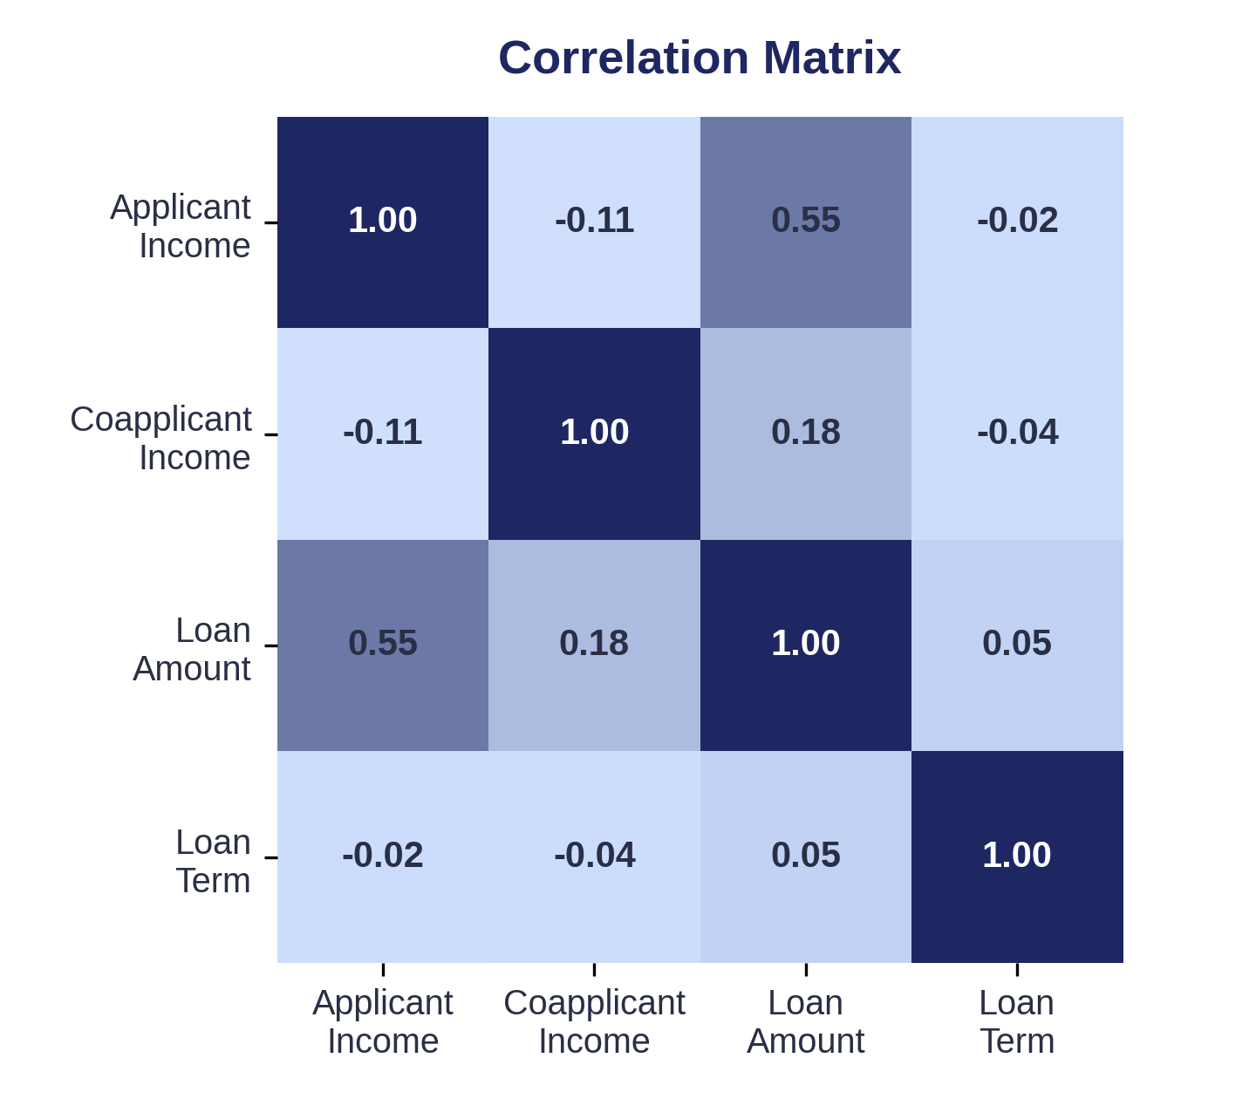
RELATIONSHIPS IN THE DATA
How the Variables Connect
Applicant Income ↔ Loan Amount
Loan Amount ↔ Property Area
Numerical Correlations
A moderate relationship (r = 0.55): income explains roughly 30% of the variation in loan amount — real, but partial.
Medians range narrowly (125–131.5 across areas) a weak effect on its own.
Combining applicant and co-applicant income lifts the correlation to 0.60 still leaving most variation unexplained by income alone.
08

Slide 9
KEY INSIGHTS
What the Data Tells Us
Applicant income alone explains only about 30% of the variation in loan amount (r = 0.55) — a real but partial relationship.
01
Adding co-applicant income raises that to about 36% (r = 0.60) — most of the variation still comes from elsewhere.
02
Self-employed applicants request notably larger loans: a median of 138 vs 126 for others, about 10% higher.
03
Graduates request modestly larger loans than non-graduates (median 130 vs 120, about 8% higher).
04
Credit history doesn't shift typical loan size, but it concentrates high-value outliers — useful for flagging, not for sizing.
05
09

Slide 10
BUSINESS DECISION
Turning Insight Into Action
Use a multi-factor assessment approach rather than relying on income or credit history alone when reviewing loan applications.
CONSIDER
Applicant income + co-applicant income as indicators of financial capacity
● Applicant characteristics such as education and self-employment
Requested loan amount in relation to that financial capacity
Property area as additional applicant context
Credit history as a flag for applications with unusually large requests
Income provides a meaningful but incomplete explanation of loan demand. The business should therefore combine financial, credit, and applicant characteristics when reviewing applications and identifying cases that may require additional assessment.
10

Slide 11
FROM DATA TO DECISION
The Path We Followed
DATA
CLEANING
ANALYSIS
INSIGHT
BUSINESS DECISION
Loan applications
Standardized categories, handled missing information, investigated unusual values
Applicant profiles, financial distributions, relationships
Use multiple data points to support structured loan assessment
Income has a moderate relationship with loan amount, while applicant characteristics and credit history provide additional context
→
→
→
→
Income matters, but it doesn't explain the whole picture.
11

