Slide 1


HumanFirst
Walkthrough

Slide 2
Agenda
Namespaces / Workspaces
Navigation (Data Management, Integrations, Organization)
Uploading Data into the tool / Data Formats
UI Overview
Prompts Example

Slide 3
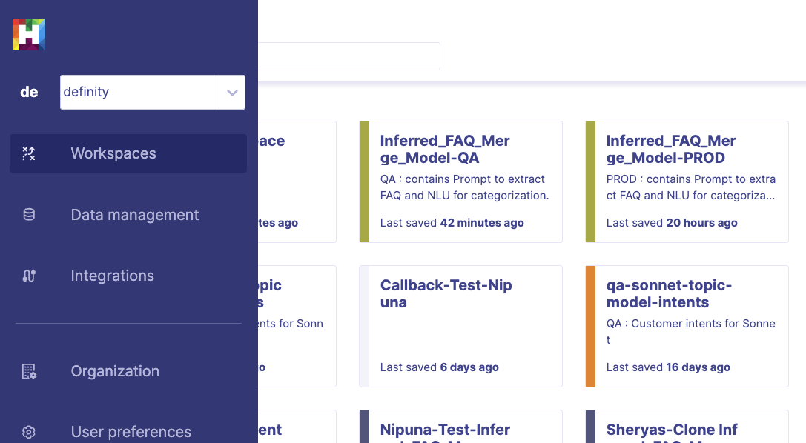
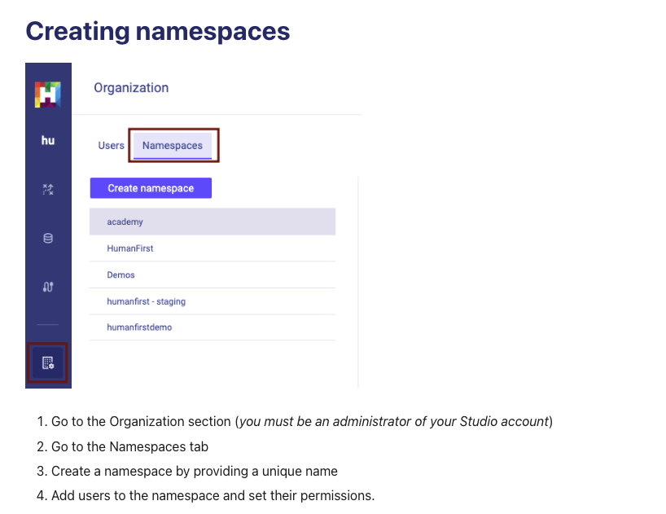
Namespaces / Workspaces
Namespaces allow multi-tenancy within your Studio organization. Setup to control access to groups of workspaces or data sets.
Namespace for HR <> Finance or DEV <> Prod
When creating a workspace it is automatically bound to the current namespace.
When data is uploaded, either from within a workspace or from the Data management section, that data will be bound to the current namespace.
Each namespace has user-specific permissions that you can set to control who has access to the data & workspaces within the namespace.

Slide 4
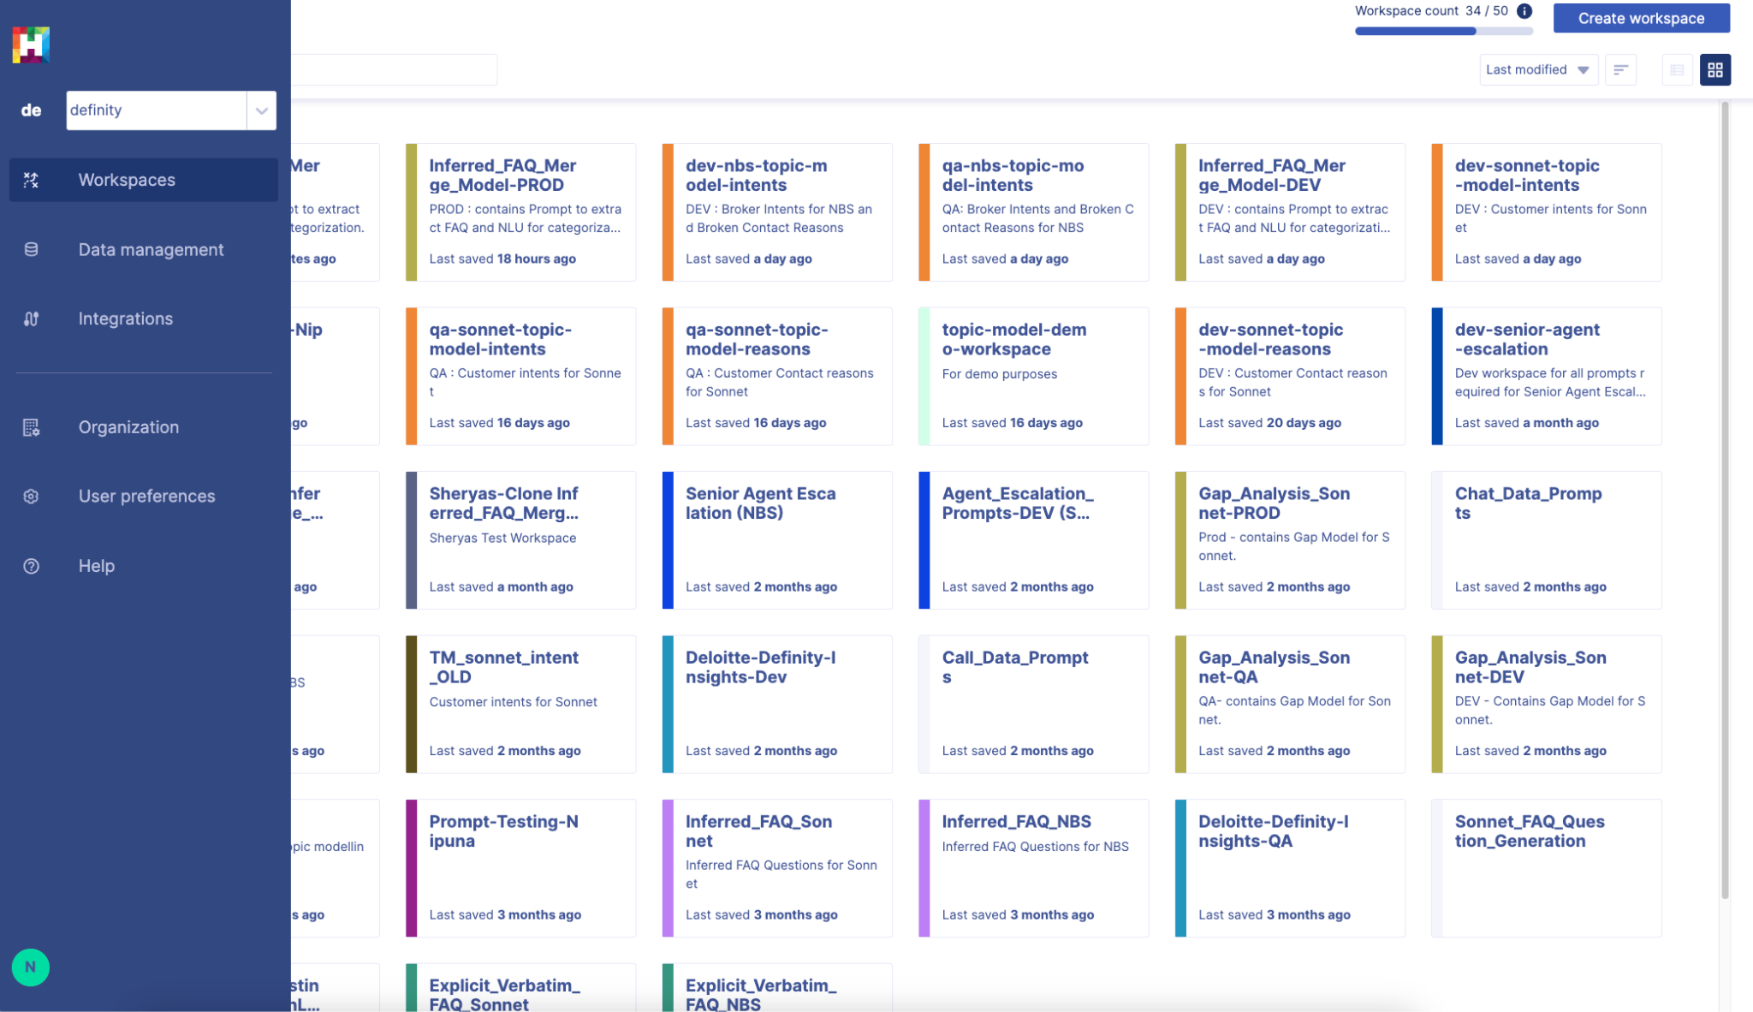
Navigation

Slide 5
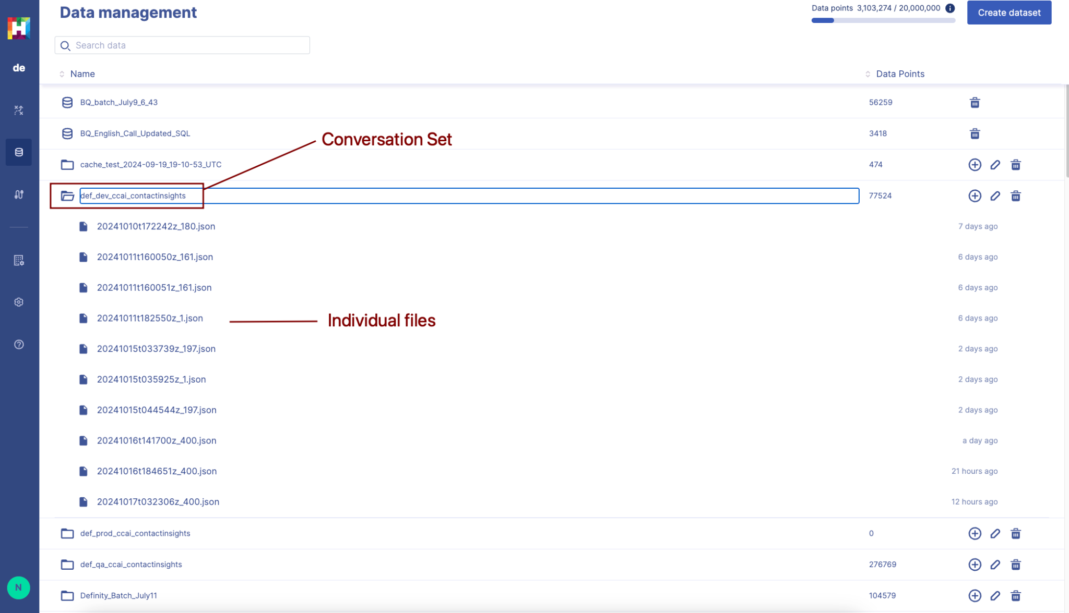
Navigation

Slide 6
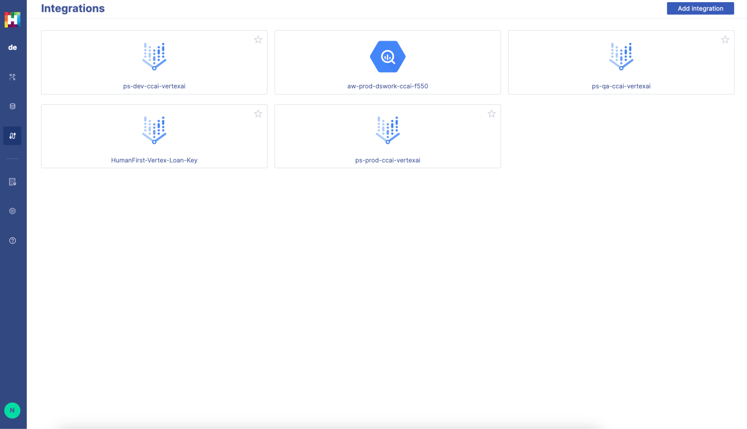
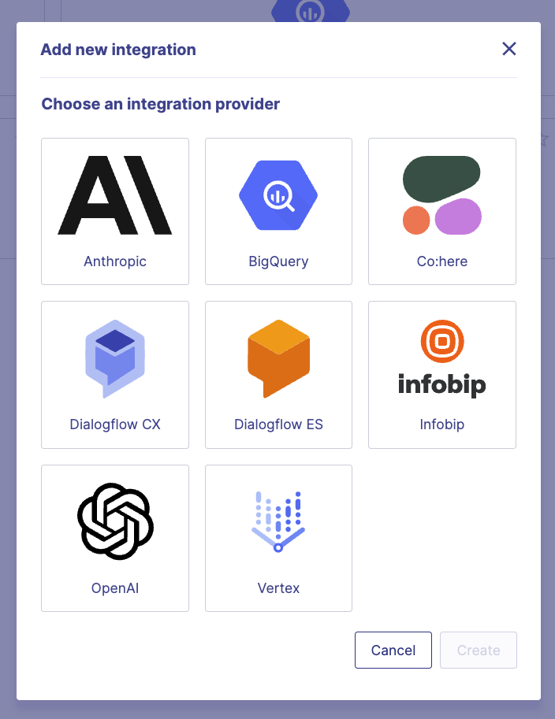
Navigation
https://docs.humanfirst.ai/docs/integrations/overview

Slide 7
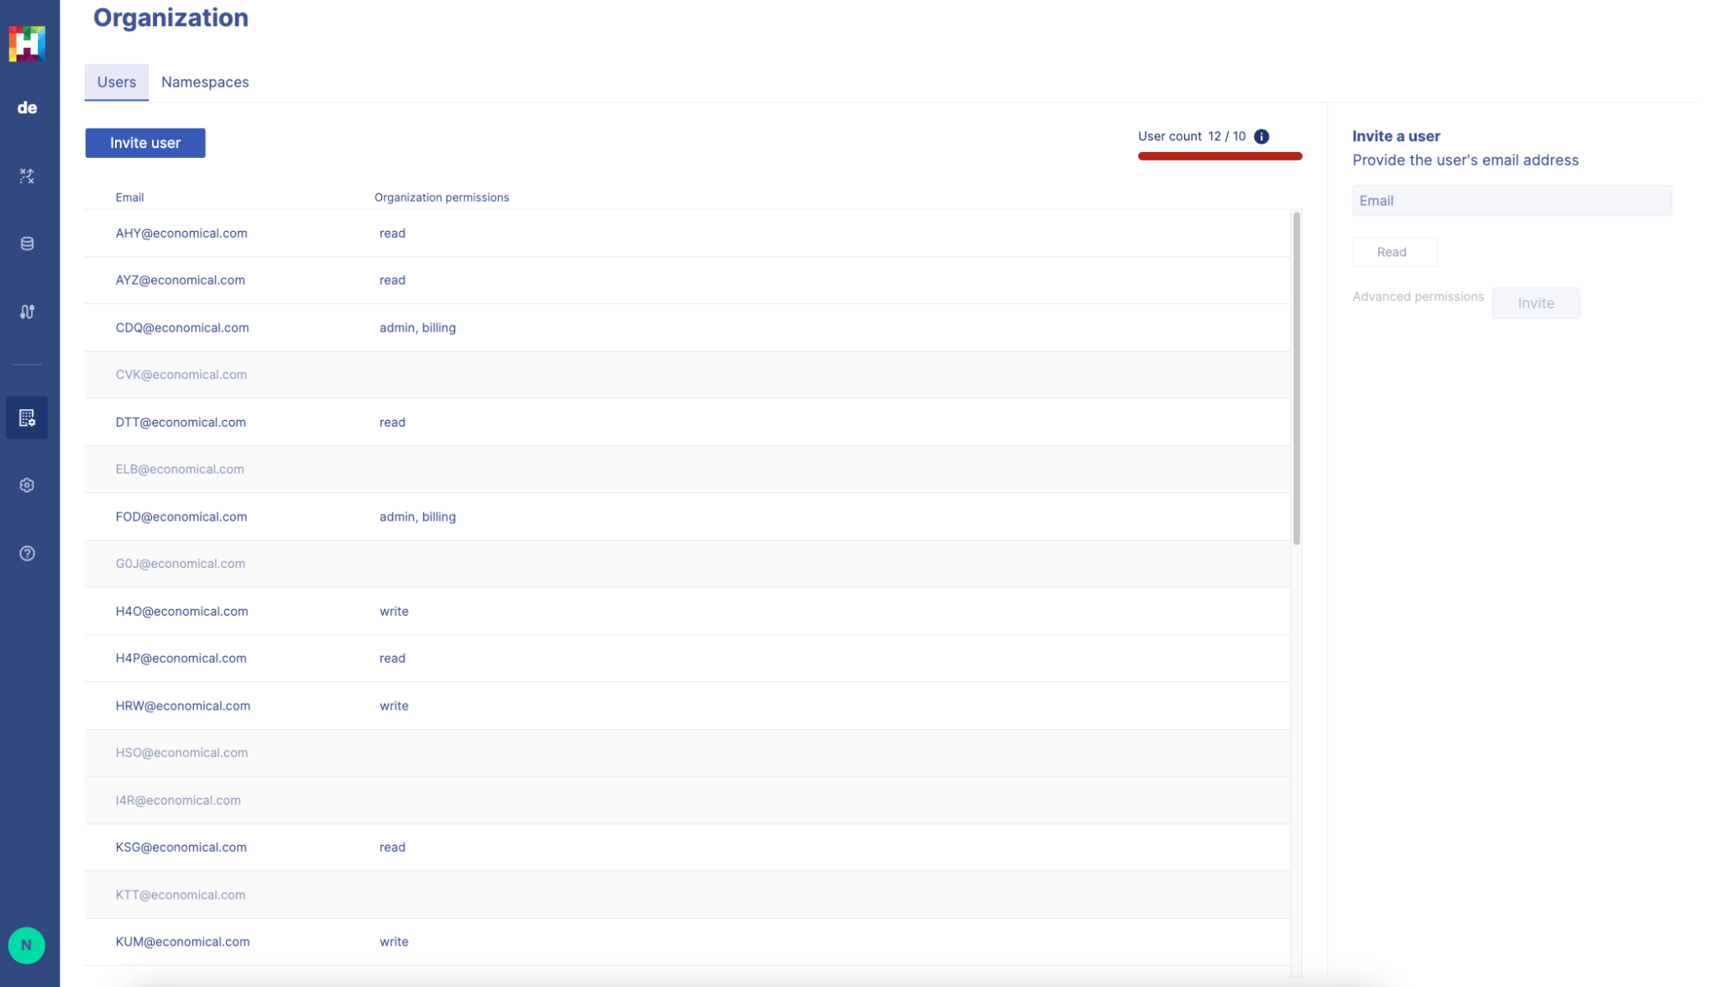
Navigation

Slide 8
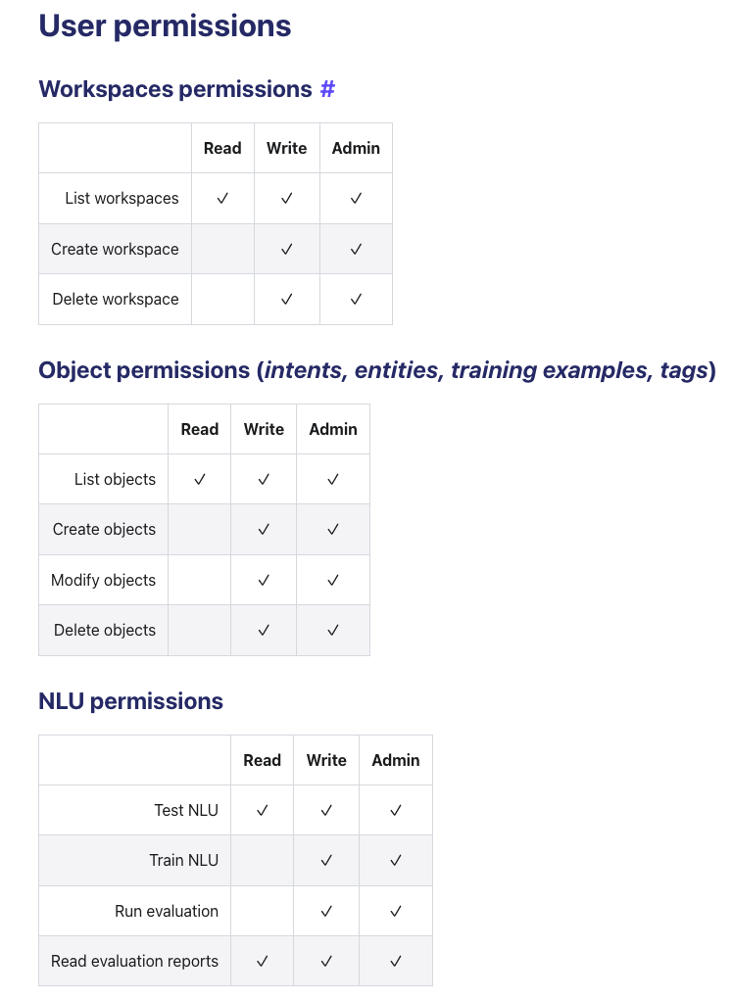
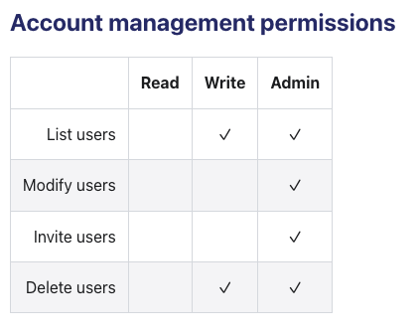
User Permissions
read - can only view
write - full control to perform most CRUD operations
admin - user management and invite controls
User permissions are configurable on a per namespace level
https://docs.humanfirst.ai/docs/permissions/user-permissions

Slide 9
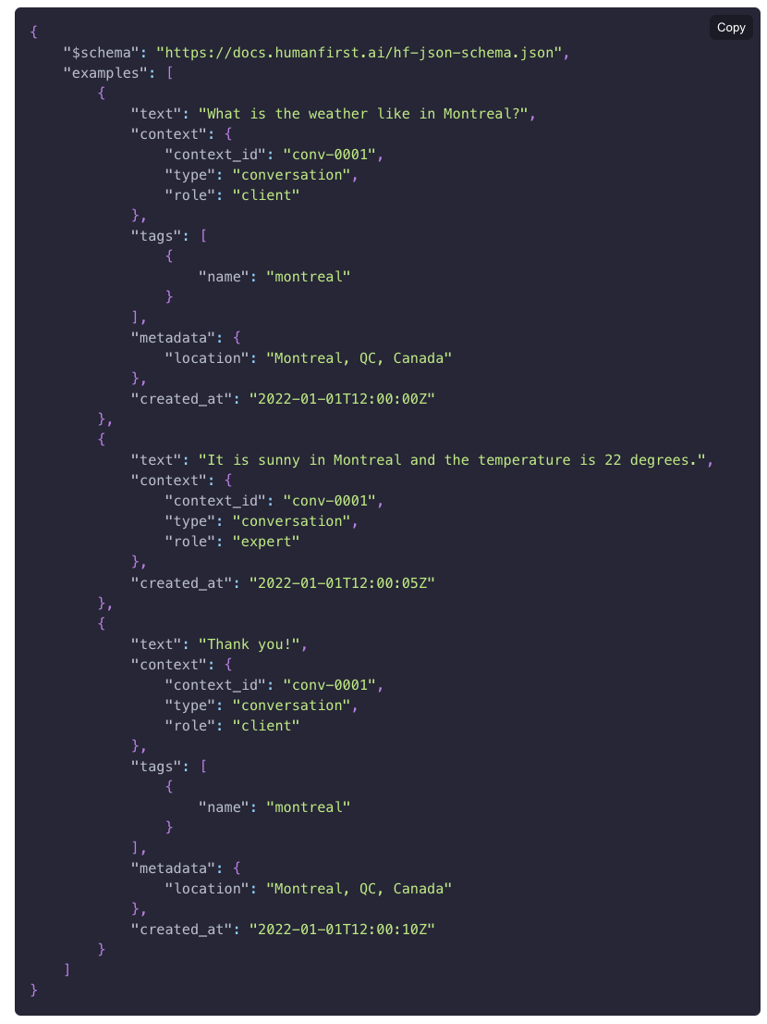
Uploading Data
Data types:
Conversations (id, role, timestamp, text)
Utterances
Data formats:
HumanFirst JSON
CSV
TXT
https://docs.humanfirst.ai/docs/advanced/humanfirst-json

Slide 10
HumanFirst
Walkthrough - #2

Slide 11
Agenda
Setting up a workspace for LLMs
UI Walk Through
Understanding PxD
Prompts Example

Slide 12
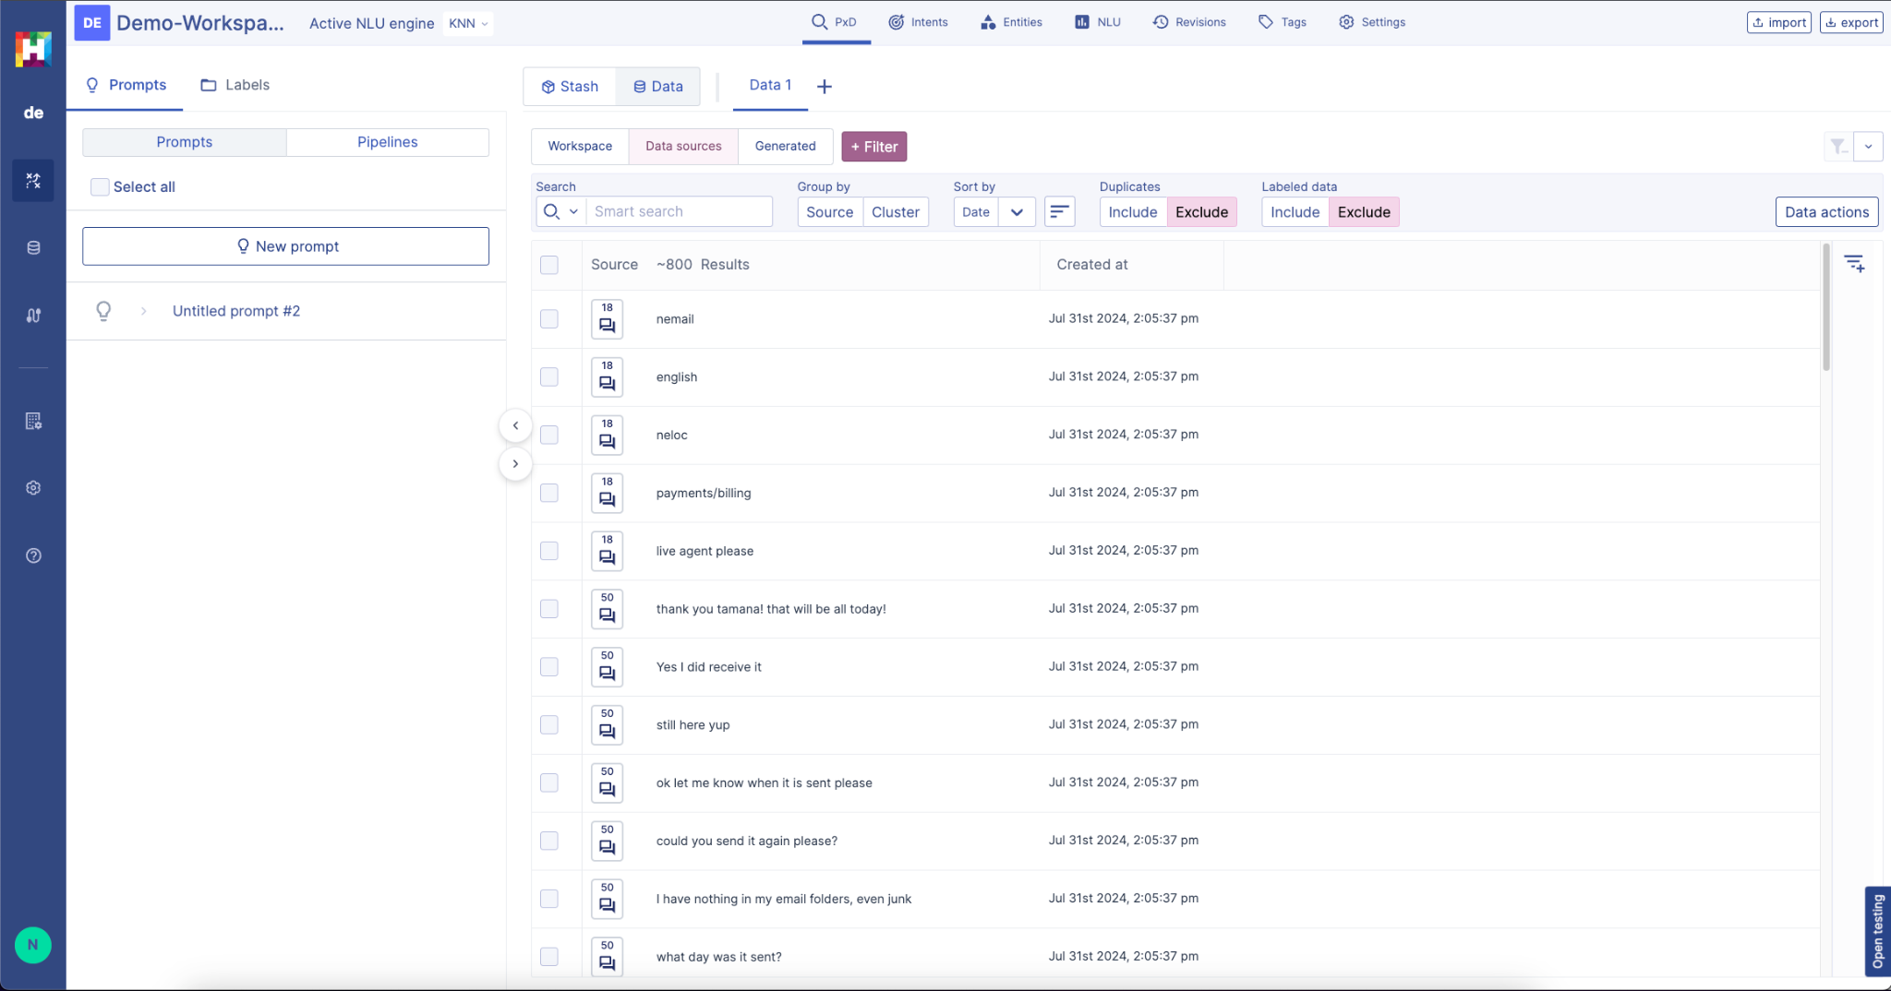
Data View
Prompts / Pipelines / Labels Pane

Slide 13
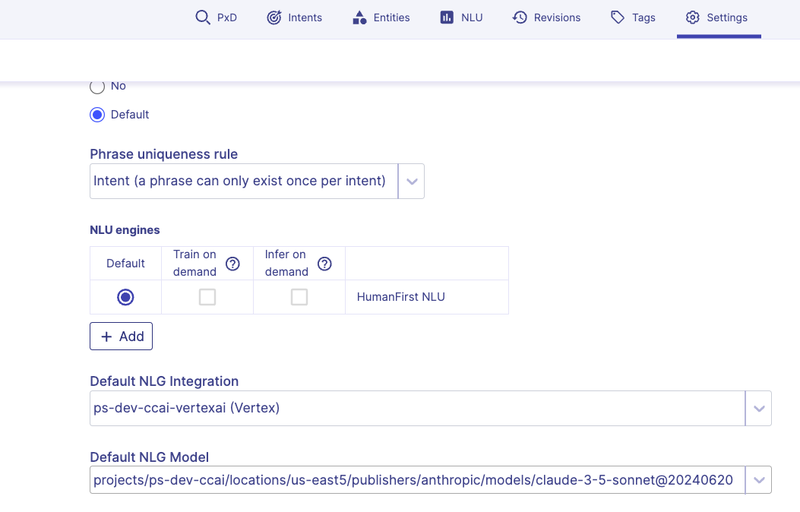
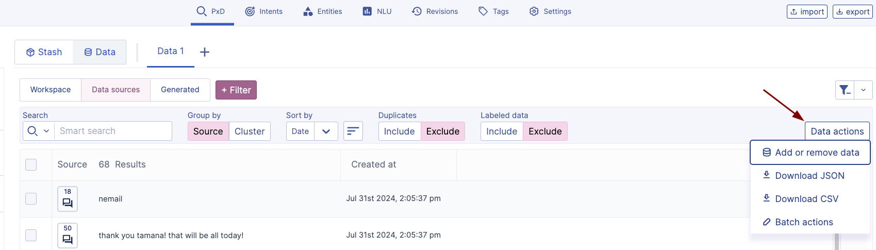
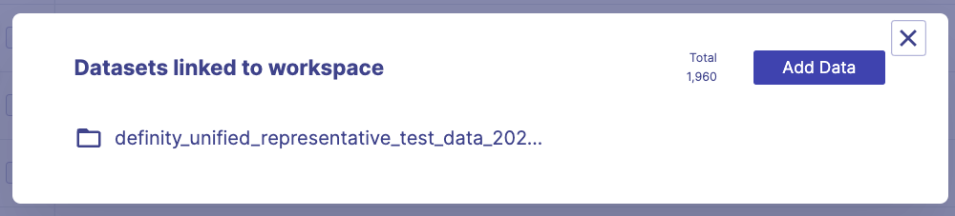
Setting up a workspace
Workspaces allow you to interact with your data (build models, run prompts)
Each workspace essentially contains a single NLU model. However can have many prompts/pipelines.
#1 Set up your NLG Provider
Head to Settings -> Default NLG Provider and Model
#2 Attaching or upload a dataset
Head to the PxD view -> Data Actions button → Add or remove data
Datasets can be linked to any workspace (even if they are uploaded directly within a workspace)
Notes:
Definity_unified_representative_test_data_2024

Slide 14
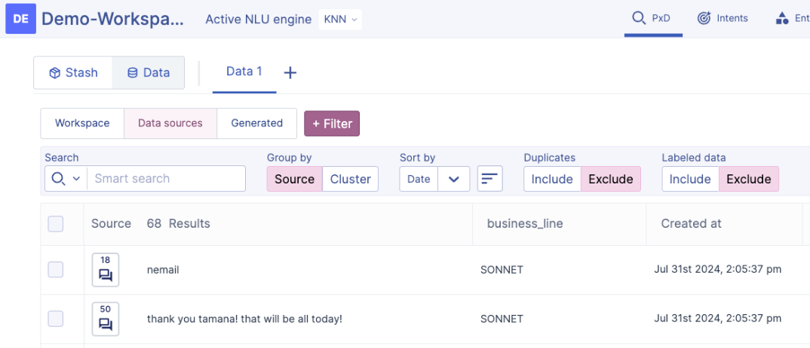
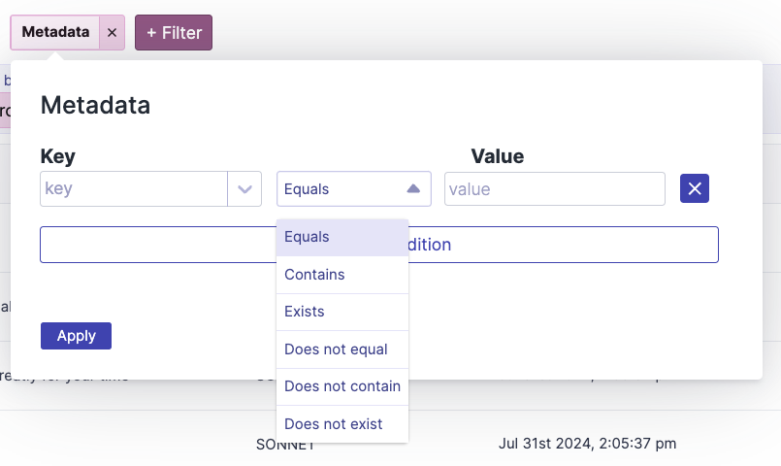
PxD View
Workspace / Data Sources / Generated Tabs
Exploring Metadata / Conversation / Adding Columns
Metadata filtering
Group by options
Sort by options
Duplicates / Labelled Data
Notes:
Definity_unified_representative_test_data_2024

Slide 15


Prompts
Long phone conversation (s)
Customer: Hi, I hope you can help me out. I've been trying to log into your website for the past hour, but every time I enter my password, it keeps saying it's incorrect. I've even tried resetting it, but no luck. Any ideas what's going on?
Agent: Oh, that sounds frustrating. Let's see what we can do to get you back in. Could you provide me with your username or email address so I can take a look?
Customer: Sure, it's "alice123".
Agent: Thanks for that. Let me check our system real quick. Hmm, it looks like there might be a technical glitch on our end. Have you tried accessing the website from a different browser or device?
Customer: Yeah, I've tried on both my laptop and my phone, but no dice.
Agent: Okay, let's try something else then. Have you recently updated your password or made any changes to your account settings?
Customer: No, I haven't touched it in weeks. It's been working fine until today.
Agent: I see. It's possible there's an issue with our servers. I'm going to escalate this to our technical team to investigate further. In the meantime, would you like me to assist you in resetting your password again?
Customer: Yeah, I guess it can't hurt to try one more..
Prompts in HumanFirst is designed around the paradigm of applying a standardized reliable prompt across your data at scale (PxD)
Prompts use a templating language to feed the context of the data its being run upon
{{ conversation }} - loads the entire conversation for a single utterance
{{ text }} - loads the utterance text
{{ sourceConversation }} - loads the source conversation of utterance
{{ meta “key” }} - loads metadata properties within an utterance
Prompts are meant to be built iteratively and the UI supports that process
Prompts
Core Call Drivers Prompt
FAQ Extraction Prompt
Generated Output
Senior Agent Escalation Prompt
Difficulty logging into the website despite correct password entry and a password reset attempt. Agent investigates technical glitches, and offers immediate assistance with password reset, ultimately resolving the problem.
Notes:
Key Issue Prompt
Prompt Templates
Running prompt
Prompt Settings
Run by run filtering
Post processing

Slide 16
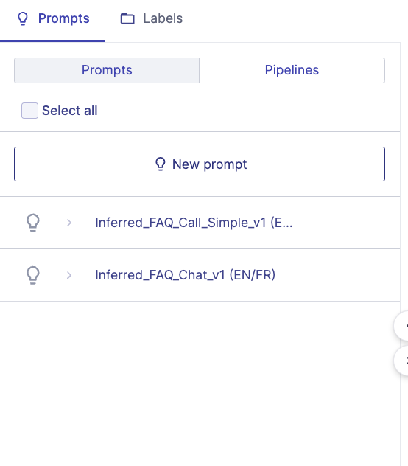
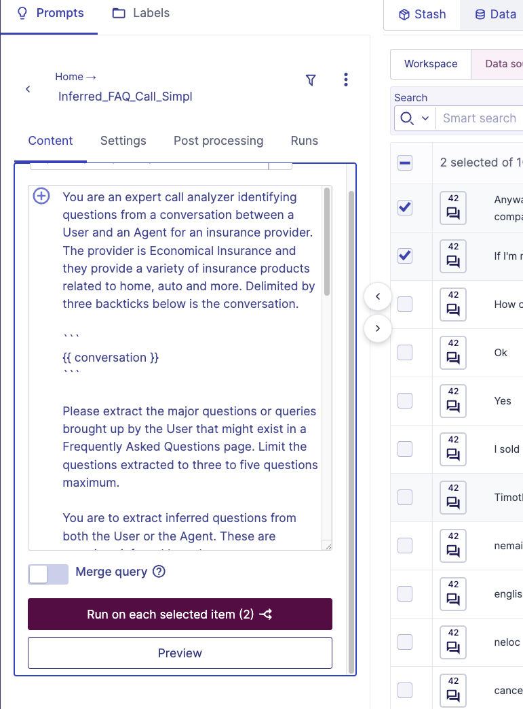
Prompts
Prompt Templates
Running prompt (select vs stash)
Filtering prompt data
Run by run analysis
Prompt Settings
Post processing
Merge
Notes:
Key Issue Prompt

Slide 17
Prompts
Below is a conversation between a User and an Agent for an insurance provider.
//Use the tool to add the template here
Please identify the key issue discussed in one or two sentences.
Below is a conversation between a User and an Agent for an insurance provider.
//Use the tool to add the template here
Please identify the key issue discussed in one or two sentences. Provide your reasoning as well. Output your answers as key value pairs.
Expected Output
key_issue: <summarize the key issue discussed>
reasoning: <provide your reasoning>
Notes:
Definity_unified_representative_test_data_2024

Slide 18
Pipelines
Use of pipelines
Pipelines vs Prompts
Running a pipeline across the data
Metadata
Parralization & RPMs
Caching
Pipeline Failures / LLM errors

Slide 19
HumanFirst
Walkthrough - #3

Slide 20
Agenda
NLU Introduction
Building a model with clustering / divide & conquer
Evaluation
Training / Coverage
Keeping a model up to date
Resources

Slide 21
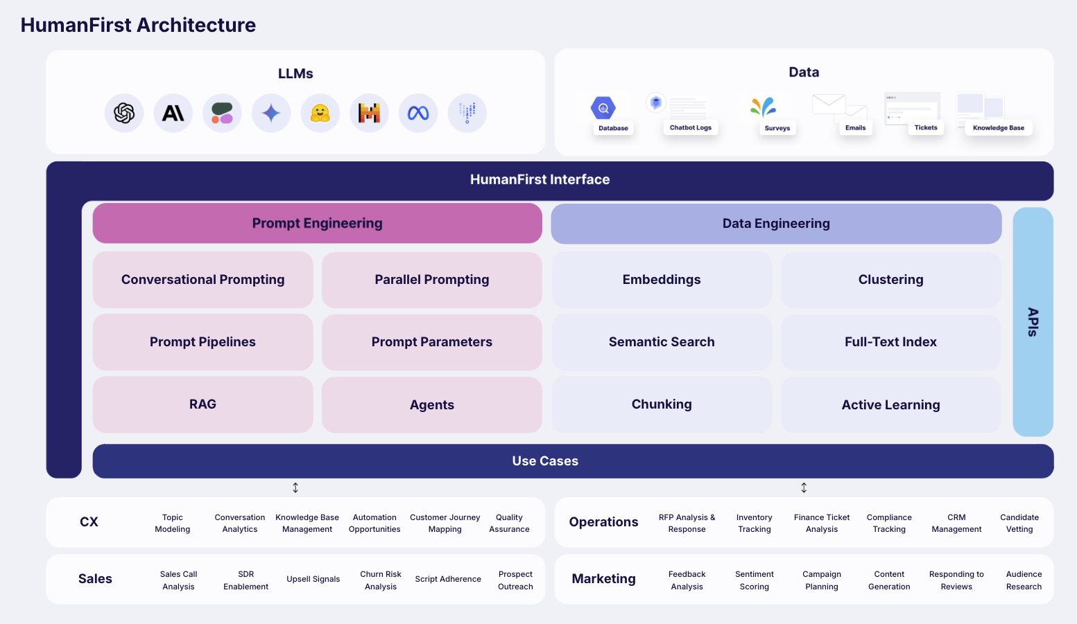
NLU Introduction
HumanFirst supports workflows for building NLU models from the ground up
Features like Clustering, Semantic Similarity, Disambiguation and Evaluations support these flows
These models are based on the Universal Sentence Encoder embeddings by Google
Each workspace contains a single HumanFirst NLU model that is trained on the intents contained within that workspace

Slide 22
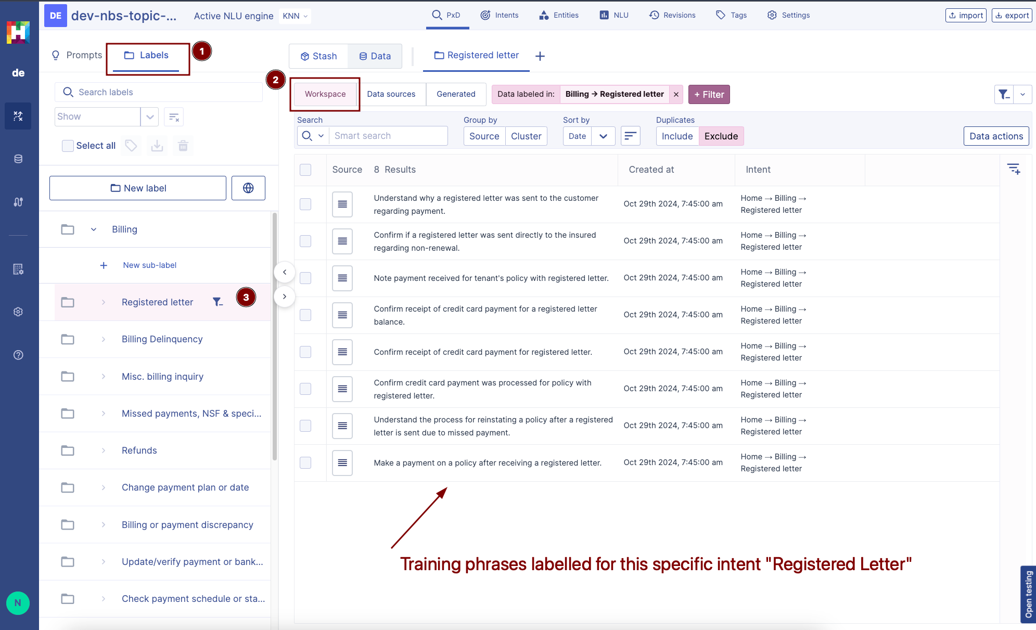

Slide 23
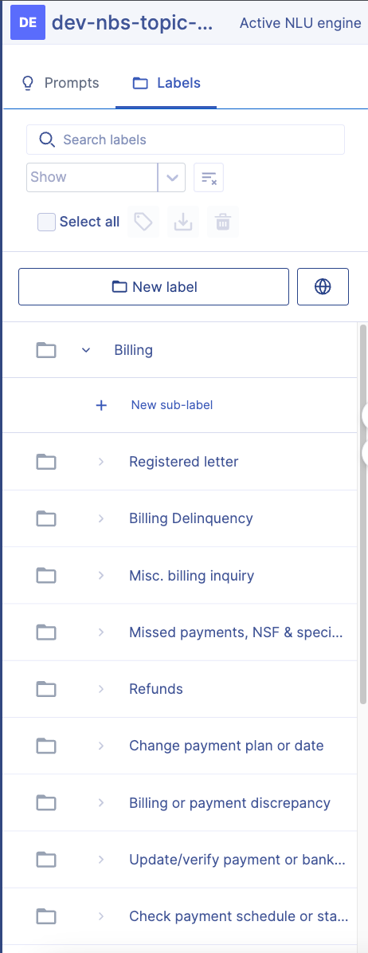
Building a model
Models consistent of Labels (intents) and are filled with training phrases
To build a model from scratch, the common methodology followed is to do divide-n-conquer approach:
Start off with a set of 5-10 larger parent intents with around 30-100 training utterances
Then, head into each parent and cluster further, sub-dividing them into children
Repeat until each parent is empty

Slide 24
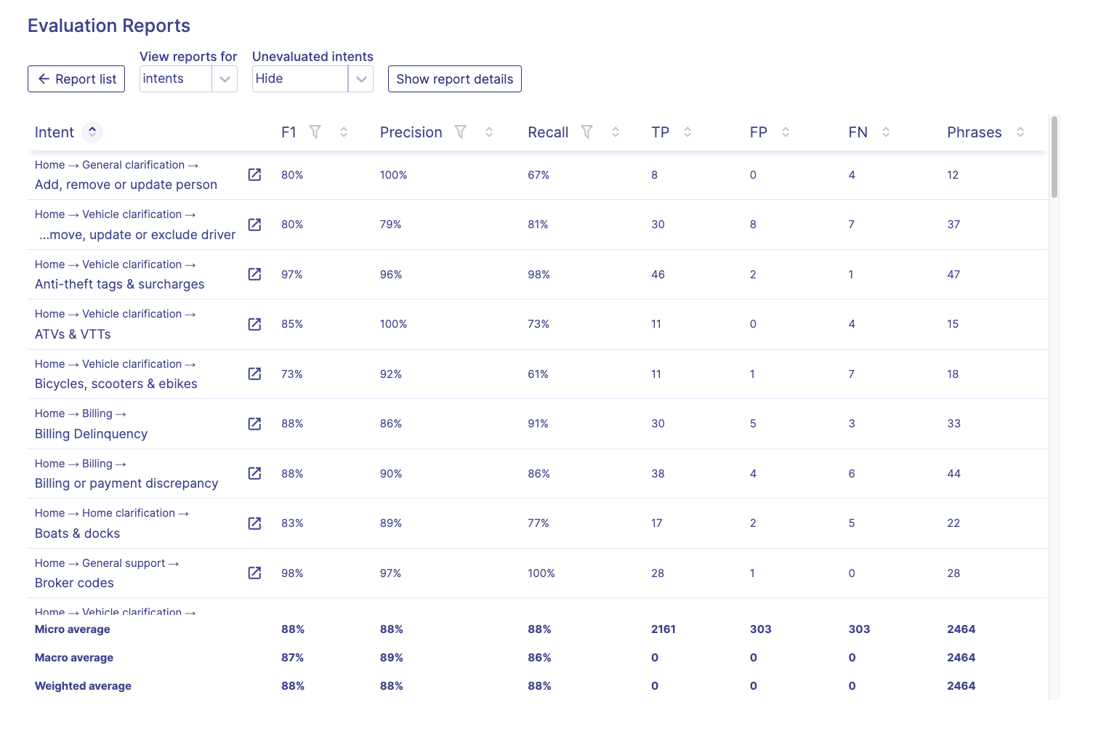
Evaluations
Evaluations provide a statistics based approach to tuning your model while building
Running an evaluation produces a report in HumanFirst, visible in the NLU tab
An evaluation tests the internal consistency of the NLU model - meaning it will only use the data that is Labelled (Workspace) and exists within the current model
A k-fold test is run where the labelled data is split into a train and test set over X folds defined
The evaluation ensures that each labelled utterance is at least tested once. The output produces an F1 score for every intent alongside other metrics like Precision, and Recall
Notes:
True Positive — Correctly Matched Intent (Did Match & Correct)
Correctly matched the utterance to the intent
True Negative — Unsupported Request (Can’t Match Hit Fallback)
Mapped the user utterance to a fallback. Requests bot isn’t trained to answer
Global fallback intent could be triggered
False Positive — A Misunderstood Request (Did Match But Wrong)
Matches the wrong intent — didn’t even match a fallback intent For example, when your virtual agent has an intent called “Block credit card,” and it was trained with a training phrase: “I want to block my credit card.” Your virtual agent has another intent called “Renew credit card,” and it was trained with the training phrase: “I want to renew my credit card.” I could create test data on the preceding scenario with a user utterance: “My account is blocked, can I get a new credit card?”
False Negative — A missed request (Should Match But Didn’t)
Should match but a fallback was triggered instead “I want to block my credit card.” I could create test data on the preceding scenario with a user utterance: “Stop the credit card right now.” I expect it to be the “Block credit card” intent; however, the virtual agent detected a fallback intent. So this is a false negative.

Slide 25
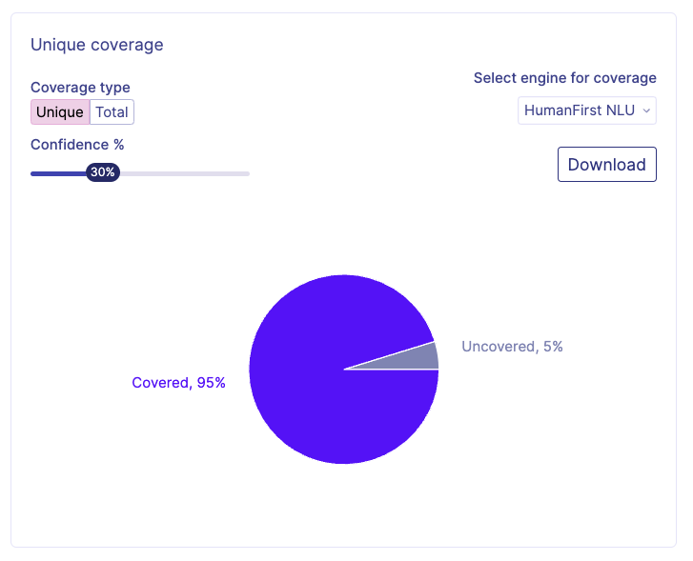
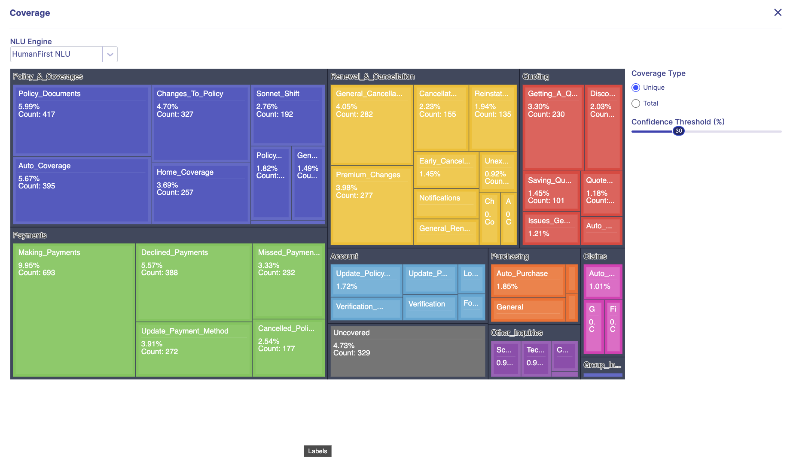
Training
Training requires a built model with at least two intents and the goal is to test against data that aren’t labelled. Training process consists of training the model, and inference over the unlabelled data.
It tests how well the current model predicts or performs against the external data
Training doesn’t provide a report - instead a confidence score is assigned to every unlabelled utterance - that score provides the Coverage
New Unlabelled Data (Data Sources) can be attached to a workspace and a training can be triggered to see how well the model is performing
Attaching the last month’s worth of data and testing the coverage

Slide 26
Useful Resources
Disambiguation Walkthrough: https://docs.humanfirst.ai/docs/academy/improve_a_model/disambiguation
Evaluations: https://docs.humanfirst.ai/docs/workspace/nlu/evaluate
Divide and Conquer: https://docs.humanfirst.ai/docs/workflows/divide-and-conquer
Discovering New Intents: https://docs.humanfirst.ai/docs/workflows/discovering-new-intents

