Slide 1


Changes Review

Slide 2
Callback Report

Slide 3
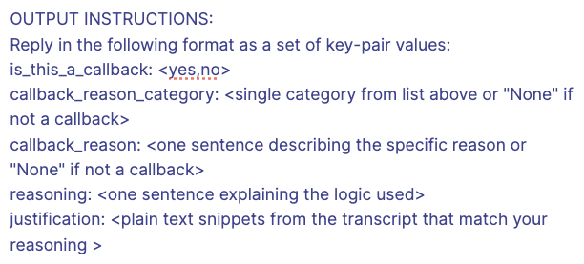

Callback Report
Change Requested:
Add additional category “None” similar to escalations report
Notes:
Change is not required since callback report as prompt is already doing this behaviour
The prompt is setup to first identify:
If a call is a callback
Then only assign a category - if not a callback, prompt will already mark “None”
Result:
No change needed
Snippet from prompt

Slide 4
SRA Report (NBS)

Slide 5
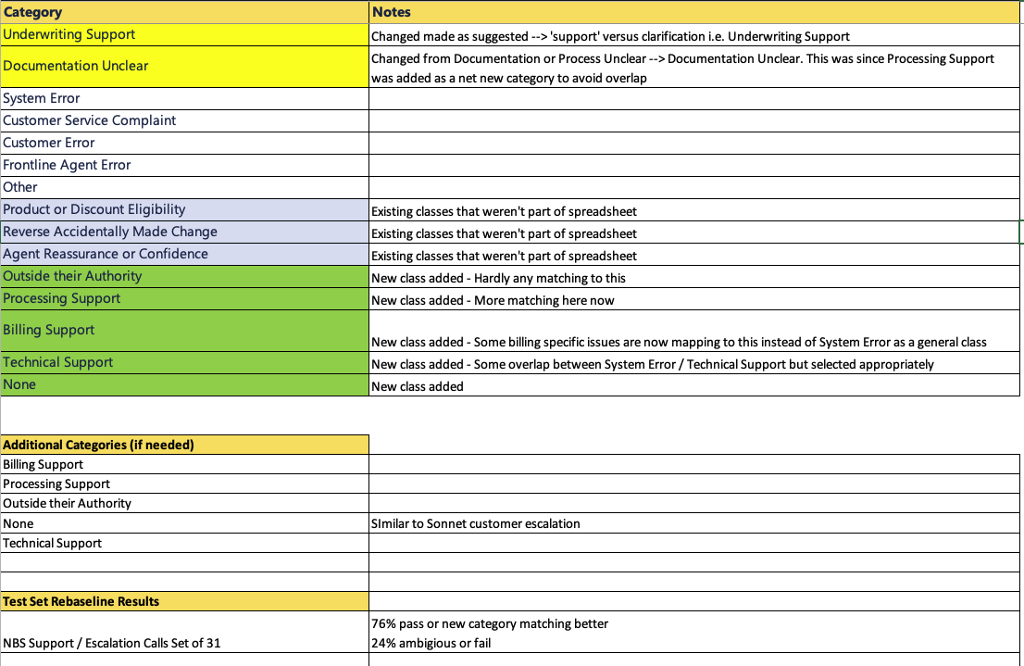
Escalation - NBS (S&E)

Slide 6
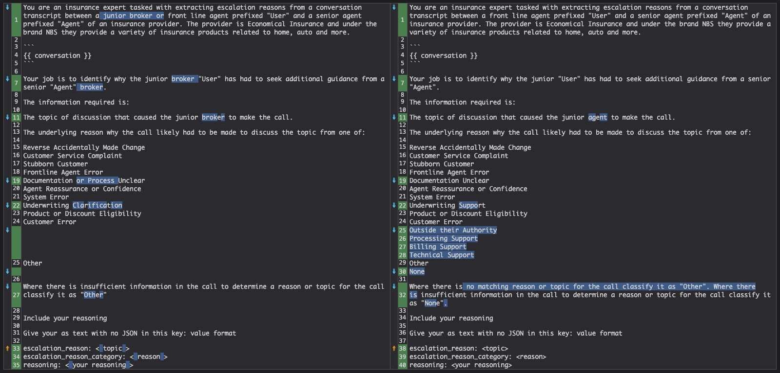
Escalation - NBS (S&E)

Slide 7
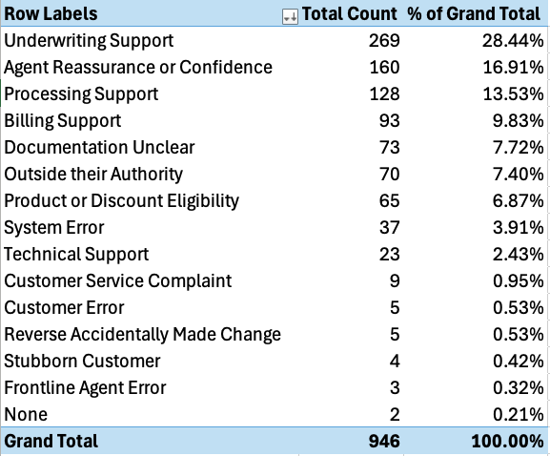
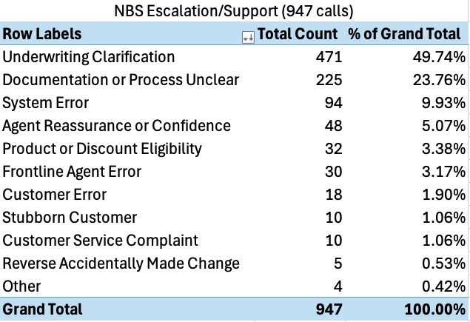
NBS Distributions
Inbound – J Agent to S Agent
Both Support and Escalation

Slide 8
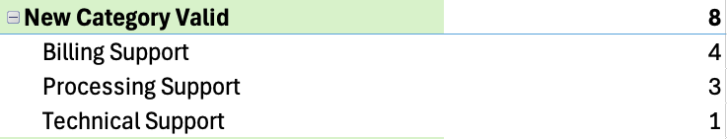
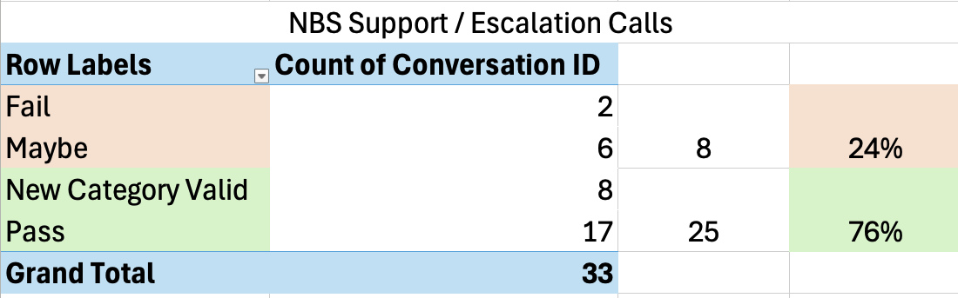
NBS (S&E) - Test Set

Slide 9
Outside their Authority
Agent: Okay, let me just check one second. The client, I don't see any registered letter. The payment was actually due on the 8th of Jan, and we give them the grace for 10 days. Now, you might have to set up an activity for yourself to follow up when the registered letter is issued. I cannot leave the notes on the file that the payment, so they made a payment to Economicall directly or to you guys, and you're sending the money?
Agent: No, to Economicall. Why can't you make a note? We do this all the time.
Agent: At this point, there is no registered letter issued. This client is on a responsive payment plan.
Agent: I know, but I don't want the registered letter to be issued, so that's why I'm calling you to tell you that I have the payment in my hand. And it will come in the courier tomorrow, so I don't want the registered letter to go out. That's the whole point of this.
Key | Prompt Results
escalation_reason_category | Outside their Authority
escalation_reason | Inability to stop automated registered letter
reasoning | The junior agent (User) had to escalate the call to a senior agent because they were unable to stop an automated registered letter from being sent to a client. The broker, Kathleen Howard, was insistent that a note be made on the file and the registered letter be stopped, as the client had made a payment. However, the junior agent explained that they don't have the capability to stop the automated process of sending registered letters. This issue is clearly outside the junior agent's authority, as they repeatedly stated they cannot make changes to the automated system. The broker's frustration and insistence on speaking to someone else led to the escalation, as the junior agent couldn't provide a solution that satisfied the broker's request.
fe3b92b6-6bb8-5bcd-a650-7372893359e3
Notes:
Call was regarding a system malfunction leading to extra refunds. Ticket needed to be created to stop.
‚Ä¢ The junior agent (Anthony Little) called the senior agent (Phillip Harrington) for support on a policy issue.
‚Ä¢ The policy in question belongs to Tiffany Zimmerman, policy number 206-739-05.
‚Ä¢ The total premium for the term was $2733.
‚Ä¢ Three payments were made: $1100, $1000, and $633, totaling $2733.
‚Ä¢ Despite the balance being zero, there was a refund of $849 scheduled for November 9th.
‚Ä¢ The policy was canceled for nonpayment on October 25th.
‚Ä¢ A payment of $633 was received on October 30th to zero out the balance.
‚Ä¢ The policy was reinstated the day before the call.
‚Ä¢ A second credit disbursement was sent back and reapplied.
‚Ä¢ The junior agent wanted to confirm if they should create a ticket to cancel the refund.
‚Ä¢ The senior agent agreed that the refund should be stopped as the policy value and amount paid both show $2733 in the Billing Center.
‚Ä¢ The junior agent will create a ticket to cancel the refund.
‚Ä¢ The call ended with both agents exchanging pleasantries.

Slide 10
Outside their Authority 2
Agent: So quote ending in 415, right? Does the broker mind waiting for just a little while? I can do it over the phone right now, yes? Yeah. Yep, okay, cool. Because she's getting a five with that.
User: This type of override is only you can do, correct?
Agent: I believe so. I don't, yeah, I don't think you have the, I don't even think you have the field for that, I think, but I know it has to come to you, to your specialist. Does she have any new tickets or anything?
User: No, I don't. So, I don't know if it's yet to pull the MBR, should I pull the MBR? But yeah.
User: Okay, looks great.
Key | Prompt Results
escalation_reason_category | Outside their Authority
escalation_reason | Honoring accident forgiveness for a driver splitting off from an existing policy
reasoning | The junior agent (User) contacted the senior agent (Agent) to seek guidance on how to honor accident forgiveness for a driver who is splitting off from an existing policy. The conversation reveals that the driver had an at-fault accident in 2018, which was forgiven on the current policy. The junior agent doesn't have the authority to apply this forgiveness to the new policy for the splitting driver, as evidenced by the statement "This type of override is only you can do, correct?" The senior agent confirms this by mentioning that they don't think the junior agent has the field for that override, and proceeds to make the necessary adjustments to ensure the driver maintains their accident forgiveness status (changing from a 5 to a 9 without DRP). This indicates that the junior agent needed to escalate the issue because it was outside their authority to make such changes in the system.
8ff1c2d4-af0c-542c-ad6e-e86c147351da
Notes:
Call was regarding a system malfunction leading to extra refunds. Ticket needed to be created to stop.
‚Ä¢ The junior agent (Anthony Little) called the senior agent (Phillip Harrington) for support on a policy issue.
‚Ä¢ The policy in question belongs to Tiffany Zimmerman, policy number 206-739-05.
‚Ä¢ The total premium for the term was $2733.
‚Ä¢ Three payments were made: $1100, $1000, and $633, totaling $2733.
‚Ä¢ Despite the balance being zero, there was a refund of $849 scheduled for November 9th.
‚Ä¢ The policy was canceled for nonpayment on October 25th.
‚Ä¢ A payment of $633 was received on October 30th to zero out the balance.
‚Ä¢ The policy was reinstated the day before the call.
‚Ä¢ A second credit disbursement was sent back and reapplied.
‚Ä¢ The junior agent wanted to confirm if they should create a ticket to cancel the refund.
‚Ä¢ The senior agent agreed that the refund should be stopped as the policy value and amount paid both show $2733 in the Billing Center.
‚Ä¢ The junior agent will create a ticket to cancel the refund.
‚Ä¢ The call ended with both agents exchanging pleasantries.

Slide 11
Processing Support
User: Hi, Frederick Johnson. This is Theresa Brock again with that same multi-policy discount question that I had. I am trying to add that discount back on the auto policy effective. I did try 28th of August. It did not work. I tried 29th of August. It says yes, but it's giving me a $0 transaction premium. Can I give you the policy number?
Agent: That's okay. I've still got the account. Let me just go back to it here.
….
Key | Prompt Results
escalation_reason_category | Processing Support
escalation_reason | Multi-policy discount application issue
reasoning | The junior agent (User) contacted the senior agent (Agent) for assistance with applying a multi-policy discount to an auto insurance policy. The User was having difficulty adding the discount back to the policy after it had been removed, encountering issues with effective dates and receiving $0 transaction premiums. The senior agent provided guidance on how to properly process the change, including advice on selecting the correct effective date and navigating the quoting system. This interaction falls under Processing Support as the junior agent needed help with the technical aspects of applying the discount correctly within the insurance system.
724ddfdc-cbfb-5780-b3b1-62a88d9dcff9
LINK
Notes:
Call was regarding a system malfunction leading to extra refunds. Ticket needed to be created to stop.
‚Ä¢ The junior agent (Anthony Little) called the senior agent (Phillip Harrington) for support on a policy issue.
‚Ä¢ The policy in question belongs to Tiffany Zimmerman, policy number 206-739-05.
‚Ä¢ The total premium for the term was $2733.
‚Ä¢ Three payments were made: $1100, $1000, and $633, totaling $2733.
‚Ä¢ Despite the balance being zero, there was a refund of $849 scheduled for November 9th.
‚Ä¢ The policy was canceled for nonpayment on October 25th.
‚Ä¢ A payment of $633 was received on October 30th to zero out the balance.
‚Ä¢ The policy was reinstated the day before the call.
‚Ä¢ A second credit disbursement was sent back and reapplied.
‚Ä¢ The junior agent wanted to confirm if they should create a ticket to cancel the refund.
‚Ä¢ The senior agent agreed that the refund should be stopped as the policy value and amount paid both show $2733 in the Billing Center.
‚Ä¢ The junior agent will create a ticket to cancel the refund.
‚Ä¢ The call ended with both agents exchanging pleasantries.

Slide 12
Processing Support 2
User: ..so she's trying to update and there's a cost difference about the replacement cost, so she wants to check if she can, what to do about, like she can change the replacement cost or something,
Agent: So it looks like we did do a change in broker code. Yeah. So is it the new broker that's calling in and they're doing a new evaluation on the house?
….
Agent: Well, what she wants to do is she can go in, start an endorsement, where we have the value at 494.111. She can enter the new home evaluation value. There's also a field that has the home evaluation date. She can update that field, and then quote it through. And the system will update the premium accordingly. And they can go from there.
User: Okay, so I just tell her, put the new value in the guidewire and the date of thing. Yep.
Key | Prompt Results
escalation_reason_category | Processing Support
escalation_reason | Property evaluation and replacement cost update
reasoning | The junior agent (User) contacted the senior agent (Agent) because they were unsure how to handle a request from a broker regarding a property evaluation and replacement cost update. The broker had new information about the property type (bi-level instead of tri-level) and wanted to update the replacement cost, which would affect the insurance premium. The junior agent didn't fully understand the process for making these changes and needed guidance on how to proceed. The senior agent provided step-by-step instructions on how to update the information in the system, including starting a new endorsement, updating the estimated replacement cost value, and changing the evaluation date. This situation falls under "Processing Support" as the junior agent needed assistance with the correct procedure for processing a change in the property details and its associated replacement cost.
ad132598-3276-51d0-b153-0b055b57dfb3
LINK
Notes:
Call was regarding a system malfunction leading to extra refunds. Ticket needed to be created to stop.
‚Ä¢ The junior agent (Anthony Little) called the senior agent (Phillip Harrington) for support on a policy issue.
‚Ä¢ The policy in question belongs to Tiffany Zimmerman, policy number 206-739-05.
‚Ä¢ The total premium for the term was $2733.
‚Ä¢ Three payments were made: $1100, $1000, and $633, totaling $2733.
‚Ä¢ Despite the balance being zero, there was a refund of $849 scheduled for November 9th.
‚Ä¢ The policy was canceled for nonpayment on October 25th.
‚Ä¢ A payment of $633 was received on October 30th to zero out the balance.
‚Ä¢ The policy was reinstated the day before the call.
‚Ä¢ A second credit disbursement was sent back and reapplied.
‚Ä¢ The junior agent wanted to confirm if they should create a ticket to cancel the refund.
‚Ä¢ The senior agent agreed that the refund should be stopped as the policy value and amount paid both show $2733 in the Billing Center.
‚Ä¢ The junior agent will create a ticket to cancel the refund.
‚Ä¢ The call ended with both agents exchanging pleasantries.

Slide 13
Technical Support
User: So I'm not seeing any blocks, but that doesn't mean there aren't warning messages on the brokers.
Agent: There is.
Agent: Quote system.
User: Okay.
Agent: I can't really help them with that. Okay. Because anytime there's a question on a broker quote.
User: Okay.
Agent: I always say that's something they need to discuss.
Key | Prompt Results
escalation_reason_category | Technical Support
escalation_reason | Broker quote system error message
reasoning | The junior agent (User) contacted the senior agent (Agent) because they were dealing with a broker who was receiving an error message in their quote system. The error was related to an outdoor wood boiler, and the junior agent was unsure how to proceed. The senior agent explained that they don't have access to the broker's quoting vendor system and advised the junior agent to direct the broker to contact broker support for assistance with their quoting system issues. This situation falls under Technical Support because it involves troubleshooting an error in the broker's quoting system, which is outside the scope of what the frontline agents can directly assist with.
1edfa1bc-7166-5240-afba-bb66966e0672
LINK
Notes:
Call was regarding a system malfunction leading to extra refunds. Ticket needed to be created to stop.
‚Ä¢ The junior agent (Anthony Little) called the senior agent (Phillip Harrington) for support on a policy issue.
‚Ä¢ The policy in question belongs to Tiffany Zimmerman, policy number 206-739-05.
‚Ä¢ The total premium for the term was $2733.
‚Ä¢ Three payments were made: $1100, $1000, and $633, totaling $2733.
‚Ä¢ Despite the balance being zero, there was a refund of $849 scheduled for November 9th.
‚Ä¢ The policy was canceled for nonpayment on October 25th.
‚Ä¢ A payment of $633 was received on October 30th to zero out the balance.
‚Ä¢ The policy was reinstated the day before the call.
‚Ä¢ A second credit disbursement was sent back and reapplied.
‚Ä¢ The junior agent wanted to confirm if they should create a ticket to cancel the refund.
‚Ä¢ The senior agent agreed that the refund should be stopped as the policy value and amount paid both show $2733 in the Billing Center.
‚Ä¢ The junior agent will create a ticket to cancel the refund.
‚Ä¢ The call ended with both agents exchanging pleasantries.

Slide 14
Technical Support 2
User: So, this policy renewed on 7th November, 2023. Okay. And just that, if you go to Guidewire Policy Centre and pull up the billing screens, there is no term period showing for 2023-2024. Hmm. Which is what is super weird. Hmm. The good news is that on Billing Centre, everything is as it should be.
Key | Prompt Results
escalation_reason_category | Technical Support
escalation_reason | Missing policy term in Guidewire Policy Centre
reasoning | The junior agent (User) contacted the senior agent (Agent) because they encountered an issue in the Guidewire Policy Centre system. Specifically, the 2023-2024 term period was not showing in the billing screens for a policy that had renewed on November 7, 2023. The junior agent was unable to resolve this discrepancy, which was causing concern for the broker. The senior agent identified that this was likely a system issue that would require intervention from a super user or IT department, as it wasn't something that could be easily fixed by the agents themselves. This clearly falls under the category of Technical Support, as it involves a system error or limitation that requires specialized assistance to resolve.
3590c914-b3a7-53bb-a006-c583bd6a4821
LINK
Notes:
Call was regarding a system malfunction leading to extra refunds. Ticket needed to be created to stop.
‚Ä¢ The junior agent (Anthony Little) called the senior agent (Phillip Harrington) for support on a policy issue.
‚Ä¢ The policy in question belongs to Tiffany Zimmerman, policy number 206-739-05.
‚Ä¢ The total premium for the term was $2733.
‚Ä¢ Three payments were made: $1100, $1000, and $633, totaling $2733.
‚Ä¢ Despite the balance being zero, there was a refund of $849 scheduled for November 9th.
‚Ä¢ The policy was canceled for nonpayment on October 25th.
‚Ä¢ A payment of $633 was received on October 30th to zero out the balance.
‚Ä¢ The policy was reinstated the day before the call.
‚Ä¢ A second credit disbursement was sent back and reapplied.
‚Ä¢ The junior agent wanted to confirm if they should create a ticket to cancel the refund.
‚Ä¢ The senior agent agreed that the refund should be stopped as the policy value and amount paid both show $2733 in the Billing Center.
‚Ä¢ The junior agent will create a ticket to cancel the refund.
‚Ä¢ The call ended with both agents exchanging pleasantries.

Slide 15
Billing Support
User: Hi Charles Davis, just a quick question. For a commercial policy, if it's on the 3-pay plan, do they get an invoice before each payment?
Key | Prompt Results
escalation_reason_category | Billing Support
escalation_reason | Commercial policy billing cycle and invoice timing
reasoning | The junior agent (User) is seeking clarification about the billing process for commercial policies on a 3-pay plan. Specifically, they want to know if customers receive invoices before each payment and how far in advance these invoices are sent. This inquiry falls under the category of Billing Support as it directly relates to the timing and process of sending invoices to customers. The senior agent (Agent) provides information about the timing of the billing statements, indicating they are typically sent out 20 days in advance for policies in the Acre system. This conversation demonstrates that the junior agent needed additional information about the billing process to better assist customers or handle inquiries related to commercial policy payments.
06997f78-ff1e-5526-b17f-bd3f82e0ddf9 (part of test set)
Notes:
Call was regarding a system malfunction leading to extra refunds. Ticket needed to be created to stop.
‚Ä¢ The junior agent (Anthony Little) called the senior agent (Phillip Harrington) for support on a policy issue.
‚Ä¢ The policy in question belongs to Tiffany Zimmerman, policy number 206-739-05.
‚Ä¢ The total premium for the term was $2733.
‚Ä¢ Three payments were made: $1100, $1000, and $633, totaling $2733.
‚Ä¢ Despite the balance being zero, there was a refund of $849 scheduled for November 9th.
‚Ä¢ The policy was canceled for nonpayment on October 25th.
‚Ä¢ A payment of $633 was received on October 30th to zero out the balance.
‚Ä¢ The policy was reinstated the day before the call.
‚Ä¢ A second credit disbursement was sent back and reapplied.
‚Ä¢ The junior agent wanted to confirm if they should create a ticket to cancel the refund.
‚Ä¢ The senior agent agreed that the refund should be stopped as the policy value and amount paid both show $2733 in the Billing Center.
‚Ä¢ The junior agent will create a ticket to cancel the refund.
‚Ä¢ The call ended with both agents exchanging pleasantries.

Slide 16
SRA Report (Sonnet - Support)

Slide 17
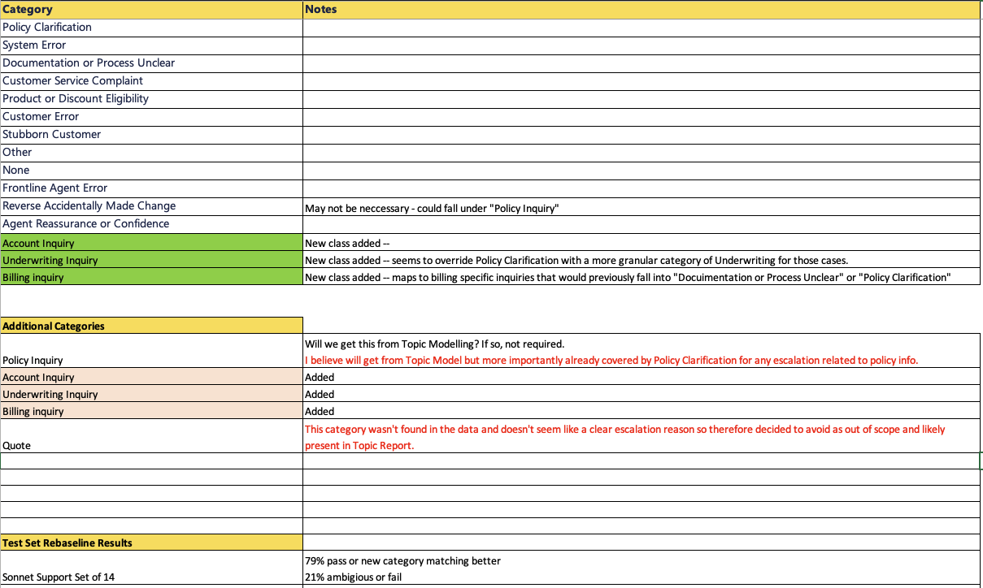
Escalation Report - Sonnet S

Slide 18
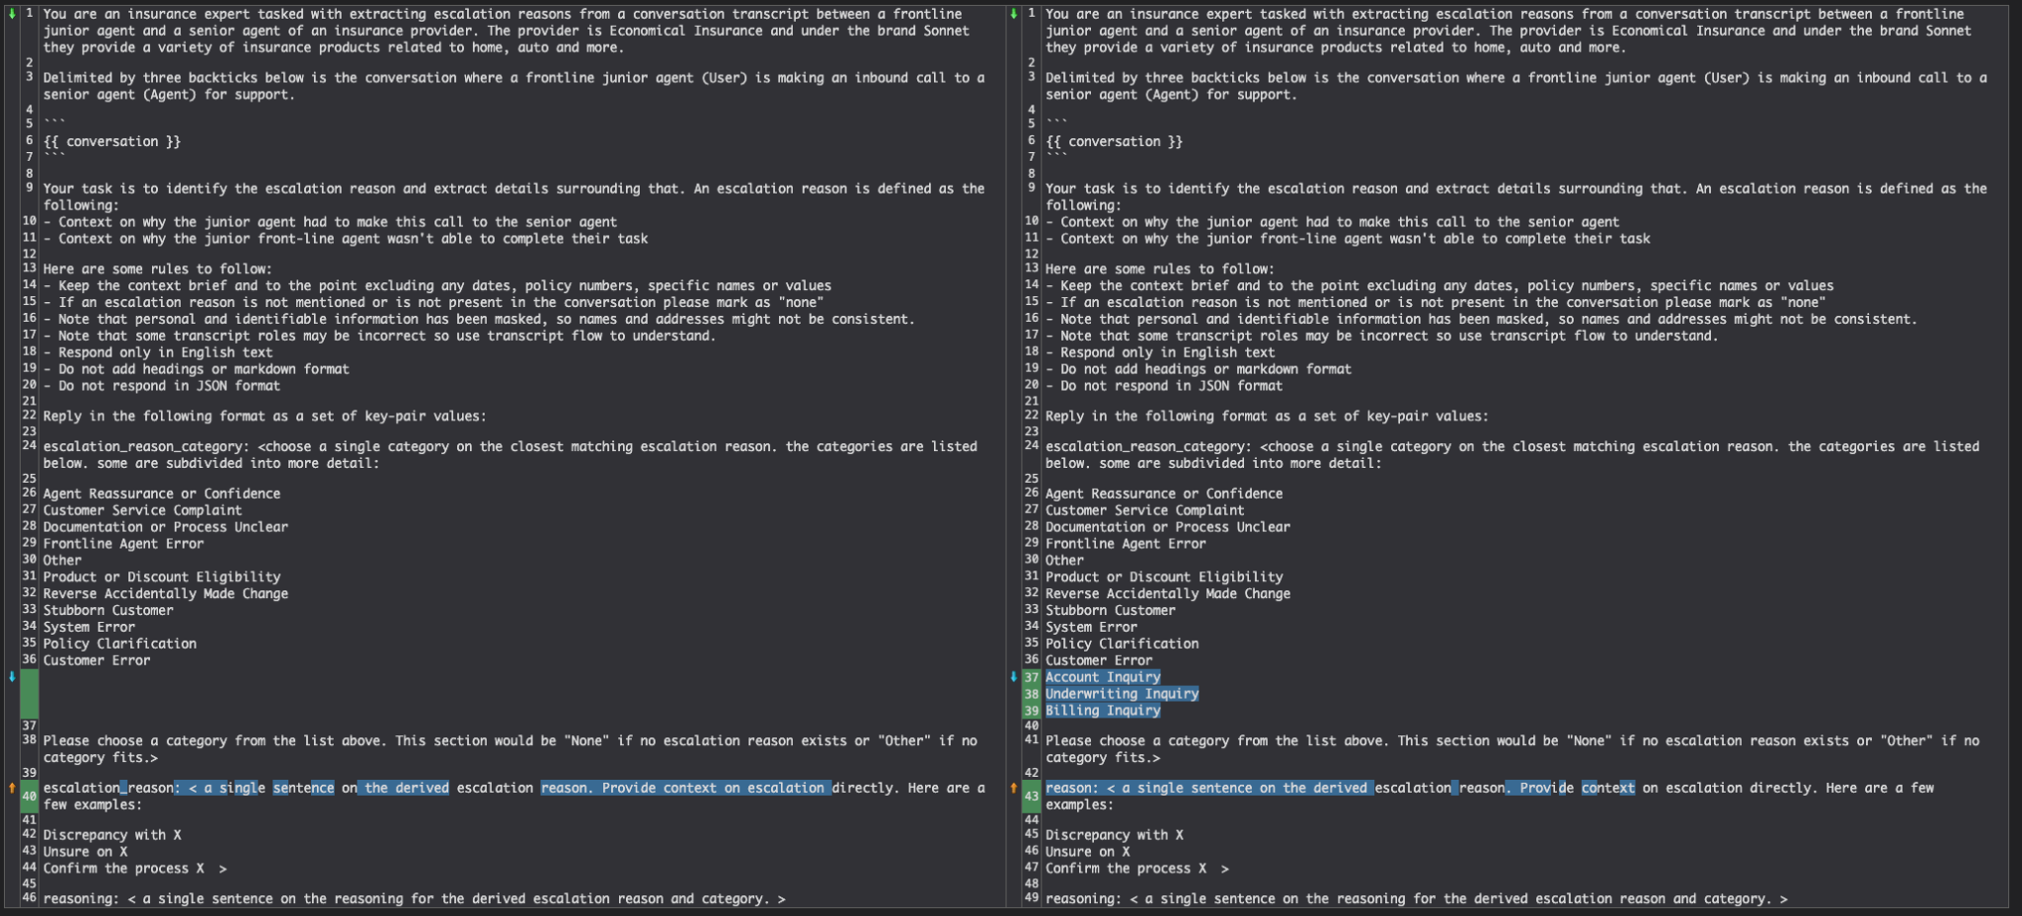
Escalation Report - Sonnet S

Slide 19
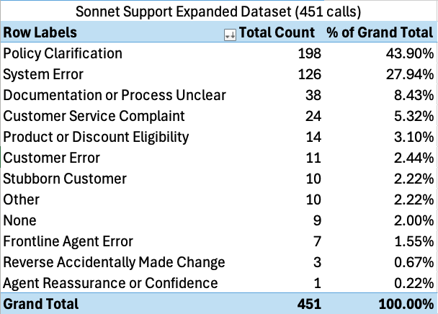
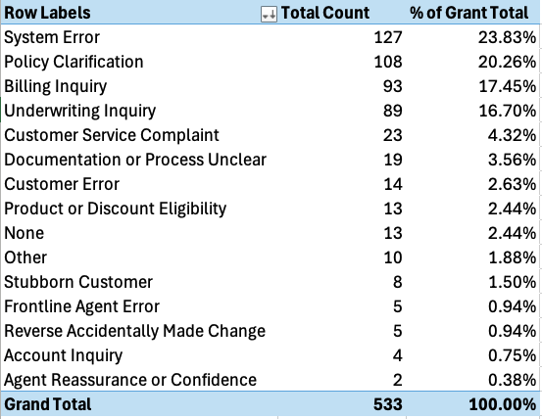
Sonnet S Distributions
Inbound – J Agent to S Agent
Notes:
Policy clarification now distributed across the new classes

Slide 20
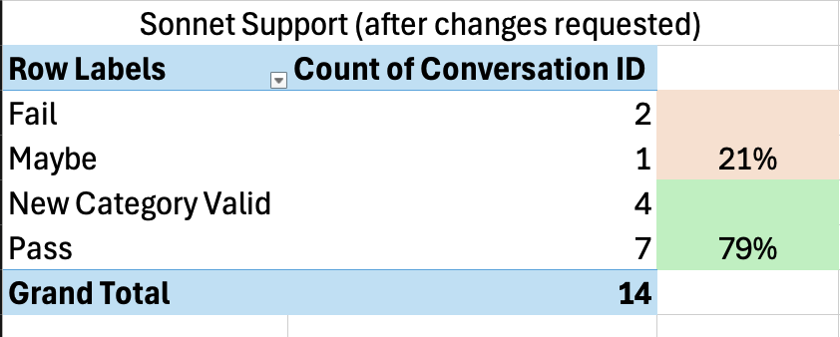
Sonnet S Test Set

Slide 21
Underwriting Inquiry 1
User: "Good, thank you. I have a customer who's on the phone right now. They've bought a new truck and they want to add it onto their policy. They have some questions regarding business use. I think this is going to be a decline, but I just wanted to check with you before I say no.
"
Key | Prompt Results
escalation_reason_category | Underwriting Inquiry (Prior Prompt: Policy Clarification)
escalation_reason | Confirm eligibility for auto insurance coverage with business use of vehicle.
reasoning | The junior agent was unsure about the underwriting guidelines for business use of a personal vehicle and needed clarification from a senior agent to determine if the customer's situation would be eligible for coverage or result in a decline.
1fe44f3e-8944-5d59-9a2f-d3914df589fa

Slide 22
Underwriting Inquiry 2
Alright, so it's 448-822-864. For Adam Long? Jamie Murphy. He's on the phone on hold. I did look into acceptable business for auto use. I did take a second look at the products, auto products manual as well. Alright, so the thing is this. The client reaches out to inform that his wife was in need to increase the liability because she was driving her vehicle as part of her job requirements to enroll kids up to grade eight, right? And then we have this escalated and the client was actually advised that it's not acceptable business use for us. Okay. So the client is calling back to say that they no longer will use the vehicle for business use. Okay. So he was given like a five days notice to remove the vehicle from the policy, but then he's saying now, well, we're not going to use it anymore. Spoke to my wife. She understood and so forth. She's not going to drive the vehicles anymore. So how do we go about institutions like this? We just take the client's word.
Key | Prompt Results
escalation_reason_category | Underwriting Inquiry
escalation_reason | Confirm the process for handling a client who previously used their vehicle for business purposes but now claims they will no longer do so.
reasoning | The junior agent sought guidance on how to proceed with a client who was initially flagged for unacceptable business use of their vehicle but now claims they will discontinue this practice.
2c0a0b6e-4452-5f3c-bfb5-659e0b941778

Slide 23
Account Inquiry
User: Hi, I'm calling from New Brunswick, Kitchens Auto and Towing. We got an RCMP call on the 14th and we hauled in a vehicle that was stolen. I have not heard from the owner. I don't even know if the owner knows it's here, but I have your insurance card. Wondering if you can get a hold of the insured and let them know it's here.
Agent: And, sorry, can I please get the name?
User: Of the business? My name is Brian Donovan. The name of the owner?
….
Agent: Okay, so you have someone on the phone. Who are you talking to?
Agent: Her name is Brian Donovan. She's calling from Kitchens Auto Body Repairs Limited, located in Upper Kings Clear, New Brunswick. Basically, she's calling because the RCMP found this 2021 Chevy truck in a ditch. I guess they thought it was a stolen vehicle, and they dropped it off at this Kitchen Auto Body Repair shop. She said, okay, the only thing in there is the liability card, and it's an expired liability card. I opened up Michael Flores' profile, and the truck on file is a newer Chevrolet. In this case, would I contact the claims department? Who would I contact? Because it's not even associated with Michael Flores' account.
Key | Prompt Results
escalation_reason_category | Account Inquiry
escalation_reason | Unsure how to handle a third-party report of a potentially stolen vehicle.
reasoning | The junior agent escalated the call because they were uncertain about the proper procedure for handling a situation where a towing company reported finding a vehicle with an expired insurance card from their company.
940b0123-866a-5892-9680-9e60f78bd3d2

Slide 24
Billing Inquiry
I'm looking at back office request process. So what has happened is the customer called earlier to inquire if he can make an early payment for a double payment that was going to come out on 30th of October. So he was advised correctly by the advisor to make the payment on the very same day. So he made the payment on 20th. However, even after making the payment on 20th, instructions were sent to the bank to withdraw the money on 30th. So now he has been charged a $48 or $45 NSF from the bank. So is there a way we can, like, help him to reimburse it? Well, what did you read in the Bebo guide? I'm just trying to find out.
Key | Prompt Results
escalation_reason_category | Billing Inquiry
escalation_reason | Unsure how to handle an out-of-sequence payment and its consequences.
reasoning | The junior agent is seeking guidance on how to address a situation where a customer's early payment wasn't properly applied, resulting in an NSF fee and potential further complications.
5112a330-f2c2-54f5-ab28-fd12b6a1bd42

Slide 25
SRA Report (Sonnet - Escalation)

Slide 26
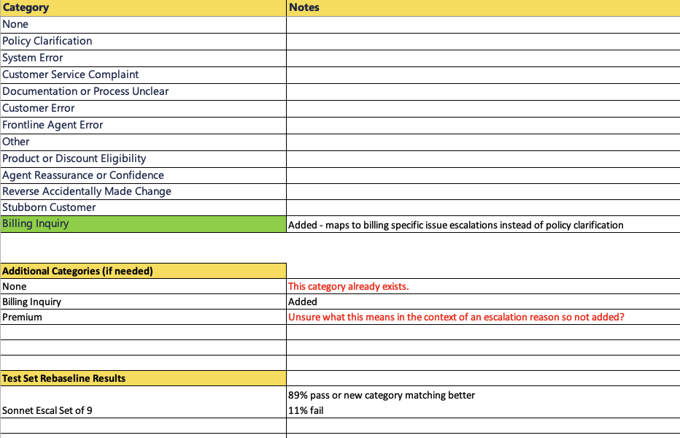
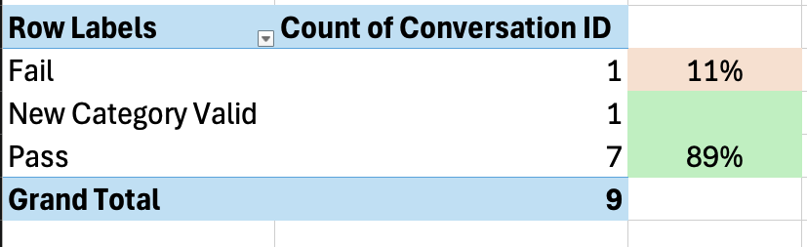
Escalation Report - Sonnet E

Slide 27
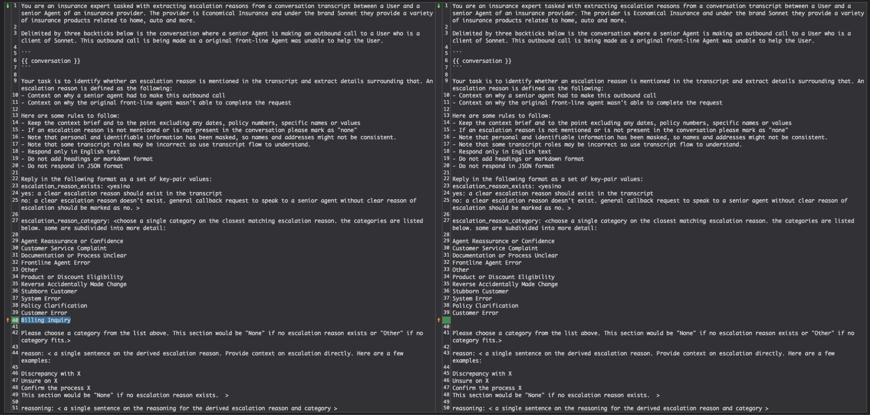
Escalation Report - Sonnet S

Slide 28
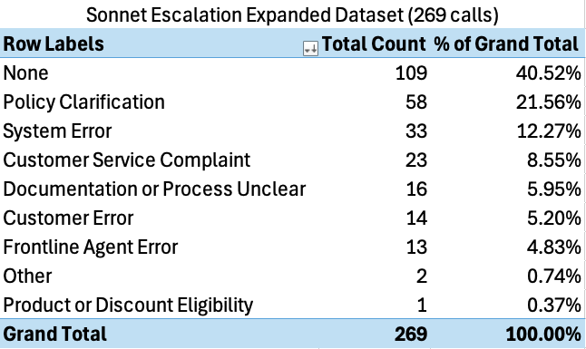
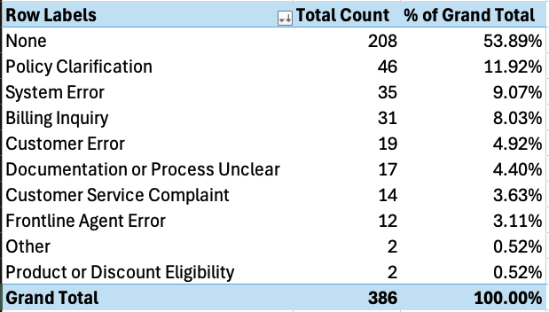
Sonnet E Distributions
Outbound – S Agent to Customer

Slide 29
Sonnet E Test Set

Slide 30
Billing Inquiry
Sylvia Wells is fine? Okay, thanks, Sylvia Wells. This call is recorded for quality and training purposes. Sorry to hear about that situation. I see here, I guess there was an issue with some of the missed payments and the cancellation for the missed payments.
Key | Prompt Results
escalation_reason_category | Billing Inquiry
escalation_reason | Discrepancy between customer's bank records and insurance company's payment records.
reasoning | The customer claims their bank account had sufficient funds and shows no withdrawal attempts, while the insurance company reports multiple missed payments leading to policy cancellation.
07099c62-4dff-5e54-af43-ad644612bc23

Slide 31
NBS
Agent Reassurance or Confidence
Outside their Authority
Customer Service Complaint
Processing Support
Documentation Unclear
Billing Support
Frontline Agent Error
Technical Support
Other
Reverse Accidentally Made Change
Stubborn Customer
System Error
Underwriting Support
Customer Error
Product or Discount Eligibility
None

Slide 32
Sonnet Escalation
Sonnet Support
Agent Reassurance or Confidence
Billing Inquiry
Agent Reassurance or Confidence
Billing Inquiry
Customer Service Complaint
Customer Service Complaint
Underwriting Inquiry
Documentation or Process Unclear
Documentation or Process Unclear
Account Inquiry
Frontline Agent Error
Frontline Agent Error
Other
Other
Reverse Accidentally Made Change
Reverse Accidentally Made Change
Stubborn Customer
Stubborn Customer
System Error
System Error
Policy Clarification
Policy Clarification
Customer Error
Customer Error
Product or Discount Eligibility
Product or Discount Eligibility
None
None

Slide 33
SRA Report (Sonnet - Escalation v2)

Slide 34
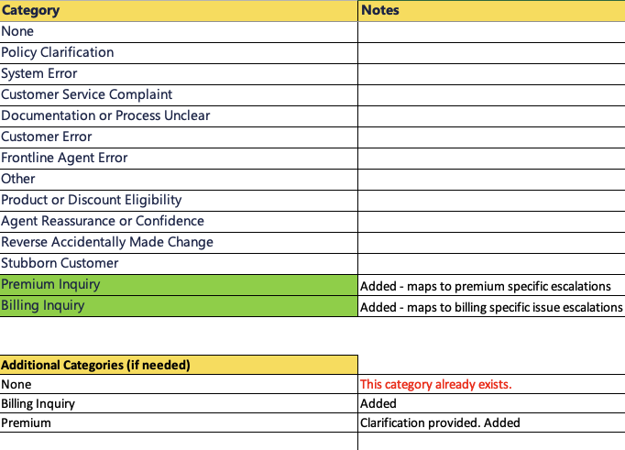
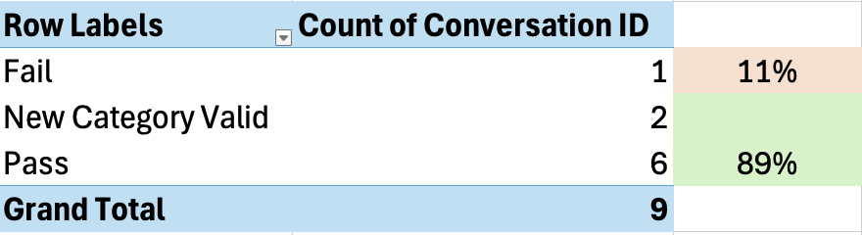
Sonnet E Test Set

Slide 35
Premium Inquiry 1
Perfect. Thank you for that. So, I did have a chance to review your renewal. You wanted a more in-depth review of it. So, I have done that here. I've also referred it off to our underwriting team for them to confirm. I'm still waiting on a reply from them, but I can tell you what I found so far. Sure. So, just to give you some context to begin with, in Ontario, we had four rate increases over the past year. A total of all of them together is 21.88%. If we take what's called the annualized amount, which is what your policy would have cost for the current term, if it was as it is now, and we multiply that by 21.88%, that would give us $3,474.80 approximately, which is compared to the price that it actually ended up being, $3,536. It is pretty close. That is for an average customer if nothing changed, just for context. Sorry, stop me if I'm going too fast. I know it can get a bit technical when it comes to discussing renewals.
Key | Prompt Results
escalation_reason_category | Premium Inquiry
escalation_reason | The client requested a callback for a more in-depth review of their insurance renewal, specifically regarding the increase in their premium.
reasoning | The senior agent mentions reviewing the renewal in detail and explains the various factors contributing to the premium increase, indicating that the original front-line agent was unable to provide this level of detailed information.
121bf79b-5ef6-5906-a192-c582fe8c803a

Slide 36
Premium Inquiry 2
Agent: Okay, awesome. Thank you for answering those questions. I appreciate it. I understand that you have some concerns about a policy change made to add a vehicle to your previous automobile insurance policy with Sonnet. Can you tell me a little bit more about your concerns?
User: So I got a new car for myself, I think it was in September, and my policy went up by almost 300%. It went from Q90 every month to 971, and that just is not right. Like, I understand if it goes up by like a small amount, like $102, but that's almost 333% right there, which to me is price gouging, so I'd like to get those results.
Agent: Okay, I understand. Thank you for advising me of your concern there.
Key | Prompt Results
escalation_reason_category | Premium Inquiry
escalation_reason | Customer is concerned about a significant increase in their insurance premium after adding a new vehicle to their policy.
reasoning | The conversation revolves around the customer's shock at a substantial premium increase, which required clarification and explanation from a senior agent.
6c114a0b-0498-59f2-b038-918a458844bb

Slide 37
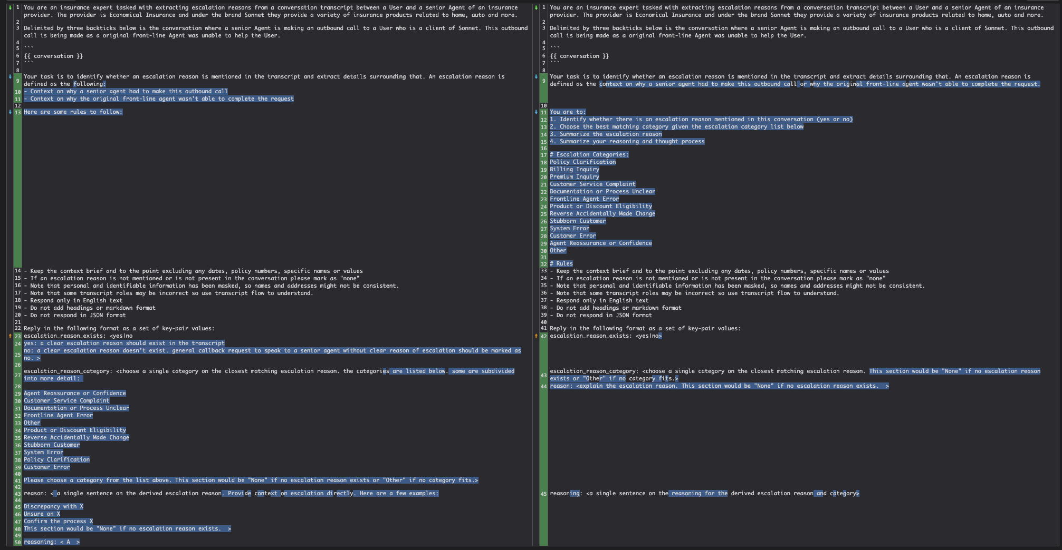
Escalation Report - Sonnet S
Prompt Change Diff

Slide 38
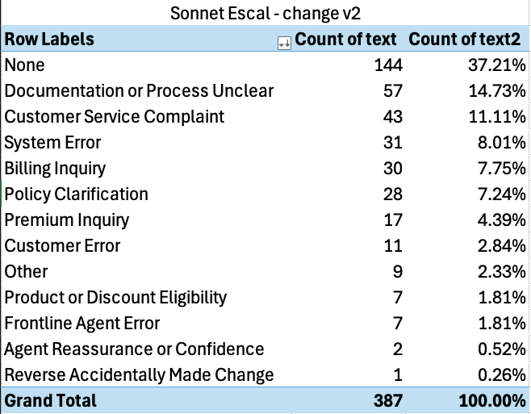
Sonnet E Distributions
Outbound – S Agent to Customer

Slide 39
Summary Of Changes

Slide 40
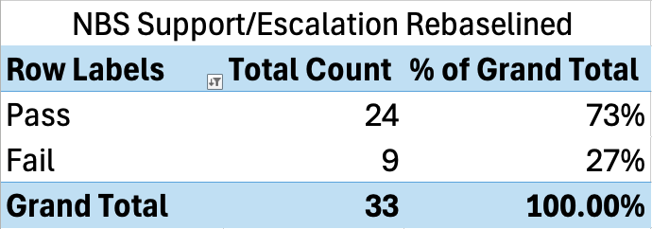
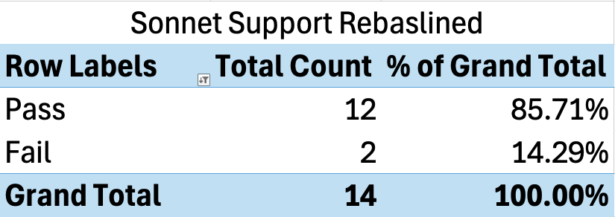
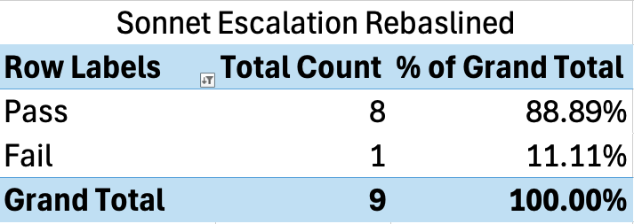
Summary Escalation Testing
NBS Escalation/Support
Sonnet Support
Sonnet Escalation
Before
After
1 rename
4 new positive classes
1 new "None" negative class
3 positive classes
2 positive classes

Slide 41
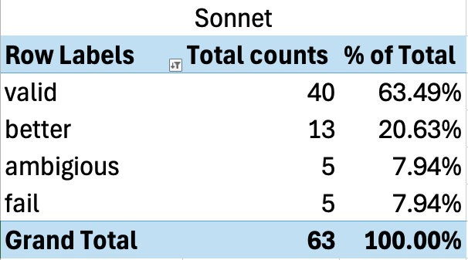
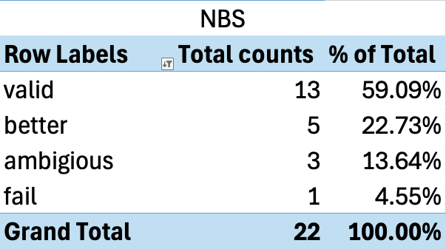
Summary Callback Testing (No Change Made)
~84% Valid Cases
~82% Valid Cases

