Slide 1


Agent Escalation
Report Update

Slide 2
Overview
Type | Direction | Context | Likelihood
Sonnet Escalation | Outbound | Agent to Customer | Unlikely to contain escalation reason
Sonnet Support | Inbound | J-Agent to S-Agent | Likely to contain escalation reason
NBS Escalation/Support | Inbound | J-Agent to S-Agent | Likely to contain escalation reason
Notes:
Sonnet escalation calls are outbound where agents are talking direct to customers.
Majority of the calls here don’t mention any escalation reason – and most of the time this is inferred by the conversation context.
Both NBS and Sonnet support are inbound calls J-S agent containing clear reasons.
Prompt to extract None when there is no clear escalation reason the LLM can identify.

Slide 3
Escalation Reasons
Sonnet
NBS
Agent Reassurance or Confidence
Agent Reassurance or Confidence
Customer Service Complaint
Customer Service Complaint
Documentation or Process Unclear
Documentation or Process Unclear
Frontline Agent Error
Frontline Agent Error
Other
Other
Reverse Accidentally Made Change
Reverse Accidentally Made Change
Stubborn Customer
Stubborn Customer
System Error
System Error
Policy Clarification
Underwriting Clarification
Customer Error
Customer Error
Product or Discount Eligibility
Product or Discount Eligibility
Notes:
Derived from both test team data provided and data discovery – 11 Classes
Difference is Policy Clarification vs Underwriting Clarification
Prompt is looking for a clear escalation reason in the conversation.
For Outbound Sonnet Escalation calls – there is much more inference.

Slide 4
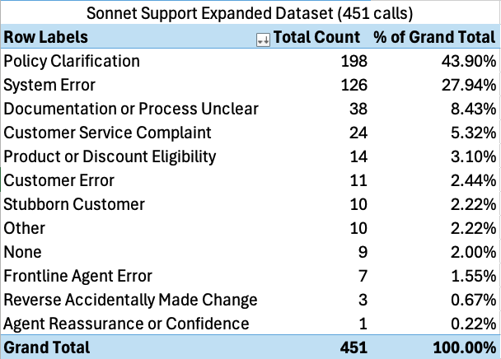
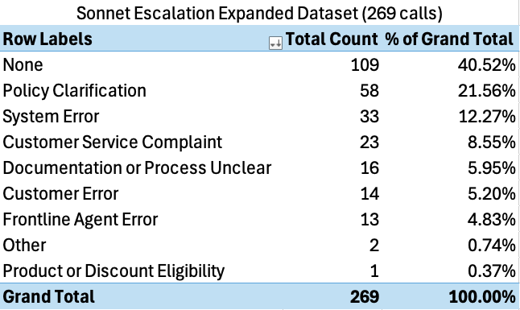
Sonnet Distributions
Inbound – J Agent to S Agent
Outbound – S Agent to Customer
Notes:
None category in Sonnet Support are calls that were directly with a customer that leaked through the logic used to identify these.
Expect this to go down as terminology / business logic used to divide the dataset gets more routinely used.
LLM reasoning sample for None: The conversation appears to be between a customer and a senior agent, not a junior agent escalating to a senior agent, and no explicit escalation reason is mentioned.

Slide 5
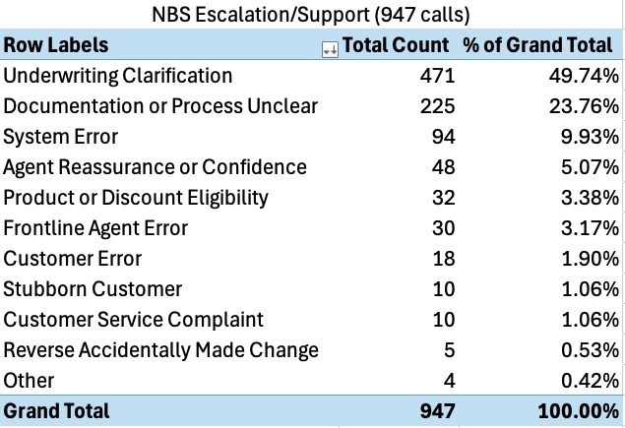
NBS Distributions
Inbound – J Agent to S Agent
Both Support and Escalation
Notes:
11 classes capture the breadth of escalation issues well
Underwriting Clarification / Documentation or Process Unclear being the two biggest is represented in the test set as well
Other category being >1% indicates that most calls fall well into the taxonomy

Slide 6
Sonnet Escalation Example
Key | Prompt Results
escalation_reason_category | Policy Clarification
escalation_reason | Clarify policy cancellation process and explore options to prevent cancellation
reasoning | The senior agent is calling to explain the cancellation process and discuss the customer's options, as the frontline agent was unable to reverse the cancellation decision.
…
User: Okay. Take your time.
User: 231 N70-6M7.
User: Thanks so much. Okay. So I understand your policy is cancelling for final non-payment. So yeah. So with this one, your payment was missed on May 31st.
User: We sent you the email to update your payment information within three business days. So that email does say to continue your policy, you have to update your payment information within three business days.
0108ac69-07c4-5cff-b31f-e29d2d077d10
Test Team: Stubborn CX
Rebaseline: Yes
Notes:
Call discussing policy cancellation and senior agent called direct to discuss with the customer why this occurred and potential reversal.

Slide 7
Sonnet Escalation Example
User: "Yeah, so I talked to my bank, and my bank and I went through all my banking, and they don't see you guys taking anything out of my account. I go on my online banking. I don't see anything from you guys coming out of my account. And you guys are telling me that you tried three times to do it, and now you're trying to cancel my insurance."
…
Agent: you know, like December the 14th, that was a missed payment, we sent you an email to update the payment information within three business days. That didn't happen. A register letter gets created. January 14th, same thing happened. And then March 14th, that was pretty much like the final one, right?
Key | Prompt Results
escalation_reason_category | Customer Error
escalation_reason | Discrepancy with missed payments and potential policy cancellation
reasoning | The customer disputes missed payments and potential policy cancellation, which the front-line agent was unable to resolve, necessitating escalation to a senior agent.
07099c62-4dff-5e54-af43-ad644612bc23
Test Team: Stubborn CX / Frontline Agent Error
Rebaseline: Yes
Notes:
Senior agent calling as there wasn't payments made by the customer that led to a cancellation. Customer claims they made payment but agent mentions it didn't show.
Senior agent confirms to Customer that email, registered letters were sent on their side
Test team identified Stubborn CX – rebaselined to new taxonomy class Customer Error

Slide 8
Sonnet Support Example
Key | Prompt Results
escalation_reason_category | Policy Clarification
escalation_reason | Unsure on business use eligibility for auto insurance
reasoning | The junior agent needed clarification on the specific criteria for business use coverage in auto insurance policies, which falls under policy clarification.
User: "I have a customer who's on the phone right now. They've bought a new truck and they want to add it onto their policy. They have some questions regarding business use. I think this is going to be a decline, but I just wanted to check with you before I say no."
Agent: Yeah, of course. Let's take a look.
1fe44f3e-8944-5d59-9a2f-d3914df589fa
Test Team: Reassurance/Agent Confidence
Rebaseline: Yes
Notes:
Call is discussing junior agent trying to understand business use for auto insurance policy.
Rebaslined to Policy Clarification since that class didn’t exist for test team.

Slide 9
Sonnet Support Example
Key | Prompt Results
escalation_reason_category | Other
escalation_reason | Reconnect customer with previous agent after call drop
reasoning | The junior agent is seeking assistance to reconnect a customer with a previous agent after an unexpected call drop, which doesn't fit neatly into the predefined categories.
User: "Hi, Jack Sharp. I was just on the phone with the resolution specialist and the call dropped. We were just wrapping up, but I was wondering if you could, are you able to reach back through them and connect me?"
307ad34f-4f94-5e58-8b5a-39795f1df7af
Test Team: Call Transfer
Rebaseline: Yes
Notes:
Case with Other class – Rebaslined to Other as Call Transfer is not a class in the taxonomy of the prompt.
Reasoning will show these additional reasons for escalation that aren’t very common

Slide 10
Sonnet Support Example
Key | Prompt Results
escalation_reason_category | Product or Discount Eligibility
escalation_reason | Confirm the process for adding a group discount retroactively
reasoning | The junior agent sought clarification on the policy for backdating group discounts, especially for an employee, to ensure they were handling the situation correctly.
User: "Yeah, so insured wanted to add a group discount and wanted to backdate it. So I told them that it's not possible. They can only add it as of today. And he's saying that he's like an Economicall employee. So when I told him about it, he said he wanted to escalate it."
401a80a4-efee-593c-ba9c-9fb6ee615c62
Test Team: Stubborn Customer
Rebaseline: Yes
Notes:
Case with a New category on discount got matched -- test team didn't have this.

Slide 11
NBS Escalation Example
Key | Prompt Results
escalation_reason_category | Underwriting Clarification
escalation_reason | Coverage for horses on property
reasoning | The junior broker (User) called to seek clarification about whether there are any decline rules for insuring properties with horses. The broker was unsure about Economical Insurance's policy regarding coverage for horses on a property with a barn and house used for personal use only. This indicates that the junior broker needed clarification on underwriting guidelines specific to this situation. The senior agent was able to provide information from a knowledge base (KB) that confirmed horses are covered under the policy for liability, both on and off the premises, as long as it's for pleasure use. This interaction falls under the category of Underwriting Clarification, as it involves seeking guidance on specific policy coverage and risk acceptance criteria.
User: "Do we have any decline rule for horses?"
01234ef0-c437-5776-9e0f-ee404033172d
Test Team: Underwriting rule
Notes:
‚Ä¢ The call was made by a junior agent (Bhavik) to a senior agent (Brian Kelly) seeking clarification on insurance policies for properties with horses.
‚Ä¢ The junior agent was responding to a broker's inquiry about a policy for a property with three horses, a barn, and a house used for personal purposes only.
‚Ä¢ The junior agent was unsure if there were any decline rules for insuring properties with horses.
‚Ä¢ The senior agent referred to a knowledge base (KB) to find information on the topic.
‚Ä¢ They found a KB entry discussing hobby farms and animals, specifically mentioning horses.
‚Ä¢ The KB stated that there is no exclusion in the policy wording for liability related to the possession of animals such as horses.
‚Ä¢ It was confirmed that coverage for horses is included both on and off the premises.
‚Ä¢ The senior agent clarified that insuring properties with horses is not a decline as long as it's for pleasure use.
‚Ä¢ The junior agent thanked the senior agent for the information and ended the call.
‚Ä¢ The final result was that the junior agent received confirmation that Economical Insurance (under the Sonnet/NBS brand) does provide coverage for properties with horses, as long as they are for personal/pleasure use.

Slide 12
NBS Escalation Example
Key | Prompt Results
escalation_reason_category | System Error
escalation_reason | Unexpected refund scheduled despite zero balance
reasoning | The junior broker (User) contacted the senior agent to verify a discrepancy in the policy's financial transactions. The policy (206-739-05 for Tiffany Zimmerman) shows a total premium of $2733, which has been fully paid through three payments. However, there is still a refund of $849 scheduled for November 9th, despite the account having a zero balance. The junior broker wanted to confirm that they weren't missing anything obvious and to verify if they should create a ticket to cancel this refund. This situation appears to be a system error where an unnecessary refund was scheduled, possibly due to the policy's cancellation and reinstatement process. The junior broker sought guidance to ensure they were interpreting the situation correctly and to determine the appropriate action to resolve the discrepancy.
User: "Perfect. I just want to make sure that I haven't gone crazy. So total premium for this term was 2733. Yeah. I see three payments, one for 1100, one for 1000, which would bring us to 2100, and the third one for 633, which would bring us to 733. So that should be a zero balance, but there still is a refund scheduled for November 9th for $849.”
02e4ed62-c068-549f-8435-cec50f3f47b9
Test Team: Billing logic
Notes:
Call was regarding a system malfunction leading to extra refunds. Ticket needed to be created to stop.
‚Ä¢ The junior agent (Anthony Little) called the senior agent (Phillip Harrington) for support on a policy issue.
‚Ä¢ The policy in question belongs to Tiffany Zimmerman, policy number 206-739-05.
‚Ä¢ The total premium for the term was $2733.
‚Ä¢ Three payments were made: $1100, $1000, and $633, totaling $2733.
‚Ä¢ Despite the balance being zero, there was a refund of $849 scheduled for November 9th.
‚Ä¢ The policy was canceled for nonpayment on October 25th.
‚Ä¢ A payment of $633 was received on October 30th to zero out the balance.
‚Ä¢ The policy was reinstated the day before the call.
‚Ä¢ A second credit disbursement was sent back and reapplied.
‚Ä¢ The junior agent wanted to confirm if they should create a ticket to cancel the refund.
‚Ä¢ The senior agent agreed that the refund should be stopped as the policy value and amount paid both show $2733 in the Billing Center.
‚Ä¢ The junior agent will create a ticket to cancel the refund.
‚Ä¢ The call ended with both agents exchanging pleasantries.

Slide 13
NBS Escalation Example
Key | Prompt Results
escalation_reason_category | Documentation or Process Unclear
escalation_reason | DCPD opt-out options for Ontario customers
reasoning | The junior broker (User) is seeking clarification about the Direct Compensation Property Damage (DCPD) opt-out process for Ontario customers. They are unsure about the timing and procedure for customers to opt out, particularly for those whose policies renewed before the January 1st implementation date. The conversation reveals that the junior broker lacks clear information about the process, indicating that the documentation or process details have not been clearly communicated to frontline staff. The senior agent also seems to have limited information, having to check for details during the call. This suggests that the escalation was necessary due to unclear or incomplete documentation about the new DCPD opt-out process.
User: "Yeah, so if somebody had a renewal in October, they can still choose to opt out from DCPD after January. Like, it's not something they have to wait for the renewal to come up, right?”
Agent: I'm not entirely sure.
034b4c5c-f95b-5248-a189-b5a95c1e334d
Test Team: Timing of DCPD opt-out - Agent is asking if insured can opt out mid-term or if they need to wait until renewal.
Notes:
Process unclear for junior agent on opt-out for DCPD / senior agent also needed to double check to find out
‚Ä¢ The frontline junior agent called to inquire about the Direct Compensation Property Damage (DCPD) opt-out option for Ontario customers.
‚Ä¢ The junior agent wanted to confirm if customers could opt out of DCPD after January 1st, even if their policy renewed earlier (e.g., in October).
‚Ä¢ The senior agent initially wasn't sure about the specifics of the opt-out process.
‚Ä¢ The junior agent suggested it might be similar to changing coverage on a policy.
‚Ä¢ The senior agent checked available information and found that customers will receive a letter about opting out at their policy renewal.
‚Ä¢ It was determined that customers would have to wait until their next renewal to opt out of DCPD.
‚Ä¢ For customers who renewed in October, they would have to wait until the following October to opt out.
‚Ä¢ The junior agent confirmed they would inform the broker about the renewal-based opt-out process.
‚Ä¢ The call ended with the junior agent having a clear answer to relay to the broker.

Slide 14
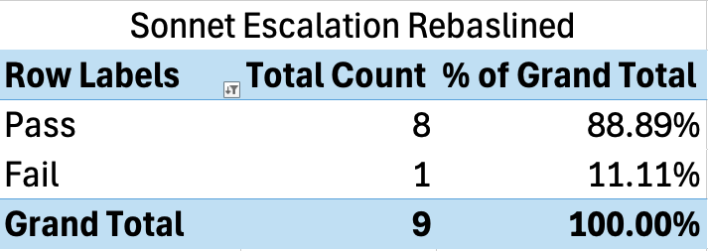
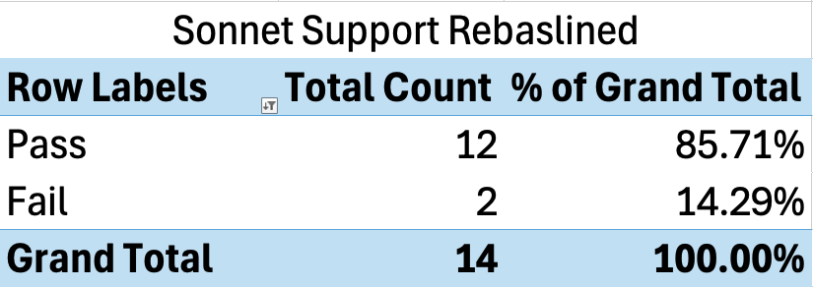
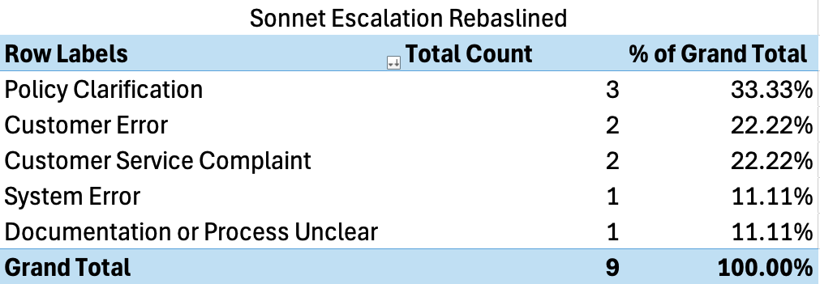
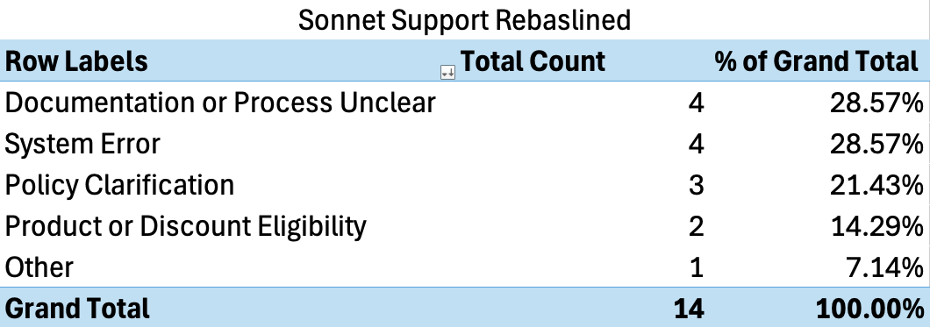
Sonnet Test Results
Notes:
After rebaselining test results, validated that majority of the identified test data results are grounded and valid.
The fail classes are usually ambiguous instances where it could be either one or the other from the test team data.

Slide 15
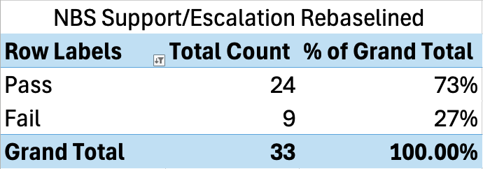
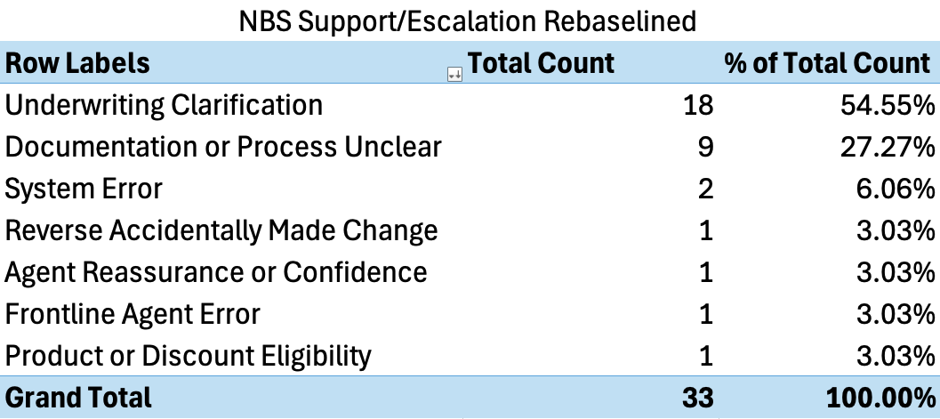
NBS Test Results
Notes:
Mirrors the larger set in terms of category distributions
9 cases are mostly ambiguous scenarios where both the prompt output and the test team rebaseline could equally match

