Slide 1


Nesto POC

Slide 2
Agenda
Goal
Process
Prompt
Dashboard
Keeping updated
Deliverables
Reports

Slide 3
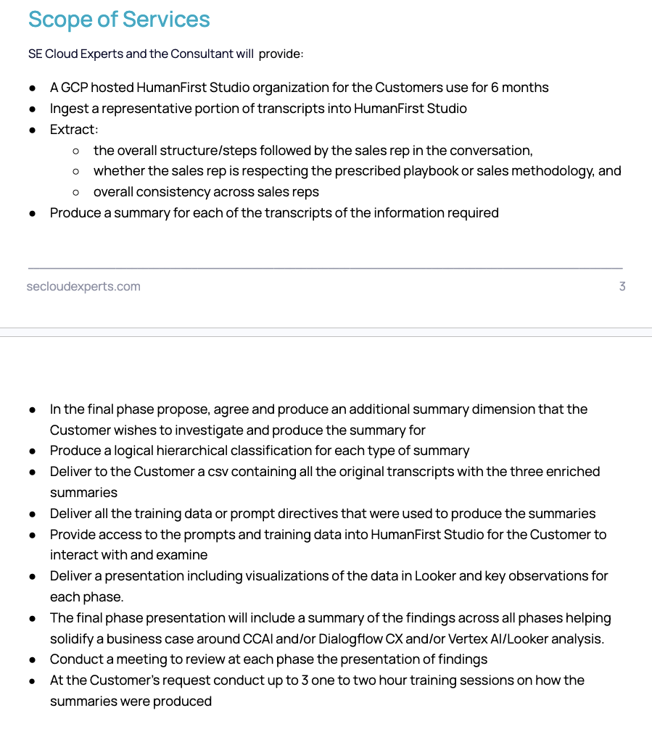
Goal
Understand and gain insight into how SDRs are performing in outbound sales calls
Focus was on CompareMortgages outbound campaigns
Score and measure adherence to the criteria outlined in the sales guidance document
Produce insights and push back to BQ for Looker dashboard on findings so that sales leaders are empowered to provide helpful coaching to SDRs

Slide 4











Process
Raw Audio Files of
SDR calls
Perform Transcription
Uploaded to HF to generate insights using
Vertex AI models
Inserted into separate BQ table
Looker Dashboard
Notes:
0D516305A6C641CAB2EE5FEAE1FB650E

Slide 5

Prompt
Agent Name
Did the Agent introduce themselves by name?
User (Customer) Name
Did the Agent greet the User by name?
Calling Organization
Did the Agent mention calling from CompareMortgages or MonMeilleurTaux explicitly?
Reason For Call
Did the Agent mention the reason for calling is regarding an inquiry started on the website?
SDR Call Guidance Prompt
Mortgage Need
Did the Agent understand the User's mortgage situation?
Mortgage Timeframe
Did the Agent verify the User's likely timeframe for getting a mortgage?
Transcribed Call Transcripts
Individual scores (0,1) per call per agent
Credit Score
Did the Agent ask the User whether they knew their credit score?
Next Steps
Did the Agent discuss or clearly communicate next steps at any point in the call?
Extracting the scoring, reasoning across 8 call guidance criteria
Notes:
0D516305A6C641CAB2EE5FEAE1FB650E

Slide 6
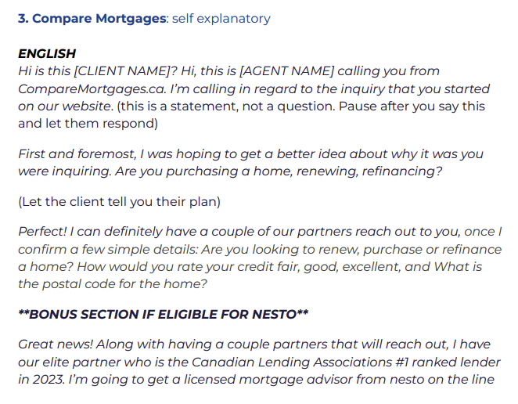
Prompt
Agent Name / Customer Name / Calling Organization / Reason For Calling
Mortgage Need / Mortgage Timeframe
Credit Score / Next Steps

Slide 7
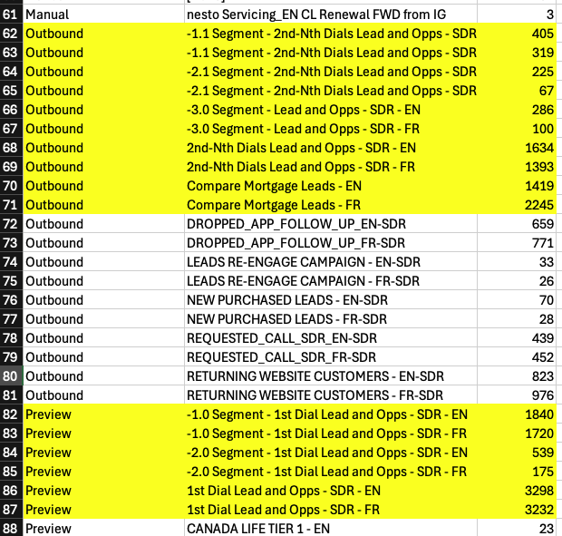
Call Campaigns
10 campaigns for Segments 1-3 with first and nth dials (EN/FR)
SDRs outbound: Segment 1 through3 EN/FR (6 campaigns), and Compre Mortgage EN/FR (10 campaigns).

Slide 8
Below is a phone conversation transcript between a "User" and a "Agent" of an online mortgage lending company in Canada called Nesto. The "Agent" in the transcription is Sales Development Representative making an outbound call to a customer or potential lead under the alias CompareMortgages or MonMeilleurTaux. The Agents's goal is to gather initial information and connect the client to a Nesto mortgage advisor that can provide an estimate on rates and next steps.
<conversation_transcript>
{{ conversation }}
</conversation_transcript>
Your job is to evaluate whether the Agent in the conversation correctly followed each of the pieces of outbound sales call guidance. Provide your reasoning with a key value of reasoning and give a value of only 0 or 1 for each of the following keys.
The call guidance is phrases as the key_value, then the key question to be answered, followed by additional guidance in brackets.
<call_guidance>
agent_name: Did the Agent introduce themselves by name?
user_name: Did the Agent greet the User by name?
calling_organization: Did the Agent mention calling from CompareMortgages or MonMeilleurTaux explicitly?
reason_for_call: Did the Agent mention the reason for calling is regarding an inquiry started on the website? (The agent must mention both the inquiry and how the User started their inquiry for instance online, web or website to be scored as 1)
mortgage_need: Did the Agent understand the User's mortgage situation? (The user mentioning or the agent inquiring their mortgage situation such as purchasing a home, looking for a new mortgage, renewing, refinancing is to be scored as 1)
mortgage_timeframe: Did the Agent verify the User's likely timeframe for getting a mortgage?
credit_score: Did the Agent ask the User whether they knew their credit score?
next_steps: Did the Agent discuss or clearly communicate next steps at any point in the call? (Setting up any follow up action such as a call back or a transfer is to be scored as a 1)
</call_guidance>
Give your answer as plain text without markdown in the following template:
agent_name_reasoning:
user_name_reasoning:
calling_organization_reasoning:
reason_for_call_reasoning:
mortgage_need_reasoning:
mortgage_timeframe_reasoning:
credit_score_reasoning:
next_steps_reasoning:
agent_name:
user_name:
calling_organization:
reason_for_call:
mortgage_need:
mortgage_timeframe:
credit_score:
next_steps:
Criteria | % Match with GT
Agent Name | 96%
User Name | 96%
Calling Organization | 94%
Reason For Call | 86%
Mortgage Need | 96%
Mortgage Timeframe | 86%
Credit Score | 90%
Next Steps | 88%
TOTAL AVERAGE | 91% accuracy
Prompt evaluation using random sample of 50 English Calls

Slide 9
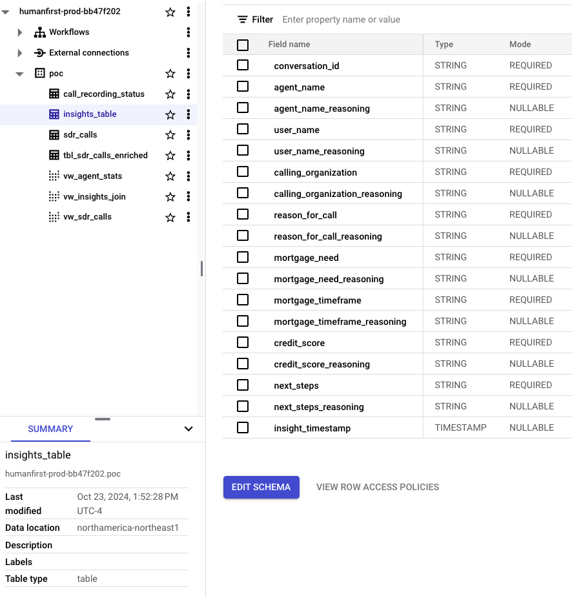
Dashboard
SELECT
sdr_calls.*,
insights.agent_name,
insights.user_name,
insights.calling_organization,
insights.reason_for_call,
insights.mortgage_need,
insights.mortgage_timeframe,
insights.credit_score,
insights.next_steps,
FROM `humanfirst-prod-bb47f202.poc.insights_table` as insights
LEFT JOIN `humanfirst-prod-bb47f202.poc.tbl_sdr_calls_enriched` as sdr_calls
ON insights.conversation_id = sdr_calls.call_id;

Slide 10
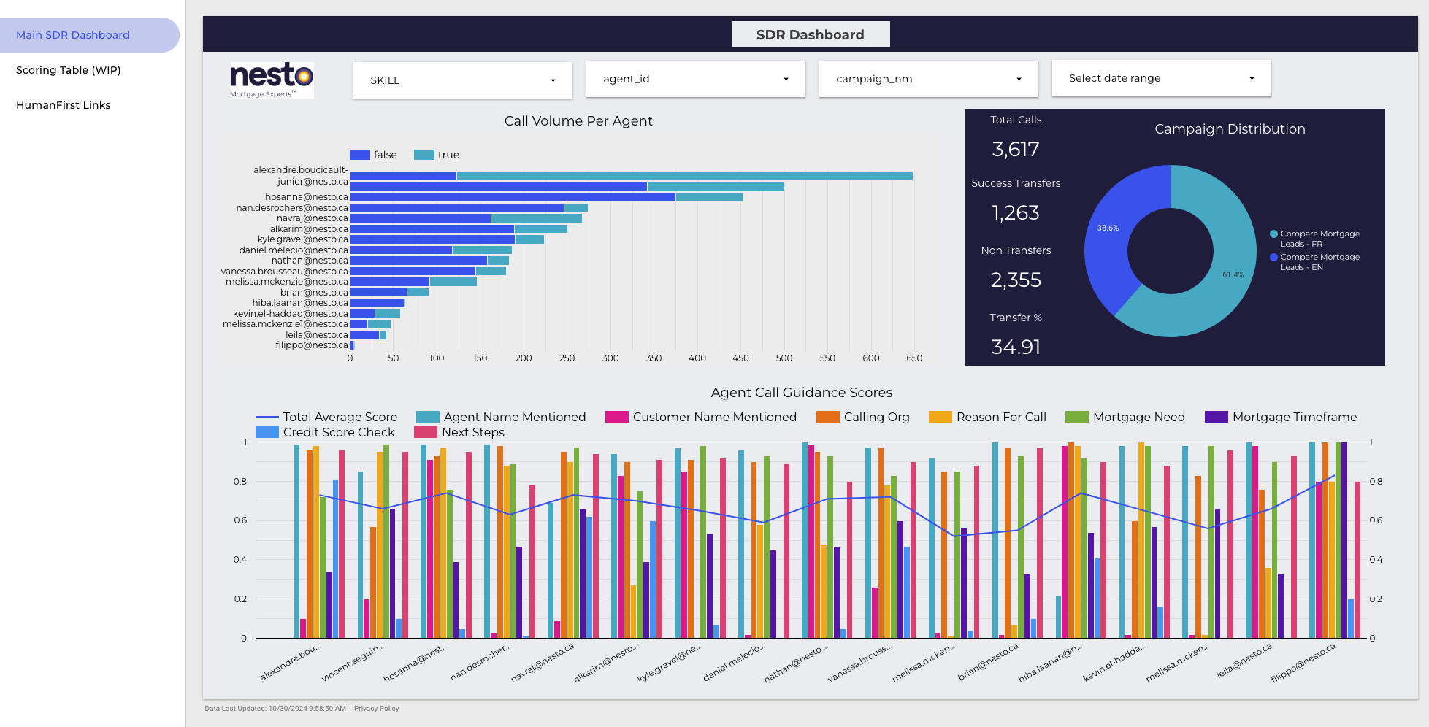
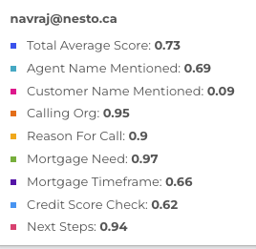
Dashboard
Example: Navraj is scoring well on all categories except Customer Name Mentioned
Hovering over the stats shows his lowest score.
LINK

Slide 11
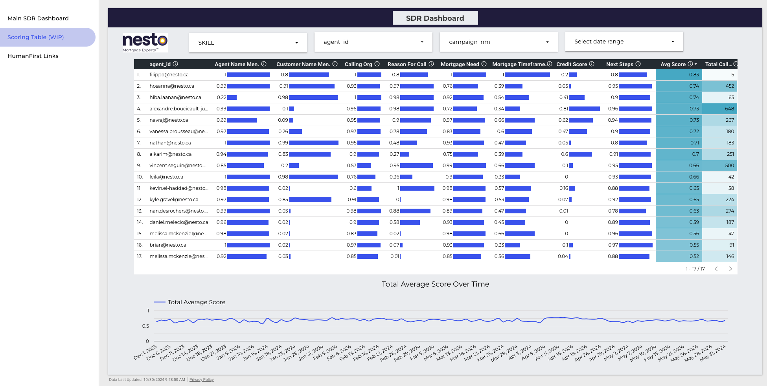
Dashboard
Visiting the scoring table its also clearly evident that its a clear point of improvement

Slide 12
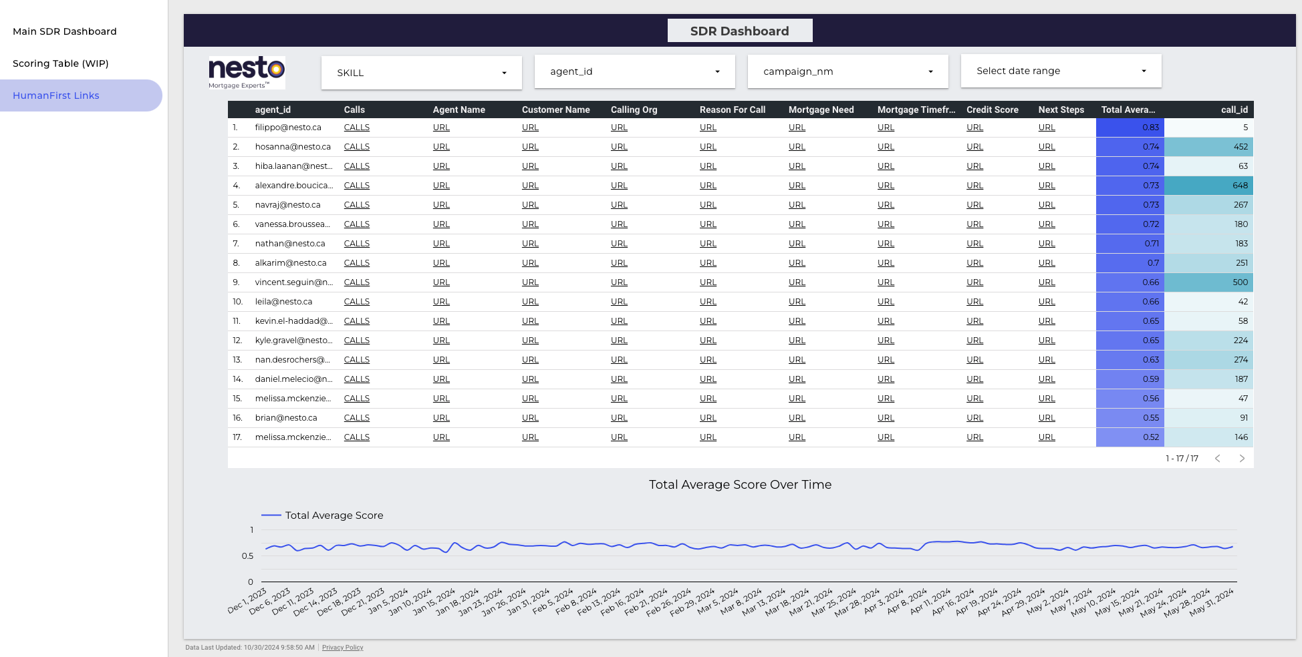
Dashboard
Clicking the Customer Name field URL for Navraj redirect immediately into HumanFirst

Slide 13
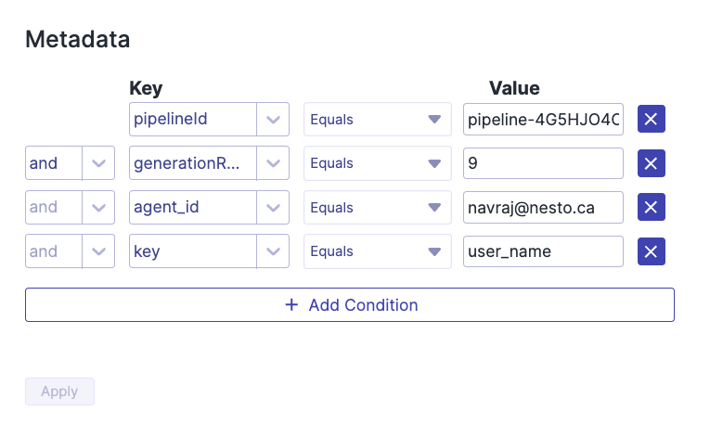
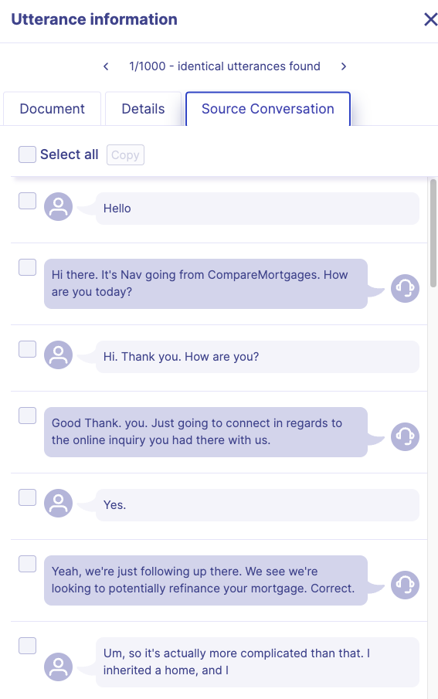
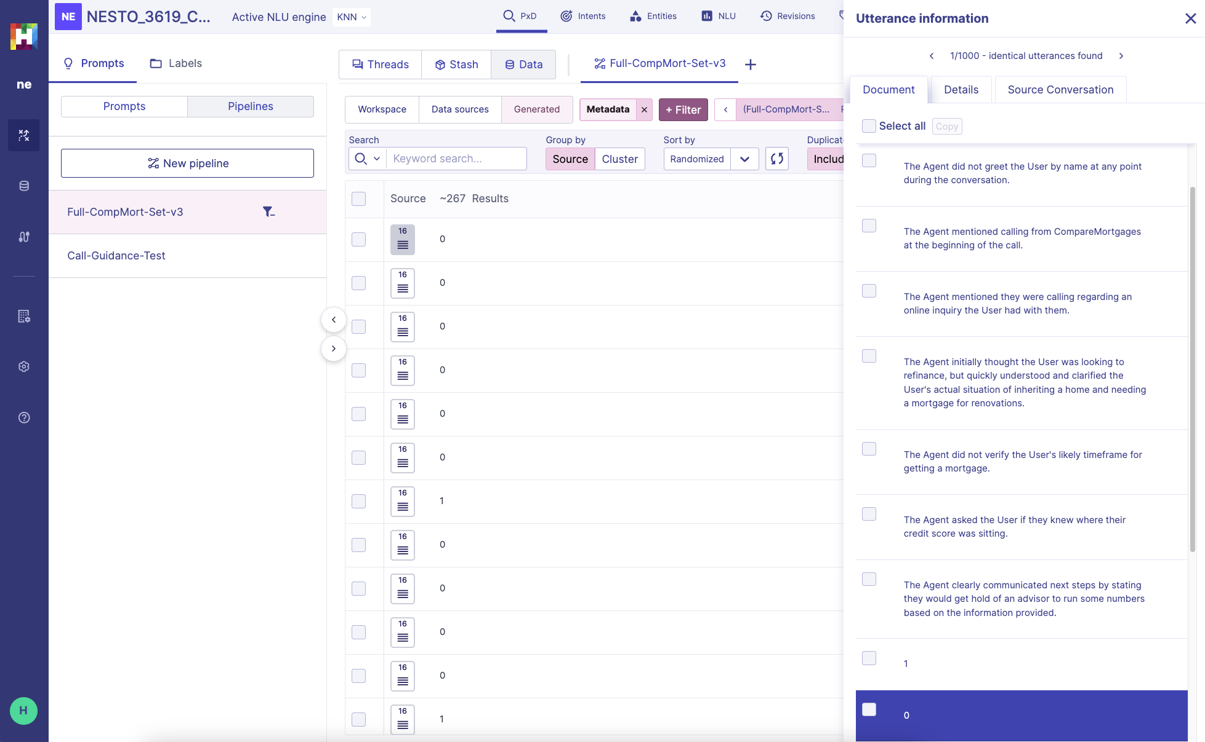
Dashboard
The URL auto filters on Navraj and that specific key. Each row is an individual call showing the current score for Customer Name

Slide 14
Keeping updated
Transcribe latest cadence of calls and convert to HF JSON
Python script for Speechmatics / HF JSON converter
Upload into HumanFirst conversation set
via API or via GUI
Trigger pipelines and upload to BQ
Python script using HF SDK to automate all this can be provided
Dashboards will auto refresh based on new data in the view

Slide 15
Deliverables
Deliverable | Status
Prompt to extract overall structure, adherence to sales playbook | DONE
Transcribe ~3.6K calls from CompareMortgages EN/FR Outbound campaigns with latest enrichment | DONE
Generate insights for calls using Vertex AI using HF (Claude Anthropic Sonnet 3.5) | DONE
Upload insights back to BigQuery dataset and create joined views | DONE
Build Looker Studio Dashboard | DONE

Slide 16
Reports
Based on the scores and reasoning provided, here's a guidance report for the current agent:
Agent Performance Report:
Strengths:
1. Consistently introducing yourself by name (10/12 calls)
2. Clearly stating you're calling from CompareMortgages (12/12 calls)
3. Generally understanding the user's mortgage situation (10/12 calls)
4. Frequently discussing next steps with the user (10/12 calls)
Areas for Improvement:
1. Greeting the user by name (only 1/12 calls)
2. Consistently verifying the user's mortgage timeframe (6/12 calls)
3. Consistently asking about the user's credit score (8/12 calls)
4. Always mentioning the reason for the call, including both the inquiry and how it was started (9/12 calls)
Guidance:
1. User Name: Make it a priority to greet the user by name. If you don't have the name initially, ask for it early in the call and use it throughout the conversation. This personalizes the interaction and builds rapport.
2. Mortgage Timeframe: Consistently verify the user's likely timeframe for getting a mortgage. This information is crucial for prioritizing leads and providing appropriate assistance. Make it a standard part of your call script.
3. Credit Score: Always ask about the user's credit score. This information is vital for assessing mortgage options. If you forget, make sure to circle back to this question before the call ends.
4. Reason for Call: Always clearly state the reason for your call, mentioning both the inquiry and how it was started (e.g., online, website). This reminds the user of their initial interest and establishes the context for the call.
5. Consistency: While you perform well in most areas, aim for consistency across all calls. Develop a checklist or script to ensure you cover all necessary points in each call.
6. Adaptability: Be prepared to adjust your approach if the user expresses disinterest. Instead of ending the call abruptly, try to understand their concerns or offer to provide information that might be useful in the future.
By focusing on these areas, you can improve the overall quality and effectiveness of your calls, potentially leading to better conversion rates and customer satisfaction.
Call 1 Scores
Merge Insight Call Guidance Report Prompt
Call 2 Scores
Call 3 Scores
Scores across multiple calls
Sample report for Navraj across 12 calls

Slide 17
Below is a set of scores for various criteria evaluating a SDR (Agent) of an online mortgage lending company in Canada called Nesto on call guidance. The "Agent" outbound call to a customer or potential lead under the alias CompareMortgages or MonMeilleurTaux.
<criteria>
agent_name: Did the Agent introduce themselves by name?
user_name: Did the Agent greet the User by name?
calling_organization: Did the Agent mention calling from CompareMortgages or MonMeilleurTaux explicitly?
reason_for_call: Did the Agent mention the reason for calling is regarding an inquiry started on the website? (The agent must mention both the inquiry and how the User started their inquiry for instance online, web or website to be scored as 1)
mortgage_need: Did the Agent understand the User's mortgage situation? (The user mentioning or the agent inquiring their mortgage situation such as purchasing a home, looking for a new mortgage, renewing, refinancing is to be scored as 1)
mortgage_timeframe: Did the Agent verify the User's likely timeframe for getting a mortgage?
credit_score: Did the Agent ask the User whether they knew their credit score?
next_steps: Did the Agent discuss or clearly communicate next steps at any point in the call? (Setting up any follow up action such as a call back or a transfer is to be scored as a 1)
</criteria>
The criteria below are in loaded in the following order:
next_steps_reasoning
credit_score_reasoning
mortgage_timeframe_reasoning
mortgage_need_reasoning
reason_for_call_reasoning
calling_organization_reasoning
user_name_reasoning
agent_name_reasoning
next_steps
credit_score
mortgage_timeframe
mortgage_need
reason_for_call
calling_organization
user_name
agent_name
<scores and reasoning>
{{ text }}
</scores and reasoning>
Produce a single report providing useful guidance for the current agent based on the scores above.

