Slide 1


SDR Script
Adherence 2

Slide 2
Updates
Tweaked prompt further
Now also including for MonMeilleurTaux (bestrates) for FR calls
Grading prompt loosened more for transcription errors
Fixed agent name transcription issues for most conversations
2 Attempts to fix mis-transcriptions:
Content Enrichment Set using Standard and Advanced transcription
Prompt Modified Set
Clickable URL field added to each call to immediately review the call
SDR successful transfer to advisor field now also included to map scores to tangible successful transfers

Slide 3
Updated Scoring

Slide 4
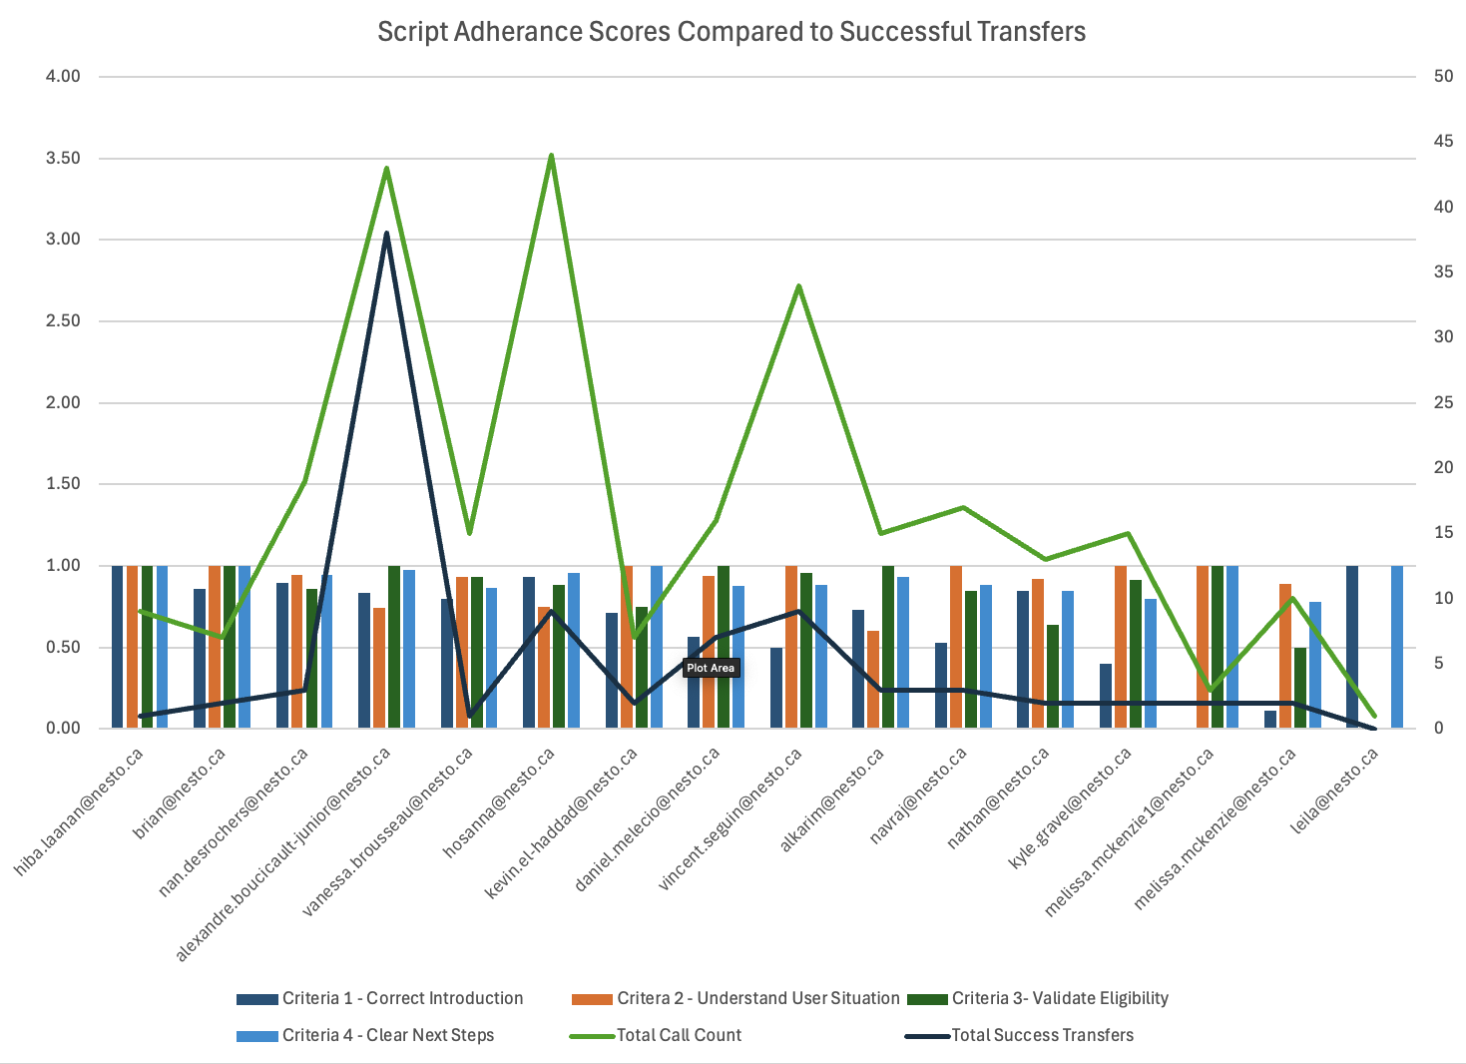
Advanced Transcripts

Slide 5
Hosanna for example has more dialled calls than Alexandre but hasn’t had nearly as much successful transfers.
Best agent performance is Alexandre with high script adherence scores and also the highest successful transfers given total calls.
Advanced Transcripts

Slide 6
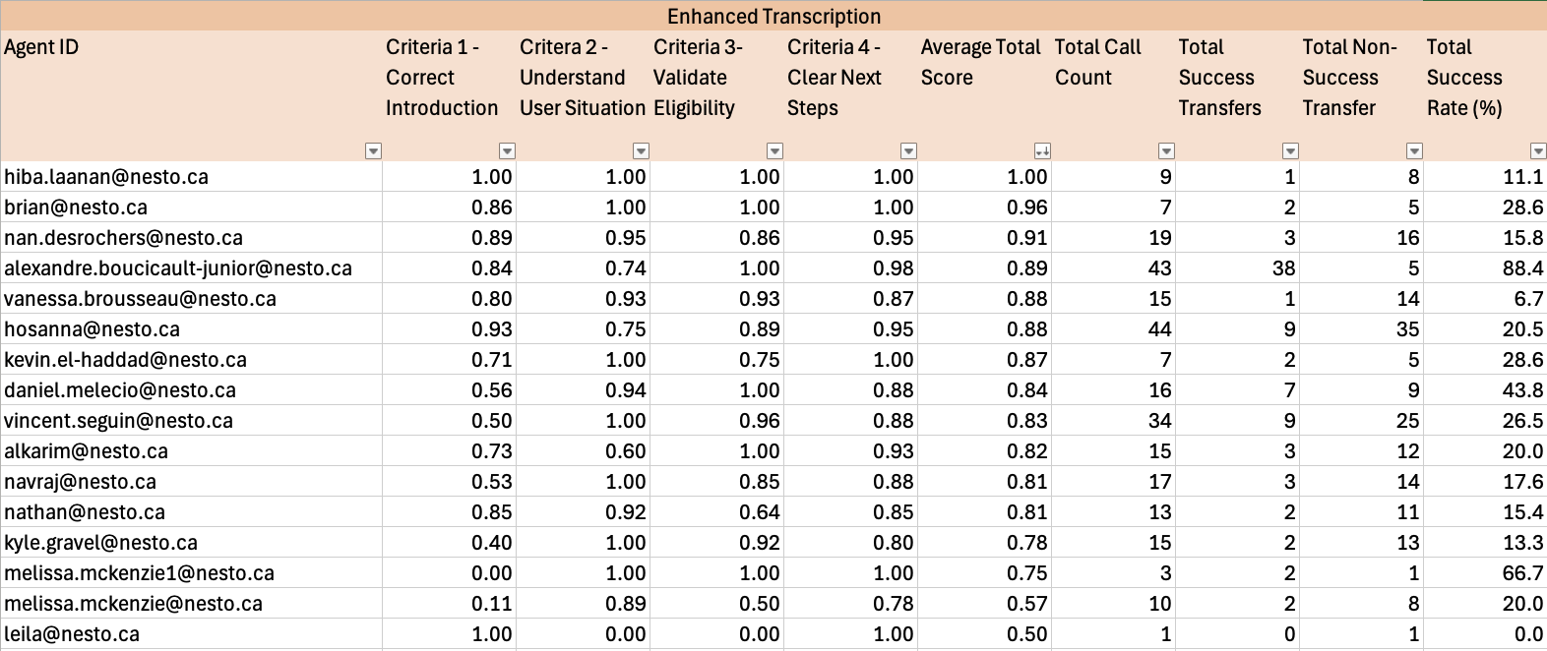
Average Agent Scores by Call Count
Averaged Across Agents - Sorted by Best Average Score
Advanced Transcription Dataset

Slide 7
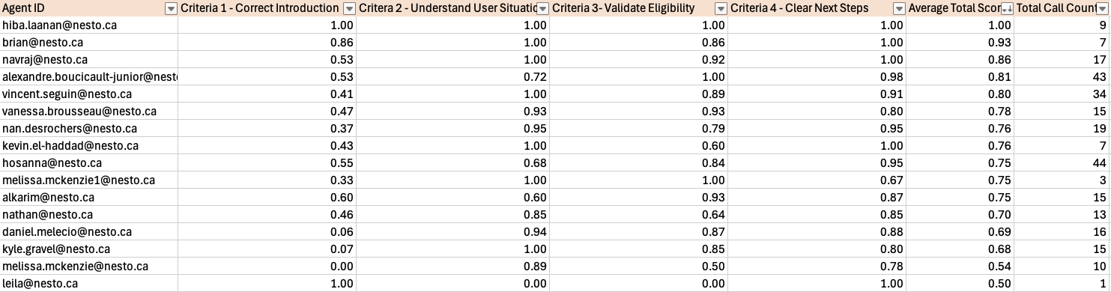

Average Agent Scores by Call Count
Big improvements in Correct Introduction scores with better transcription. Overall the average agent scores have increased as well.
Almost all agents with substantial calls are above the 80% avg score mark.

Slide 8
Transcription Improvements

Slide 9
Standard vs Advanced
Input all names of the agents in the content enrichment
Call ID | Standard | Advanced | Call Link
600000001961900 | mon nom Susanna, j'appelle de la part de mon meilleur taux K. Donc je fais le suivi de la demande que vous avez lancé sur notre site web. ….. | mon nom c'est Hosanna. J'appelle de la part de mon meilleur tout ca. Donc je fais le suivi de la demande que vous avez lancé sur notre site web. …. | LINK
700000000970021 | Hi there is now calling from Compare Mortgages. How are you today? | Hi, there is Nav calling from Compare Mortgage Leads. How are you today? | LINK
700000000962403 | Heather is now calling from Compare Mortgage Leads. How are you today? | Hi there. It's Nav calling from Compare Mortgage Leads. How are you today? | LINK
Notes:
“Leads" portion is due to wrong content enrichment – will be removed from data in the next run and updated tommorow

Slide 10
Call Quality Issues
Some introductions have poor quality or have unclear annunciated words which regardless of the transcription method it will not pick up
Overall majority of the clear audio files are transcribed correctly as seen by the scores
Call ID | Standard | Advanced | Call Link
600000001812333 | Others snap along with national mortgages. How are you today? | Hi there. It's namgoong with national mortgages. How are you today? | LINK
600000002090787 | Hi, there is Nathan from Compare Mortgage Leads How. are you today? | Hi there. It's Naquan from Compare Mortgage Leads. How are you today? | LINK

Slide 11
Prompt Improvement
To get around low quality audio or wrong transcription → Can “forcefully” use a prompt to correct mis-transcribed names
Downside is that this will forcefully correct name transcription regardless of what was in the actual audio
Call ID | Standard | Advanced | Prompt Fix | Call Link
600000001812333 | Others snap along with national mortgages. How are you today? | Hi there. It's namgoong with national mortgages. How are you today? | Nav here with National Mortgages. How are you today? | LINK
600000002090787 | Hi, there is Nathan from Compare Mortgage Leads How. are you today? | Hi there. It's Naquan from Compare Mortgage Leads. How are you today? | Hi. There is Nav from Compare Mortgages. How are you today? | LINK

Slide 12
Grading Prompt
French website MonMeilleurTaux (bestrates)
Attempts to read between the lines of mistranscriptions - especially common in French
Call ID | 600000001965315
Text | “Bonjour Anne-Marie, mon nom c'est Hosanna. J'appelle de la part de mon meilleur tout ca. Donc je fais le suivi de la demande que vous avez lancé sur notre site web.”
C1 - Score | 1
C1 - Reasoning | The agent introduced themselves and mentioned they were calling regarding a request made on the website. "Mon meilleur tout ca" is likely a mistranscription of "MonMeilleurTaux", which aligns with the expected introduction.
Call ID | 600000001900729
Text | “Bonjour, ici Vanessa de chez mon meilleur taux. K”
C1 - Score | 1
C1 - Reasoning | The agent introduced herself as Vanessa and mentioned she was calling regarding a request started on their website about refinancing. Although the company name is mistranscribed, it's likely a valid variation of "MonMeilleurTaux".

