Slide 1


Nesto Session 4

Slide 2
Updates
Simplified Script Adherence prompt to universal Nesto Call Guidance Prompt
8 clear criteria that can be used universally across Nesto campaigns and easily verified without ambiguity
Manual human evaluation results
Completed a manual eval across 50 English calls
3600 calls (CompareMortgages Campaign) processed and ready to be written into Insight tables

Slide 3

Call Guidance
Agent Name: Did the Agent introduce themselves by name?
User Name: Did the Agent greet the User by name?
Calling Organization: Did the Agent mention calling from CompareMortgages or MonMeilleurTaux explicitly?
Scores 0 or 1 for each key
Reasoning
Reason For Call: Did the Agent mention the reason for calling is regarding an inquiry started on the website?
Mortgage Need: Did the Agent understand the User's mortgage situation?
Mortgage Timeframe: Did the Agent verify the User's likely timeframe for getting a mortgage?
Credit Score: Did the Agent ask the User whether they knew their credit score?
Next Steps: Did the Agent discuss or clearly communicate next steps at any point in the call?

Slide 4
Prompt Evaluation
Criteria | % Match with GT
Agent Name | 96%
User Name | 96%
Calling Organization | 94%
Reason For Call | 86%
Mortgage Need | 96%
Mortgage Timeframe | 86%
Credit Score | 90%
Next Steps | 88%
TOTAL AVERAGE | 91% accuracy
Random sample of 50 English Calls

Slide 5
Timelines
Action | Timeline
Simplified prompt + test set annotated w/ manual evaluation | DONE
Run ~3.6K CompareMortgages EN/FR Outbound Campaigns transcription with latest enrichment on prompt | DONE
Verify other campaign guidance matches | Follow Up (Karim/Chase)
Get permissions to create, update, and load data to BQ + Looker Studio | Requested (Ata)
Build initial Looker Dashboard for CompareMortgages | TBD

Slide 6
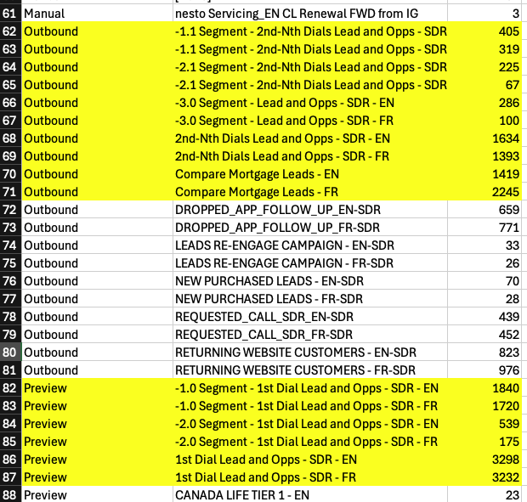
Campaigns
10 campaigns for Segments 1-3 with first and nth dials (EN/FR)
SDRs outbound: Segment 1 through3 EN/FR (6 campaigns), and Compre Mortgage EN/FR (10 campaigns).

Slide 7
Results

Slide 8
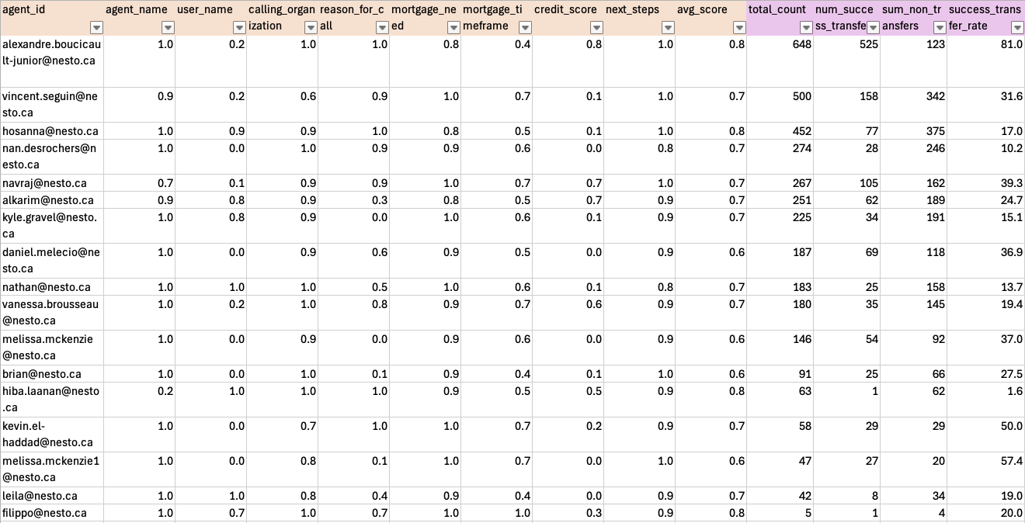

Slide 9
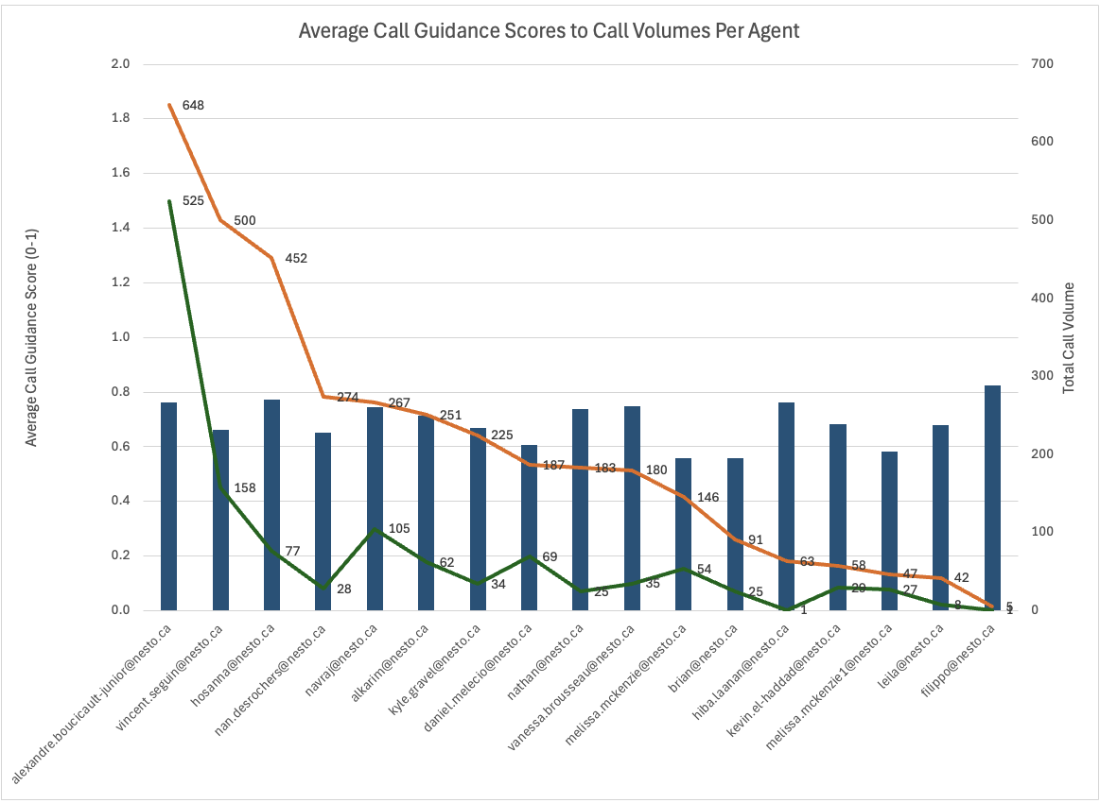

Slide 10
