Slide 1


Nesto
Hand-over

Slide 2
Agenda
Process
Tool walkthrough
Step 1 - Transcription
Step 2 - Uploading Data
Step 3 - Prompts & Pipelines
Step 4 - Inserting to BQ
Automation

Slide 3











Process
Raw Audio Files of
SDR calls
Perform Transcription
Uploaded to HF to generate insights using
Vertex AI models
Inserted into separate BQ table
Looker Dashboard

Slide 4
1 - Transcription
HumanFirst did transcription using Speechmatics.
Used HumanFirst Academy scripts to transcribe from a GCP bucket or local directory and convert to HumanFirst-compatible CSV.
Transcription Script.
To use the script, would need
Speechmatics API
Audio files either in GCP or stored locally
Converted Speechmatics transcriptions into HumanFirst CSV using this script
Can find other helpful speechmatics related scripts here.
If going with different transcription approach, then please ensure to have a timestamp per utterance, a role, the transcribed text, and a unique id (call_id) in the final dataset.

Slide 5
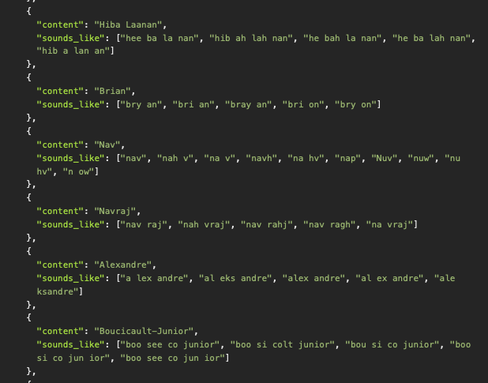
1 - Transcription
Content enrichment was added to ensure agent names, companies were correctly recognized to the transcription to avoid affecting scoring

Slide 6
2- Uploading Data
HumanFirst accepts conversations in either CSV or HF JSON. They must have:
conversation_id (ex call_id for Nesto)
text (column containing the actual text being spoken)
timestamp (support timestamps below)
role (2 unique roles ex: client and expert)
https://docs.humanfirst.ai/docs/data-management/uploading-data/conversations/
Head to Data Management → Click on Create Dataset → Rename to the current call time frame being ingested (calls_01/01/2024-03/01/2024)
Click the “+” icon and upload the dataset
Match the corresponding roles if uploading a CSV file

Slide 7
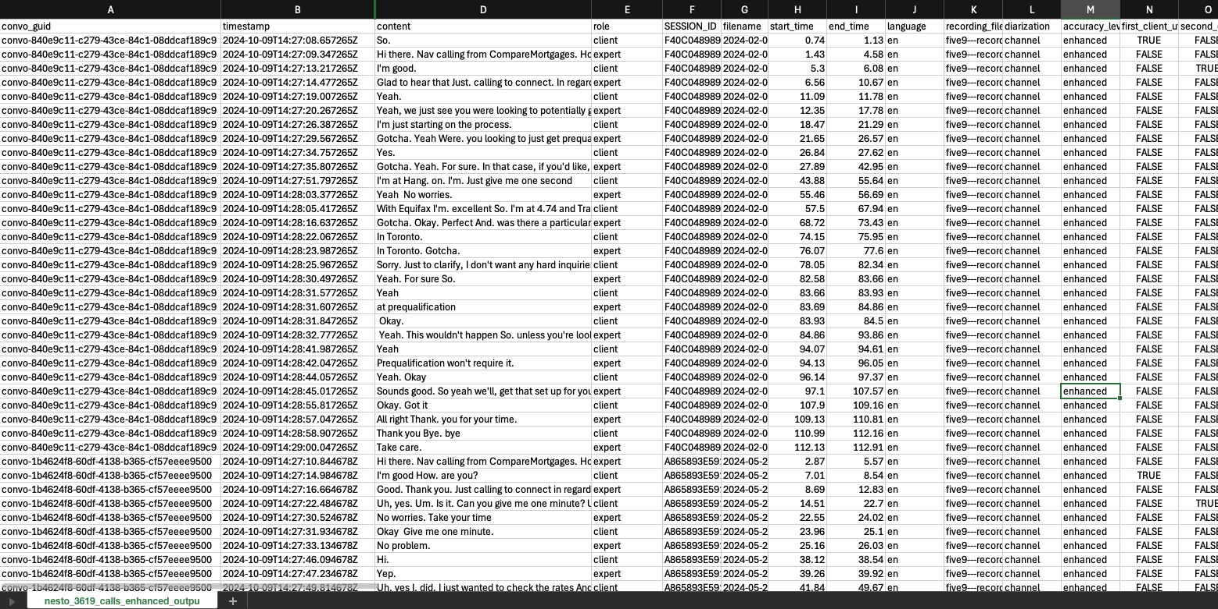
2- Uploading Data

Slide 8
3- Prompts / Pipelines
Create a new workspace or open an existing one
Link the dataset to the workspace. (Data Actions → Add Data → Re-use Existing Data → Select the conversation set)
Click on the Pipelines tab and trigger the pipeline
Wait for pipeline to complete and filter on the output
Export the JSON file with the following settings:
No Group By Selected
Include Duplicates

Slide 9

Prompt
Agent Name
Did the Agent introduce themselves by name?
User (Customer) Name
Did the Agent greet the User by name?
Calling Organization
Did the Agent mention calling from CompareMortgages or MonMeilleurTaux explicitly?
Reason For Call
Did the Agent mention the reason for calling is regarding an inquiry started on the website?
SDR Call Guidance Prompt
Mortgage Need
Did the Agent understand the User's mortgage situation?
Mortgage Timeframe
Did the Agent verify the User's likely timeframe for getting a mortgage?
Transcribed Call Transcripts
Individual scores (0,1) per call per agent
Credit Score
Did the Agent ask the User whether they knew their credit score?
Next Steps
Did the Agent discuss or clearly communicate next steps at any point in the call?
Extracting the scoring, reasoning across 8 call guidance criteria
Notes:
0D516305A6C641CAB2EE5FEAE1FB650E

Slide 10
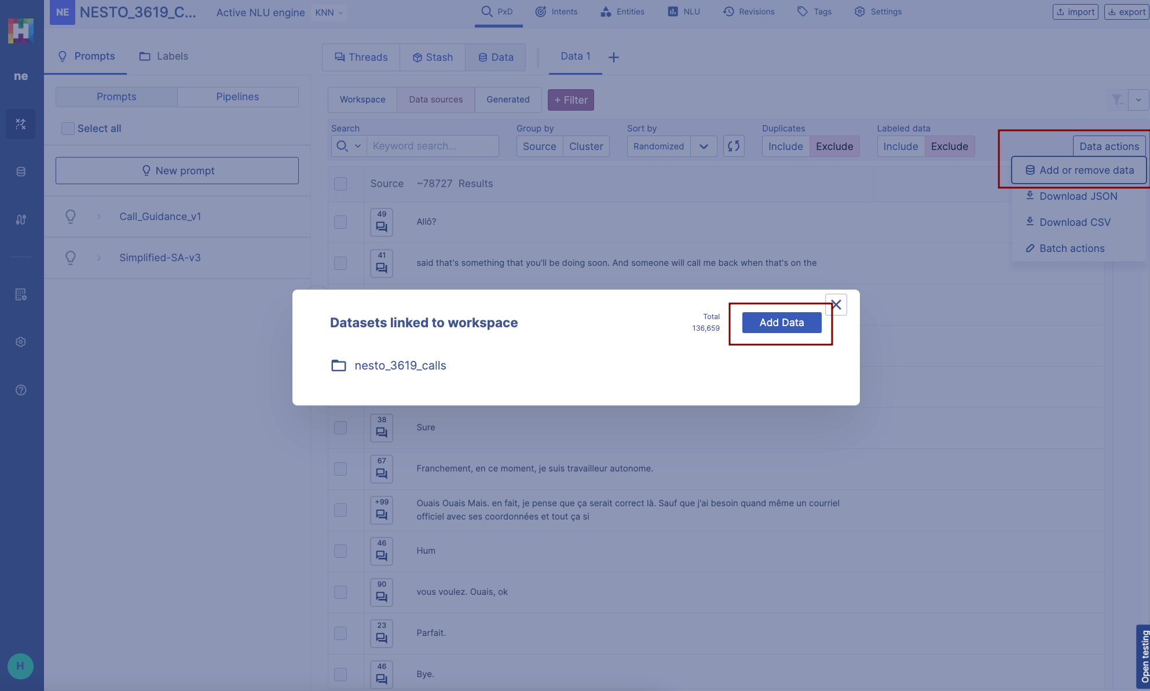
3- Prompts / Pipelines

Slide 11
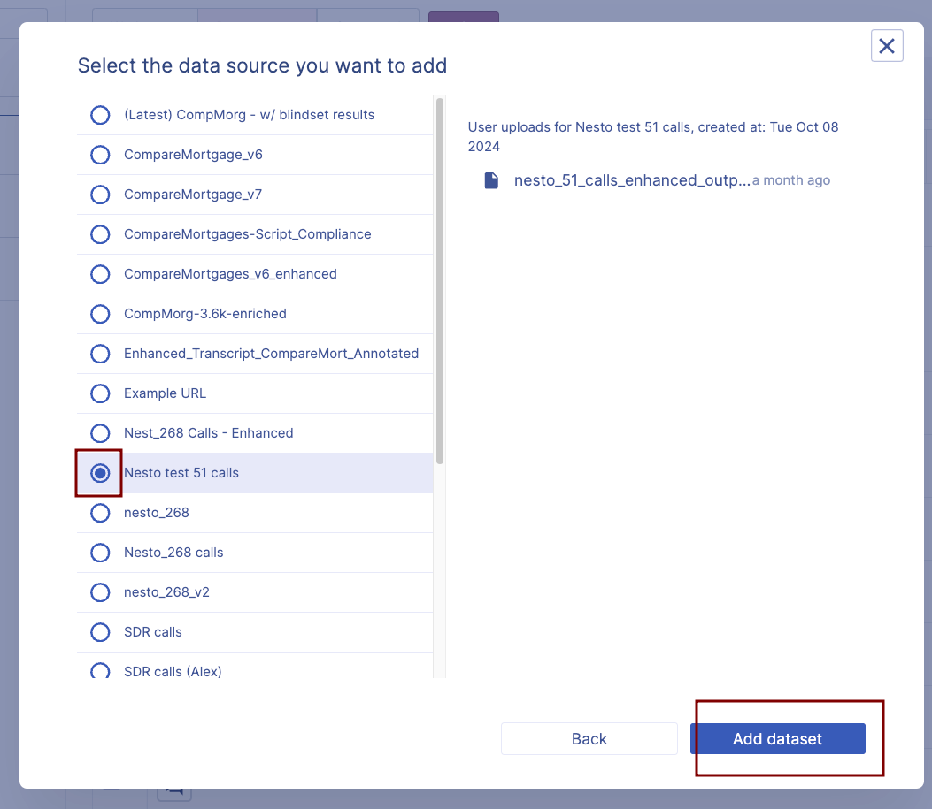
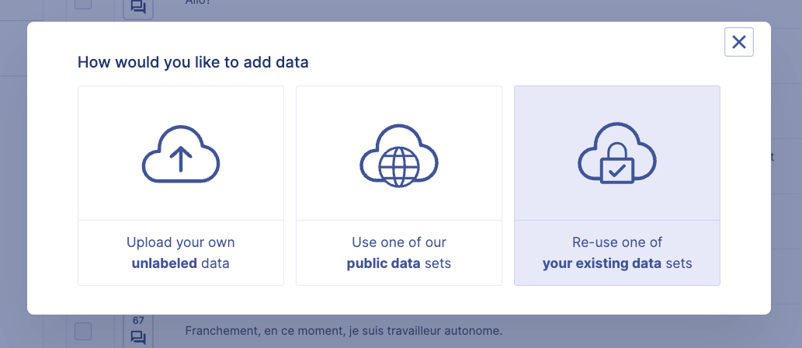
3- Prompts / Pipelines

Slide 12
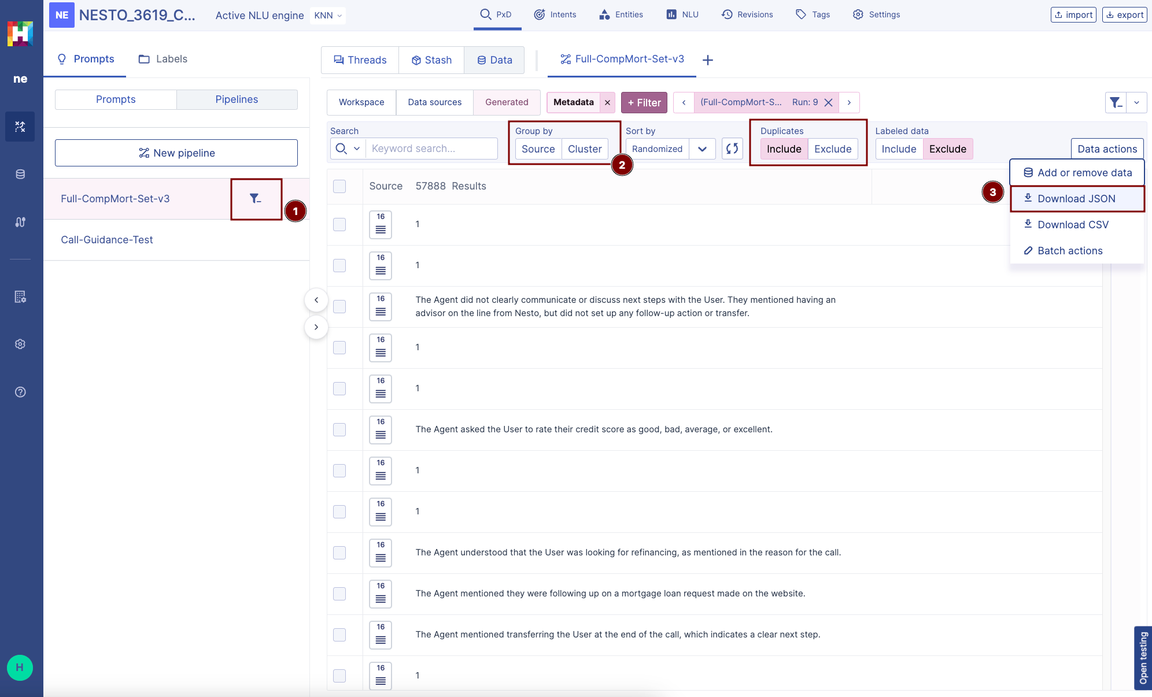
3- Prompts / Pipelines

Slide 13
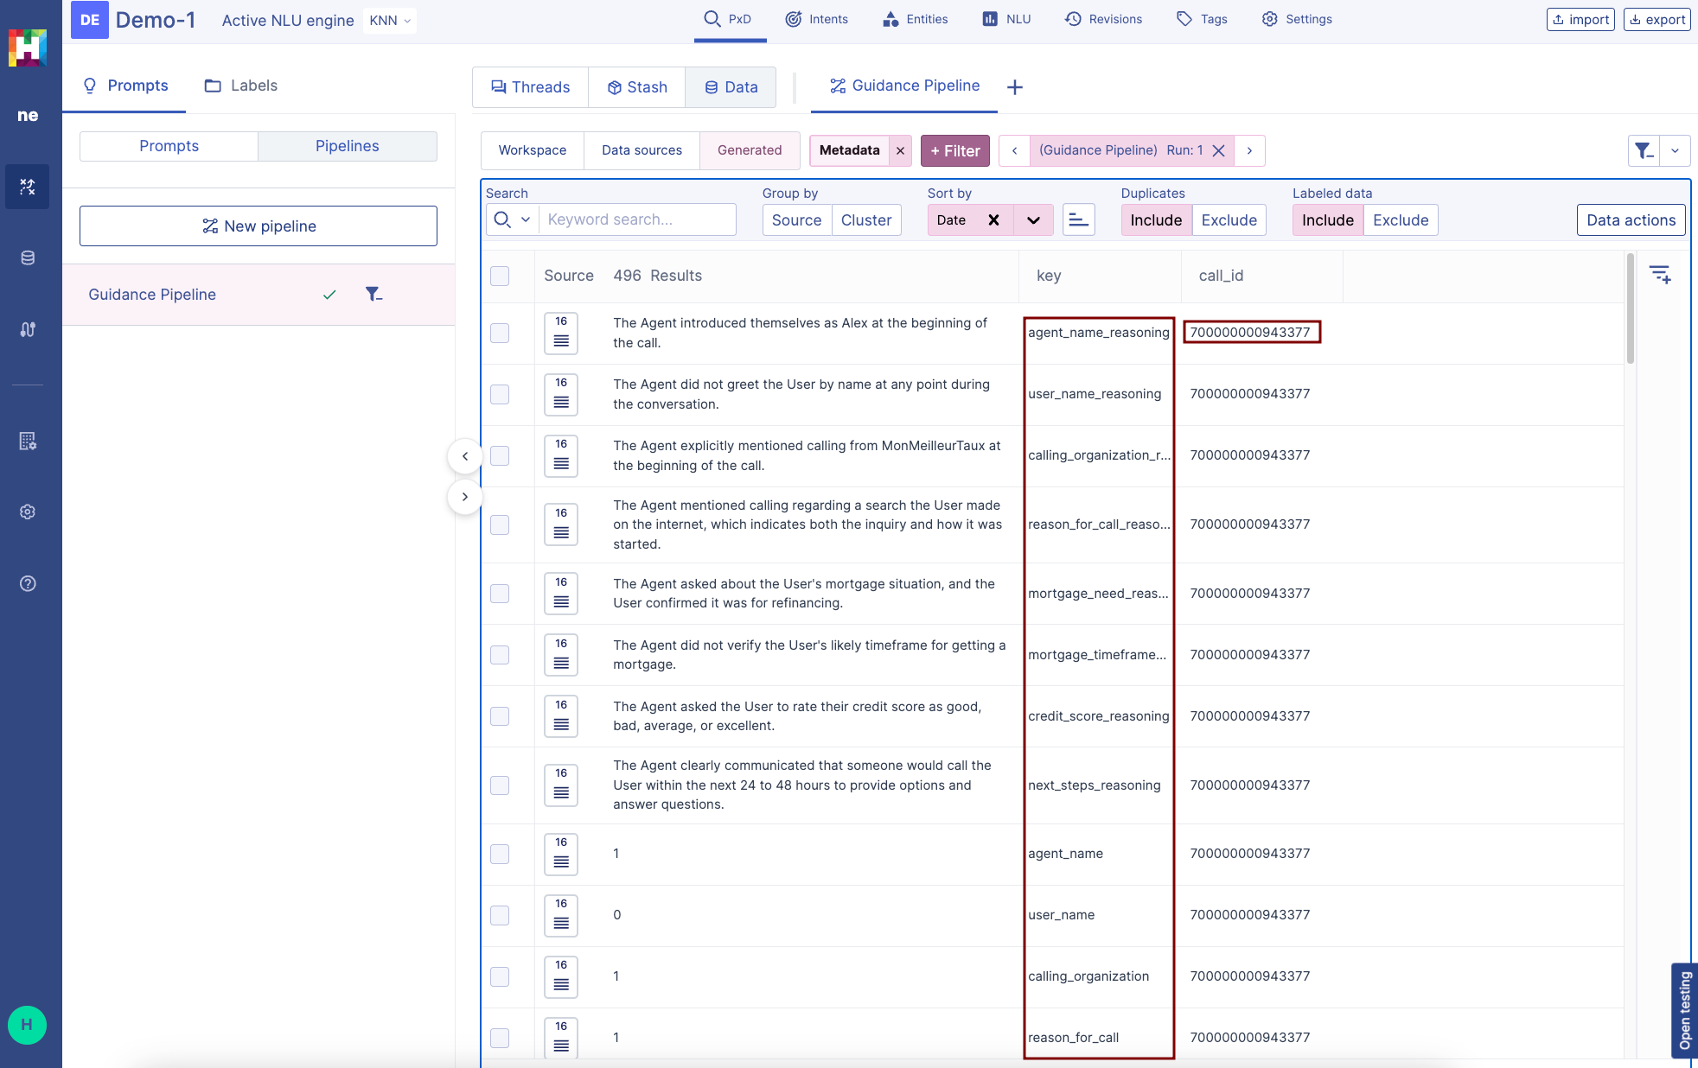
3- Prompts / Pipelines

Slide 14
4- Pushing to BQ (Script)
Go to HumanFirst and Filter by Pipeline output
Data Actions -> Download as JSON
Download the JSON file and ensure the file is complete
Download the script files (here)
Create a python venv and install requirements.txt
Copy the JSON file to pipeline_downloads folder
Edit the input variables in the main.py file
Ensure authentication either via Service Account Key Credentials (.env) or authentication locally via gcloud CLI is setup with access to insert/create/read data from BQ
Run script
Data Pipeline Results to BigQuery Walkthrough 📊 - Watch Video

Slide 15
4- Pushing to BQ (Script)
Script will:
Read the HF JSON file
Pivot the outputs on the specified column (call_id)
Create / Use Existing Table on BQ
Extract & verify the relevant required and optional columns
Delete any existing call_id’s in the BQ table that are in the current dataframe to ensure no duplicates
Append pivoted DataFrame into BQ table using BQ Python SDK
Data Pipeline Results to BigQuery Walkthrough 📊 - Watch Video

Slide 16
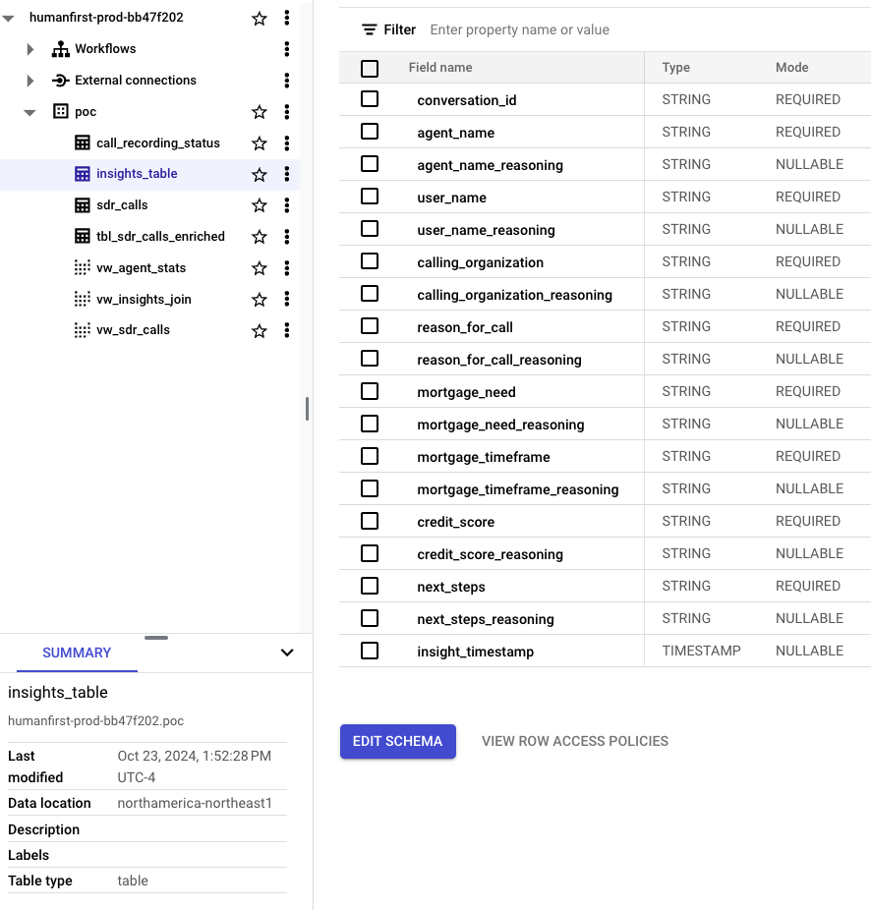
4- Pushing to BQ (Script)
SELECT
sdr_calls.*,
insights.agent_name,
insights.user_name,
insights.calling_organization,
insights.reason_for_call,
insights.mortgage_need,
insights.mortgage_timeframe,
insights.credit_score,
insights.next_steps,
FROM `humanfirst-prod-bb47f202.poc.insights_table` as insights
LEFT JOIN `humanfirst-prod-bb47f202.poc.tbl_sdr_calls_enriched` as sdr_calls
ON insights.conversation_id = sdr_calls.call_id;

Slide 17
Automation
HumanFirst supports HTTP API’s where all major actions in the flow can be automated
Note for Nesto being “on-prem” the API endpoint needs to be configured differently and is not the same API endpoint as found in the docs. (will follow up with steps on how to expose this on-prem)
https://docs.humanfirst.ai/docs/api/
Python based SDK that is a wrapper around the HTTP API’s
https://pypi.org/project/humanfirst/
Airflow SDK Example WIP

