Slide 1


SDR Script
Adherence

Slide 2
Agenda
Recap status goals
Overview of Compare Mortgages outbound call guidance compliance
Detailed coaching examples on compliance for
Melissa - a “room for improvement”
Navraj - higher performance - still things could tweak.
Optional deep dive on method

Slide 3
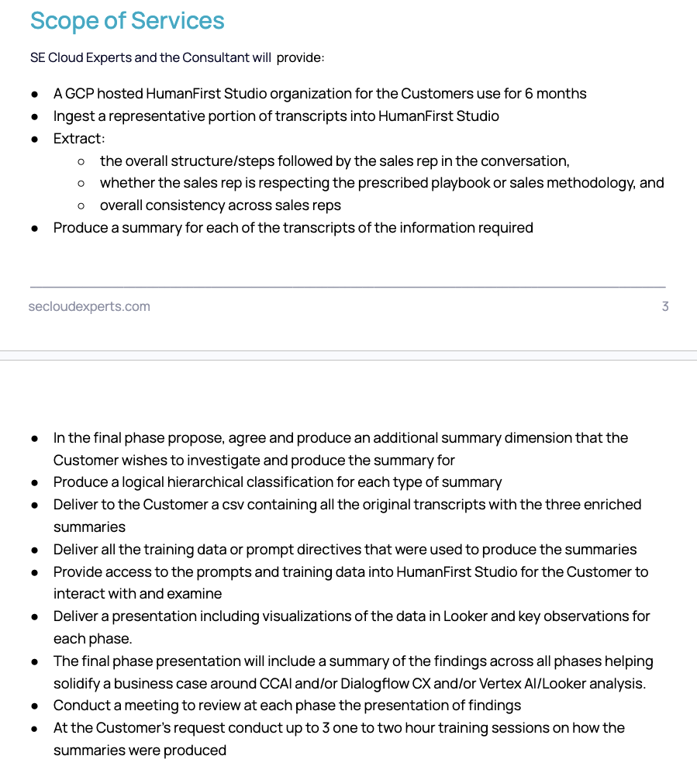
Status
3
days in with data and model
Deep dive into findings around consistency to prescribed playbook.

Slide 4
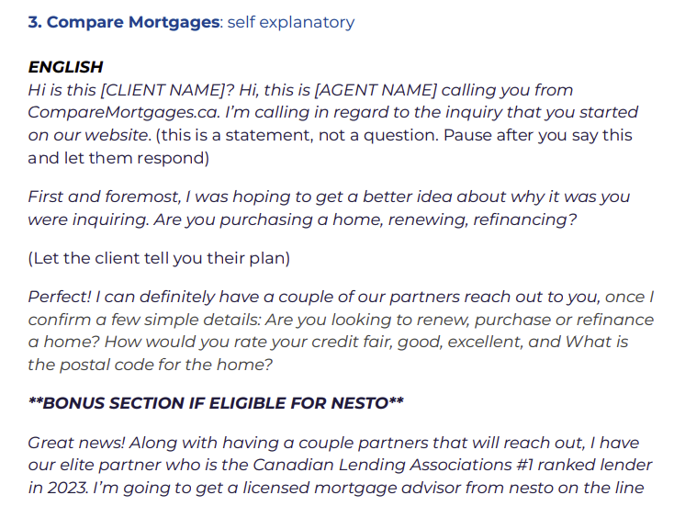
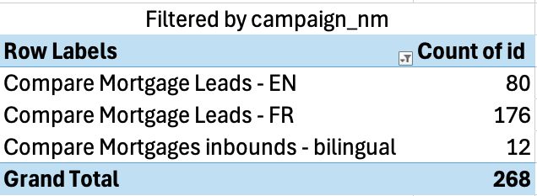
Overview
Focused on Compare Mortgages campaign calls
Prompt is trying to evaluate and score how best an SDR adheres to the outlined script per conversation
Total of 268 calls across EN / FR with majority in French

Slide 5
How well are they…
Giving the correct specified introduction.
Understanding the user Situation
Validating the user’s eligibility
Confirmining clear next steps with the prescribed eminence emphasis

Slide 6
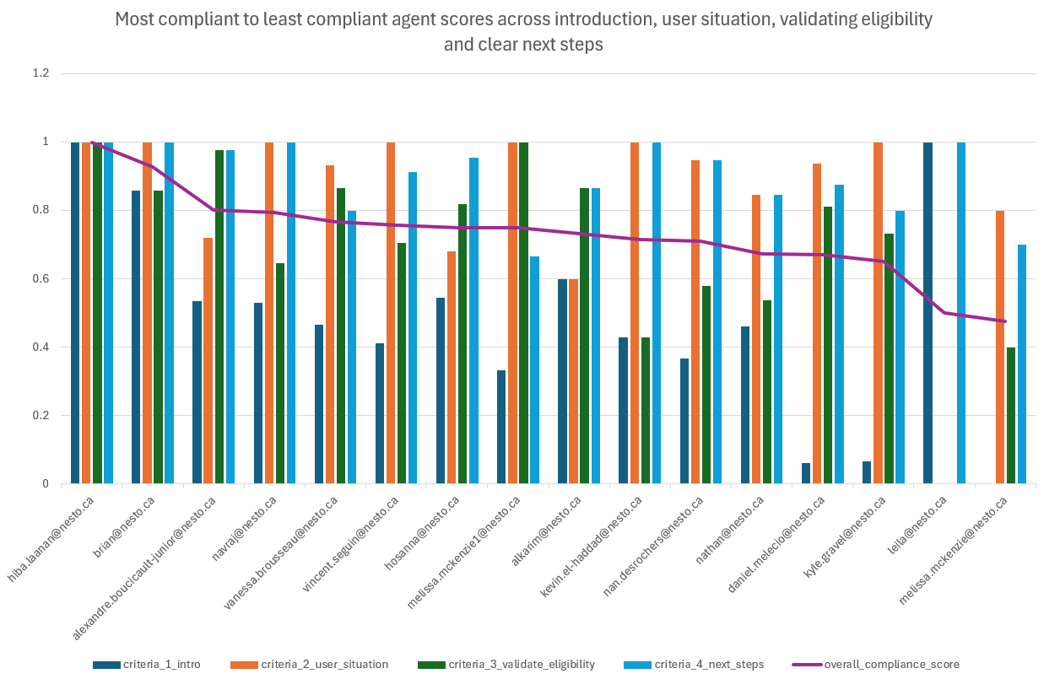
Across 268 calls

Slide 7
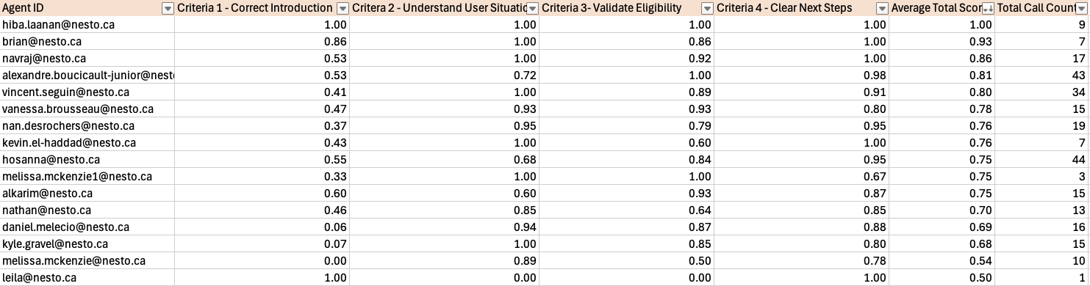
Average Agent Scores by Call Count
Averaged Across Agents - Sorted by Best Average Score

Slide 8
Example - Room to improve

Slide 9
Across 268 calls

Slide 10
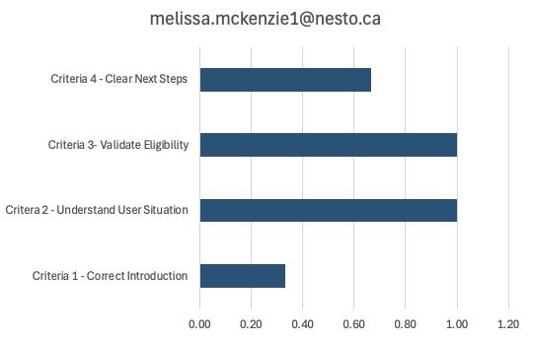
Personalised Report
Total Calls: 3 calls
Scoring perfect in C2 and C3
Room for improvement in C1 and C4
melissa.mckenzie1@nesto.ca
call_id=600000001845604.0
FILTERED LINK
Notes:
3 calls (melissa.mckenzie1@nesto.ca)
Scoring perfect on all 3 calls for Criteria 2 (Understand User Situation) and Criteria 3 (Validate Eligibility)
Didn’t set the context this was a call regarding an inquiry started on the website

Slide 11
Melissa Report
Overall Performance
Melissa demonstrates a mixed performance across her calls. While she shows strengths in understanding user situations and validating eligibility, there are significant areas for improvement, particularly in her introduction and emphasis on Nesto's credentials.
1. Improve Introduction and Call Context:
• Current: "Hi there. This is Melissa from Compare Mortgages. Are you looking at getting some different mortgage rates?"
• Recommended: "Hello, this is Melissa calling from CompareMortgages.ca regarding the inquiry you started on our website about getting different mortgage rates. Is this a good time to talk?"
- Always mention CompareMortgages.ca and reference the website inquiry to establish context and credibility.
2. Emphasize Nesto's Credentials:
• Current: "Can you just hold the line I'll? get you right over to one of our best agents. Okay?"
• Recommended: "I'll now transfer you to one of our expert Nesto mortgage advisors. Nesto is our trusted partner known for their competitive rates and excellent service. They'll provide you with personalized advice and the best available rates."
- Consistently highlight Nesto's expertise and partnership to build trust and set expectations.
Strengths
1. Effectively allows users to explain their situations
2. Asks relevant questions to validate eligibility
3. Provides clear next steps for most calls
Areas for Improvement
1. Consistent and proper introduction
2. Setting the context of the call by mentioning the website inquiry
3. Emphasizing Nesto's credentials and partnership
4. Clearer explanation of the transfer process to Nesto advisors
3. Clarify the Transfer Process:
• Current: "So just hold the line I'll get you right over to an agent, and then I'll have another lender get Ahold of you. Okay?"
• Recommended: "I'll now transfer you to a Nesto mortgage advisor who will provide you with a detailed estimate and discuss next steps. Additionally, another advisor will reach out to you soon, allowing you to compare options and ensure you get the best rate. Is that okay with you?"
- Clearly explain the two-step process (immediate transfer and follow-up call) to set proper expectations and highlight the benefit of multiple options.
Notes:
Run: 19

Slide 12
Melissa Coaching Tips
Total Calls: 3 calls
Scoring perfect in C2 and C3
Room for improvement in C1 and C4
Correct Actions | Allowed user to explain their situation, asked relevant questions to validate eligibility
Incorrect Actions | Improper introduction, failed to set context for the call, did not emphasize Nesto's credentials or explain next steps clearly
melissa.mckenzie1@nesto.ca
call_id=600000001845604.0
FILTERED LINK
Notes:
3 calls (melissa.mckenzie1@nesto.ca)
Scoring perfect on all 3 calls for Criteria 2 (Understand User Situation) and Criteria 3 (Validate Eligibility)
Didn’t set the context this was a call regarding an inquiry started on the website

Slide 13
Melissa Coaching Tips
Total Calls: 3 calls
Scoring perfect in C2 and C3
Room for improvement in C1 and C4
C1 - Score | 0
C1 - Reasoning | The agent did not properly introduce themselves or set the context of the call. They did not mention that the call was regarding an inquiry started on the website, which is a key part of the expected introduction.
C1 - Snippet | “Hi there. This is Melissa from Compare Mortgages. Are you looking at getting some different mortgage rates?”
Expectation (per script) | “Hi is this [CLIENT NAME]? Hi, this is [AGENT NAME] calling you from CompareMortgages.ca. I’m calling in regard to the inquiry that you started on our website.”
melissa.mckenzie1@nesto.ca
call_id=600000001845604.0
FILTERED LINK
Notes:
Didn’t set the context this was a call regarding an inquiry started on the website

Slide 14
Melissa Coaching Tips
Total Calls: 3 calls
Scoring perfect in C2 and C3
Room for improvement in C1 and C4
C4 - Score | 0
C4 - Reasoning | The agent failed to emphasize credentials or mention that a partner or mortgage advisor from Nesto would be helping. They simply mentioned transferring to "one of our best agents" without providing context about Nesto or its credentials.
C4 - Snippet | “Gotcha. Okay perfect,. And those are all the questions I have for you. Can you just hold the line I'll? get you right over to one of our best agents. Okay?”
Expectation (per script) | “Great news! Along with having a couple partners that will reach out, I have our elite partner who is the Canadian Lending Associations #1 ranked lender in 2023. I’m going to get a licensed mortgage advisor from nesto on the line for you right now, can you bear with me a moment?”
melissa.mckenzie1@nesto.ca
call_id=600000001845604.0
FILTERED LINK
Notes:
Emphasize Nesto credentials

Slide 15
Example - Higher performer (English)

Slide 16
Across 268 calls

Slide 17
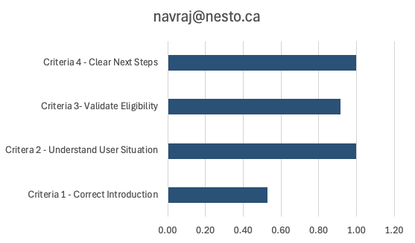
Personalised Chart
Total Calls: 17 calls
Overall High Scorer
Room for improvement in C1
navraj@nesto.ca
call_id=700000000962403.0
FILTERED LINK

Slide 18
Navraj Report
Overall Performance
Navraj demonstrates a moderate level of competence in handling customer calls. While they show strengths in certain areas, there are significant opportunities for improvement, particularly in the initial introduction and consistently following the prescribed script.
1. Improve Introduction:
• Current: "Hi there is now calling from Compare mortgages. Are you today?"
• Recommended: "Hello, this is [Your Name] calling from CompareMortgages.ca. How are you today? I'm reaching out regarding the online inquiry you submitted on our website."
• Always clearly state your name, the company name (CompareMortgages.ca), and the reason for the call (online inquiry)
• Practice the introduction until it becomes natural and consistent across all calls
2. Emphasize Nesto's Credentials:
• Current: Often fails to mention Nesto's credentials or unique selling points
• Recommended: "We're partnered with Nesto, Canada's top-ranked online mortgage lender, to provide you with the best possible rates and service."
• Incorporate this information early in the call to establish credibility and differentiate from competitors
• Highlight Nesto's benefits when discussing next steps or transferring to a mortgage advisor
Strengths
1. Generally good at attempting to understand the user's situation
2. Often provides clear next steps for customers
3. Demonstrates flexibility in adapting to different customer circumstances
Areas for Improvement
1. Inconsistent and often unclear introductions
2. Lack of emphasis on Nesto's credentials and unique selling points
3. Inconsistent approach to eligibility validation
4. Failure to consistently mention the website inquiry that prompted the call
3. Clarify Next Steps:
• Current: "So yeah, we'll have our partner reach out. They usually take about two business days."
• Recommended: "Our Nesto mortgage advisor will reach out to you within two business days. They'll provide detailed quotes, answer any questions you have, and guide you through the next steps in the mortgage process. Is there a preferred time or method for them to contact you?"
• Be specific about who will contact the customer (Nesto advisor), what they'll provide (quotes, information), and when (within two business days)
• Offer to set a specific appointment time if possible to increase the likelihood of successful follow-up
Notes:
Run: 20

Slide 19
Navraj Coaching Tips
Total Calls: 17 calls
Overall High Scorer
Room for improvement in C1
Correct Actions | Introduced self and purpose of call, allowed user to explain situation, validated eligibility with multiple questions, provided clear next steps
Incorrect Actions | None apparent
navraj@nesto.ca
call_id=700000000962403.0
FILTERED LINK

Slide 20
Navraj Coaching Tips
Total Calls: 17 calls
Overall High Scorer
Room for improvement in C1
C1 - Score | 1
C1 - Reasoning | The agent introduced herself as calling from Compare Mortgages and mentioned the call was regarding an online inquiry. Although the introduction wasn't verbatim, it contained the essential elements.
C1 - Snippet | Heather is now calling from Compare Mortgages. How are you today?, Just calling to connect in regards to an online inquiry you had there with us.
Expectation (per script) | “Hi is this [CLIENT NAME]? Hi, this is [AGENT NAME] calling you from CompareMortgages.ca. I’m calling in regard to the inquiry that you started on our website.”
navraj@nesto.ca
call_id=700000000962403.0
FILTERED LINK

Slide 21
Navraj Coaching Tips
Total Calls: 17 calls
Overall High Scorer
Room for improvement in C1
C2 - Score | 1
C2 - Reasoning | The agent allowed the user to explain their situation and asked follow-up questions to understand better. The agent confirmed the user's renewal date and property details.
C2 - Snippet | Yeah, I have to redo my mortgage but, um, I haven't shopped around for rates, so I was just looking online to see if I could get any information., Yeah. For sure. Do you know when your renewal is coming up there?
Expectation (per script) | First and foremost, I was hoping to get a better idea about why it was you were inquiring. Are you purchasing a home, renewing, refinancing? (Let the client tell you their plan)
navraj@nesto.ca
call_id=700000000962403.0
FILTERED LINK

Slide 22
Navraj Coaching Tips
Total Calls: 17 calls
Overall High Scorer
Room for improvement in C1
C3 - Score | 1
C3 - Reasoning | The agent asked several questions to validate eligibility, including credit score, mortgage balance, employment status, income, and co-applicant information. This demonstrates a thorough attempt to validate eligibility.
C3 - Snippet | All right, so just a few things in terms of credit score roughly. Do you know where abouts you're sitting., And for the balance on the mortgage what, was remaining there?, Are you self-employed? Salaried?, And roughly the annual income there., And did you have a co applicant or just yourself there?
Expectation (per script) | “Perfect! I can definitely have a couple of our partners reach out to you, once I confirm a few simple details: Are you looking to renew, purchase or refinance a home? How would you rate your credit fair, good, excellent, and What is the postal code for the home?”
navraj@nesto.ca
call_id=700000000962403.0
FILTERED LINK

Slide 23
Navraj Coaching Tips
Total Calls: 17 calls
Overall High Scorer
Room for improvement in C1
C4 - Score | 1
C4 - Reasoning | The agent clearly stated the next steps, mentioning that an advisor would run some numbers and provide quotes. While the agent didn't emphasize credentials, they did set the context for transferring to a mortgage advisor.
C4 - Snippet | All right. Perfect. Looks good. So in that case, bear with me a moment. Here, let me get Ahold of our advisor to run some numbers and get you some cool to see what we can do for you Okay.?
Expectation (per script) | “Great news! Along with having a couple partners that will reach out, I have our elite partner who is the Canadian Lending Associations #1 ranked lender in 2023. I’m going to get a licensed mortgage advisor from nesto on the line for you right now, can you bear with me a moment?”
navraj@nesto.ca
call_id=700000000962403.0
FILTERED LINK

Slide 24
Method

Slide 25
Scoring Criteria 1 - 2
Script Guidance | Evaluation Key | Possible Scores | Notes
Hi is this [CLIENT NAME]? Hi, this is [AGENT NAME] calling you from CompareMortgages.ca. I’m calling in regard to the inquiry that you started on our website. (this is a statement, not a question. Pause after you say this and let them respond) | Correct Introduction | 1,0 or "unclear" | - Checking if the agent correctly introduced themselves as calling from CompareMortgages and correctly set the context that it was regarding an inquiry started on the website. - The prompt is also checking whether the lead was confused and had to re-verify
First and foremost, I was hoping to get a better idea about why it was you were inquiring. Are you purchasing a home, renewing, refinancing? (Let the client tell you their plan) | Understand User Situation | 1,0 or "unclear" | - Checking to see if the agent allowed the User to explain their situation and understood them before progressing

Slide 26
Scoring Criteria - 3 and 4
Script Guidance | Evaluation Key | Possible Scores | Notes
Perfect! I can definitely have a couple of our partners reach out to you, once I confirm a few simple details: Are you looking to renew, purchase or refinance a home? How would you rate your credit fair, good, excellent, and What is the postal code for the home? | Validate Eligibility | 1, 0,"no_need_to_validate" or "unclear" | If the Agent determines the User is not meeting the requirements they do not need to validate credit, postal code or other details. If the Agent determines User did meet basic requirements, they are to properly validate eligibility. Extra category (no need to validate) added to account for those cases where agent determined no need to validate.
Great news! Along with having a couple partners that will reach out, I have our elite partner who is the Canadian Lending Associations #1 ranked lender in 2023. I’m going to get a licensed mortgage advisor from nesto on the line for you right now, can you bear with me a moment? | Clear Next Steps | 1,0 or "unclear" | When providing clear steps there are two paths the Agent can take. If the Agent determines the customer is not eligible they are to briefly mention a callback from a partner or a different bank and politely end the call. If the Agent determines they were eligible, they are to properly set the context for the transfer to a mortgage advisor emphasizing Nesto credentials.

Slide 27
Example
"Agent: Yes. Hello.
User: Yes. Come on.
Agent: This is Nathan calling from Compare Mortgages. A my speaking with George Nydig.
User: Yes.
Agent: Yes, George. I'm reaching out regarding the inquiry made on our website for your mortgage renewal. Compare
User: Yes
Agent: mortgages work with multiple lenders. I just wanted to see if you would be interested in receiving some rate options from our bank partners
User: Sure. Sure.
Agent: Perfect. When is the renewal date of your mortgage?
User: October.
Agent: October 2024.
User: That.
Agent: Okay this, is for your primary residence.
User: Yes.
Agent: Perfect. So I'm going to put the notes regarding that. Our bank partner will do a follow up with you in the next 24 to 48 hours.
User: Rich playing partner.
Agent: We work with banks like BMO, CIBC National Bank Ek, Bank, so it will be about 2 to 3 lenders that will be reaching out to you and make you an offer of rates. And then you can compare with the options that you have currently.
User: Right. Okay.
Agent: Thank you very much for the time, George. You have a good day
User: Thank you. Bye.
Agent: Bye bye.
User: Bye bye."
Key | Prompt Results
criteria1_correct_introduction | 1
criteria2_understand_user_situation | 1
criteria3_validate_eligibility | 1
criteria4_clear_next_steps | 1
total_script_adherance_score | 4
incorrect actions | None identified
correct actions | Introduced himself and the company, Asked about renewal date, Confirmed primary residence, Explained next steps with timeline and partner banks
call_id: 600000001773451.0

Slide 28
Example - Correct Intro
"Agent: Yes. Hello.
User: Yes. Come on.
Agent: This is Nathan calling from Compare Mortgages. A my speaking with George Nydig.
User: Yes.
Agent: Yes, George. I'm reaching out regarding the inquiry made on our website for your mortgage renewal. Compare
User: Yes
Agent: mortgages work with multiple lenders. I just wanted to see if you would be interested in receiving some rate options from our bank partners
User: Sure. Sure.
Agent: Perfect. When is the renewal date of your mortgage?
User: October.
Agent: October 2024.
User: That.
Agent: Okay this, is for your primary residence.
User: Yes.
Agent: Perfect. So I'm going to put the notes regarding that. Our bank partner will do a follow up with you in the next 24 to 48 hours.
User: Rich playing partner.
Agent: We work with banks like BMO, CIBC National Bank Ek, Bank, so it will be about 2 to 3 lenders that will be reaching out to you and make you an offer of rates. And then you can compare with the options that you have currently.
User: Right. Okay.
Agent: Thank you very much for the time, George. You have a good day
User: Thank you. Bye.
Agent: Bye bye.
User: Bye bye."
Key | Prompt Results
criteria1_correct_introduction | 1
criteria1_reasoning | The agent correctly introduced himself as Nathan from Compare Mortgages and mentioned the inquiry made on their website regarding mortgage renewal. Despite some minor transcription errors, the introduction meets the criteria.
criteria1_snippet | This is Nathan calling from Compare Mortgages. A my speaking with George Nydig., I'm reaching out regarding the inquiry made on our website for your mortgage renewal.
call_id: 600000001773451.0
Notes:
- Checking if the agent correctly introduced themselves as calling from CompareMortgages and correctly set the context that it was regarding an inquiry started on the website.
- The prompt is also checking whether the lead was confused and had to re-verify who the person is

Slide 29
Example - Understand Situation
"Agent: Yes. Hello.
User: Yes. Come on.
Agent: This is Nathan calling from Compare Mortgages. A my speaking with George Nydig.
User: Yes.
Agent: Yes, George. I'm reaching out regarding the inquiry made on our website for your mortgage renewal. Compare
User: Yes
Agent: mortgages work with multiple lenders. I just wanted to see if you would be interested in receiving some rate options from our bank partners
User: Sure. Sure.
Agent: Perfect. When is the renewal date of your mortgage?
User: October.
Agent: October 2024.
User: That.
Agent: Okay this, is for your primary residence.
User: Yes.
Agent: Perfect. So I'm going to put the notes regarding that. Our bank partner will do a follow up with you in the next 24 to 48 hours.
User: Rich playing partner.
Agent: We work with banks like BMO, CIBC National Bank Ek, Bank, so it will be about 2 to 3 lenders that will be reaching out to you and make you an offer of rates. And then you can compare with the options that you have currently.
User: Right. Okay.
Agent: Thank you very much for the time, George. You have a good day
User: Thank you. Bye.
Agent: Bye bye.
User: Bye bye."
Key | Prompt Results
criteria2_understand_user_situation | 1
criteria2_reasoning | The agent asked about the renewal date and confirmed it was for the primary residence, showing an effort to understand the user's situation. The user was able to provide the necessary information.
criteria2_snippet | Perfect. When is the renewal date of your mortgage?, October., October 2024., Okay this, is for your primary residence.
call_id: 600000001773451.0
Notes:
- Checking to see if the agent allowed the User to explain their situation and understood them before progressing
- Expectation: In this part of the script, the Agent should allow the User to communicate their plan and current situation.
- Score: Give score of 1 if the agent allowed the User to explain their situation and understood them. Give score of 0 if the Agent didn't make any attempts to understand the User's current situation. Respond "unclear" if it cannot be determined.

Slide 30
Example - Validate Eligibility
"Agent: Yes. Hello.
User: Yes. Come on.
Agent: This is Nathan calling from Compare Mortgages. A my speaking with George Nydig.
User: Yes.
Agent: Yes, George. I'm reaching out regarding the inquiry made on our website for your mortgage renewal. Compare
User: Yes
Agent: mortgages work with multiple lenders. I just wanted to see if you would be interested in receiving some rate options from our bank partners
User: Sure. Sure.
Agent: Perfect. When is the renewal date of your mortgage?
User: October.
Agent: October 2024.
User: That.
Agent: Okay this, is for your primary residence.
User: Yes.
Agent: Perfect. So I'm going to put the notes regarding that. Our bank partner will do a follow up with you in the next 24 to 48 hours.
User: Rich playing partner.
Agent: We work with banks like BMO, CIBC National Bank Ek, Bank, so it will be about 2 to 3 lenders that will be reaching out to you and make you an offer of rates. And then you can compare with the options that you have currently.
User: Right. Okay.
Agent: Thank you very much for the time, George. You have a good day
User: Thank you. Bye.
Agent: Bye bye.
User: Bye bye."
Key | Prompt Results
criteria3_validate_eligibility | 1
criteria3_reasoning | The agent attempted to validate eligibility by asking about the renewal date and confirming it was for the primary residence. While not extensive, these questions serve to validate basic eligibility.
criteria3_snippet | Perfect. When is the renewal date of your mortgage?, Okay this, is for your primary residence.
call_id: 600000001773451.0
Notes:
When validating eligibility there are two paths the Agent can take. If the Agent determines the User is not meeting the requirements they do not need to validate credit, postal code or other details. If the Agent determines User did meet basic requirements, they are to properly validate eligibility. Note that the Agents may have some context on the type of mortgage application the User is inquiring about prior to the call.
"Perfect! I can definitely have a couple of our partners reach out to you, once I confirm a few simple details: Are you looking to renew, purchase or refinance a home? How would you rate your credit fair, good, excellent, and What is the postal code for the home?"
- Expectation: Here the agent is to validate the customers eligibility before transitioning to the mortgage advisor.
- Score: Give score of 1 if the agent attempted to validate eligibility using a few questions. Give score of 0 if the Agent didn't make any attempts to validate User's before transfering. Respond "unclear" if it cannot be determined. Respond "no_need_to_validate" if the User doesn't meet the basic requirements.

Slide 31
Example - Clear Next Steps
"Agent: Yes. Hello.
User: Yes. Come on.
Agent: This is Nathan calling from Compare Mortgages. A my speaking with George Nydig.
User: Yes.
Agent: Yes, George. I'm reaching out regarding the inquiry made on our website for your mortgage renewal. Compare
User: Yes
Agent: mortgages work with multiple lenders. I just wanted to see if you would be interested in receiving some rate options from our bank partners
User: Sure. Sure.
Agent: Perfect. When is the renewal date of your mortgage?
User: October.
Agent: October 2024.
User: That.
Agent: Okay this, is for your primary residence.
User: Yes.
Agent: Perfect. So I'm going to put the notes regarding that. Our bank partner will do a follow up with you in the next 24 to 48 hours.
User: Rich playing partner.
Agent: We work with banks like BMO, CIBC National Bank Ek, Bank, so it will be about 2 to 3 lenders that will be reaching out to you and make you an offer of rates. And then you can compare with the options that you have currently.
User: Right. Okay.
Agent: Thank you very much for the time, George. You have a good day
User: Thank you. Bye.
Agent: Bye bye.
User: Bye bye."
Key | Prompt Results
criteria4_clear_next_steps | 1
criteria4_reasoning | The agent clearly explained the next steps, mentioning that bank partners would follow up within 24 to 48 hours and specified some of the banks involved. This provides clear information on what the user can expect.
criteria4_snippet | Our bank partner will do a follow up with you in the next 24 to 48 hours., We work with banks like BMO, CIBC National Bank Ek, Bank, so it will be about 2 to 3 lenders that will be reaching out to you and make you an offer of rates.
call_id: 600000001773451.0
Notes:
When providing clear steps there are two paths the Agent can take. If the Agent determines the customer is not eligible they are to briefly mention a callback from a partner or a different bank and politely end the call. If the Agent determines they were eligible, they are to properly set the context for the transfer to a mortgage advisor.
If Agent determines User IS not Eligible: "No worries, I will make a note here and have our team or partner [BANK NAME (S)] give you a call back and follow up in [TIMEFRAME]. Thank you for your time. Have a great day."
If Agent determines User IS Eligible: "Great news! Along with having a couple partners that will reach out, I have our elite partner who is the Canadian Lending Associations #1 ranked lender in 2023. I’m going to get a licensed mortgage advisor from Nesto on the line for you right now, can you bear with me a moment?"
- Expectation: The agent is expected to use one of the two variations above depending on the eligibility of the User. The phrasing doesn't have to be verbatim but should be aligned with either of the responses.
- Score: Give score of 1 if the agent correctly provided the next steps and mentioned a parter will reach out or a mortgage advisor will help them. If User is Eligible, the agent should also try their best to emphasize credentials if being transferred. If User is not Eligible, the agent should have ended the call politely. Give score of 0 ONLY if the Agent failed to set any context on next steps. Respond "unclear" if it cannot be determined.

Slide 32
Average Agent Scores by Call Count
Averaged Across Agents - Sorted by Best Average Score

