Slide 1

WEB APPLICATION
Real-Time Scores, Your Source for Liberian Sports Action!

Slide 2
PROBLEM
Lack of Live Data
Low Engagement
Underdeveloped Infrastructure

Slide 3
SOLUTION
Live Score Updates
Interactive Features
User-Friendly Design

Slide 4
Revenue Generation
Advertising Partnerships
Premium Memberships
Merchandise Sales

Slide 5
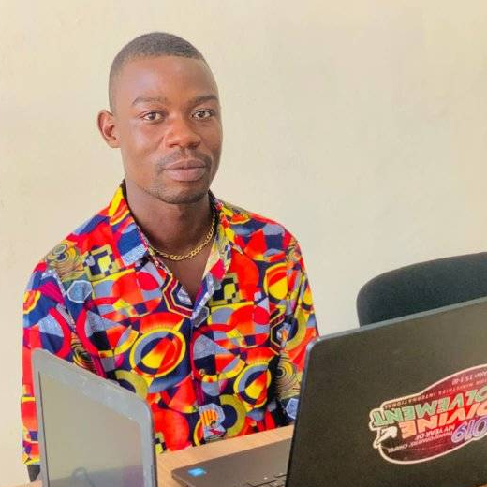
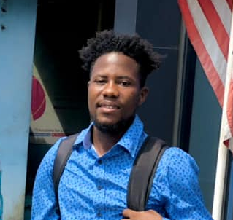
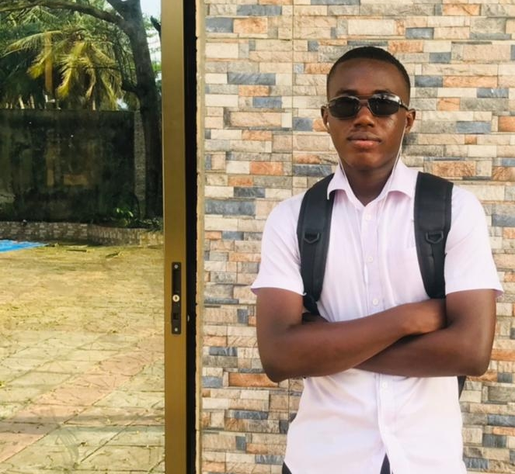

TEAM MEMBERS
Timothy T. Joe
Sylvester Ikel Jr.
Soleymana Dosso
Terryson Tarr

Slide 6
WEB APPLICATION
Real-Time Scores, Your Source for Liberian Sports Action!

