Slide 1
OPINIONATED OBJECTS · AADHAR.SH/LENS
—
□
×
Address
aadhar.sh › lens › slides › 01
Go
Every page has
two audiences.
the person looking at it
the machine reading over their shoulder
Lens makes the disagreement visible.
6 MINUTES · LIVE + OFFLINE BACKUP
start
▣ lens — demo
01 / 07
Notes:
0:00–0:35
Open with the claim, then make it concrete: a page is simultaneously a visual object and a machine-readable object.
Lens is an opinionated object because it takes a side: machine access should be explicit, inspectable, and attributable.
[Sources]
- https://aadhar.sh/lens

Slide 2
The Other Web
—
□
×
Address
aadhar.sh › lens › slides › 02
Go
Give me a website.
One you actually use.
https://
your answer goes here
GO
a local publication
a favorite blog
a useful tool
If it refuses us, that is part of the measurement.
BACKUPS: aadhar.sh · stripe.com · en.wikipedia.org/wiki/Semantic_Web
start
▣ lens — demo
02 / 07
Notes:
0:35–1:05
Ask for exactly one site. Repeat the URL aloud while entering it.
Do not apologize if it blocks framing, bots, or rendering. Say: refusal is evidence too.
If the room stalls, use aadhar.sh. If network or live execution fails, continue to the next slide without explaining the machinery.
[Sources]
- https://aadhar.sh/lens

Slide 3
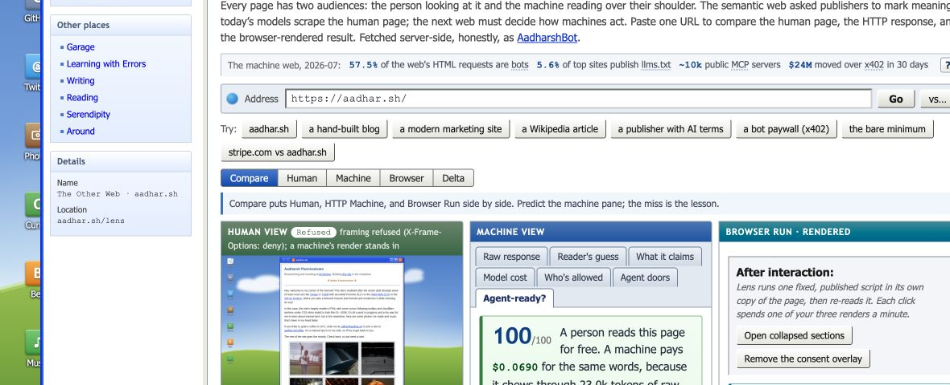
The Other Web
—
□
×
Address
aadhar.sh › lens › slides › 03
Go
One URL. Three readers.
human page · HTTP response · rendered browser
start
▣ lens — demo
03 / 07
Notes:
1:05–2:10
This is the live-demo backup frame. Point left to right: what a person sees, what an identified HTTP client receives, and what survives after JavaScript runs.
Ask the audience to predict whether the machine version is smaller, cleaner, or more permissive before revealing the panes.
The point is not that one renderer is correct. The disagreement is the object.
[Sources]
- https://aadhar.sh/lens

Slide 4
The Other Web
—
□
×
Address
aadhar.sh › lens › slides › 04
Go
The web keeps changing its answer
to “what is this page for?”
01
02
03
PAST
PRESENT
FUTURE
describe meaning
scrape presentation
negotiate action
semantic HTML
RDF + linked data
microformats
HTML + JavaScript
robots + terms
expensive cleanup
tools + permissions
auth + payment
intent + provenance
start
▣ lens — demo
04 / 07
Notes:
2:10–3:00
The early semantic-web wager was that publishers could describe meaning in machine-readable form.
The current agent web often recovers meaning after the fact from interfaces built for eyes.
The future question is more demanding: what may a machine do, for whom, under which terms, and with what proof?
[Sources]
- https://www.w3.org/2001/sw/
- https://blog.cloudflare.com/agent-readiness/

Slide 5
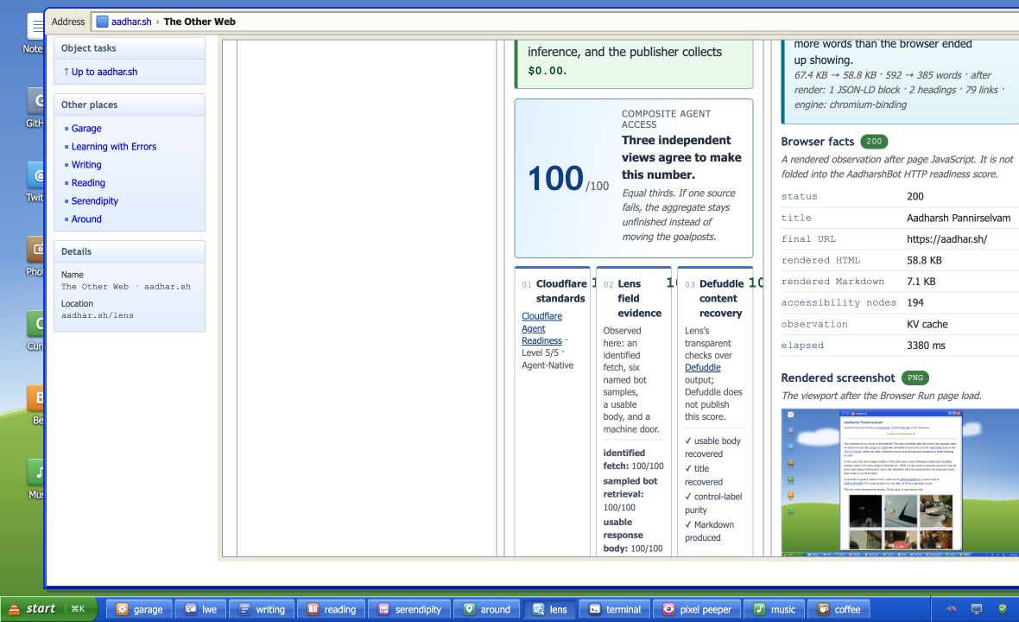
The Other Web
—
□
×
Address
aadhar.sh › lens › slides › 05
Go
A useful score must expose its opinion.
No hidden reweighting. No single vendor as oracle.
100
COMPOSITE AGENT ACCESS
Cloudflare standards
100
Lens field evidence
100
Defuddle recovery
100
equal thirds · missing input = unfinished
start
▣ lens — demo
05 / 07
Notes:
3:00–4:15
This is the criticism-preemption slide. The Cloudflare score is one input, not the product.
Lens adds an observed field score, and Defuddle provides an independent extraction whose output Lens evaluates with four published binary checks.
Each source gets exactly one third. If any source fails, the result says unfinished instead of silently moving the goalposts.
[Sources]
- https://blog.cloudflare.com/agent-readiness/
- https://isitagentready.com/
- https://github.com/kepano/defuddle
- https://aadhar.sh/lens

Slide 6
The Other Web
—
□
×
Address
aadhar.sh › lens › slides › 06
Go
Not a wrapper.
A disagreement detector.
STANDARDS
Did the publisher declare machine interfaces?
BEHAVIOR
What happened when identified bots actually tried?
RECOVERY
Did the response resolve into useful content?
The score is the compact view. The evidence remains inspectable.
start
▣ lens — demo
06 / 07
Notes:
4:15–5:10
Cloudflare measures declared readiness. Lens measures observed behavior. Defuddle gives us a separate content-recovery result.
A disagreement is more interesting than a perfect score: it tells the publisher where standards, enforcement, and actual legibility diverge.
The aggregate is a summary. Every component remains visible and falsifiable below it.
[Sources]
- https://blog.cloudflare.com/agent-readiness/
- https://github.com/kepano/defuddle
- https://aadhar.sh/lens

Slide 7
THE OTHER WEB · AADHAR.SH/LENS
—
□
×
Address
aadhar.sh › lens › slides › 07
Go
Machine legibility
is a design choice.
What view does your object express—
and who is allowed to act on it?
https://aadhar.sh/lens
Open
start
▣ lens — demo
07 / 07
Notes:
5:10–6:00
Return to the event prompt: this object expresses a view from somewhere. It believes access should be explicit, evidence-backed, and legible to both sides.
Invite questions about the score, the fetch identity, refusal as evidence, or what publishers might expose next.
If the live site failed, end here without apology: the static proof has already shown the interaction and the result.
[Sources]
- https://aadhar.sh/lens

