Slide 1
DATA COMMUNICATIONS
Topics to be discussed in this lecture:
Data communications: Course Handout
Data communications: Definition
Data communications: Basic Terminologies
Simplified Communications Model
Data Communications Model

Slide 2
Human Communications
A transmitter: mouth
A receiver: ear
The media: air
Question: Can you talk at outer space?
The protocol: a common human language
Question: why do we learn English?

Slide 3
DATA COMMUNICATIONS
The term telecommunication means communication at a distance. The word data refers to information presented in whatever form is agreed upon by the parties creating and using the data. Data communications are the exchange of data between two devices via some form of transmission medium such as a wire cable.

Slide 4
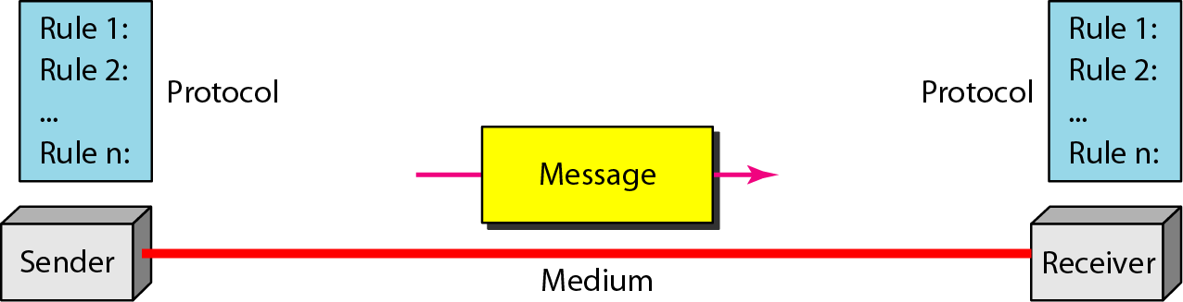
Figure 1.1 Components of a data communication system

Slide 5
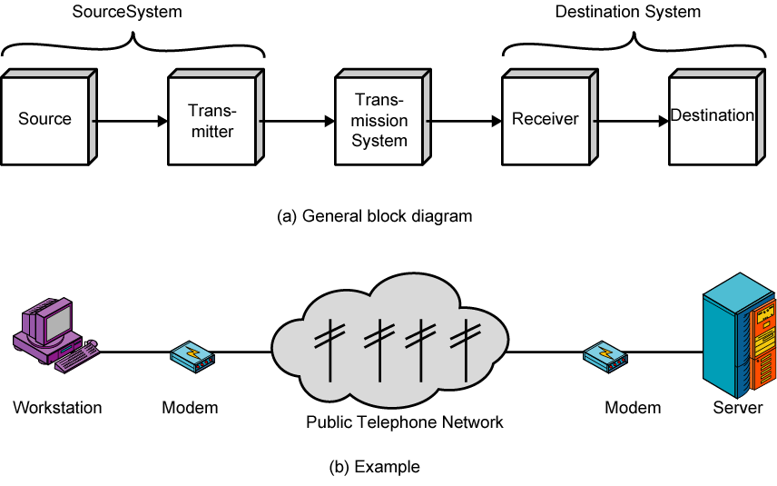
Simplified Communications Model

Slide 6
A Communications Model
What is the purpose of communications?
Exchange of information between two parties
Key elements
Source: Generates data to be transmitted. E.g., telephones, PCs.
Transmitter: A transmitter transforms and encodes the information in such a way as to produce electromagnetic signals that can be transmitted across some sort of transmission system.
Transmission System
It can be a single transmission line or a complex network connecting source and destination.
Destination: Takes incoming data from the receiver
Receiver: The receiver accepts the signal from the transmission system and converts it into a form that can be handled by the destination device.

Slide 7
Basic Terminologies
Data
Refers to information irrespective of its type for example text, audio, video, image etc.
It is efficient for processing, storing and moving
Data Communication
Denotes exchange of data between two communicating devices
Data communications deals with the transmission of signals in a reliable and efficient manner.
Computer Network or Data Network
Set of communication capable devices that are interconnected by links and connecting-devices (like switches, routers, hubs etc.)
Provides set of services based on exchange of data
Deals with technology & architecture of communication n/w used to interconnect devices

Slide 8
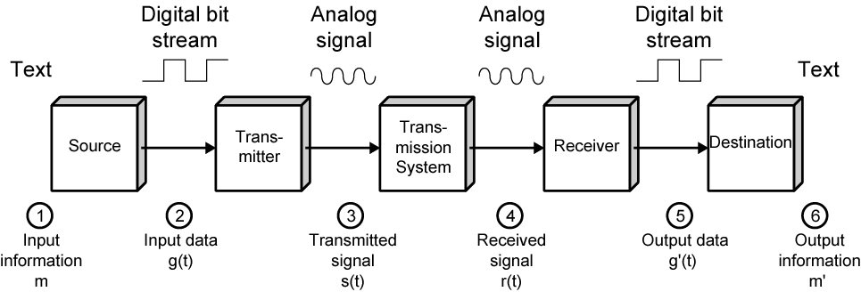
Data Communications Model
Notes:
The next section of the text on "Data Communications”, deals with the most fundamental aspects of the communications function, focusing on the transmission of signals in a reliable and efficient manner.
Stallings DCC8e Figure 1.3 provides a new perspective on the communications model of Figure 1.2a.
We trace the details of this figure using electronic mail as an example. Assume a PC user wants to send an email message m to another user.
The process is modeled as follows:
user keys in message m comprising bits g buffered in source PC memory
input data is transferred to I/O device (transmitter) as sequence of bits g(t) using voltage shifts
transmitter converts these into a signal s(t) suitable for transmission media being used
whilst transiting media signal may be impaired so received signal r(t) may differ from s(t)
receiver decodes signal recovering g’(t) as estimate of original g(t)
which is buffered in destination PC memory as bits g’ being the received message m’

Slide 9
Transmission Medium
selection is a basic choice
internal use entirely up to business
long-distance links made by carrier
rapid technology advances change mix
fiber optic
wireless
transmission costs still high
hence interest in efficiency improvements
Notes:
The basic building block of any communications facility is the transmission line.
One of the basic choices facing a business user is the transmission medium. For use within the business premises, this choice is generally completely up to the business. For long-distance communications, the choice is generally but not always made by the long-distance carrier.
In either case, changes in technology are rapidly changing the mix of media used. The ever-increasing capacity of fiber optic channels is making channel capacity a virtually free resource. However, switching is now becoming the bottleneck. The growing use of wireless transmission, is a result of the trend toward universal personal telecommunications and universal access to communications.
Despite the growth in the capacity and the drop in cost of transmission facilities, transmission services remain the most costly component of a communications budget for most businesses. Thus, the manager needs to be aware of techniques that increase the efficiency of the use of these facilities, such as multiplexing and compression.

