Slide 1
Data Communications
Lecture 7
3.<number>

Slide 2
3-4 TRANSMISSION IMPAIRMENT
Signals travel through transmission media, which are not perfect. The imperfection causes signal impairment. This means that the signal at the beginning of the medium is not the same as the signal at the end of the medium. What is sent is not what is received. Three causes of impairment are attenuation, distortion, and noise.
3.<number>

Slide 3

Figure 3.26 Attenuation (the first impairment)
3.<number>

Slide 4
Decibels
Signal strength is measured in decibels (dB)
dB is a relative measure of loss (or gain)
N_{dB} = 10 x log₁₀ (P2 / P1)
  P2 = ending power level in watts
  P1 = beginning power level in watts
Example: P1 = 10 watts, P2 = 5 watts
Losses and gains are additive

Slide 5
Signal to Noise Ratio (SNR or S/N)
Signal to noise ratio shows the ratio of signal power to noise power
Power often expressed in watts
S/N = signal power/noise power
Just a simple ratio

Slide 6
Signal to Noise Ratio_{dB}
(SNR_{dB} or S/N_{dB})
Signal to noise ratio_{dB} shows the ratio of signal power to noise power in decibels
S/N_{dB} = 10 log₁₀ (signal power/noise power)
Example 1: Signal power = 1000 watts, noise power = 20 mw
Example 2: Signal power = 100 w, noise power = 0.000002w

Slide 7

Example 3.31
The power of a signal is 10 mW and the power of the noise is 1 μW; what are the values of SNR and SNR_{dB} ?
Solution
The values of SNR and SNRdB can be calculated as follows:
3.<number>

Slide 8

Example 3.32
The values of SNR and SNRdB for a noiseless channel are
We can never achieve this ratio in real life; it is an ideal.
3.<number>

Slide 9

Example 3.28
One reason that engineers use the decibel to measure the changes in the strength of a signal is that decibel numbers can be added (or subtracted) when we are measuring several points (cascading) instead of just two. In Figure 3.27 a signal travels from point 1 to point 4. In this case, the decibel value can be calculated as
3.<number>

Slide 10

Figure 3.27 Decibels for Example 3.28
3.<number>

Slide 11

Example 3.29
Sometimes the decibel is used to measure signal power in milliwatts. In this case, it is referred to as dB_{m} and is calculated as dB_{m} = 10 log10 P_{m} , where P_{m} is the power in milliwatts. Calculate the power of a signal with dB_{m} = −30.
Solution
We can calculate the power in the signal as
3.<number>

Slide 12

Example 3.30
The loss in a cable is usually defined in decibels per kilometer (dB/km). If the signal at the beginning of a cable with −0.3 dB/km has a power of 2 mW, what is the power of the signal at 5 km?
Solution
The loss in the cable in decibels is 5 × (−0.3) = −1.5 dB. We can calculate the power as
3.<number>

Slide 13

Figure 3.28 Distortion (the second impairment)
3.<number>

Slide 14

Figure 3.29 Noise (the third impairment)
3.<number>

Slide 15

Figure 3.30 Two cases of SNR: a high SNR and a low SNR
3.<number>

Slide 16
Noise
additional signals inserted between transmitter and receiver
thermal
  due to thermal agitation of electrons
  uniformly distributed
  white noise
Notes:
For any data transmission event, the received signal will consist of the transmitted signal, modified by the various distortions imposed by the transmission system, plus additional unwanted signasl, referred to as noise, that are inserted somewhere between transmission and reception. Noise is a major limiting factor in communications system performance. Noise may be divided into four categories.
Thermal noise is due to thermal agitation of electrons. It is present in all electronic devices and transmission media and is a function of temperature. Thermal noise is uniformly distributed across the bandwidths typically used in communications systems and hence is often referred to as white noise. Thermal noise cannot be eliminated and therefore places an upper bound on communications system performance, and. is particularly significant for satellite communication.
When signals at different frequencies share the same transmission medium, the result may be intermodulation noise. The effect of intermodulation noise is to produce signals at a frequency that is the sum or difference of the two original frequencies or multiples of those frequencies, thus possibly interfering with services at these frequencies. It is produced by nonlinearities in the transmitter, receiver, and/or intervening transmission medium.

Slide 17
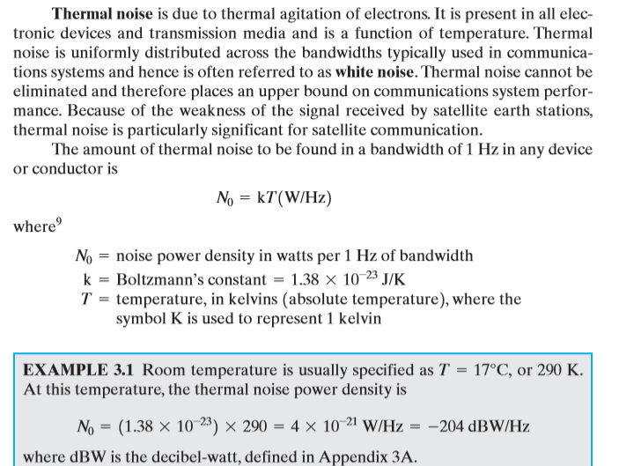


Slide 18
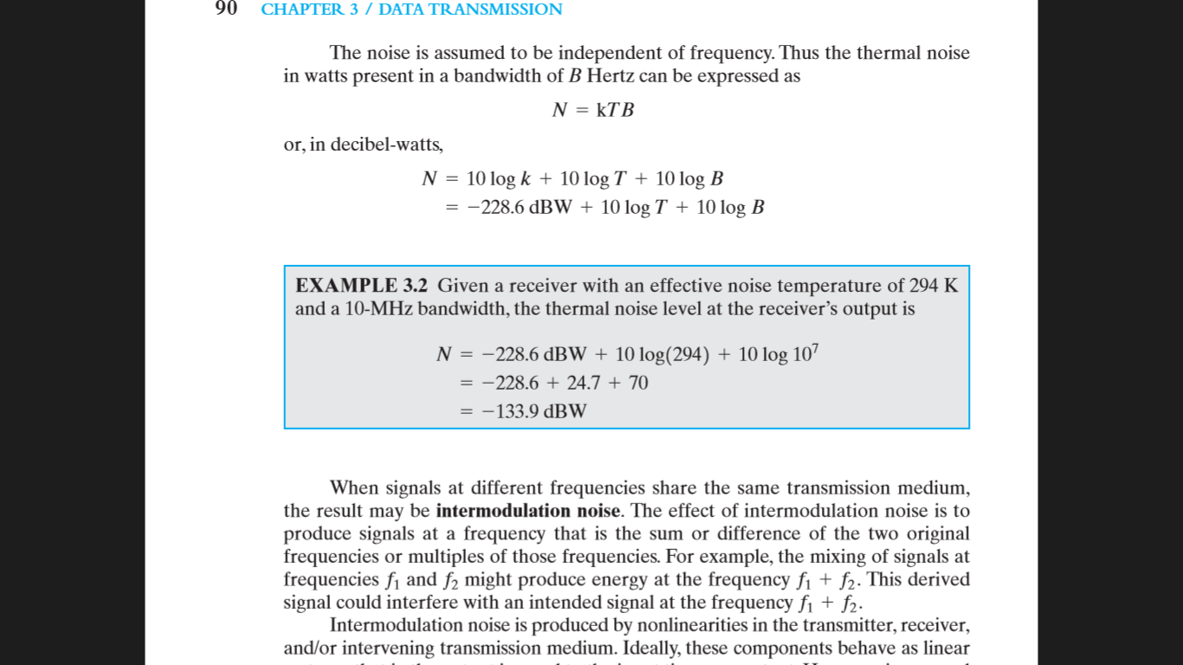

Slide 19
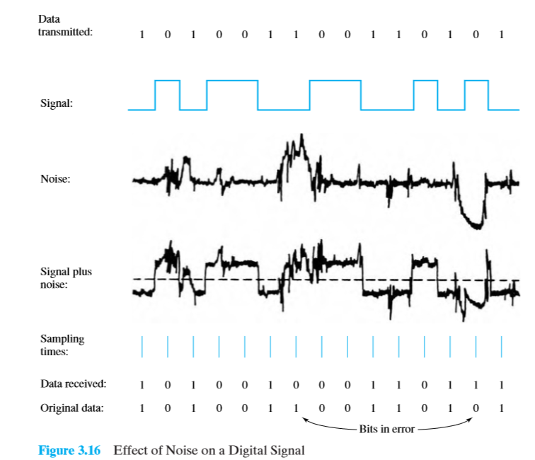

Slide 20
Channel Capacity
max possible data rate on comms channel
is a function of
  data rate - in bits per second
  bandwidth - in cycles per second or Hertz
  noise - on comms link
  error rate - of corrupted bits
limitations due to physical properties
want most efficient use of capacity
Notes:
The maximum rate at which data can be transmitted over a given communication channel, under given conditions, is referred to as the channel capacity. There are four concepts here that we are trying to relate to one another.
• Data rate, in bits per second (bps), at which data can be communicated
• Bandwidth, as constrained by the transmitter and the nature of the transmission medium, expressed in cycles per second, or Hertz
• Noise, average level of noise over the communications path
• Error rate, at which errors occur, where an error is the reception of a 1 when a 0 was transmitted or the reception of a 0 when a 1 was transmitted
All transmission channels of any practical interest are of limited bandwidth, which arise from the physical properties of the transmission medium or from deliberate limitations at the transmitter on the bandwidth to prevent interference from other sources. Want to make as efficient use as possible of a given bandwidth. For digital data, this means that we would like to get as high a data rate as possible at a particular limit of error rate for a given bandwidth. The main constraint on achieving this efficiency is noise.

Slide 21
Nyquist Bandwidth
consider noise free channels
if rate of signal transmission is 2B then can carry signal with frequencies no greater than B
  ie. given bandwidth B, highest signal rate is 2B
for binary signals, 2B bps needs bandwidth B Hz
can increase rate by using M signal levels
Nyquist Formula is: C = 2B log₂M
so increase rate by increasing signals
  at cost of receiver complexity
  limited by noise & other impairments
Notes:
Consider a noise free channel where the limitation on data rate is simply the bandwidth of the signal. Nyquist states that if the rate of signal transmission is 2B, then a signal with frequencies no greater than B is sufficient to carry the signal rate. Conversely given a bandwidth of B, the highest signal rate that can be carried is 2B. This limitation is due to the effect of intersymbol interference, such as is produced by delay distortion.
If the signals to be transmitted are binary (two voltage levels), then the data rate that can be supported by B Hz is 2B bps. However signals with more than two levels can be used; that is, each signal element can represent more than one bit. For example, if four possible voltage levels are used as signals, then each signal element can represent two bits. With multilevel signaling, the Nyquist formulation becomes: C = 2B log₂ M, where M is the number of discrete signal or voltage levels.
So, for a given bandwidth, the data rate can be increased by increasing the number of different signal elements. However, this places an increased burden on the receiver, as it must distinguish one of M possible signal elements. Noise and other impairments on the transmission line will limit the practical value of M.

Slide 22
Shannon Capacity Formula
consider relation of data rate, noise & error rate
  faster data rate shortens each bit so bursts of noise affects more bits
  given noise level, higher rates means higher errors
Shannon developed formula relating these to signal to noise ratio (in decibels)
SNR_{db}⁼10 log₁₀ (signal/noise)
Capacity C=B log₂(1+SNR)
  theoretical maximum capacity
  get lower in practise
Notes:
Consider the relationship among data rate, noise, and error rate. The presence of noise can corrupt one or more bits. If the data rate is increased, then the bits become "shorter" so that more bits are affected by a given pattern of noise. Mathematician Claude Shannondeveloped a formula relating these. For a given level of noise, expect that a greater signal strength would improve the ability to receive data correctly in the presence of noise. The key parameter involved is the signal-to-noise ratio (SNR, or S/N), which is the ratio of the power in a signal to the power contained in the noise that is present at a particular point in the transmission. Typically, this ratio is measured at a receiver, because it is at this point that an attempt is made to process the signal and recover the data. For convenience, this ratio is often reported in decibels. This expresses the amount, in decibels, that the intended signal exceeds the noise level. A high SNR will mean a high-quality signal and a low number of required intermediate repeaters.
The signal-to-noise ratio is important in the transmission of digital data because it sets the upper bound on the achievable data rate. Shannon's result is that the maximum channel capacity, in bits per second, obeys the equation shown. C is the capacity of the channel in bits per second and B is the bandwidth of the channel in Hertz. The Shannon formula represents the theoretical maximum that can be achieved. In practice, however, only much lower rates are achieved, in part because formula only assumes white noise (thermal noise).

