Slide 1
Data Communications
Lecture 8

Slide 2
Topics discussed
Data transmission
Frequency, spectrum & bandwidth
Analog vs Digital signals
Transmission impairments
Notes:
Stallings DCC8e Chapter 3 summary.

Slide 3
Topics to be discussed
Noiseless Channel: Nyquist Bit Rate
Noisy Channel: Shannon Capacity
Transmission Media

Slide 4
DATA RATE LIMITS
A very important consideration in data communications is how fast we can send data, in bits per second, over a channel. Data rate depends on three factors:
1. The bandwidth available
2. The level of the signals we use
3. The quality of the channel (the level of noise)

Slide 5
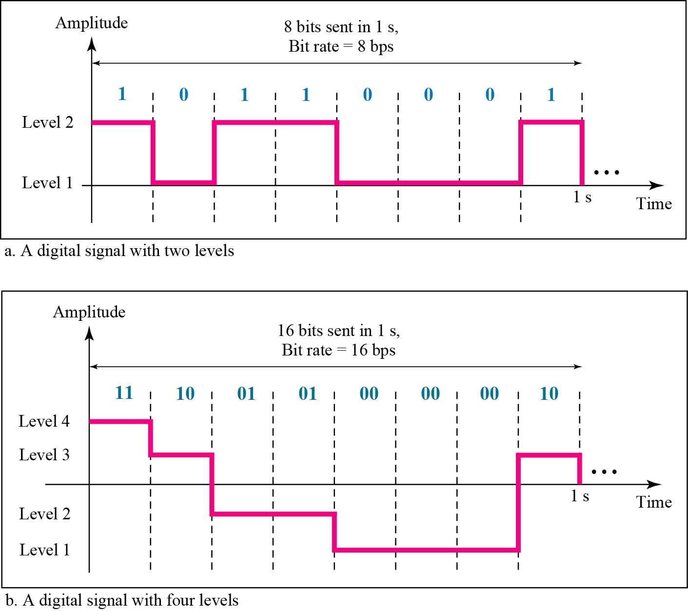
Channel Capacity /Capacity of System
The bit rate of a system increases with an increase in the number of signal levels we use to denote a symbol.
If a symbol can consist of a single bit or “n” bits.
Then, the number of signal levels M= 2^{n}.
Notes:
As the number of levels goes up, the spacing between level decreases -> increasing the probability of an error occurring in the presence of transmission impairments.

Slide 6
Nyquist Theorem
Nyquist theorem states that for a noiseless channel:
C = 2 B log₂2^{n}
C = 2B log₂M
C= capacity in bps
B = bandwidth in Hz
so increase rate by increasing signals
at cost of receiver complexity
limited by noise & other impairments
Notes:
Consider a noise free channel where the limitation on data rate is simply the bandwidth of the signal. Nyquist states that if the rate of signal transmission is 2B, then a signal with frequencies no greater than B is sufficient to carry the signal rate. Conversely given a bandwidth of B, the highest signal rate that can be carried is 2B. This limitation is due to the effect of intersymbol interference, such as is produced by delay distortion.
If the signals to be transmitted are binary (two voltage levels), then the data rate that can be supported by B Hz is 2B bps. However signals with more than two levels can be used; that is, each signal element can represent more than one bit. For example, if four possible voltage levels are used as signals, then each signal element can represent two bits. With multilevel signaling, the Nyquist formulation becomes: C = 2B log₂ M, where M is the number of discrete signal or voltage levels.
So, for a given bandwidth, the data rate can be increased by increasing the number of different signal elements. However, this places an increased burden on the receiver, as it must distinguish one of M possible signal elements. Noise and other impairments on the transmission line will limit the practical value of M.

Slide 7

Note
Increasing the levels of a signal increases the probability of an error occurring, in other words it reduces the reliability of the system.

Slide 8
Example 8.1
Consider a noiseless channel with a bandwidth of 3000 Hz transmitting a signal with two signal levels. The maximum bit rate can be calculated as

Slide 9
Example 8.2
Consider the same noiseless channel transmitting a signal with four signal levels (for each level, we send 2 bits). The maximum bit rate can be calculated as

Slide 10
Example 8.3
We need to send 265 kbps over a noiseless channel with a bandwidth of 20 kHz. How many signal levels do we need?
Solution
We can use the Nyquist formula as shown:
Since this result is not a power of 2, we need to either increase the number of levels or reduce the bit rate. If we have 128 levels, the bit rate is 280 kbps. If we have 64 levels, the bit rate is 240 kbps.

Slide 11
Channel Capacity
max possible data rate on comms channel
is a function of
data rate - in bits per second
bandwidth - in cycles per second or Hertz
noise - on comms link
error rate - of corrupted bits
limitations due to physical properties
want most efficient use of capacity
Notes:
The maximum rate at which data can be transmitted over a given communication channel, under given conditions, is referred to as the channel capacity. There are four concepts here that we are trying to relate to one another.
• Data rate, in bits per second (bps), at which data can be communicated
• Bandwidth, as constrained by the transmitter and the nature of the transmission medium, expressed in cycles per second, or Hertz
• Noise, average level of noise over the communications path
• Error rate, at which errors occur, where an error is the reception of a 1 when a 0 was transmitted or the reception of a 0 when a 1 was transmitted
All transmission channels of any practical interest are of limited bandwidth, which arise from the physical properties of the transmission medium or from deliberate limitations at the transmitter on the bandwidth to prevent interference from other sources. Want to make as efficient use as possible of a given bandwidth. For digital data, this means that we would like to get as high a data rate as possible at a particular limit of error rate for a given bandwidth. The main constraint on achieving this efficiency is noise.

Slide 12
Shannon Capacity Formula
consider relation of data rate, noise & error rate
faster data rate shortens each bit so bursts of noise affects more bits
given noise level, higher rates means higher errors
Shannon developed formula relating these to signal to noise ratio (in decibels)
SNR_{db}⁼10 log₁₀ (signal/noise)
Notes:
Consider the relationship among data rate, noise, and error rate. The presence of noise can corrupt one or more bits. If the data rate is increased, then the bits become "shorter" so that more bits are affected by a given pattern of noise. Mathematician Claude Shannondeveloped a formula relating these. For a given level of noise, expect that a greater signal strength would improve the ability to receive data correctly in the presence of noise. The key parameter involved is the signal-to-noise ratio (SNR, or S/N), which is the ratio of the power in a signal to the power contained in the noise that is present at a particular point in the transmission. Typically, this ratio is measured at a receiver, because it is at this point that an attempt is made to process the signal and recover the data. For convenience, this ratio is often reported in decibels. This expresses the amount, in decibels, that the intended signal exceeds the noise level. A high SNR will mean a high-quality signal and a low number of required intermediate repeaters.
The signal-to-noise ratio is important in the transmission of digital data because it sets the upper bound on the achievable data rate. Shannon's result is that the maximum channel capacity, in bits per second, obeys the equation shown. C is the capacity of the channel in bits per second and B is the bandwidth of the channel in Hertz. The Shannon formula represents the theoretical maximum that can be achieved. In practice, however, only much lower rates are achieved, in part because formula only assumes white noise (thermal noise).

Slide 13
Shannon’s Theorem
Shannon’s theorem gives the capacity of a system in the presence of noise.
C = B log₂(1 + SNR)

Slide 14
Example 8.4
Consider an extremely noisy channel in which the value of the signal-to-noise ratio is almost zero. In other words, the noise is so strong that the signal is faint. For this channel the capacity C is calculated as
This means that the capacity of this channel is zero regardless of the bandwidth. In other words, we cannot receive any data through this channel.

Slide 15
Example 8.5
We can calculate the theoretical highest bit rate of a regular telephone line. A telephone line normally has a bandwidth of 3000. The signal-to-noise ratio is usually 3162. For this channel the capacity is calculated as
This means that the highest bit rate for a telephone line is 34.860 kbps. If we want to send data faster than this, we can either increase the bandwidth of the line or improve the signal-to-noise ratio.

Slide 16
Example 8.6
The signal-to-noise ratio is often given in decibels. Assume that SNR_{dB} = 36 and the channel bandwidth is 2 MHz. The theoretical channel capacity can be calculated as

Slide 17


Example 3.40
For practical purposes, when the SNR is very high, we can assume that SNR + 1 is almost the same as SNR. In these cases, the theoretical channel capacity can be simplified to
For example, we can calculate the theoretical capacity of the previous example as

Slide 18
Example 8.7
We have a channel with a 1-MHz bandwidth. The SNR for this channel is 63. What are the appropriate bit rate and signal level?
Solution
First, we use the Shannon formula to find the upper limit.

Slide 19
Example 8.7 (continued)
The Shannon formula gives us 6 Mbps, the upper limit. For better performance we choose something lower, 4 Mbps, for example. Then we use the Nyquist formula to find the number of signal levels.

Slide 20
Note
The Shannon capacity gives us the upper limit; the Nyquist formula tells us how many signal levels we need.

