Slide 1
Data Communications
Lecture 10

Slide 2

Ex
ample
What are the propagation time and the transmission time for a 5-MB (megabyte) message (an image) if the bandwidth of the network is 1 Mbps? Assume that the distance between the sender and the receiver is 12,000 km and that light travels at 2.4 × 108 m/s.
Solution
We can calculate the propagation and transmission times as

Slide 3







Bandwidth-Delay Product
Bandwidth and delay are two performance metrics of a link.
What is very important in data communications is the product of the two, the bandwidth-delay product.

Slide 4
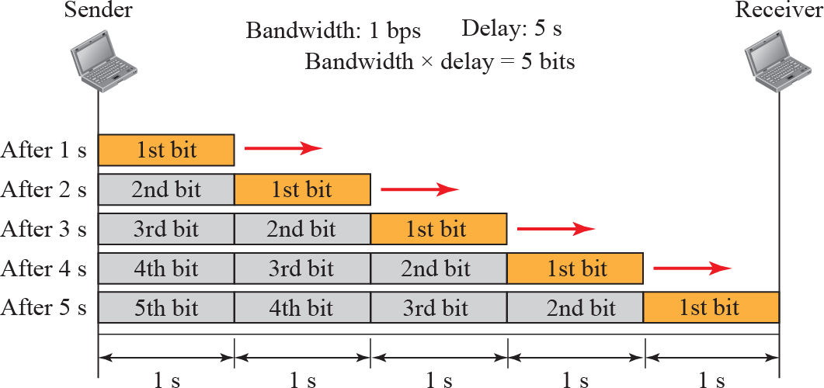
Filling the links with bits for Case 1

Slide 5
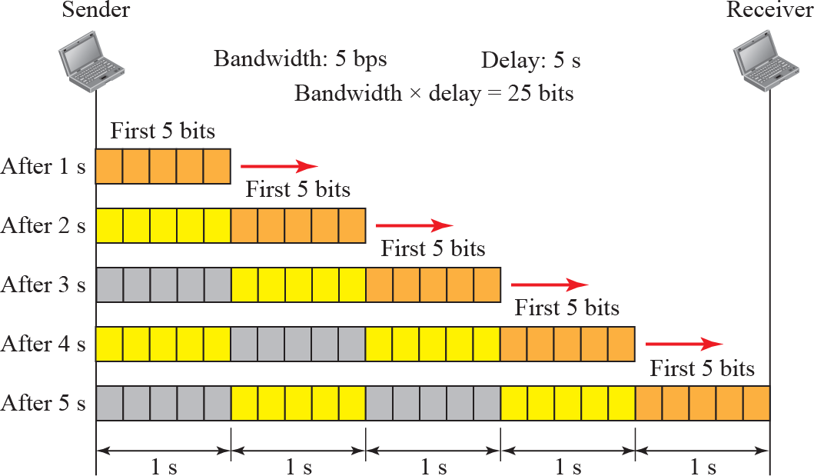
Filling the pipe with bits for Case 2

Slide 6
ample
Ex
We can think about the link between two points as a pipe.
The cross section of the pipe represents the bandwidth, and the length of the pipe represents the delay.
We can say the volume of the pipe defines the bandwidth-delay product

Slide 7



Figure 3.34: Concept of bandwidth-delay product

Slide 8
Transmission Media

Slide 9
INTRODUCTION
Transmission media are
located below the physical layer
are directly controlled by the physical layer.

Slide 10

Transmission media and physical layer

Slide 11
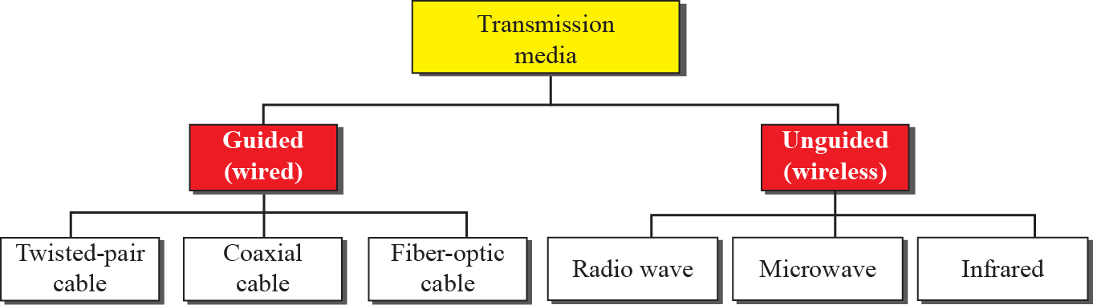
Classes of transmission media

Slide 12
GUIDED MEDIA
provide a conduit from one device to another, include twisted-pair cable, coaxial cable, and fiber-optic cable
A signal traveling along any of these media is directed and contained by the physical limits of the medium.

Slide 13
Twisted-Pair Cable
consists of two conductors (normally copper), each with its own plastic insulation, twisted together
One of the wires is used to carry signals to the receiver, and the other is used only as a ground reference.
In addition to the signal sent by the sender on
one of the wires, interference (noise) and crosstalk may affect both wires and
create
unwanted signals

Slide 14

Twisted-pair cable

Slide 15
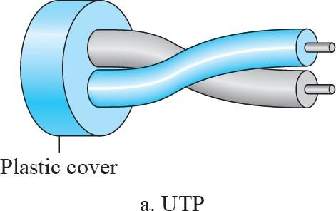
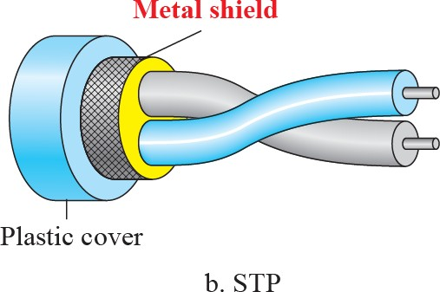
UTP and STP cables

Slide 16
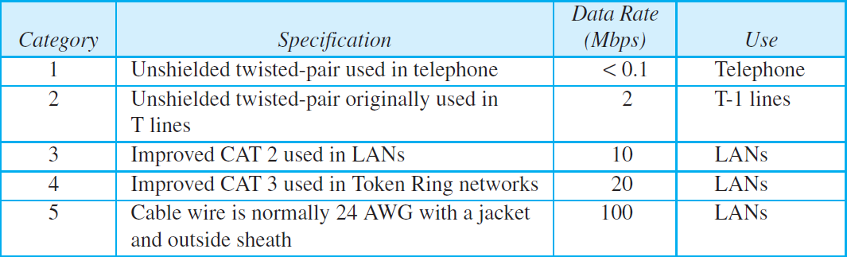
Unshielded twisted-pair cables

Slide 17
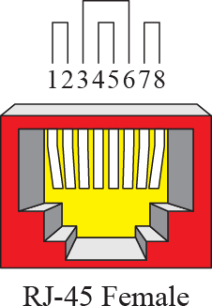
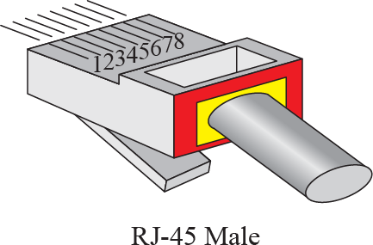
UTP Connectors

Slide 18
Coaxial Cable
carries signals of higher frequency ranges than those in twisted pair cable, in part because the two media are constructed quite differently.
coax has a central core conductor of solid or stranded wire (usually copper) enclosed in an insulating sheath, which is, in turn, encased in an outer conductor of metal foil, braid, or a combination of the two.
The outer metallic wrapping serves both as a shield against noise and as the second conductor, which completes the circuit.

Slide 19
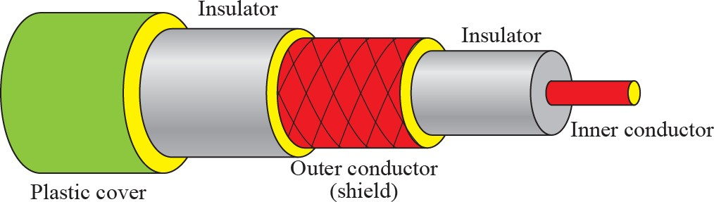
Coaxial cable

Slide 20
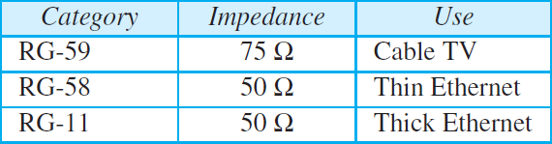
coaxial cables

Slide 21
Fiber-Optic Cable
is made of glass or plastic and transmits signals in the form of light
Light travels in a straight line as long as it is moving through a single uniform substance.
If a ray of light traveling through one substance suddenly enters another substance (of a different density), the ray changes direction.

Slide 22
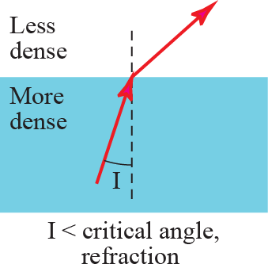
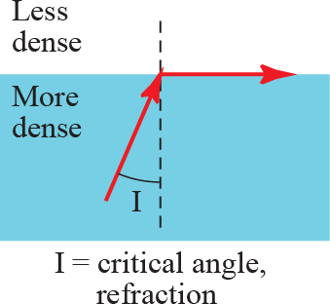
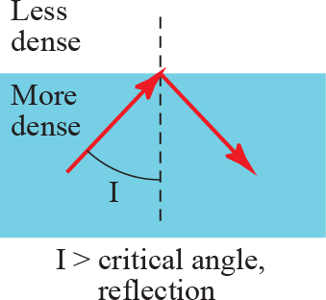
Bending of light ray

Slide 23
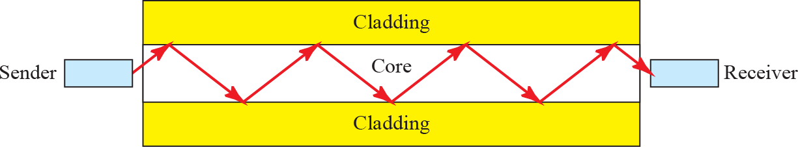
Optical fiber

Slide 24
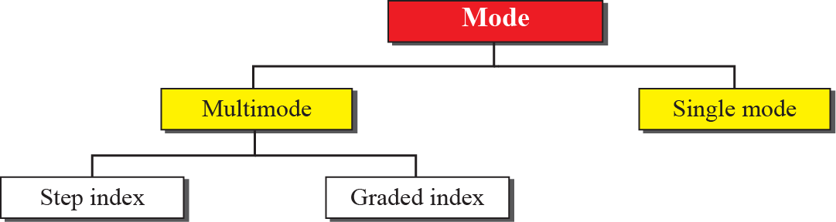
Propagation modes

Slide 25


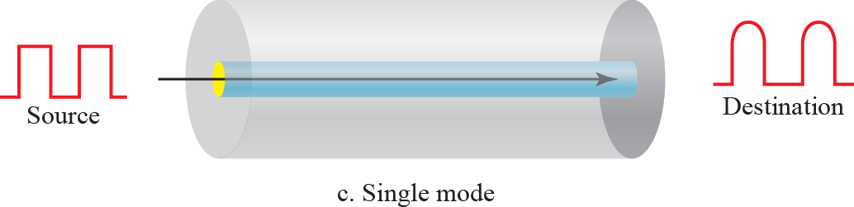
Modes

Slide 26
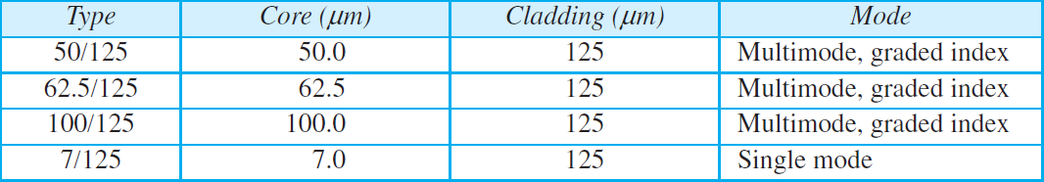
Fiber types

Slide 27
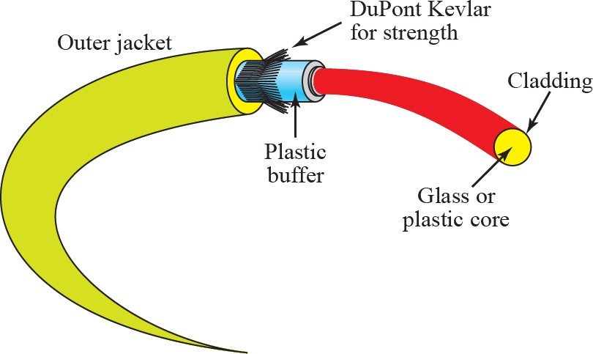
Fiber connection

Slide 28
UNGUIDED MEDIA
transport waves without using a physical conductor
This type of communication is often referred to as wireless communication.
Signals are normally broadcast through free space and thus are available to anyone who has a device capable of receiving them.

Slide 29
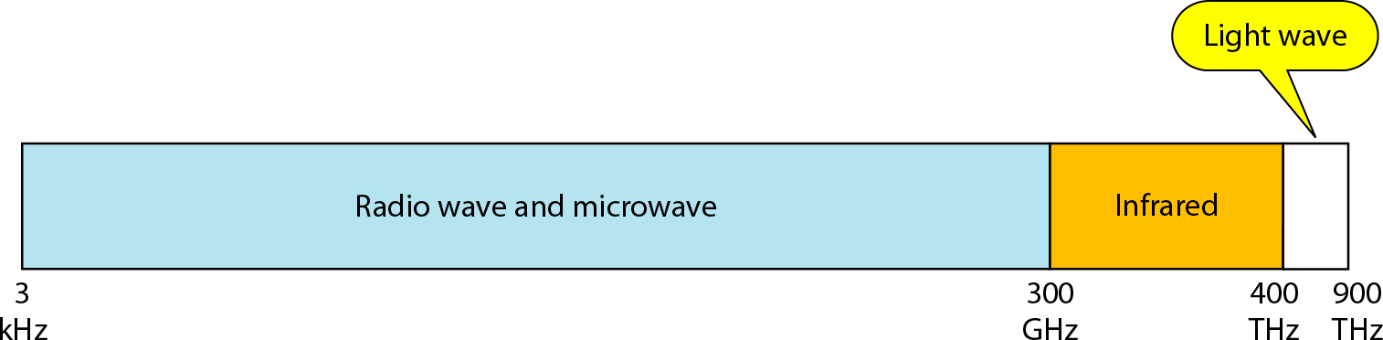
Electromagnetic spectrum for wireless communication

Slide 30
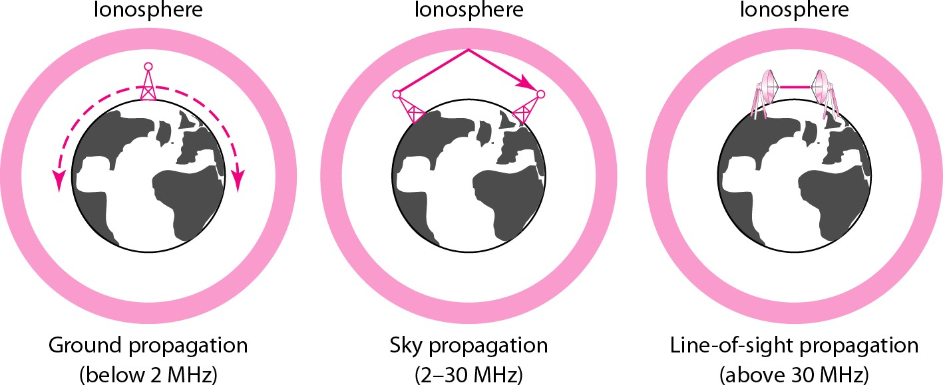
Propagation methods

Slide 31
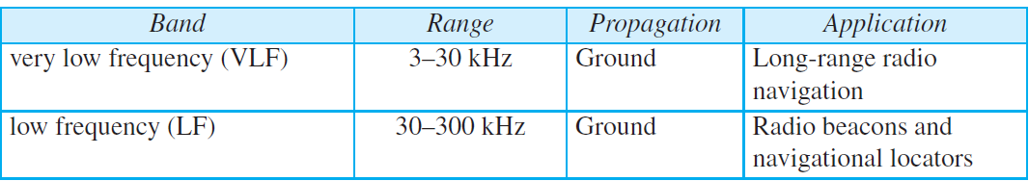
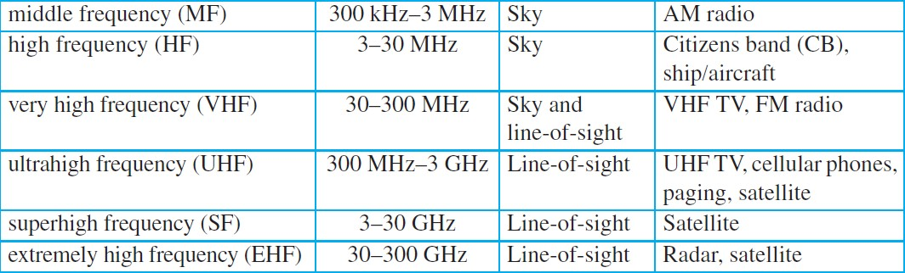
Bands

Slide 32
Radio Waves
electromagnetic waves ranging in frequencies between 3 kHz and 1 GHz are normally called radio waves
waves ranging in frequencies between 1 and 300 GHz are called microwaves.

Slide 33

Omnidirectional antenna

Slide 34
Microwaves
having frequencies between 1 and 300 GHz
unidirectional. When an antenna transmits microwaves
the sending and receiving antennas need to be aligned.

Slide 35
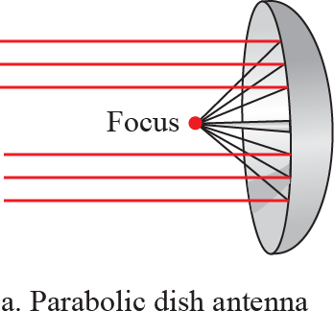
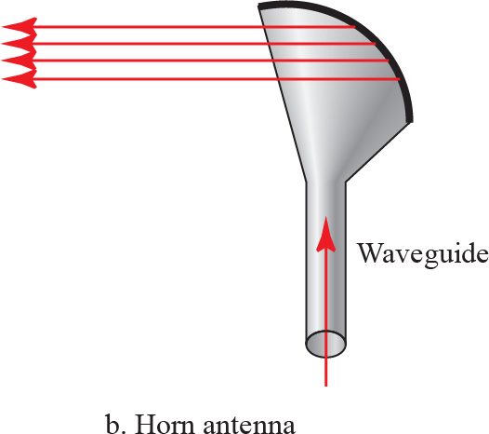
Unidirectional antenna

Slide 36
Infrared
frequencies from 300 GHz to 400 THz (wavelengths from 1 mm to 770 nm)
can be used for short-range communication
Infrared waves, having high frequencies, cannot penetrate walls.

