Slide 1
Data Communications
Lecture 11

Slide 2
Review Questions
1. What is the position of the transmission media in the OSI or the Internet model?
2. Name the two major categories of transmission media.
3. How do guided media differ from unguided media?
4. What are the three major classes of guided media?
5. What is the significance of the twisting in twisted-pair cable? Or Why are the wires twisted in twisted-pair copper wire?
6. What is refraction? What is reflection?
7. What is the purpose of cladding in an optical fiber?
8. Name the advantages of optical fiber over twisted-pair and coaxial cable.

Slide 3
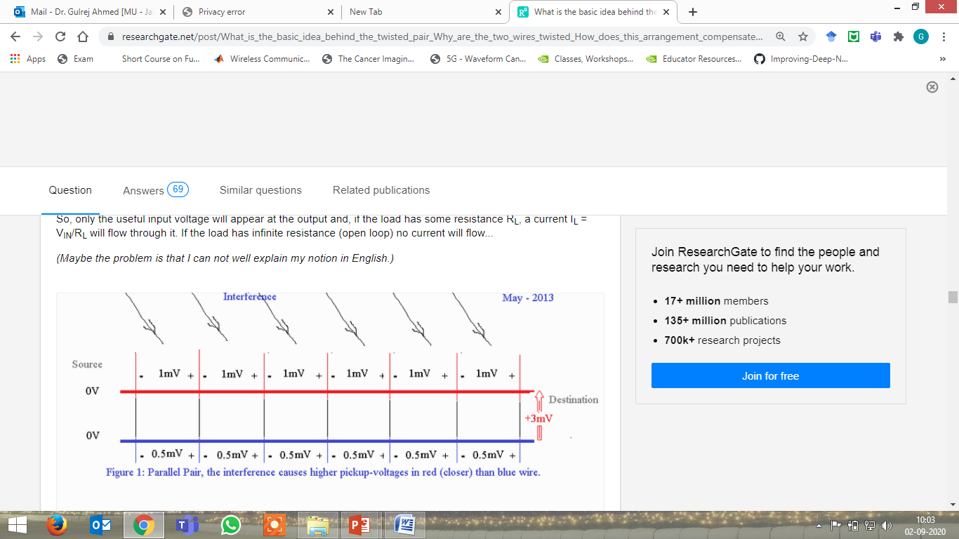
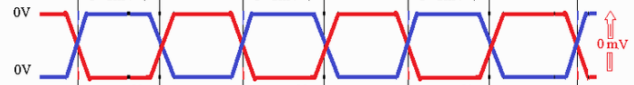
Why are the wires twisted in twisted-pair copper wire:

Slide 4
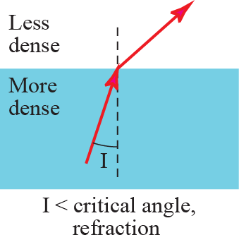
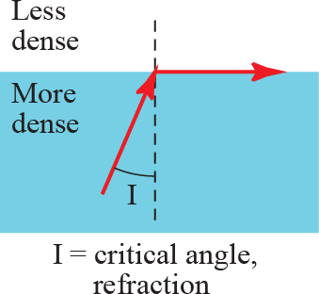
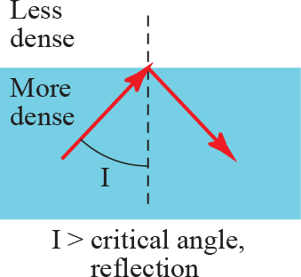
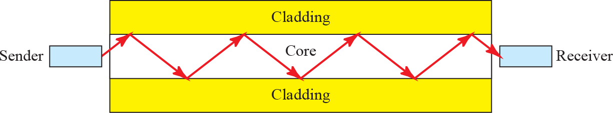
Bending of light ray in Optical fiber

Slide 5
Advantages of Optical Fiber
Fiber-optic cable has several advantages over metallic cable (twisted pair or coaxial).
Higher bandwidth
Less signal attenuation
Immunity to electromagnetic
interference Resistance to corrosive materials
Light weight
Greater immunity to tapping
Notes:
Fiber-optic cable can support dramatically higher bandwidths (and hence data rates) than either twisted-pair or coaxial cable. Currently, data rates and bandwidth utilization over fiber-optic cable are limited not by the medium but by the signal generation and reception technology available.
Fiber-optic transmission distance is significantly greater than that of other guided media. A signal can run for 50 km without requiring regeneration. We need repeaters every 5 km for coaxial or twisted-pair cable.
Electromagnetic noise cannot affect fiber-optic cables.
Glass is more resistant to corrosive materials than copper.
Fiber-optic cables are much lighter than copper cables.
Fiber-optic cables are more immune to tapping than copper cables. Copper cables create antenna effects that can easily be tapped.

Slide 6
Disadvantages of Optical Fiber
There are some disadvantages in the use of optical fiber.
Installation and maintenance
Unidirectional light propagation.
Cost.
Notes:
Its installation and maintenance require expertise.
Propagation of light is unidirectional. If we need bidirectional communication, two fibers are needed.
The cable and the interfaces are relatively more expensive than those of other guided media. If the demand for bandwidth is not high, often the use of optical fiber cannot be justified.

Slide 7
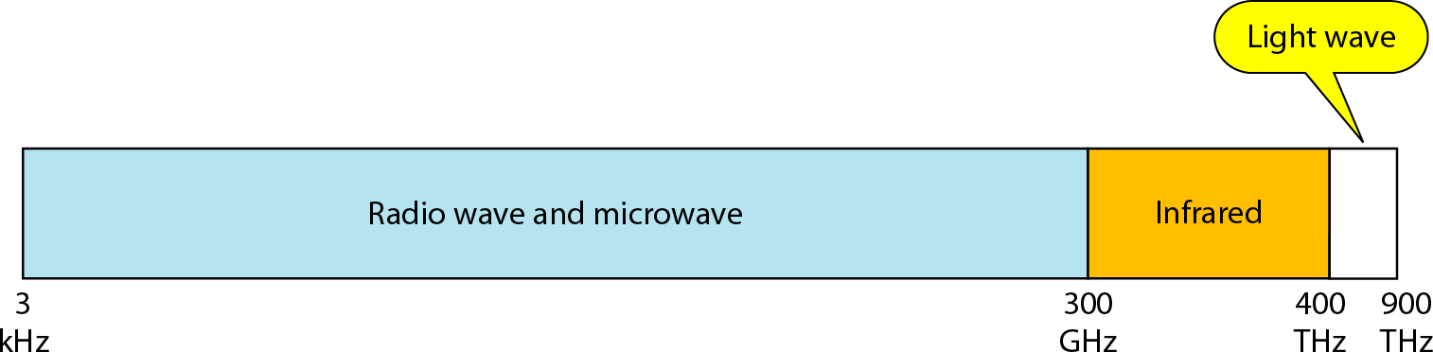
Electromagnetic spectrum for wireless communication
Notes:
electromagnetic waves ranging in frequencies between 3 kHz and 1 GHz are normally called radio waves
waves ranging in frequencies between 1 and 300 GHz are called microwaves.

Slide 8
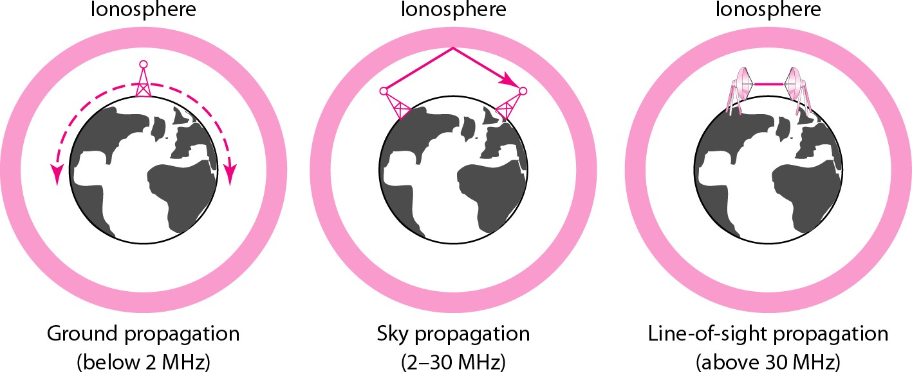
Unguided Media: Wireless Propagation methods
Notes:
In ground propagation, radio waves travel through the lowest portion of the atmosphere. These low-frequency signals emanate in all directions from the transmitting antenna and follow the curvature ofthe planet.
Distance depends on the amount ofpower in the signal: The greater the power, the greater the distance.
In sky propagation, higher-frequency radio waves radiate upward into the ionosphere (the layer of atmosphere where particles exist as ions) where they are reflected back to earth. This type of transmission allows for greater distances with lower output power.
In line-or-sight propagation, very high-frequency signals are transmitted in straight lines directly from antenna to antenna. Antennas must be directional, facing each other, and either tall enough or close enough together not to be affected by the curvature of the earth. Line-of-sight propagation is tricky because radio transmissions cannot be completely focused.

