Slide 1
Data Communications
Lecture 13

Slide 2
Digital Transmission

Slide 3

Line Coding
The process of converting a sequence of bits to digital signals.
At the sender, digital data are encoded into a digital signal
at the receiver, the digital data are recreated by decoding the digital signal.

Slide 4
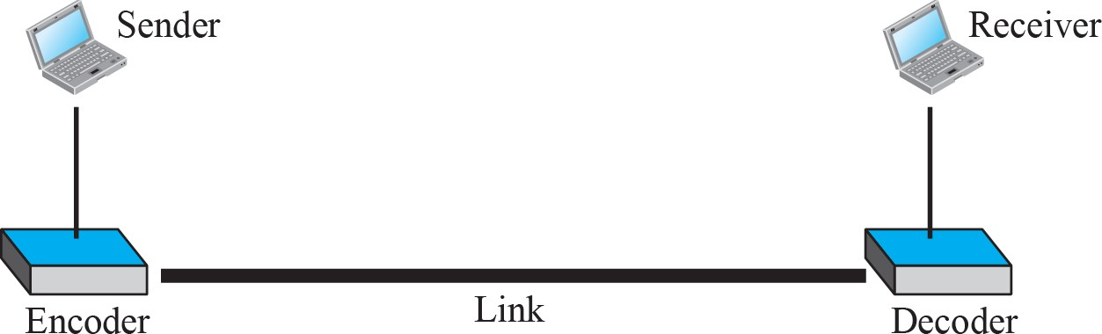
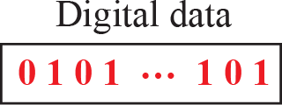
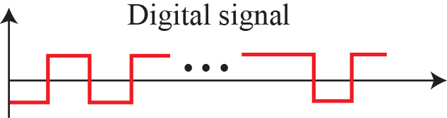
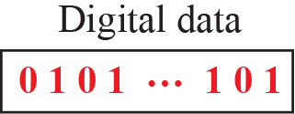
Line coding and decoding

Slide 5
Characteristics of Line Coding
Before discussing different line coding schemes, we address their common characteristics.
Signal Element Versus Data Element:
A signal element is the shortest unit (timewise) of a digital signal. In other words, data elements are what we need to send; signal elements are what we can send. Data elements are being carried; signal elements are the carriers.
Data Rate Versus Signal Rate
One goal in data communications is to increase the data rate while decreasing the signal rate. Increasing the data rate increases the speed of transmission; decreasing the signal rate decreases the bandwidth requirement.

Slide 6
Bandwidth
Although the actual bandwidth of a digital signal is infinite, the effective bandwidth is finite.
DC Components
When the voltage level in a digital signal is constant for a while, the spectrum creates very low frequencies (results of Fourier analysis). These frequencies around zero, called DC (direct-current) components, present problems for a system that cannot pass low frequencies or a system that uses electrical coupling (via a transformer). For example, a telephone line cannot pass frequencies below 200 Hz. Also a long-distance link may use one or more transformers to isolate different parts of the line electrically. For these systems, we need a scheme with no DC component.

Slide 7
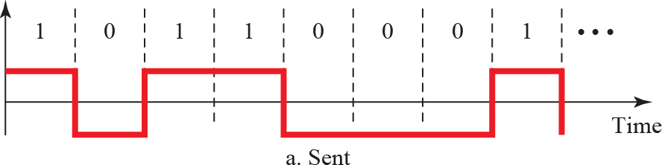
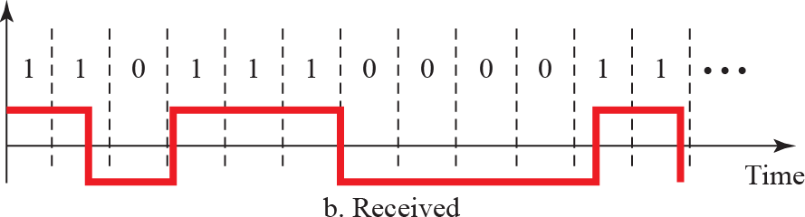
Self-synchronization
To correctly interpret the signals received from the sender, the receiver's bit intervals must correspond exactly to the sender's bit intervals. If the receiver clock is faster or slower, the bit intervals are not matched and the receiver might misinterpret the signals.
Figure shows a situation in which the receiver has a shorter bit duration. The sender sends 10110001, while the receiver receives 110111000011.

Slide 8
Characteristics Built-in Error Detection It is desirable to have a built-in error-detecting capability in the generated code to detect some of or all the errors that occurred during transmission. Some encoding schemes that we will discuss have this capability to some extent. Immunity to Noise and Interference Another desirable code characteristic is a code I that is immune to noise and other interferences. Some encoding schemes that we will discuss have this capability. Complexity A complex scheme is more costly to implement than a simple one. For example, a scheme that uses four signal levels is more difficult to interpret than one that uses only two levels.

Slide 9
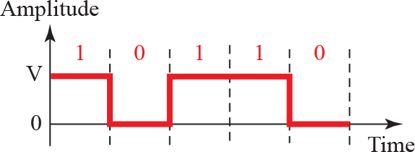
Line Coding: Unipolar scheme

Slide 10
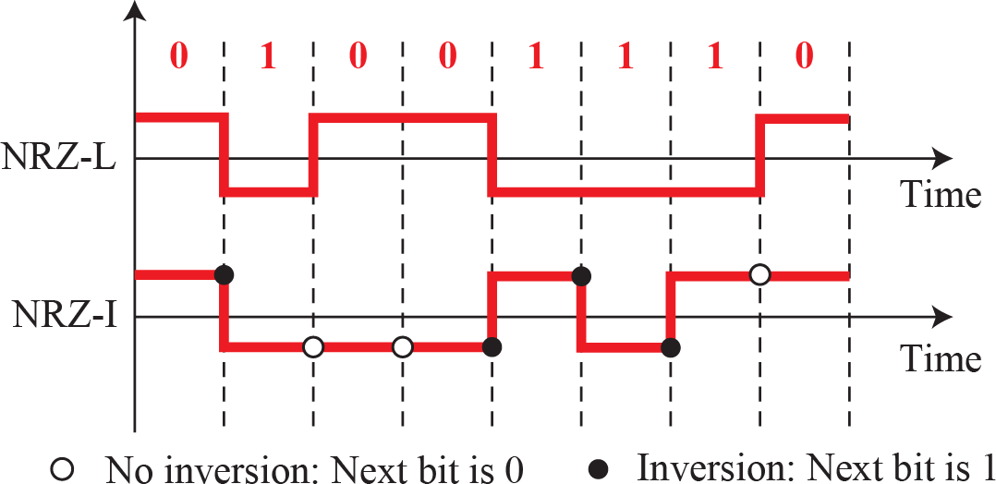
Polar schemes (NRZ-L and NRZ-I)

Slide 11
Example
A system is using NRZ-I to transfer 10-Mbps data. What are the average signal rate and minimum bandwidth?
Solution
The average signal rate is S = N/2 = 500 kbaud. The minimum bandwidth for this average baud rate is B_{min} = S = 500 kHz.

Slide 12
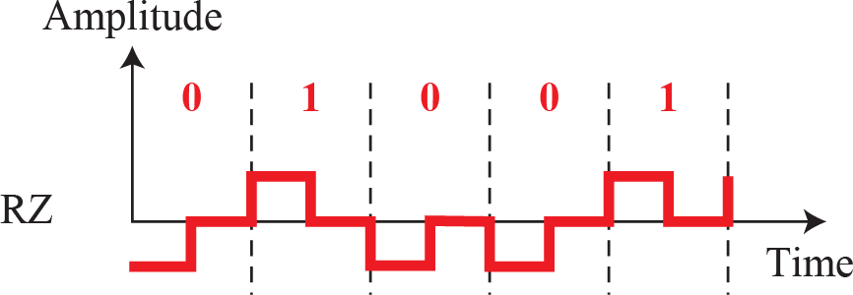
Polar schemes (RZ)

Slide 13
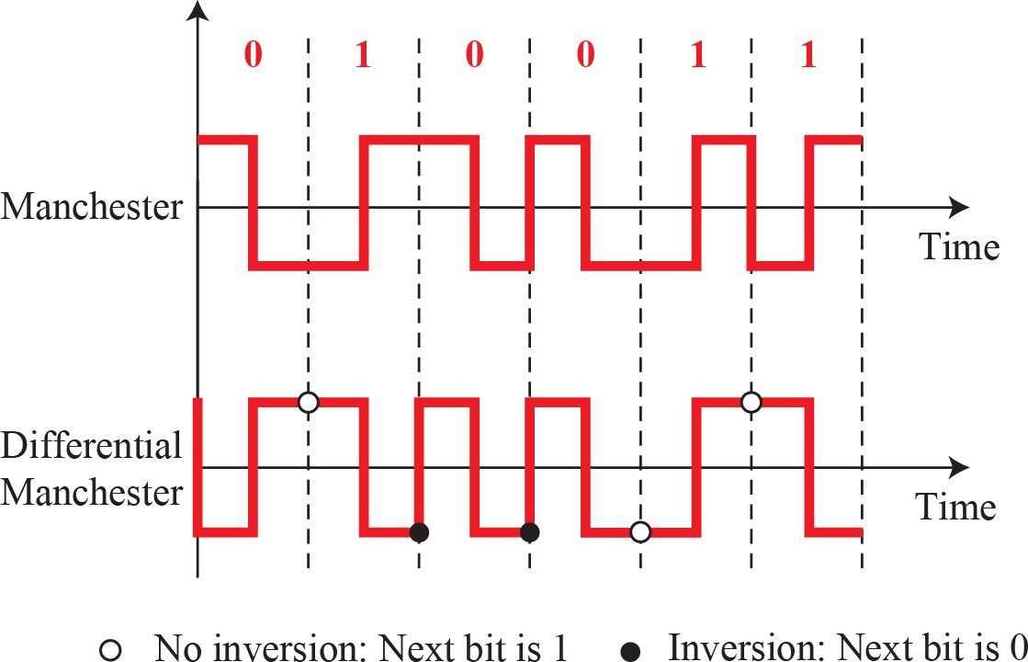
Polar biphase

Slide 14
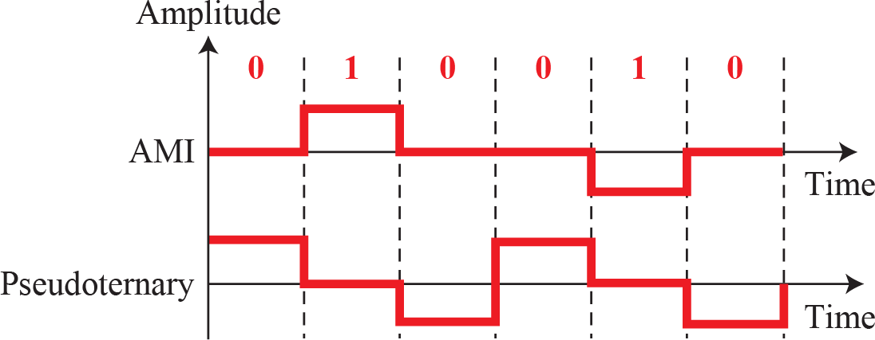
Polar schemes: AMI and pseudoternary

Slide 15
Polar schemes (RZ)

Slide 16
Polar biphase

Slide 17
Polar schemes: AMI and pseudoternary

