Slide 1
Data Communications
Lecture 15

Slide 2










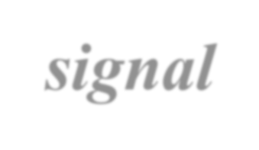



ANALOG-TO-DIGITAL CONVERSION
- to change an analog signal to digital data

Slide 3
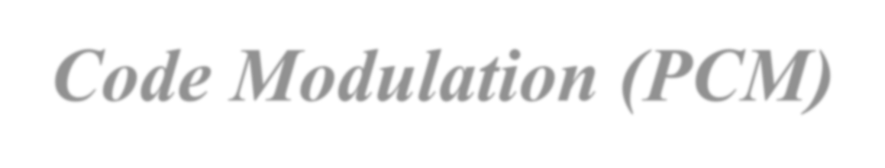


Pulse Code Modulation (PCM)
The most common technique to change an analog signal to digital data (digitization)

Slide 4
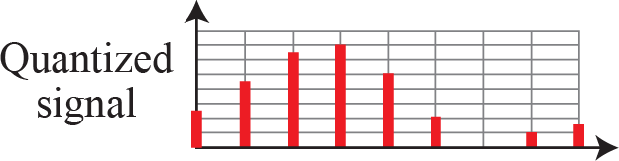
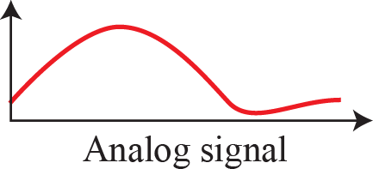
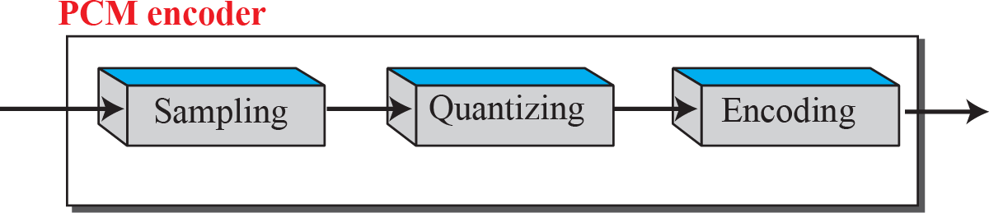
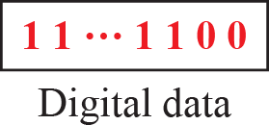
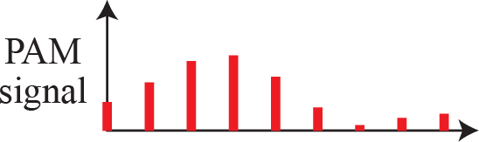
Components of PCM encoder

Slide 5
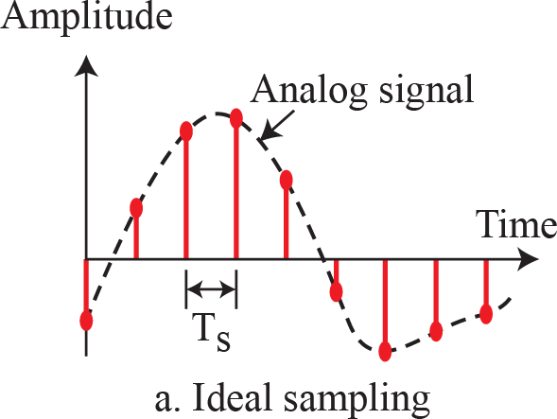
Three different sampling methods for PCM

Slide 6
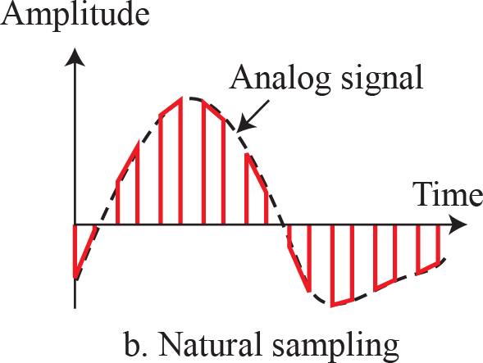
Three different sampling methods for PCM

Slide 7
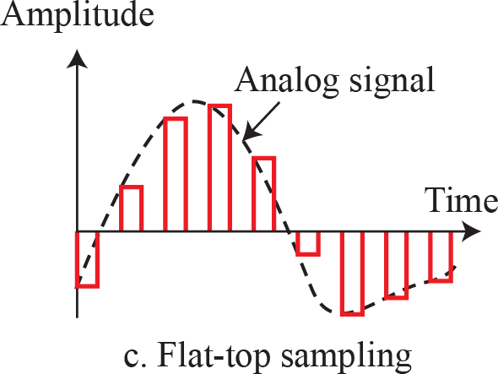
Three different sampling methods for PCM

Slide 8
Example
Telephone | companies | digitize | voice by | assuming a
maximum | frequency | of 4000 | Hz. The | sampling rate
therefore is 8000 samples per second.

Slide 9
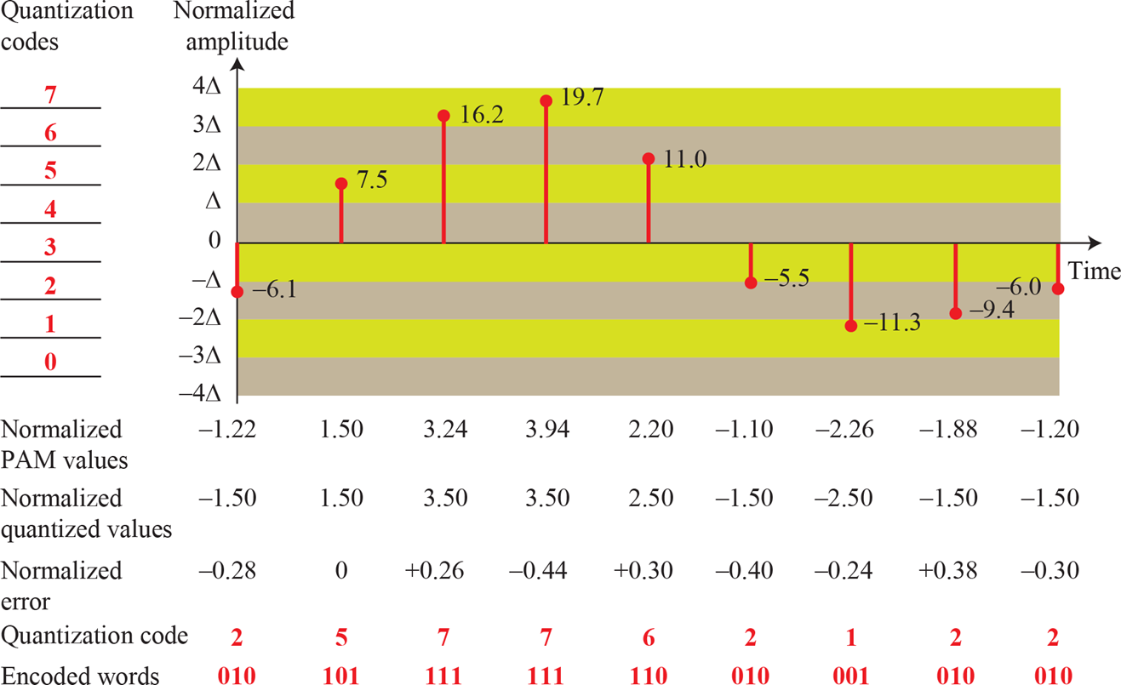
Quantization a sampled signal

Slide 10
Quantization a sampled signal

Slide 11

Quantization and encoding of a sampled signal

Slide 12
It can be proven that the contribution of the quantization error to the SNR dB of the signal depends on the number of quantization levels L, or the bits per sample nb as shown in the following formula:
SNR dB =6.02nb + 1.76 dB

Slide 13

Example
We want to digitize the human voice. What is the bit rate, assuming 8 bits per sample?
Solution
The human voice normally contains frequencies from 0 to 4000 Hz. So the sampling rate and bit rate are calculated as follows:

Slide 14
Example
What is the Nyquist sampling rate for each of the following signals?
a. A low-pass signal with bandwidth of 200 KHz?
b. A band-pass signal with bandwidth of 200 KHz if the lowest frequency is 100 KHz?
We have sampled a low-pass signal with a bandwidth of200 KHz using 1024 levels of quantization.
Calculate the bit rate of the digitized signal.
Calculate the SNRdB for this signal.
Calculate the PCM bandwidth of this signal.
What is the maximum data rate of a channel with a bandwidth of 200 KHz if we use four levels of digital signaling.
An analog signal has a bandwidth of 20 KHz. If we sample this signal and send it through a 30 Kbps channel what is the SNRdB?

Slide 15
Analog Transmission

Slide 16





DIGITAL-TO-ANALOG CONVERSION
- the process of changing one of the characteristics of an analog signal based on the information in digital data.

Slide 17
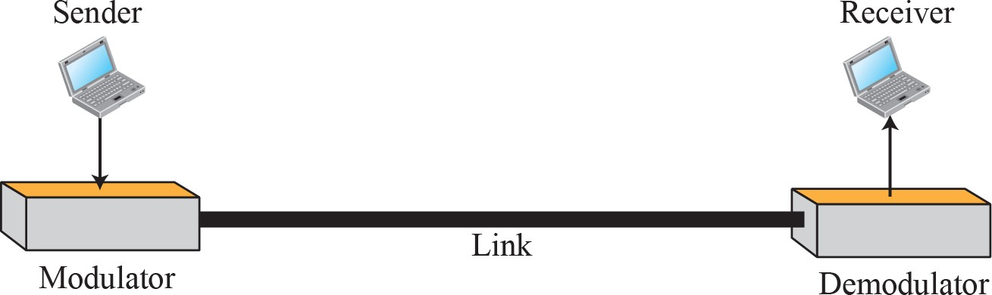
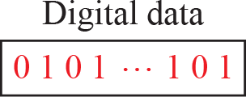
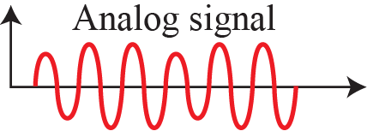
Digital-to-analog conversion
- Figure shows the relationship between the digital information, the digital-to-analog modulating process, and the resultant analog signal.

Slide 18
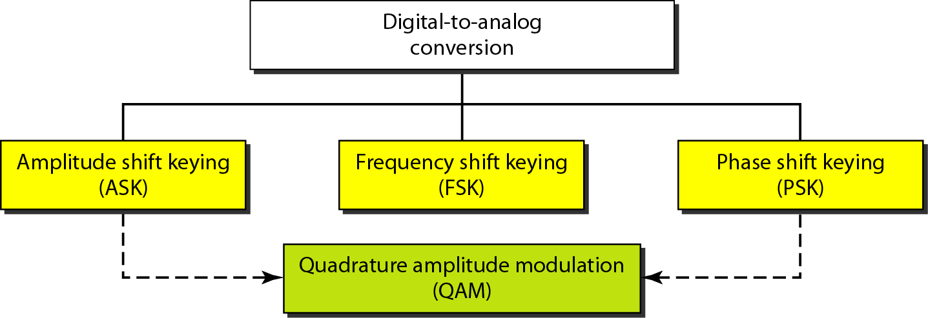
Types of digital to analog conversion

Slide 19


Amplitude Shift Keying
In amplitude shift keying, the amplitude of the carrier signal is varied to create signal elements.
Both frequency and phase remain constant while the amplitude changes.

Slide 20
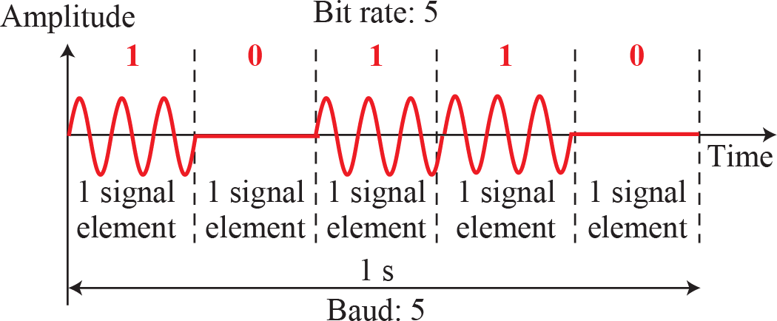
Binary amplitude shift keying

Slide 21


Frequency Shift Keying
In frequency shift keying, the frequency of the carrier signal is varied to represent data.
Both peak amplitude and phase remain constant for all signal elements.

Slide 22
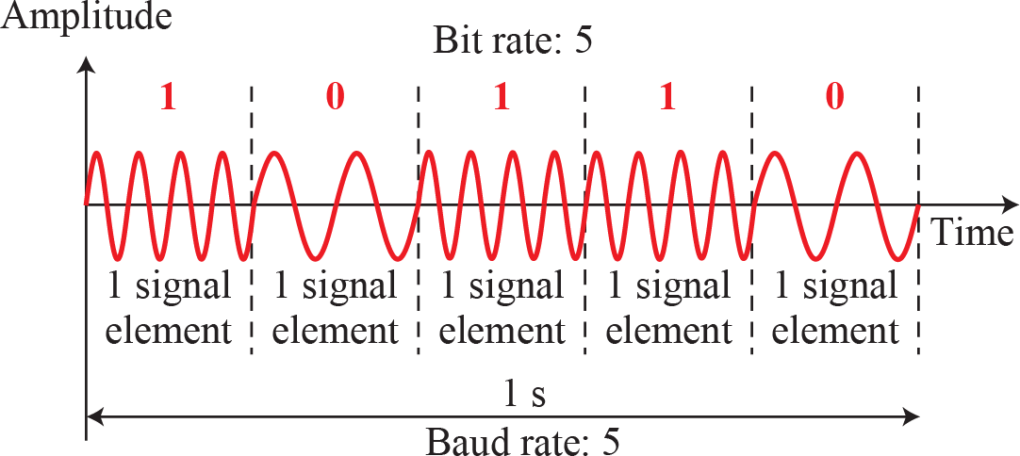
Binary frequency shift keying

Slide 23

Phase Shift Keying
In phase shift keying, the phase of the carrier is varied to represent two or more different signal elements.
Both peak amplitude and frequency remain constant as the phase changes.
Today, PSK is more common than ASK or FSK.

Slide 24
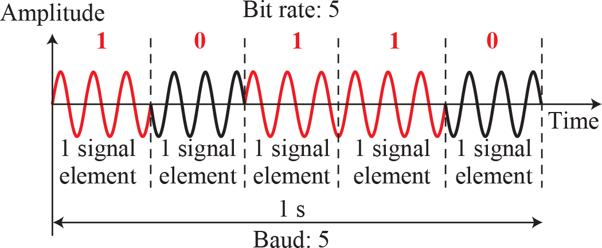
Binary phase shift keying

Slide 25


ANALOG-TO-ANALOG CONVERSION
Analog-to-analog conversion, or analog modulation, is the representation of analog information by an analog signal.
Analog-to-analog conversion can be accomplished in three ways: AM FM and PM.

Slide 26
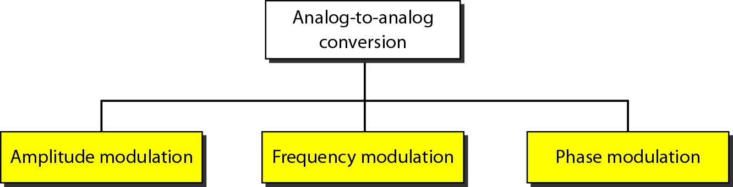
Types of analog-to-analog modulation

Slide 27
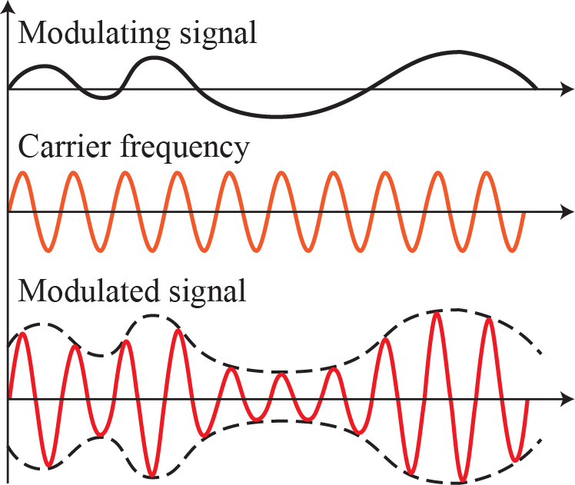
Amplitude modulation

Slide 28
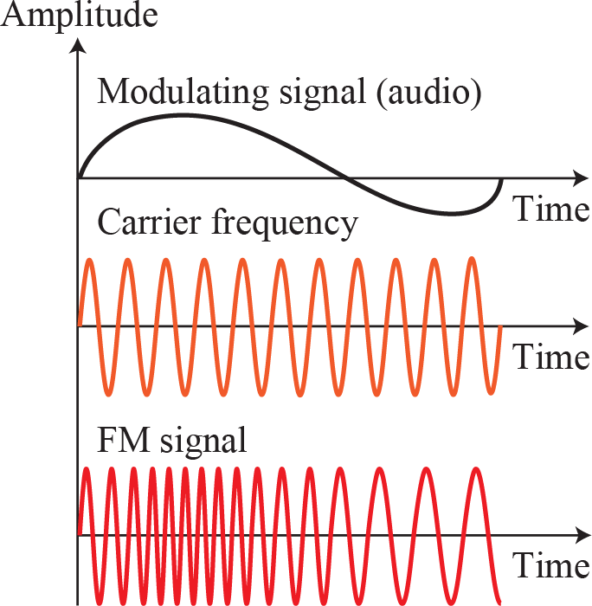
Frequency modulation

Slide 29
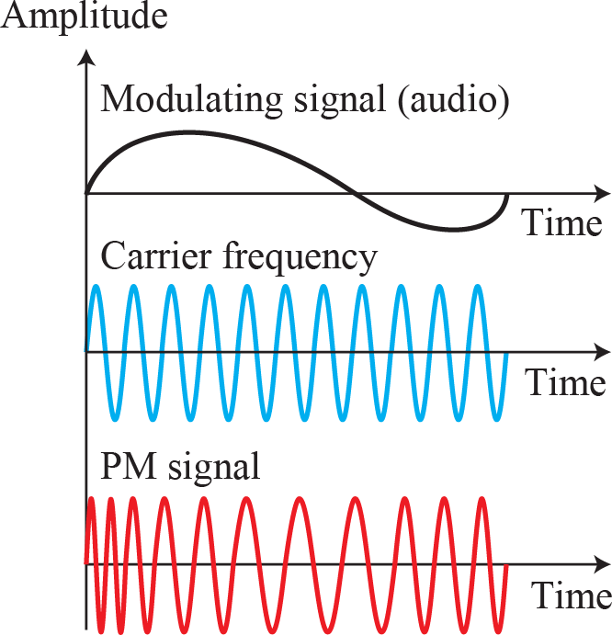
Phase modulation

