Slide 1
Data Communications
Lecture 16

Slide 2
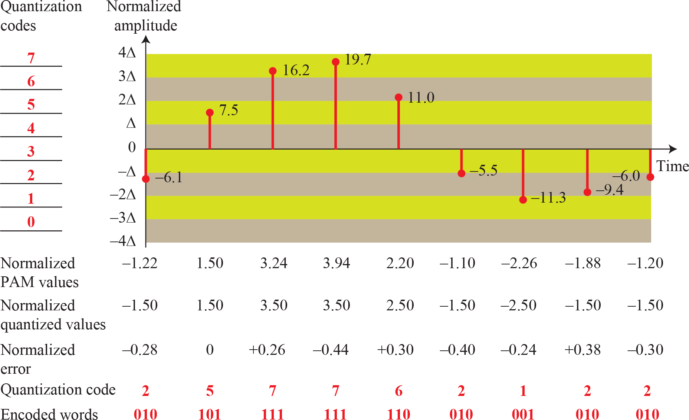
Quantization and encoding of a sampled signal

Slide 3
Quantization and encoding of a sampled signal

Slide 4
Quantization and encoding of a sampled signal

Slide 5
Quantization and encoding of a sampled signal

Slide 6
Quantization and encoding of a sampled signal

Slide 8
It can be proven that the contribution of the quantization error to the SNR dB of the signal depends on the number of quantization levels L, or the bits per sample nb as shown in the following formula:
SNR dB =6.02nb + 1.76 dB

Slide 9

Example
We want to digitize the human voice. What is the bit rate, assuming 8 bits per sample?
Solution
The human voice normally contains frequencies from 0 to 4000 Hz. So the sampling rate and bit rate are calculated as follows:

Slide 10
Example
What is the Nyquist sampling rate for each of the following signals?
a. A low-pass signal with bandwidth of 200 KHz?
b. A band-pass signal with bandwidth of 200 KHz if the lowest frequency is 100 KHz?
We have sampled a low-pass signal with a bandwidth of200 KHz using 1024 levels of quantization.
Calculate the bit rate of the digitized signal.
Calculate the SNRdB for this signal.
Calculate the PCM bandwidth of this signal.
What is the maximum data rate of a channel with a bandwidth of 200 KHz if we use four levels of digital signaling.
An analog signal has a bandwidth of 20 KHz. If we sample this signal and send it through a 30 Kbps channel what is the SNRdB?

Slide 11
Analog Transmission

Slide 12






DIGITAL-TO-ANALOG CONVERSION
- the process of changing one of the characteristics of an analog signal based on the information in digital data.

Slide 13
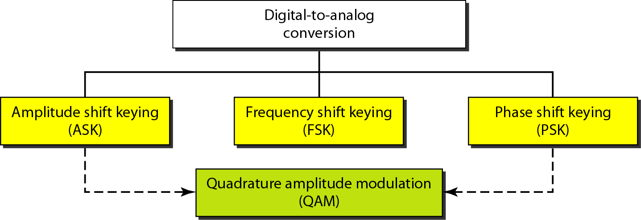
Types of digital to analog conversion

Slide 14
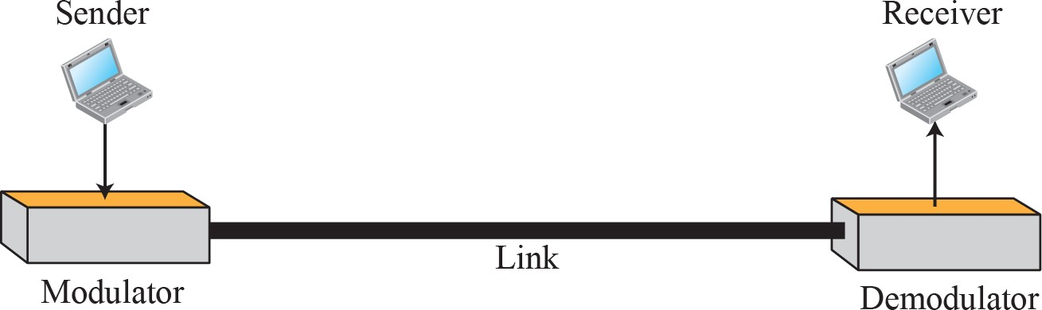
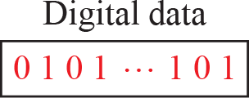
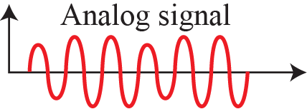
Digital-to-analog conversion
- Figure shows the relationship between the digital information, the digital-to-analog modulating process, and the resultant analog signal.

Slide 15



Amplitude Shift Keying
In amplitude shift keying, the amplitude of the carrier signal is varied to create signal elements.
Both frequency and phase remain constant while the amplitude changes.

Slide 16
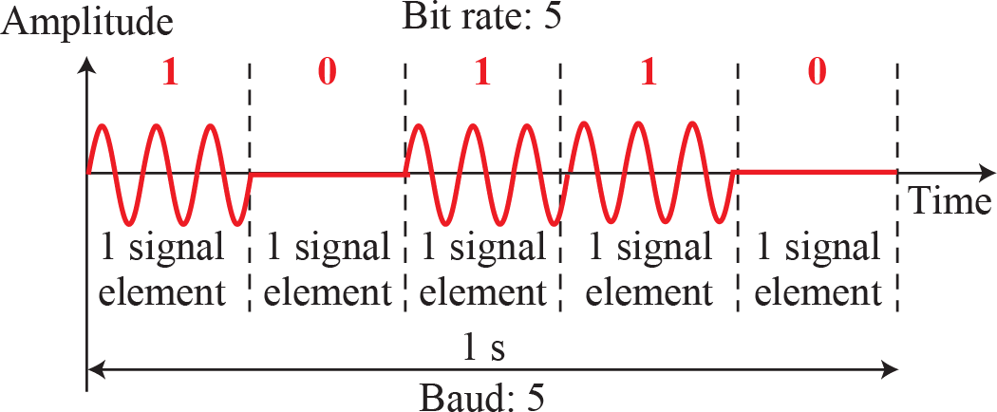
Binary amplitude shift keying

Slide 17


Frequency Shift Keying
In frequency shift keying, the frequency of the carrier signal is varied to represent data.
Both peak amplitude and phase remain constant for all signal elements.

Slide 18
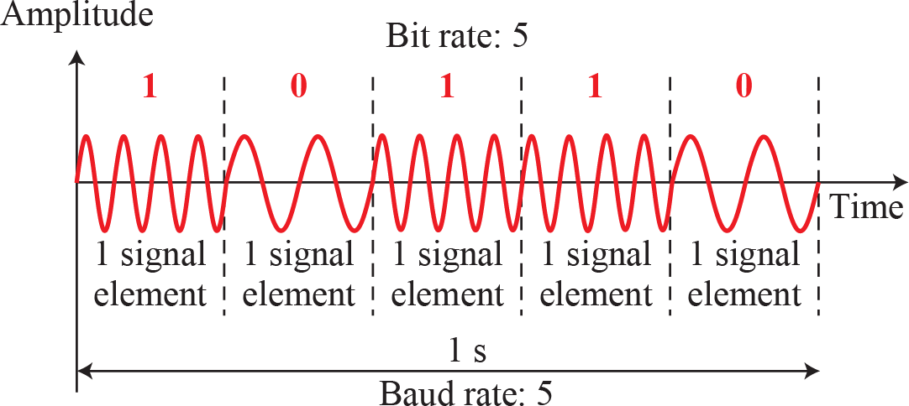
Binary frequency shift keying

Slide 19

Phase Shift Keying
In phase shift keying, the phase of the carrier is varied to represent two or more different signal elements.
Both peak amplitude and frequency remain constant as the phase changes.
Today, PSK is more common than ASK or FSK.

Slide 20
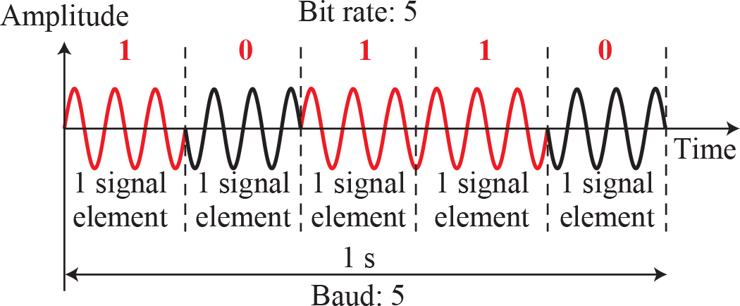
Binary phase shift keying

Slide 21





ANALOG-TO-ANALOG CONVERSION
Analog-to-analog conversion, or analog modulation, is the representation of analog information by an analog signal.
Analog-to-analog conversion can be accomplished in three ways: AM FM and PM.

Slide 22
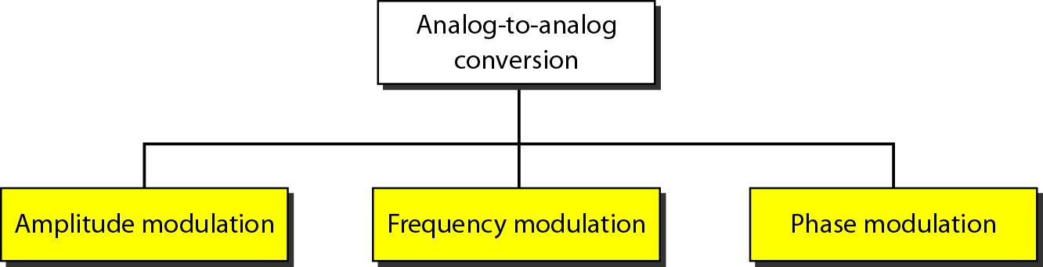
Types of analog-to-analog modulation

Slide 23
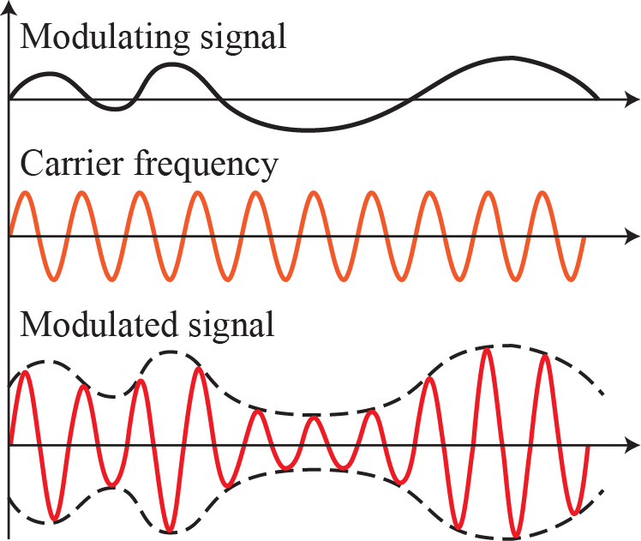
Amplitude modulation

Slide 24
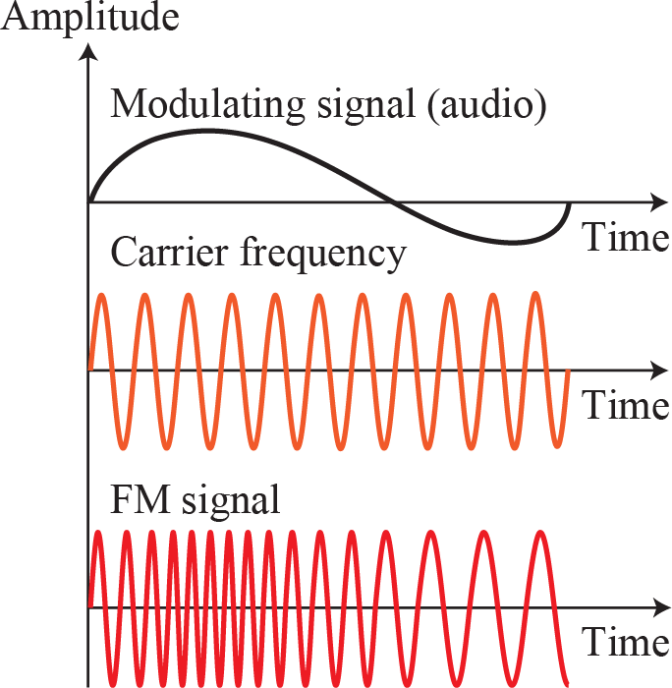
Frequency modulation

Slide 25
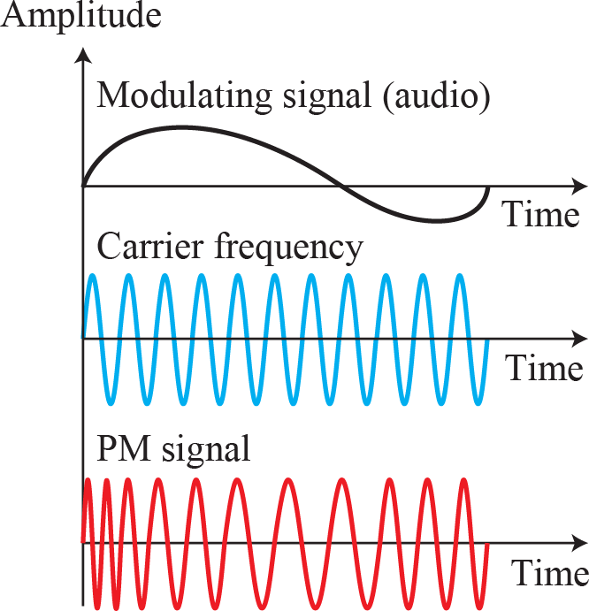
Phase modulation

