Slide 1
Data Communications
Lecture 17

Slide 2
Example
What is the Nyquist sampling rate for each of the following signals?
a. A low-pass signal with bandwidth of 200 KHz?
b. A band-pass signal with bandwidth of 200 KHz if the lowest frequency is 100 KHz?
We have sampled a low-pass signal with a bandwidth of200 KHz using 1024 levels of quantization.
Calculate the bit rate of the digitized signal.
Calculate the SNRdB for this signal.
Calculate the PCM bandwidth of this signal.
What is the maximum data rate of a channel with a bandwidth of 200 KHz if we use four levels of digital signaling.
An analog signal has a bandwidth of 20 KHz. If we sample this signal and send it through a 30 Kbps channel what is the SNRdB?

Slide 3






DIGITAL-TO-ANALOG CONVERSION
- the process of changing one of the characteristics of an analog signal based on the information in digital data.

Slide 4
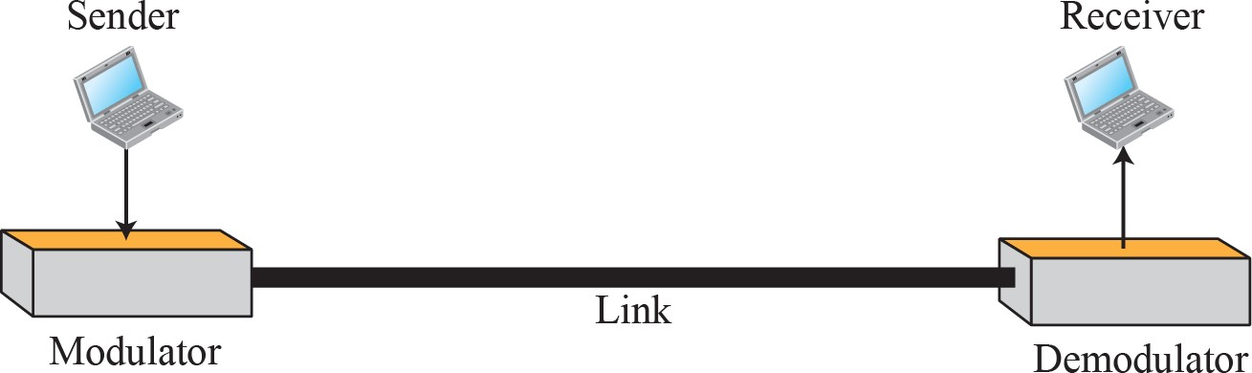
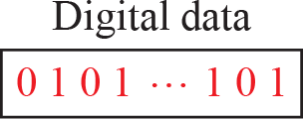
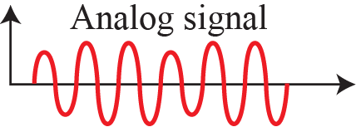
Digital-to-analog conversion
- Figure shows the relationship between the digital information, the digital-to-analog modulating process, and the resultant analog signal.

Slide 5
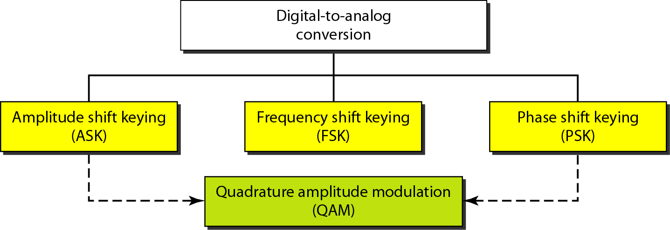
Types of digital to analog conversion

Slide 6



Amplitude Shift Keying
In amplitude shift keying, the amplitude of the carrier signal is varied to create signal elements.
Both frequency and phase remain constant while the amplitude changes.

Slide 7
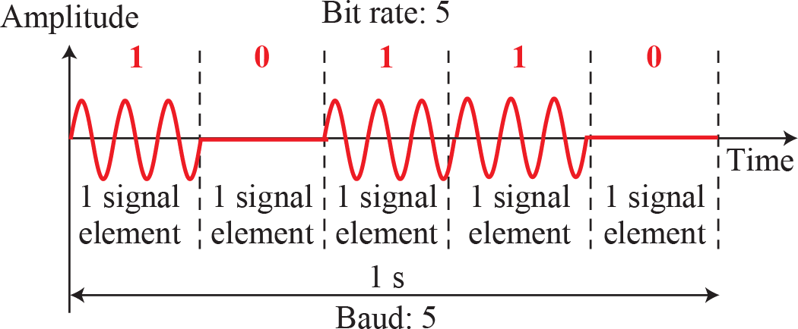
Binary amplitude shift keying

Slide 8


Frequency Shift Keying
In frequency shift keying, the frequency of the carrier signal is varied to represent data.
Both peak amplitude and phase remain constant for all signal elements.

Slide 9
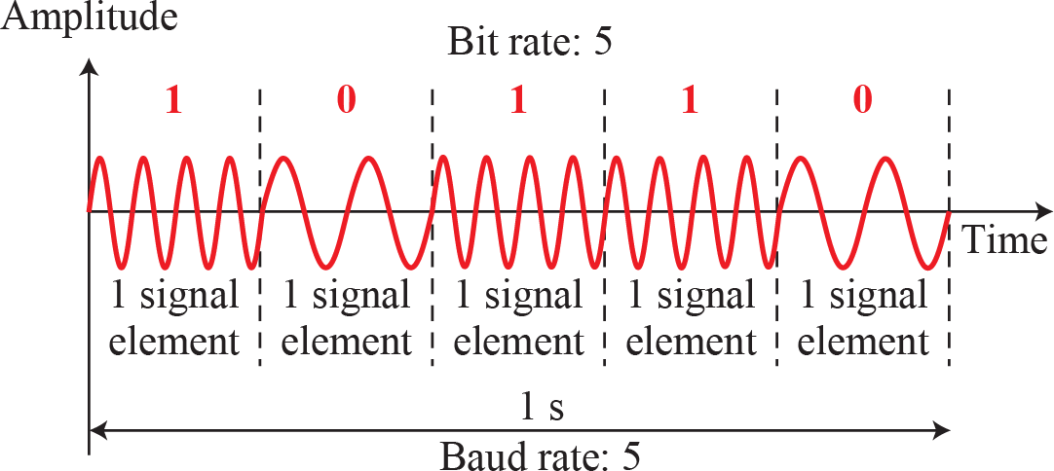
Binary frequency shift keying

Slide 10

Phase Shift Keying
In phase shift keying, the phase of the carrier is varied to represent two or more different signal elements.
Both peak amplitude and frequency remain constant as the phase changes.
Today, PSK is more common than ASK or FSK.

Slide 11
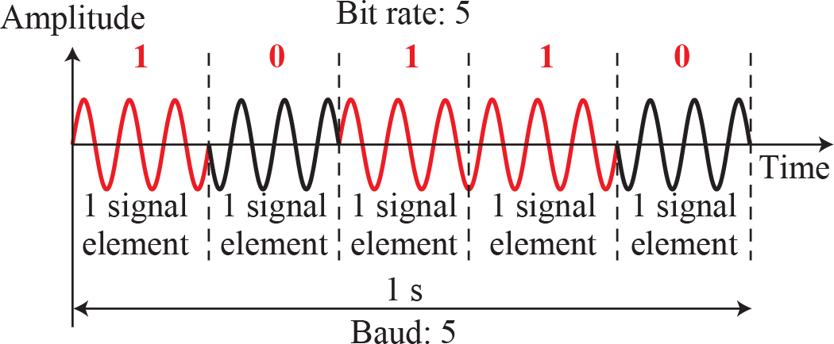
Binary phase shift keying

Slide 12
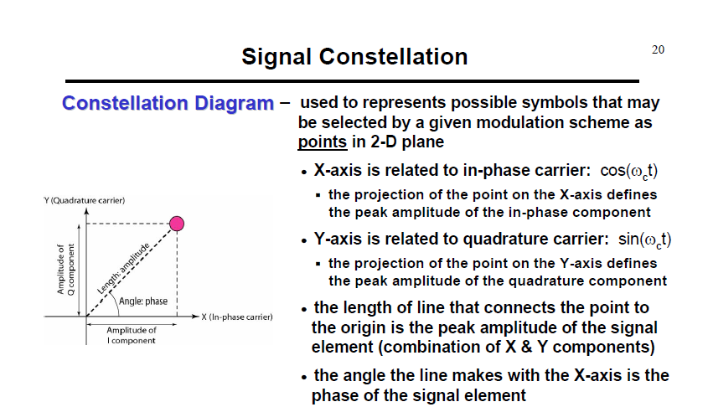

Slide 13


