Slide 1
Data Communications
Lecture 18

Slide 2
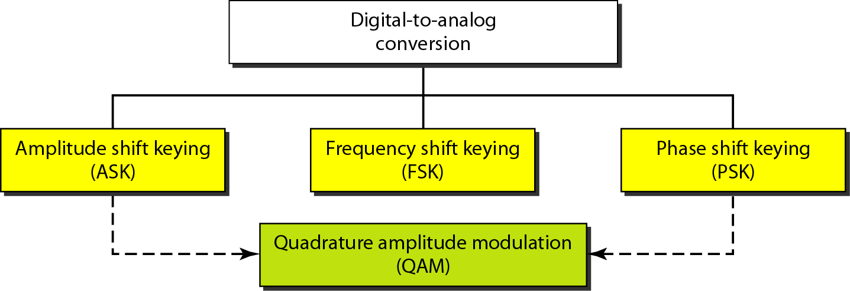
Types of digital to analog conversion

Slide 3
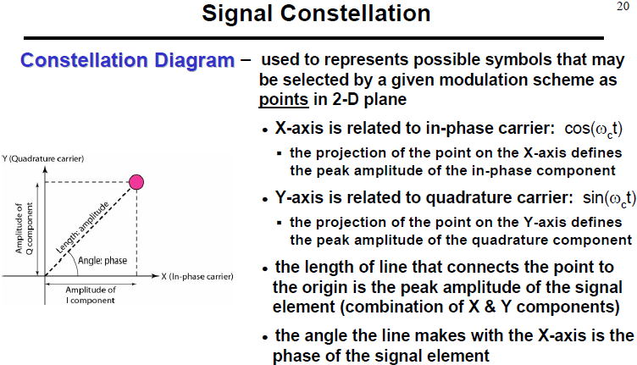

Slide 4

Constellation Diagram

Slide 5
Constellation Diagram

Slide 6
Constellation Diagram

Slide 7
Constellation Diagram

Slide 8
ASK:Constellation Diagram

Slide 9
PSK:Constellation Diagram

Slide 10
QPSK:Constellation Diagram

Slide 11
FSK:Constellation Diagram

Slide 12
GENRATION OF ASK:

Slide 13
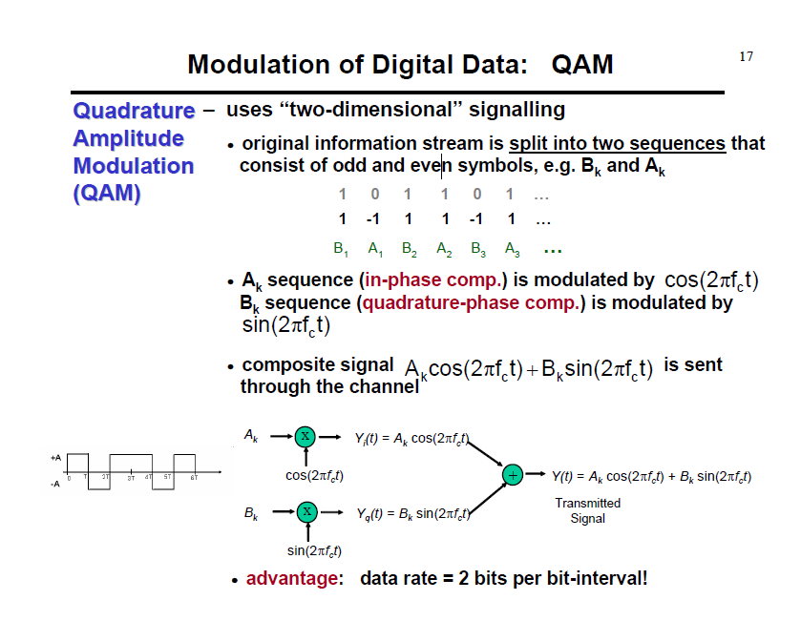

Slide 15
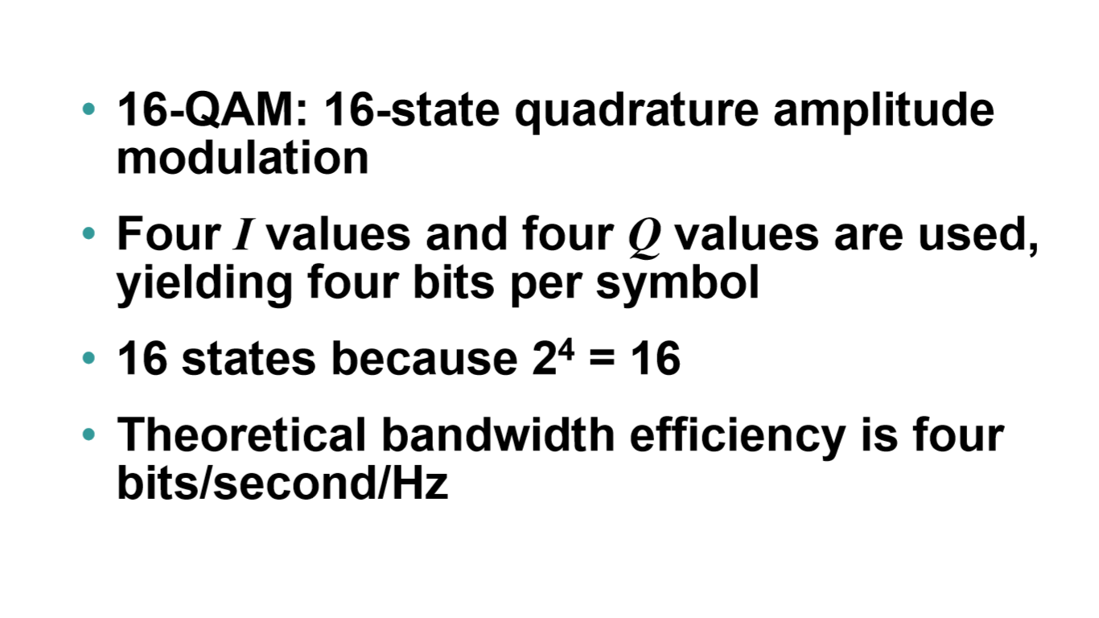

Slide 16
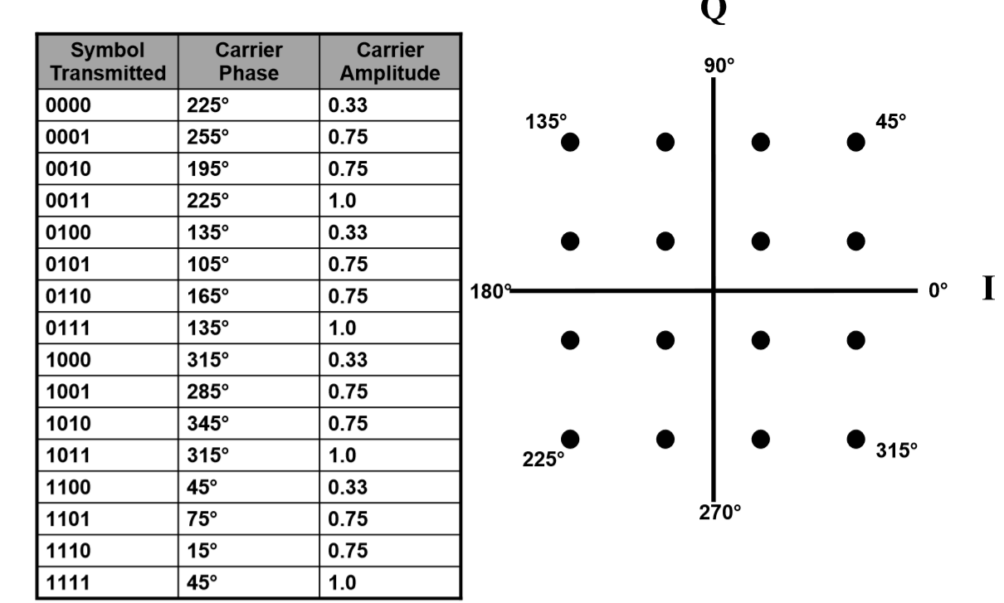

Slide 17
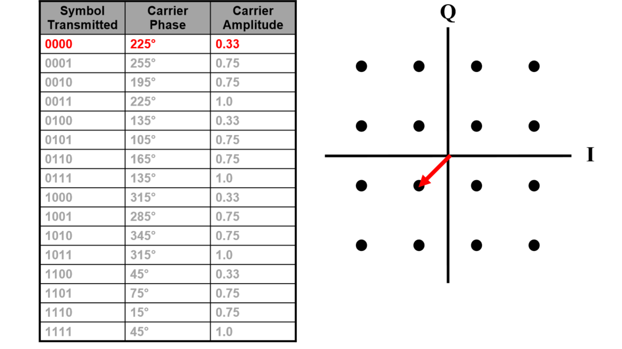

Slide 18
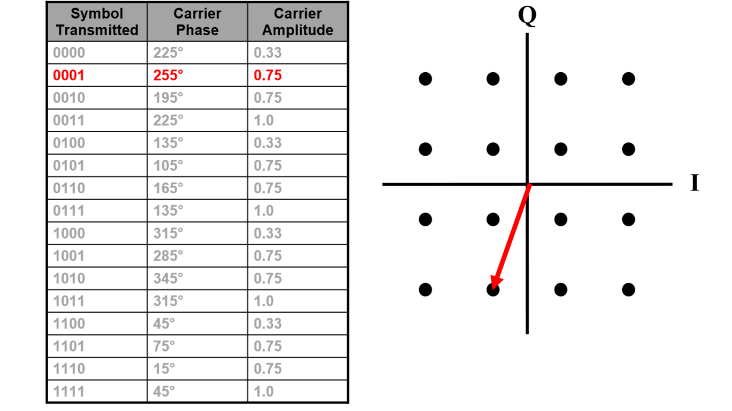

Slide 19
