Slide 1
Data Communications
Lecture 20

Slide 2
Generation & Detection of QAM

Slide 3
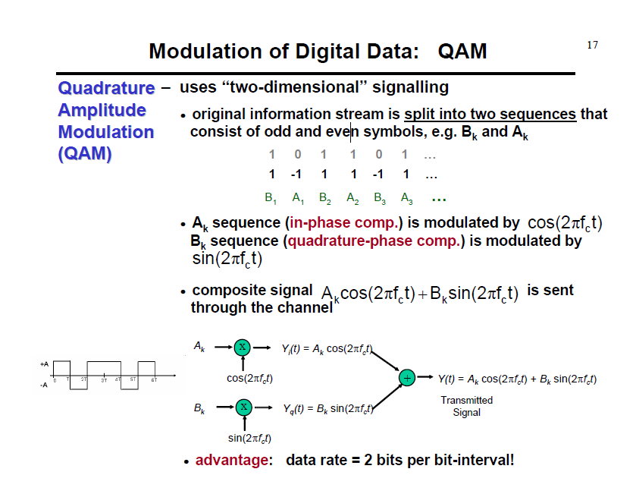

Slide 4
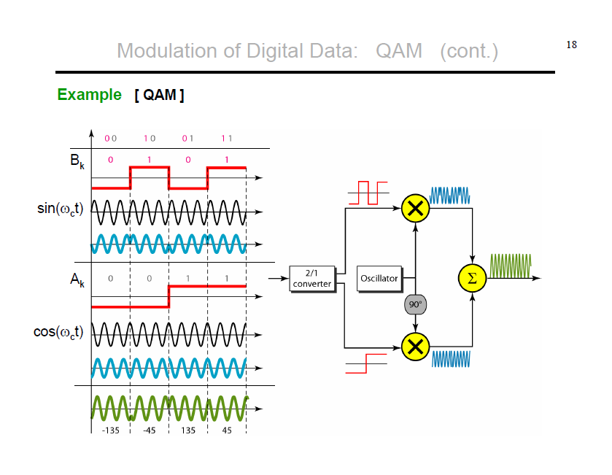

Slide 5
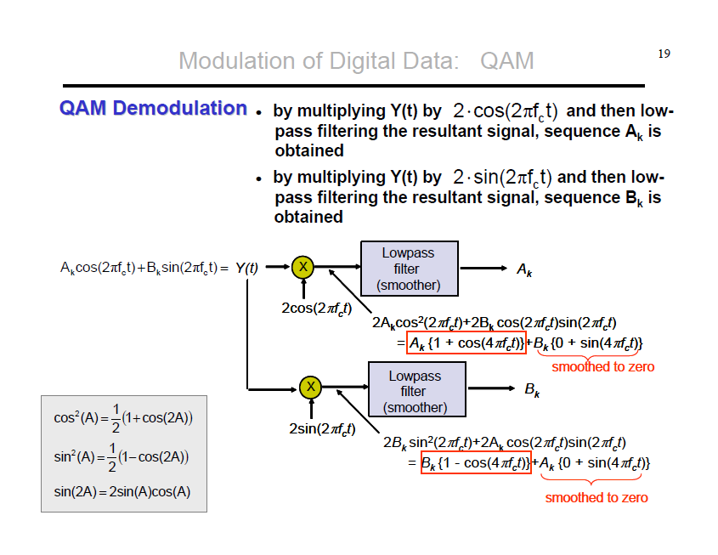

Slide 7
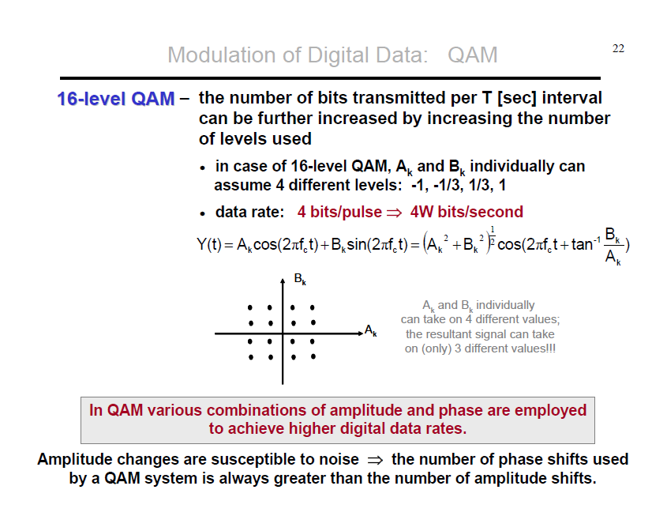
4-QAM, 8-QAM, 16-QAM, 32-QAM, 64-QAM, 128-QAM, 256-QAM

Slide 10
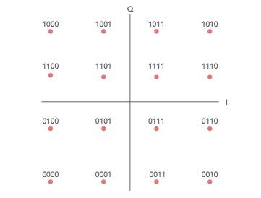

Slide 11
QAM FORMATS & BIT RATES COMPARISON
MODULATION | BITS PER SYMBOL | SYMBOL RATE
ASK/BPSK | 1 | 1 x bit rate
4QAM | 2 | 1/2 bit rate
8QAM | 3 | 1/3 bit rate
16QAM | 4 | 1/4 bit rate
32QAM | 5 | 1/5 bit rate
64QAM | 6 | 1/6 bit rate

