Slide 1
Data Communications
Lecture 24

Slide 2
Review Questions and Exercises

Slide 3
Draw the constellation diagram for the following: a. ASK, with peak amplitude values of 1 and 3 b. BPSK, with a peak amplitude value of2 c. QPSK, with a peak amplitude value of 3 d. 8-QAM with two different peak amplitude values, I and 3, and four different phases.

Slide 4
Define constellation diagram.
A constellation diagram helps us to define the amplitude and phase of a signal element.
The diagram is useful when we are dealing with multilevel PSK, or QAM.
In a constellation diagram, a signal element type is represented as a dot. The bit or combination of bits it can carry is often written next to it. The diagram has two axes. The horizontal X axis is related to the in-phase carrier; the vertical Y axis is related to the quadrature carrier.

Slide 5
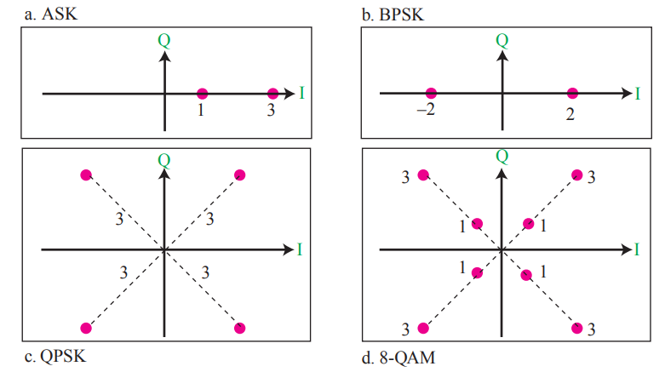
a. ASK, with peak amplitude values of 1 and 3 b. BPSK, with a peak amplitude value of 2 c. QPSK, with a peak amplitude value of 3 d. 8-QAM with two different peak amplitude values, I and 3, and four different phases.

Slide 6
Draw the constellation diagram for the following cases. Find the peak amplitude value for each case and define the type of modulation (ASK, FSK, PSK, or QAM). The numbers in parentheses define the values of I and Q respectively.
a. Two points at (2, 0) and (3, 0).
b. Two points at (3, 0) and (-3, 0).
c. Four points at (2, 2), (-2, 2), (-2, -2), and (2, -2).
d. Two points at (0 , 2) and (0, -2).

Slide 7
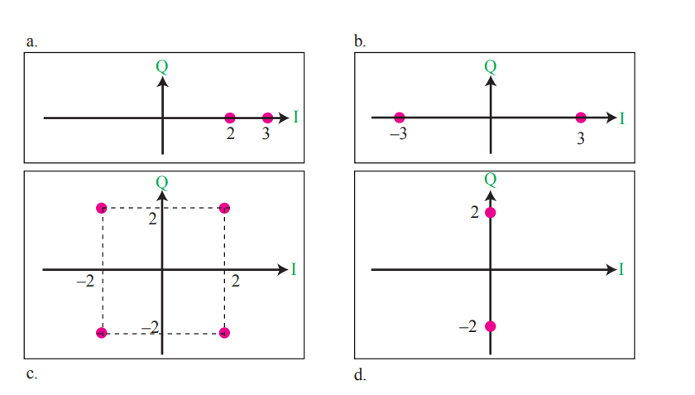

Slide 8
How many bits per baud can we send in each of the following cases if the signal constellation has one of the following number of points?
a. 2
b. 4
c. 16
d. 1024

Slide 9
What is the required bandwidth for the following cases if we need to send 4000 bps? Let d = 1.
a. ASK
b. FSK with 2df =4 KHz
c. QPSK
d. 16-QAM

Slide 10
The telephone line has 4 KHz bandwidth. What is the maximum number of bits we can send using each of the following techniques? Let d = O.
a. ASK
b. QPSK
c. 16-QAM
d.64-QAM

