Slide 1
Data Communications
Lecture 25

Slide 2
Digital Data Communication Techniques

Slide 3
Error Detection and Correction

Slide 4
Types of Errors
Whenever bits flow from one point to another, they are subject to unpredictable changes because of interference.
Single-bit error: only 1 bit data is changed from 1 to 0 or from 0 to 1.
Burst error: 2 or more bits have changed from 1 to 0 or from 0 to 1.

Slide 5
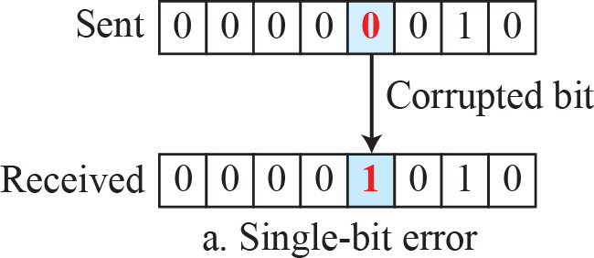
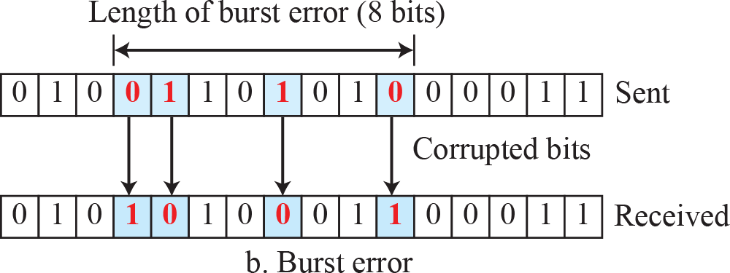
Single-bit and burst error

Slide 6
Redundancy
The central concept in detecting or correcting errors is redundancy.
To be able to detect or correct errors, we need to send some extra bits with our data.
These redundant bits are added by the sender and removed by the receiver.

Slide 7
Coding
Redundancy is achieved through various coding schemes.
The sender adds redundant bits through a process that creates a relationship between the redundant bits and the actual data bits.
The receiver checks the relationships between the two sets of bits to detect errors.

Slide 8
Block Coding
We divide our message into blocks, each of k bits, called datawords.
We add r redundant bits to each block to make the length n = k + r.
The resulting n-bit blocks are called codewords.

Slide 9
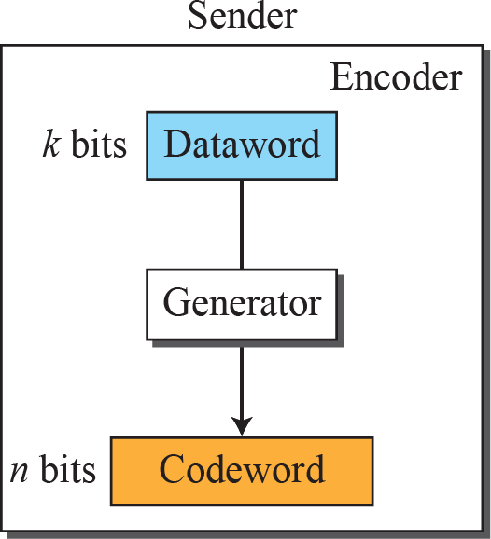
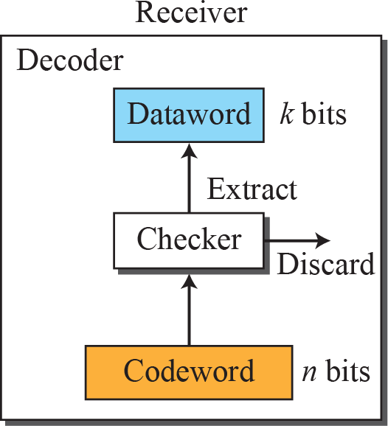

Process of error detection in block coding

Slide 10
Parity-check code

Slide 11
Cyclic Redundancy Check
is used in networks such as LANs and WANs.

Slide 12
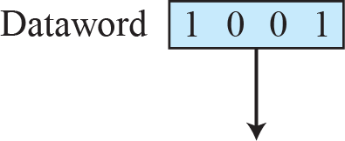
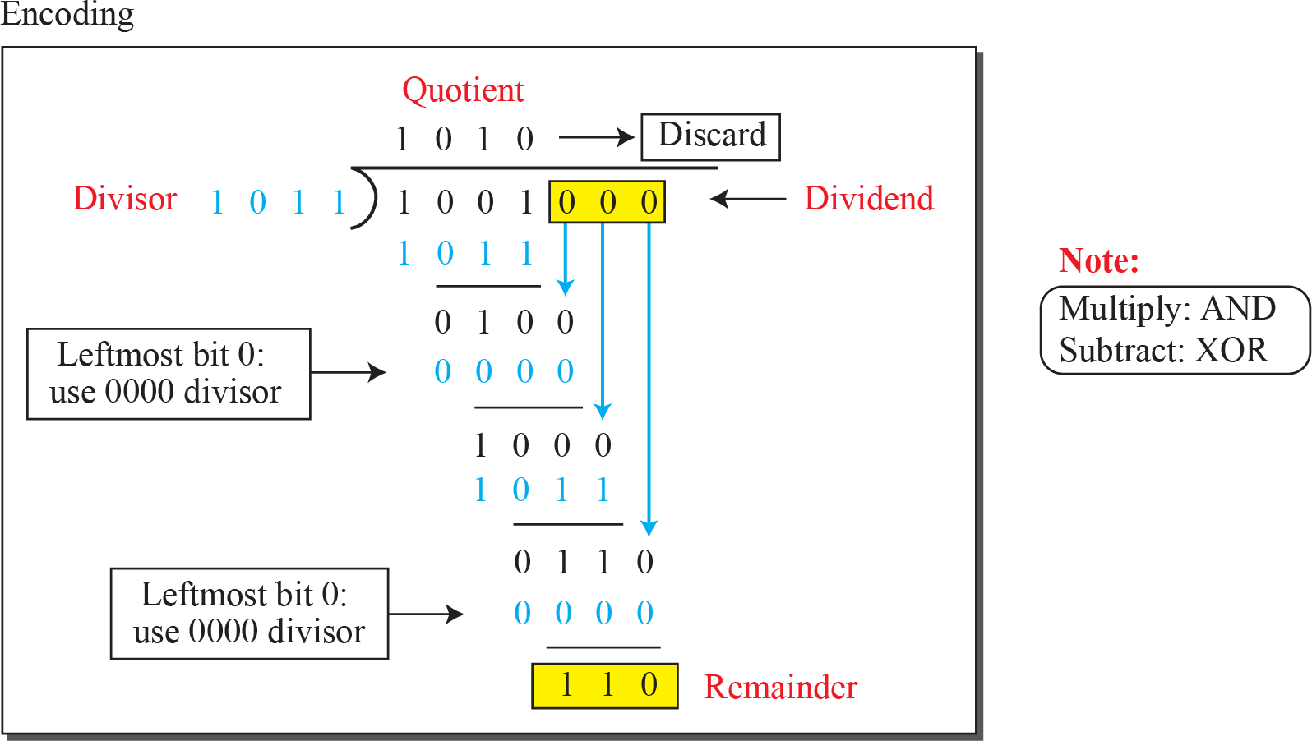
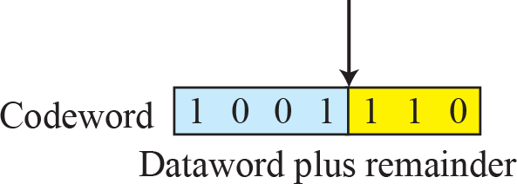
Figure 10.6: Division in CRC encoder

Slide 13
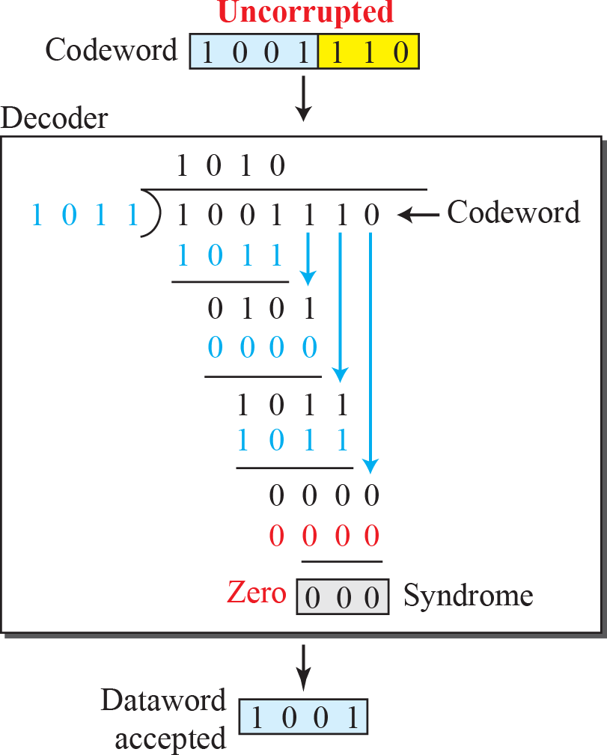
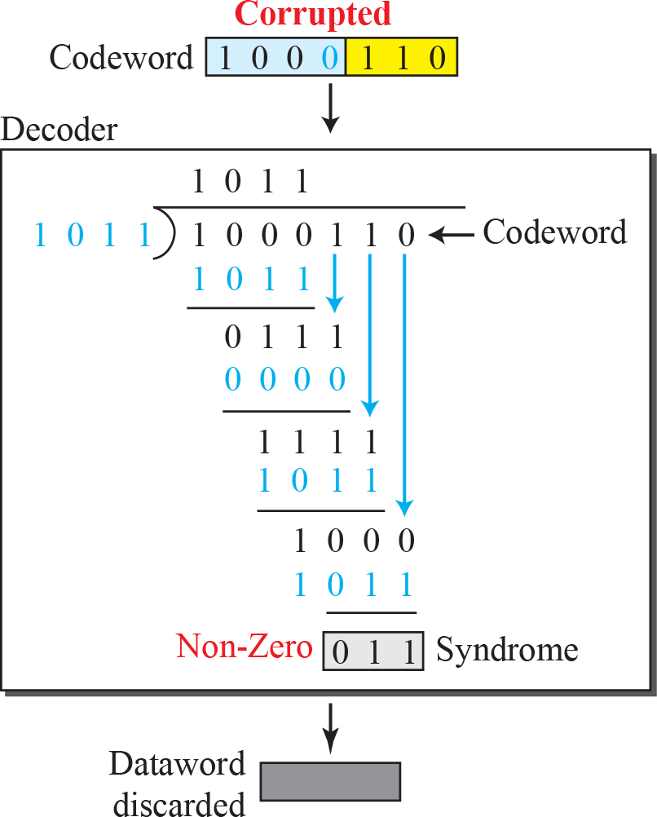
Division in the CRC decoder for two cases

Slide 14
Polynomials
A better way to understand cyclic codes
A pattern of 0s and 1s can be represented as a polynomial with coefficients of 0 and 1.
The power of each term shows the position of the bit
the coefficient shows the value of the bit.

Slide 15
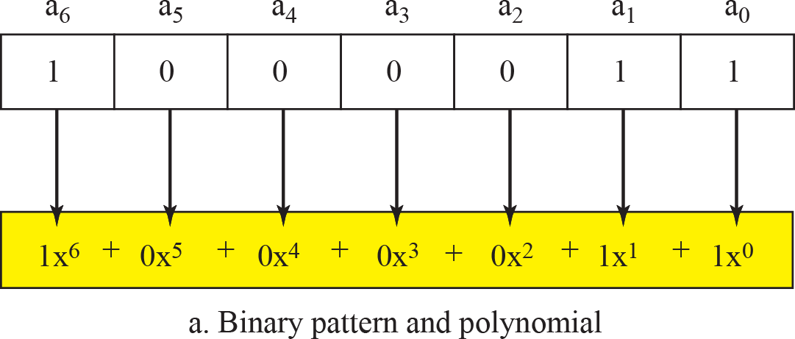
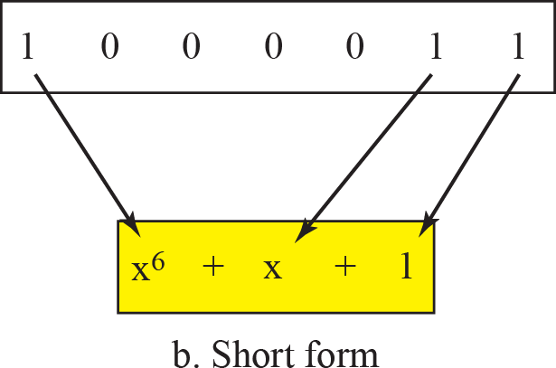
Figure 10.8: A polynomial to represent a binary word

Slide 16
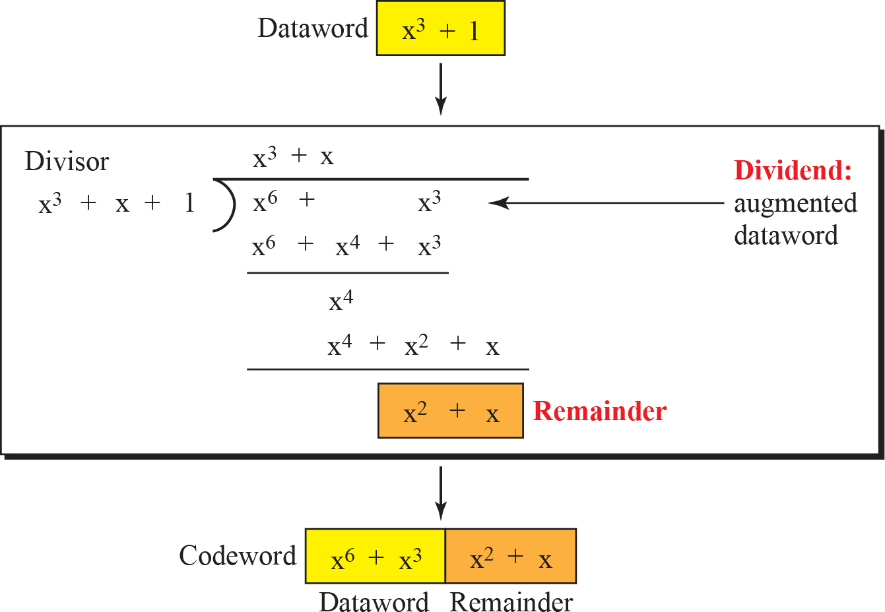
CRC division using polynomials

Slide 17
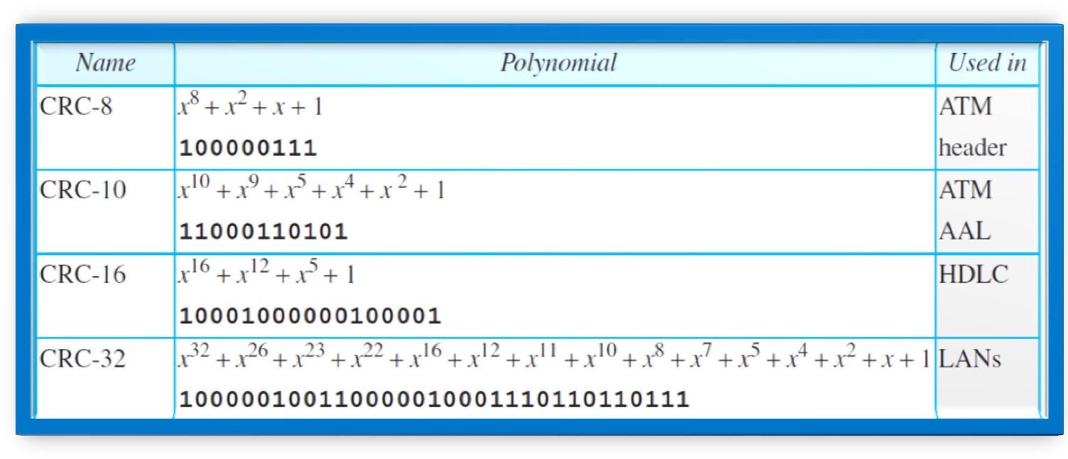
Standard polynomials

Slide 18
Checksum
Checksum is an error-detecting technique that can be applied to a message of any length.
In the Internet, the checksum technique is mostly used at the network and transport layer rather than the data-link layer.

