Slide 1
Data Communications
Lecture 26

Slide 2
Cyclic Redundancy Check
is used in networks such as LANs and WANs.

Slide 3
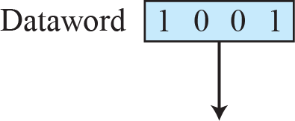
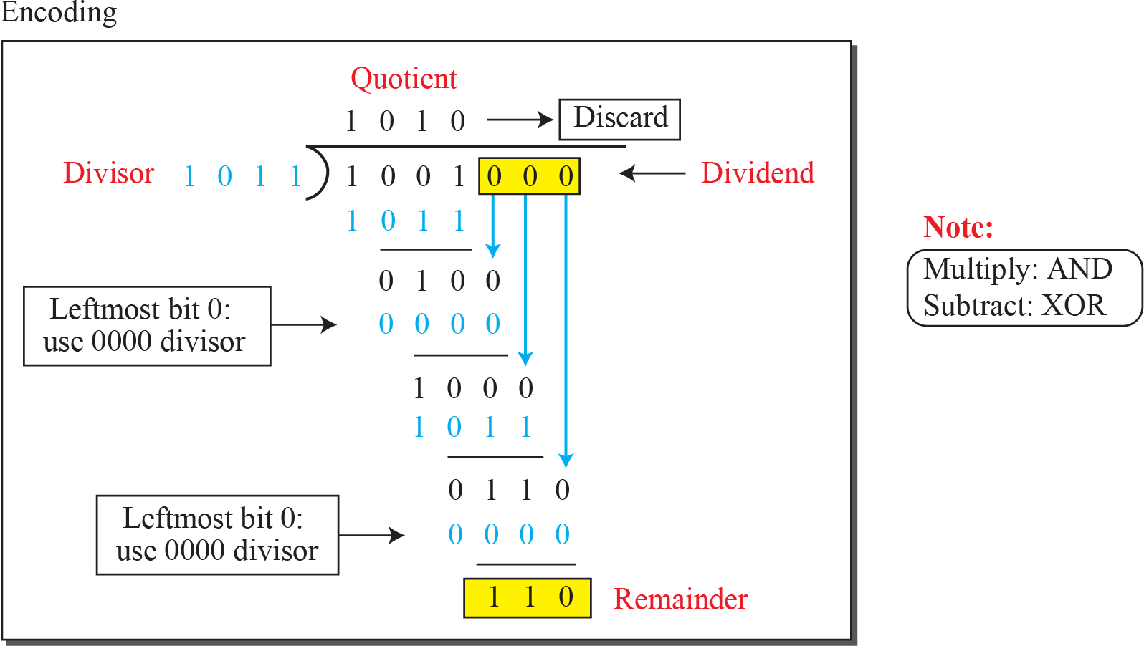
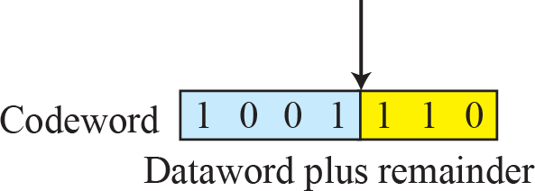
Division in CRC encoder

Slide 4
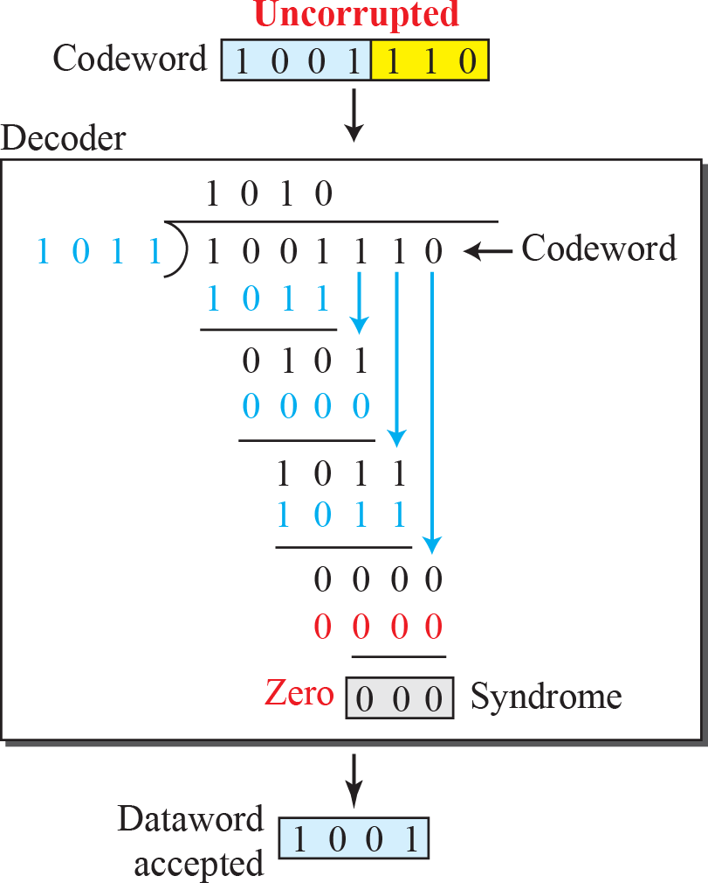
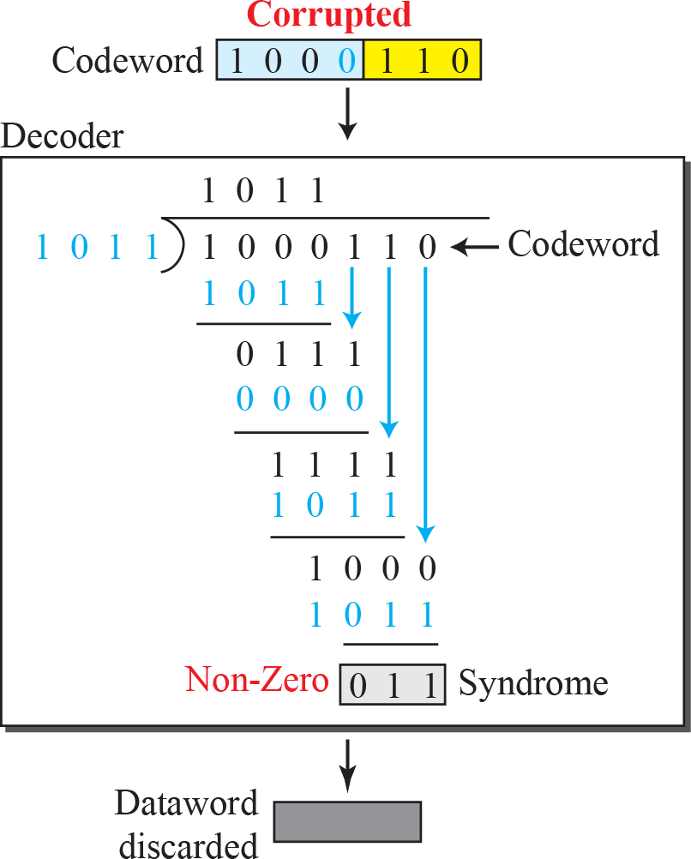
Division in the CRC decoder for two cases

Slide 5
Polynomials
A better way to understand cyclic codes
A pattern of 0s and 1s can be represented as a polynomial with coefficients of 0 and 1.
The power of each term shows the position of the bit
the coefficient shows the value of the bit.

Slide 6
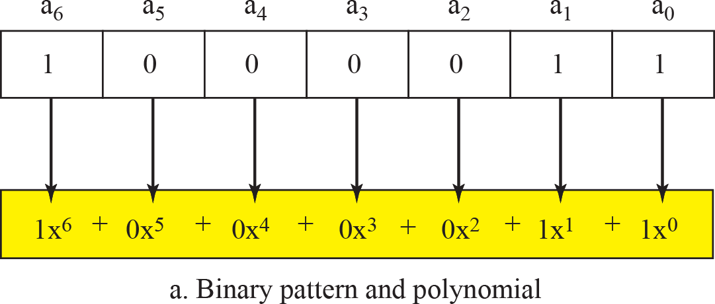
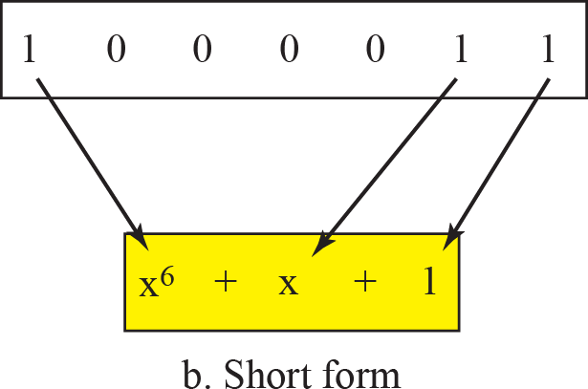
A polynomial to represent a binary word

Slide 7
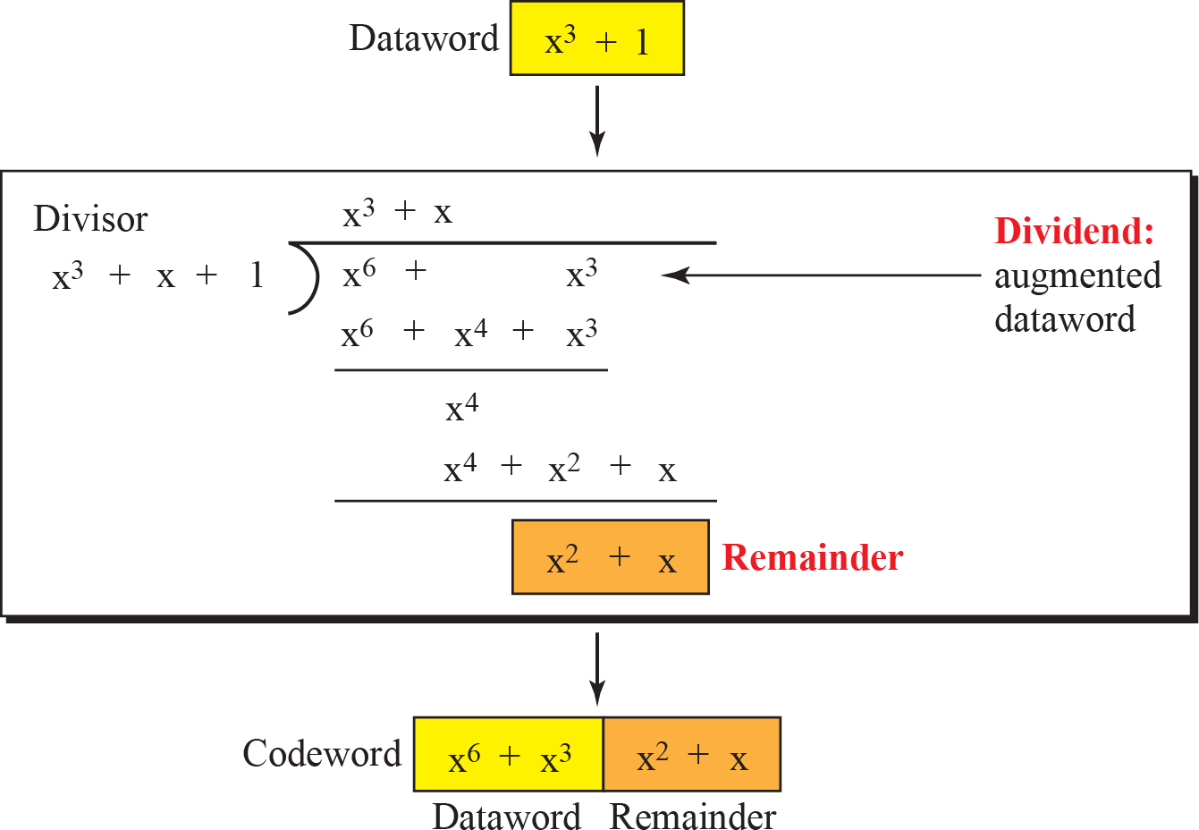
CRC division using polynomials

Slide 8
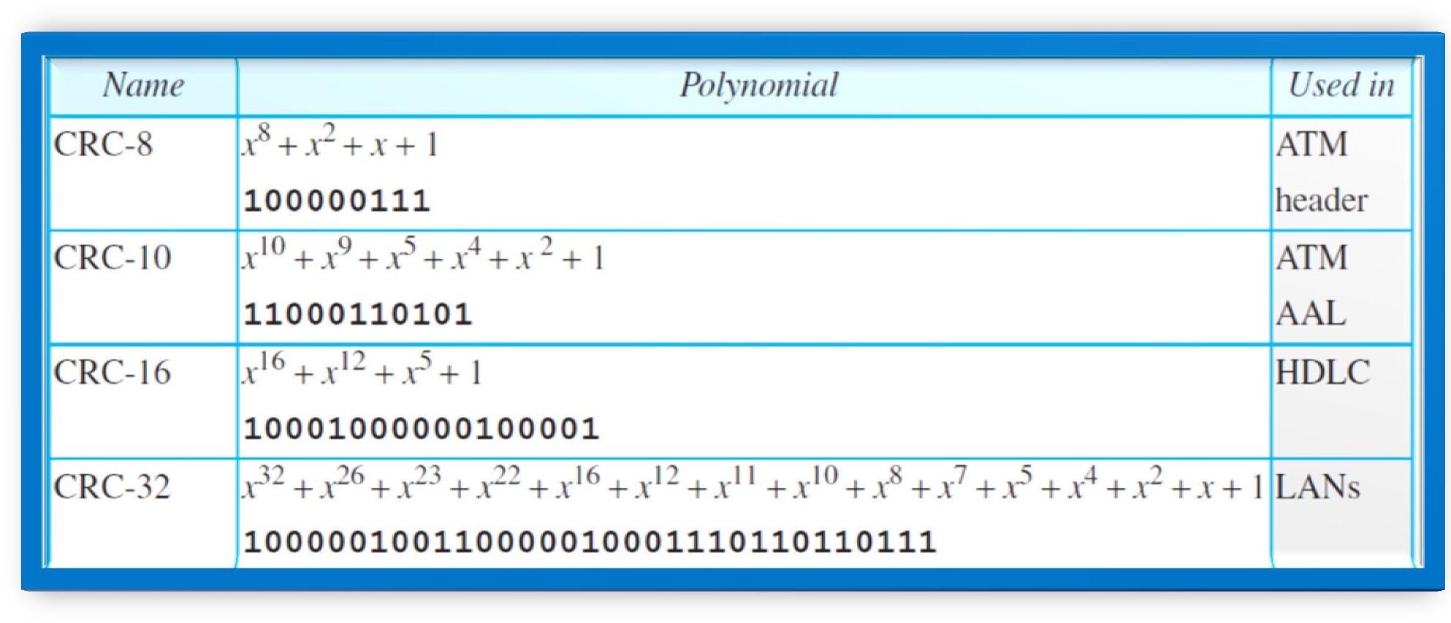
Standard polynomials

Slide 9

Note
The Hamming distance between two words is the number of differences between corresponding bits.

Slide 10
Example
Let us find the Hamming distance between two pairs of words.
1. The Hamming distance d(000, 011) is 2 because
2. The Hamming distance d(10101, 11110) is 3 because

Slide 11
Example
Find the minimum Hamming distance of the coding scheme in following Table

Slide 12
Example
Solution
We first find all the Hamming distances.
The d_{min} in this case is 3.

Slide 13
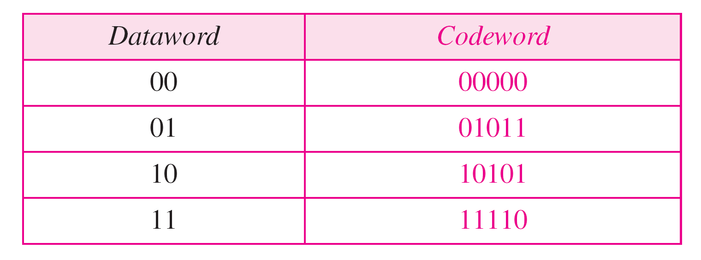
Example
Find the minimum Hamming distance of the coding scheme in Table.

Slide 14
Example
Solution
We first find all the Hamming distances.
The d_{min} in this case is 3.

Slide 15
Note
To guarantee the detection of up to s errors in all cases, the minimum
Hamming distance in a block code must be d_{min} = s + 1.

Slide 16
Checksum
Checksum is an error-detecting technique that can be applied to a message of any length.
In the Internet, the checksum technique is mostly used at the network and transport layer rather than the data-link layer.

