Slide 1
Data Communications
Lecture 27

Slide 2
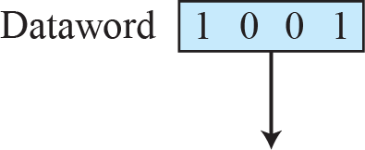
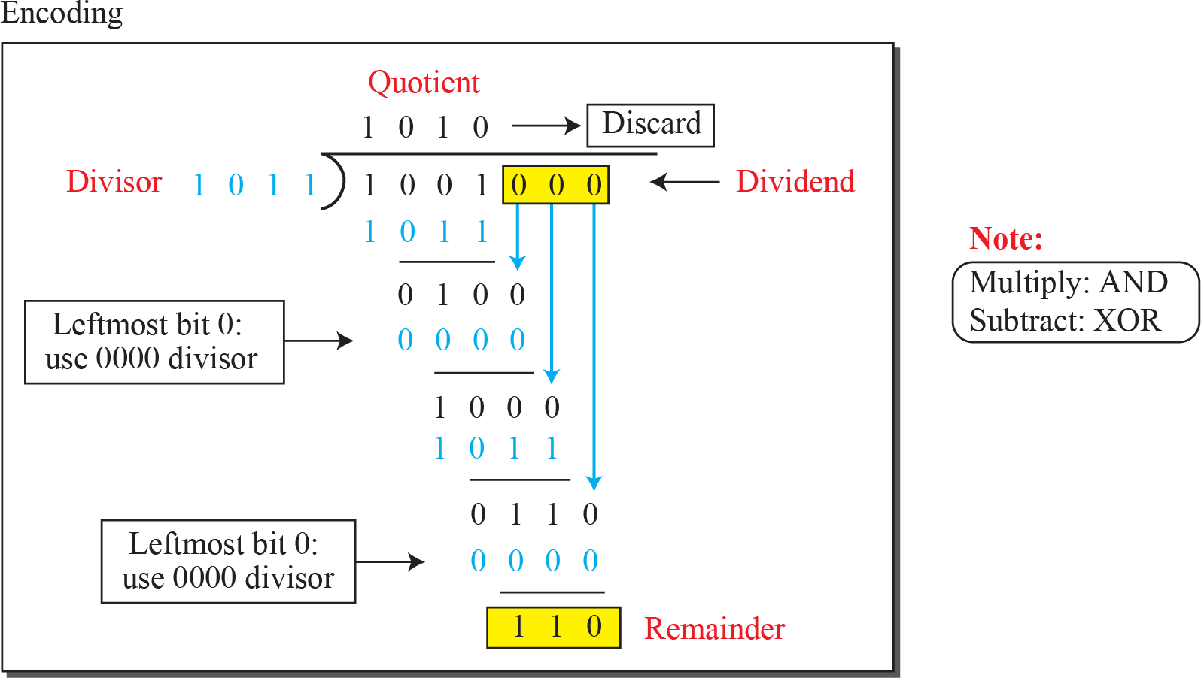
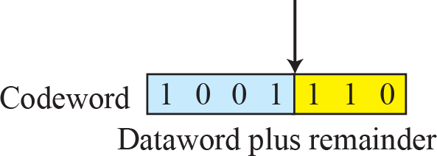
Division in CRC encoder

Slide 3
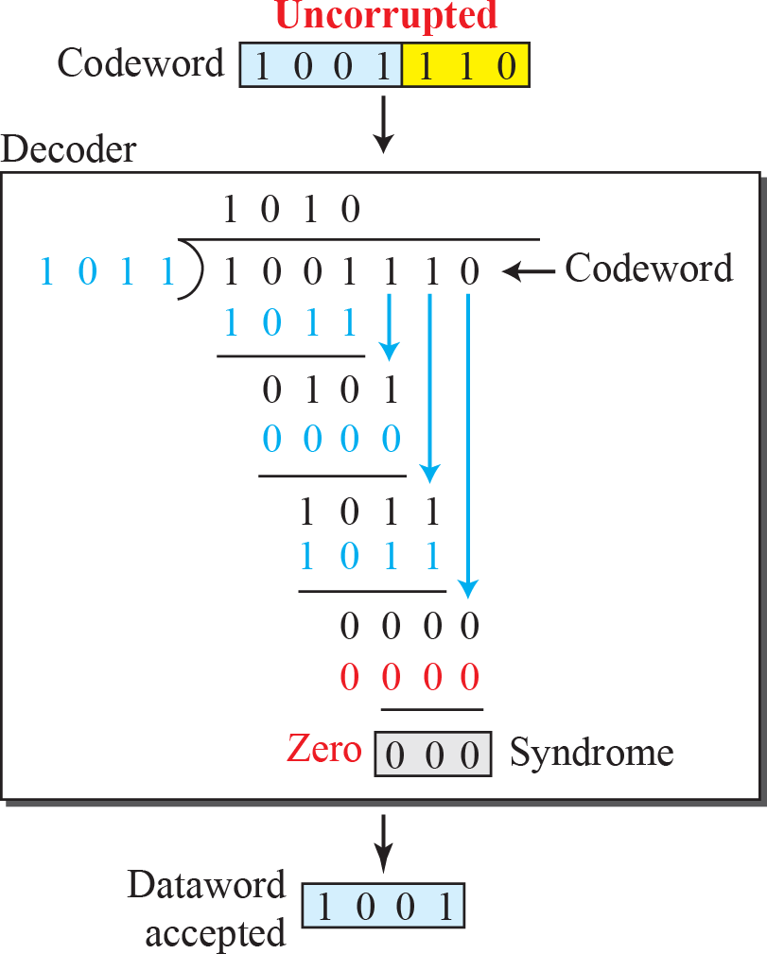
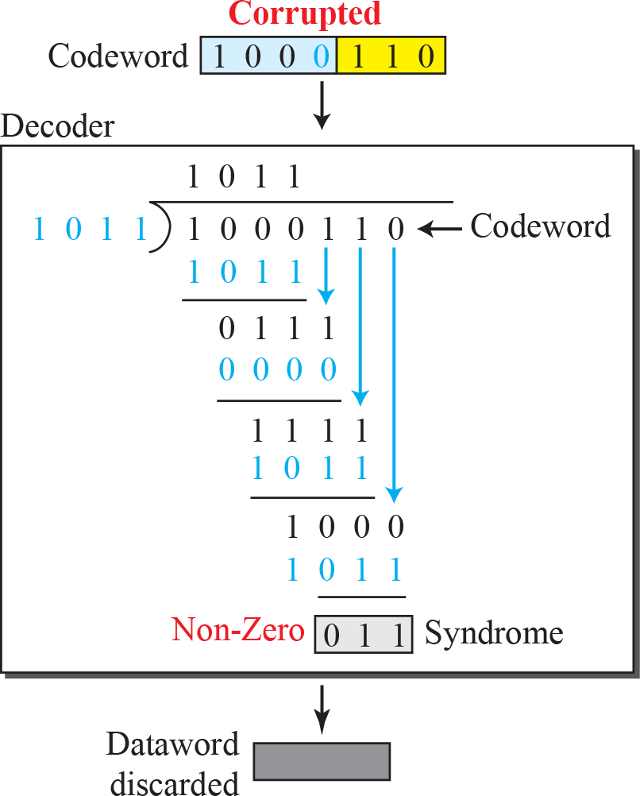
Division in the CRC decoder for two cases

Slide 4
The only relationship between the size of the codeword and dataword is the one based on the definition: n = k + r., where n is the size of the codeword, k is the size of the dataword, and r is the size of the remainder.
The remainder is always one bit smaller than the divisor.

Slide 5
Example
Given the dataword 1010011110 and the divisor 10111,
Show the generation of the codeword at the sender site (using binary division).
h. Show the checking of the codeword at the receiver site (assume no error).

Slide 7
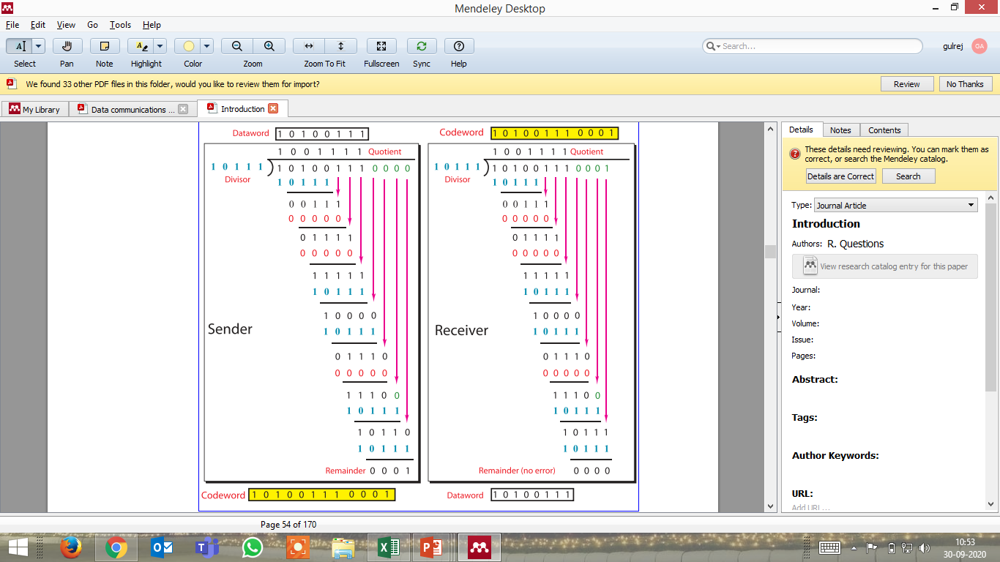

Slide 9
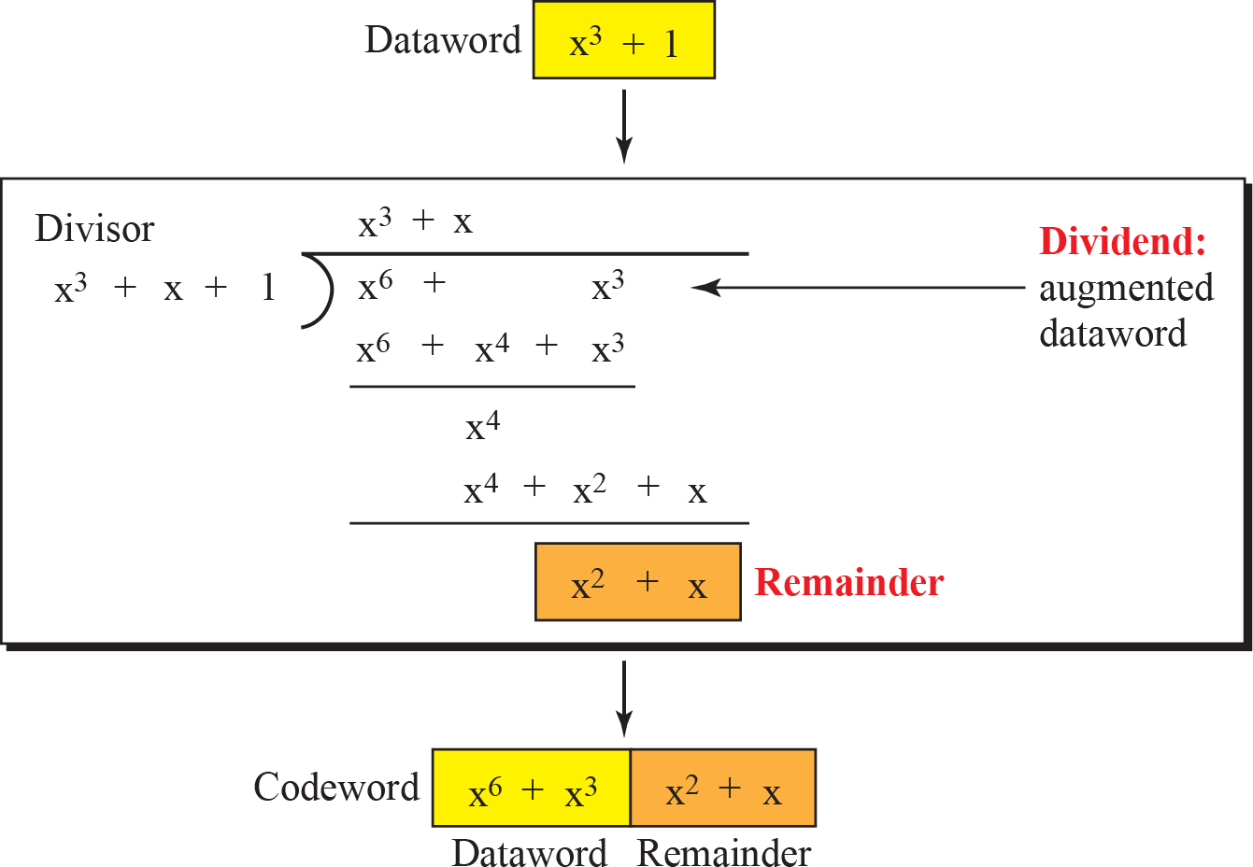
CRC division using polynomials

Slide 10
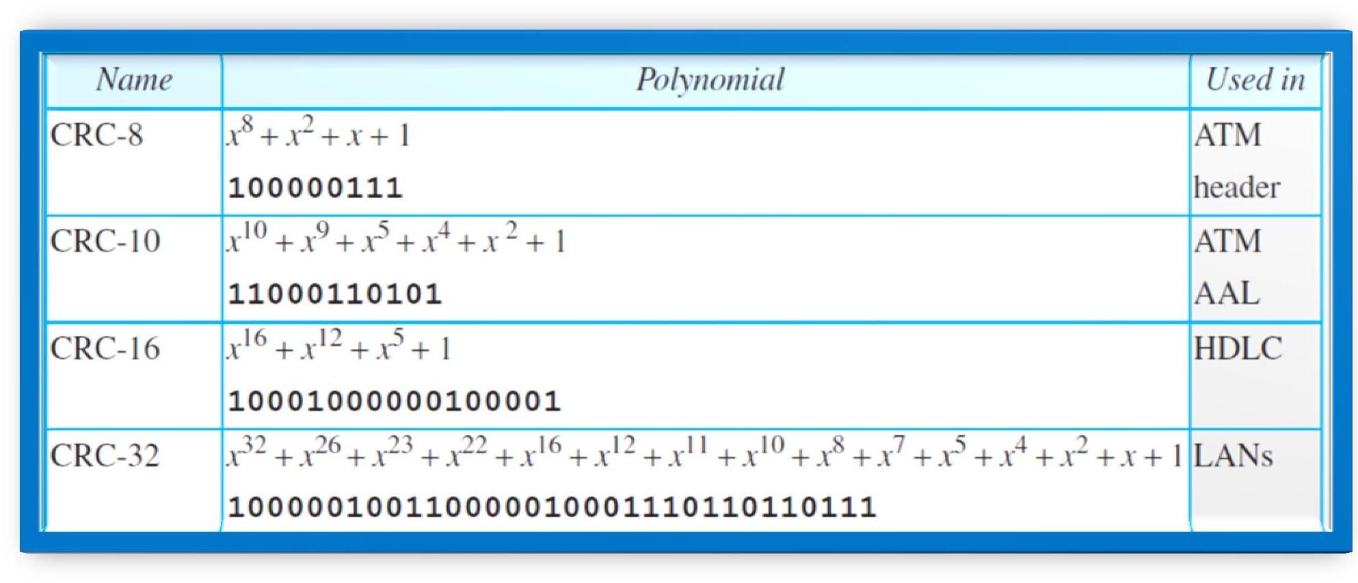
Standard polynomials

Slide 11

Note
The Hamming distance between two words is the number of differences between corresponding bits.

Slide 12
Example
Let us find the Hamming distance between two pairs of words.
1. The Hamming distance d(000, 011) is 2 because
2. The Hamming distance d(10101, 11110) is 3 because

Slide 13
Example
Find the minimum Hamming distance of the coding scheme in following Table

Slide 14
Example
Solution
We first find all the Hamming distances.
The d_{min} in this case is 3.

Slide 15
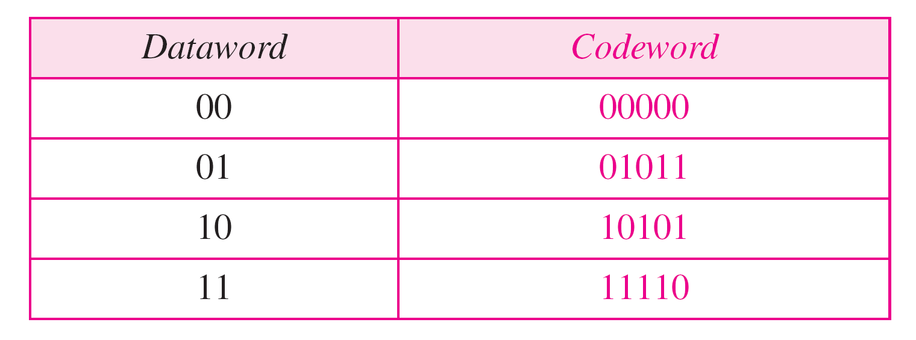
Example
Find the minimum Hamming distance of the coding scheme in Table.

Slide 16
Example
Solution
We first find all the Hamming distances.
The d_{min} in this case is 3.

Slide 17
Note
To guarantee the detection of up to s errors in all cases, the minimum
Hamming distance in a block code must be d_{min} = s + 1.

Slide 18
Checksum
Checksum is an error-detecting technique that can be applied to a message of any length.
In the Internet, the checksum technique is mostly used at the network and transport layer rather than the data-link layer.

