Slide 1
Data Communications
Lecture 28

Slide 2
Table 1 A code for error detection
What if we want to send 01? We code it as 011. If 011
is received, no problem.
What if 001 is received? Error detected.
What if 000 is received? Error occurred, but not detected.

Slide 3
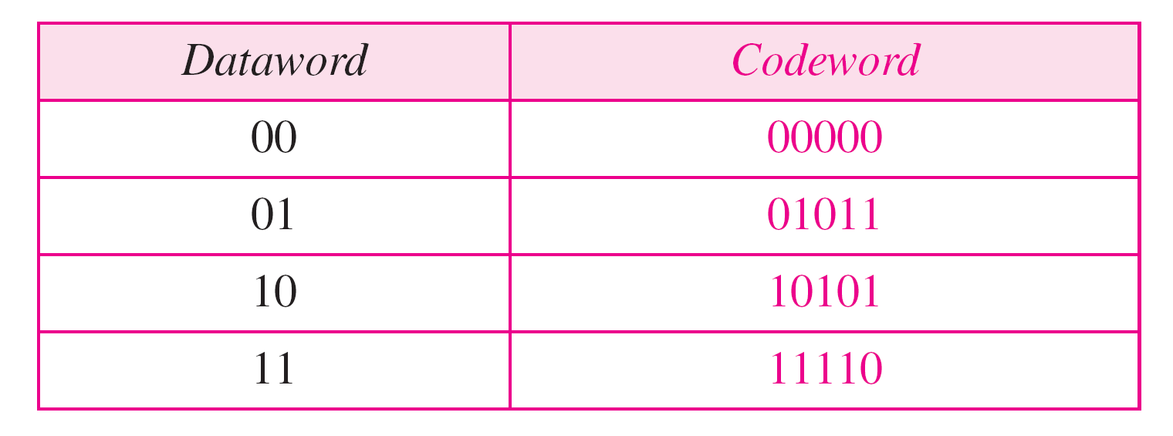
Let’s add more redundant bits to see if we can correct error.
Table 2 A code for error correction
Let’s say we want to send 01. We then transmit 01011.
What if an error occurs and we receive 01001. If we
assume one bit was in error, we can correct.

Slide 4

Note
The minimum Hamming distance is the smallest Hamming distance between all possible pairs in a set of words.

Slide 5
Example 1
Find the minimum Hamming distance of the coding scheme in Table 1.
Solution
We first find all Hamming distances.
The d_{min} in this case is 2.

Slide 6
Example 2
Find the minimum Hamming distance of the coding scheme in Table 2.
Solution
We first find all the Hamming distances.
The d_{min} in this case is 3.

Slide 7
Note
The Hamming distance between two words is the number of differences between corresponding bits.

Slide 8
Note
To guarantee the detection of up to s errors in all cases, the minimum
Hamming distance in a block code must be d_{min} = s + 1.

Slide 9
Example 3
The minimum Hamming distance for our first code scheme (Table 1) is 2.
This code guarantees detection of only a single error.
For example, if the third codeword (101) is sent and one error occurs, the received codeword does not match any valid codeword.
If two errors occur, however, the received codeword may match a valid codeword and the errors are not detected.

Slide 10
Example 4
Our second block code scheme (Table.2) has d_{min} = 3. This code can detect up to two errors.
Again, we see that when any of the valid codewords is sent, two errors create a codeword which is not in the table of valid codewords. The receiver cannot be fooled.
However, some combinations of three errors change a valid codeword to another valid codeword.
The receiver accepts the received codeword and the errors are undetected.

Slide 11
Note
To guarantee correction of up to t errors in all cases, the minimum Hamming distance in a block code must be d_{min} = 2t + 1.

Slide 12
Example 5
A code scheme has a Hamming distance d_{min} = 4. What is the error detection and correction capability of this scheme?
Solution
This code guarantees the detection of up to three errors (s = 3), but it can correct up to one error. In other words, if this code is used for error correction, part of its capability is wasted. Error correction codes need to have an odd minimum distance (3, 5, 7, . . . ).

Slide 13
Note
To guarantee the detection of up to s errors in all cases, the minimum
Hamming distance in a block code must be d_{min} = s + 1.

Slide 14
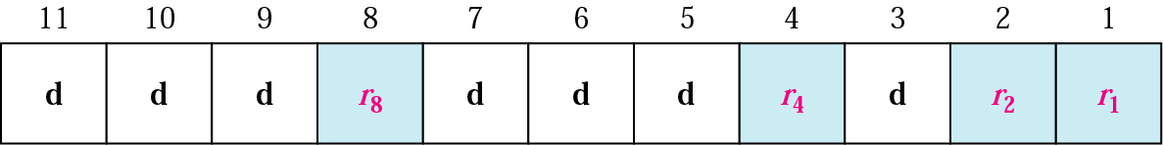
Positions of redundancy bits in Hamming code
Let’s examine a Hamming Code

Slide 15
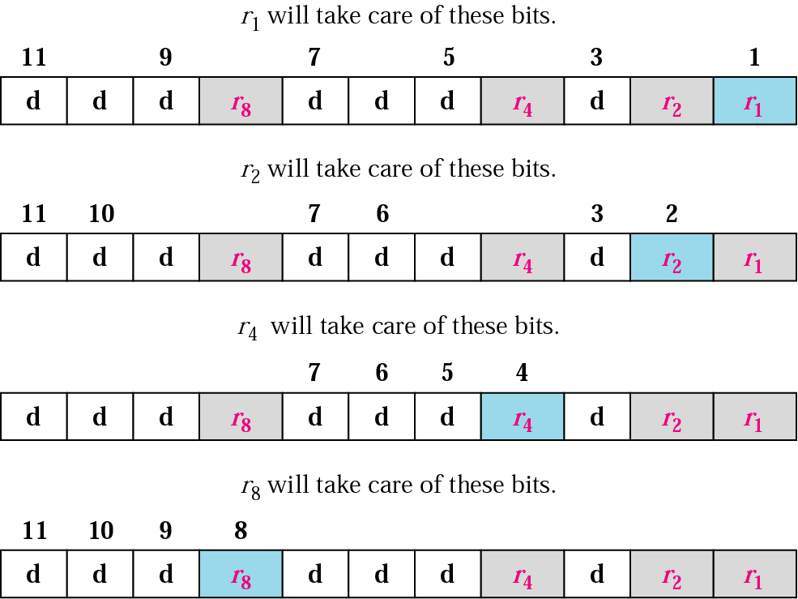
Redundancy bits calculation

Slide 16
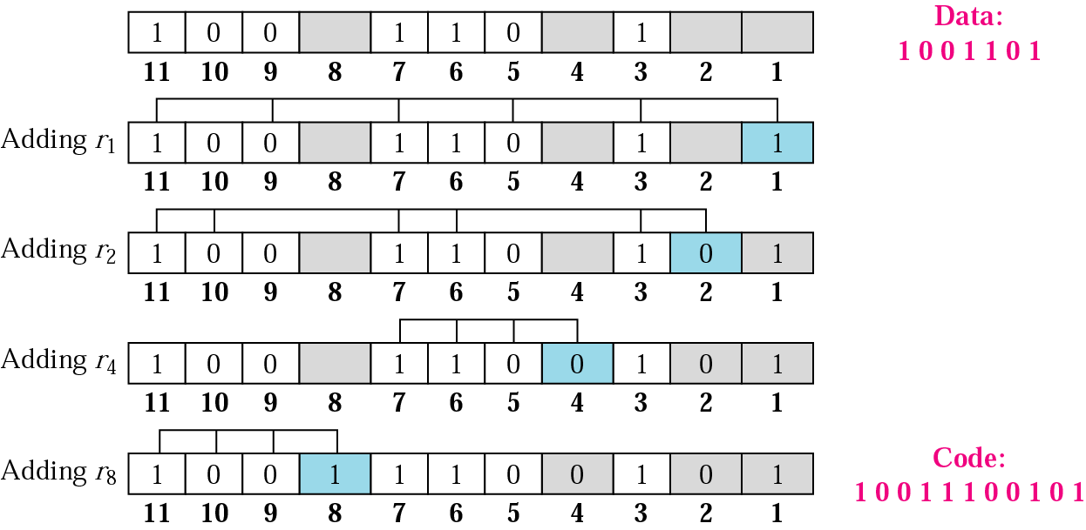
Example of redundancy bit calculation

Slide 17
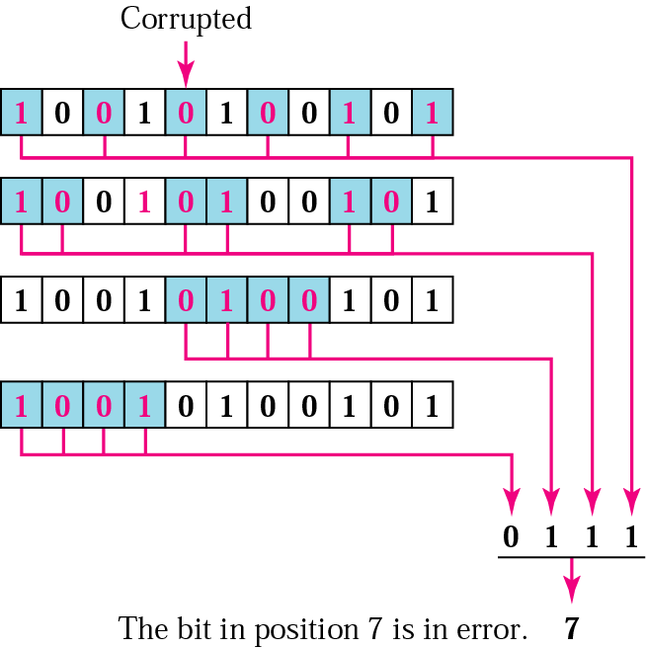
Error detection using Hamming code

Slide 18
Checksum
Checksum is an error-detecting technique that can be applied to a message of any length.
In the Internet, the checksum technique is mostly used at the network and transport layer rather than the data-link layer.

