Slide 1
Data Communications
Lecture 29

Slide 2
Review
1. In a single bit error only one bit of a data unit is corrupted; in a burst error more than one bit is corrupted (not necessarily contiguous).
2. Redundancy is a technique of adding extra bits to each data unit.
3. A linear block code is a block code in which the exclusive-or of any two code- words results in another codeword. A cyclic code is a linear block code in which the rotation of any codeword results in another codeword.

Slide 3
4. The Hamming distance between two words (of the same size) is the number of differences between the corresponding bits. The Hamming distance can easily be found if we apply the XOR operation on the two words and count the number of 1s in the result. The minimum Hamming distance is the smallest Hamming distance between all possible pairs in a set of words.
5. The single parity check uses one redundant bit for the whole data unit. In a two- dimenssional parity check, original data bits are organized in a table of rows and columns. The parity bit is then calculated for each column and each row.

Slide 4
6. The only relationship between the size of the codeword and dataword is the one based on the definition: n = k + r., where n is the size of the codeword, k is the size of the dataword, and r is the size of the remainder.
The remainder is always one bit smaller than the divisor.

Slide 5
Exercises:
What is the maximum effect of a 2-ms burst of noise on data transmitted at the following rates?
1500 bps
12 kbps
100 kbps
100 Mbps

Slide 6
We can say that (vulnerable bits) = (data rate) × (burst duration)
vulnerable bits = (1,500) × (2 × 10⁻³)= 3 bits
vulnerable bits = (12 × 10³) × (2 × 10⁻³)= 24 bits
vulnerable bits = (100 × 10³) × (2 × 10⁻³)= 200 bits
vulnerable bits = (100 × 10⁶) × (2 × 10⁻³)= 200,000 bits
The last example shows how a noise of small duration can affect so many bits if the data rate is high.

Slide 7
Exercise:
Apply the exclusive-or operation on the following pair of :
a. (10001) XOR (10000)
b. (10001) XOR (10001)
c. (11100) XOR (00000)
d. (10011) XOR(11111)

Slide 8
What is the Hamming distance for each of the following code words:
d (10000, 00000)
b. d (10101, 10000)
c. d (11111,11111)
d. d (000, 000)

Slide 9
d (10000, 00000) = 1
b. d (10101, 10000) = 2
c. d (1111, 1111) = 0
d. d (000, 000) = 0
Comment: Part c and d show that the distance between a codeword and itself is 0.

Slide 10
Find the minimum Hamming distance for the following cases:
Detection of two errors.
b. Correction of two errors.
c. Detection of 3 errors or correction of 2 errors.
d. Detection of 6 errors or correction of 2 errors.

Slide 11
For error detection → dmin = s + 1 = 2 + 1 = 3
b. For error correction → dmin = 2t + 1 = 2 × 2 + 1 = 5
c. For error section → dmin = s + 1 = 3 + 1 = 4
For error correction → dmin = 2t + 1 = 2 × 2 + 1 = 5
Therefore dmin should be 5.
d. For error detection → dmin = s + 1 = 6 + 1 = 7
For error correction → dmin = 2t + 1 = 2 × 2 + 1 = 5
Therefore dmin should be 7

Slide 12
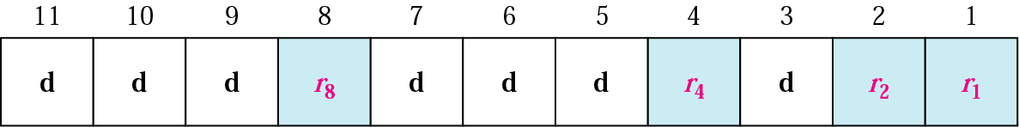
Positions of redundancy bits in Hamming code
Let’s examine a Hamming Code

Slide 13
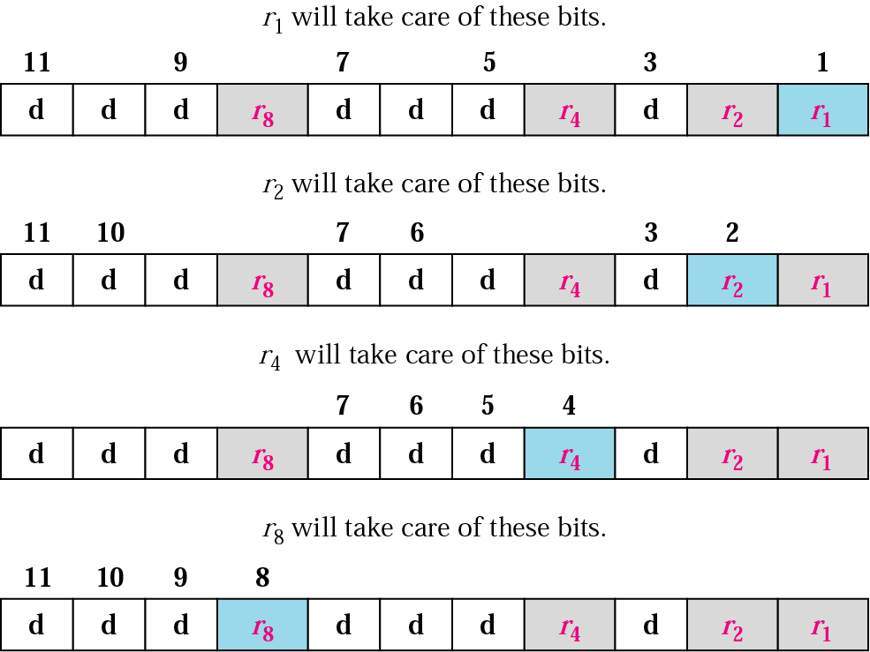
Redundancy bits calculation

Slide 14
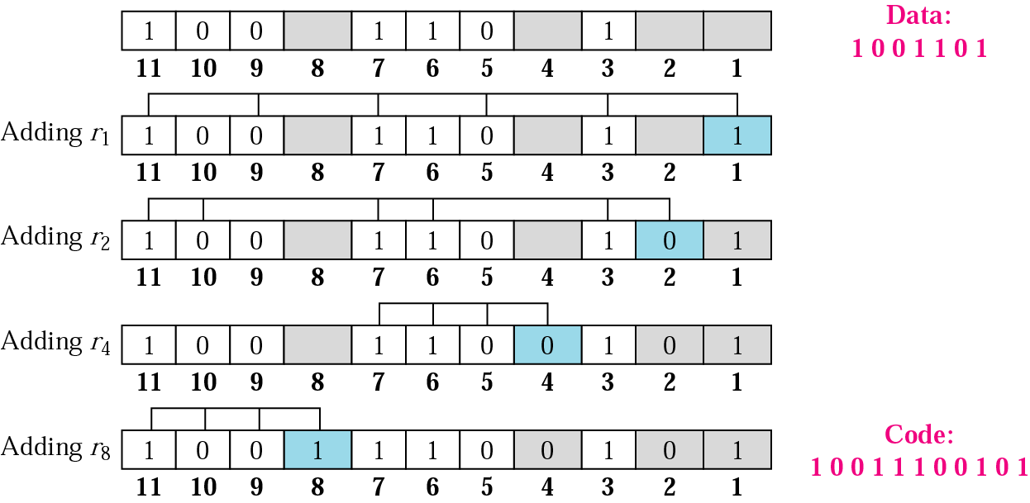
Example of redundancy bit calculation

