Slide 1
Data Communications
Lecture 30

Slide 2
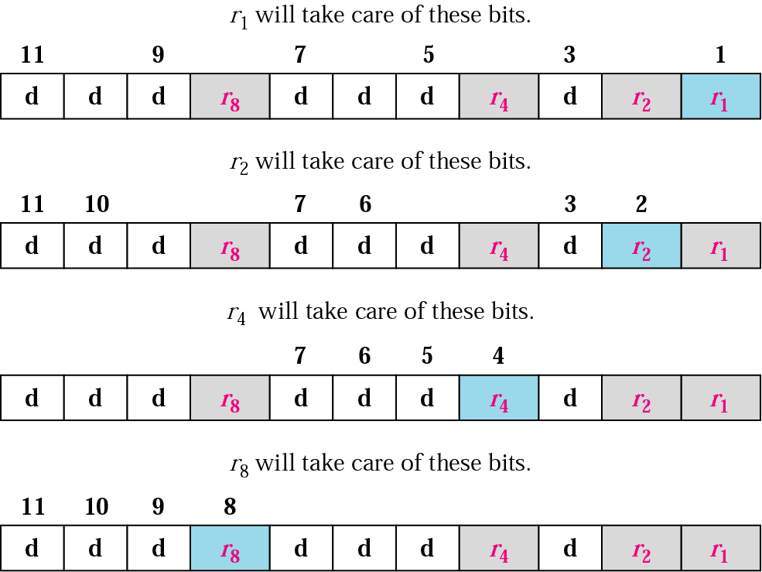
Redundancy bits calculation

Slide 3
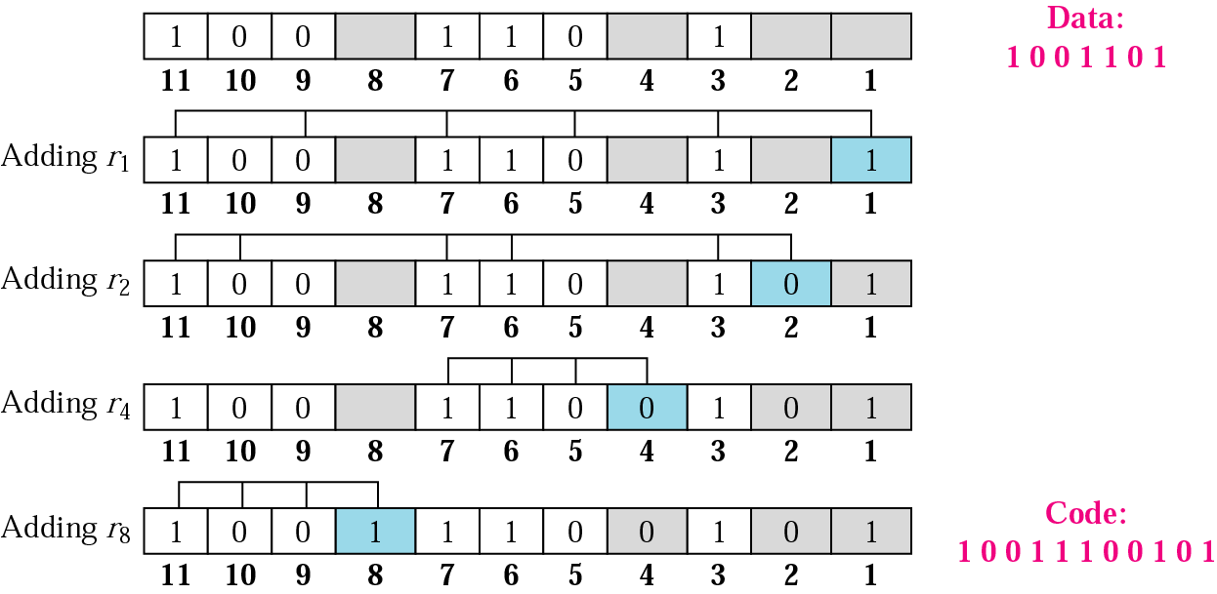
Example of redundancy bit calculation

Slide 4
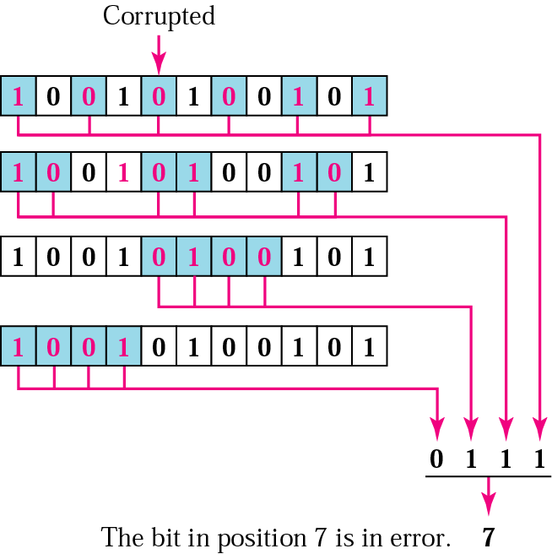
Error detection using Hamming code

Slide 6
Four types of redundancy checks are used
in data communications

Slide 7
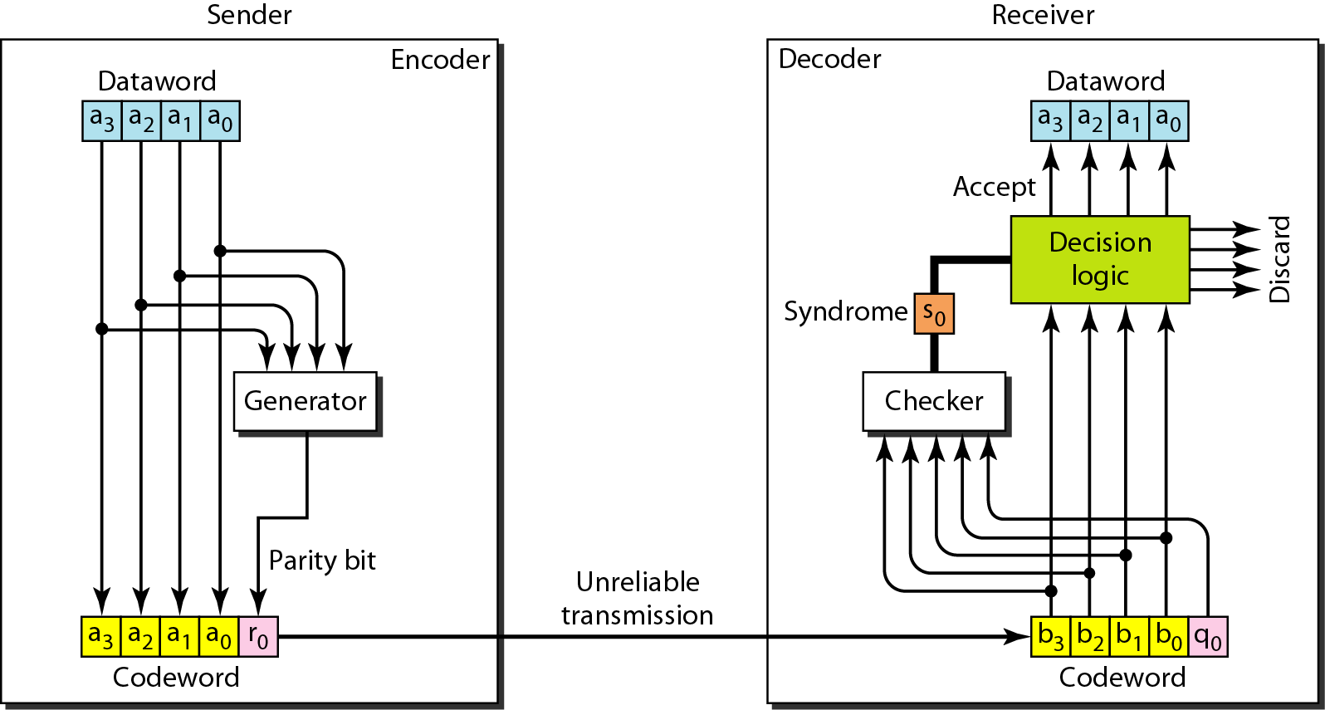
Encoder and decoder for simple parity-check code

Slide 8
Table Simple parity-check code C(5, 4)

Slide 9
Example
Let us look at some transmission scenarios. Assume the sender sends the dataword 1011. The codeword created from this dataword is 10111, which is sent to the receiver. We examine five cases:
1. No error occurs; the received codeword is 10111. The syndrome is 0. The dataword 1011 is created.
2. One single-bit error changes a₁ . The received codeword is 10011. The syndrome is 1. No dataword is created.
3. One single-bit error changes r₀ . The received codeword is 10110. The syndrome is 1. No dataword is created.

Slide 10
Example (continued)
4. An error changes r₀ and a second error changes a₃ .
The received codeword is 00110. The syndrome is 0. The dataword 0011 is created at the receiver. Note that
here the dataword is wrongly created due to the
syndrome value.
5. Three bits—a₃, a₂, and a₁—are changed by errors. The received codeword is 01011. The syndrome is 1. The dataword is not created. This shows that the simple parity check, guaranteed to detect one single error, can also find any odd number of errors.

Slide 11

Note
A simple parity-check code can detect an odd number of errors.

Slide 12
Error detection
Error detection means to decide whether the received data is correct or not without having a copy of the original message.
Error detection uses the concept of redundancy, which means adding extra bits for detecting errors at the destination.
Notes:
Make sense of message.
Make sense of message.

Slide 13
Redundancy

Slide 14
Vertical Redundancy Check
VRC

Slide 15
Performance
It can detect single bit error
It can detect burst errors only if the total number of errors is odd.

Slide 16
Longitudinal Redundancy Check
LRC

Slide 17
Performance
LCR increases the likelihood of detecting burst errors.
If two bits in one data units are damaged and two bits in exactly the same positions in another data unit are also damaged, the LRC checker will not detect an error.

Slide 18
VRC and LRC

Slide 19
Checksum: At the sender
The unit is divided into k sections, each of n bits.
All sections are added together using one’s complement to get the sum.
The sum is complemented and becomes the checksum.
The checksum is sent with the data

Slide 20
Checksum

Slide 21
At the receiver
The unit is divided into k sections, each of n bits.
All sections are added together using one’s complement to get the sum.
The sum is complemented.
If the result is zero, the data are accepted: otherwise, they are rejected.

Slide 22
Performance
The checksum detects all errors involving an odd number of bits.
It detects most errors involving an even number of bits.
If one or more bits of a segment are damaged and the corresponding bit or bits of opposite value in a second segment are also damaged, the sums of those columns will not change and the receiver will not detect a problem.

Slide 23
Error Correction
It can be handled in two ways:
receiver can have the sender retransmit the entire data unit.
The receiver can use an error-correcting code, which automatically corrects certain errors.

