Slide 1
Data Communications
Lecture 31

Slide 2
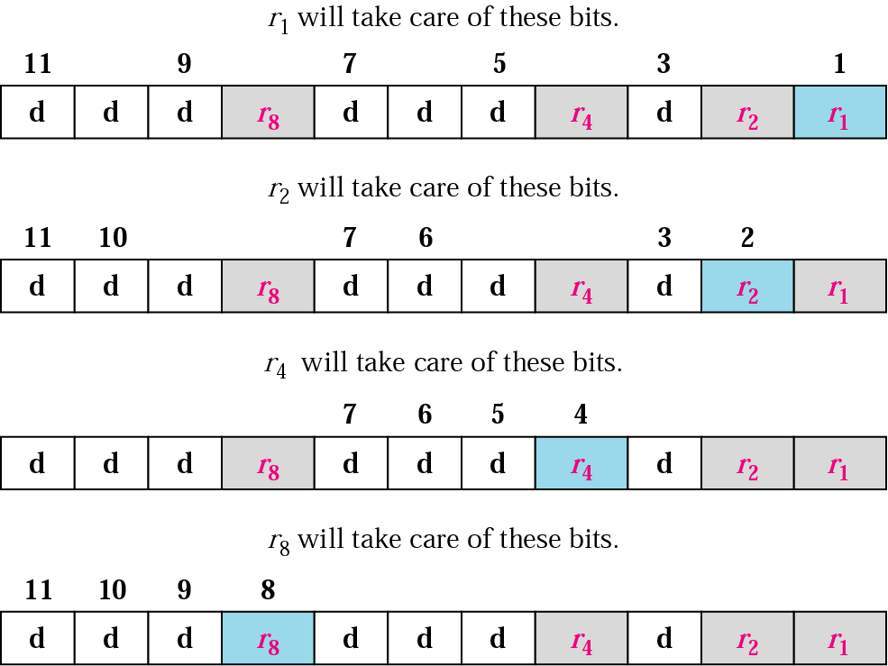
Recap: Hamming code

Slide 3
Four types of redundancy checks are used
in data communications

Slide 4
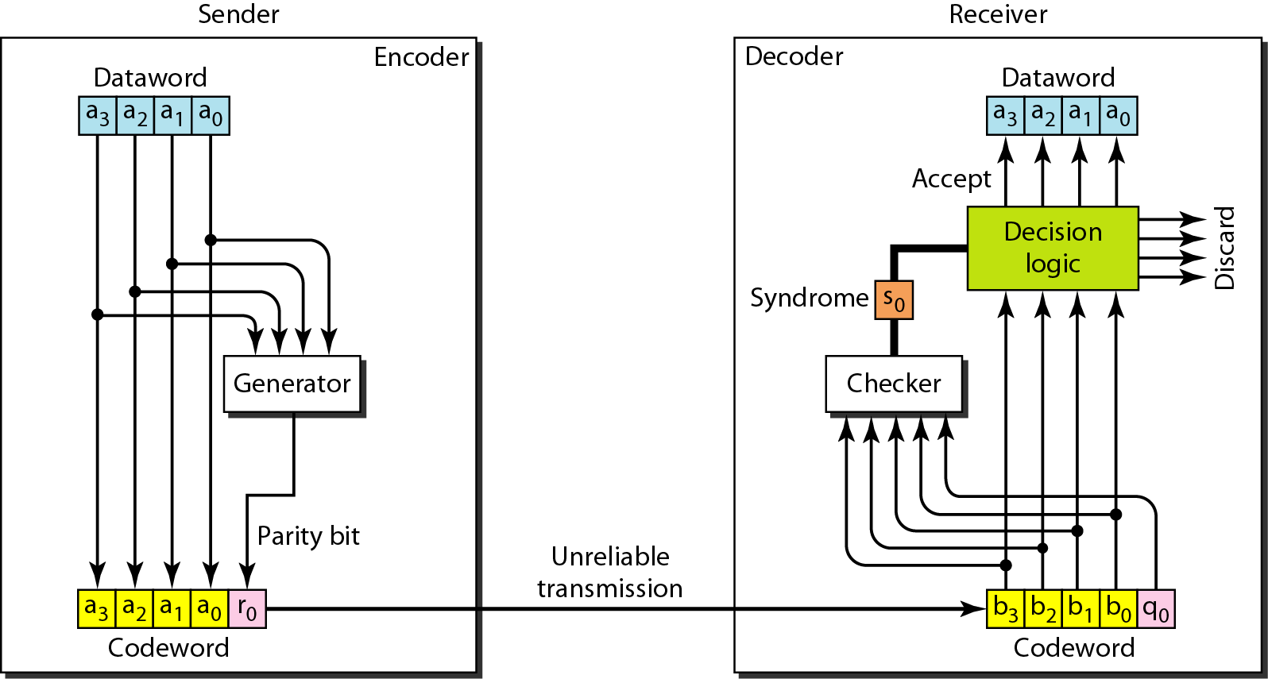
Encoder and decoder for simple parity-check code

Slide 5
Redundancy Check :Error detection
Error detection means to decide whether the received data is correct or not without having a copy of the original message.
Error detection uses the concept of redundancy, which means adding extra bits for detecting errors at the destination.
Notes:
Make sense of message.
Make sense of message.

Slide 6
Redundancy Check:

Slide 7
Vertical Redundancy Check
VRC

Slide 8
Performance
It can detect single bit error
It can detect burst errors only if the total number of errors is odd.

Slide 9
Longitudinal Redundancy Check
LRC

Slide 10
Performance
LCR increases the likelihood of detecting burst errors.
If two bits in one data units are damaged and two bits in exactly the same positions in another data unit are also damaged, the LRC checker will not detect an error.

Slide 11
VRC and LRC

Slide 12
Checksum: At the sender
The unit is divided into k sections, each of n bits.
All sections are added together using one’s complement to get the sum.
The sum is complemented and becomes the checksum.
The checksum is sent with the data

Slide 13
Checksum

Slide 14
At the receiver
The unit is divided into k sections, each of n bits.
All sections are added together using one’s complement to get the sum.
The sum is complemented.
If the result is zero, the data are accepted: otherwise, they are rejected.

Slide 15
Performance
The checksum detects all errors involving an odd number of bits.
It detects most errors involving an even number of bits.
If one or more bits of a segment are damaged and the corresponding bit or bits of opposite value in a second segment are also damaged, the sums of those columns will not change and the receiver will not detect a problem.

Slide 16
Error Correction
It can be handled in two ways:
receiver can have the sender retransmit the entire data unit.
The receiver can use an error-correcting code, which automatically corrects certain errors.

