Slide 1
Data Communications
Lecture 32

Slide 2
CHECKSUM
The last error detection method to be discussed here is the checksum.
The checksum is used in the Internet by several protocols although not at the data link layer.
Like linear and cyclic codes, the checksum is based on the concept of redundancy.

Slide 3
CHECKSUM
The concept of the checksum is not difficult: Let us illustrate it with following examples.
Example 1:
Suppose our data is a list of five 4-bit numbers (7, 11, 12, 0, 6) that we want to send to a destination. In addition to sending these numbers, we send the sum of the numbers.
At sender:
It sends (7, 11, 12,0,6,36), where 36 is the sum of the original numbers.
At receiver:
It adds the five numbers and compares the result with the sum. If the two are the same, the receiver assumes no error, accepts the five numbers, and discards the sum. Otherwise, there is an error somewhere and the data are not accepted.

Slide 4
CHECKSUM
Example 2:
In this example if we send the negative (complement) of the sum, called the checksum.
At Sender:
In this case, It sends (7, 11, 12,0,6, -36).
At Receiver:
The receiver can add all the numbers received (including the checksum). If the result is 0, it assumes no error; otherwise, there is an error.

Slide 5
CHECKSUM
Example 3:
The previous example has one major drawback. All of our data can be written as a 4-bit word (they are less than 15) except for the checksum. One solution is to use one's complement arithmetic.
In this arithmetic, we can represent unsigned numbers between 0 and
2^{n} -1 using only n bits.
If the number has more than n bits, the extra leftmost bits need to be added to the n rightmost bits (wrapping).
In one's complement arithmetic, a negative number can be represented by inverting all bits (changing a 0 to a 1 and a 1 to a 0). This is the same as subtracting the number from 2^{n} -1.

Slide 6
CHECKSUM
Example 4:
How can the number 21 be represented in one's complement arithmetic using only four bits?
Solution
The number 21 in binary is 10101 (it needs five bits). We can wrap the leftmost bit and add it to the four rightmost bits.
We have (0101 + 1) = 0110 or 6.

Slide 7
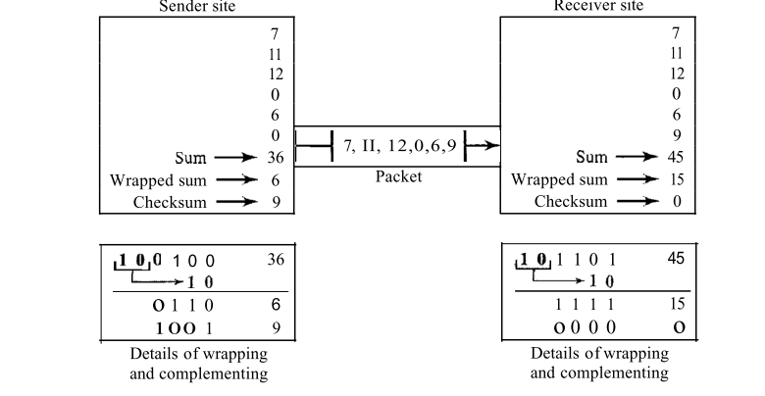
CHECKSUM

Slide 8
Checksum: At the sender
The unit is divided into k sections, each of n bits.
All sections are added together using one’s complement to get the sum.
The sum is complemented and becomes the checksum.
The checksum is sent with the data

Slide 9
Checksum

Slide 10
At the receiver
The unit is divided into k sections, each of n bits.
All sections are added together using one’s complement to get the sum.
The sum is complemented.
If the result is zero, the data are accepted: otherwise, they are rejected.

Slide 11
Performance
The checksum detects all errors involving an odd number of bits.
It detects most errors involving an even number of bits.
If one or more bits of a segment are damaged and the corresponding bit or bits of opposite value in a second segment are also damaged, the sums of those columns will not change and the receiver will not detect a problem.

Slide 12
Error Correction
It can be handled in two ways:
receiver can have the sender retransmit the entire data unit.
The receiver can use an error-correcting code, which automatically corrects certain errors.

Slide 13
Numerical
A sender needs to send the four data items 1001, 1100, 1000, and 1101. Answer the following:
a. Find the checksum at the sender site.
b. Find the checksum at the receiver site if there is no error.
c. Find the checksum at the receiver site if the second data item is changed to 1010

