Slide 1
Data Communications
Lecture 35

Slide 2

Taxonomy of protocols discussed in this chapter

Slide 3
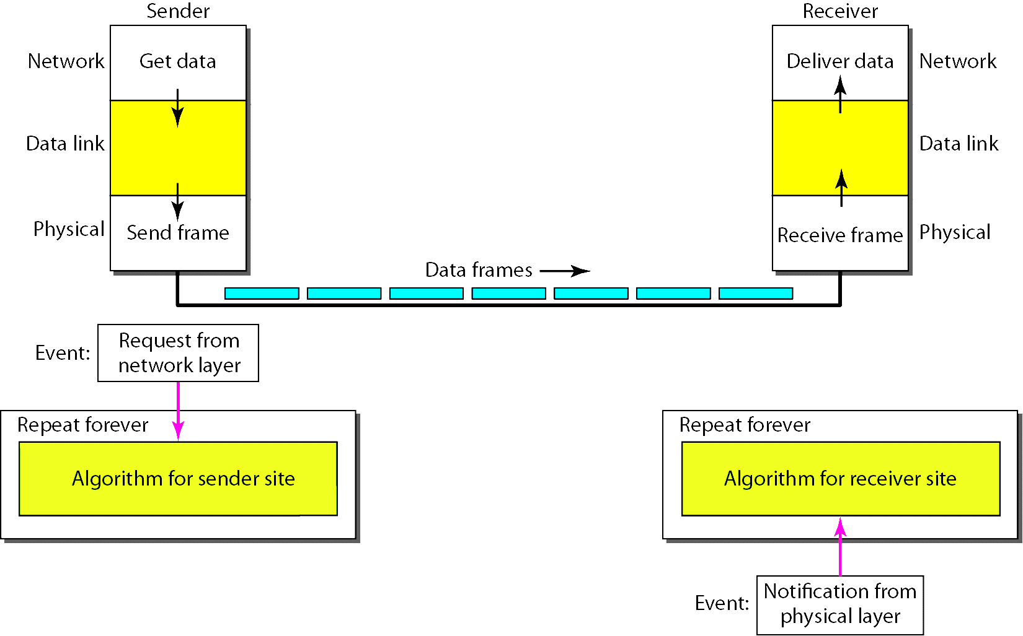
Simplest protocol: Without flow control or error control

Slide 4
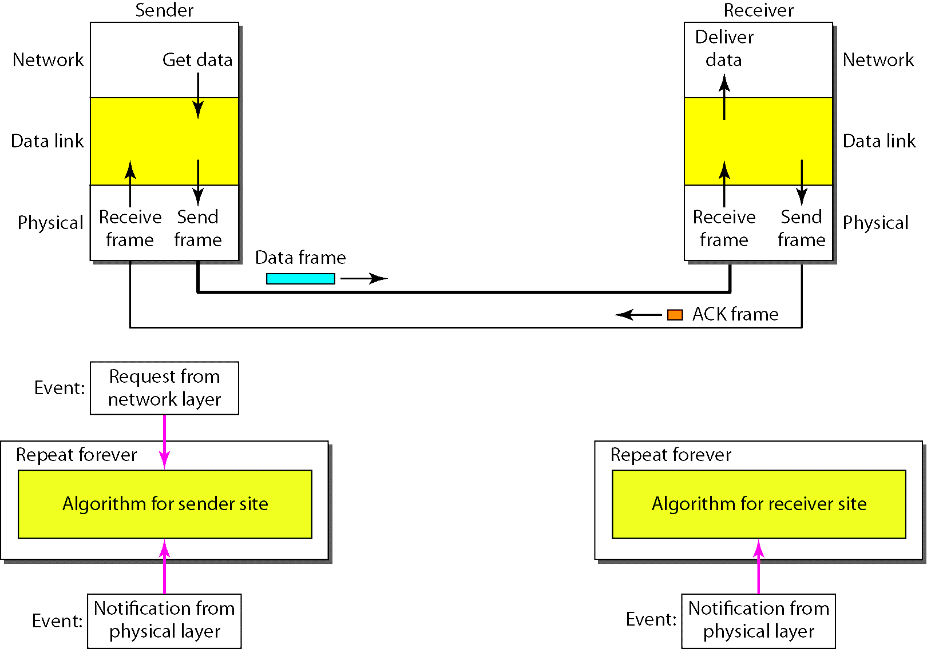
Design of Stop-and-Wait Protocol

Slide 5
Example: Stop-and-Wait Protocol
Figure 2. shows an example of communication using this protocol. It is still very simple. The sender sends one frame and waits for feedback from the receiver. When the ACK arrives, the sender sends the next frame. Note that sending two frames in the protocol involves the sender in four events and the receiver in two events.

Slide 6
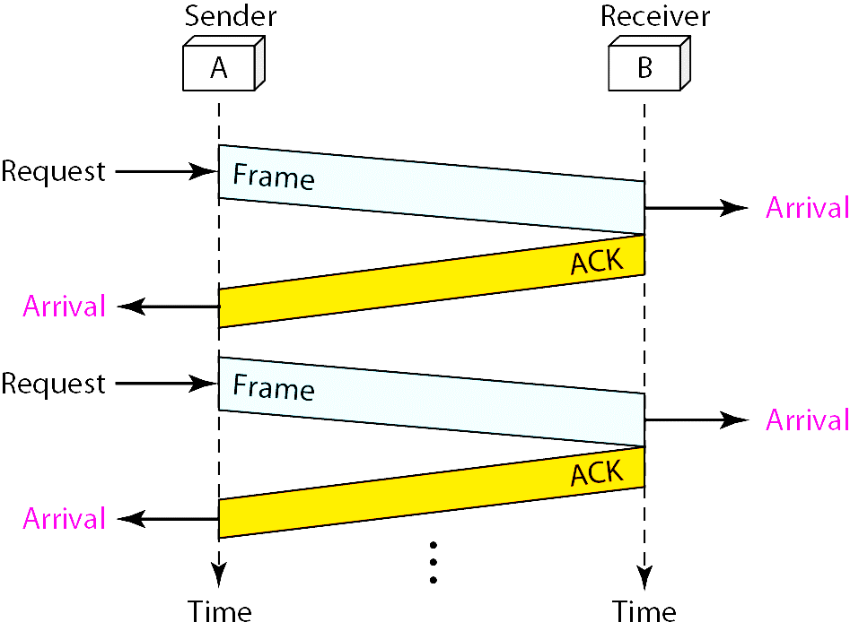
Figure 2. Flow diagram

Slide 7
NOISY CHANNELS
Although the Stop-and-Wait Protocol gives us an idea of how to add flow control to its predecessor, noiseless channels are nonexistent. We discuss three protocols in this section that use error control.
Stop-and-Wait Automatic Repeat Request
Go-Back-N Automatic Repeat Request
Selective Repeat Automatic Repeat Request

Slide 8

Note
Error correction in Stop-and-Wait ARQ is done by keeping a copy of the sent frame and retransmitting of the frame when the timer expires.

Slide 9
Note
In Stop-and-Wait ARQ, we use sequence numbers to number the frames.
The sequence numbers are based on modulo-2 arithmetic.

Slide 10
Note
In Stop-and-Wait ARQ, the acknowledgment number always announces in modulo-2 arithmetic the sequence number of the next frame expected.

Slide 11
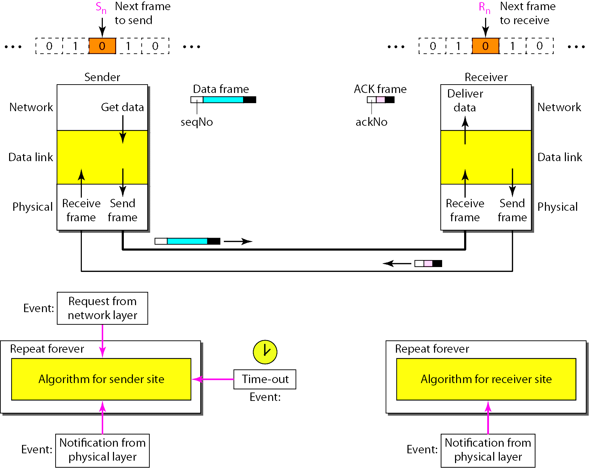
Figure 2. Design of the Stop-and-Wait ARQ Protocol

Slide 12
Example 3
Figure 3. shows an example of Stop-and-Wait ARQ. Frame 0 is sent and acknowledged. Frame 1 is lost and resent after the time-out. The resent frame 1 is acknowledged and the timer stops. Frame 0 is sent and acknowledged, but the acknowledgment is lost. The sender has no idea if the frame or the acknowledgment is lost, so after the time-out, it resends frame 0, which is acknowledged.

Slide 13
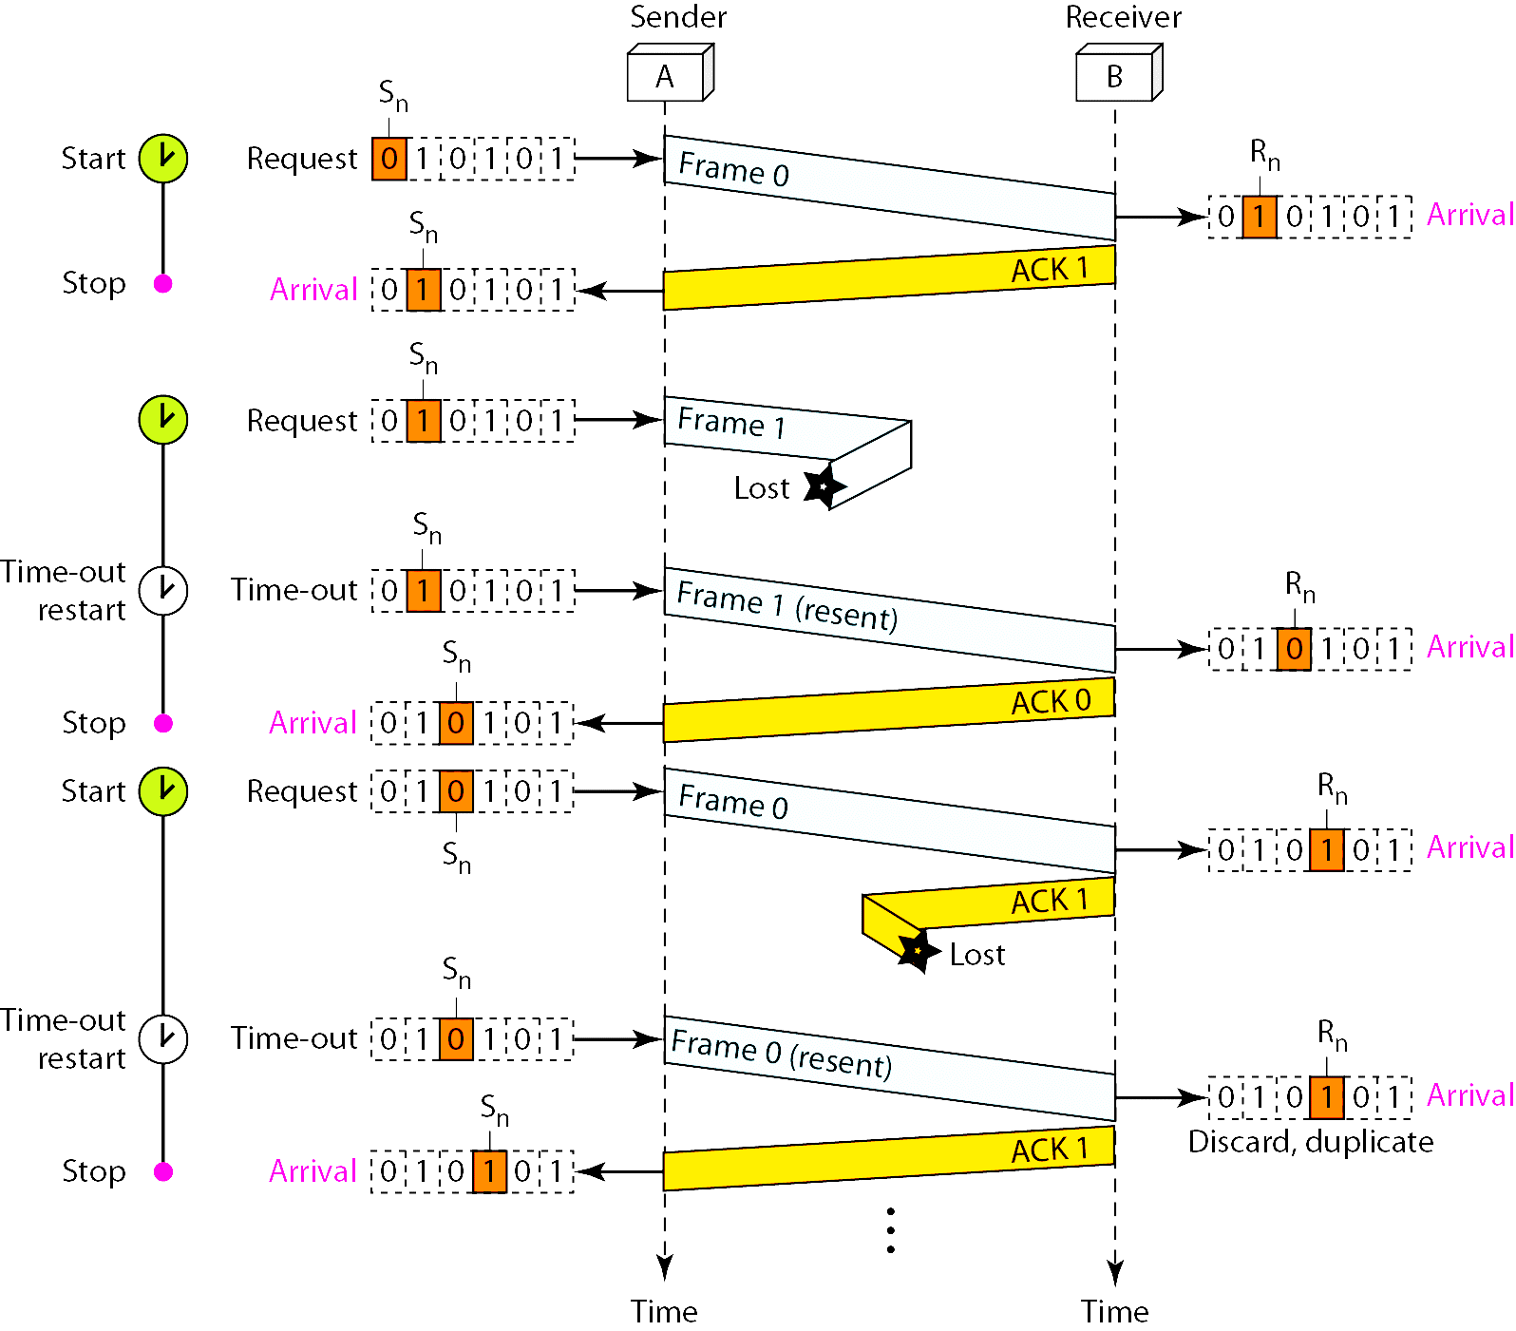
Figure 3. Flow diagram for Example

Slide 14
Example 4
Assume that, in a Stop-and-Wait ARQ system, the bandwidth of the line is 1 Mbps, and 1 bit takes 20 ms to make a round trip. What is the bandwidth-delay product? If the system data frames are 1000 bits in length, what is the utilization percentage of the link?
Solution
The bandwidth-delay product is

Slide 15
Example 4 (continued)
The system can send 20,000 bits during the time it takes for the data to go from the sender to the receiver and then back again. However, the system sends only 1000 bits. We can say that the link utilization is only 1000/20,000, or 5 percent. For this reason, for a link with a high bandwidth or long delay, the use of Stop-and-Wait ARQ wastes the capacity of the link.

Slide 16
Example 5
What is the utilization percentage of the link in Example 4 if we have a protocol that can send up to 15 frames before stopping and worrying about the acknowledgments?
Solution
The bandwidth-delay product is still 20,000 bits. The system can send up to 15 frames or 15,000 bits during a round trip. This means the utilization is 15,000/20,000, or 75 percent. Of course, if there are damaged frames, the utilization percentage is much less because frames have to be resent.

Slide 17
Note
In the Go-Back-N Protocol, the sequence numbers are modulo 2^{m},
where m is the size of the sequence number field in bits.

Slide 18

Send window for Go-Back-N ARQ

Slide 19
Note
The send window is an abstract concept defining an imaginary box of size 2^{m} − 1 with three variables: S_{f}, S_{n}, and S_{size}.

Slide 20
Note
The send window can slide one
or more slots when a valid acknowledgment arrives.

Slide 21

Receive window for Go-Back-N ARQ

Slide 22
Note
The receive window is an abstract concept defining an imaginary box
of size 1 with one single variable R_{n}.
The window slides
when a correct frame has arrived; sliding occurs one slot at a time.

Slide 23
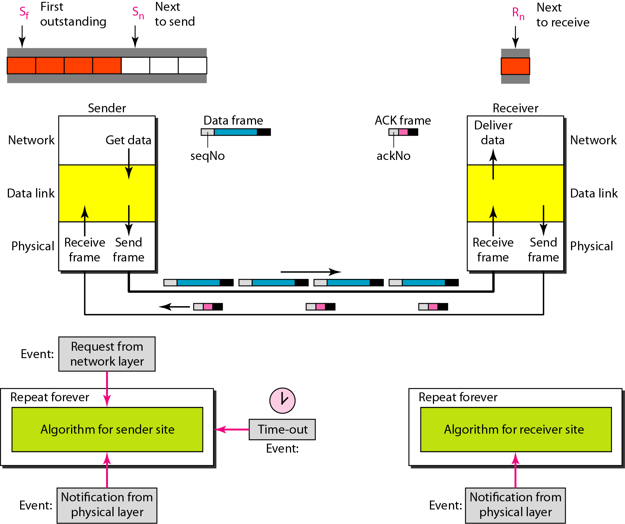
Design of Go-Back-N ARQ

Slide 24

Window size for Go-Back-N ARQ

Slide 25
Note
In Go-Back-N ARQ, the size of the send window must be less than 2^{m};
the size of the receiver window
is always 1.

Slide 26
Go-Back-N sender algorithm
_{(continued)}

Slide 27
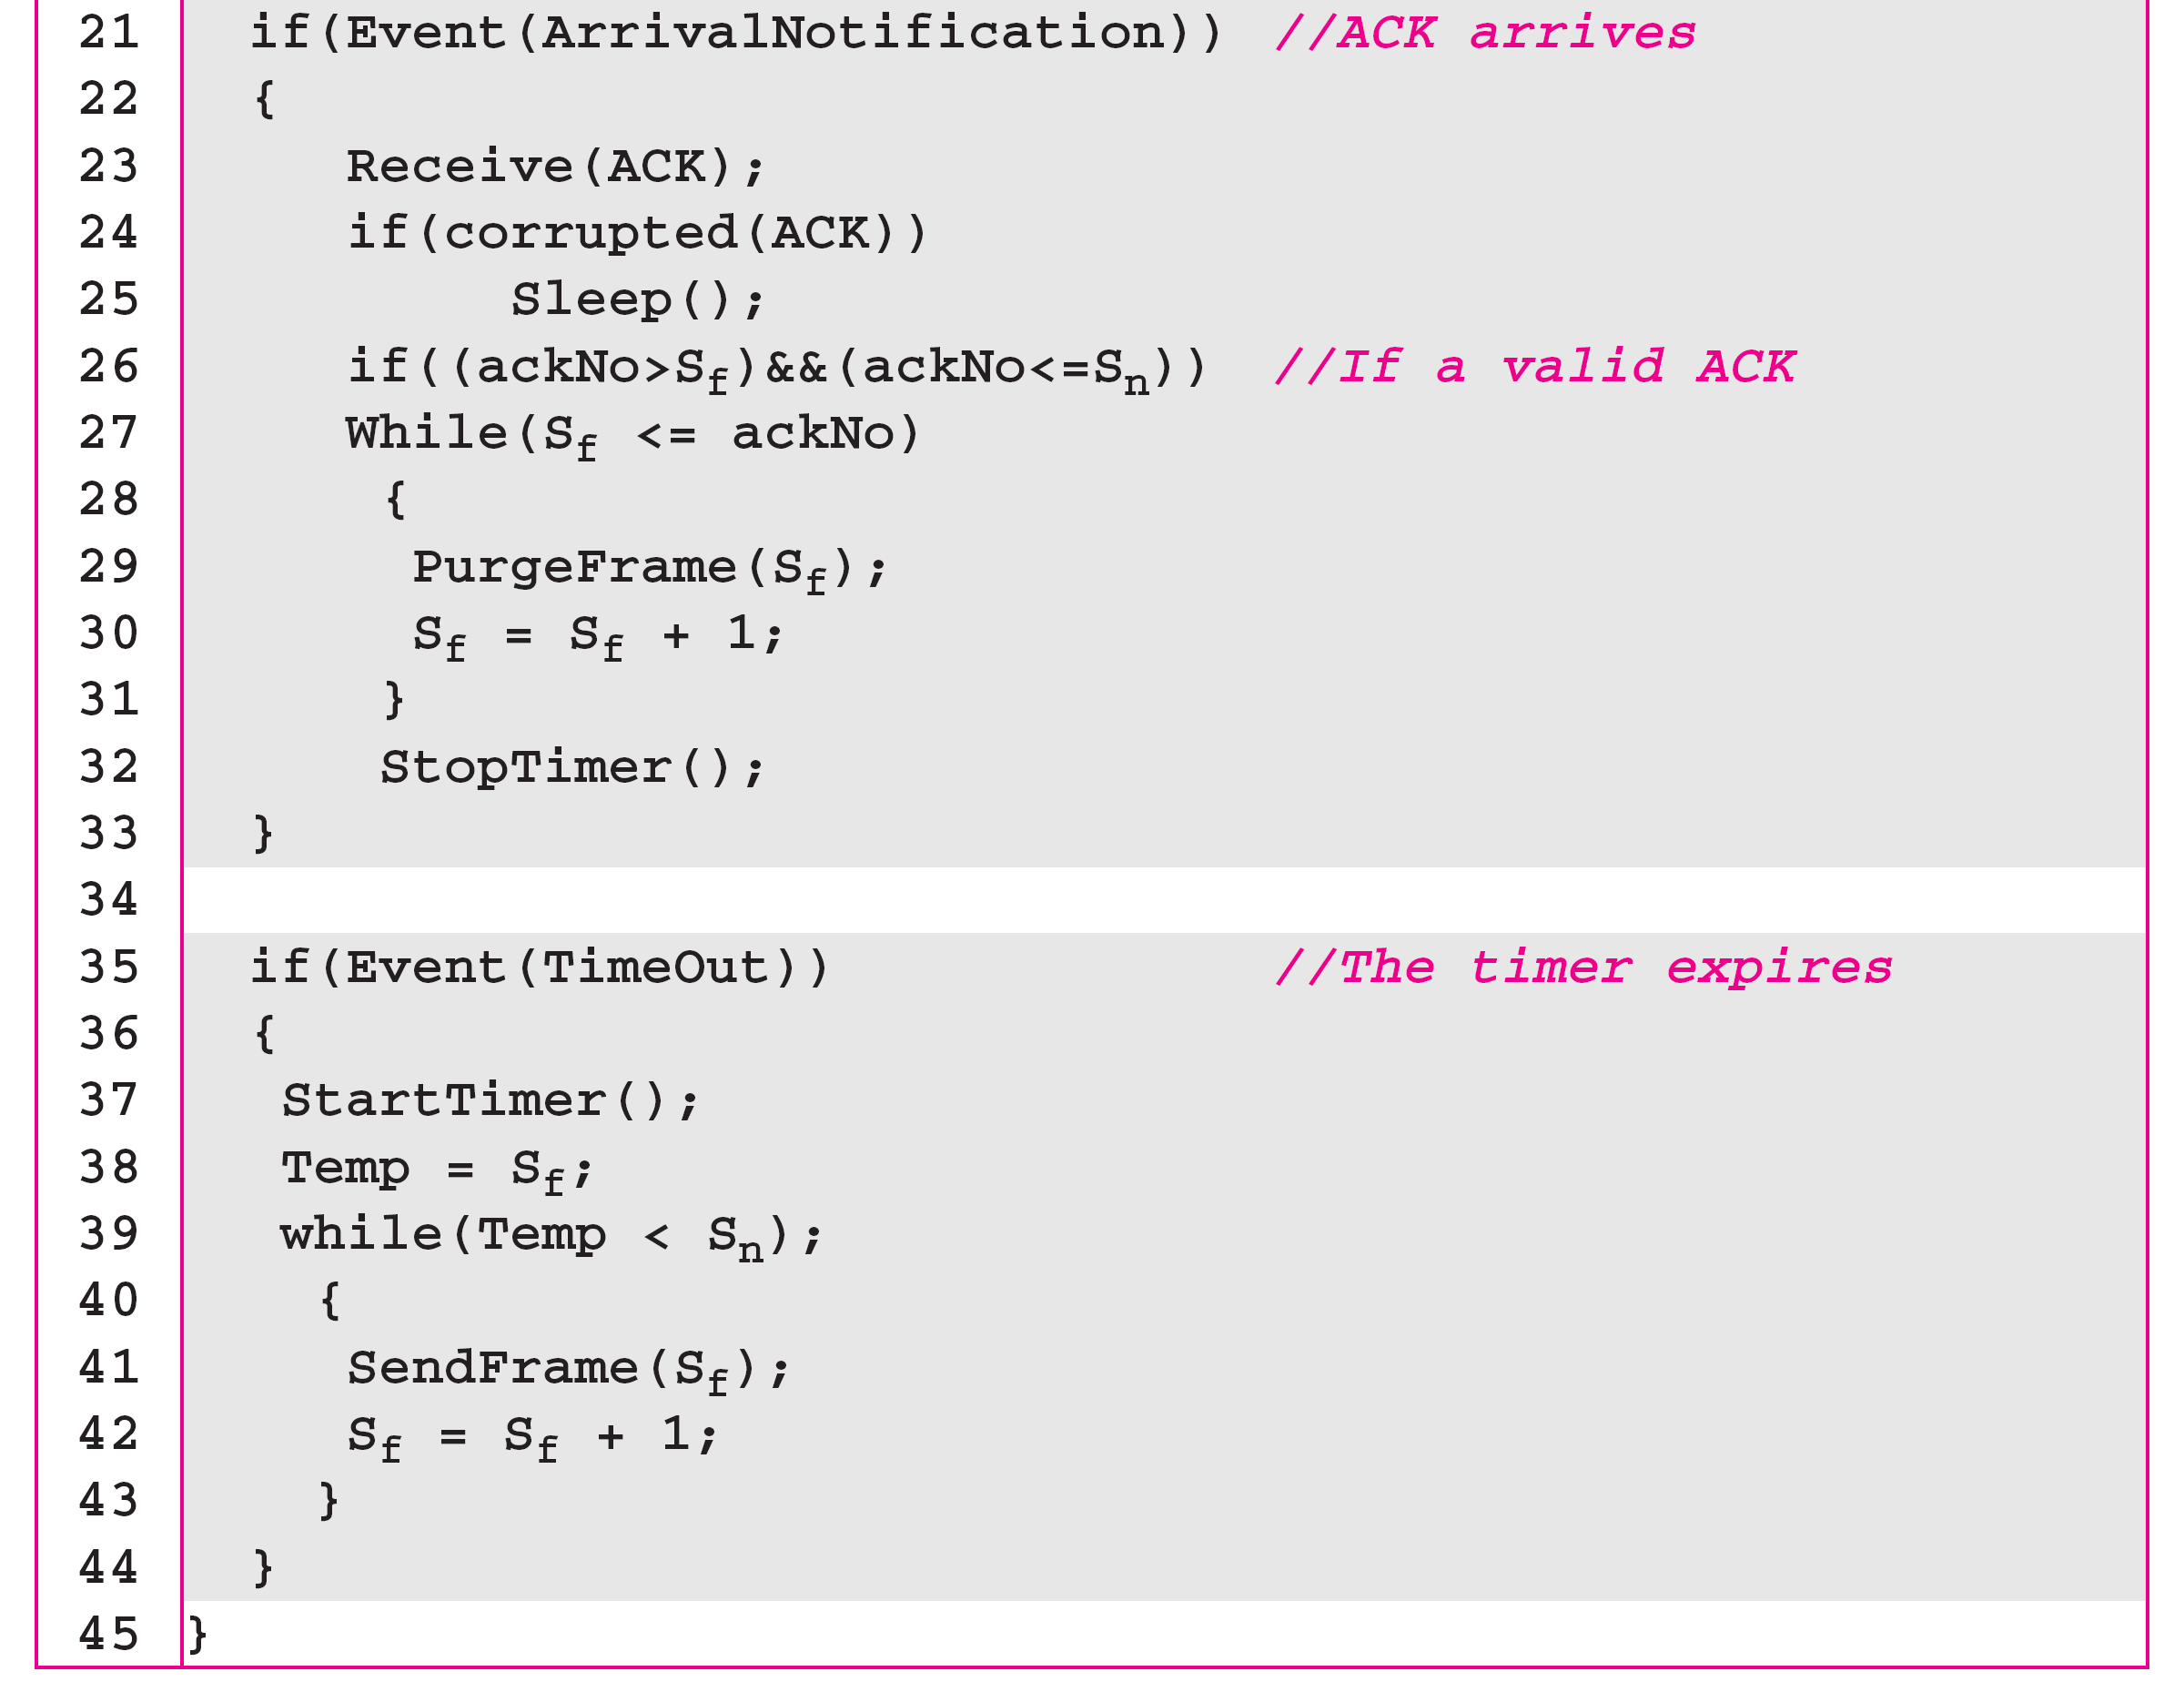
Algorithm 11.7 Go-Back-N sender algorithm
_{(continued)}

Slide 28
Algorithm 11.8 Go-Back-N receiver algorithm

Slide 29
Example 11.6
Figure 11.16 shows an example of Go-Back-N. This is an example of a case where the forward channel is reliable, but the reverse is not. No data frames are lost, but some ACKs are delayed and one is lost. The example also shows how cumulative acknowledgments can help if acknowledgments are delayed or lost. After initialization, there are seven sender events. Request events are triggered by data from the network layer; arrival events are triggered by acknowledgments from the physical layer. There is no time-out event here because all outstanding frames are acknowledged before the timer expires. Note that although ACK 2 is lost, ACK 3 serves as both ACK 2 and ACK 3.

Slide 30

Figure 11.16 Flow diagram for Example 11.6

Slide 31
Example 11.7
Figure 11.17 shows what happens when a frame is lost. Frames 0, 1, 2, and 3 are sent. However, frame 1 is lost. The receiver receives frames 2 and 3, but they are discarded because they are received out of order. The sender receives no acknowledgment about frames 1, 2, or 3. Its timer finally expires. The sender sends all outstanding frames (1, 2, and 3) because it does not know what is wrong. Note that the resending of frames 1, 2, and 3 is the response to one single event. When the sender is responding to this event, it cannot accept the triggering of other events. This means that when ACK 2 arrives, the sender is still busy with sending frame 3.

Slide 32
Example 11.7 (continued)
The physical layer must wait until this event is completed and the data link layer goes back to its sleeping state. We have shown a vertical line to indicate the delay. It is the same story with ACK 3; but when ACK 3 arrives, the sender is busy responding to ACK 2. It happens again when ACK 4 arrives. Note that before the second timer expires, all outstanding frames have been sent and the timer is stopped.

Slide 33

Figure 11.17 Flow diagram for Example 11.7

Slide 34
Note
Stop-and-Wait ARQ is a special case of Go-Back-N ARQ in which the size of the send window is 1.

Slide 35

Figure 11.18 Send window for Selective Repeat ARQ

Slide 36

Figure 11.19 Receive window for Selective Repeat ARQ

Slide 37
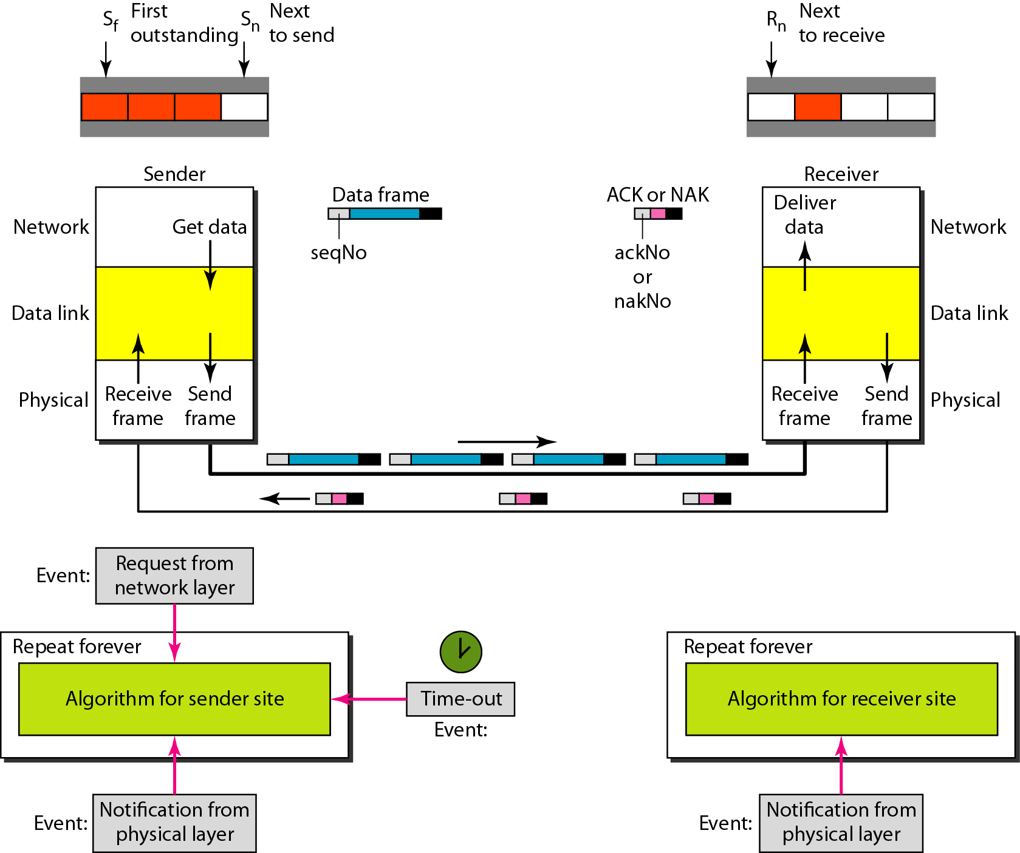
Figure 11.20 Design of Selective Repeat ARQ

Slide 38

Figure 11.21 Selective Repeat ARQ, window size

Slide 39
Note
In Selective Repeat ARQ, the size of the sender and receiver window
must be at most one-half of 2^{m}.

Slide 40

Figure 11.22 Delivery of data in Selective Repeat ARQ

Slide 41
Example 11.8
This example is similar to Example 11.3 in which frame 1 is lost. We show how Selective Repeat behaves in this case. Figure 11.23 shows the situation. One main difference is the number of timers. Here, each frame sent or resent needs a timer, which means that the timers need to be numbered (0, 1, 2, and 3). The timer for frame 0 starts at the first request, but stops when the ACK for this frame arrives. The timer for frame 1 starts at the second request, restarts when a NAK arrives, and finally stops when the last ACK arrives. The other two timers start when the corresponding frames are sent and stop at the last arrival event.

Slide 42
Example 11.8 (continued)
At the receiver site we need to distinguish between the acceptance of a frame and its delivery to the network layer. At the second arrival, frame 2 arrives and is stored and marked, but it cannot be delivered because frame 1 is missing. At the next arrival, frame 3 arrives and is marked and stored, but still none of the frames can be delivered. Only at the last arrival, when finally a copy of frame 1 arrives, can frames 1, 2, and 3 be delivered to the network layer. There are two conditions for the delivery of frames to the network layer: First, a set of consecutive frames must have arrived. Second, the set starts from the beginning of the window.

Slide 43
Example 11.8 (continued)
Another important point is that a NAK is sent after the second arrival, but not after the third, although both situations look the same. The reason is that the protocol does not want to crowd the network with unnecessary NAKs and unnecessary resent frames. The second NAK would still be NAK1 to inform the sender to resend frame 1 again; this has already been done. The first NAK sent is remembered (using the nakSent variable) and is not sent again until the frame slides. A NAK is sent once for each window position and defines the first slot in the window.

Slide 44
Example 11.8 (continued)
The next point is about the ACKs. Notice that only two ACKs are sent here. The first one acknowledges only the first frame; the second one acknowledges three frames. In Selective Repeat, ACKs are sent when data are delivered to the network layer. If the data belonging to n frames are delivered in one shot, only one ACK is sent for all of them.

Slide 45

Figure 11.23 Flow diagram for Example 11.8

Slide 46
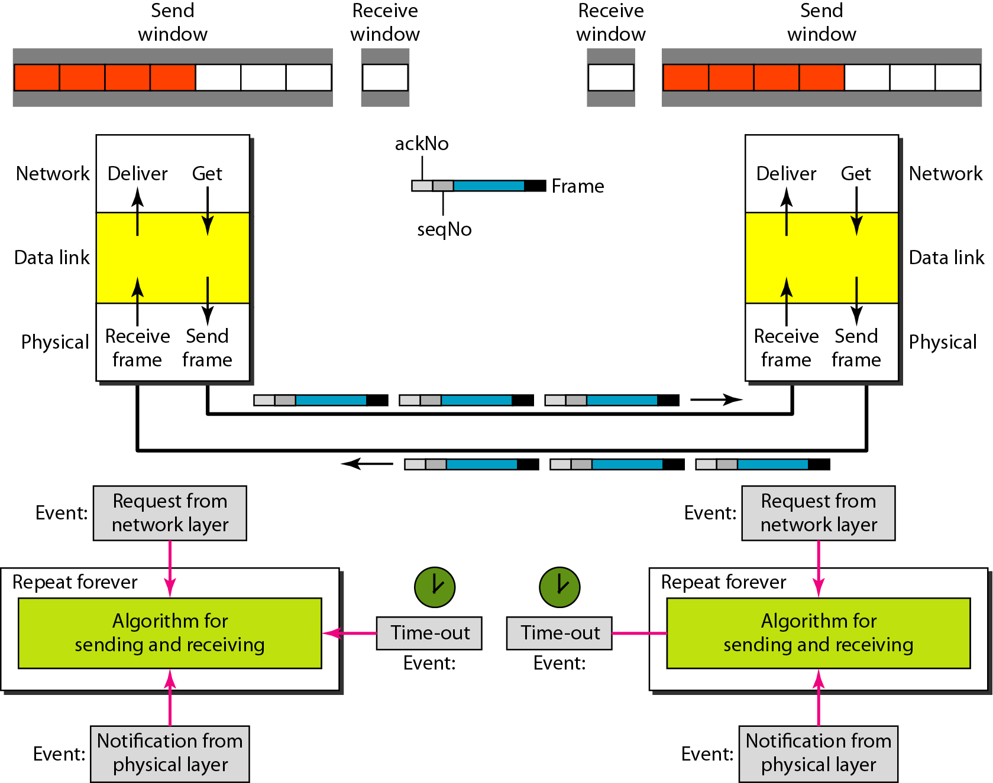
Figure 11.24 Design of piggybacking in Go-Back-N ARQ

Slide 47
11-6 HDLC
High-level Data Link Control (HDLC) is a bit-oriented protocol for communication over point-to-point and multipoint links. It implements the ARQ mechanisms we discussed in this chapter.
Topics discussed in this section:
Configurations and Transfer Modes
Frames
Control Field

Slide 48
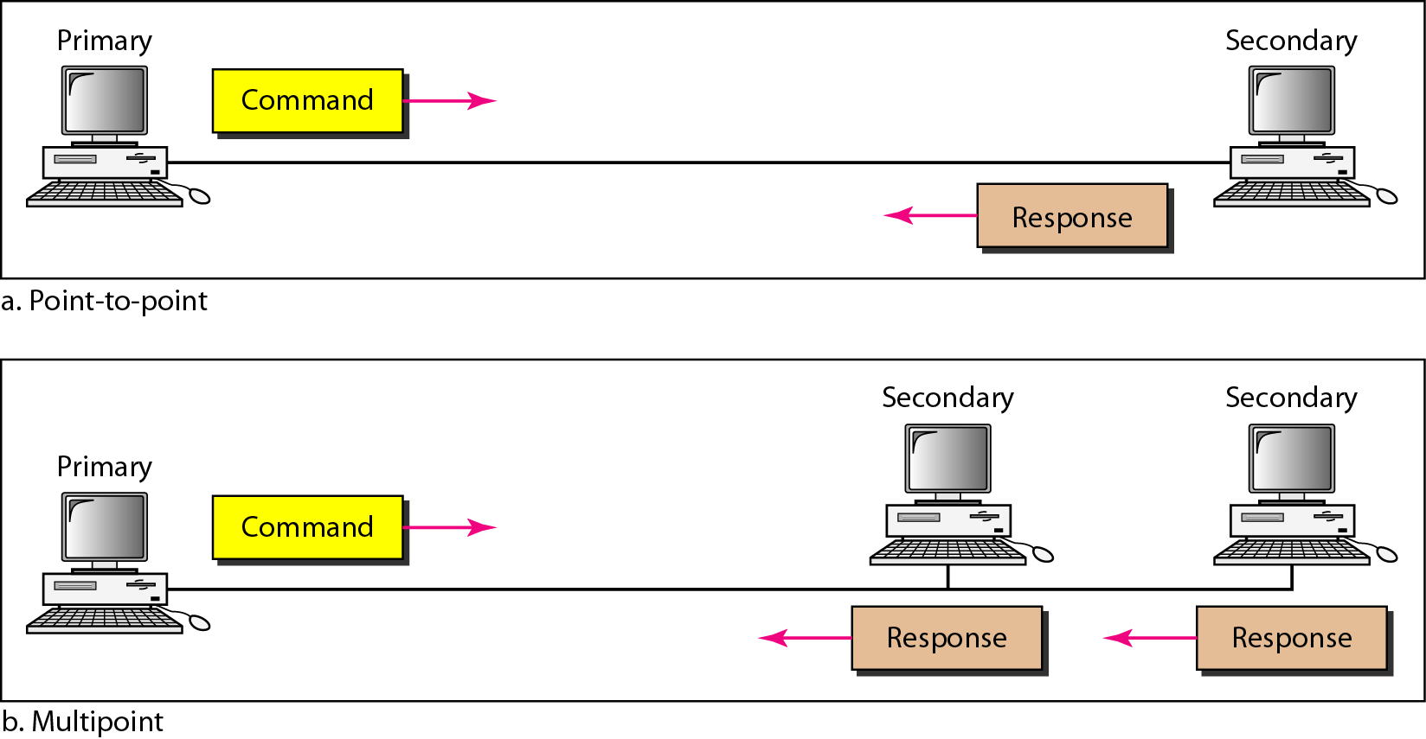
Figure 11.25 Normal response mode

Slide 49
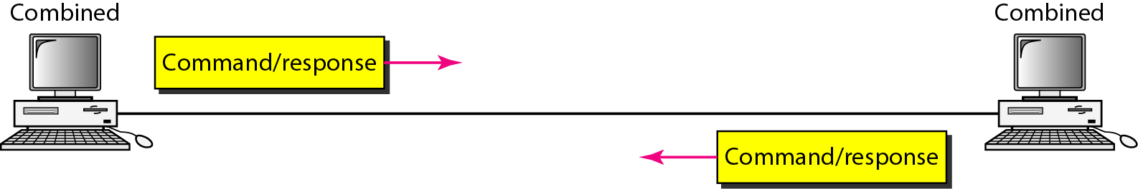
Figure 11.26 Asynchronous balanced mode

Slide 50
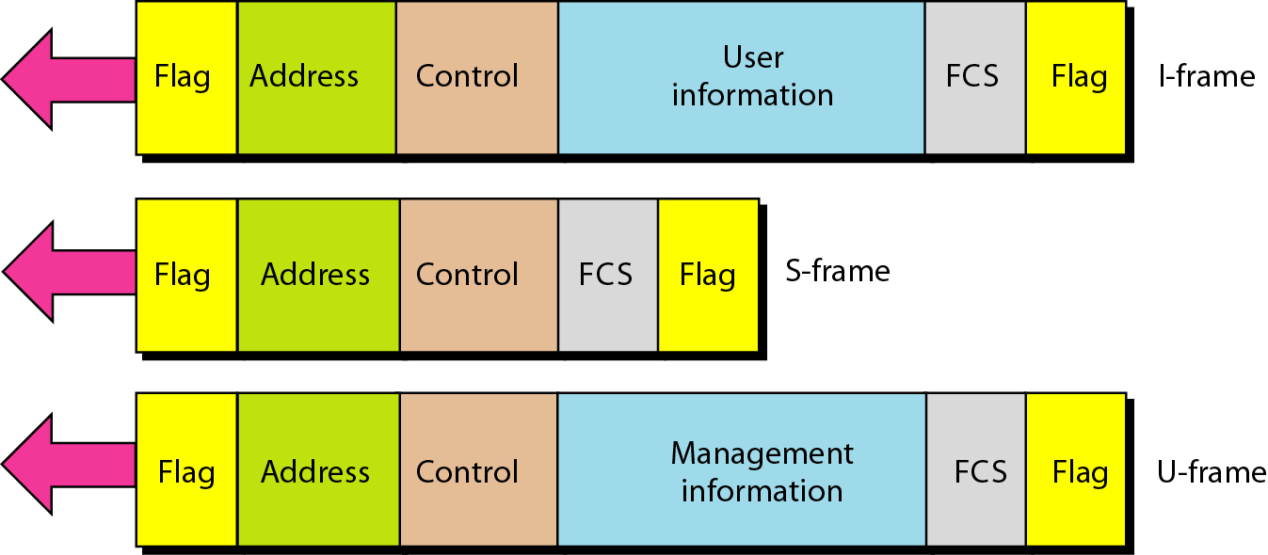
Figure 11.27 HDLC frames

Slide 51
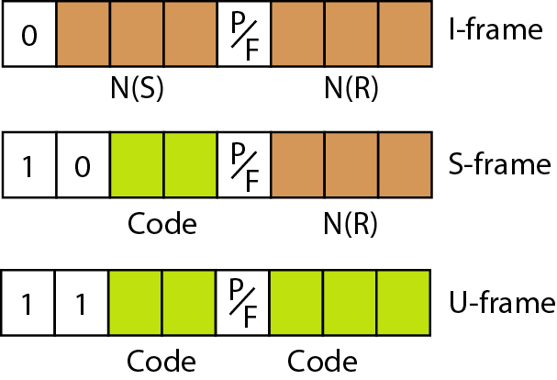
Figure 11.28 Control field format for the different frame types

Slide 52
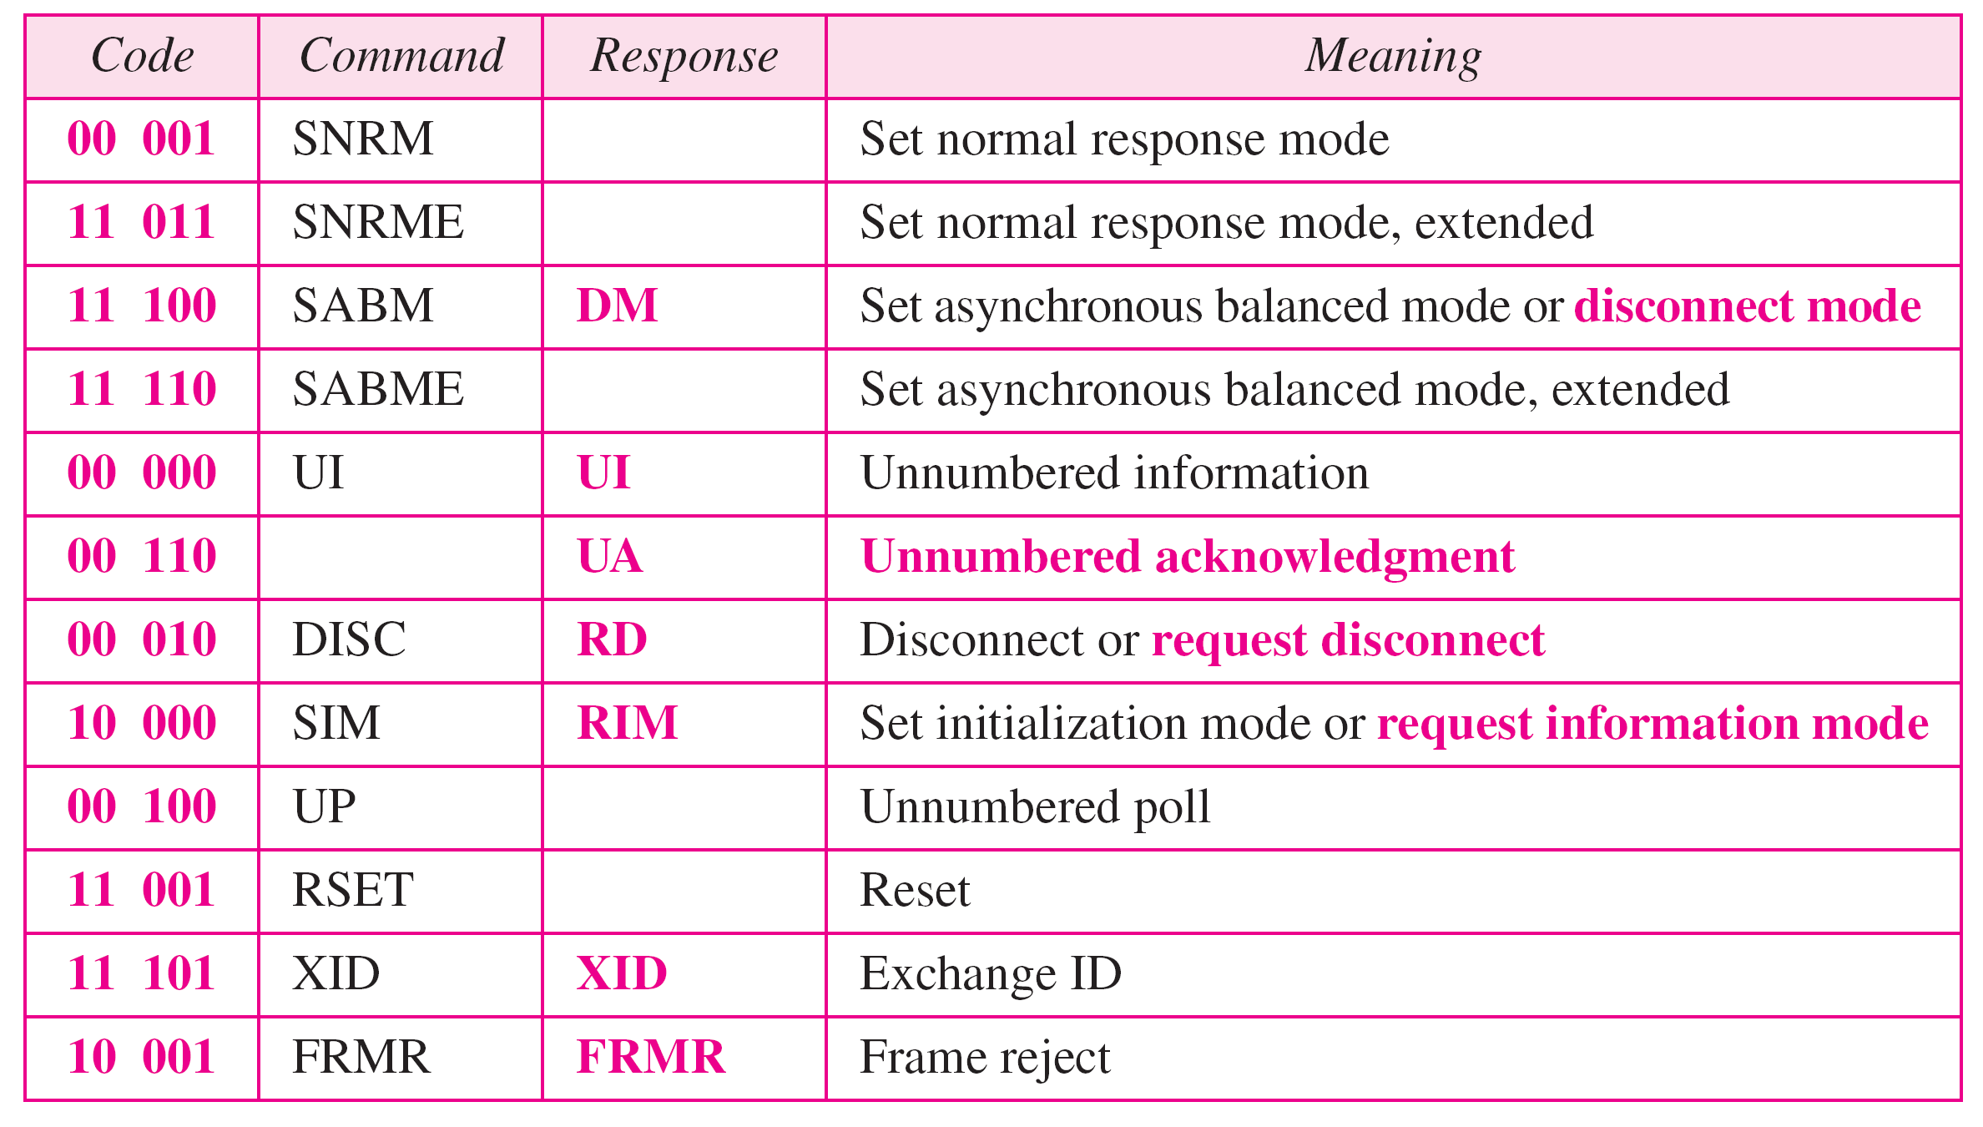
Table 11.1 U-frame control command and response

Slide 53
Example 11.9
Figure 11.29 shows how U-frames can be used for connection establishment and connection release. Node A asks for a connection with a set asynchronous balanced mode (SABM) frame; node B gives a positive response with an unnumbered acknowledgment (UA) frame. After these two exchanges, data can be transferred between the two nodes (not shown in the figure). After data transfer, node A sends a DISC (disconnect) frame to release the connection; it is confirmed by node B responding with a UA (unnumbered acknowledgment).

Slide 54
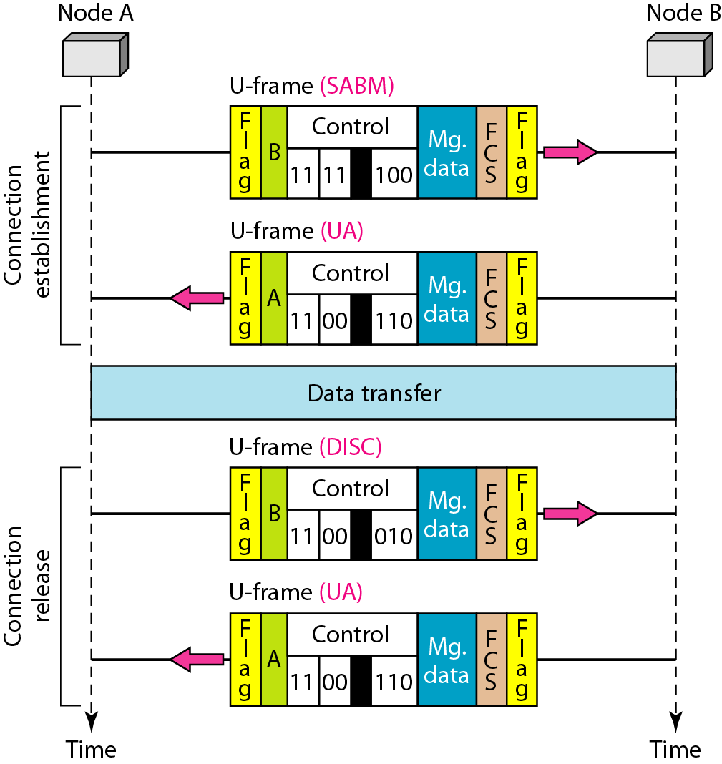
Figure 11.29 Example of connection and disconnection

Slide 55
Example 11.10
Figure 11.30 shows an exchange using piggybacking. Node A begins the exchange of information with an
I-frame numbered 0 followed by another I-frame numbered 1. Node B piggybacks its acknowledgment of both frames onto an I-frame of its own. Node B’s first
I-frame is also numbered 0 [N(S) field] and contains a 2 in its N(R) field, acknowledging the receipt of A’s frames 1 and 0 and indicating that it expects frame 2 to arrive next. Node B transmits its second and third I-frames (numbered 1 and 2) before accepting further frames from node A.

Slide 56
Example 11.10 (continued)
Its N(R) information, therefore, has not changed: B frames 1 and 2 indicate that node B is still expecting A’s frame 2 to arrive next. Node A has sent all its data. Therefore, it cannot piggyback an acknowledgment onto an I-frame and sends an S-frame instead. The RR code indicates that A is still ready to receive. The number 3 in the N(R) field tells B that frames 0, 1, and 2 have all been accepted and that A is now expecting frame number 3.

Slide 57
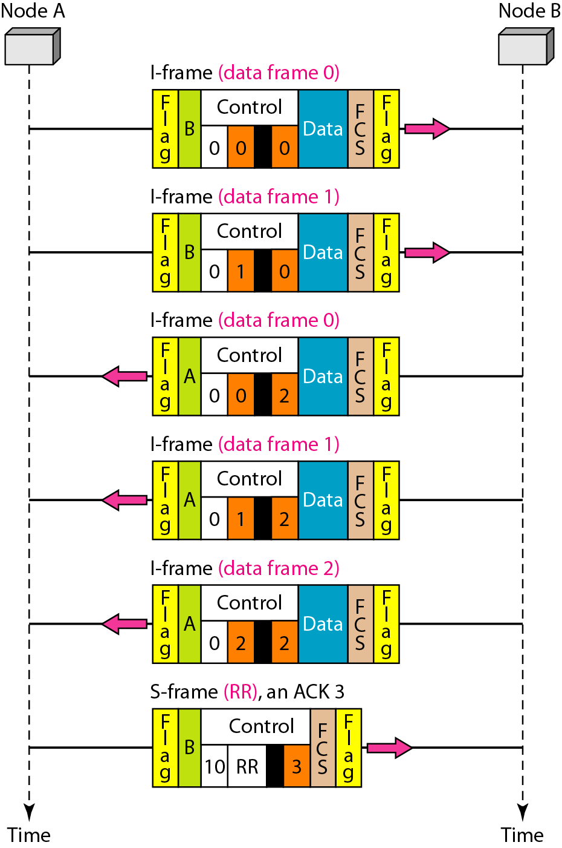
Figure 11.30 Example of piggybacking without error

Slide 58
Example 11.11
Figure 11.31 shows an exchange in which a frame is lost. Node B sends three data frames (0, 1, and 2), but frame 1 is lost. When node A receives frame 2, it discards it and sends a REJ frame for frame 1. Note that the protocol being used is Go-Back-N with the special use of an REJ frame as a NAK frame. The NAK frame does two things here: It confirms the receipt of frame 0 and declares that frame 1 and any following frames must be resent. Node B, after receiving the REJ frame, resends frames 1 and 2. Node A acknowledges the receipt by sending an RR frame (ACK) with acknowledgment number 3.

Slide 59
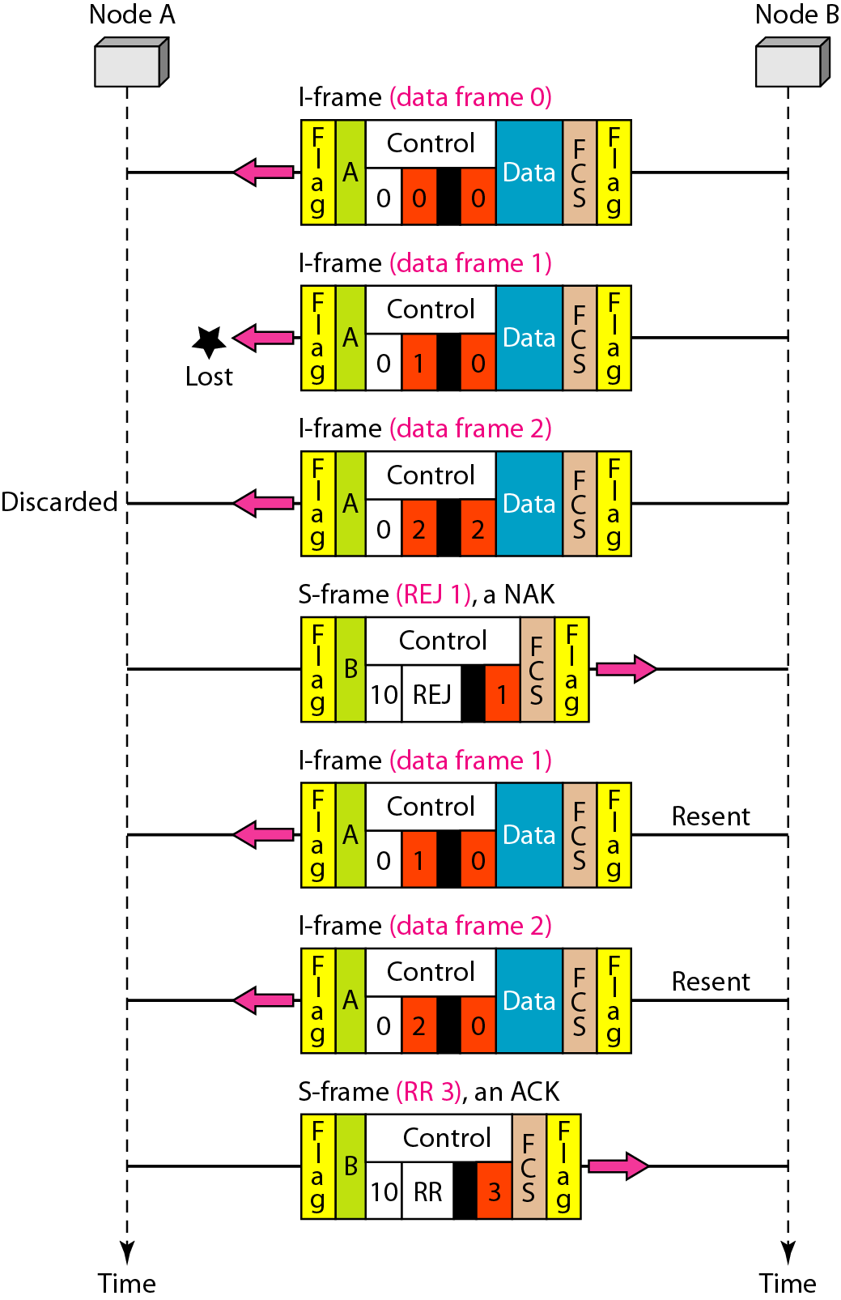
Figure 11.31 Example of piggybacking with error

Slide 60
11-7 POINT-TO-POINT PROTOCOL
Although HDLC is a general protocol that can be used for both point-to-point and multipoint configurations, one of the most common protocols for point-to-point access is the Point-to-Point Protocol (PPP). PPP is a byte-oriented protocol.
Topics discussed in this section:
Framing
Transition Phases
Multiplexing
Multilink PPP

Slide 61
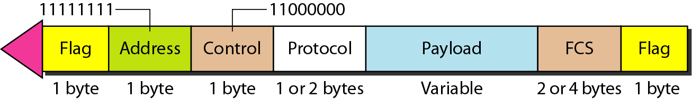
Figure 11.32 PPP frame format

Slide 62
Note
PPP is a byte-oriented protocol using byte stuffing with the escape byte 01111101.

Slide 63
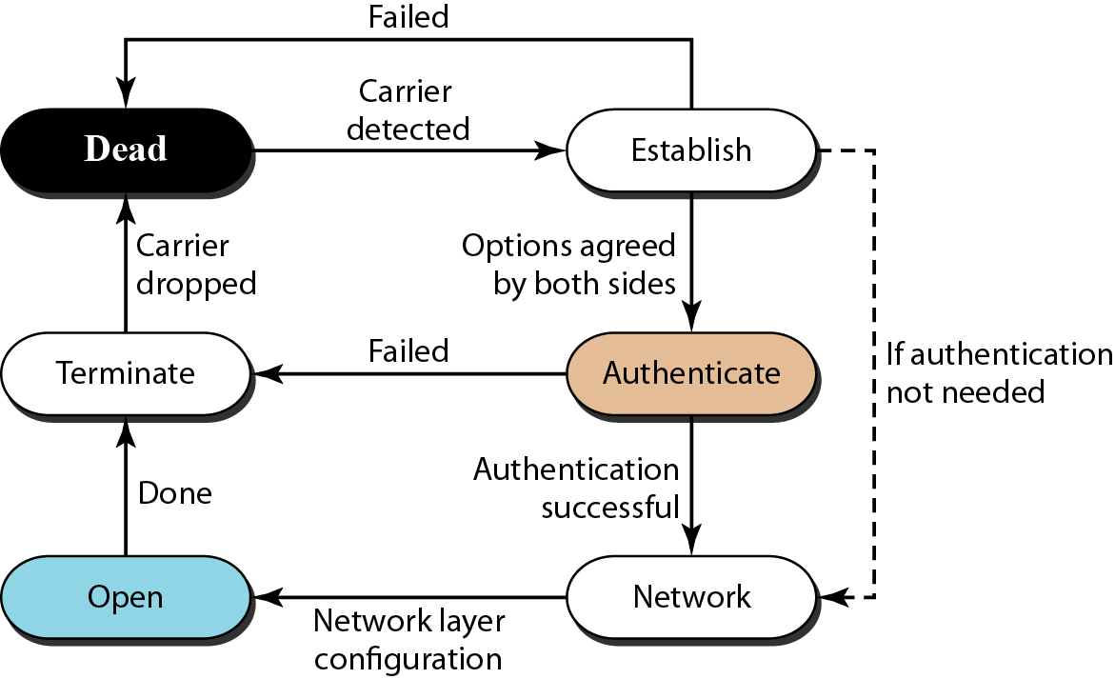
Figure 11.33 Transition phases

Slide 64
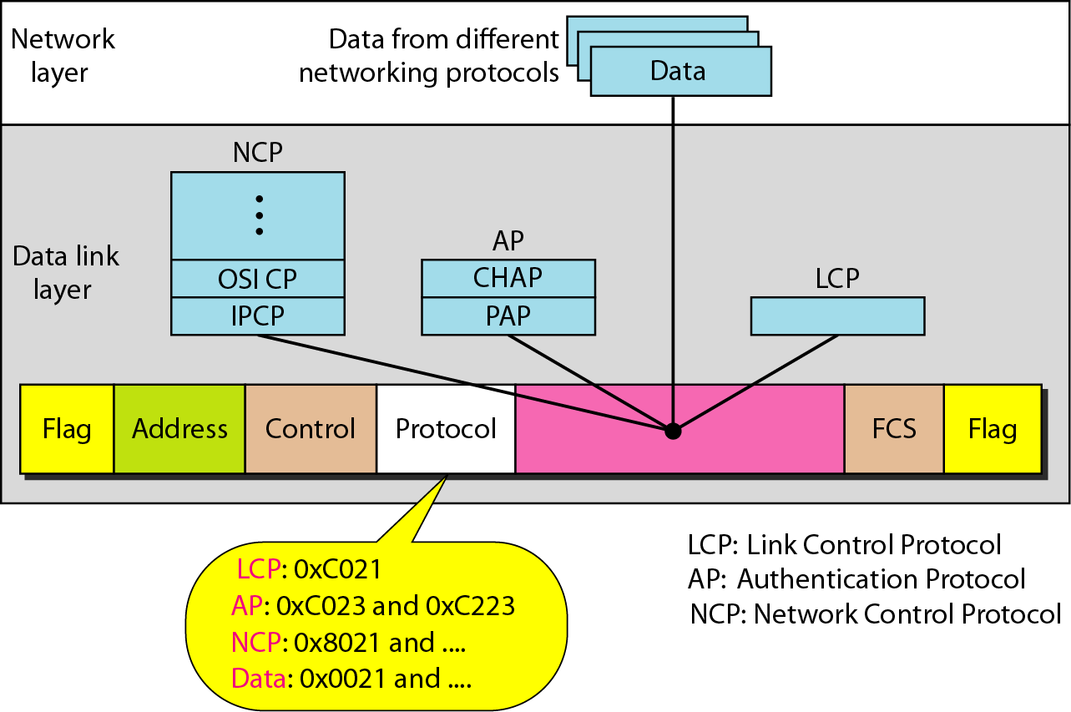
Figure 11.34 Multiplexing in PPP

Slide 65
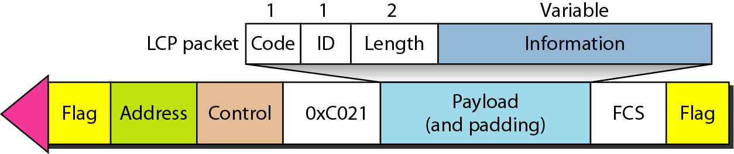
Figure 11.35 LCP packet encapsulated in a frame

Slide 66
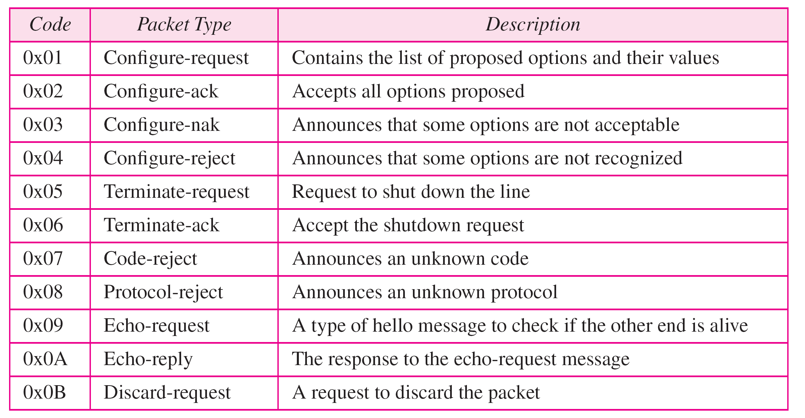
Table 11.2 LCP packets

Slide 67
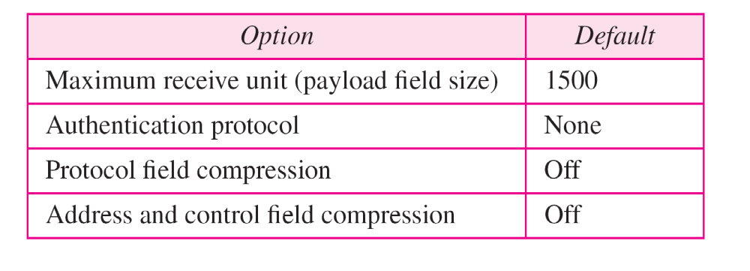
Table 11.3 Common options

Slide 68
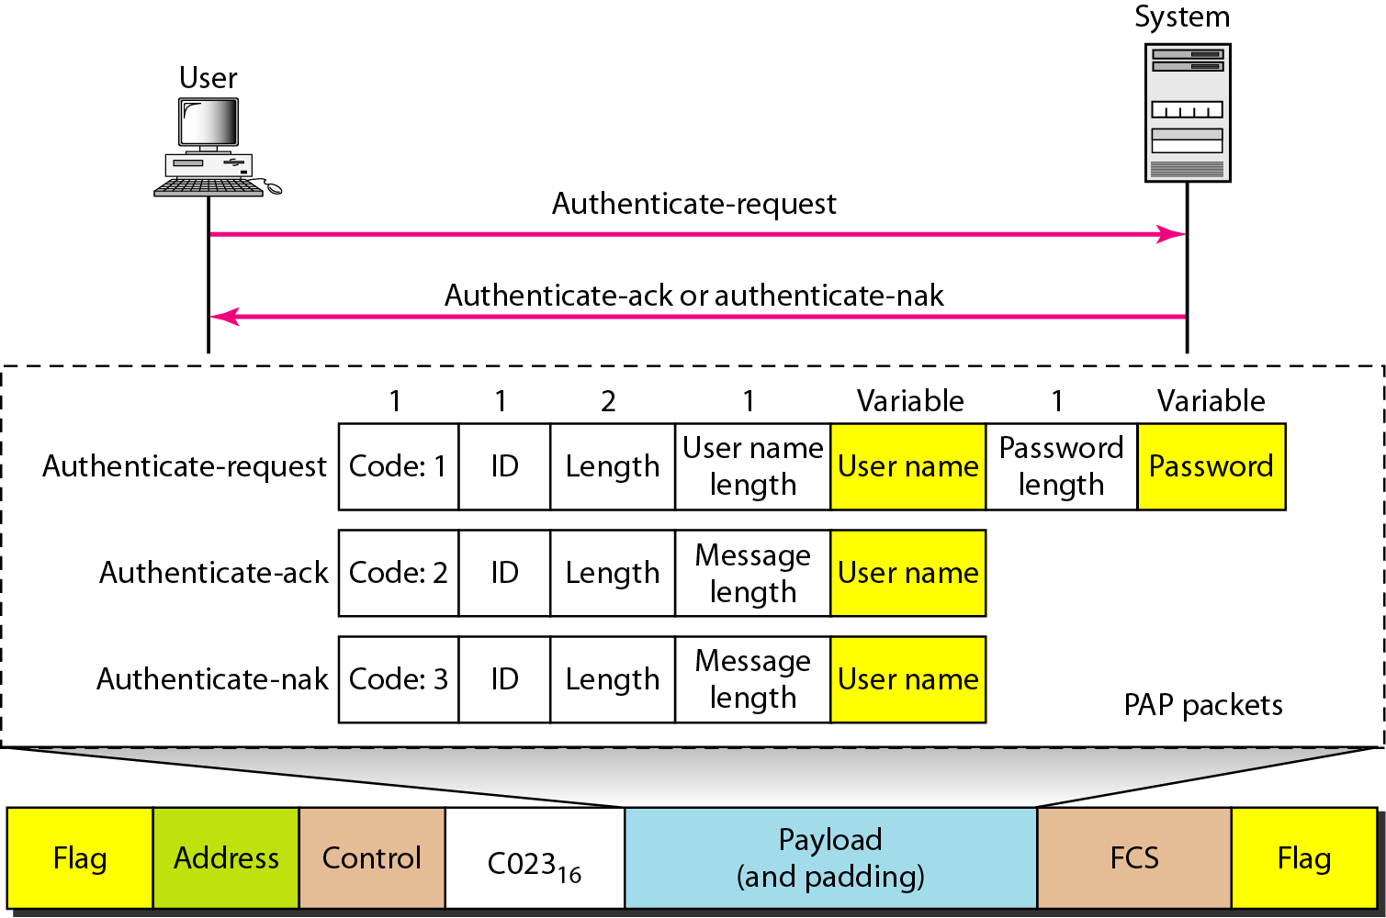
Figure 11.36 PAP packets encapsulated in a PPP frame

Slide 69
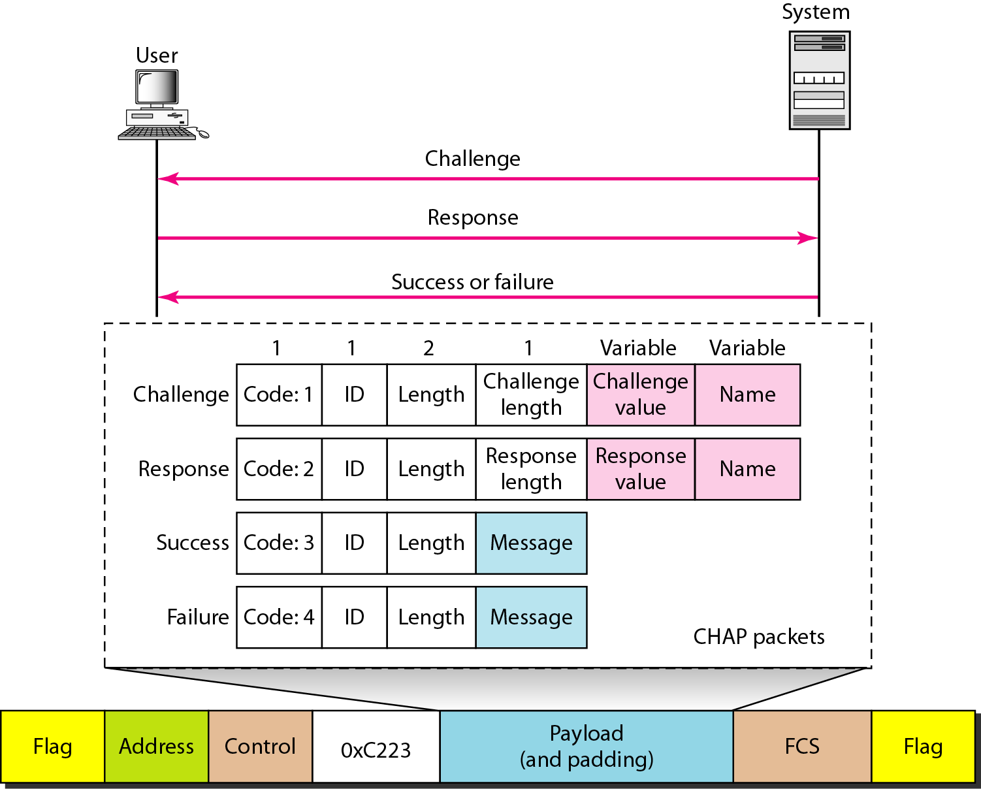
Figure 11.37 CHAP packets encapsulated in a PPP frame

Slide 70
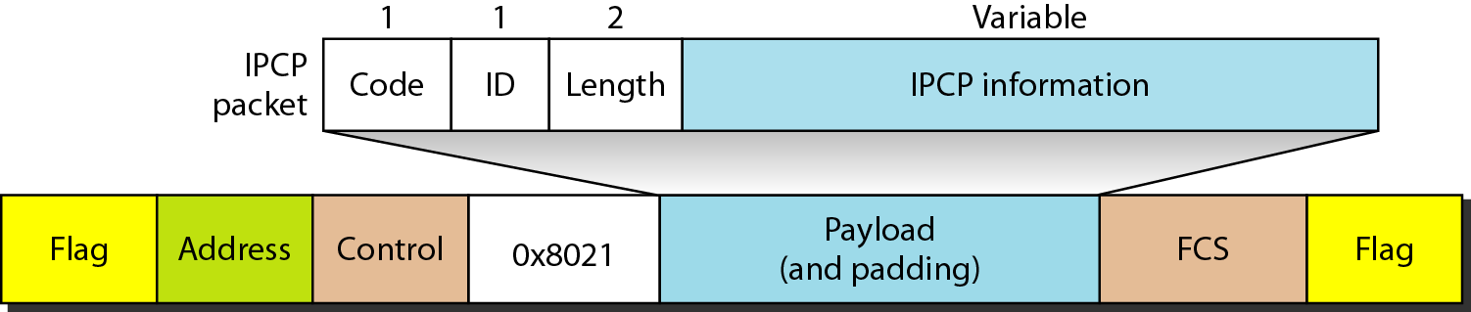
Figure 11.38 IPCP packet encapsulated in PPP frame

Slide 71
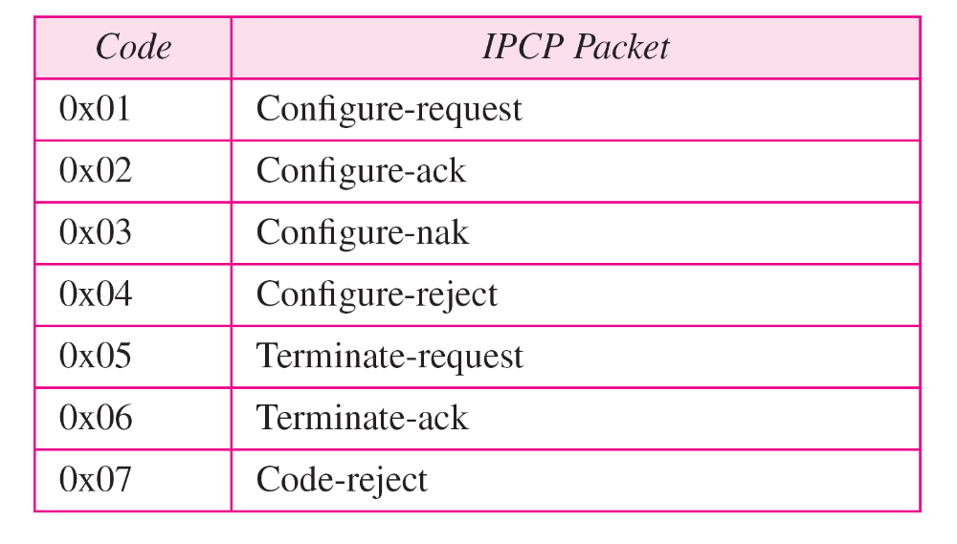
Table 11.4 Code value for IPCP packets

Slide 72
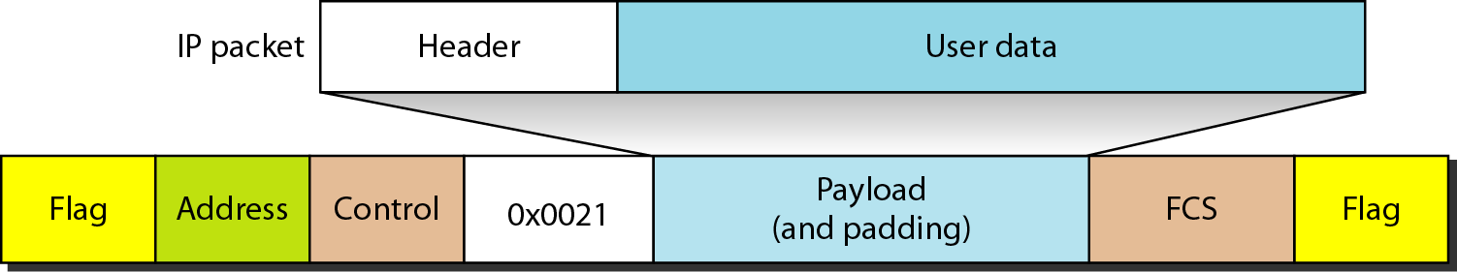
Figure 11.39 IP datagram encapsulated in a PPP frame

Slide 73
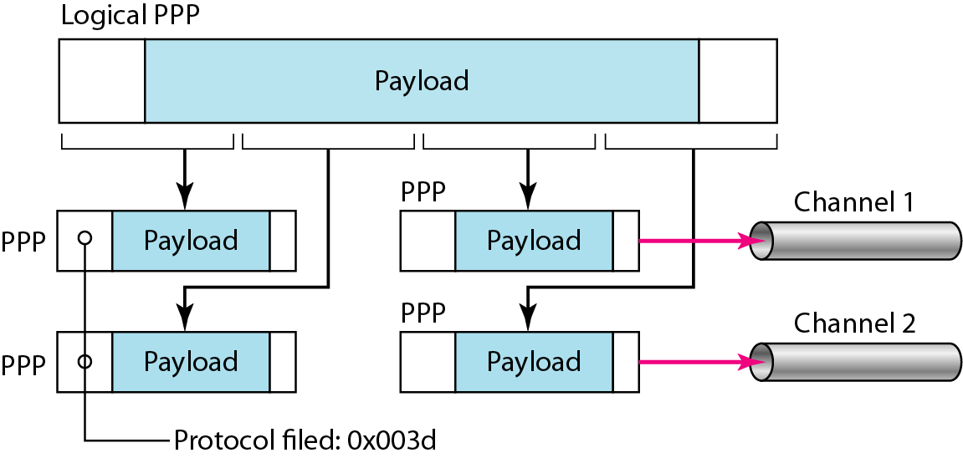
Figure 11.40 Multilink PPP

Slide 74
Example 11.12
Let us go through the phases followed by a network layer packet as it is transmitted through a PPP connection. Figure 11.41 shows the steps. For simplicity, we assume unidirectional movement of data from the user site to the system site (such as sending an e-mail through an ISP).
The first two frames show link establishment. We have chosen two options (not shown in the figure): using PAP for authentication and suppressing the address control fields. Frames 3 and 4 are for authentication. Frames 5 and 6 establish the network layer connection using IPCP.

Slide 75
Example 11.12 (continued)
The next several frames show that some IP packets are encapsulated in the PPP frame. The system (receiver) may have been running several network layer protocols, but it knows that the incoming data must be delivered to the IP protocol because the NCP protocol used before the data transfer was IPCP.
After data transfer, the user then terminates the data link connection, which is acknowledged by the system. Of course the user or the system could have chosen to terminate the network layer IPCP and keep the data link layer running if it wanted to run another NCP protocol.

Slide 76
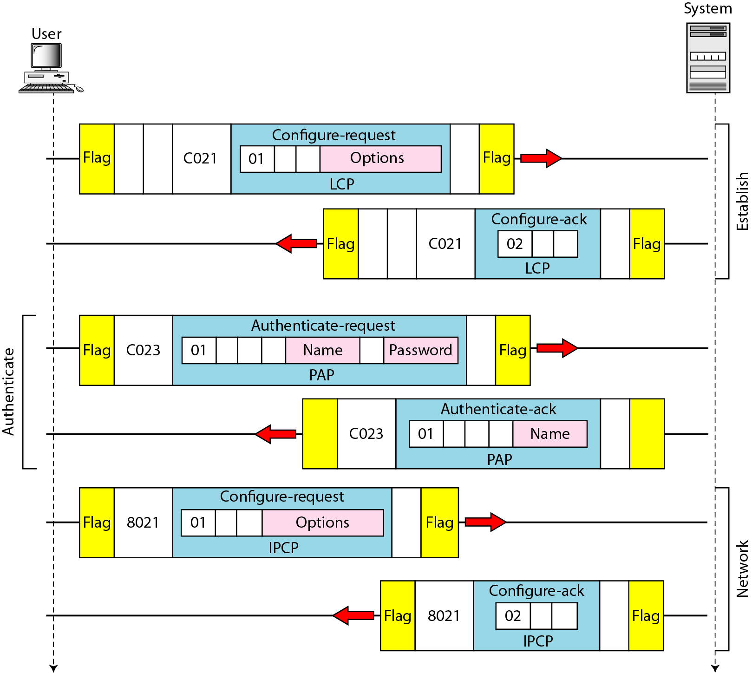
Figure 11.41 An example

Slide 77
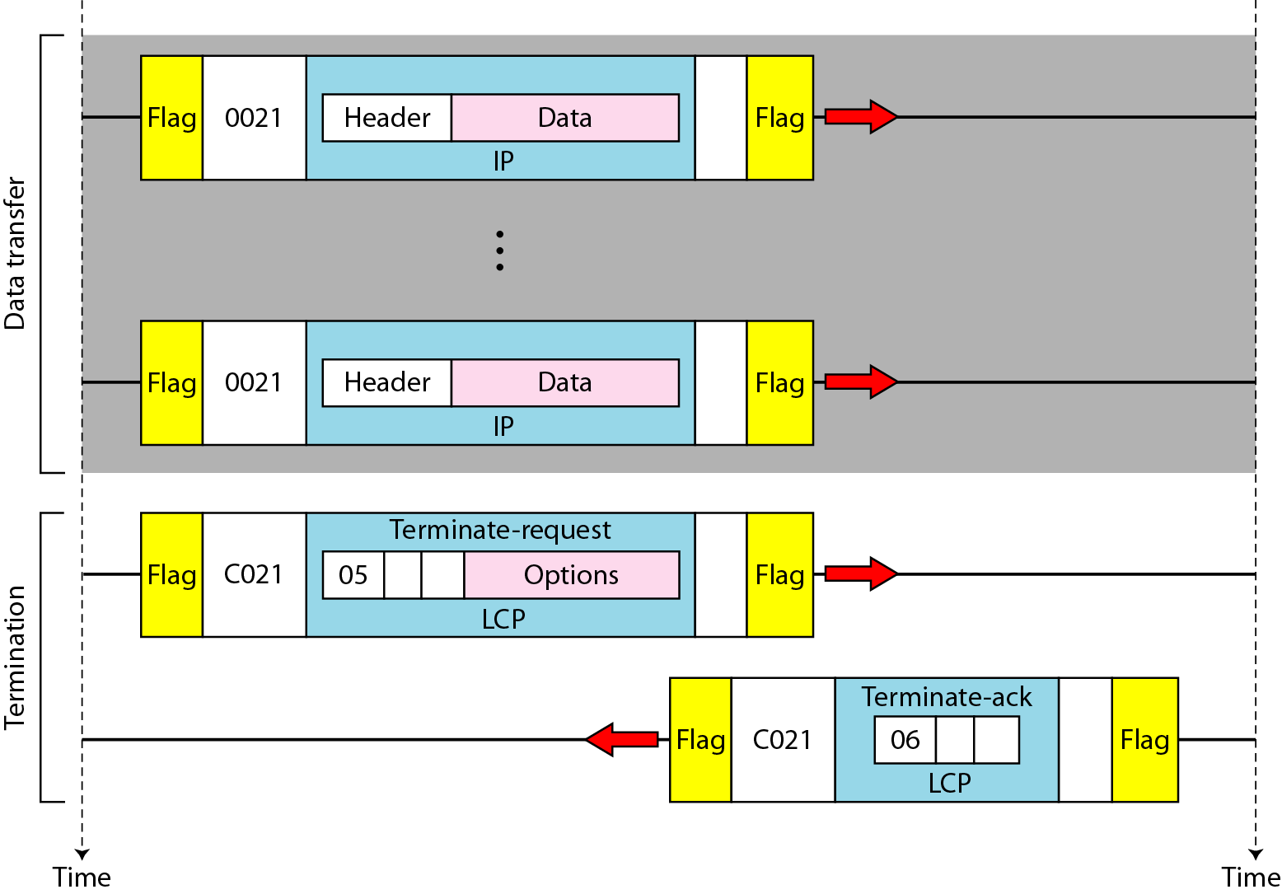
Figure 11.41 An example (continued)

