Slide 1
Data Communications
Lecture 37

Slide 2
Go-Back-N Protocol
Motivation
  Inefficiency of Stop-and-Wait protocol
  S continuously sends enough frames so that the channel is kept busy while S waits for ACK.
Procedure
  S has a limit on the number of outstanding frames (S_{w}), and each frame is associated with a timer
  S sends frame 0 followed by additional frames, so S_{w} frames are outstanding.
  Upon receiving ACK k, S sends frames up to S_{w} + k.
  If time-out occurs, go back to S_{w} previous frames (outstanding frames) which are outstanding in S, and re-transmit all those outstanding frames.
_{time-out period}
₀
₁
₂
₃
₄
₅
₆
₇
₈
₅
₆
₇
₈
_{S}
₀
₁
₂
₃
₄
₅
₆
₇
_{D}
_{11.<number>}

Slide 3

Send window for Go-Back-N ARQ

Slide 4
Example 1
Figure 1 shows an example of Go-Back-N. This is an example of a case where the forward channel is reliable, but the reverse is not. No data frames are lost, but some ACKs are delayed and one is lost. The example also shows how cumulative acknowledgments can help if acknowledgments are delayed or lost. After initialization, there are seven sender events. Request events are triggered by data from the network layer; arrival events are triggered by acknowledgments from the physical layer. There is no time-out event here because all outstanding frames are acknowledged before the timer expires. Note that although ACK 2 is lost, ACK 3 serves as both ACK 2 and ACK 3.

Slide 5

Figure 1 Flow diagram for Example 1

Slide 6
Example 2
Figure 2 shows what happens when a frame is lost. Frames 0, 1, 2, and 3 are sent. However, frame 1 is lost. The receiver receives frames 2 and 3, but they are discarded because they are received out of order. The sender receives no acknowledgment about frames 1, 2, or 3. Its timer finally expires. The sender sends all outstanding frames (1, 2, and 3) because it does not know what is wrong. Note that the resending of frames 1, 2, and 3 is the response to one single event. When the sender is responding to this event, it cannot accept the triggering of other events. This means that when ACK 2 arrives, the sender is still busy with sending frame 3.

Slide 7
Example 2 (continued)
The physical layer must wait until this event is completed and the data link layer goes back to its sleeping state. We have shown a vertical line to indicate the delay. It is the same story with ACK 3; but when ACK 3 arrives, the sender is busy responding to ACK 2. It happens again when ACK 4 arrives. Note that before the second timer expires, all outstanding frames have been sent and the timer is stopped.

Slide 8

Figure 2 Flow diagram for Example 2

Slide 9

Note
Stop-and-Wait ARQ is a special case of Go-Back-N ARQ in which the size of the send window is 1.

Slide 10

Figure 11.18 Send window for Selective Repeat ARQ

Slide 11

Figure 11.19 Receive window for Selective Repeat ARQ

Slide 12
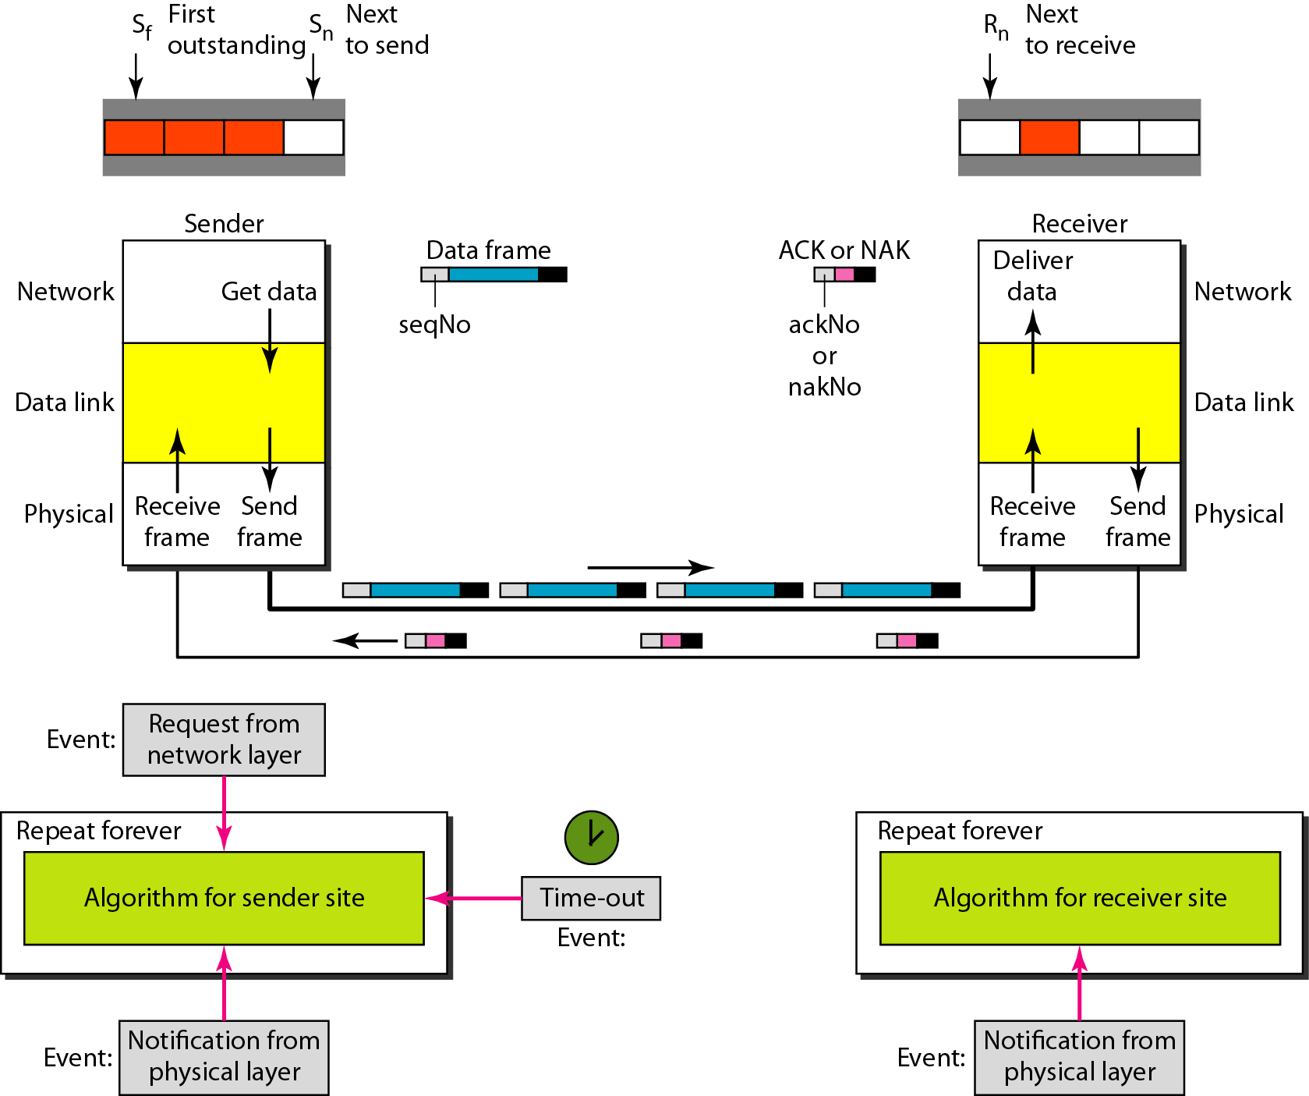
Figure 11.20 Design of Selective Repeat ARQ

Slide 13

Figure 11.21 Selective Repeat ARQ, window size

Slide 14
Note
In Selective Repeat ARQ, the size of the sender and receiver window
must be at most one-half of 2^{m}.

Slide 15

Figure 11.22 Delivery of data in Selective Repeat ARQ

Slide 16
Example 11.8
This example is similar to Example 11.3 in which frame 1 is lost. We show how Selective Repeat behaves in this case. Figure 11.23 shows the situation. One main difference is the number of timers. Here, each frame sent or resent needs a timer, which means that the timers need to be numbered (0, 1, 2, and 3). The timer for frame 0 starts at the first request, but stops when the ACK for this frame arrives. The timer for frame 1 starts at the second request, restarts when a NAK arrives, and finally stops when the last ACK arrives. The other two timers start when the corresponding frames are sent and stop at the last arrival event.

Slide 17
Example 11.8 (continued)
At the receiver site we need to distinguish between the acceptance of a frame and its delivery to the network layer. At the second arrival, frame 2 arrives and is stored and marked, but it cannot be delivered because frame 1 is missing. At the next arrival, frame 3 arrives and is marked and stored, but still none of the frames can be delivered. Only at the last arrival, when finally a copy of frame 1 arrives, can frames 1, 2, and 3 be delivered to the network layer. There are two conditions for the delivery of frames to the network layer: First, a set of consecutive frames must have arrived. Second, the set starts from the beginning of the window.

Slide 18
Example 11.8 (continued)
Another important point is that a NAK is sent after the second arrival, but not after the third, although both situations look the same. The reason is that the protocol does not want to crowd the network with unnecessary NAKs and unnecessary resent frames. The second NAK would still be NAK1 to inform the sender to resend frame 1 again; this has already been done. The first NAK sent is remembered (using the nakSent variable) and is not sent again until the frame slides. A NAK is sent once for each window position and defines the first slot in the window.

Slide 19
Example 11.8 (continued)
The next point is about the ACKs. Notice that only two ACKs are sent here. The first one acknowledges only the first frame; the second one acknowledges three frames. In Selective Repeat, ACKs are sent when data are delivered to the network layer. If the data belonging to n frames are delivered in one shot, only one ACK is sent for all of them.

Slide 20

Figure 11.23 Flow diagram for Example 11.8

Slide 21
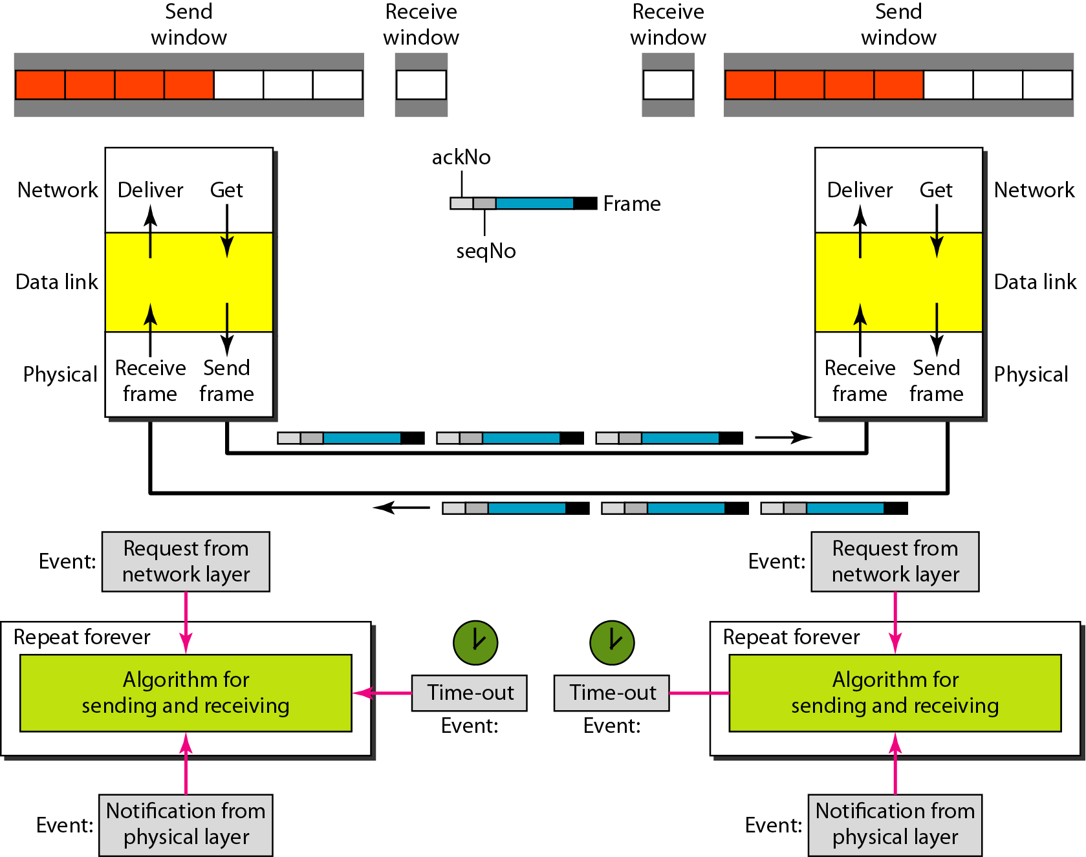
Figure 11.24 Design of piggybacking in Go-Back-N ARQ

Slide 22
11-6 HDLC
High-level Data Link Control (HDLC) is a bit-oriented protocol for communication over point-to-point and multipoint links. It implements the ARQ mechanisms we discussed in this chapter.
Topics discussed in this section:
Configurations and Transfer Modes
Frames
Control Field

Slide 23
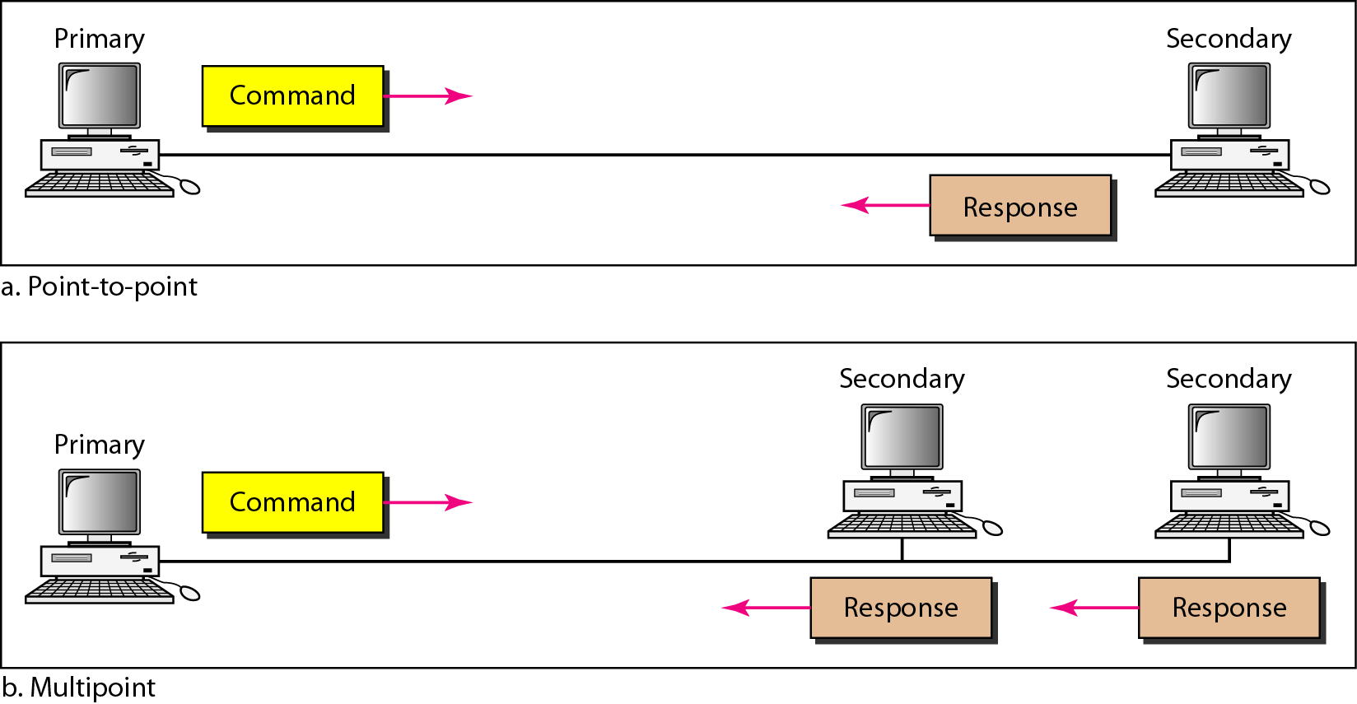
Figure 11.25 Normal response mode

Slide 24
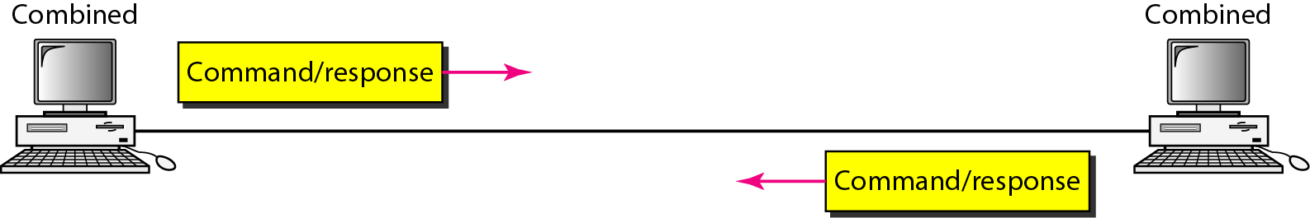
Figure 11.26 Asynchronous balanced mode

Slide 25
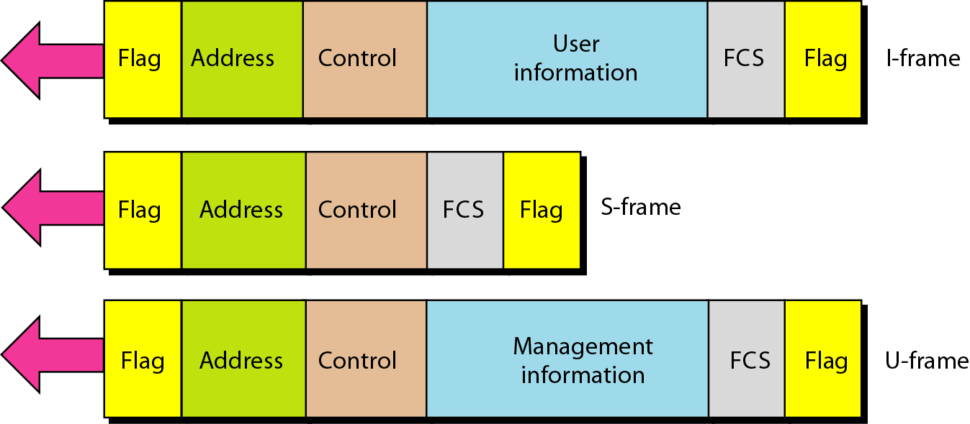
Figure 11.27 HDLC frames

Slide 26
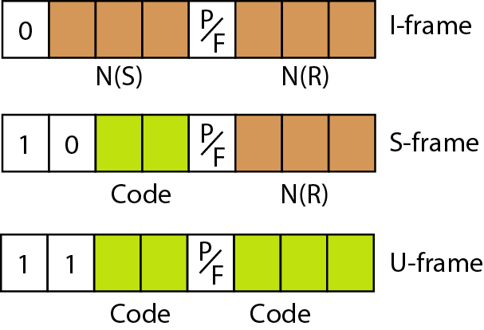
Figure 11.28 Control field format for the different frame types

Slide 27
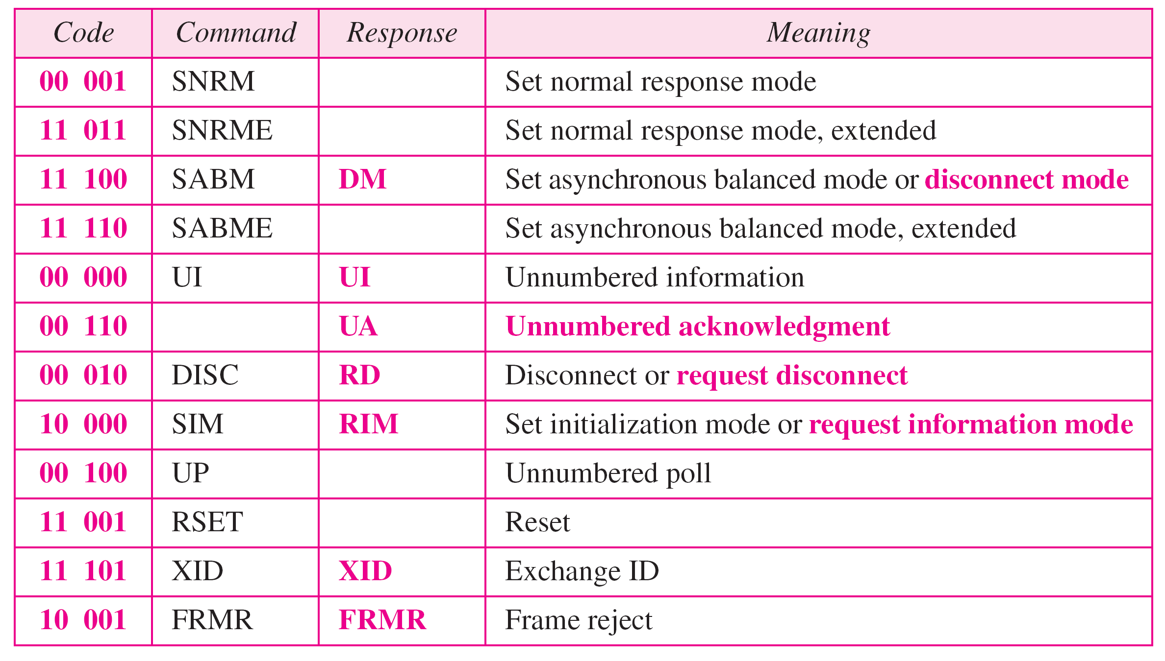
Table 11.1 U-frame control command and response

Slide 28
Example 11.9
Figure 11.29 shows how U-frames can be used for connection establishment and connection release. Node A asks for a connection with a set asynchronous balanced mode (SABM) frame; node B gives a positive response with an unnumbered acknowledgment (UA) frame. After these two exchanges, data can be transferred between the two nodes (not shown in the figure). After data transfer, node A sends a DISC (disconnect) frame to release the connection; it is confirmed by node B responding with a UA (unnumbered acknowledgment).

Slide 29
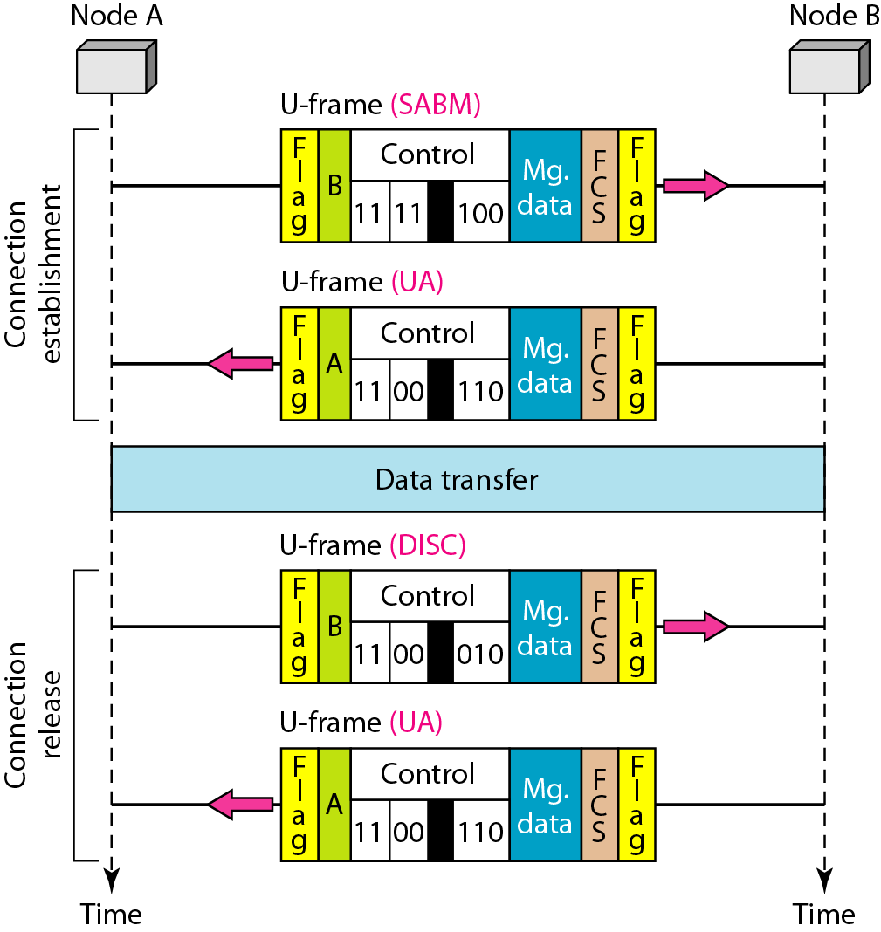
Figure 11.29 Example of connection and disconnection

Slide 30
Example 11.10
Figure 11.30 shows an exchange using piggybacking. Node A begins the exchange of information with an
I-frame numbered 0 followed by another I-frame numbered 1. Node B piggybacks its acknowledgment of both frames onto an I-frame of its own. Node B’s first
I-frame is also numbered 0 [N(S) field] and contains a 2 in its N(R) field, acknowledging the receipt of A’s frames 1 and 0 and indicating that it expects frame 2 to arrive next. Node B transmits its second and third I-frames (numbered 1 and 2) before accepting further frames from node A.

Slide 31
Example 11.10 (continued)
Its N(R) information, therefore, has not changed: B frames 1 and 2 indicate that node B is still expecting A’s frame 2 to arrive next. Node A has sent all its data. Therefore, it cannot piggyback an acknowledgment onto an I-frame and sends an S-frame instead. The RR code indicates that A is still ready to receive. The number 3 in the N(R) field tells B that frames 0, 1, and 2 have all been accepted and that A is now expecting frame number 3.

Slide 32
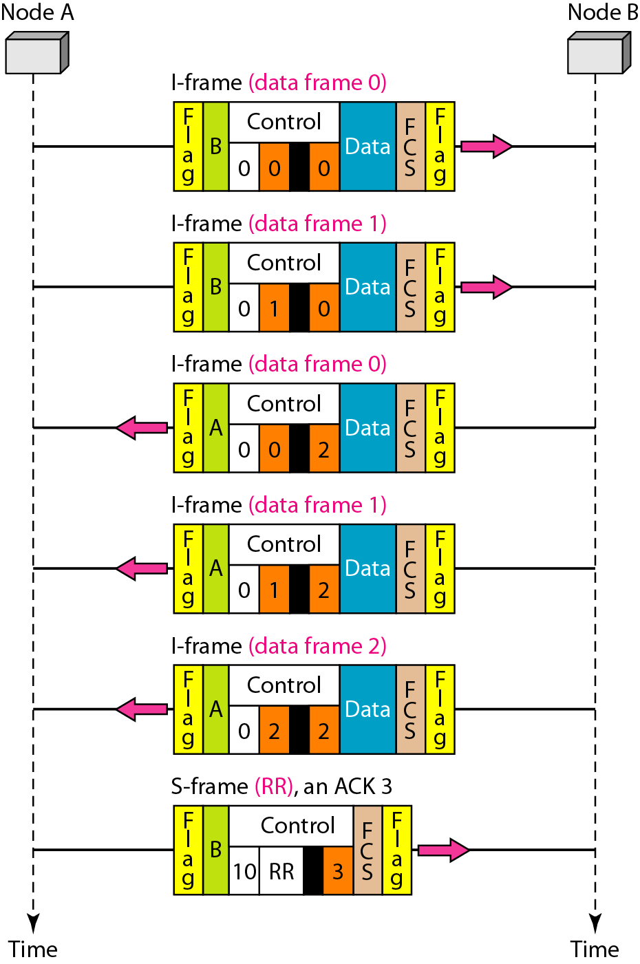
Figure 11.30 Example of piggybacking without error

Slide 33
Example 11.11
Figure 11.31 shows an exchange in which a frame is lost. Node B sends three data frames (0, 1, and 2), but frame 1 is lost. When node A receives frame 2, it discards it and sends a REJ frame for frame 1. Note that the protocol being used is Go-Back-N with the special use of an REJ frame as a NAK frame. The NAK frame does two things here: It confirms the receipt of frame 0 and declares that frame 1 and any following frames must be resent. Node B, after receiving the REJ frame, resends frames 1 and 2. Node A acknowledges the receipt by sending an RR frame (ACK) with acknowledgment number 3.

Slide 34
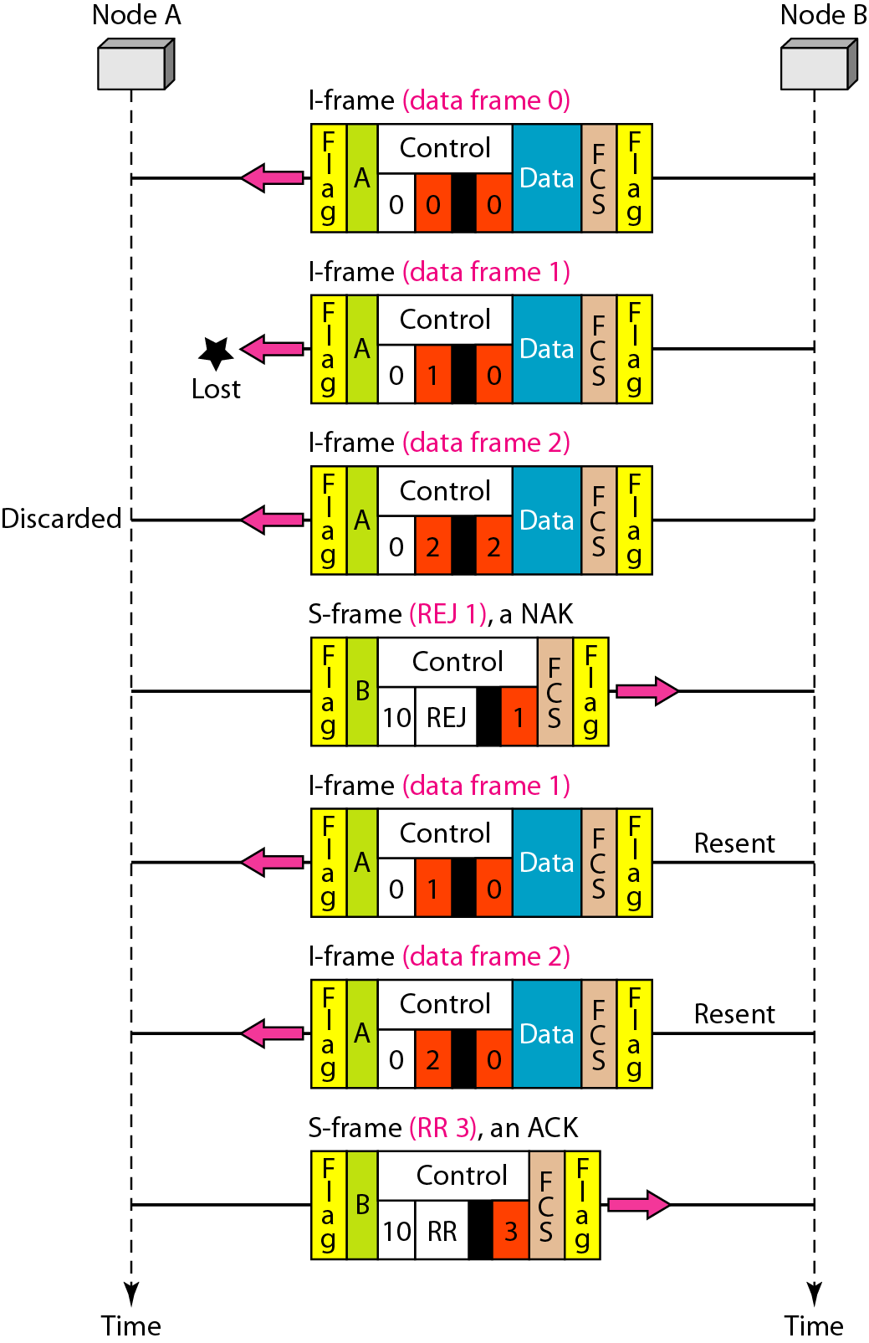
Figure 11.31 Example of piggybacking with error

Slide 35
11-7 POINT-TO-POINT PROTOCOL
Although HDLC is a general protocol that can be used for both point-to-point and multipoint configurations, one of the most common protocols for point-to-point access is the Point-to-Point Protocol (PPP). PPP is a byte-oriented protocol.
Topics discussed in this section:
Framing
Transition Phases
Multiplexing
Multilink PPP

Slide 36
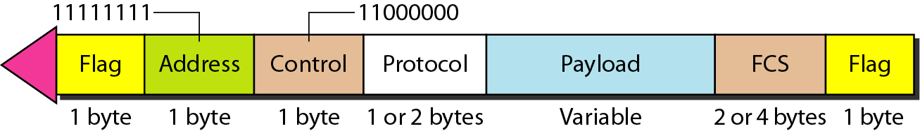
Figure 11.32 PPP frame format

Slide 37
Note
PPP is a byte-oriented protocol using byte stuffing with the escape byte 01111101.

Slide 38
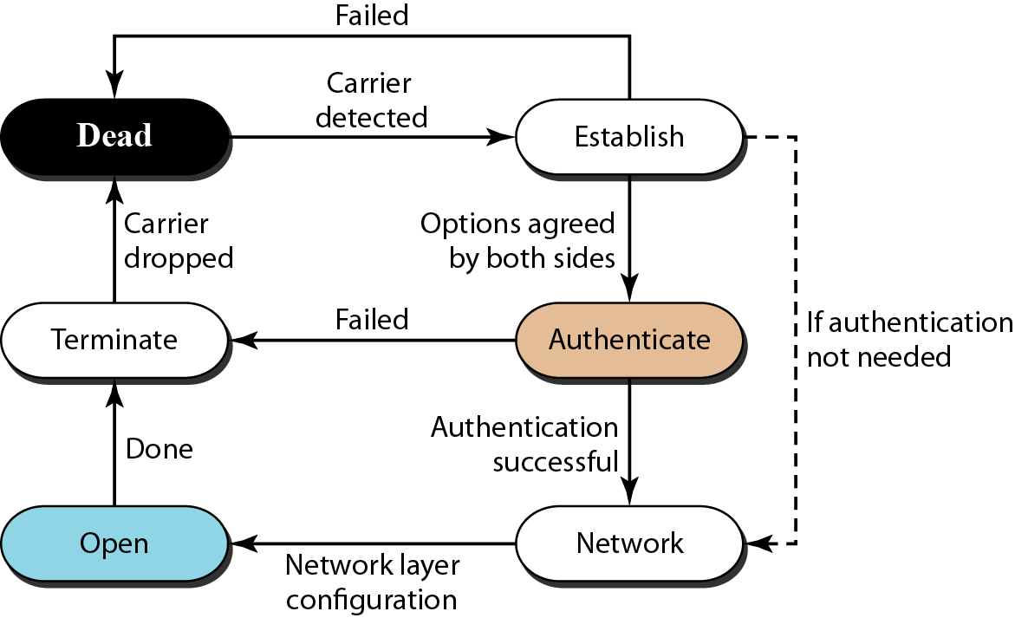
Figure 11.33 Transition phases

Slide 39
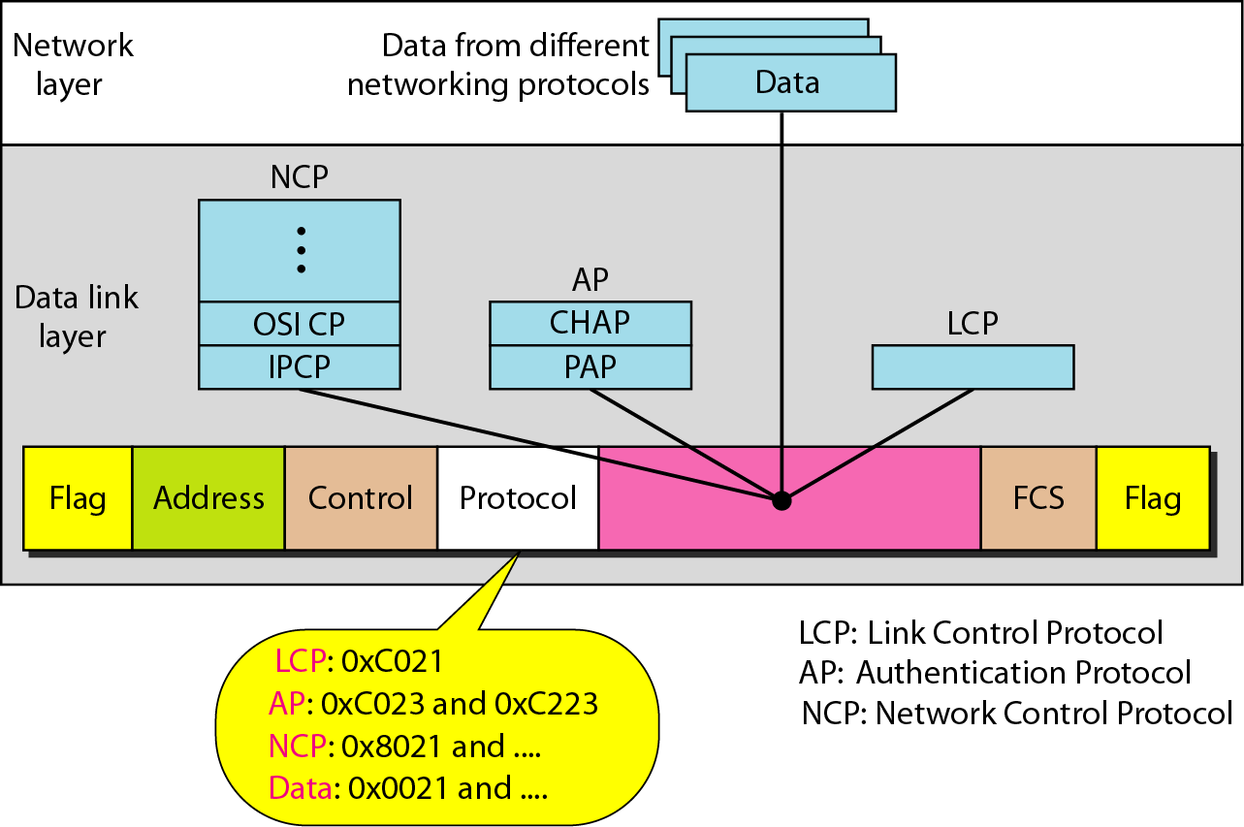
Figure 11.34 Multiplexing in PPP

Slide 40
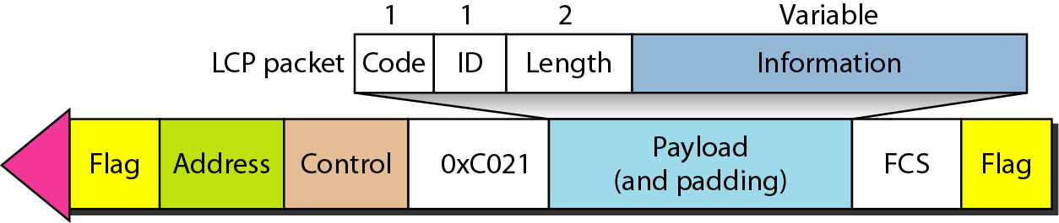
Figure 11.35 LCP packet encapsulated in a frame

Slide 41
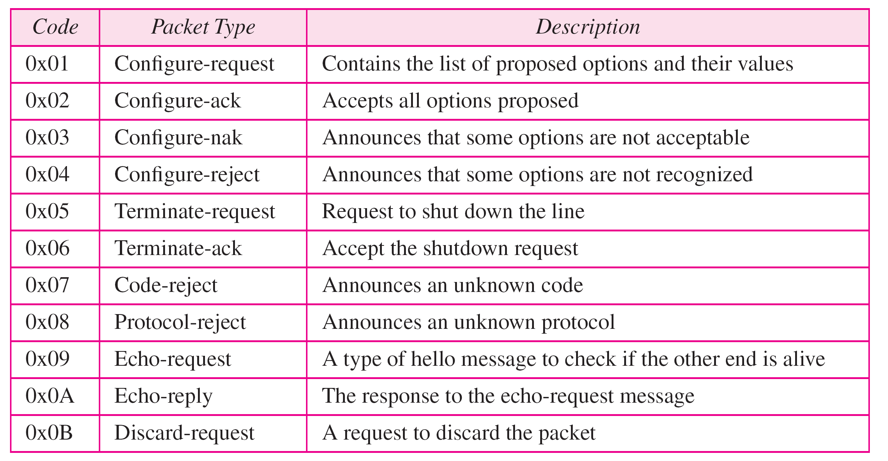
Table 11.2 LCP packets

Slide 42
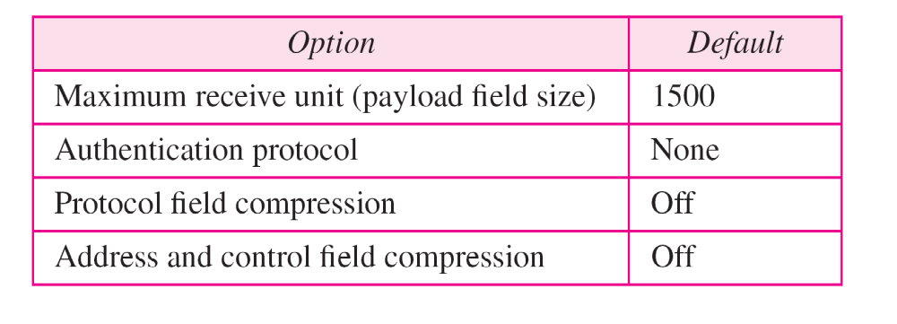
Table 11.3 Common options

Slide 43
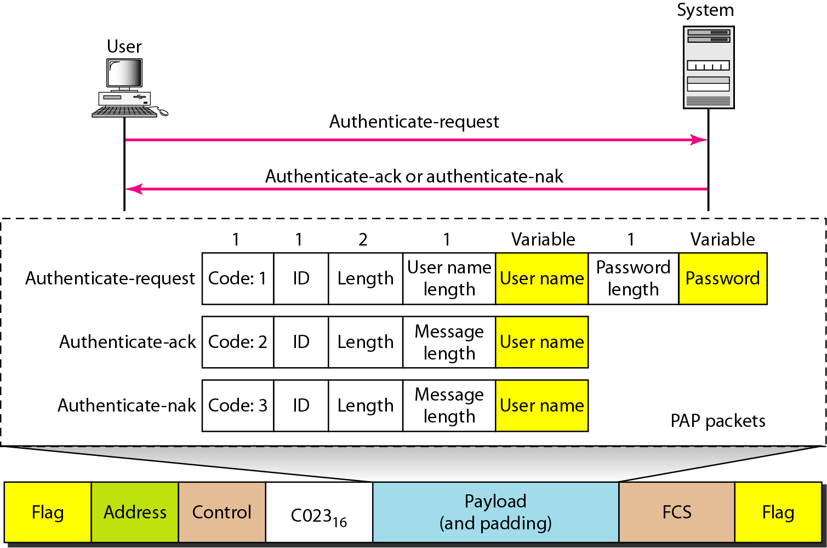
Figure 11.36 PAP packets encapsulated in a PPP frame

Slide 44
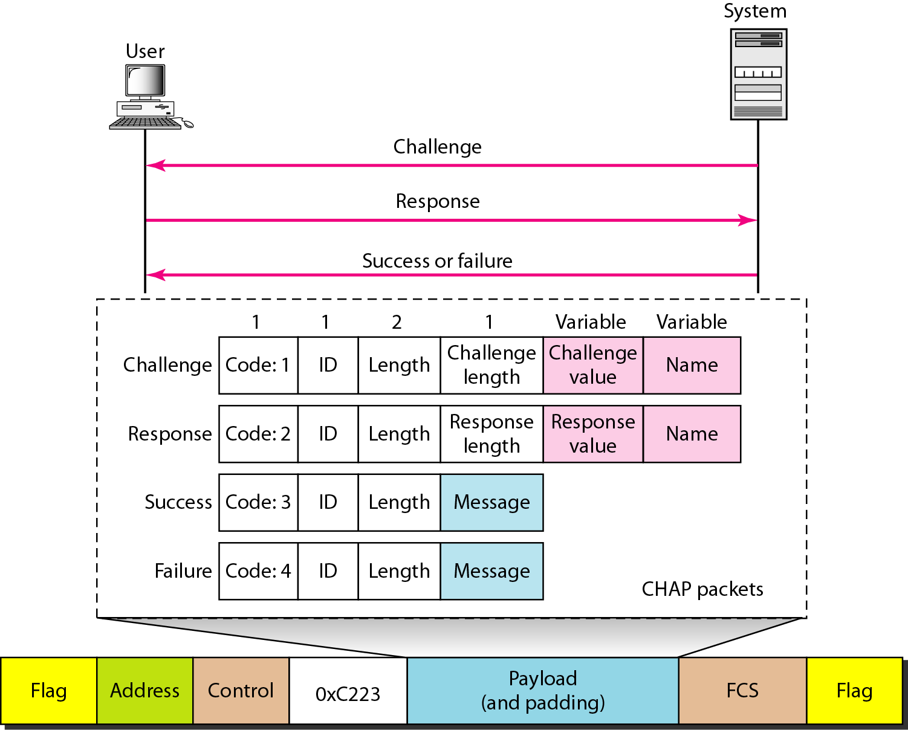
Figure 11.37 CHAP packets encapsulated in a PPP frame

Slide 45
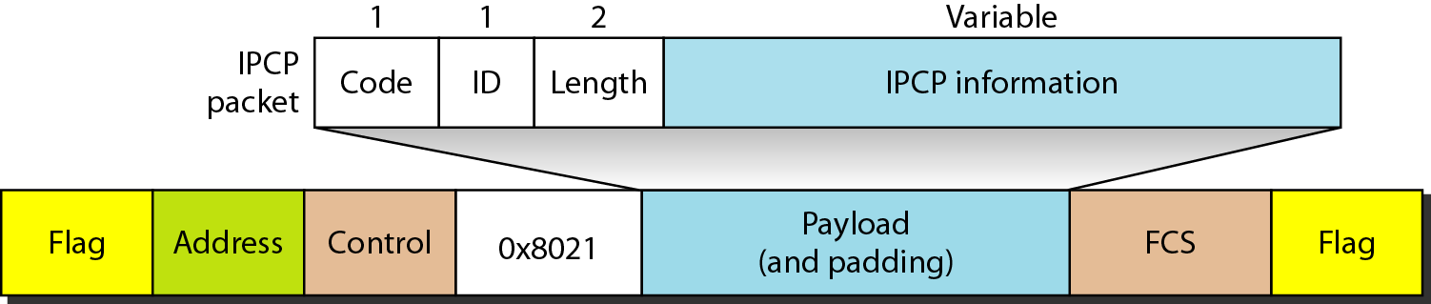
Figure 11.38 IPCP packet encapsulated in PPP frame

Slide 46
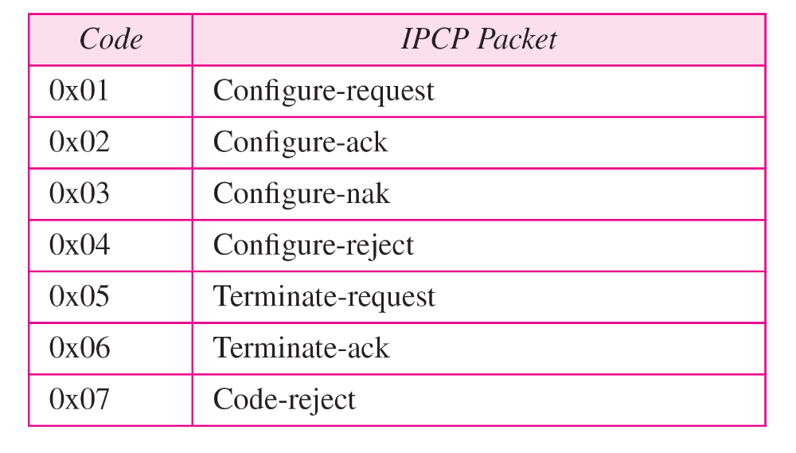
Table 11.4 Code value for IPCP packets

Slide 47
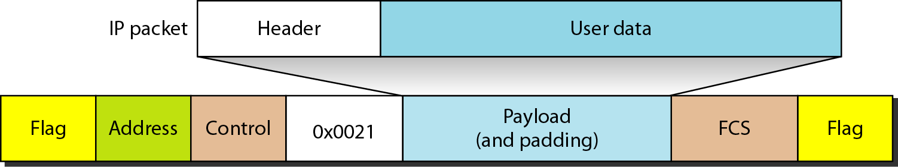
Figure 11.39 IP datagram encapsulated in a PPP frame

Slide 48
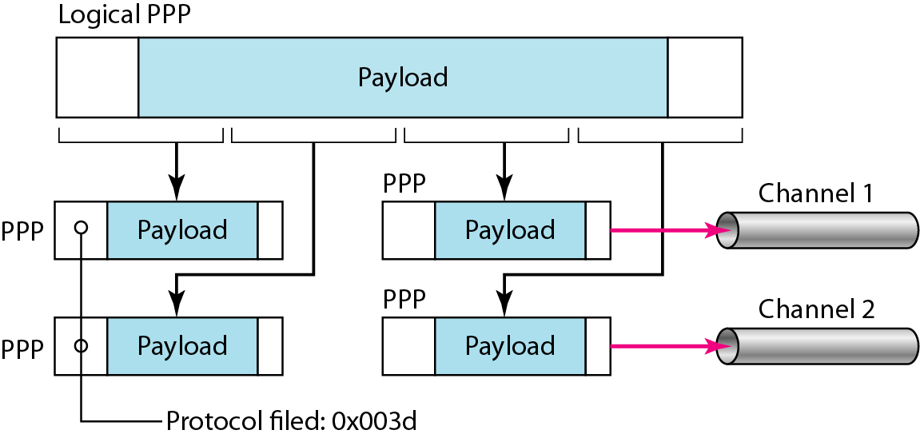
Figure 11.40 Multilink PPP

Slide 49
Example 11.12
Let us go through the phases followed by a network layer packet as it is transmitted through a PPP connection. Figure 11.41 shows the steps. For simplicity, we assume unidirectional movement of data from the user site to the system site (such as sending an e-mail through an ISP).
The first two frames show link establishment. We have chosen two options (not shown in the figure): using PAP for authentication and suppressing the address control fields. Frames 3 and 4 are for authentication. Frames 5 and 6 establish the network layer connection using IPCP.

Slide 50
Example 11.12 (continued)
The next several frames show that some IP packets are encapsulated in the PPP frame. The system (receiver) may have been running several network layer protocols, but it knows that the incoming data must be delivered to the IP protocol because the NCP protocol used before the data transfer was IPCP.
After data transfer, the user then terminates the data link connection, which is acknowledged by the system. Of course the user or the system could have chosen to terminate the network layer IPCP and keep the data link layer running if it wanted to run another NCP protocol.

Slide 51
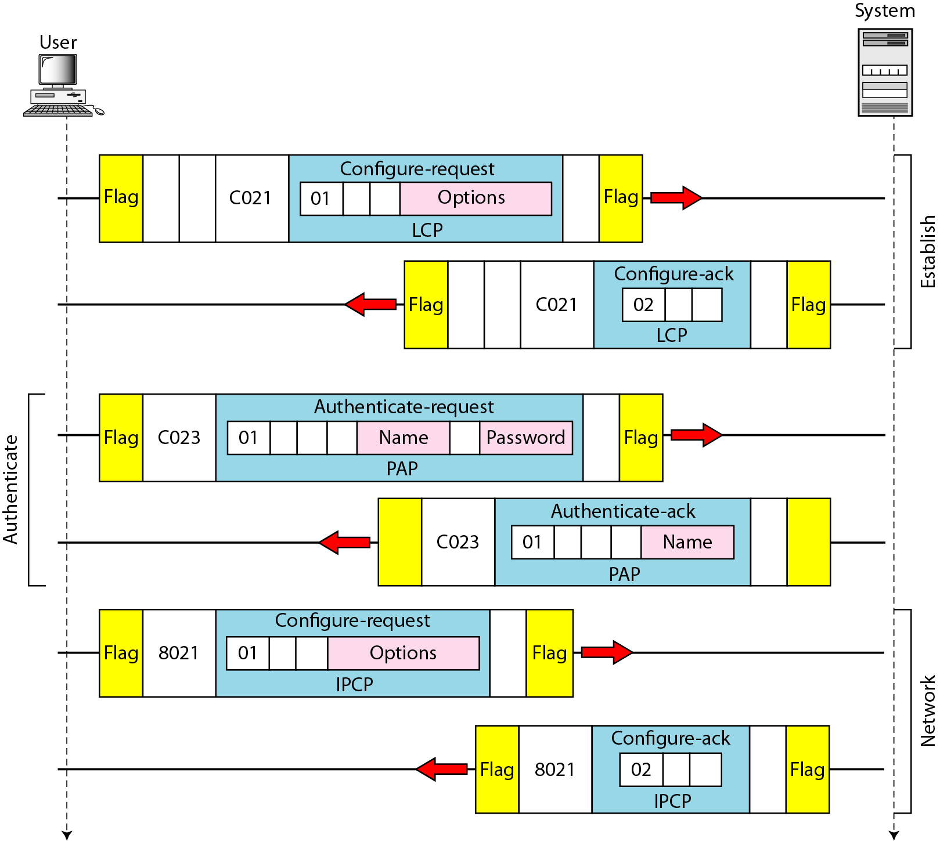
Figure 11.41 An example

Slide 52
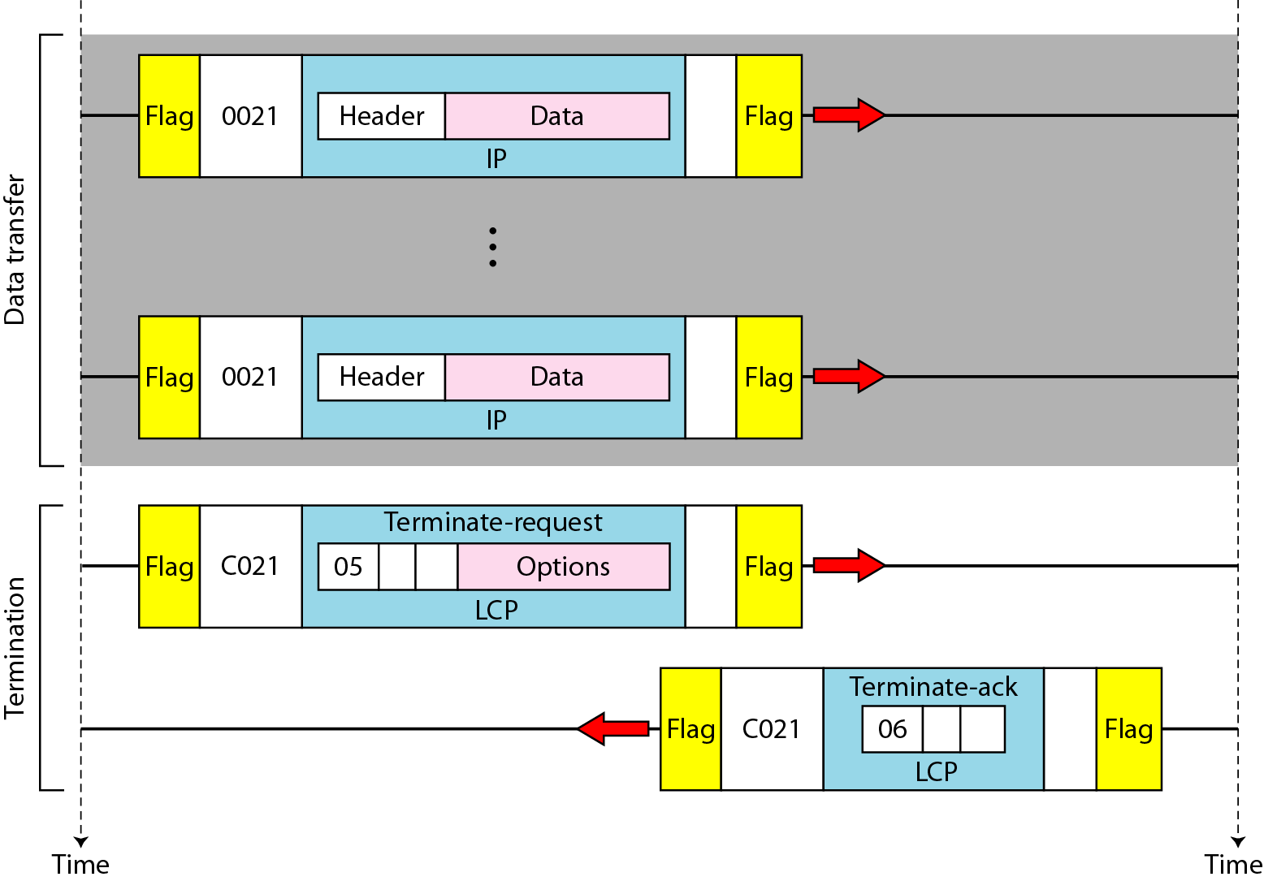
Figure 11.41 An example (continued)

