Slide 1
Data Communications
Lecture 39

Slide 2
HDLC
High-level Data Link Control (HDLC) is a bit-oriented protocol for communication over point-to-point and multipoint links. It implements the ARQ mechanisms.
Configurations and Transfer Modes
Frames
Control Field

Slide 3
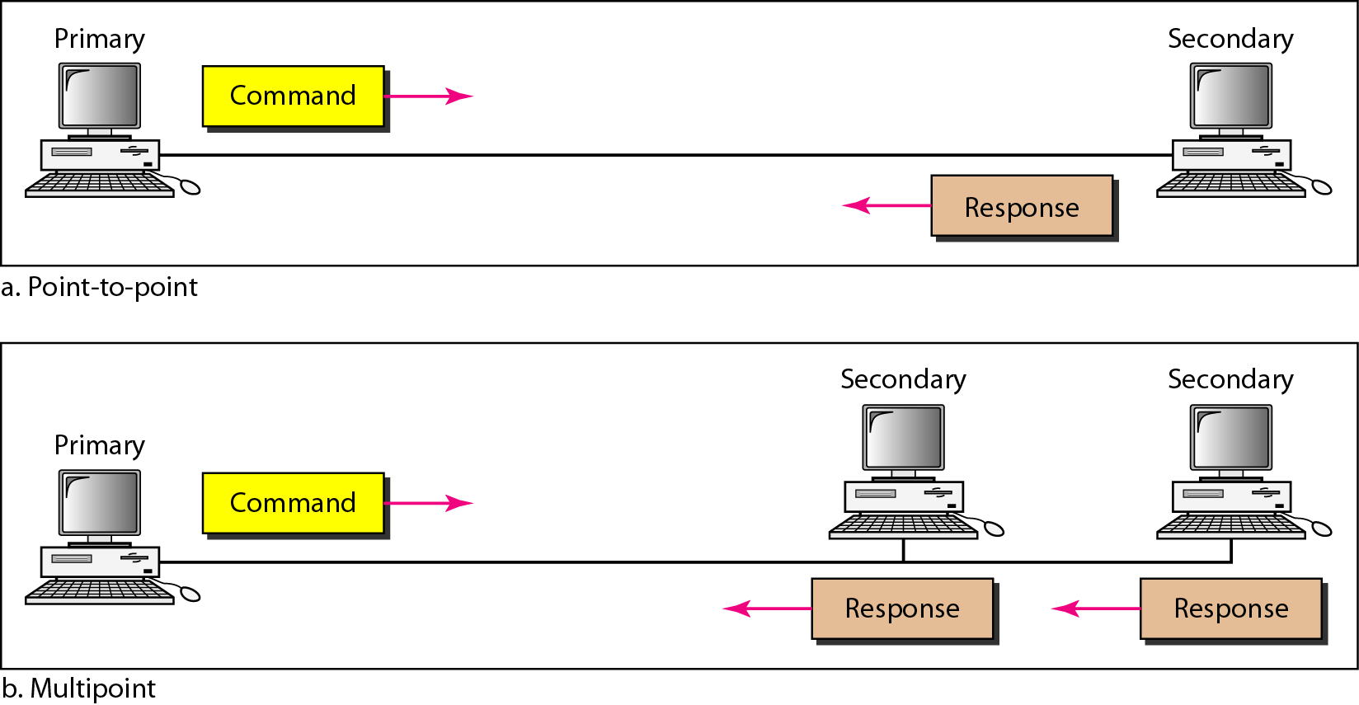
Normal response mode

Slide 4
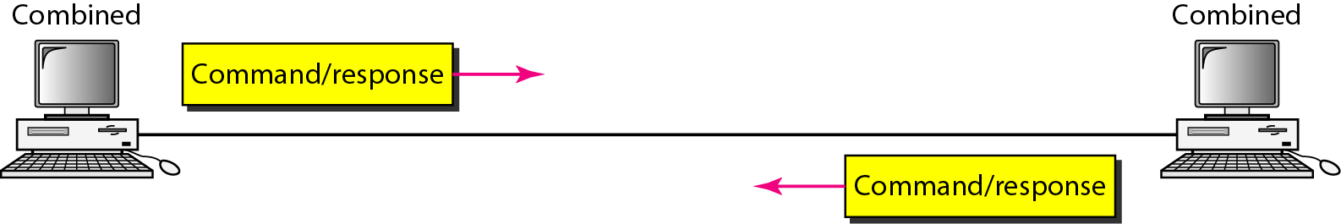
Asynchronous balanced mode

Slide 5
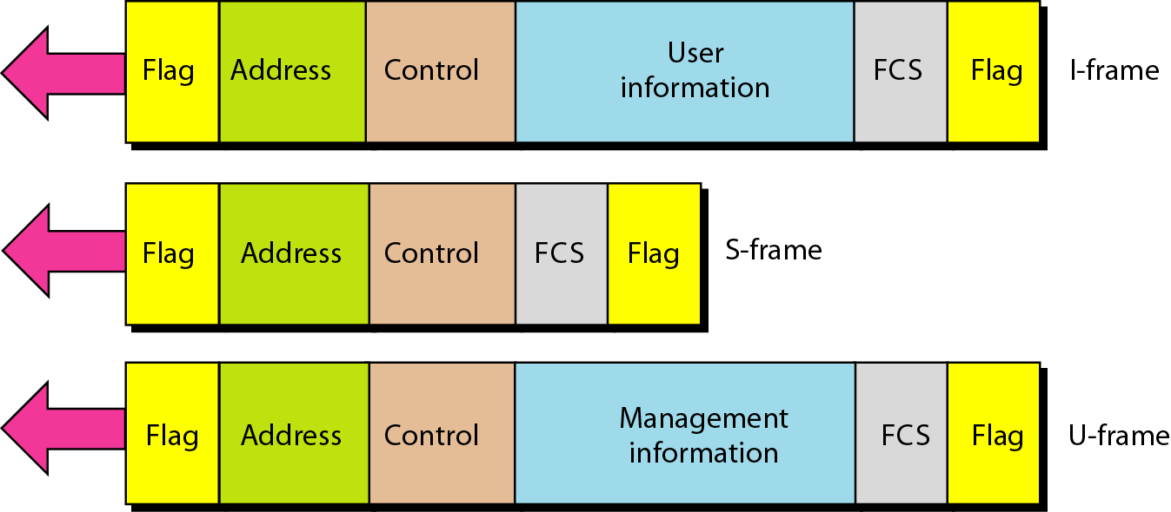
HDLC frames

Slide 6
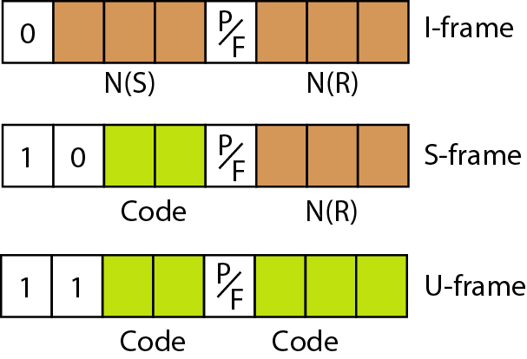
Control field format for the different frame types

Slide 7
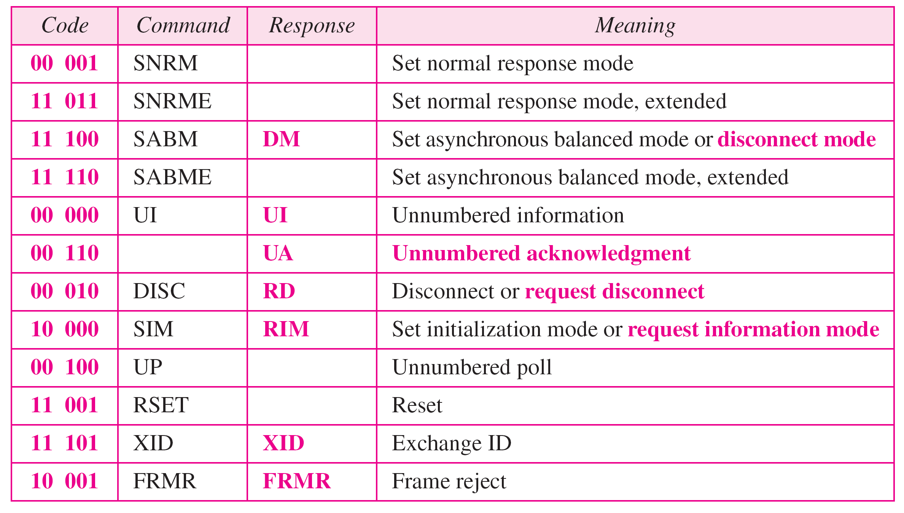
Table 11.1 U-frame control command and response

Slide 8
Example 11.9
Figure 11.29 shows how U-frames can be used for connection establishment and connection release. Node A asks for a connection with a set asynchronous balanced mode (SABM) frame; node B gives a positive response with an unnumbered acknowledgment (UA) frame. After these two exchanges, data can be transferred between the two nodes (not shown in the figure). After data transfer, node A sends a DISC (disconnect) frame to release the connection; it is confirmed by node B responding with a UA (unnumbered acknowledgment).

Slide 9
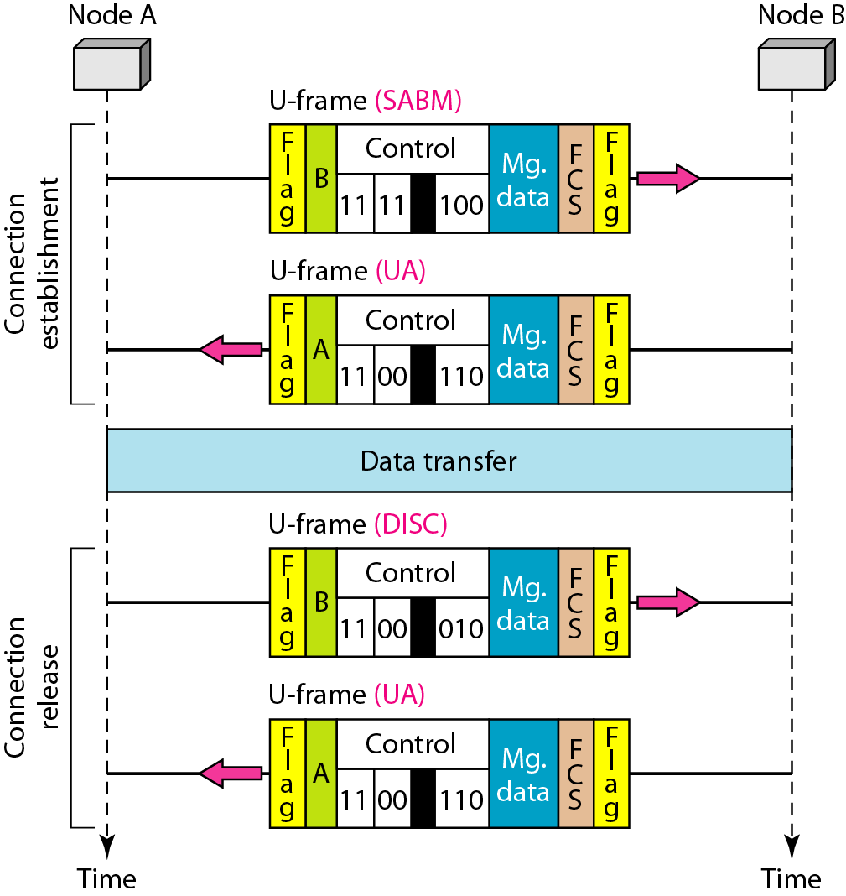
Figure 11.29 Example of connection and disconnection

