Slide 1
Data Communications
Lecture 40

Slide 2

High Level Data Link Control (HDLC)
an important data link control protocol
station types:
  Primary - controls operation of link
  Secondary - under control of primary station
  Combined - issues commands and responses
link configurations
  Unbalanced - 1 primary, multiple secondary
  Balanced - 2 combined stations
Notes:
The most important data link control protocol is HDLC (ISO 3009, ISO 4335). Not only is HDLC widely used, but it is the basis for many other important data link control protocols, which use the same or similar formats and the same mechanisms as employed in HDLC.
To satisfy a variety of applications, HDLC defines: three station types:
• Primary station: Responsible for controlling the operation of the link. Frames issued by the primary are called commands.
• Secondary station: Operates under the control of the primary station. Frames issued by a secondary are called responses. The primary maintains a separate logical link with each secondary station on the line.
• Combined station: Combines the features of primary and secondary. A combined station may issue both commands and responses.
It also defines two link configurations:
• Unbalanced configuration: Consists of one primary and one or more secondary stations and supports both full-duplex and half-duplex transmission.
• Balanced configuration: Consists of two combined stations and supports both full-duplex and half-duplex transmission.

Slide 3
HDLC Transfer Modes
Normal Response Mode (NRM)
  unbalanced config, primary initiates transfer
Asynchronous Balanced Mode (ABM)
  balanced config, either station initiates transmission, has no polling overhead, widely used
Asynchronous Response Mode (ARM)
  unbalanced config, secondary may initiate transmit without permission from primary, rarely used
Notes:
HDLC defines three data transfer modes:
• Normal response mode (NRM): Used with an unbalanced configuration. The primary may initiate data transfer to a secondary, but a secondary may only transmit data in response to a command from the primary. NRM is used on multi-drop lines, in which a number of terminals are connected to a host computer.
• Asynchronous balanced mode (ABM): Used with a balanced configuration. Either combined station may initiate transmission without receiving permission from the other combined station. ABM is the most widely used of the three modes; it makes more efficient use of a full-duplex point-to-point link because there is no polling overhead.
• Asynchronous response mode (ARM): Used with an unbalanced configuration. The secondary may initiate transmission without explicit permission of the primary. The primary still retains responsibility for the line, including initialization, error recovery, and logical disconnection. ARM is rarely used; it is applicable to some special situations in which a secondary may need to initiate transmission.

Slide 4
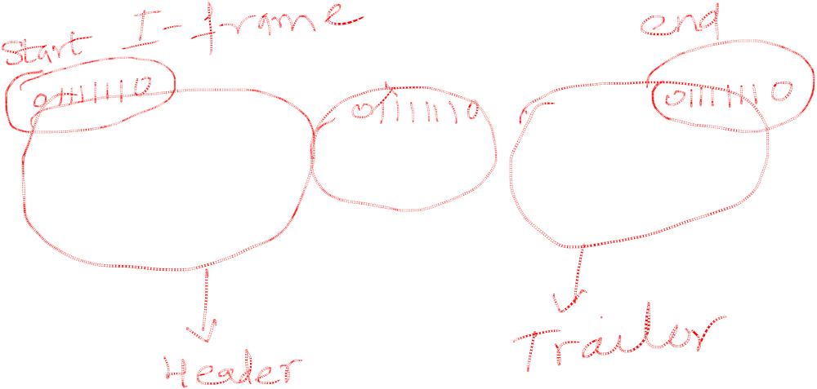
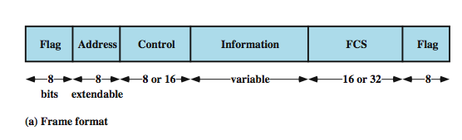
HDLC Frame Structure
synchronous transmission of frames
single frame format used
Notes:
HDLC uses synchronous transmission. All transmissions are in the form of frames, and a single frame format suffices for all types of data and control exchanges.
Stallings DCC8e Figure 7.7a depicts the structure of the HDLC frame. The flag, address, and control fields that precede the information field are known as a header. The FCS and flag fields following the data field are referred to as a trailer.

Slide 5
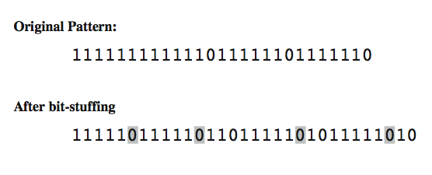

Flag Fields and Bit Stuffing
delimit frame at both ends with 01111110 seq
receiver hunts for flag sequence to synchronize
bit stuffing used to avoid confusion with data containing flag seq 01111110
  0 inserted after every sequence of five 1s
  if receiver detects five 1s it checks next bit
  if next bit is 0, it is deleted (was stuffed bit)
  if next bit is 1 and seventh bit is 0, accept as flag
  if sixth and seventh bits 1, sender is indicating abort
Notes:
Flag fields delimit the frame at both ends with the unique pattern 01111110. A single flag may be used as the closing flag for one frame and the opening flag for the next. On both sides of the user-network interface, receivers are continuously hunting for the flag sequence to synchronize on the start of a frame. While receiving a frame, a station continues to hunt for that sequence to determine the end of the frame.
Because the protocol allows the presence of arbitrary bit patterns, there is no assurance that the pattern 01111110 will not appear somewhere inside the frame, thus destroying synchronization. To avoid this problem, a procedure known as bit stuffing is used. For all bits between the starting and ending flags, the transmitter inserts an extra 0 bit after each occurrence of five 1s in the frame. After detecting a starting flag, the receiver monitors the bit stream. When a pattern of five 1s appears, the sixth bit is examined. If this bit is 0, it is deleted. If the sixth bit is a 1 and the seventh bit is a 0, the combination is accepted as a flag. If the sixth and seventh bits are both 1, the sender is indicating an abort condition. With the use of bit stuffing, arbitrary bit patterns can be inserted into the data field of the frame. This property is known as data transparency. Stallings DCC8e Figure 7.8 shows an example of bit stuffing. Note that in the first two cases, the extra 0 is not strictly necessary for avoiding a flag pattern but is necessary for the operation of the algorithm.

Slide 6
Information & FCS Fields
Information Field
  in information and some unnumbered frames
  must contain integral number of octets
  variable length
Frame Check Sequence Field (FCS)
  used for error detection
  either 16 bit CRC or 32 bit CRC
Notes:
The information field is present only in I-frames and some U-frames. The field can contain any sequence of bits but must consist of an integral number of octets. The length of the information field is variable up to some system-defined maximum.
The frame check sequence (FCS) is an error-detecting code calculated from the remaining bits of the frame, exclusive of flags. The normal code is the 16-bit CRC-CCITT defined in Section 6.3. An optional 32-bit FCS, using CRC-32, may be employed if the frame length or the line reliability dictates this choice.

Slide 7

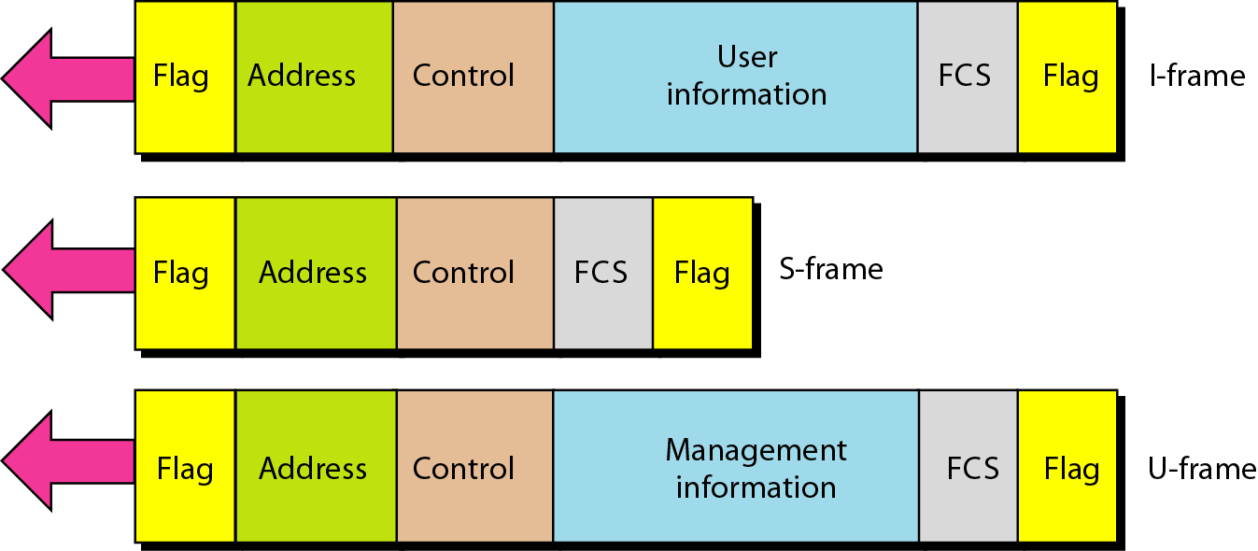
HDLC frames

Slide 8

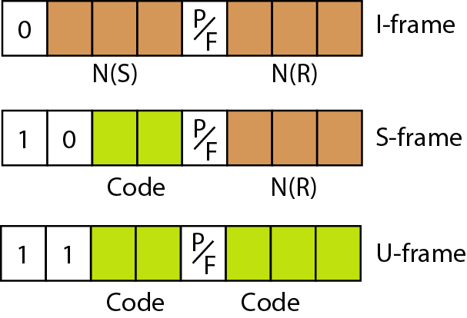
Control field format for the different frame types

Slide 9
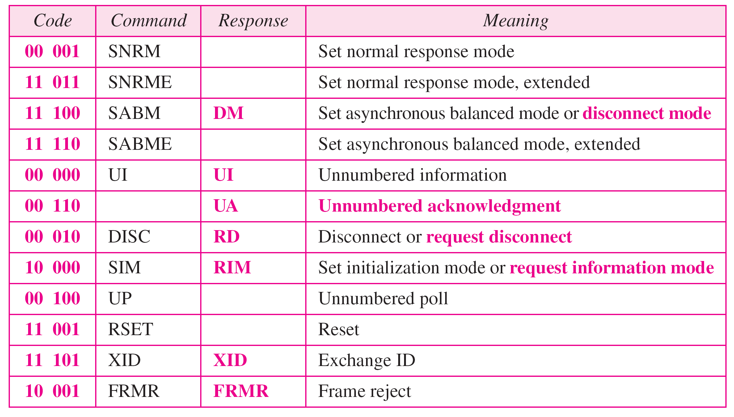
Table 11.1 U-frame control command and response

Slide 10
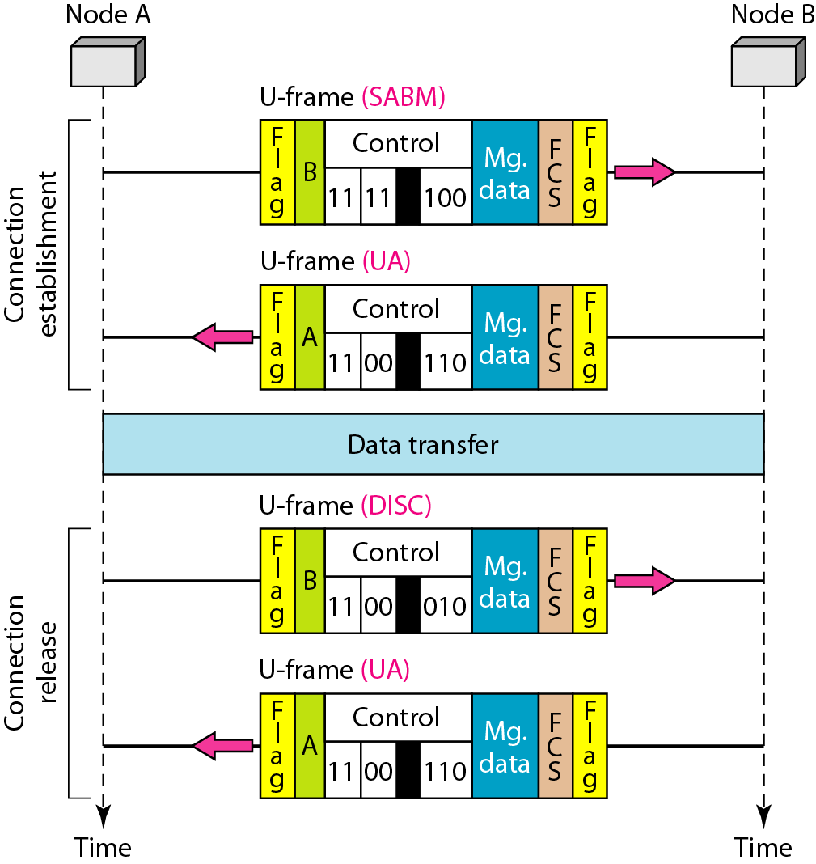

Figure 11.29 Example of connection and disconnection

Slide 11
Example 11.10
Figure 11.30 shows an exchange using piggybacking. Node A begins the exchange of information with an
I-frame numbered 0 followed by another I-frame numbered 1. Node B piggybacks its acknowledgment of both frames onto an I-frame of its own. Node B’s first
I-frame is also numbered 0 [N(S) field] and contains a 2 in its N(R) field, acknowledging the receipt of A’s frames 1 and 0 and indicating that it expects frame 2 to arrive next. Node B transmits its second and third I-frames (numbered 1 and 2) before accepting further frames from node A.

Slide 12
Example 11.10 (continued)
Its N(R) information, therefore, has not changed: B frames 1 and 2 indicate that node B is still expecting A’s frame 2 to arrive next. Node A has sent all its data. Therefore, it cannot piggyback an acknowledgment onto an I-frame and sends an S-frame instead. The RR code indicates that A is still ready to receive. The number 3 in the N(R) field tells B that frames 0, 1, and 2 have all been accepted and that A is now expecting frame number 3.

Slide 13
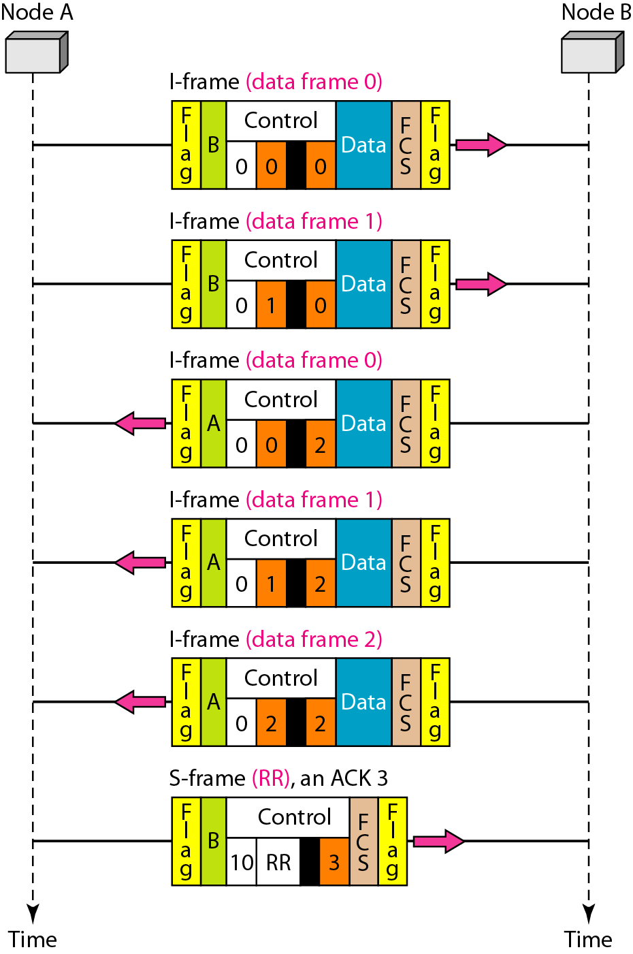
Figure 11.30 Example of piggybacking without error

Slide 14
Example 11.11
Figure 11.31 shows an exchange in which a frame is lost. Node B sends three data frames (0, 1, and 2), but frame 1 is lost. When node A receives frame 2, it discards it and sends a REJ frame for frame 1. Note that the protocol being used is Go-Back-N with the special use of an REJ frame as a NAK frame. The NAK frame does two things here: It confirms the receipt of frame 0 and declares that frame 1 and any following frames must be resent. Node B, after receiving the REJ frame, resends frames 1 and 2. Node A acknowledges the receipt by sending an RR frame (ACK) with acknowledgment number 3.

Slide 15
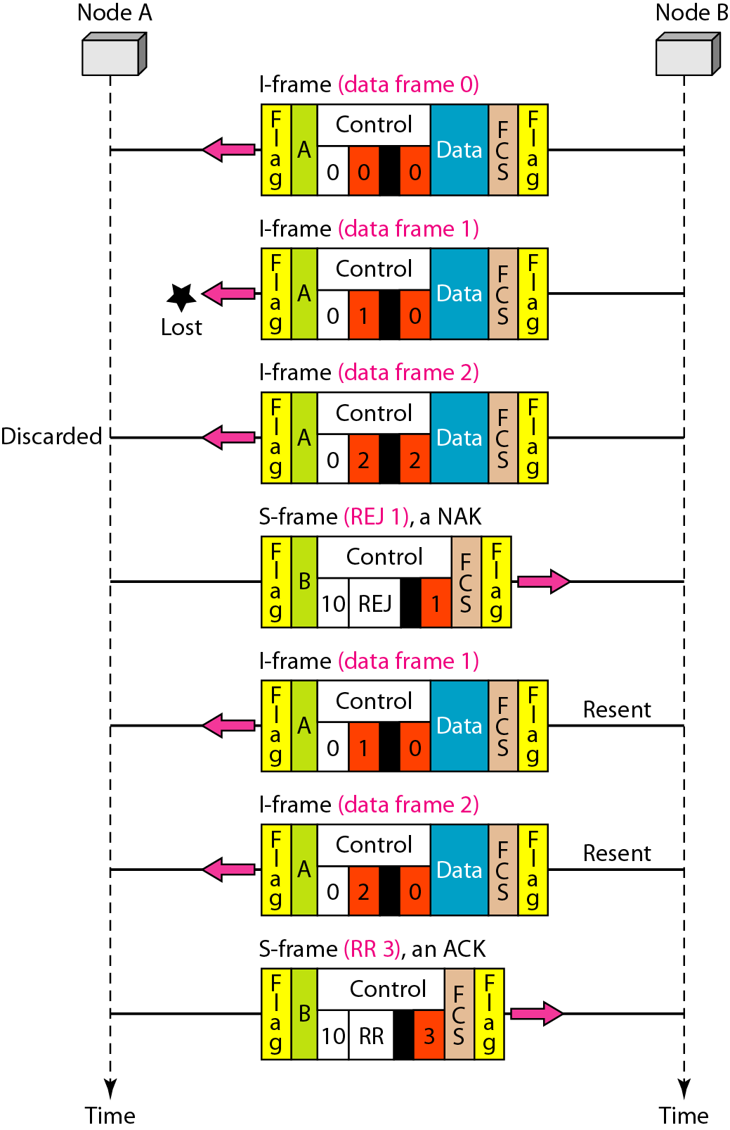
Figure 11.31 Example of piggybacking with error

Slide 16
