Slide 1
Data Communications
Lecture 42

Slide 2
Recap:

Slide 3
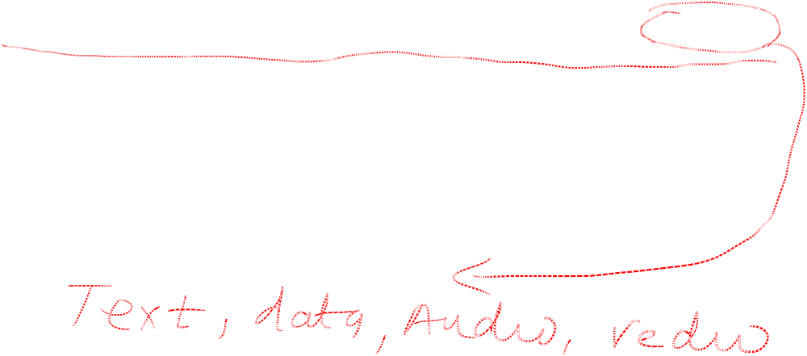
Multiplexing is the set of techniques that allows the (simultaneous) transmission of multiple signals across a single data link. As data and telecommunications use increases, so does traffic.
Frequency-Division Multiplexing is one of the multiplexing techniques.
Frequency-Division Multiplexing
6.<number>

Slide 4
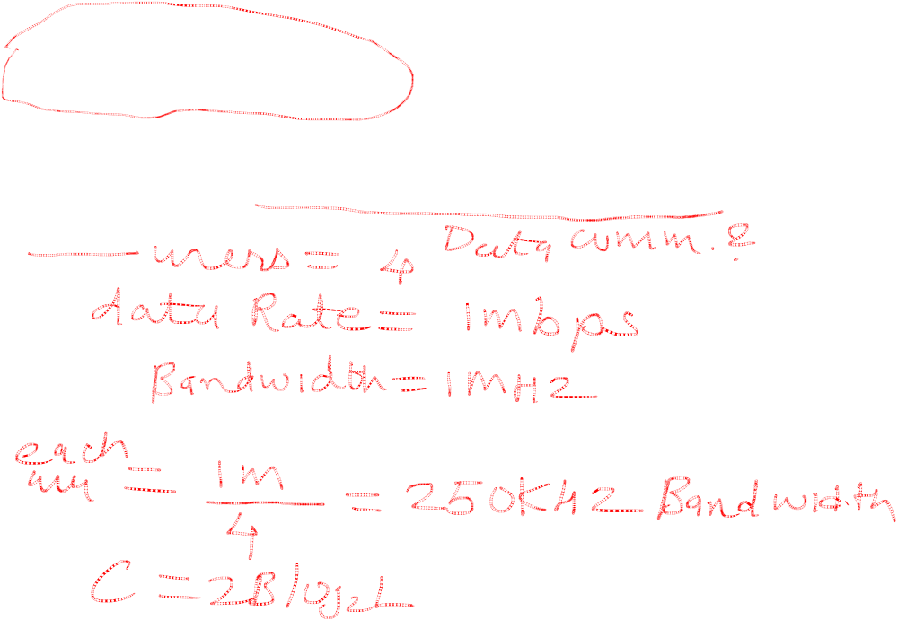
_{Example}
Four data channels (digital), each transmitting at 1 Mbps, use a satellite channel of 1 MHz. Design an appropriate configuration, using FDM.
6.<number>

Slide 5
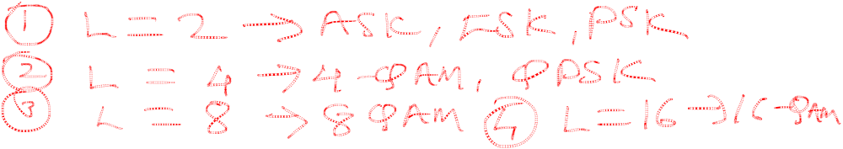
_{Example}
Four data channels (digital), each transmitting at 1 Mbps, use a satellite channel of 1 MHz. Design an appropriate configuration, using FDM.
_{Solution}
The satellite channel is analog. We divide it into four channels, each channel having 1M/4=250-kHz bandwidth.
Each digital channel of 1 Mbps must be transmitted over a 250KHz channel. Assuming no noise we can use Nyquist to get:
C = 1Mbps = 2x250K x log2 L -> L = 4 or n = 2 bits/signal element.
One solution is 4-QAM modulation.

Slide 6
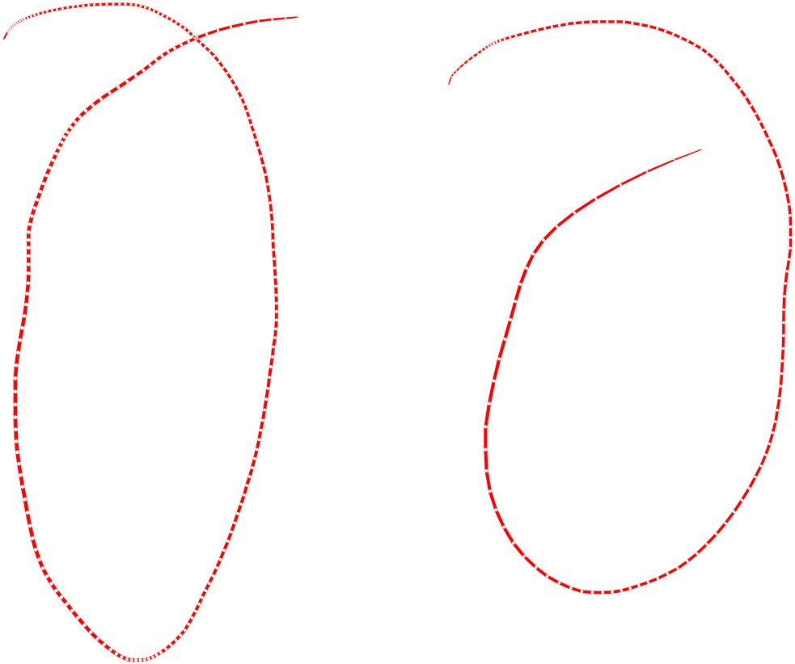

6.<number>

Slide 7
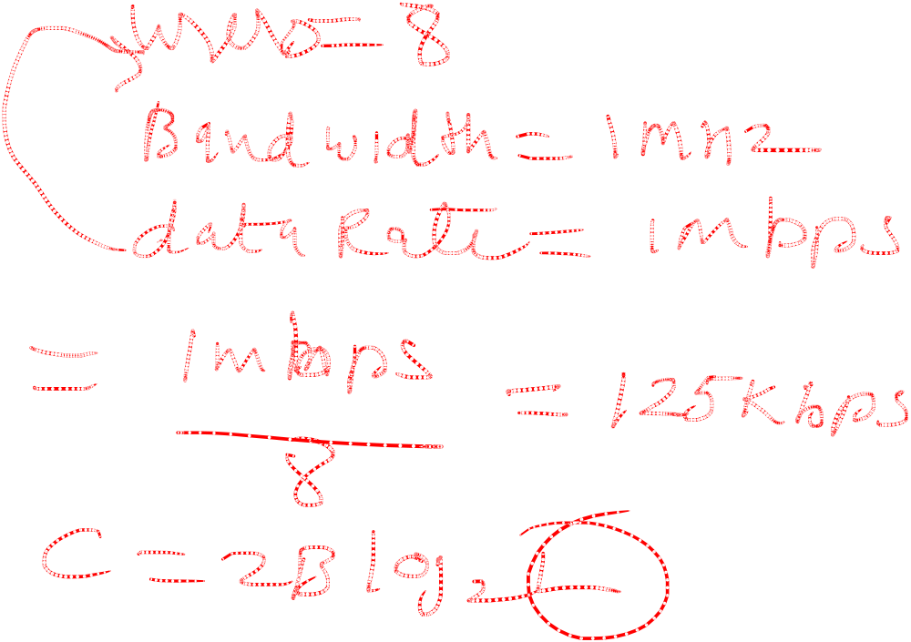
_{Example}
Eight data channels (digital), each transmitting at 1 Mbps, use a satellite channel of 1 MHz. Design an appropriate configuration, using FDM.
6.<number>

Slide 8
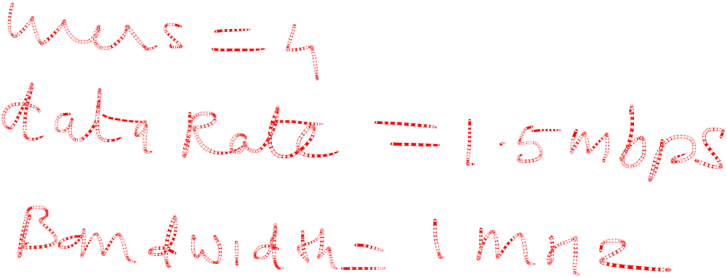
_{Example}
Four data channels (digital), each transmitting at 1.5 Mbps, use a satellite channel of 1 MHz. Design an appropriate configuration, using FDM.
6.<number>

Slide 9
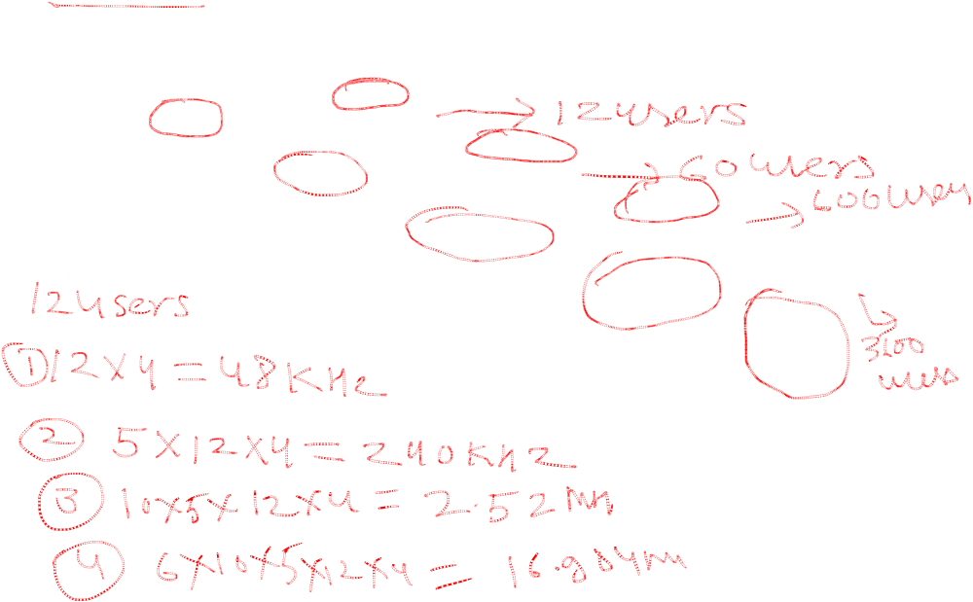

_{Analog hierarchy}
6.<number>

Slide 10
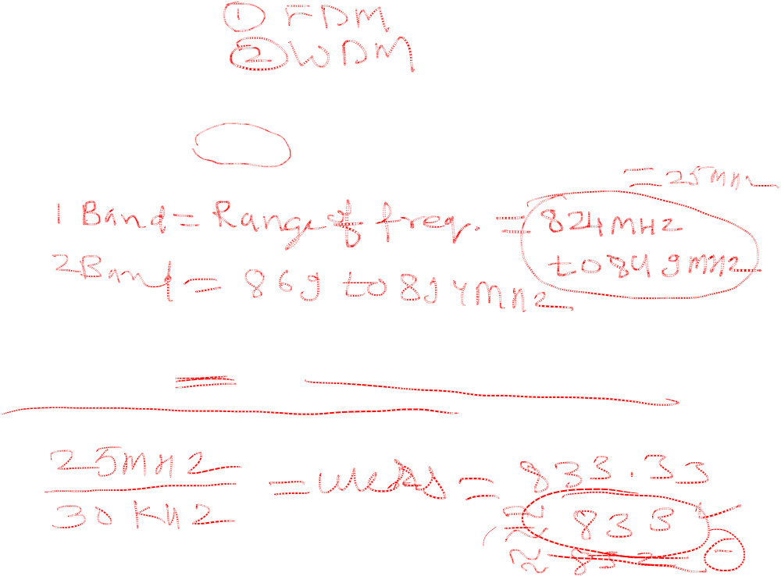
_{Example}
The Advanced Mobile Phone System (AMPS) uses two bands. The first band of 824 to 849 MHz is used for sending, and 869 to 894 MHz is used for receiving. Each user has a bandwidth of 30 kHz in each direction. How many people can use their cellular phones simultaneously?
_{Solution}
Each band is 25 MHz. If we divide 25 MHz by 30 kHz, we get 833.33. In reality, the band is divided into 832 channels. Of these, 42 channels are used for control, which means only 790 channels are available for cellular phone users.
6.<number>

Slide 11
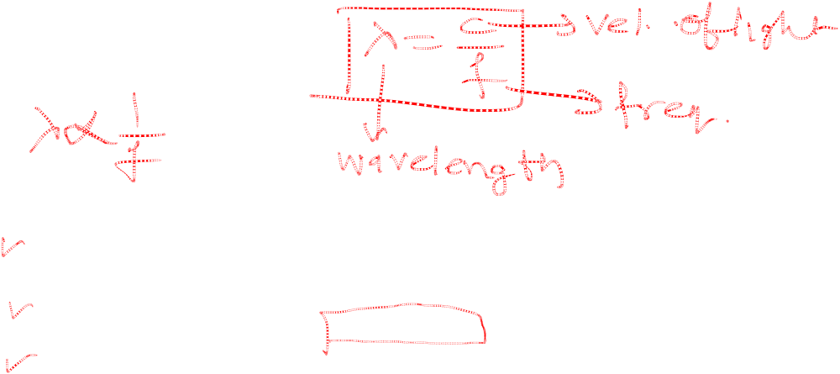

Wavelength-division multiplexing (WDM)
6.<number>

Slide 12

_{Note}
WDM is an analog multiplexing technique to combine optical signals.
6.<number>

Slide 13


Prisms in wavelength-division multiplexing and demultiplexing
6.<number>

Slide 14

Time Division Multiplexing (TDM)
6.<number>

Slide 15
_{Note}
TDM is a digital multiplexing technique for combining several low-rate digital
channels into one high-rate one.
6.<number>

Slide 16

Synchronous time-division multiplexing
6.<number>

Slide 17
_{Note}
In synchronous TDM, the data rate
of the link is n times faster, and the unit duration is n times shorter.
6.<number>

Slide 18
_{Example}
In las t example, the data rate for each one of the 3 input connection is 1 kbps. If 1 bit at a time is multiplexed (a unit is 1 bit), what is the duration of (a) each input slot, (b) each output slot, and (c) each frame?
Solution
We can answer the questions as follows:
a. The data rate of each input connection is 1 kbps. This means that the bit duration is 1/1000 s or 1 ms. The duration of the input time slot is 1 ms (same as bit duration).
6.<number>

Slide 19
_{Example (continued)}
b. The duration of each output time slot is one-third of the input time slot. This means that the duration of the output time slot is 1/3 ms.
c. Each frame carries three output time slots. So the duration of a frame is 3 × 1/3 ms, or 1 ms.
Note: The duration of a frame is the same as the duration of an input unit.
6.<number>

Slide 20

_{Example}
Figure shows synchronous TDM with 4 1Mbps data stream inputs and one data stream for the output. The unit of data is 1 bit. Find (a) the input bit duration, (b) the output bit duration, (c) the output bit rate, and (d) the output frame rate.
Solution
We can answer the questions as follows:
a. The input bit duration is the inverse of the bit rate:
1/1 Mbps = 1 μs.
b. The output bit duration is one-fourth of the input bit duration, or ¼ μs.
6.<number>

Slide 21
_{Example(continued)}
c. The output bit rate is the inverse of the output bit duration or 1/(4μs) or 4 Mbps. This can also be deduced from the fact that the output rate is 4 times as fast as any input rate; so the output rate = 4 × 1 Mbps = 4 Mbps.
d. The frame rate is always the same as any input rate. So the frame rate is 1,000,000 frames per second. Because we are sending 4 bits in each frame, we can verify the result of the previous question by multiplying the frame rate by the number of bits per frame.
6.<number>

Slide 22
_{Example}
Four 1-kbps connections are multiplexed together. A unit is 1 bit. Find (a) the duration of 1 bit before multiplexing, (b) the transmission rate of the link, (c) the duration of a time slot, and (d) the duration of a frame.
Solution
We can answer the questions as follows:
a. The duration of 1 bit before multiplexing is 1 / 1 kbps, or 0.001 s (1 ms).
b. The rate of the link is 4 times the rate of a connection, or 4 kbps.
6.<number>

Slide 23
_{Example (continued)}
c. The duration of each time slot is one-fourth of the duration of each bit before multiplexing, or 1/4 ms or 250 μs. Note that we can also calculate this from the data rate of the link, 4 kbps. The bit duration is the inverse of the data rate, or 1/4 kbps or 250 μs.
d. The duration of a frame is always the same as the duration of a unit before multiplexing, or 1 ms. We can also calculate this in another way. Each frame in this case has four time slots. So the duration of a frame is 4 times 250 μs, or 1 ms.
6.<number>

Slide 24
Interleaving
The process of taking a group of bits from each input line for multiplexing is called interleaving.
We interleave bits (1 - n) from each input onto one output.
6.<number>

Slide 25

_{Figure 6.15 Interleaving}
6.<number>

Slide 26
_{Example 6.8}
Four channels are multiplexed using TDM. If each channel sends 100 bytes /s and we multiplex 1 byte per channel, show the frame traveling on the link, the size of the frame, the duration of a frame, the frame rate, and the bit rate for the link.
_{Solution}
The multiplexer is shown in Figure 6.16. Each frame carries 1 byte from each channel; the size of each frame, therefore, is 4 bytes, or 32 bits. Because each channel is sending 100 bytes/s and a frame carries 1 byte from each channel, the frame rate must be 100 frames per second. The bit rate is 100 × 32, or 3200 bps.
6.<number>

Slide 27

_{Figure 6.16 Example 6.8}
6.<number>

Slide 28
_{Example 6.9}
A multiplexer combines four 100-kbps channels using a time slot of 2 bits. Show the output with four arbitrary inputs. What is the frame rate? What is the frame duration? What is the bit rate? What is the bit duration?
_{Solution}
Figure 6.17 shows the output (4x100kbps) for four arbitrary inputs. The link carries 400K/(2x4)=50,000 2x4=8bit frames per second. The frame duration is therefore 1/50,000 s or 20 μs. The bit duration on the output link is 1/400,000 s, or 2.5 μs.
6.<number>

Slide 29

_{Figure 6.17 Example 6.9}
6.<number>

Slide 30
Data Rate Management
Not all input links maybe have the same data rate.
Some links maybe slower. There maybe several different input link speeds
There are three strategies that can be used to overcome the data rate mismatch: multilevel, multislot and pulse stuffing
6.<number>

Slide 31
Data rate matching
Multilevel: used when the data rate of the input links are multiples of each other.
Multislot: used when there is a GCD between the data rates. The higher bit rate channels are allocated more slots per frame, and the output frame rate is a multiple of each input link.
Pulse Stuffing: used when there is no GCD between the links. The slowest speed link will be brought up to the speed of the other links by bit insertion, this is called pulse stuffing.
6.<number>

Slide 32

Figure 6.19 Multilevel multiplexing
6.<number>

Slide 33

Figure 6.20 Multiple-slot multiplexing
6.<number>

Slide 34

_{Figure 6.21 Pulse stuffing}
6.<number>

Slide 35
Synchronization
To ensure that the receiver correctly reads the incoming bits, i.e., knows the incoming bit boundaries to interpret a “1” and a “0”, a known bit pattern is used between the frames.
The receiver looks for the anticipated bit and starts counting bits till the end of the frame.
Then it starts over again with the reception of another known bit.
These bits (or bit patterns) are called synchronization bit(s).
They are part of the overhead of transmission.
6.<number>

Slide 36

_{Figure 6.22 Framing bits}
6.<number>

Slide 37
_{Example 6.10}
We have four sources, each creating 250 8-bit characters per second. If the interleaved unit is a character and 1 synchronizing bit is added to each frame, find (a) the data rate of each source, (b) the duration of each character in each source, (c) the frame rate, (d) the duration of each frame, (e) the number of bits in each frame, and (f) the data rate of the link.
Solution
We can answer the questions as follows:
a. The data rate of each source is 250 × 8 = 2000 bps = 2 kbps.
6.<number>

Slide 38
_{Example 6.10 (continued)}
b. Each source sends 250 characters per second; therefore, the duration of a character is 1/250 s, or
4 ms.
c. Each frame has one character from each source, which means the link needs to send 250 frames per second to keep the transmission rate of each source.
d. The duration of each frame is 1/250 s, or 4 ms. Note that the duration of each frame is the same as the duration of each character coming from each source.
e. Each frame carries 4 characters and 1 extra synchronizing bit. This means that each frame is
4 × 8 + 1 = 33 bits.
6.<number>

Slide 39
_{Example 6.11}
Two channels, one with a bit rate of 100 kbps and another with a bit rate of 200 kbps, are to be multiplexed. How this can be achieved? What is the frame rate? What is the frame duration? What is the bit rate of the link?
_{Solution}
We can allocate one slot to the first channel and two slots to the second channel. Each frame carries 3 bits. The frame rate is 100,000 frames per second because it carries 1 bit from the first channel. The bit rate is 100,000 frames/s × 3 bits per frame, or 300 kbps.
6.<number>

Slide 40

_{Figure 6.23 Digital hierarchy}
6.<number>

Slide 41

_{Table 6.1 DS and T line rates}
6.<number>

Slide 42

Figure 6.24 T-1 line for multiplexing telephone lines
6.<number>

Slide 43

Figure 6.25 T-1 frame structure
6.<number>

Slide 44

_{Table 6.2 E line rates}
6.<number>

Slide 45
Inefficient use of Bandwidth
Sometimes an input link may have no data to transmit.
When that happens, one or more slots on the output link will go unused.
That is wasteful of bandwidth.
6.<number>

Slide 46

_{Figure 6.18 Empty slots}
6.<number>

Slide 47

Figure 6.26 TDM slot comparison
6.<number>

