Slide 1
Data Communications
Lecture 44
TOPIC: Spread Spectrum

Slide 2
Spread Spectrum
Spread spectrum is an important form of encoding for wireless communications.
The use of spread spectrum makes jamming and interception more difficult and provides improved reception.
The basic idea of spread spectrum is to modulate the signal so as to increase significantly the bandwidth (spread the spectrum) of the signal to be transmitted.

Slide 3
Spread Spectrum Techniques
Frequency-hopping spread spectrum is a form of spread spectrum in which the signal is broadcast over a seemingly random series of radio frequencies, hopping from frequency to frequency at fixed intervals.
Direct sequence spread spectrum is a form of spread spectrum in which each bit in the original signal is represented by multiple bits in the transmitted signal, using a spreading code.
Code division multiple access exploits the nature of spread spectrum transmission to enable multiple users to independently use the same bandwidth with very little interference

Slide 4
Spread Spectrum
important encoding method for wireless communications
analog & digital data with analog signal
spreads data over wide bandwidth
makes jamming and interception harder
two approaches, both in use:
Frequency Hopping
Direct Sequence
Notes:
Spread spectrum is an increasingly important form of encoding for wireless communications. It it can be used to transmit either analog or digital data, using an analog signal.The basic idea of spread spectrum is to modulate the signal so as to increase significantly the bandwidth (spread the spectrum) of the signal to be transmitted. It was initially developed for military and intelligence requirements. The use of spread spectrum makes jamming and interception more difficult and provides improved reception. The first type of spread spectrum developed is known as frequency hopping. A more recent type of spread spectrum is direct sequence. Both of these techniques are used in various wireless communications standards and products.

Slide 5
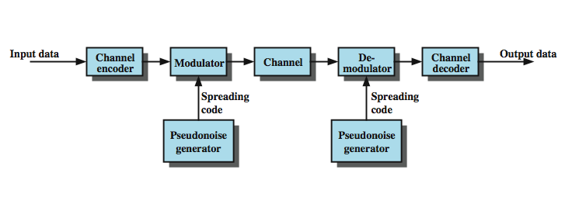
General Model of Spread Spectrum System
Notes:
Stallings DCC8e Figure 9.1 highlights the key characteristics of any spread spectrum system. Input is fed into a channel encoder that produces an analog signal with a relatively narrow bandwidth around some center frequency. This signal is further modulated using a sequence of digits known as a spreading code or spreading sequence. Typically, but not always, the spreading code is generated by a pseudonoise, or pseudorandom number, generator. The effect of this modulation is to increase significantly the bandwidth (spread the spectrum) of the signal to be transmitted. On the receiving end, the same digit sequence is used to demodulate the spread spectrum signal. Finally, the signal is fed into a channel decoder to recover the data.

Slide 6
Spread Spectrum Advantages
immunity from noise and multipath distortion
can hide / encrypt signals
several users can share same higher bandwidth with little interference
CDM/CDMA Mobile telephones
Notes:
Several advantages can be gained from this apparent waste of spectrum by this approach:
• The signals gains immunity from various kinds of noise and multipath distortion. The earliest applications of spread spectrum were military, where it was used for its immunity to jamming.
• It can also be used for hiding and encrypting signals. Only a recipient who knows the spreading code can recover the encoded information.
• Several users can independently use the same higher bandwidth with very little interference. This property is used in cellular telephony applications, with a technique know as code division multiplexing (CDM) or code division multiple access (CDMA).

Slide 7
Pseudorandom Numbers
generated by a deterministic algorithm
not actually random
but if algorithm good, results pass reasonable tests of randomness
starting from an initial seed
need to know algorithm and seed to predict sequence
hence only receiver can decode signal
Notes:
A comment about pseudorandom numbers is in order. These numbers are generated by an algorithm using some initial value called the seed. The algorithm is deterministic and therefore produces sequences of numbers that are not statistically random. However, if the algorithm is good, the resulting sequences will pass many reasonable tests of randomness. Such numbers are often referred to as pseudorandom numbers. The important point is that unless you know the algorithm and the seed, it is impractical to predict the sequence. Hence, only a receiver that shares this information with a transmitter will be able to decode the signal successfully.

Slide 8
Frequency Hopping Spread Spectrum (FHSS)
signal is broadcast over seemingly random series of frequencies
receiver hops between frequencies in sync with transmitter
eavesdroppers hear unintelligible blips
jamming on one frequency affects only a few bits
Notes:
With frequency-hopping spread spectrum (FHSS), the signal is broadcast over a seemingly random series of radio frequencies, hopping from frequency to frequency at fixed intervals. A receiver, hopping between frequencies in synchronization with the transmitter, picks up the message. Would-be eavesdroppers hear only unintelligible blips. Attempts to jam the signal on one frequency succeed only at knocking out a few bits of it.

Slide 9
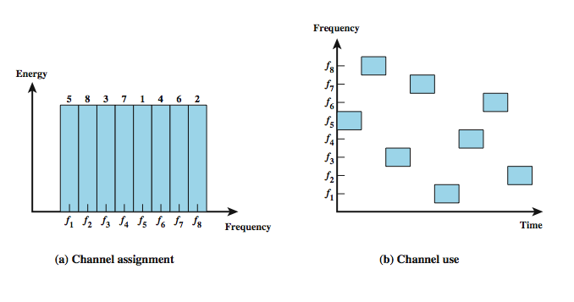
Frequency Hopping Example
Notes:
Stallings DCC8e Figure 9.2 shows an example of a frequency-hopping signal. A number of channels are allocated for the FH signal. Typically, there are 2^{k} carrier frequencies forming 2^{k} channels. The spacing between carrier frequencies and hence the width of each channel usually corresponds to the bandwidth of the input signal. The transmitter operates in one channel at a time for a fixed interval; for example, the IEEE 802.11 standard uses a 300-ms interval. During that interval, some number of bits (possibly a fraction of a bit, as discussed subsequently) is transmitted using some encoding scheme. A spreading code dictates the sequence of channels used. Both transmitter and receiver use the same code to tune into a sequence of channels in synchronization.

