Slide 1
Data Communications
Lecture 45
TOPIC: FHSS

Slide 2
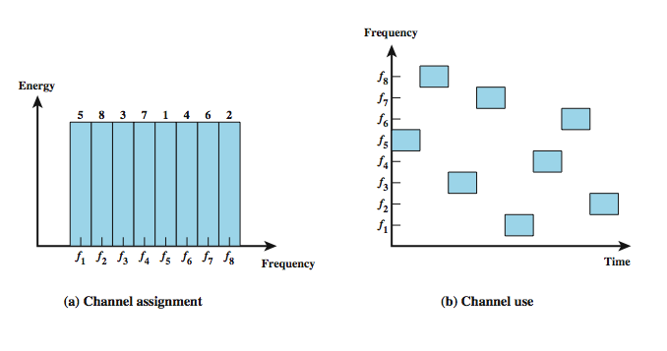
Frequency Hopping Example
Notes:
Stallings DCC8e Figure 9.2 shows an example of a frequency-hopping signal. A number of channels are allocated for the FH signal. Typically, there are 2^{k} carrier frequencies forming 2^{k} channels. The spacing between carrier frequencies and hence the width of each channel usually corresponds to the bandwidth of the input signal. The transmitter operates in one channel at a time for a fixed interval; for example, the IEEE 802.11 standard uses a 300-ms interval. During that interval, some number of bits (possibly a fraction of a bit, as discussed subsequently) is transmitted using some encoding scheme. A spreading code dictates the sequence of channels used. Both transmitter and receiver use the same code to tune into a sequence of channels in synchronization.

Slide 3
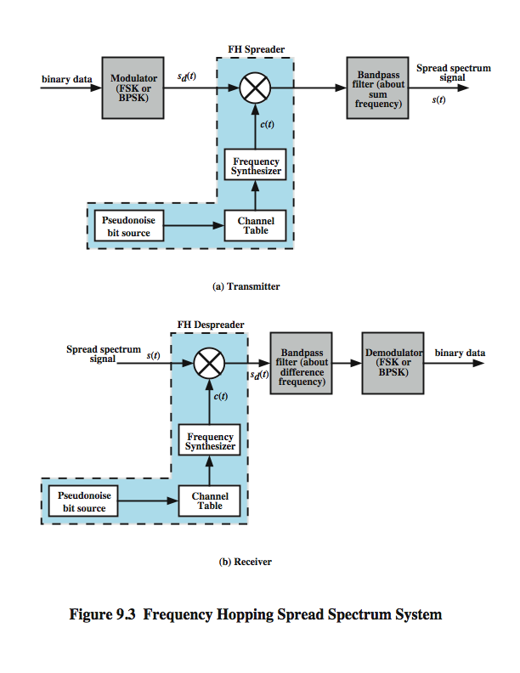
FHSS (Transmitter)
Notes:
Stallings DCC8e Figure 9.3 shows a typical block diagram for a frequency-hopping system. For transmission, binary data are fed into a modulator using some digital-to-analog encoding scheme, such as frequency shift keying (FSK) or binary phase shift keying (BPSK). The resulting signal s_{d}(t) is centered on some base frequency. A pseudonoise (PN), or pseudorandom number, source serves as an index into a table of frequencies; this is the spreading code referred to previously. Each k bits of the PN source specifies one of the 2^{k} carrier frequencies. At each successive interval (each k PN bits), a new carrier frequency is selected. The frequency synthesizer generates a constant-frequency tone whose frequency hops among a set of 2^{k} frequencies, with the hopping pattern determined by k bits from the PN sequence. This is known as the spreading or chipping signal c(t). This is then modulated by the signal produced from the initial modulator to produce a new signal with the same shape but now centered on the selected carrier frequency. A bandpass filter is used to block the difference frequency and pass the sum frequency, yielding the final FHSS signal s(t).

Slide 4
Frequency Hopping Spread Spectrum System (Receiver)
Notes:
On reception, Stallings DCC8e Figure 9.3 shows that the spread spectrum signal is demodulated using the same sequence of PN-derived frequencies and then demodulated to produce the output data. At the receiver, a signal of the form s(t) defined on the previous slide, will be received. This is multiplied by a replica of the spreading signal to yield a product signal. A bandpass filter is used to block the sum frequency and pass the difference frequency, which is then demodulated to recover the binary data.

Slide 5
FHSS Using MFSK:
A common modulation technique used in conjunction with FHSS is multiple FSK (MFSK).
MFSK uses M = 2^{L} different frequencies to encode the digital input L bits at a time
have frequency shifted every T_{c} seconds
duration of signal element is T_{s} seconds

Slide 6
Example
we have M = 4, which means that four different frequencies are used to encode the data input 2 bits at a time.
Each signal element is a discrete frequency tone, and the total MFSK bandwidth is Wd = Mfd.
We use an FHSS scheme with k=2 That is, there are 4 = 2^{k} different channels, each of width The total Wd. FHSS bandwidth is Ws = 2^{k}Wd.
Each 2 bits of the PN sequence is used to select one of the four channels.

Slide 7
Example
Slow Frequency Hop Spread Spectrum Using MFSK M = 4, k = 2.
PN sequence : 00 11 01 10 00
Input binary data: 01 11 00 11 11 01 10 00 00 11
Tc = 2Ts = 4T

Slide 8
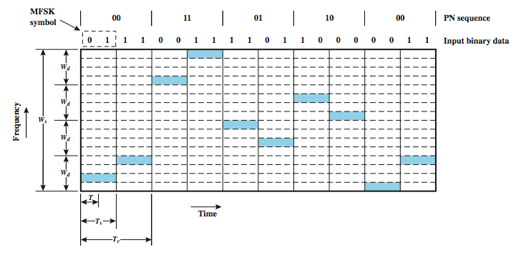
Slow FHSS
Notes:
Stallings DCC8e Figure 9.4 shows an example of slow FHSS, using the MFSK example from Stallings DCC8e Figure 5.9. Here we have M = 4, which means that four different frequencies are used to encode the data input 2 bits at a time. Each signal element is a discrete frequency tone, and the total MFSK bandwidth is W_{d} = Mf_{d}. We use an FHSS scheme with k = 2. That is, there are 4 = 2^{k} different channels, each of width W_{d}. The total FHSS bandwidth is W_{s} = 2^{k}W_{d}. Each 2 bits of the PN sequence is used to select one of the four channels. That channel is held for a duration of two signal elements, or four bits (T_{c} = 2T_{s} = 4T).

Slide 9
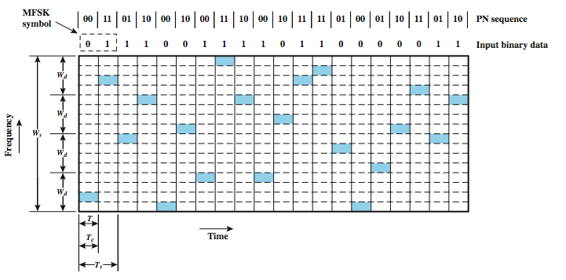
Fast FHSS
Notes:
Stallings DCC8e Figure 9.5 shows an example of fast FHSS, using the same MFSK example. Again, M = 4 and k = 2. In this case, however, each signal element is represented by two frequency tones. Again, W_{d} = Mf_{d} and W_{s} = 2^{k}W_{d}. In this example T_{s} = 2T_{c} = 2T. In general, fast FHSS provides improved performance compared to slow FHSS in the face of noise or jamming. For example, if three or more frequencies (chips) are used for each signal element, the receiver can decide which signal element was sent on the basis of a majority of the chips being correct.

