Slide 1
Data Communications
Lecture 47
TOPICS: CDMA & Introduction to LANs

Slide 2
Recap: Code Division Multiple Access (CDMA)
a multiplexing technique used with spread spectrum
given a data signal rate D
break each bit into k chips according to a fixed chipping code specific to each user
resulting new channel has chip data rate kD chips per second
can have multiple channels superimposed
Notes:
CDMA is a multiplexing technique used with spread spectrum. The scheme works in the following manner. We start with a data signal with rate D, which we call the bit data rate. We break each bit into k chips according to a fixed pattern that is specific to each user, called the user’s code, or chipping code. The new channel has a chip data rate, or chipping rate, of kD chips per second. With CDMA, the receiver can sort out transmission from the desired sender, even when there may be other users broadcasting in the same cell.

Slide 3
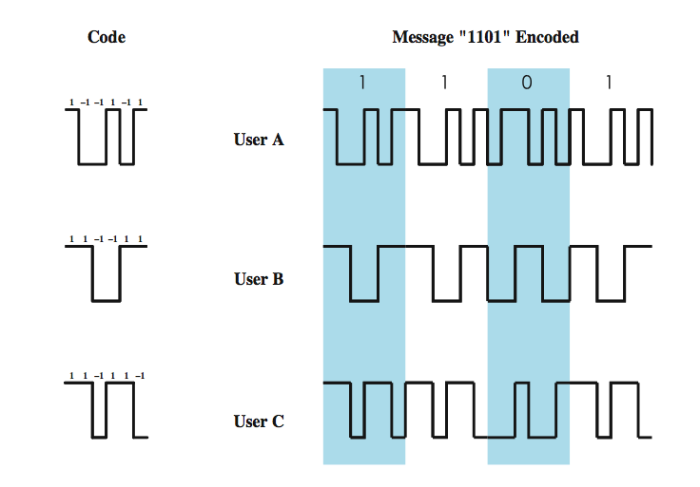
CDMA Example
Notes:
As an illustration we consider a simple example with k = 6. It is simplest to characterize a chipping code as a sequence of 1s and –1s. Figure 9.10 shows the codes for three users, A, B, and C, each of which is communicating with the same base station receiver, R. Thus, the code for user A is c_{A} = <1, –1, –1, 1, –1, 1>. Similarly, user B has code c_{B} = <1, 1, –1, –1, 1, 1>, and user C has c_{C} = <1, 1, –1, 1, 1, –1>. We now consider the case of user A communicating with the base station. The base station is assumed to know A’s code. For simplicity, we assume that communication is already synchronized so that the base station knows when to look for codes. If A wants to send a 1 bit, A transmits its code as a chip pattern <1, –1, –1, 1, –1, 1>. If a 0 bit is to be sent, A transmits the complement (1s and –1s reversed) of its code, <–1, 1, 1, –1, 1, –1>.
At the base station the receiver decodes the chip patterns. If the decoder is linear and if A and B transmit signals s_{A} and s_{B}, respectively, at the same time, then S_{A} (s_{A} + s_{B}) = S_{A} (s_{A}) + S_{A} (s_{B}) = S_{A} (s_{A}) since the decoder ignores B when it is using A’s code. The codes of A and B that have the property that S_{A} (c_{B}) = S_{B} (c_{A}) = 0 are called orthogonal. Using the decoder, S_{u}, the receiver can sort out transmission from u even when there may be other users broadcasting in the same cell. In practice, the CDMA receiver can filter out the contribution from unwanted users or they appear as low-level noise. However, if there are many users competing for the channel with the user the receiver is trying to listen to, or if the signal power of one or more competing signals is too high, perhaps because it is very near the receiver (the “near/far” problem), the system breaks down.

Slide 4
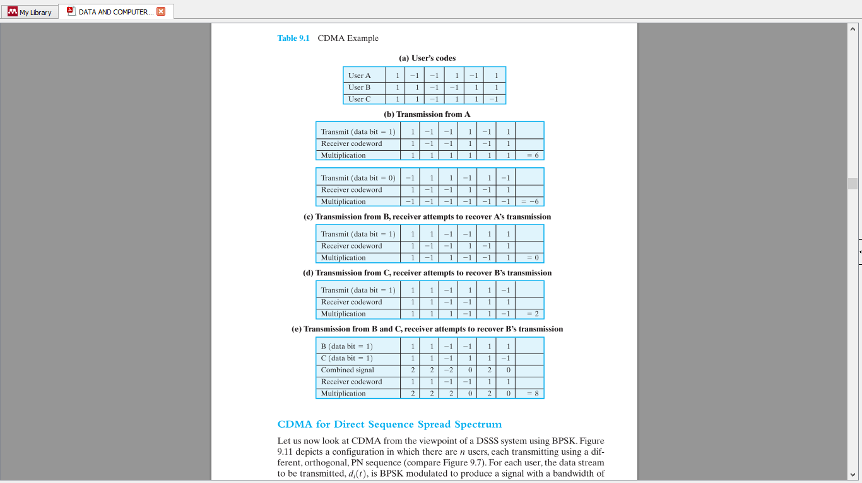

Slide 6
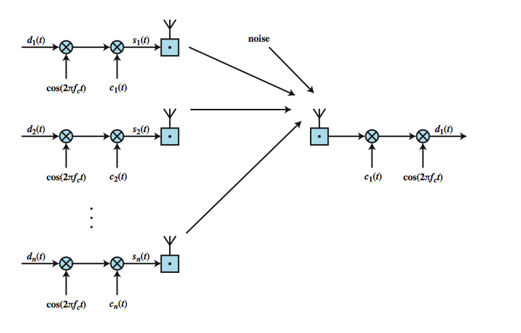
CDMA for DSSS
Notes:
Let us now look at CDMA from the viewpoint of a DSSS system using BPSK. Stallings DCC8eFigure 9.11 depicts a configuration in which there are n users, each transmitting using a different, orthogonal, PN sequence (compare Figure 9.7). For each user, the data stream to be transmitted, d_{i}(t), is BPSK modulated to produce a signal with a bandwidth of W_{s} and then multiplied by the spreading code for that user, c_{i}(t). All of the signals, plus noise, are received at the receiver's antenna. Suppose that the receiver is attempting to recover the data of user 1. The incoming signal is multiplied by the spreading code of user 1 and then demodulated. The effect of this is to narrow the bandwidth of that portion of the incoming signal corresponding to user 1 to the original bandwidth of the unspread signal, which is proportional to the data rate. Incoming signals from other users are not despread by the spreading code from user 1 and hence retain their bandwidth of W_{s}. Thus the unwanted signal energy remains spread over a large bandwidth and the wanted signal is concentrated in a narrow bandwidth. The bandpass filter at the demodulator can therefore recover the desired signal.

Slide 7
LAN Architecture
topologies
transmission medium
layout
medium access control
Notes:
The key elements of a LAN are listed on the slide. Together, these elements determine not only the cost and capacity of the LAN, but also the type of data that may be transmitted, the speed and efficiency of communications, and even the kinds of applications that can be supported.
This section provides a survey of the major technologies in the first two of these categories. It will be seen that there is an interdependence among the choices in different categories. Accordingly, a discussion of pros and cons relative to specific applications is best done by looking at preferred combinations. This, in turn, is best done in the context of standards, which is

Slide 8
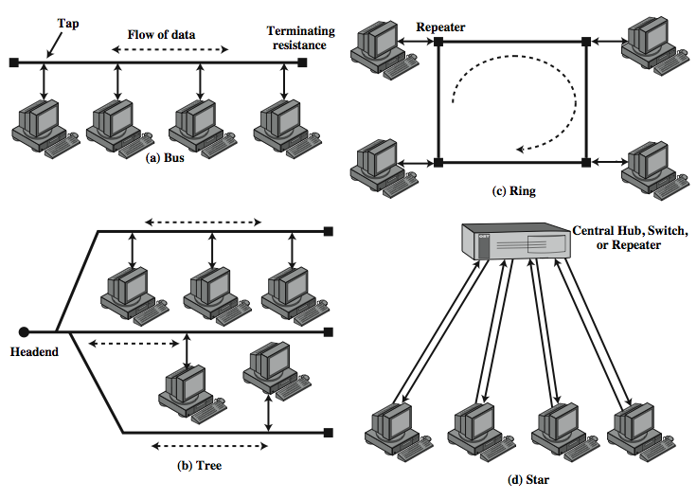
LAN Topologies
Notes:
In the context of a communication network, the term topology refers to the way in which the end points, or stations, attached to the network are interconnected. The common topologies for LANs are shown in Stallings DCC8e Figure 15.2 and include: bus, tree, ring, and star. The bus is a special case of the tree, with only one trunk and no branches.

Slide 9
Bus and Tree
used with multipoint medium
transmission propagates throughout medium
heard by all stations
full duplex connection between station and tap
allows for transmission and reception
need to regulate transmission
to avoid collisions and hogging
terminator absorbs frames at end of medium
tree a generalization of bus
headend connected to branching cables
Notes:
Both bus and tree topologies are characterized by the use of a multipoint medium. For the bus, all stations attach, through appropriate hardware interfacing known as a tap, directly to a linear transmission medium, or bus. Full-duplex operation between the station and the tap allows data to be transmitted onto the bus and received from the bus. A transmission from any station propagates the length of the medium in both directions and can be received by all other stations. At each end of the bus is a terminator, which absorbs any signal, removing it from the bus.
The tree topology is a generalization of the bus topology. The transmission medium is a branching cable with no closed loops. The tree layout begins at a point known as the headend. One or more cables start at the headend, and each of these may have branches. The branches in turn may have additional branches to allow quite complex layouts. Again, a transmission from any station propagates throughout the medium and can be received by all other stations.

Slide 10
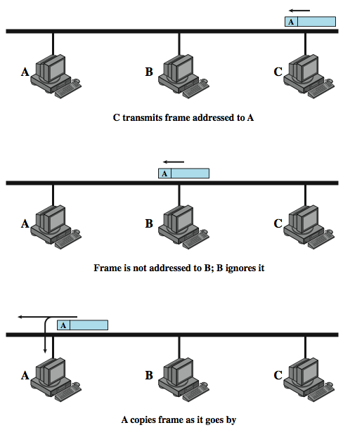
Frame Transmission on Bus LAN
Notes:
Two problems present themselves in these topologies. First, because a transmission from any one station can be received by all other stations, there needs to be some way of indicating for whom the transmission is intended. Second, a mechanism is needed to regulate transmission. To solve these problems, stations transmit data in small blocks, known as frames. Each frame consists of a portion of the data that a station wishes to transmit, plus a frame header that contains control information. Each station on the bus is assigned a unique address, or identifier, and the destination address for a frame is included in its header.
Stallings DCC8e Figure 15.3 illustrates the scheme. In this example, station C wishes to transmit a frame of data to A. The frame header includes A's address. As the frame propagates along the bus, it passes B. B observes the address and ignores the frame. A, on the other hand, sees that the frame is addressed to itself and therefore copies the data from the frame as it goes by. The use of frames also provides the basic tool for solving the second problem, the regulation of access. In particular, the stations take turns sending frames in some cooperative fashion. This involves putting additional control information into the frame header.

Slide 11
Ring Topology
a closed loop of repeaters joined by point to point links
receive data on one link & retransmit on another
links unidirectional
stations attach to repeaters
data in frames
circulate past all stations
destination recognizes address and copies frame
frame circulates back to source where it is removed
media access control determines when a station can insert frame
Notes:
In the ring topology, the network consists of a set of repeaters joined by point-to-point links in a closed loop. The repeater is a comparatively simple device, capable of receiving data on one link and transmitting them, bit by bit, on the other link as fast as they are received. The links are unidirectional; that is, data are transmitted in one direction only, so that data circulate around the ring in one direction (clockwise or counterclockwise). Each station attaches to the network at a repeater and can transmit data onto the network through the repeater. As with the bus and tree, data are transmitted in frames. Because multiple stations share the ring, medium access control is needed to determine at what time each station may insert frames.

Slide 12
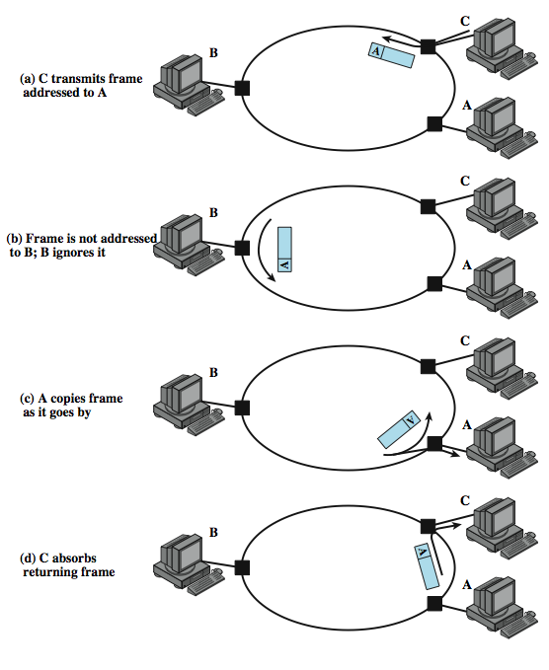
Frame Transmission Ring LAN
Notes:
Stallings DCC8e Figure 15.4 illustrates how a frame continues to circulate until it returns to the source station, where it is removed .

Slide 13
Star Topology
each station connects to central node
usually via two point to point links
either central node can broadcast
physical star, logical bus
only one station can transmit at a time
or central node can act as frame switch
Notes:
In the star LAN topology, each station is directly connected to a common central node. Typically, each station attaches to a central node via two point-to-point links, one for transmission and one for reception. In general, there are two alternatives for the operation of the central node. One approach is for the central node to operate in a broadcast fashion. A transmission of a frame from one station to the node is retransmitted on all of the outgoing links. In this case, although the arrangement is physically a star, it is logically a bus: A transmission from any station is received by all other stations, and only one station at a time may successfully transmit. In this case, the central element is referred to as a hub. Another approach is for the central node to act as a frame-switching device. An incoming frame is buffered in the node and then retransmitted on an outgoing link to the destination station.

Slide 14
Choice of Topology
reliability
expandability
performance
needs considering in context of:
medium
wiring layout
access control
Notes:
The choice of topology depends on a variety of factors, including reliability, expandability, and performance. This choice is part of the overall task of designing a LAN and thus cannot be made in isolation, independent of the choice of transmission medium, wiring layout, and access control technique.

Slide 15
Bus LAN Transmission Media (1)
twisted pair
early LANs used voice grade cable
didn’t scale for fast LANs
not used in bus LANs now
baseband coaxial cable
uses digital signalling
original Ethernet
Notes:
There are four alternative media that can be used for a bus LAN:
• Twisted pair: In the early days of LAN development, voice-grade twisted pair was used to provide an inexpensive, easily installed bus LAN. A number of systems operating at 1 Mbps were implemented. Scaling twisted pair up to higher data rates in a shared-medium bus configuration is not practical, so this approach was dropped long ago.
• Baseband coaxial cable: A baseband coaxial cable is one that makes use of digital signaling. The original Ethernet scheme makes use of baseband coaxial cable.

Slide 16
Bus LAN Transmission Media (2)
broadband coaxial cable
as in cable TV systems
analog signals at radio frequencies
expensive, hard to install and maintain
no longer used in LANs
optical fiber
expensive taps
better alternatives available
not used in bus LANs
less convenient compared to star topology twisted pair
coaxial baseband still used but not often in new installations
Notes:
The other alternative media that can be used for a bus LAN are:
• Broadband coaxial cable: Broadband coaxial cable is the type of cable used in cable television systems. Analog signaling is used at radio and television frequencies. This type of system is more expensive and more difficult to install and maintain than baseband coaxial cable. This approach never achieved popularity and such LANs are no longer made.
• Optical fiber: There has been considerable research relating to this alternative over the years, but the expense of the optical fiber taps and the availability of better alternatives have resulted in the demise of this option as well.
For a bus topology, only baseband coaxial cable has achieved widespread use, primarily for Ethernet systems. Compared to a star-topology twisted pair or optical fiber installation, the bus topology using baseband coaxial cable is difficult to work with. Even simple changes may require access to the coaxial cable, movement of taps, and rerouting of cable segments. Accordingly, few if any new installations are being attempted. Despite its limitations, there is a considerable installed base of baseband coaxial cable bus LANs.

Slide 17
Ring and Star Usage
ring
very high speed links over long distances
single link or repeater failure disables network
star
uses natural layout of wiring in building
best for short distances
high data rates for small number of devices
Notes:
Very-high-speed links over considerable distances can be used for the ring topology. Hence, the ring has the potential of providing the best throughput of any topology. One disadvantage of the ring is that a single link or repeater failure could disable the entire network.
The star topology takes advantage of the natural layout of wiring in a building. It is generally best for short distances and can support a small number of devices at high data rates.

Slide 18
Choice of Medium
constrained by LAN topology
capacity
reliability
types of data supported
environmental scope
Notes:
The choice of transmission medium is determined by a number of factors. It is, we shall see, constrained by the topology of the LAN. Other factors come into play, including
• Capacity: to support the expected network traffic
• Reliability: to meet requirements for availability
• Types of data supported: tailored to the application
• Environmental scope: to provide service over the range of environments required
The choice is part of the overall task of designing a local network, which is addressed in Chapter 16. Here we can make a few general observations.

Slide 19
Media Available
Voice grade unshielded twisted pair (UTP)
Cat 3 phone, cheap, low data rates
Shielded twisted pair / baseband coaxial
more expensive, higher data rates
Broadband cable
even more expensive, higher data rate
High performance UTP
Cat 5+, very high data rates, switched star topology
Optical fibre
security, high capacity, small size, high cost
Notes:
Voice-grade unshielded twisted pair (Cat-3 UTP) is an inexpensive, well-understood medium. Typically, office buildings are wired to meet the anticipated telephone system demand plus a healthy margin; thus, there are no cable installation costs. However, the data rate that can be supported is generally quite limited, with the exception of very small LAN. Category 3 UTP is likely to be the most cost-effective for a single-building, low-traffic LAN installation.
Shielded twisted pair and baseband coaxial cable are more expensive than Category 3 UTP but provide greater capacity. Broadband cable is even more expensive but provides even greater capacity. However, in recent years, the trend has been toward the use of high-performance UTP, especially Category 5 UTP. Category 5 UTP supports high data rates for a small number of devices, but larger installations can be supported by the use of the star topology and the interconnection of the switching elements in multiple star-topology configurations.
Optical fiber has a number of attractive features, such as electromagnetic isolation, high capacity, and small size, which have attracted a great deal of interest. As yet the market penetration of fiber LANs is low; this is primarily due to the high cost of fiber components and the lack of skilled personnel to install and maintain fiber systems. This situation is beginning to change rapidly as more products using fiber are introduced.

Slide 20
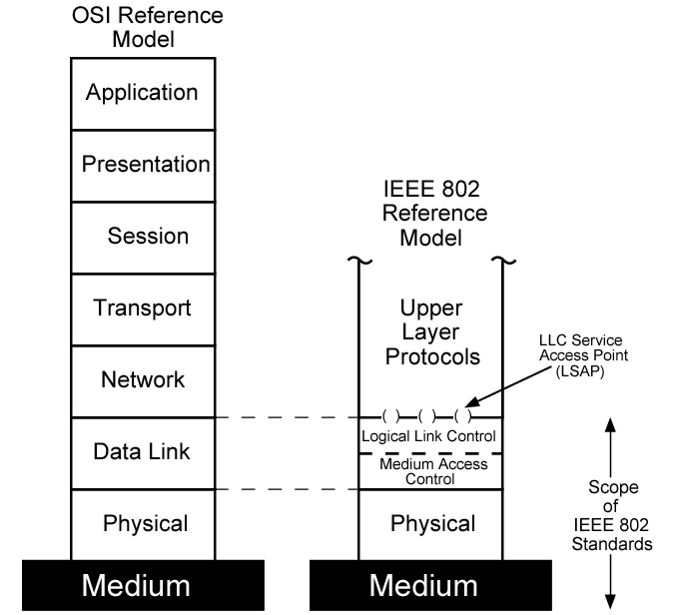
LAN Protocol Architecture
Notes:
The architecture of a LAN is best described in terms of a layering of protocols that organize the basic functions of a LAN. These include physical, medium access control (MAC), and logical link control (LLC) layers. Protocols defined specifically for LAN and MAN transmission address issues relating to the transmission of blocks of data over the network. In OSI terms, a discussion of LAN protocols is concerned principally with lower layers of the OSI model.
Stallings DCC8e Figure 15.5 relates the LAN protocols to the OSI architecture (see Stallings DCC8e Figure 2.6). This architecture was developed by the IEEE 802 LAN standards committee and has been adopted by all organizations working on the specification of LAN standards. It is generally referred to as the IEEE 802 reference model.

Slide 21
IEEE 802 Layers (1)
Physical
encoding/decoding of signals
preamble generation/removal
bit transmission/reception
transmission medium and topology
Notes:
Working from the bottom up, the lowest layer of the IEEE 802 reference model corresponds to the physical layer of the OSI model and includes such functions as:
• Encoding/decoding of signals
• Preamble generation/removal (for synchronization)
• Bit transmission/reception
In addition, the physical layer of the 802 model includes a specification of the transmission medium and the topology. Generally, this is considered "below" the lowest layer of the OSI model. However, the choice of transmission medium and topology is critical in LAN design, and so a specification of the medium is included.

Slide 22
IEEE 802 Layers (2)
Logical Link Control
interface to higher levels
flow and error control
Media Access Control
on transmit assemble data into frame
on receive disassemble frame
govern access to transmission medium
for same LLC, may have several MAC options
Notes:
Above the physical layer are the functions associated with providing service to LAN users. These include
• On transmission, assemble data into a frame with address and error-detection fields.
• On reception, disassemble frame, and perform address recognition and error detection.
• Govern access to the LAN transmission medium.
• Provide an interface to higher layers and perform flow and error control.
These are functions typically associated with OSI layer 2. The set of functions in the last bullet item are grouped into a logical link control (LLC) layer. The functions in the first three bullet items are treated as a separate layer, called medium access control (MAC). The separation is done for the following reasons:
• The logic required to manage access to a shared-access medium is not found in traditional layer 2 data link control.
For the same LLC, several MAC options may be provided.

