Slide 1
Data Communications
Lecture 48
TOPICS: LAN Standards: IEEE 802.XX

Slide 2
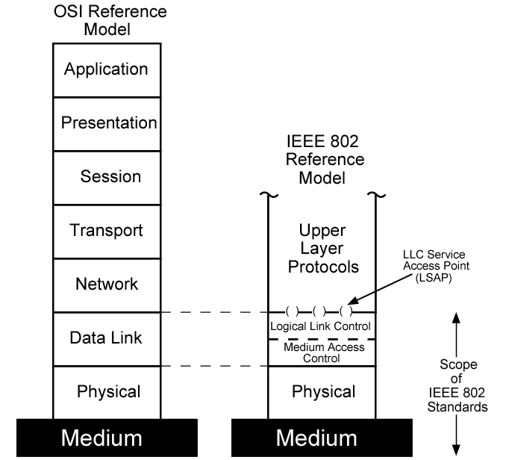
LAN Protocol Architecture
Notes:
The architecture of a LAN is best described in terms of a layering of protocols that organize the basic functions of a LAN. These include physical, medium access control (MAC), and logical link control (LLC) layers. Protocols defined specifically for LAN and MAN transmission address issues relating to the transmission of blocks of data over the network. In OSI terms, a discussion of LAN protocols is concerned principally with lower layers of the OSI model.
Stallings DCC8e Figure 15.5 relates the LAN protocols to the OSI architecture (see Stallings DCC8e Figure 2.6). This architecture was developed by the IEEE 802 LAN standards committee and has been adopted by all organizations working on the specification of LAN standards. It is generally referred to as the IEEE 802 reference model.

Slide 3
IEEE 802 Layers (1)
Physical
encoding/decoding of signals
preamble generation/removal
bit transmission/reception
transmission medium and topology
Notes:
Working from the bottom up, the lowest layer of the IEEE 802 reference model corresponds to the physical layer of the OSI model and includes such functions as:
• Encoding/decoding of signals
• Preamble generation/removal (for synchronization)
• Bit transmission/reception
In addition, the physical layer of the 802 model includes a specification of the transmission medium and the topology. Generally, this is considered "below" the lowest layer of the OSI model. However, the choice of transmission medium and topology is critical in LAN design, and so a specification of the medium is included.

Slide 4
IEEE 802 Layers (2)
Logical Link Control
interface to higher levels
flow and error control
Media Access Control
on transmit assemble data into frame
on receive disassemble frame
govern access to transmission medium
for same LLC, may have several MAC options
Notes:
Above the physical layer are the functions associated with providing service to LAN users. These include
• On transmission, assemble data into a frame with address and error-detection fields.
• On reception, disassemble frame, and perform address recognition and error detection.
• Govern access to the LAN transmission medium.
• Provide an interface to higher layers and perform flow and error control.
These are functions typically associated with OSI layer 2. The set of functions in the last bullet item are grouped into a logical link control (LLC) layer. The functions in the first three bullet items are treated as a separate layer, called medium access control (MAC). The separation is done for the following reasons:
• The logic required to manage access to a shared-access medium is not found in traditional layer 2 data link control.
For the same LLC, several MAC options may be provided.

Slide 5
Ethernet (CSMA/CD)
most widely used LAN standard
developed by
Xerox - original Ethernet
IEEE 802.3
Carrier Sense Multiple Access with Collision Detection (CSMA/CD)
random / contention access to media
Notes:
The most widely used high-speed LANs today are based on Ethernet and were developed by the IEEE 802.3 standards committee. As with other LAN standards, there is both a medium access control layer and a physical layer. The media access uses CSMA/CD. This and its precursors can be termed random access, or contention, techniques. They are random access in the sense that there is no predictable or scheduled time for any station to transmit; station transmissions are ordered randomly. They exhibit contention in the sense that stations contend for time on the shared medium.

Slide 6
ALOHA
developed for packet radio nets
when station has frame, it sends
then listens for a bit over max round trip time
if receive ACK then fine
if not, retransmit
if no ACK after repeated transmissions, give up
uses a frame check sequence (as in HDLC)
frame may be damaged by noise or by another station transmitting at the same time (collision)
any overlap of frames causes collision
max utilization 18%
Notes:
The earliest of these techniques, known as ALOHA, was developed for packet radio networks. However, it is applicable to any shared transmission medium. ALOHA, or pure ALOHA as it is sometimes called, specifies that a station may transmit a frame at any time. The station then listens for an amount of time equal to the maximum possible round-trip propagation delay on the network (twice the time it takes to send a frame between the two most widely separated stations) plus a small fixed time increment. If the station hears an acknowledgment during that time, fine; otherwise, it resends the frame. If the station fails to receive an acknowledgment after repeated transmissions, it gives up. A receiving station determines the correctness of an incoming frame by examining a frame check sequence field, as in HDLC. If the frame is valid and if the destination address in the frame header matches the receiver's address, the station immediately sends an acknowledgment. The frame may be invalid due to noise on the channel or because another station transmitted a frame at about the same time. In the latter case, the two frames may interfere with each other at the receiver so that neither gets through; this is known as a collision. If a received frame is determined to be invalid, the receiving station simply ignores the frame. ALOHA is as simple as can be, and pays a penalty for it. Because the number of collisions rises rapidly with increased load, the maximum utilization of the channel is only about 18%.

Slide 7
Slotted ALOHA
time on channel based on uniform slots equal to frame transmission time
need central clock (or other sync mechanism)
transmission begins at slot boundary
frames either miss or overlap totally
max utilization 37%
both have poor utilization
fail to use fact that propagation time is much less than frame transmission time
Notes:
To improve efficiency, a modification of ALOHA, known as slotted ALOHA, was developed. In this scheme, time on the channel is organized into uniform slots whose size equals the frame transmission time. Some central clock or other technique is needed to synchronize all stations. Transmission is permitted to begin only at a slot boundary. Thus, frames that do overlap will do so totally. This increases the maximum utilization of the system to about 37%. Both ALOHA and slotted ALOHA exhibit poor utilization. Both fail to take advantage of one of the key properties of both packet radio networks and LANs, which is that propagation delay between stations may be very small compared to frame transmission time.

Slide 8
CSMA
stations soon know transmission has started
so first listen for clear medium (carrier sense)
if medium idle, transmit
if two stations start at the same instant, collision
wait reasonable time
if no ACK then retransmit
collisions occur at leading edge of frame
max utilization depends on propagation time (medium length) and frame length
Notes:
The foregoing observations led to the development of carrier sense multiple access (CSMA). With CSMA, a station wishing to transmit first listens to the medium to determine if another transmission is in progress (carrier sense). If the medium is in use, the station must wait. If the medium is idle, the station may transmit. It may happen that two or more stations attempt to transmit at about the same time. If this happens, there will be a collision; the data from both transmissions will be garbled and not received successfully. To account for this, a station waits a reasonable amount of time after transmitting for an acknowledgment, taking into account the maximum round-trip propagation delay and the fact that the acknowledging station must also contend for the channel to respond. If there is no acknowledgment, the station assumes that a collision has occurred and retransmits. This strategy is effective for networks in which the average frame transmission time is much longer than the propagation time. Collisions can occur only when more than one user begins transmitting within a short time interval (the period of the propagation delay). If a station begins to transmit a frame, and there are no collisions during the time it takes for the leading edge of the packet to propagate to the farthest station, then there will be no collision for this frame because all other stations are now aware of the transmission. The maximum utilization achievable using CSMA can far exceed that of ALOHA or slotted ALOHA. The maximum utilization depends on the length of the frame and on the propagation time; the longer the frames or the shorter the propagation time, the higher the utilization.

Slide 9
IEEE 802.3
IEEE 802.3 is a set of standards and protocols that define Ethernet-based networks. Ethernet technologies are primarily used in LANs, though they can also be used in MANs and even WANs. IEEE 802.3 defines the physical layer and the medium access control (MAC) sub-layer of the data link layer for wired Ethernet networks

Slide 10
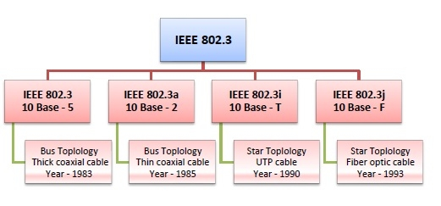
IEEE 802.3 Versions

Slide 11
IEEE 802.3 Versions
IEEE 802.3: This was the original standard given for 10BASE-5. It used a thick single coaxial cable into which a connection can be tapped by drilling into the cable to the core. Here, 10 is the maximum throughput, i.e. 10 Mbps, BASE denoted use of baseband transmission, and 5 refers to the maximum segment length of 500m.
IEEE 802.3a: This gave the standard for thin coax (10BASE-2), which is a thinner variety where the segments of coaxial cables are connected by BNC connectors. The 2 refers to the maximum segment length of about 200m (185m to be precise).
IEEE 802.3i: This gave the standard for twisted pair (10BASE-T) that uses unshielded twisted pair (UTP) copper wires as physical layer medium. The further variations were given by IEEE 802.3u for 100BASE-TX, 100BASE-T4 and 100BASE-FX.
IEEE 802.3i: This gave the standard for Ethernet over Fiber (10BASE-F) that uses fiber optic cables as medium of transmission.

Slide 12
10Mbps Specification (Ethernet)
Notes:
The IEEE 802.3 committee has defined a number of alternative physical configurations. This is both good and bad. On the good side, the standard has been responsive to evolving technology. On the bad side, the customer, not to mention the potential vendor, is faced with a bewildering array of options. However, the committee has been at pains to ensure that the various options can be easily integrated into a configuration that satisfies a variety of needs. Thus, the user that has a complex set of requirements may find the flexibility and variety of the 802.3 standard to be an asset. To distinguish the various implementations that are available, the committee has developed a concise notation: <data rate in Mbps> <signaling method><max segment length in hundreds of meters>
The defined alternatives for 10-Mbps are:
• 10BASE5: Specifies the use of 50-ohm coaxial cable and Manchester digital signaling. The maximum length of a cable segment is set at 500 meters. Can extend using up to 4 repeaters.
• 10BASE2: lower-cost alternative to 10BASE5 using a thinner cable, with fewer taps over a shorter distance than the 10BASE5 cable.
• 10BASE-T: Uses unshielded twisted pair in a star-shaped topology, with length of a link is limited to 100 meters. As an alternative, an optical fiber link may be used out to 500 m.
• 10BASE-F: Contains three specifications using optical fibre

Slide 13
100Mbps Fast Ethernet
Notes:
Fast Ethernet refers to a set of specifications developed by the IEEE 802.3 committee to provide a low-cost, Ethernet-compatible LAN operating at 100 Mbps. The blanket designation for these standards is 100BASE-T. The committee defined a number of alternatives to be used with different transmission media. Stallings DCC8e Table 16.3 summarizes key characteristics of the 100BASE-T options. All of the 100BASE-T options use the IEEE 802.3 MAC protocol and frame format. 100BASE-X refers to a set of options that use two physical links between nodes; one for transmission and one for reception. 100BASE-TX makes use of shielded twisted pair (STP) or high-quality (Category 5) unshielded twisted pair (UTP). 100BASE-FX uses optical fiber. For all of the 100BASE-T options, the topology is similar to that of 10BASE-T, namely a star-wire topology.
In many buildings, any of the 100BASE-X options requires the installation of new cable. For such cases, 100BASE-T4 defines a lower-cost alternative that can use Category 3, voice-grade UTP in addition to the higher-quality Category 5 UTP. To achieve the 100-Mbps data rate over lower-quality cable, 100BASE-T4 dictates the use of four twisted-pair lines between nodes, with the data transmission making use of three pairs in one direction at a time.

Slide 14
IEEE 802.11 standard
IEEE 802.11 standard, popularly known as WiFi, lays down the architecture and specifications of wireless LANs (WLANs). WiFi or WLAN uses high frequency radio waves for connecting the nodes.
There are several standards of IEEE 802.11 WLANs. The prominent among them are 802.11, 802.11a, 802.11b, 802.11g, 802.11n and 802.11p. All the standards use carrier-sense multiple access with collision avoidance (CSMA/CA). Also, they have support for both centralised base station based as well as ad hoc networks.

Slide 15
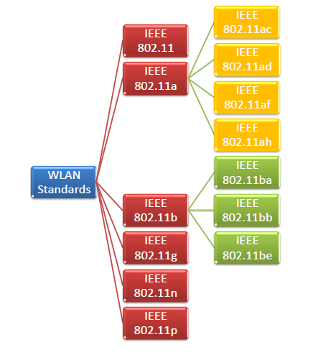
IEEE 802.11 standard

Slide 16
IEEE 802.11 standard
IEEE 802.11 was the original version released in 1997. It provided 1 Mbps or 2 Mbps data rate in the 2.4 GHz band and used either frequency-hopping spread spectrum (FHSS) or direct-sequence spread spectrum (DSSS). It is obsolete now.
IEEE 802.11a
802.11a was published in 1999 as a modification to 802.11, with orthogonal frequency division multiplexing (OFDM) based air interface in physical layer instead of FHSS or DSSS of 802.11. It provides a maximum data rate of 54 Mbps operating in the 5 GHz band. Besides it provides error correcting code. As 2.4 GHz band is crowded, relatively sparsely used 5 GHz imparts additional advantage to 802.11a.
IEEE 802.11b
802.11b is a direct extension of the original 802.11 standard that appeared in early 2000. It uses the same modulation technique as 802.11, i.e. DSSS and operates in the 2.4 GHz band. It has a higher data rate of 11 Mbps as compared to 2 Mbps of 802.11, due to which it was rapidly adopted in wireless LANs. However, since 2.4 GHz band is pretty crowded, 802.11b devices faces interference from other devices.

Slide 17
IEEE 802.11 standard
IEEE 802.11g
802.11g was indorsed in 2003. It operates in the 2.4 GHz band (as in 802.11b) and provides a average throughput of 22 Mbps. It uses OFDM technique (as in 802.11a). It is fully backward compatible with 802.11b. 802.11g devices also faces interference from other devices operating in 2.4 GHz band.
IEEE 802.11n
802.11n was approved and published in 2009 that operates on both the 2.4 GHz and the 5 GHz bands. It has variable data rate ranging from 54 Mbps to 600 Mbps. It provides a marked improvement over previous standards 802.11 by incorporating multiple-input multiple-output antennas (MIMO antennas).
IEEE 802.11p
802.11 is an amendment for including wireless access in vehicular environments (WAVE) to support Intelligent Transportation Systems (ITS). They include network communications between vehicles moving at high speed and the environment. They have a data rate of 27 Mbps and operate in 5.9 GHz band.

